Slide 1

Computer Engineering Department
Faculty of Engineering
Cairo University
Modeling and Simulation
Lab# 3: SPICE Simulation

Slide 2
Agenda
Modified Nodal analysis for Capacitor and Inductor

Slide 3
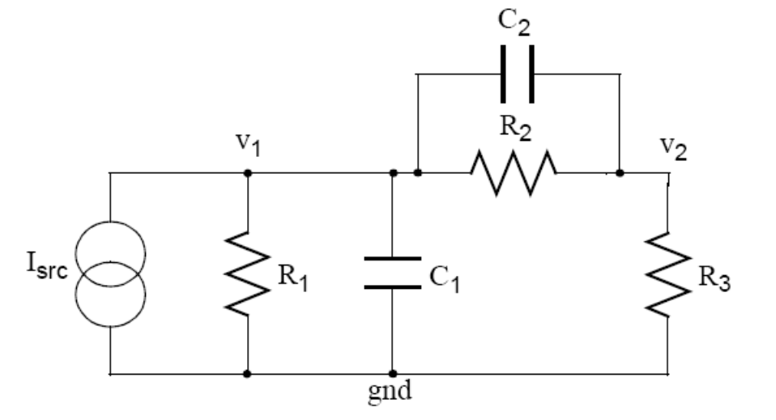
SPICE Simulator
It takes an analog circuit schematic, simulates,
calculates and plots the voltage at each node, and the current produced by each voltage source.

Slide 4
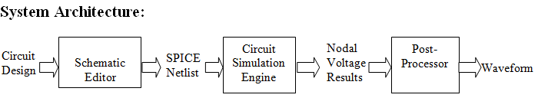
SPICE Simulator

Slide 5

Recall
Modified Nodal analysis (MNA)
Straightforward analog circuit solver technique based on KCL and KVL.
MNA applied to a circuit with only passive elements (resistors) and independent current and voltage sources results in a matrix equation of the form:
Ax=z
The circuit is solved by a simple matrix manipulation:
Notes:
A is a matrix consists only of known quantities.
Z is a vector holds only known quantities
X is a vector holds the unknown quantities (nodal voltages and current sources we want)

Slide 6
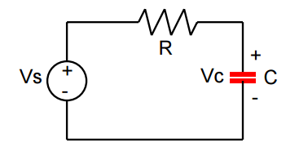
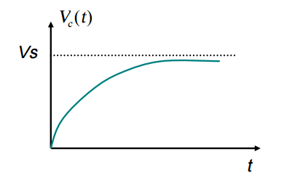
What about Capacitors/inductors?!
1
2
Current through capacitor
I = c dV/dt
Apply KCL at Node 2
(Vs-Vc)/R = c dVc/dt >>What about differential term?

Slide 7
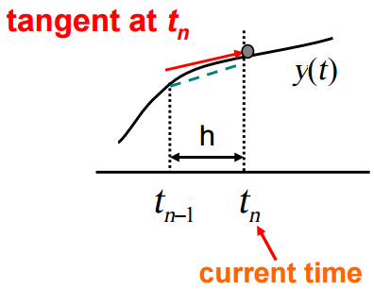
Euler Backward Method
Apply KCL at Node 2
(Vs-Vc)/R = c dVc/dt
(Vs-Vc)/R = C(Vn+1 - Vn)/h

Slide 8
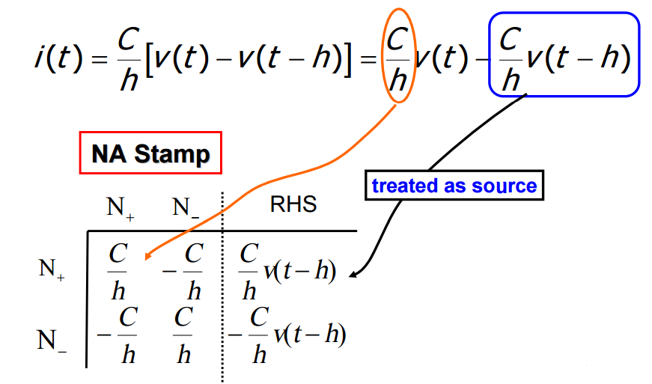
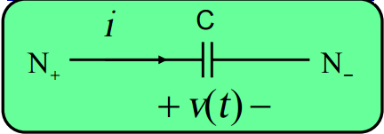
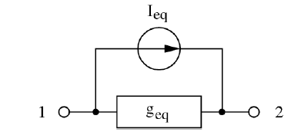
Capacitor Stamp
V0 is given (the initial value of the cap.)

Slide 9
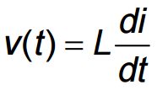
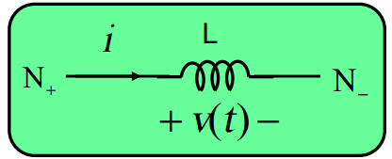
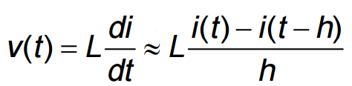
Inductor
>>Using Euler Method
I_L(0) is given (the initial value of the Ind.)

Slide 10
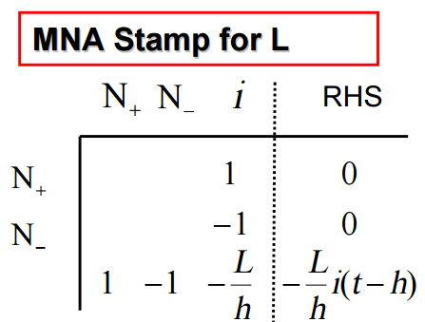
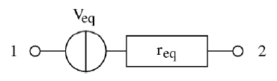
Inductor Stamp
Rn = L/h
Note: Add m+1 because the voltage source and the new current I_L.

Slide 11
System Flow chart
Netlist Parsing
Create matrix A and vectors x, z
Fill A, x, z by the MNA stamps for each component
Solve the algebraic system of equations
Time = time +h
Update z
No
End of time
Yes
Plot data in table and waveform

Slide 12


