Slide 1
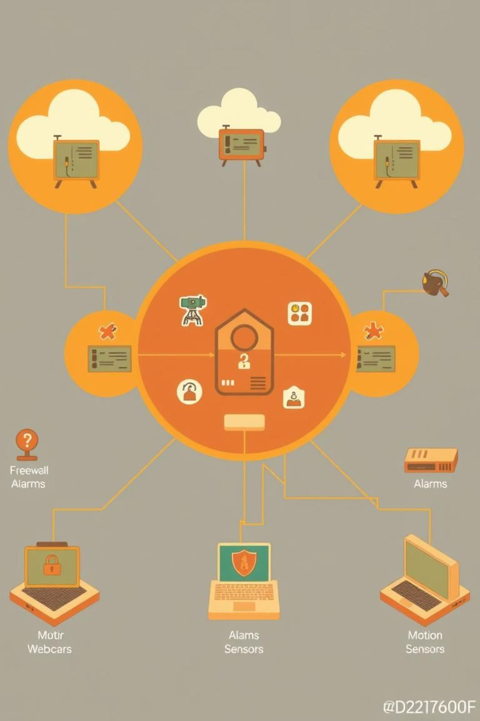
Network Security Project Documentation
This document outlines the implementation of a secure network infrastructure designed and simulated using Cisco Packet Tracer. The project focuses on establishing a robust, multi-layered security framework across seven distinct zones.
Each zone integrates both logical and physical security measures, including webcams, alarms, trip sensors, and motion sensors. To further enhance security, all unused switch and router ports were administratively disabled, and any unused physical slots on servers were sealed with covers.

Slide 2
Section 2
Subnetting Table: Detailed Allocation
The network design employs a meticulously planned subnetting scheme to optimize IP address utilization and segment the network for enhanced security and management. Each zone and inter-router link has a dedicated subnet, ensuring clear logical separation.
Subnet Area | Hosts | CIDR | Network Address
ACL | 8 | /28 | 192.168.1.0
AAA | 5 | /29 | 192.168.1.16
VPN LEFT | 4 | /29 | 192.168.1.24
NTP & SYSLOG | 4 | /29 | 192.168.1.32
Layer 2 Sec Left | 4 | /29 | 192.168.1.40
Layer 2 Sec Right | 4 | /29 | 192.168.1.48
ZPF | 4 | /29 | 192.168.1.56
INSIDE | 4 | /29 | 192.168.1.64
VPN RIGHT | 4 | /29 | 192.168.1.72
Test Network | 3 | /29 | 192.168.1.80
R5 → R8 | 2 | /30 | 192.168.1.88
R5 → R7 | 2 | /30 | 192.168.1.92
R7 → R3 | 2 | /30 | 192.168.1.96
R7 → R0 | 2 | /30 | 192.168.1.100
R7 → R1 | 2 | /30 | 192.168.1.104
R1 → R4 | 2 | /30 | 192.168.1.108
R1 → R6 | 2 | /30 | 192.168.1.112
R1 → R2 | 2 | /30 | 192.168.1.116

Slide 3
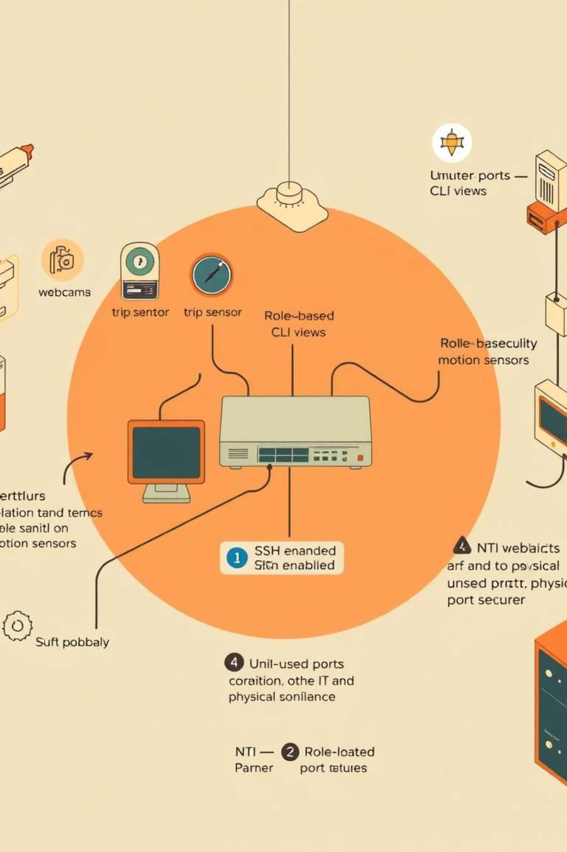
Section 3
Zone 1: Perimeter Security and Access Control
Devices: 1 Switch connected to 4 PCs, with an integrated router.
Physical Security: Webcams, trip sensors, alarms, and motion sensors are deployed throughout the zone for comprehensive physical surveillance.
Secure Management: SSH is enabled on the router to ensure encrypted remote access and management.
Port Security: Configured with MAC address binding for each active port. All unused ports are administratively disabled to prevent unauthorized access.
Role-Based CLI: Two distinct views are configured on the router:
  IT View: Offers limited access tailored for network technicians for monitoring and basic troubleshooting.
  NTI View: Provides full administrative access for network engineers.

Slide 4
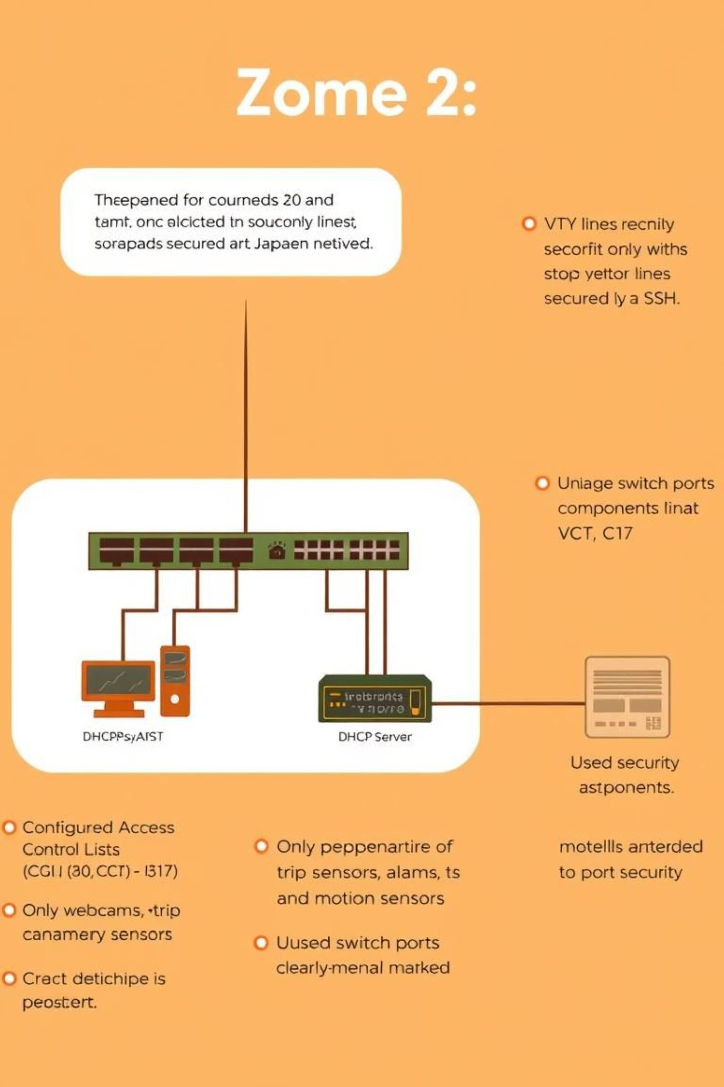
Section 4
Zone 2: Controlled Access and VTY Line Hardening
Devices: 1 Switch connected to 6 devices, including a DHCP Server.
Access Control: Robust Access Control Lists (ACLs) are meticulously configured to regulate network traffic flow and enforce security policies.
VTY Line Security: VTY lines are secured using SSH, allowing access only from authorized lines (C6, C7, C17). All other VTY lines are denied to mitigate unauthorized remote access attempts.
Physical Security: Webcams, trip sensors, alarms, and motion sensors are installed to provide continuous physical threat detection.
Port Security: Configured with MAC address binding for active ports. All unused ports are administratively disabled to minimize the attack surface.

Slide 5
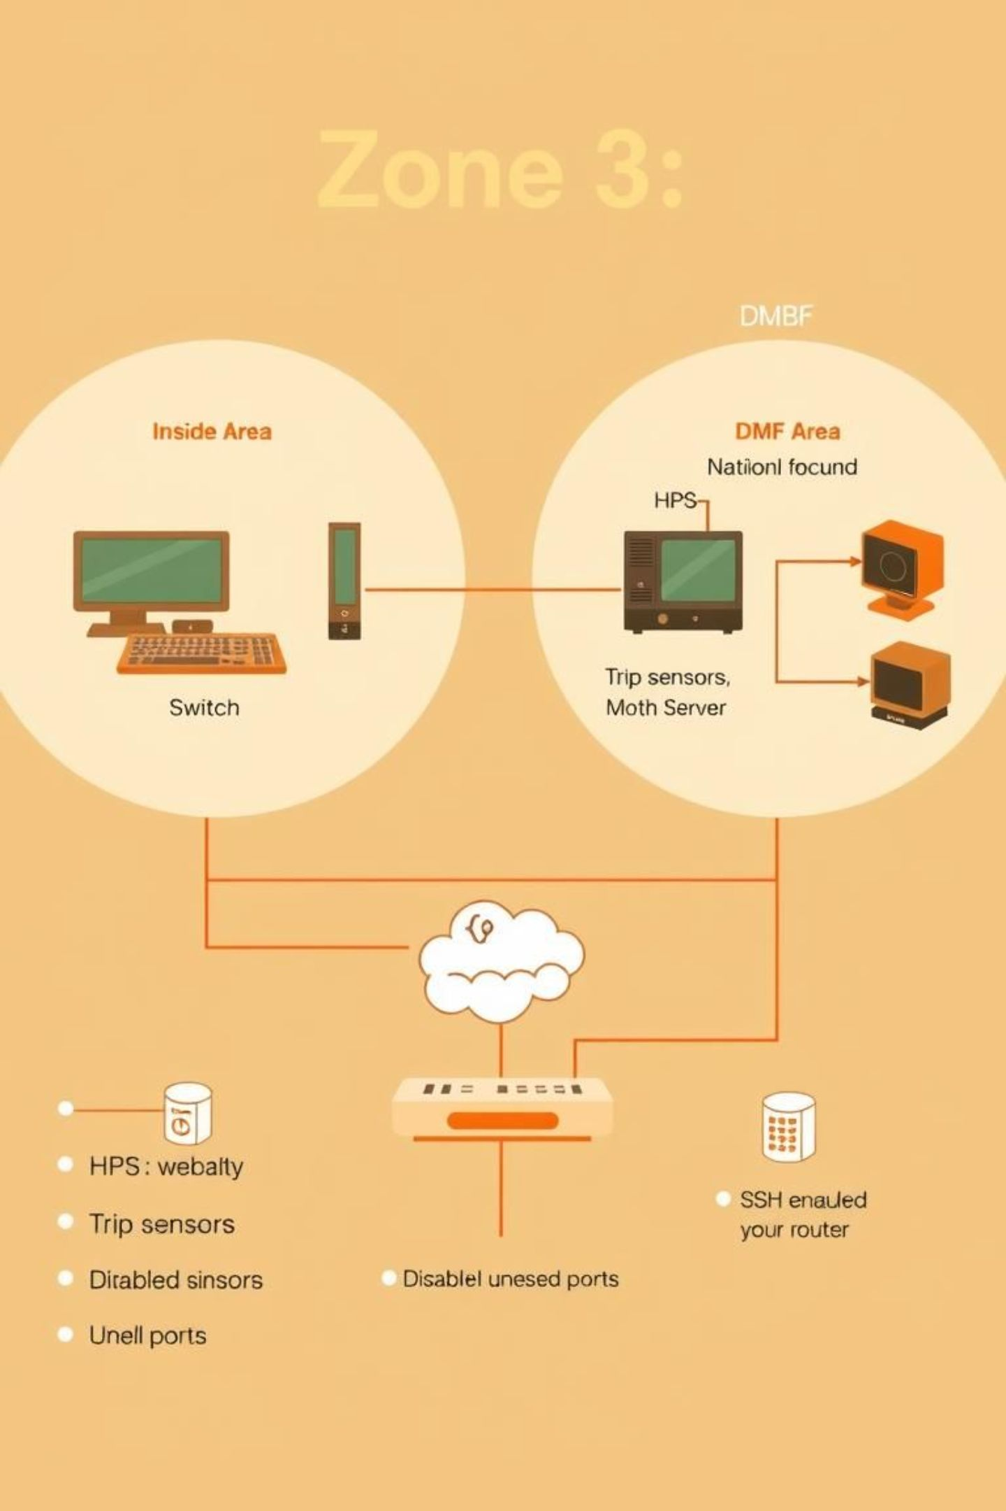
Section 5
Zone 3: DMZ and Zone-Based Firewall Implementation
Devices:
  Inside Area: 1 Switch connected to 2 PCs.
  DMZ Area: 1 Switch connected to 1 PC and 1 Web Server. This separation protects internal resources from direct external access.
Physical Security: Webcams, trip sensors, alarms, and motion sensors provide continuous monitoring and intrusion detection.
Zone-Based Firewall (ZBF): Configured to inspect and filter traffic based on zones, specifically matching Host Intrusion Prevention System (HIPS) and ICMP traffic to prevent reconnaissance and attacks.
Secure Management: SSH is enabled on the router for secure remote administration.
Port Security: Enabled on switches, with all unused ports administratively disabled to prevent unauthorized physical connections.

Slide 6
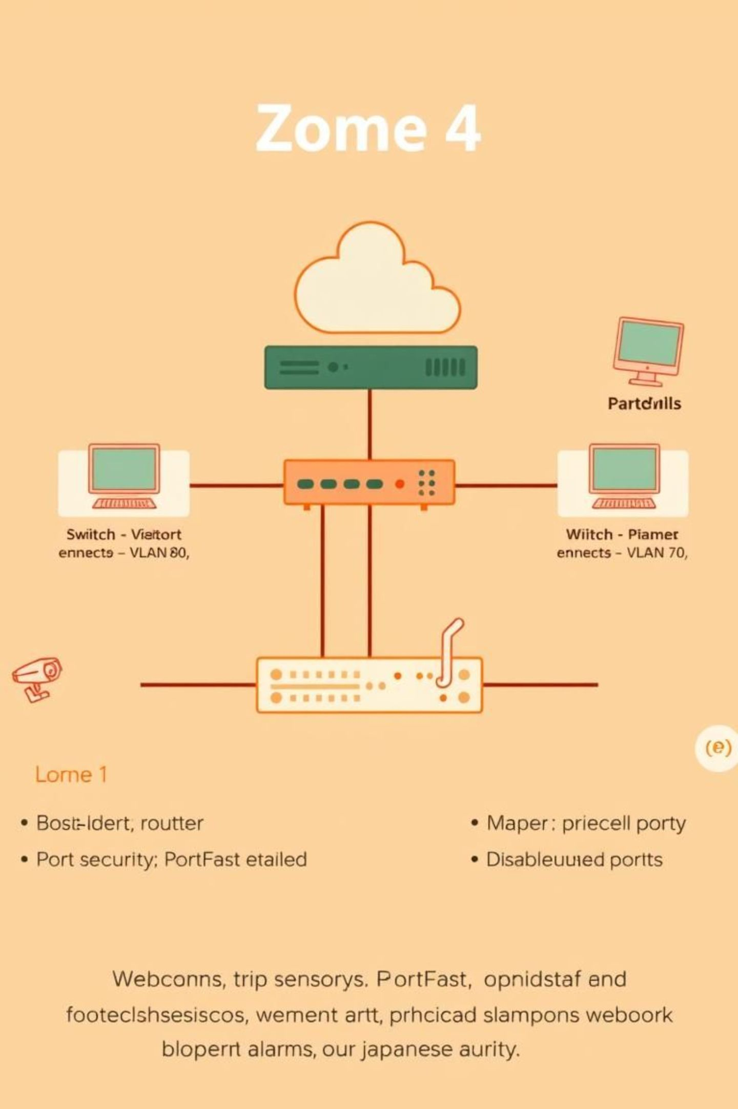
Section 6
Zone 4: Enhanced Layer 2 Security
Devices: 1 Router connected to 1 main switch, which then connects to:
  Switch 1 → VLAN 80 → 1 PC
  Switch 2 → VLAN 70 → 1 PC
Physical Security: Webcams, trip sensors, alarms, and motion sensors are installed for comprehensive environmental monitoring.
Layer 2 Security:
  Port Security: Configured on all switches to limit MAC addresses per port, preventing MAC flooding attacks.
  PortFast: Enabled on access ports to bypass the listening and learning states of Spanning Tree Protocol (STP), reducing network downtime.
  Unused Ports Disabled: All inactive switch ports are administratively shut down to prevent unauthorized connections.

Slide 7
Section 7
Zone 5: AAA, Logging
Devices: 1 Router, connecting to:
  Switch 1 → NTB Server, Syslog Server
  Switch 2 → VC (Voice Communication), TACACS+, RADIUS Servers
  Switch 3 → 2 PCs, Web Server 2
Physical Security: Webcams, trip sensors, alarms, and smoke sensors ensure multi-faceted physical threat detection.
AAA Implementation:
  TACACS+: Utilized for centralized command authorization and administrator authentication, providing granular control over CLI commands.
  RADIUS: Employed for user authentication and accounting, especially for network access and VPN connections.
Network Logging: A dedicated Syslog Server is configured to collect and centralize network logs from all devices for auditing and incident response.
Port Security: Configured across all switches, with unused ports disabled to prevent unauthorized network access.

Slide 8

Section 8
Zone 6: Secure Web Presence and Access
Devices: 1 Router and 1 Switch connected to 2 PCs and Web Server 2.
Physical Security: Webcams, trip sensors, alarms, and motion sensors are strategically placed to monitor the environment for any unauthorized activity.
Secure Management: SSH is enabled on the router, providing secure encrypted channels for remote configuration and management, protecting against eavesdropping and tampering.
Port Security: Configured on the switch to bind MAC addresses to specific ports and disable all unused ports. This prevents unauthorized devices from connecting to the network and limits potential attack vectors.

Slide 9
Section 9
Zone 7: Advanced ACLs
Devices: 1 Router and 1 Switch connected to 2 PCs and a DHCP Server.
Physical Security: Webcams, trip sensors, alarms, and motion sensors are deployed for comprehensive physical intrusion detection.
Extended ACLs: Sophisticated extended ACLs are configured to deny specific types of traffic, bolstering network defense:
  ICMP traffic is blocked to prevent network reconnaissance.
  HTTP (port 80) and HTTPS (port 443) traffic are blocked, restricting web access for specific devices or zones as per policy.
VTY Line Security: An ACL is applied to VTY lines, ensuring that SSH access is permitted exclusively from authorized management devices..
Port Security: Implemented on the switch, with all unused ports administratively disabled to prevent unauthorized access.

Slide 10
Conclusion: A Multi-Layered Security Architecture
This project successfully designed and implemented a secure network infrastructure within Cisco Packet Tracer, demonstrating a robust, multi-layered approach to network defense. By segmenting the network into seven distinct zones, we achieved enhanced control and reduced the attack surface.
The seamless connectivity across zones is maintained through OSPF routing, ensuring efficient and resilient data flow. Crucially, each zone integrates both logical security measures—such as ACLs, SSH for secure management, AAA for authentication and authorization, and Zone-Based Firewalls (ZBF)—and physical security components, including webcams, alarms, trip sensors, motion sensors, and the sealing of unused server slots.
This comprehensive design adheres to best practices, effectively protecting critical network resources and enforcing stringent access controls to mitigate a wide array of cyber and physical threats.

