Slide 1


Digital Freelancer:
Managing Freelancing Projects
Project: Working with a Mock Client

Slide 2
Part 1
Project Listing

Slide 3
Sample Project Listing #1: Web Development
Web application development support needed for healthcare application.
Posted 2 hours ago
Hourly: $35.00 - $65.00 Based on experience.
Project Time: 3 months, 25 hours a week.
Project Description:
We are a web development company working with a healthcare client looking to connect patients directly with their doctors. We need someone to be able to take PSD mockup files from our designer and convert them into custom code using HTML, CSS, and JavaScript. We have not decided on which JavaScript library to use, but will be open to working with the one you’re most familiar with. We have the designs for 10 pages and will need them to be completed in 3 months. We are open to working with all levels of experience, but the pay will be adjusted based on your experience.

Slide 4
Sample Project Listing #2:
Digital Marketing
Email Marketer for Annual Fundraising Event.
Posted 2 days ago
Hourly: $30.00 - $40.00.
Project Time: 1 month, 10 - 15 hours a week.
Project Description:
We are looking for someone to create a drip email campaign to help us sell tickets for our annual fundraising event for our non-profit. This would require audience segmentation, custom email creation, and call-to-action development. We are to reach our goal of 700 tickets sold. We haven’t decided on the best tool to do this yet and would be open to your recommendations. Serious inquiries only.

Slide 5
Sample Project Listing #3: Data Analyst
Seeking experienced Data Analyst to build dashboard for local insurance company.
Posted 1 week ago
Hourly: $90.00 Based on experience.
Project Time: 1 year, 20 hours a week.
Project Description:
I have taken over a local car insurance company from my parents and have inherited hundreds of Excel spreadsheets with past and current customer information. I need help organizing this data and creating a dashboard to allow me to filter the data and create reports as needed. I would also need guidance on how to transfer the data to the tool of your choice. Looking forward to working together!

Slide 6
Part 2
Expression of Interest

Slide 7
Expression of Interest
Write an initial expression of interest (EoI) to the client:
Now that you’ve understood what the client is asking for, it’s time for you to reach out to them.
Write out an EoI message addressing their requirements as well as how you can help them.
This message will be their first impression of how you communicate with them, so it is good to be professional.
Please keep word limit between 200 - 300 words.

Slide 8
Expression of Interest (Provided)
Which Sample Project Listing did you select to respond to?
Answer: Sample Project Listing #1: Web Development
Please type your initial response to the client below. This should be between 200 - 300 words.
Expression of Interest:
Dear Client. My name is Ahmed Saleh. I am a Computer Engineering grad, and I have major skills in Web Development and Software Engineering. I have started my Web Development two years ago in 2020. I have been working on a wide section of web applications such as landing pages, responsive layouts, Async, Web packs, and more in the field. I mainly use CSS, HTML, Native Javascript, React JS, and Next JS frameworks with software engineering principles in development to build software projects. I believe your task would be suitable for my level to start and deliver at the time with the following: - React JS framework., and Redux. - Fetch API, HTTP requests, and Async. Or if you prefer any frameworks or methods I can implement. For the price, I would go with a competitive price of your range since I am just starting out on this platform, and my level of experience is still at a junior level. and the project looks like it is easy to work on, meets your specifications, and requirements, and delivers on time through three months as you mentioned before.
My solution will increase the business value of the company as the project will be a reliable, usable software product to connect doctors and their patients, save resources for the company, save time and money for patients, and organize the work of doctors, that will increase number of both patients and doctors, increase their retention, increase available appointments on the platform.
Please feel free to contact me if you need more details about me or my portfolio. Thank you and Looking forward to hearing from you. Best Regards, Ahmed,

Slide 9
Expression of Interest (Own)
Please paste the screenshot of the project listing you found on the freelancer marketplace you wish to respond to below:
Paste screenshot here

Slide 10
Expression of Interest (Own)
Please type your initial response to the client below. This should be between 200 - 300 words.
Expression of Interest:

Slide 11
Part 3
Project Management Process

Slide 12
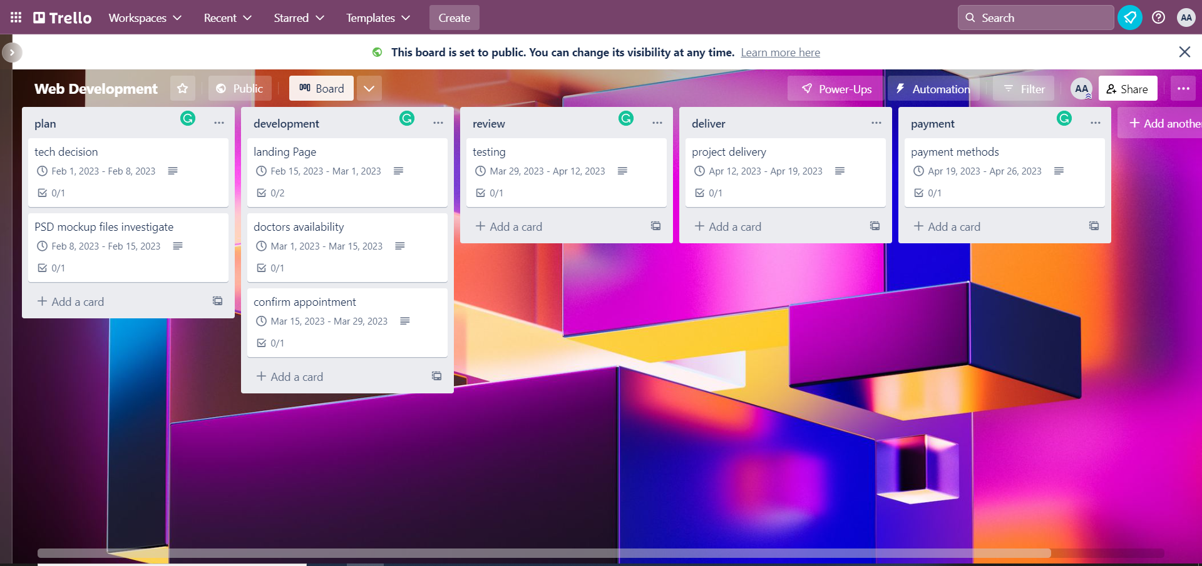
Trello Board
Please include the following information for your Trello board:
A link to your public Trello board should be provided here:
https://trello.com/b/t22KMeqN/web-development
Include a screenshot of the board below:
Paste screenshot here

Slide 13
Part 4
Invoice and Payment Options

Slide 14
[Ahmed Saleh]
[Heliopolis, Cairo, Egypt]
Invoice
Recipient:
[Web Development Company]
[Palo Alto, CA, USA]
Invoice #: [991]
Date issued: [1/2/2023]
Date due: [1/5/2023]
Services Rendered (Continue on next page)
Service | Description of Work Done | Hours Spent | Amount Per Hour | Total
[invesitage design files] | [Check design files to decide methods of implementaion] | [8] | [$35.00 ] | (8) x ($35.00 ) = [$280]
[system design] | [design the software system based on requirements and spesifications ] | [8] | [$35.00 ] | (8) x ($35.00 ) = [[$280]
[Idevelop html] | [writng html code with the required elements] | [8] | [$35.00 ] | (8) x ($35.00 ) = [[$280]
[develop css] | [writing css code for the html like ids, types, and classes] | [8] | [$35.00 ] | (8) x ($35.00 ) = [[$280]

Slide 15
[Your Full Name or Your Company Name]
[Your Address or Address Your Company is Registered to]
Invoice
Services Rendered (continued)
Service | Description of Work Done | Hours Spent | Amount Per Hour | Total
[develop js code] | [develop the app.js code for dynamic pages in the system] | [8] | [$35.00 ] | (8) x ($35.00 ) = [[$280]
[develop react compnents] | [Convert design compnents from design files into react software compontnets] | [8] | [$35.00 ] | (8) x ($35.00 ) = [[$280]
[develop async code] | [writing async code with promises and http request to run system environment] | [8] | [$35.00 ] | (8) x ($35.00 ) = [[$280]
[testing] | [testing all files and components to work together internally] | [8] | [$35.00 ] | (8) x ($35.00 ) = [[$280]
Total Payment Due: $2240.00
Payment Options: Paypal account no. 123456 at email address: ahmed.saleh@gmail.com or my bank account no. 1002345678

