Slide 1
HEADBRAIN

Slide 2
What is the brain
The human brain is the central organ of the human nervous system, and with the spinal cord makes up the central nervous system . The brain consists of the cerebrum , the brainstem and the cerebellum. It controls most of the activities of the body, processing, integrating, and coordinating the information it receives from the sense organs, and making decisions as to the instructions sent to the rest of the body

Slide 3
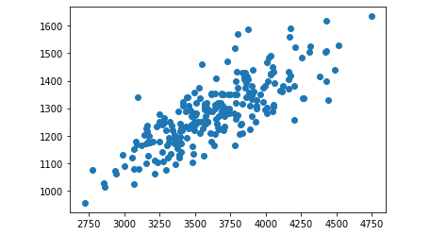
The adult human brain weighs on average about 1.2–1.4 kg (2.6–3.1 lb) which is about 2% of the total body weight, with a volume of around 1260 cm³ in men and 1130 cm³ in women. There is substantial individual variation, with the standard reference range for men being 1,180–1,620 g (2.60–3.57 lb) and for women 1,030–1,400 g (2.27–3.09 lb).

Slide 4
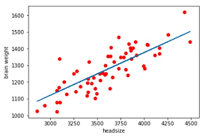
This is a relationship between brain weight and size, and it appears to be a positive relationship

Slide 5
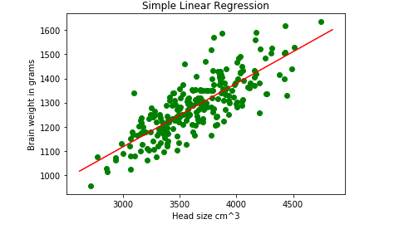
This is another relationship between the weight of the brain and its volume, in which the weight is in grams and the volume is in cubic centimeters

Slide 6
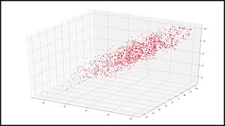
This is a three-dimensional relationship between brain weight and volume and it is a direct relationship

