Slide 1



Customers and Products Dimensional Modeling
SIC 8
BD Course
G 16
Notes:
Note:
1

Slide 2
Agenda
Team
Introduction
Problem Statement
Methodology
Key Tasks
Results and Insights
Conclusion
Q&A
Samsung Innovation Campus
Notes:
Note:
2

Slide 3


Team
Mai Elsayed
Dina Abdelmonem
Abdelrahman Ashraf
Ahmed Helmy
Mai Elsayed
Dina Abdelmonem
Facilitated by Ganna Sabahy
Samsung Innovation Campus
Notes:
Note:
2

Slide 4
Agenda
Team
Introduction
Problem Statement
Methodology
Key Tasks
Results and Insights
Conclusion
Q&A
Samsung Innovation Campus
Notes:
Note:
3

Slide 5
Introduction
E-commerce platforms generate massive volumes of transactional data daily — customers, products, orders, and payments.
This project builds a Data Warehouse pipeline using the Olist Brazilian E-Commerce dataset to transform raw operational data into analysis-ready dimensional models.
Goal: Enable business teams to answer questions like "who are our most valuable customers?" and "how has product pricing evolved?"
Samsung Innovation Campus
Notes:
Note:
4

Slide 6
Agenda
Team
Introduction
Problem Statement
Key Tasks
Methodology
Results and Insights
Conclusion
Q&A
Samsung Innovation Campus
Notes:
Note:
5

Slide 7
Problem Statement
Raw transactional data (customers, orders, products) is scattered across normalized tables — not analysis-friendly.
No historical tracking of product price changes over time.
No way to identify or segment customers by value (who buys often, recently, and spends the most).
Need: A dimensional model (Star Schema) that supports fast, reliable business intelligence queries.
Samsung Innovation Campus
Notes:
Note:
6

Slide 8
Agenda
Team
Introduction
Problem Statement
Methodology
Key Tasks
Results and Insights
Conclusion
Q&A
Samsung Innovation Campus
Notes:
Note:
7

Slide 9
Methodology
Ingestion: Raw CSV files loaded into MariaDB via Batch Load, then connected to Spark using JDBC.
Storage: Data stored in Hadoop Distributed File System (HDFS) as part of the data lake.
Processing: PySpark was used for data transformation (ETL jobs).
Warehousing: Apache Hive external tables.
Data Modeling: Employed a star schema with Fact and Dimension tables.
SQL: Used HiveQL for KPI queries.
Samsung Innovation Campus
Notes:
Note:
6

Slide 10
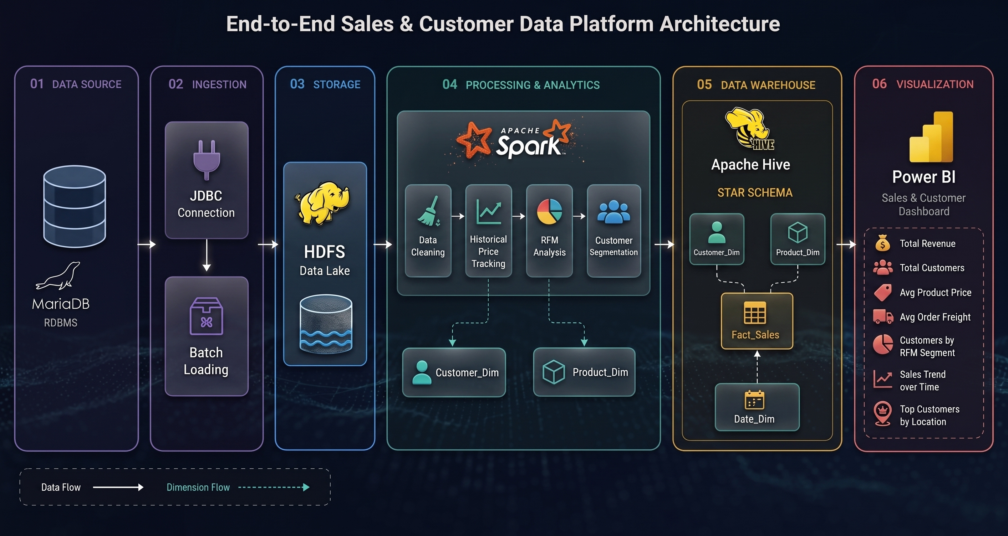
Notes:
Note:
6

Slide 11
Agenda
Team
Introduction
Problem Statement
Methodology
Key Tasks
Results and Insights
Conclusion
Q&A
Samsung Innovation Campus
Notes:
Note:
8

Slide 12
Key Tasks
Ingest raw data from MySQL into Spark via JDBC
Land raw data on HDFS (Raw Zone) as part of the Data Lake
DFS (Raw Zone) as part of the Data Lake - Clean & validate Customers, Products, Orders, and Payments data
Build Dim_Product with SCD Type 2 (historical price tracking)
Calculate RFM Score (Recency, Frequency, Monetary) for
Dim_Customer
Load final dimension tables into Hive as external tables
Samsung Innovation Campus
Notes:
Note:
6

Slide 13
Creating Dim-Date Table
The Dim_Date table was created from the order purchase dates and contains the main calendar attributes required for time-based analysis.
The dimension includes the following attributes:
date_key – unique key used to link dates with the fact table.
full_date – the complete calendar date.
year – year of the date.
quarter – quarter of the year.
month – month of the year.
day – day of the month.
Samsung Innovation Campus
Notes:
Note:
6

Slide 14
Creating Fact Table
The Fact_Sales table was generated by combining the required transactional data from orders, products, and payments. It contains the main sales and order-related information required for analysis.
The fact table includes:
sales_key – unique key for each sales record.
order_id – stored directly in the fact table as a degenerate dimension.
cust_key – foreign key referencing Dim_Customer.
product_key – foreign key referencing Dim_Product.
order_purchase_date_key – foreign key referencing Dim_Date.
order_status – status of the order.
price – product price.
freight_value – shipping/freight value.
payment_value – payment amount.
payment_type – payment method.
order_year and order_month – partitioning attributes used to organize the fact data.
Samsung Innovation Campus
Notes:
Note:
6

Slide 15
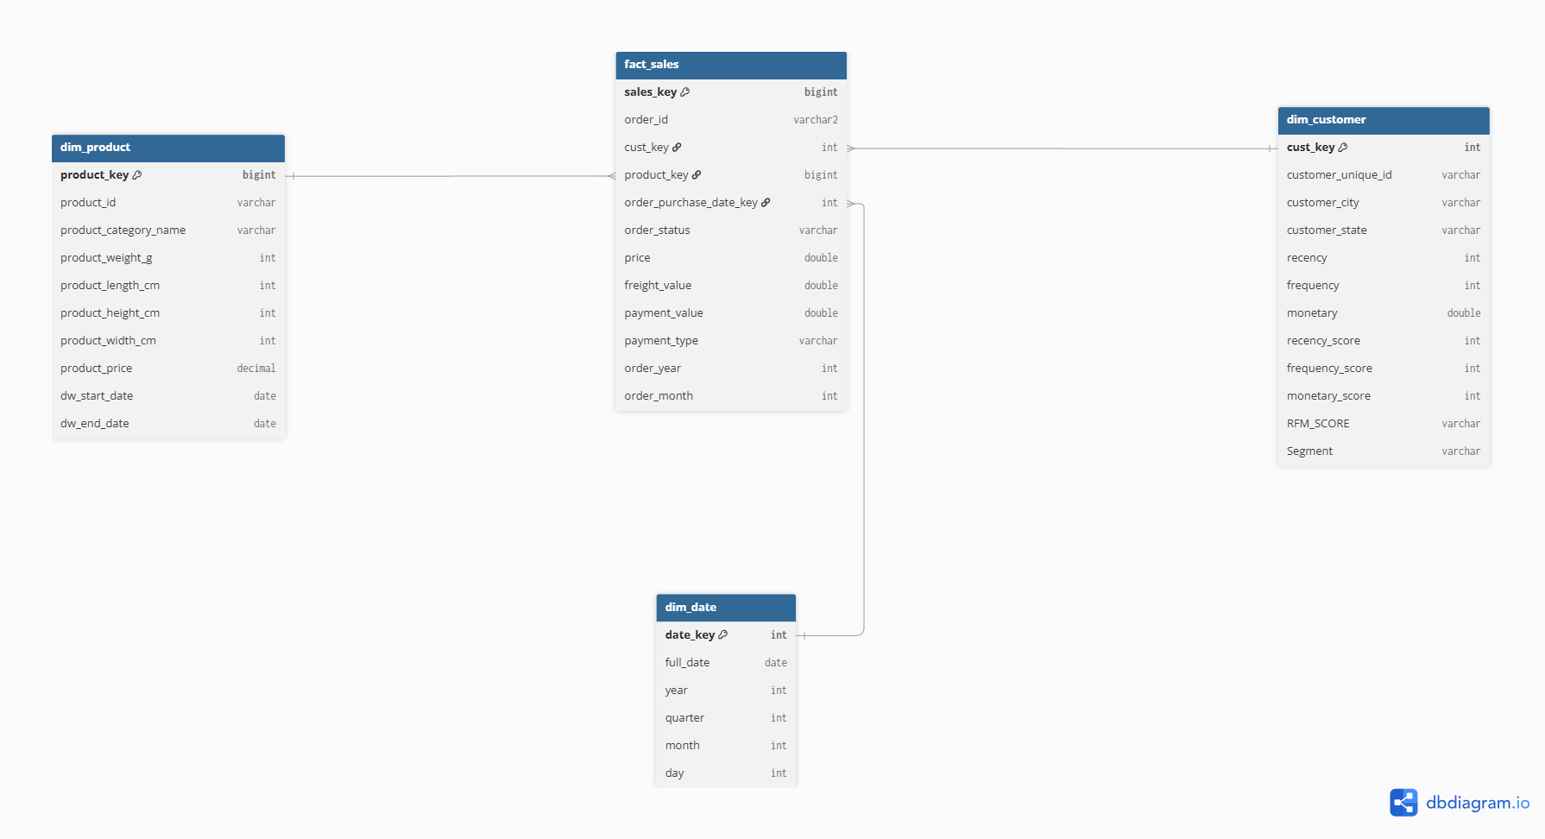
Notes:
Note:
6

Slide 16
Agenda
Team
Introduction
Problem Statement
Methodology
Key Tasks
Results and Insights
Conclusion
Q&A
Samsung Innovation Campus
Notes:
Note:
8

Slide 17
Results and Insights
Overview
This section documents the Sales & Customer Dashboard created in Power BI, presenting key business metrics, pricing analysis, customer RFM segmentation, revenue trends over time, and customer geographic distribution.
KPI Cards
Total Revenue | $15.74M
Cumulative payment value across all orders.
Total Customer | 96,092
Total count of distinct customers.
Avg Product Price | $145.7
Average price of products.
Avg Order Freight | $19.99
Average freight value per order.
Samsung Innovation Campus
Notes:
Note:
6

Slide 18
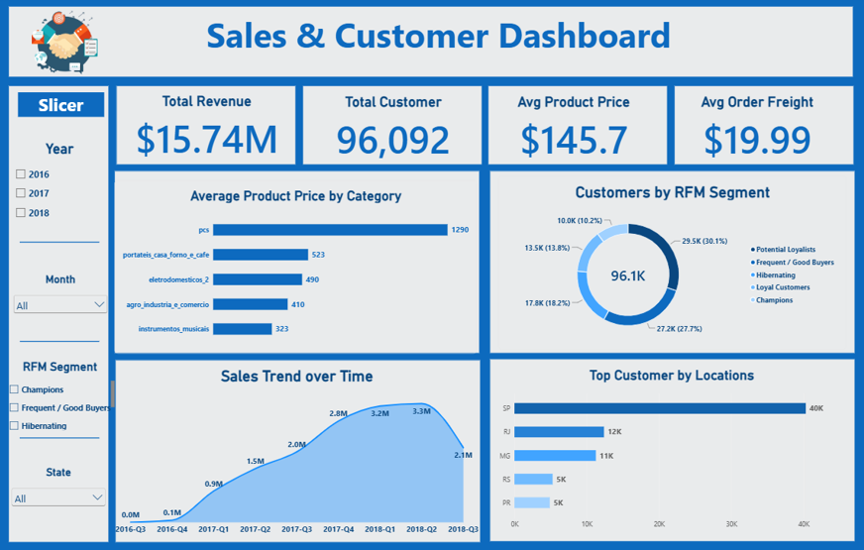
Notes:
Note:
6

Slide 19
ML (Late Delivery Prediction)
Objective
Predict whether an e-commerce order will arrive late to proactively manage supply chain bottlenecks.
Technical approach
Engineered Features: Vectorized numerical and categorical data, focusing heavily on physical logistics and customer geographyCumulative payment value across all orders.
Algorithm of Choice: PySpark MLlib Random Forest Classifier.
Model Selection: Chosen for its high interpretability and robustness against overfitting, outperforming initial alternative baseline models.
Samsung Innovation Campus
Notes:
Note:
6

Slide 20
ML (Late Delivery Prediction)
What Drives Shipping Delays?
Logistics & Geography: The model identified total_weight, freight_value, and customer_state as the highest predictors of late deliveries.
Myth Busted: Internal payment approvals and order processing times were not significant factors in delivery delays.
Actionable Business Value:
Enables the operations team to optimize heavy-freight carriers.
Allows the business to target and negotiate better SLAs for problematic shipping routes.
Samsung Innovation Campus
Notes:
Note:
6

Slide 21
Agenda
Team
Introduction
Problem Statement
Methodology
Key Tasks
Results and Insights
Conclusion
Q&A
Samsung Innovation Campus
Notes:
Note:
8

Slide 22
Conclusion
Built an end-to-end batch ETL pipeline: MySQL → HDFS → Spark → Hive
Delivered two production-ready dimension tables (Dim_Product, Dim_Customer) following industry-standard Star Schema design
Demonstrated key data engineering concepts: SCD Type 2, RFM analysis, and Data Lake zoning
Foundation ready for future Fact tables (Sales, Logistics) , BI dashboards and ML Models
Samsung Innovation Campus
Notes:
Note:
6

Slide 23
Agenda
Team
Introduction
Problem Statement
Methodology
Key Tasks
Results and Insights
Conclusion
Q&A
Samsung Innovation Campus
Notes:
Note:
8

Slide 24
Thank you
Questions?
Samsung Innovation Campus
Notes:
Note:
8

Slide 25

ⓒ2020 SAMSUNG. All rights reserved.
Samsung Electronics Corporate Citizenship Office holds the copyright of book.
This book is a literary property protected by copyright law so reprint and reproduction without permission are prohibited.
To use this book other than the curriculum of Samsung innovation Campus or to use the entire or part of this book, you must receive written consent from copyright holder.
Notes:
10

