Slide 1
Faculty of Engineering —Cairo University
Mobile Communications
ELC4017 · 4th Year · 2nd Semester · 2025 / 2026
EDGE Networks Enhanced Data rate for GSM Evolution
Submitted to:
Prof. Hebat-Allah M. Mourad
Presented by:
• Ibrahim Ramadan Ibrahim Hassan
• Ahmed Khalaf Mohamed Ali
• Hassan Osama Hassan Mohamed
• Hussein Abd El-Aal Ali Abd El-Aal
• Khaled Mohamed Ali Ramadan
• Mohamed Khaled Mohamed Shata
1

Slide 2
Agenda
01
Architecture & Components
Network elements, BTS, BSC, MSC, topology
02
Services & Specifications
Data rates, MCS levels, GPRS/EDGE services
03
Cell Coverage
Propagation models, link budget, enhancement techniques
04
Interference
CCI, ACI, ISI — measurement & mitigation
05
Radio / Air Interface & Channel Structure
Burst types, logical channels, TDMA frame structure
2

Slide 3

SECTION 1
Introduction &
Network Architecture
Background & Evolution · Dual Domain · MS · BSS/GERAN · Core Network · PCU
3

Slide 4
Introduction to EDGE
What is EDGE?
Evolution Path
Enhanced Data rates for GSM Evolution — 2.75G
3GPP standardized to bridge 2G → 3G gap
Upgrades the air interface only — not the core
GMSK replaced by 8PSK → 3 bits/symbol
Same 200 kHz channels & TDMA frame as GSM
Peak downlink: 384 kbps (theoretical)
Typical deployment: 120–200 kbps
GSM → Circuit-switched voice, 9.6 kbps
GPRS → Packet data, up to ~114 kbps
EDGE → 8PSK upgrade, up to 384 kbps
Economic Motivation
WCDMA/UMTS deployment cost was prohibitive
Operators needed 3G speeds on 2G investment
Hardware changes limited to MS & BTS edges
BSC & core needed software upgrades only
4
EDGE — Introduction & Architecture

Slide 5
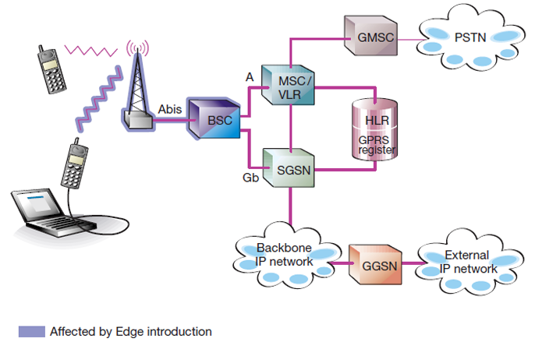
Network Architecture — Dual Domain
Unlike flat LTE, EDGE uses a Dual Domain architecture — circuit-switched voice bolted to a packet-switched data network.
Circuit-Switched (CS) Domain
Voice calls & SMS → MSC (Mobile Switching Centre)
Legacy GSM NSS — completely unchanged
GMSC bridges to external PSTN
🖼
Insert Figure 1 here
Packet-Switched (PS) Domain
Dual Domain Architecture of the EDGE Network
Data traffic → PCU → SGSN → GGSN → Internet
HLR: shared subscriber database (both domains)
Bursty data never overwhelms voice MSC
(Right-click → Replace Image)
Fig. 1 — Dual Domain Architecture [2]
5
EDGE — Introduction & Architecture

Slide 6
Network Components — MS & BSS / GERAN
Mobile Station (MS)
BSS / GERAN
Mobile Equipment (ME) + SIM card
Multislot Classes: how many of 8 TDMA slots it can use simultaneously
Higher class → more slots → higher throughput
Needs 8PSK-capable RF transceiver — hardware upgrade required
New equalizers to handle 8PSK demodulation
BTS: antennas & transceivers — hardware upgrade (new 8PSK TRX boards)
BSC: controls multiple BTS — software upgrade only (link adaptation & IR protocols)
PCU (at BSC): traffic router — inspects & separates voice vs. packet data
Abis interface links BTS to BSC
6
EDGE — Introduction & Architecture

Slide 7
Core Network & Architectural Significance of the PCU
Core Network (NSS & GPRS Core)
CS: NSS → MSC (voice switching)
PS: SGSN → mobility mgmt & packet routing
PS: GGSN → IP gateway, allocates addresses
HLR: shared subscriber DB (CS & PS)
SGSN/GGSN: software only — no hardware changes
🖼
Insert Figure 7 here
Radio Access & Control Interfaces
in the EDGE Architecture
(Right-click → Replace Image)
Why the PCU & Dual Domain Matter
Voice & data decoupled — MSC never overloaded
Hardware changes confined to edges (MS & BTS)
Fig.2— — Dual Domain Architecture [2]
7
EDGE — Introduction & Architecture

Slide 8
SECTION 2
Services & Specifications
EDGE Data Services · Modulation Schemes · MCS Ladder · Spectral Efficiency
8

Slide 9
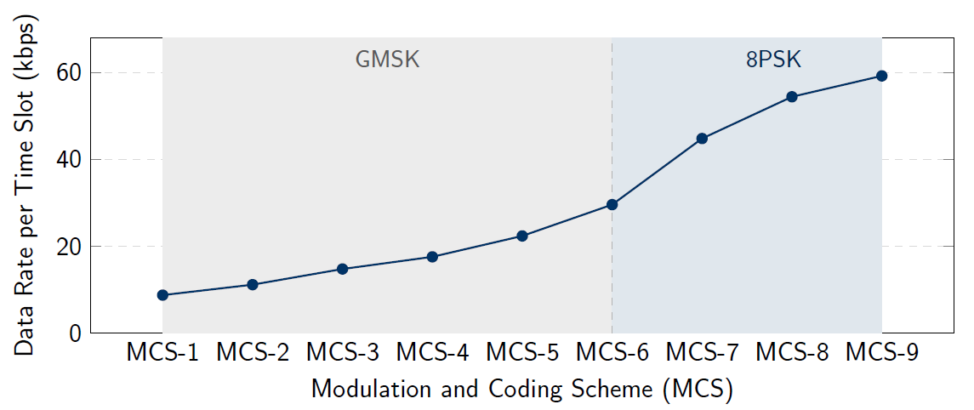
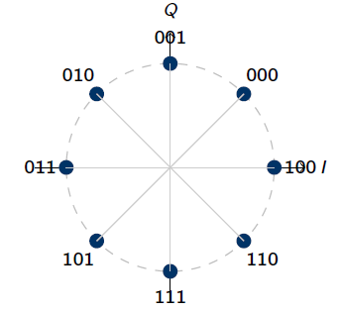
Modulation & Coding Schemes (MCS)
GMSK (MCS : 1 → 6)
1 bit/symbol — constant envelope
8PSK (MCS : 7 → 9)
3 bits/symbol — 3 × spectral efficiency
Max 8 slots × 59.2 = 384 kbps
Max 8 slots × 59.2 = 473.6 kbps
Link Adaptation (LA)
EDGE Services & Specs
10

Slide 10
EDGE Data Services
High-Speed Internet
MMS
Corporate Access
Streaming
Mobile Applications
120–200 kbps typical field rate
Packet-switched bearer
Always-on bearer (no call setup)
32–64 kbps audio (MP3/AAC)
Banking & m-commerce
473.6 kbps
120–200 kbps
150–200 ms
≈7×
Peak raw data rate (MCS-9, 8 slots)
Typical real-world throughput
One-way latency (vs. 300–500 ms GPRS)
Speed improvement over GPRS
EDGE Services & Specs
9

Slide 11
Spectral Efficiency & Backward Compatibility
Spectral Efficiency
Backward Compatibility
Same 200 kHz channel — no new spectrum needed
3 × raw efficiency
More simultaneous users per carrier
Same 200 kHz carrier & TDMA frame as legacy GSM
EDGE MS falls back to GPRS/GSM on poor signal
Non-EDGE handsets continue to operate on same BTS
Bits per Symbol Comparison
GMSK
1 bit
8PSK
3 bits
EDGE Services & Specs
11

Slide 12

SECTION 3
Cell Coverage in EDGE
Coverage Fundamentals · Propagation Models · Link Budget · Enhancement Techniques
12

Slide 13
Cell Coverage — Introduction
What is Cell Coverage?
Requires C/I > 30 dB
Limited to near base station only
The ability of a wireless network to provide an acceptable received signal level to users within a geographic area.
EDGE vs GSM Coverage:
Higher data rates → Higher SNR needed
High-speed services → Smaller coverage areas
Lower data rates → Usable near cell edge
13
EDGE Coverage Study

Slide 14



Factors Affecting EDGE Coverage
Frequency Band
TX Power & RX Sensitivity
Terrain & Environment
900 MHz: Lower path loss, larger cells
1800/1900 MHz: Higher loss, smaller radius
850/900/1800/1900 MHz bands in EDGE
Higher TX power → greater signal reach
Better RX sensitivity → lower signal needed
High-rate services need stronger signal
Path Loss: decreases with distance
Shadow Fading: buildings & terrain blockage
Multipath Fading: reflected signal copies
14
EDGE Coverage Study

Slide 15
Propagation Models
Free Space
$$\text{L}\text{ = }\text{32}\text{.}\text{44 }\text{+ }\text{20}\text{log}\text{(}\text{f}\text{) + }\text{20}\text{log}\text{(}\text{d}\text{)}$$
Baseline model assuming line-of-sight. f = frequency (MHz), d = distance (km). Starting point for all coverage estimation.
Okumura-Hata
$$\text{L}\text{ = }\text{69}\text{.}\text{55 }\text{+ }\text{26}\text{.}\text{16}\text{log}\text{(}f_{c}\text{) }\text{− }\text{13}\text{.}\text{82}\text{log}\text{(}h_{b}\text{) }\text{− }\text{a}\text{(}h_{m}\text{) + [}\text{44}\text{.}\text{9 }\text{− }\text{6}\text{.}\text{55}\text{log}\text{(}h_{b}\text{)]}\text{log}\text{(}\text{d}\text{)}$$
Primary empirical model for EDGE/GSM macro-cellular outdoor planning. Accounts for BS height, mobile height, and distance.
COST-231
$$L = 46.3 + 33.9log(f_{c}) − 13.82log(h_{b}) − a(h_{m}) + [44.9 − 6.55log(h_{b})]log(d) +C_{m}$$
Hata extension for 1800–1900 MHz. Adds Cm: 0 dB for medium cities, 3 dB for metro centres. Valid for dense urban 5G planning.
15
EDGE Coverage Study

Slide 16
Link Budget — The Core Planning Tool
$$MAPL = P_{tx}+G_{tx}+G_{rx}− L_{tx_cable}−L_{rx_cable}− P_{rx_sensitivity}− M_{interference} − M_{fading}$$
Maximum Allowed Path Loss — determines the maximum cell range for each EDGE service
Parameter | Description | Typical Value
Ptx | Transmitter output power | 43 dBm (BTS), 30 dBm (MS @ 900 MHz)
Gtx / Grx | Antenna gains | 18 dBi sectorised BTS, 0 dBi MS (omni)
Lcable | Cable & connector losses | 2–3 dB at BTS side
Prx_sensitivity | Minimum acceptable received power | Service-dependent threshold
Minterference | Interference degradation margin | Accounts for co-channel frequency reuse
Mfading | Slow fading margin (95% coverage) | ≈ 7.3 dB (σ=7 dB, γ=3.5)
16
EDGE Coverage Study

Slide 17


Coverage Enhancement Techniques
Sectorization
Microcells
Division of a cell into multiple directional sectors (typically 3 × 120°) using directional antennas.
Small coverage areas (50–500 m radius) designed for dense urban environments.
Increases antenna gain per sector → better link budget
Reduces inter-cell interference by focusing signal
Improves signal quality at the cell edge
Low transmit power, very small cell radius
Improves indoor & hotspot coverage
Reduces path loss in dense areas
Use cases: malls, business districts, subways
17
EDGE Coverage Study

Slide 18

SECTION 4
Interference in EDGE
18

Slide 19
INTERFERENCE IN EDGE NETWORKS
1
Co-Channel Interference (CCI)
Signals received from other cells using the same frequency (Due to frequency reuse).
2
Adjacent Channel Interference (ACI)
Power leakage from nearby frequency bands (Due to imperfect filtering or amplifier(
3
Intersymbol Interference (ISI)
Consecutive symbols smearing together (Caused by delayed reflections / Multipath fading).
19

Slide 20
INTERFERENCE IN EDGE NETWORKS
Freq. Hopping (FH)
Averages CCI statistically by rapid frequency changing
SAIC / DARP
Single Antenna Interference Cancellation via Joint Detection (TSC-based) or Blind Interference Cancellation (BIC) to suppress dominant interferers.
MLSE Equalizer
Combats ISI using Viterbi algorithm & 26-bit training sequence
Link Adaptation + IR
Downgrades MCS under poor C/I & soft-combines retransmissions.
20

Slide 21
SECTION 5
Radio / Air Interface
GERAN Architecture & Interfaces · Um Physical Layer · Modulation · MCS & Link Adaptation · Incremental Redundancy · Channel Structure
21

Slide 22
Overview
Enhancement of the GSM/GPRS air interface
115 kbps
→
384 kbps
GPRS peak
EDGE peak
EDGE is a Release-99 enhancement to GSM/GPRS that triples the per-timeslot data rate through changes confined to the Um (air) interface. The core network, BSS hardware, frequency plan, and channel architecture remain unchanged.
Classified as a 2.75G technology; standardised by 3GPP in TS 45.003 and TS 43.064.
22
Radio / Air Interface · 1 · Overview

Slide 23
GERAN Architecture & Interfaces
Voice core (CS)
Only one link is modified by EDGE — the wireless one
MSC
PSTN
A
MS
Um
BTS
Abis
BSC + PCU
(air interface)
Gb
SGSN
Gn
GGSN
Data core (PS) → Internet
Modified by EDGE
Unchanged from GSM/GPRS
EDGE changes only the radio waveform on Um. Every cable, every protocol, every core-network box behind the BTS stays exactly the same.
23
Radio / Air Interface · 2 · Architecture

Slide 24
The Um Skeleton — Inherited from GSM
200 kHz carriers, 8 timeslots per TDMA frame, 156.25 symbols per burst
TDMA frame (4.615 ms · 8 timeslots)
TS0
TS1
TS2
TS3
TS4
TS5
TS6
TS7
One burst = 156.25 symbols ≈ 577 μs
3 tail
58 data
26
58 data
3 tail
(payload)
training
(payload)
The slot layout is fixed. The question is: how many bits fit in the data fields?
EDGE keeps all of this. The change comes one layer up — at the modulation.
24
Radio / Air Interface · 3 · Physical Layer

Slide 25
The Actual Change: GMSK → 8-PSK
Same symbol rate. 3× the bits per symbol. 3× the data rate.
GMSK (GSM / GPRS / EDGE MCS-1 to 4)
8-PSK (EDGE MCS-5 to 9)
→
1 bit / symbol
3 bits / symbol
same symbol rate
22.8 kbps per timeslot
(270.833 ksps)
69.2 kbps per timeslot
Each symbol is one of 8 phase states instead of 2. The receiver must distinguish finer differences, so 8-PSK needs a cleaner channel — which is why EDGE keeps GMSK as a fallback for weaker signals.
25
Radio / Air Interface · 4 · Modulation

Slide 26
9 Coding Schemes + Link Adaptation
The system picks the best MCS for the current channel — every 20 ms
GMSK Schemes (MCS-1 to 4)
8-PSK Schemes (MCS-5 to 9)
MCS-1
8.8 kbps
Robust, best cell-edge coverage
MCS-5
22.4 kbps
Entry 8-PSK
MCS-2
11.2 kbps
Good fallback
MCS-6
29.6 kbps
MCS-7
44.8 kbps
High throughput
MCS-3
14.8 kbps
MCS-8
54.4 kbps
MCS-4
17.6 kbps
Best GMSK scheme
MCS-9
59.2 kbps
Peak: near-tower only
Link Adaptation re-selects the MCS every TTI = 20 ms based on channel quality (C/I measurement)
26
Radio / Air Interface · 5 · Coding & Link Adaptation

Slide 27
Incremental Redundancy (IR)
The safety net when Link Adaptation picks too aggressively
1st Transmission
Receiver Decodes
Heavy puncturing (few parity bits)
CRC check → FAILS!
NACK
2nd Transmission
Receiver Combines
Decoded ✓
DIFFERENT parity bits — new info, not a repeat
stored bits (TX1) + new bits (TX2)
Effectively a stronger code
Retransmissions add new redundancy, not duplicates — Type-II hybrid ARQ gives 2–5 dB coding gain vs. simple GPRS-style retransmit.
Together, Link Adaptation picks the MCS and IR cleans up when the choice was too optimistic.
27
Radio / Air Interface · 6 · Incremental Redundancy

Slide 28
Channel Structure — Inherited from GPRS
EDGE adds no new channels. It just runs faster on the existing ones.
Physical Channel
Logical Channels on the PDCH
PDCH
carries
PDTCH
PACCH
PBCCH · PCCCH
Packet Data Traffic (user payload)
Dedicated control: ACK/NACK, power ctrl
Broadcast / common: paging, access grants
Packet Data Channel — one timeslot reserved for packets on a 52-frame multiframe
PTCCH — Packet Timing Advance Control Channel: keeps each MS aligned within its TDMA slot
EDGE keeps all of these channels — what it changes is what goes inside the bursts.
The PDTCH now carries 8.8–59.2 kbps of payload (MCS-1 to MCS-9) instead of GPRS’s 8–20 kbps (CS-1 to CS-4). Up to 8 PDTCHs can be aggregated to one mobile.
28
Radio / Air Interface · 7 · Channel Structure

Slide 29
The Numbers, and the Bridge to 3G
Per timeslot × 8 slots = the headline rate
Per timeslot
× slots aggregated
Peak user rate
8.8 – 59.2
× 4 – 8
∼384
kbps (MCS-1 to MCS-9)
multislot class
kbps (8-slot terminal)
That was enough to call EDGE “2.75G” — fast enough for early mobile internet, cheap for operators (no core rebuild), a stopgap until UMTS / HSPA / LTE arrived.
▸ Only the Um air interface changed
▸ 8-PSK tripled the bits per symbol
▸ 9 MCS schemes + Link Adaptation + IR made it work in real channels
29
Radio / Air Interface · 8 · Conclusion

Slide 30
References
[1] T. Halonen, J. Romero, and J. Melero, GSM, GPRS and EDGE Performance: Evolution.
Towards 3G/UMTS, 2nd ed. Chichester, UK: John Wiley & Sons, 2003.
[2] A. Furuskär, S. Mazur, F. Muller, and H. Olofsson, “EDGE: Enhanced Data Rates for GSM and TDMA/136 Evolution,” IEEE Personal Communications, vol. 6, no. 3, pp. 56–66, Jun. 1999. [Online]. Available: https://courses.cs.washington.edu/courses/cse590y/02sp/furaskar.pdf
[3] T. S. Rappaport, Wireless Communications: Principles and Practice, 2nd ed.Upper Saddle River, NJ, USA: Prentice Hall, 2002, ch. 2, pp. 54–58. [Online].Available: https://telkom2013.wordpress.com/wp-content/uploads/2014/02/wireless-comm-princip-n-practice-theodoresrappaport.pdfn
[4] 3GPP TS 45.005, “Radio transmission and reception,” 3rd Generation Partnership Project (3GPP), Release 99.
30

Slide 31
Thank You
31

