Slide 1
Presentation “Hospital Database”

Slide 2
Creators :
01
04
02
03
Ahmed Khaled
Toka Hussein
Basmala Tarek
Radwa Reda
Supervisor : Dr Wael Zakaria & Dr Mohamed Hashem

Slide 3
Importance of Hospital Database
Why did we create the database?
For easy return of data if we need it.
Recording all statistics, such as the number of patients diagnosed.
a database can help streamline and organize patient information.
making it easier for healthcare professionals to access and update records.
It also allows for better coordination and communication between different departments within the hospital.
a database can enhance data security and privacy.

Slide 4
Requierments :
Let a sample database appliciation, called Hosiptal keeps track of a database Patient, Doctor , room, prescription , Medical Test, Nurse , Payement, Department, Medicine, Emergency.
Data requirements for the Hospital database are:
Each Patient has a unique SSN, Name, Phone, Email and a Gender.
The Patient has a Doctor , Prescription, Medical Test.
Each Doctor has a unique SSN, Name, Phone, Email, Salary and a Gender.
Each prescription has a unique ID and a Date.
Each Medical Test has a unique ID and a Name.

Slide 5
Requierments :
Relationship Describe related one Patient to one Doctor to many Prescription to many Medical Test.
Each Department has a unique Number and a Name and related a Doctor one department to many Doctor and one Doctor can manage one Department, not more.
Each Room has a unique Number and a capacity and related a Patient, one Room stays in one Patient or 4 maximum.
Each Nurse has an ID, Name, Shift Time and a salary and related the Room, one or more Nurse serve one or more Room.
The Prescription has Medicine.
Each Medicine has a unique Code and Name related the Prescription, one or more Prescription has one or more Medicine.

Slide 6
Requierments :
Each Medicine has a unique Code and Name related the Prescription, one or more Prescription has one or more Medicine.
Each Payment has a unique ID and a price related patient, one patient to one Payment, .
Each Emergency has a unique number.
relationship Treat related many patient to many doctor to one Emergency.
After Understanding The Requirements of Hospital Database Create its ER Model.

Slide 7
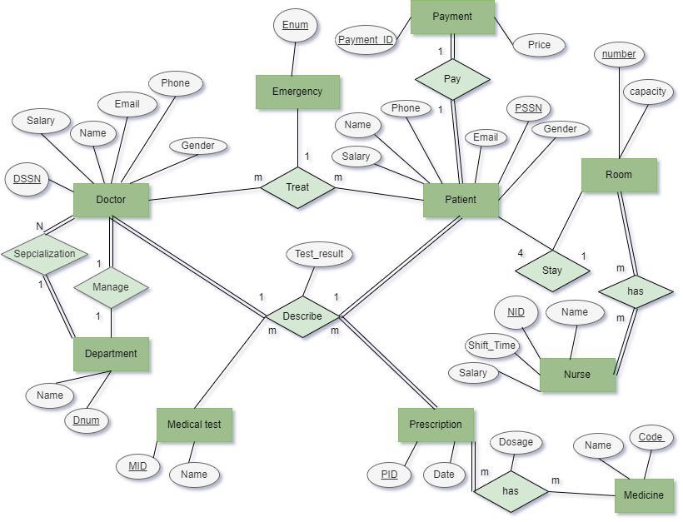
➔ER - Diagram

Slide 8
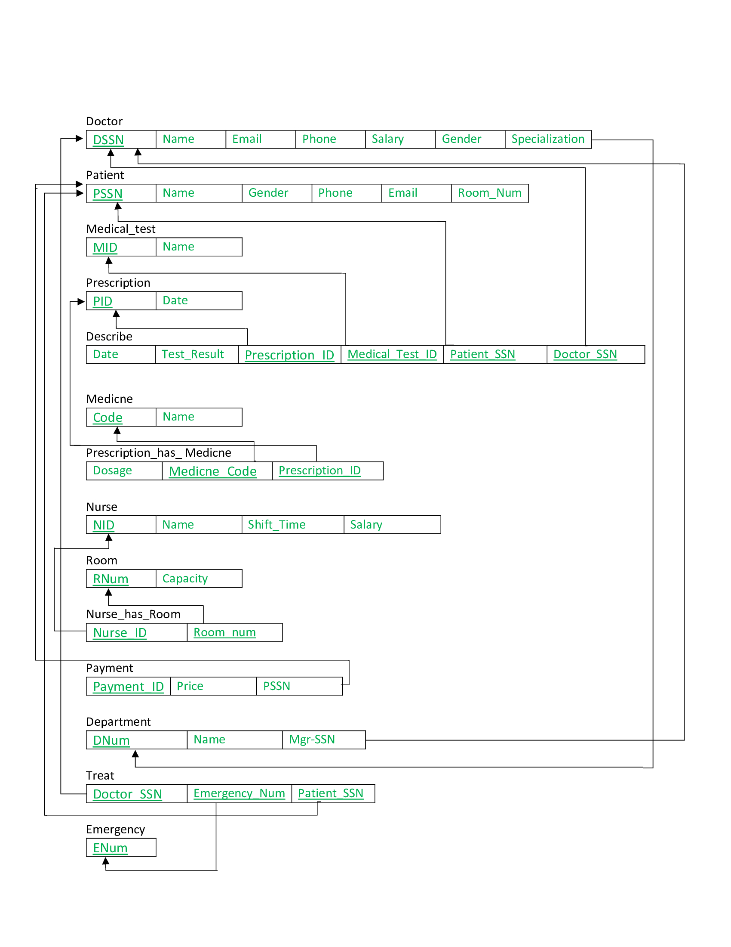
Relational Model (Mapping)

Slide 9
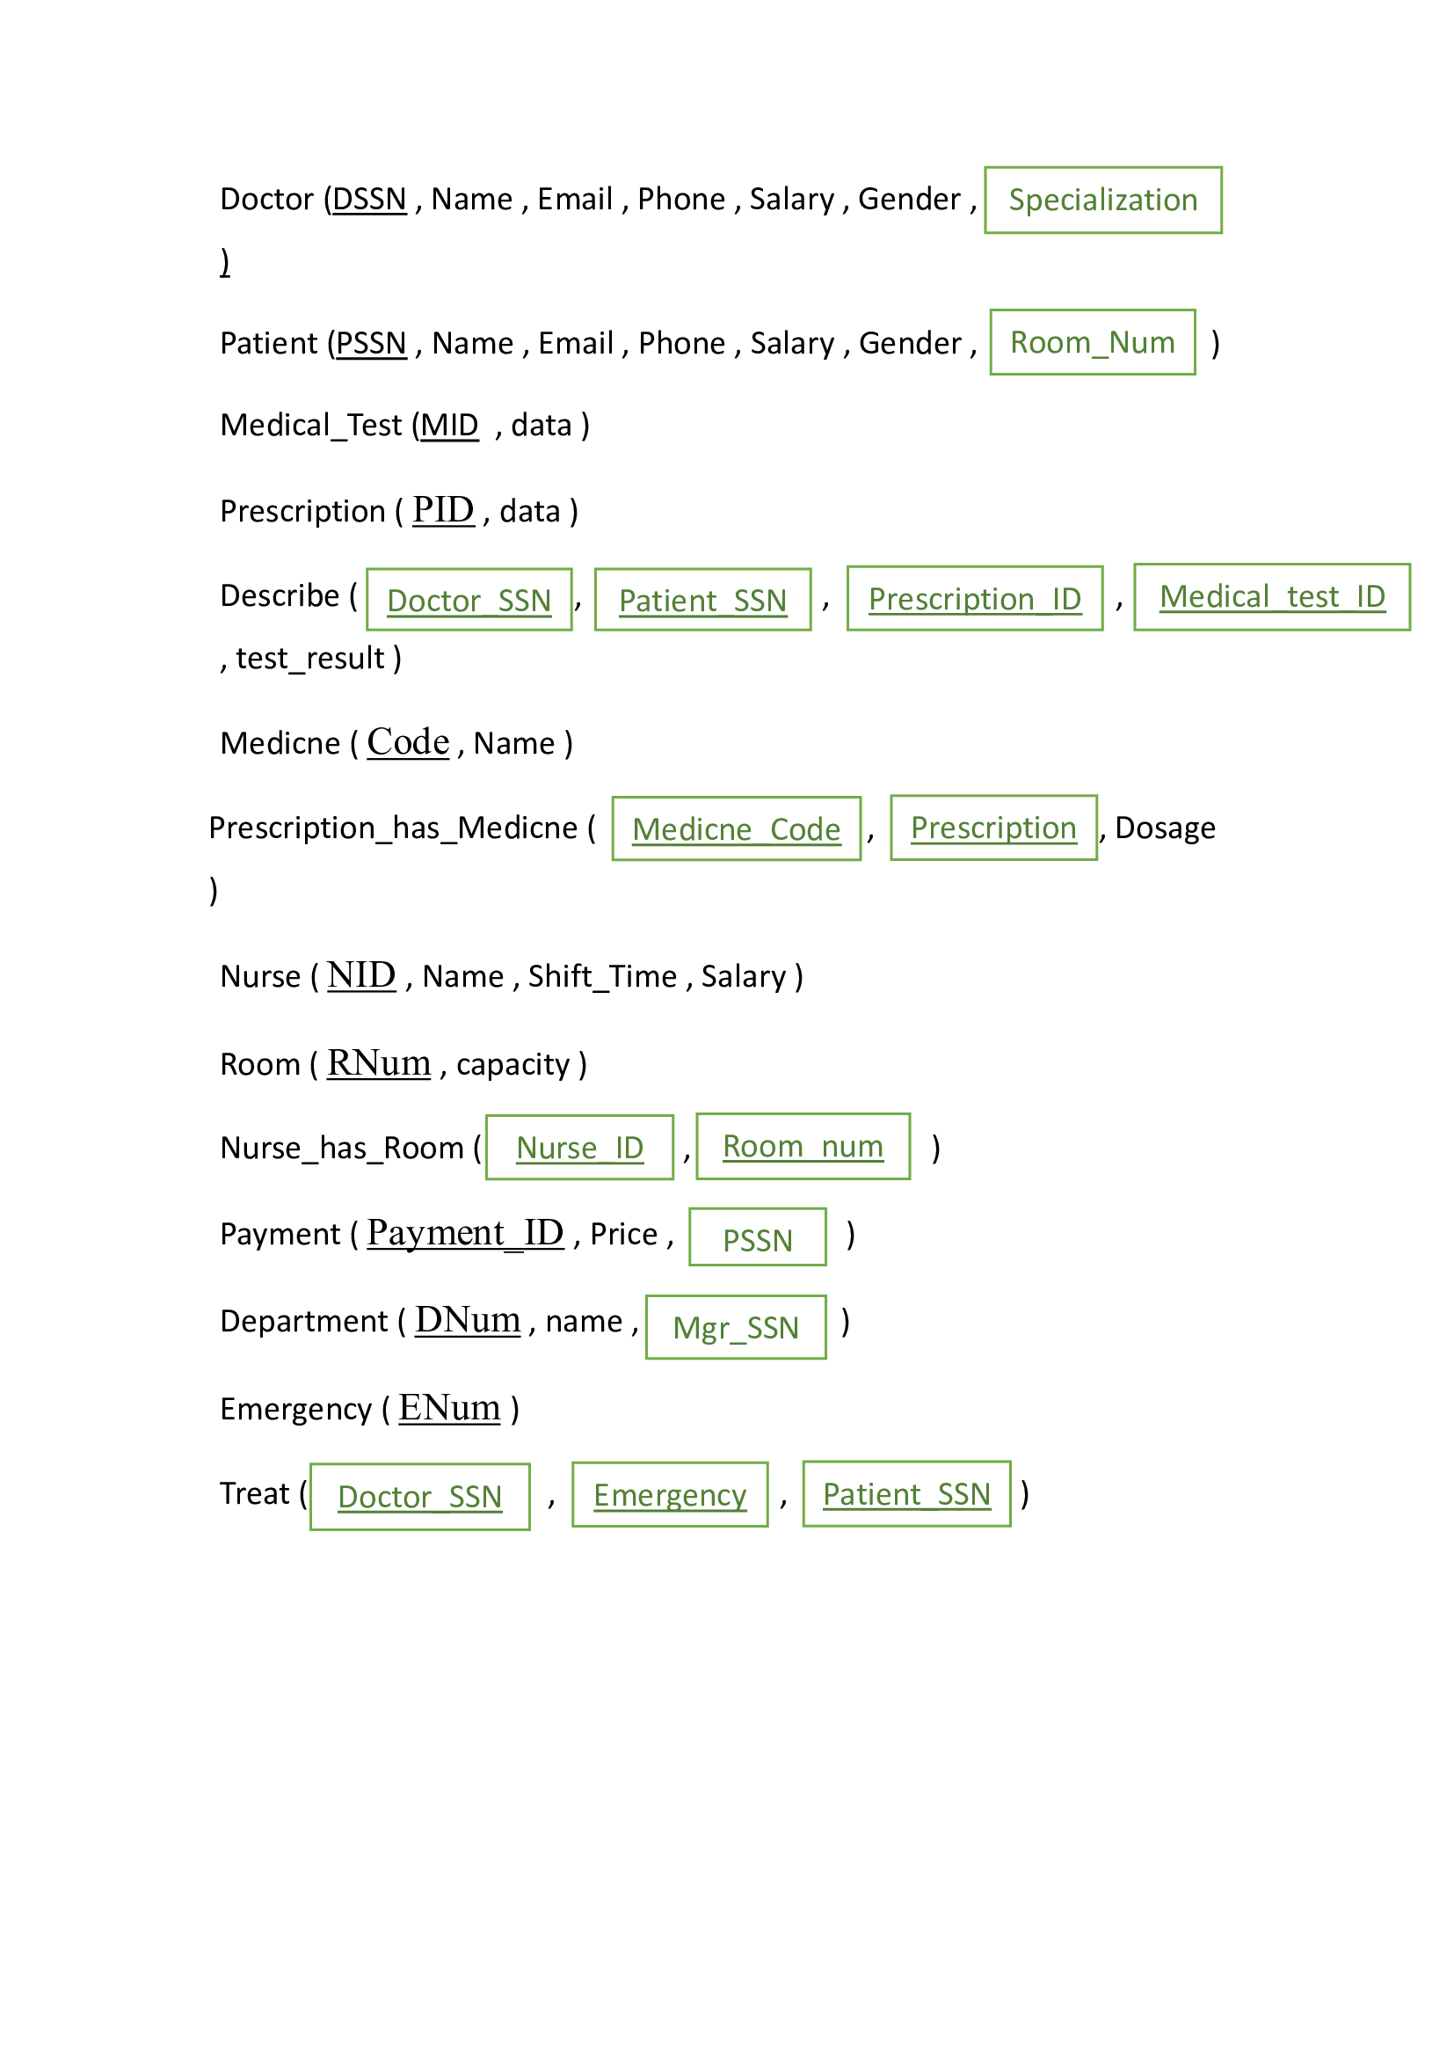
Another way for Relational Model (Mapping)

Slide 10
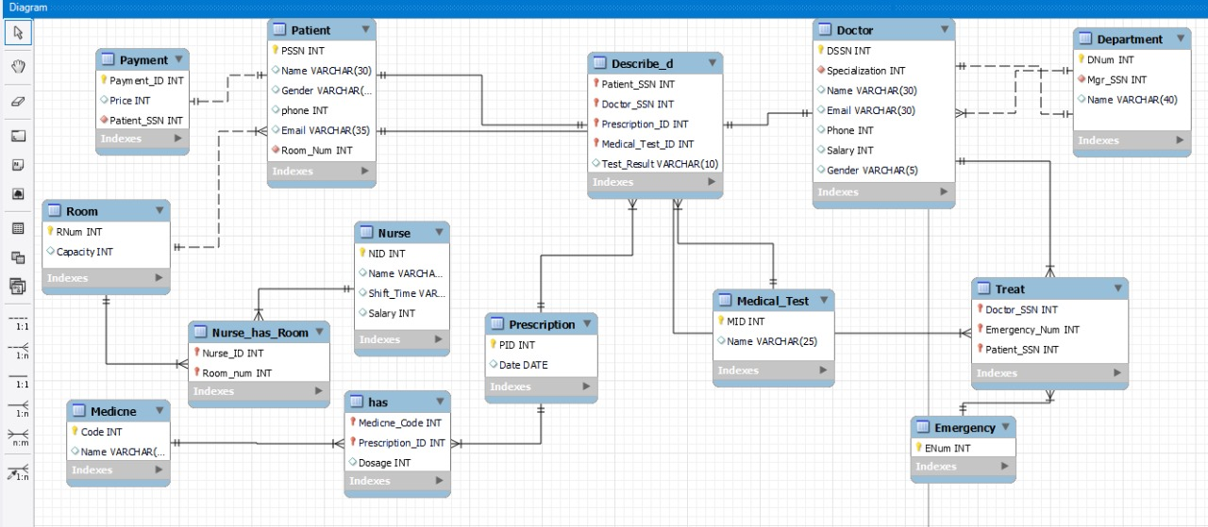
ER-Diagram on Work-Bench

Slide 11
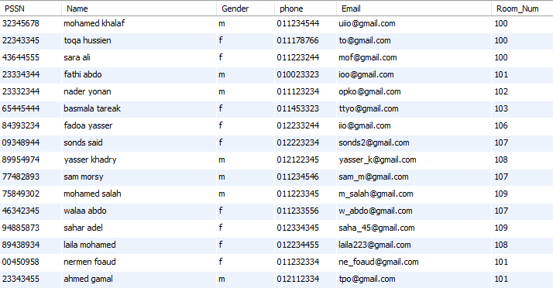
Patient :

Slide 12
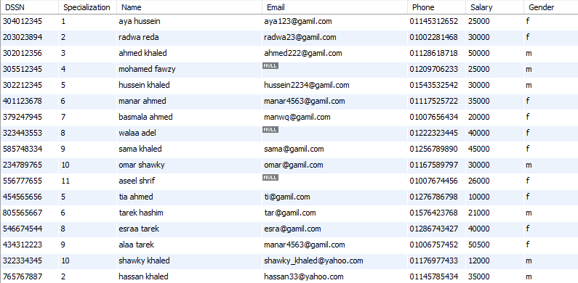
Doctor :

Slide 13
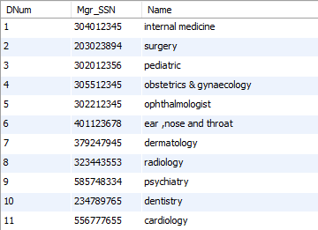
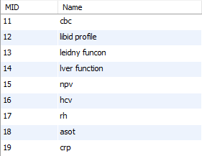
Department and medical test :

Slide 14
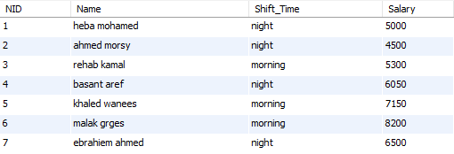

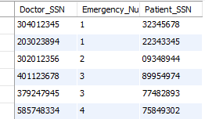
Emergency , Nurse and treat :

Slide 15
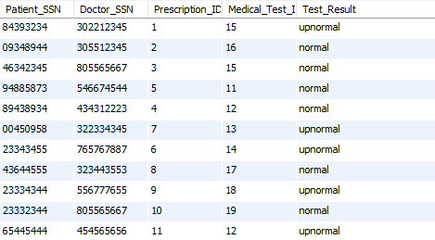
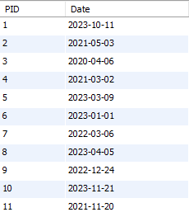
Prescription and Describe :

Slide 16
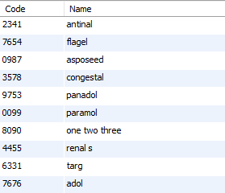
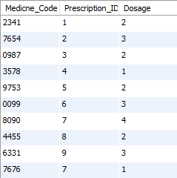
Medicine and has relationship :

Slide 17
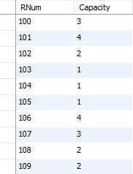
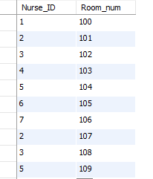
Room and relationship Nurse_has_Room :

Slide 18
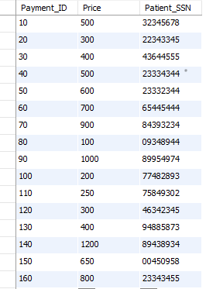
Payment :

Slide 19
Some queries on one table

Slide 20
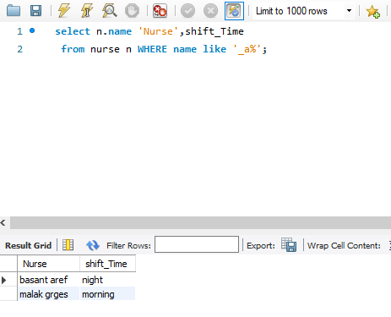
Retrieve the nurse whose second letter of his/her name is ‘A’ and shift time

Slide 21
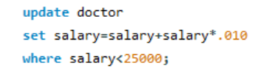
Increase the salary for each doctor whose salary is more than 25000 by adding 10% of the last salary

Slide 22
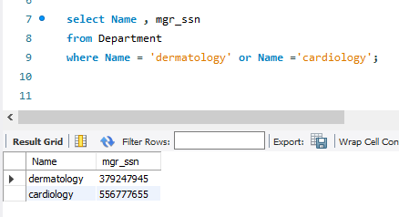
Retrieve the department of “dermatology” “cardiology” and the SSN of their manager

Slide 23
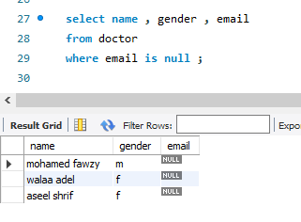
Retrieve the name and gender of each doctor doesn’t have an email

Slide 24
Some queries on many tables

Slide 25
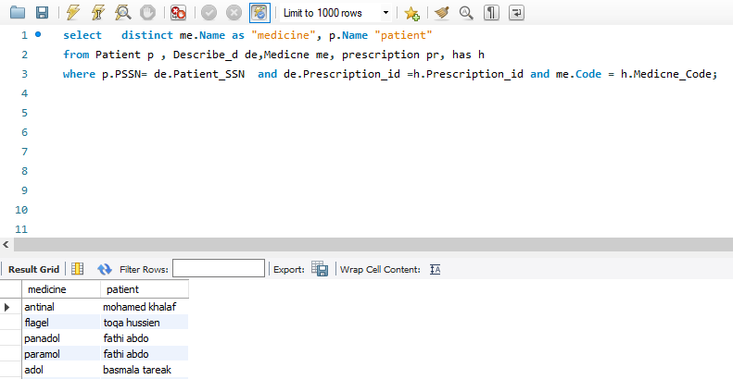
Retrieve the name of the patient and his medicine

Slide 26
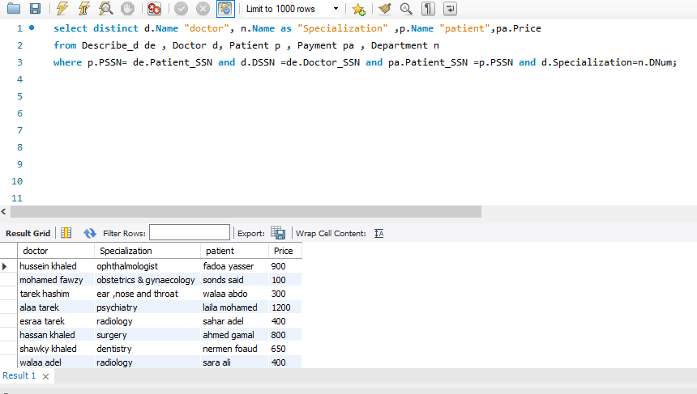
the name of the doctor his, patient, his specialization and total payments

Slide 27
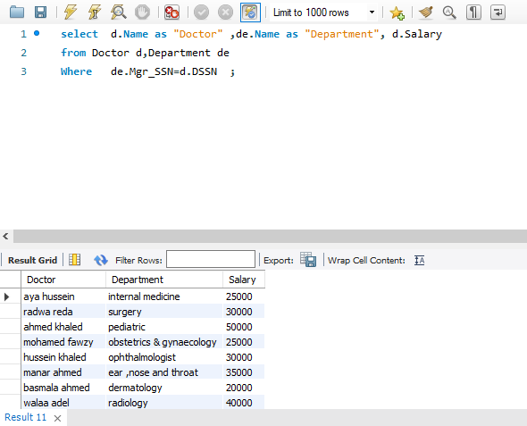
Retrieve the manger of each department and his salary

Slide 28
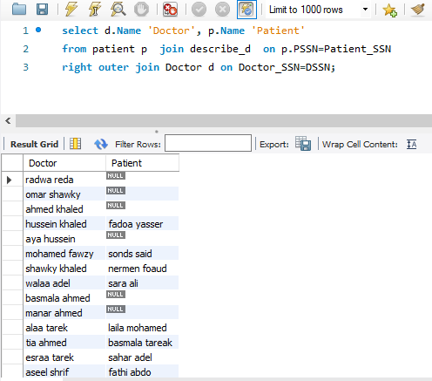
Retrieve all doctor and if he has a patient or not

Slide 29
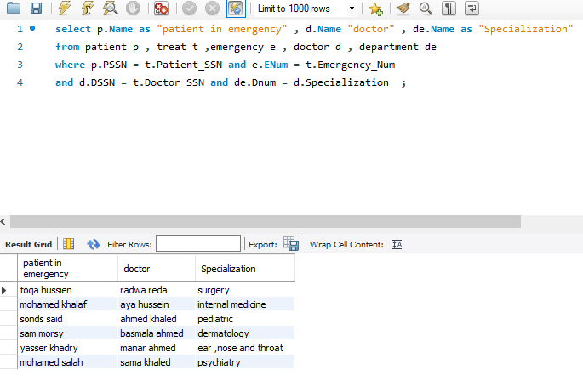
Retrieve all the patients in emergency and their doctors and doctors specialization

Slide 30
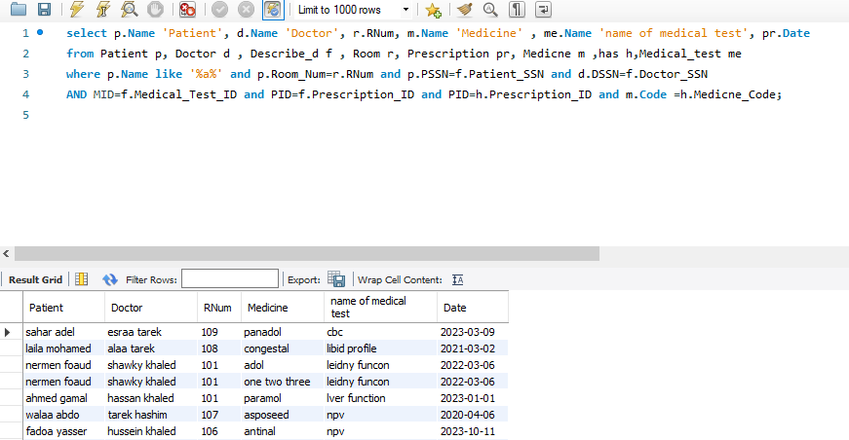
Retrieve (names of patients which contain the letter a, their doctors , number of room , name of medicine , name of medical test , date of prescription)

Slide 31
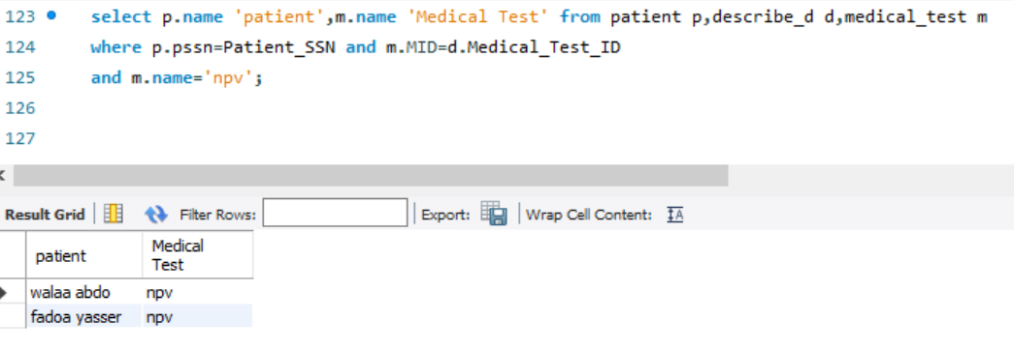
Retrieve all the patient who have a medical test=“npv”

Slide 32
Some queries use aggregate ,group by ,and having

Slide 33
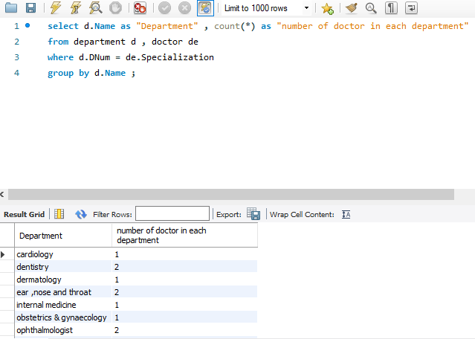
Retrieve how many doctors in each department

Slide 34
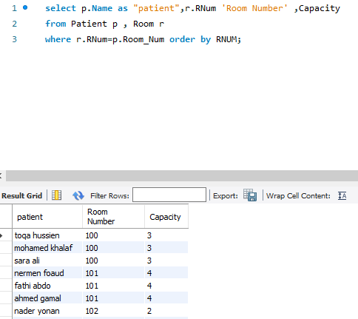
Retrieve the patient , his room and capacity of the room

Slide 35
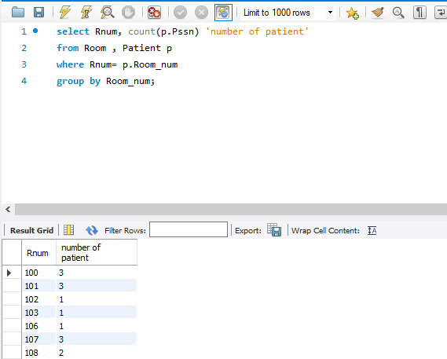
Retrieve room number and the number of patients in this room

Slide 36
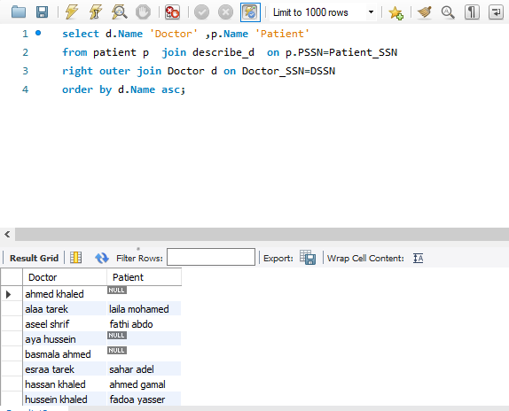
Retrieve all doctors and if they have a patient or not

Slide 37
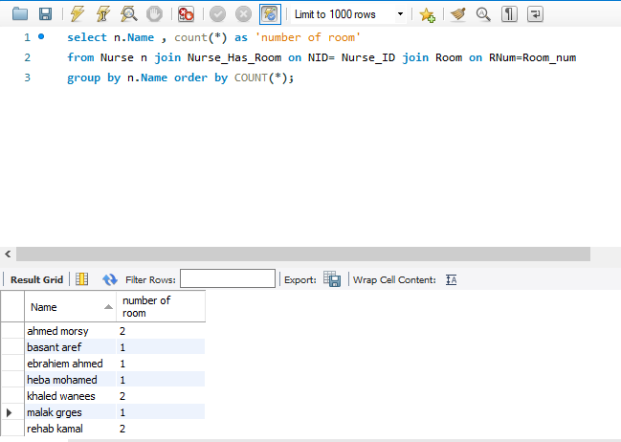
Retrieve all nurses and the number of rooms they serve

Slide 38
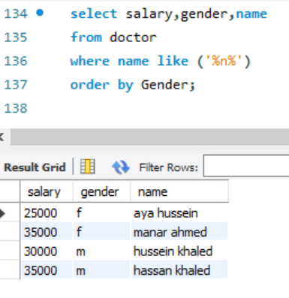
Retrieve the name and the salary of each doctor whose name contains the letter N and sort them by gender

Slide 39
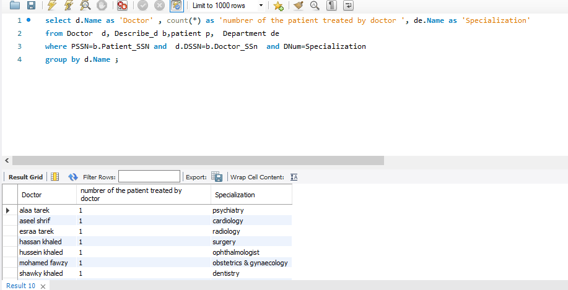
Retrieve each doctor and his department and how many patients he has diagnosed

Slide 40
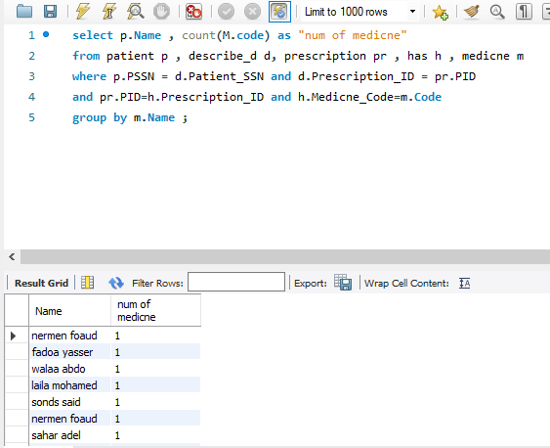
Retrieve patient name and his number of medicine

Slide 41
Some nested queries

Slide 42
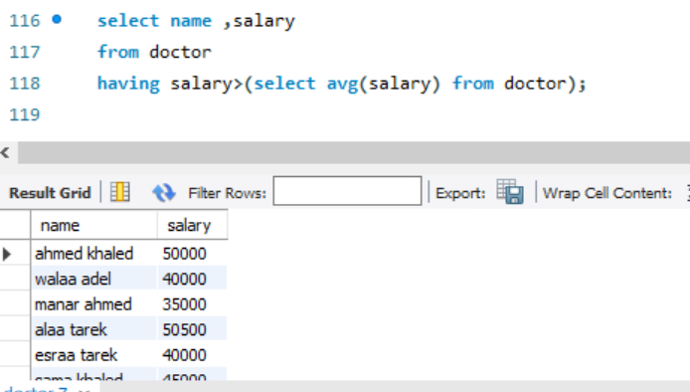
Retrieve the salary of the doctors with salary more than average salary

Slide 43
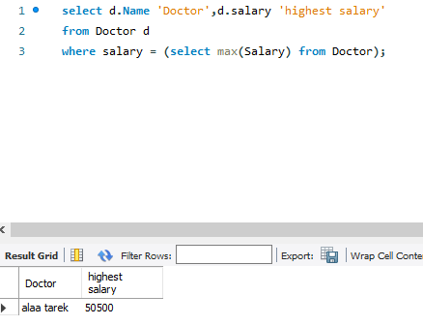
Retrieve the doctor with highest salary

Slide 44
Thank you

