Slide 1
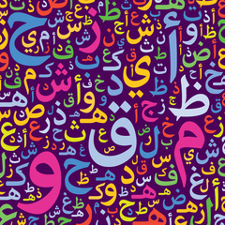
Sentiment Analysis For Arabic Tweets
Team 09
Supervised by : Prof. Mervat Abuelkheir and Eng. Mayar Osama

Slide 2
Outline
Introduction
Motivation
Dataset
Data Analysis & Preprocessing
Challenges
Proposed System Architecture
Conclusion

Slide 3
Outline
Introduction
Motivation
Dataset
Data Analysis & Preprocessing
Challenges
Proposed System Architecture
Conclusion

Slide 4
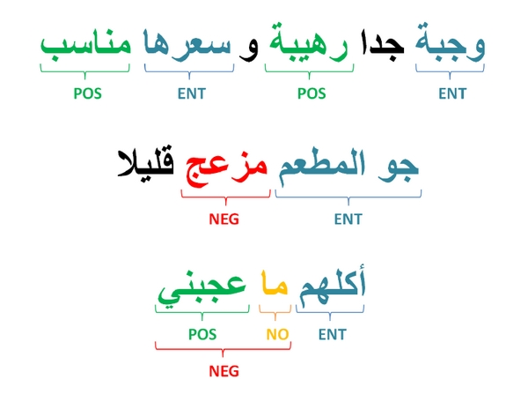
Introduction
Sentiment analysis is the task of automatically identifying the emotional tone or attitude expressed in a piece of text, such as positive or negative.
Twitter data is popular for sentiment analysis.
Arabic is a challenging language for sentiment analysis.
Notes:
Sentiment analysis is the task of automatically identifying the emotional tone or attitude expressed in a piece of text, such as positive, negative, or neutral.
Social media platforms like Twitter have become popular sources of data for sentiment analysis, since they allow people to express their opinions and emotions publicly and in real-time.
Arabic is one of the most widely spoken languages in the world, with over 420 million native speakers. It is also a challenging language for sentiment analysis due to its complex grammar, rich vocabulary, and diverse dialects.

Slide 5
Outline
Introduction
Motivation
Dataset
Data Analysis & Preprocessing
Challenges
Proposed System Architecture
Conclusion

Slide 6
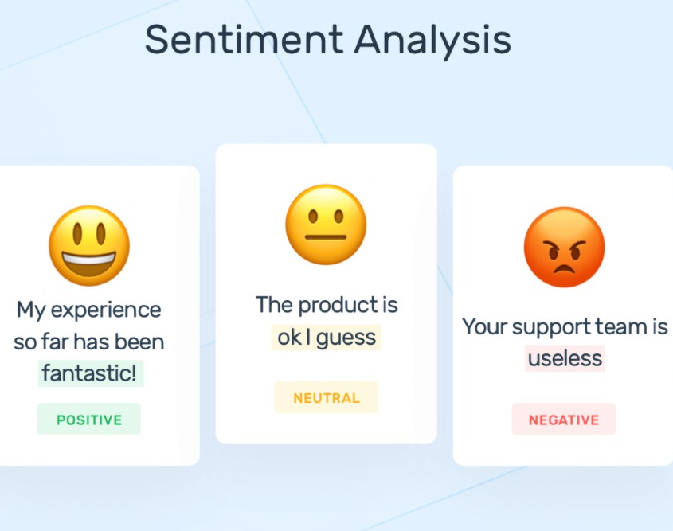
Motivation
Understand customer opinions and feedback
Monitor brand reputation
Improve customer experience

Slide 7
Outline
Introduction
Motivation
Dataset
Data Analysis & Preprocessing
Challenges
Proposed System Architecture
Conclusion

Slide 8
Dataset
This dataset was collected in April 2019
It contains 58K Arabic tweets tweets annotated in positive and negative label
Balanced dataset

Slide 9
Outline
Introduction
Motivation
Dataset
Data Analysis & Preprocessing
Challenges
Proposed System Architecture
Conclusion

Slide 10
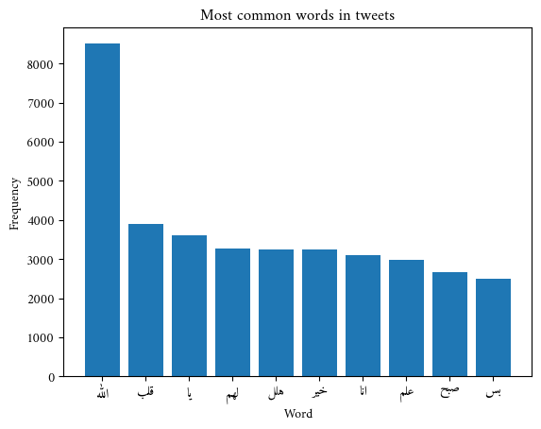
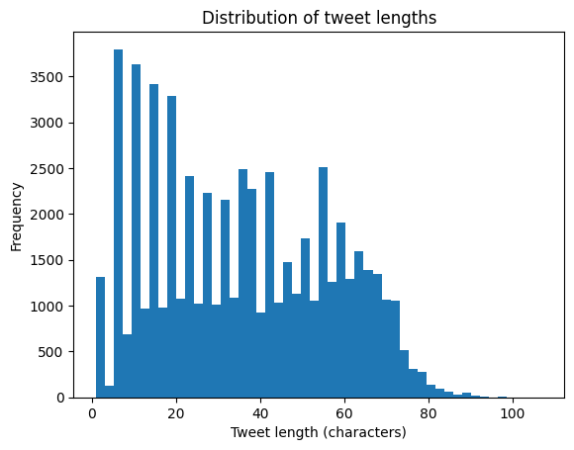
Data Analysis & Preprocessing
Data cleaning reduced dataset size.
"Allah" is the most common word.

Slide 11
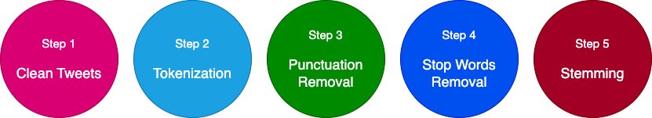
Data Analysis & Preprocessing

Slide 12
Outline
Introduction
Motivation
Dataset
Data Analysis & Preprocessing
Challenges
Proposed System Architecture
Conclusion

Slide 13
Challenges
Matplot lib doesn’t support all Arabic words
Some Arabic words can’t be stemmed such as ( 'يقين )
Dialects: There are many different dialects of Arabic, each with their own unique vocabulary and grammar rules.

Slide 14
Outline
Introduction
Motivation
Dataset
Data Analysis & Preprocessing
Challenges
Proposed System Architecture
Conclusion

Slide 15
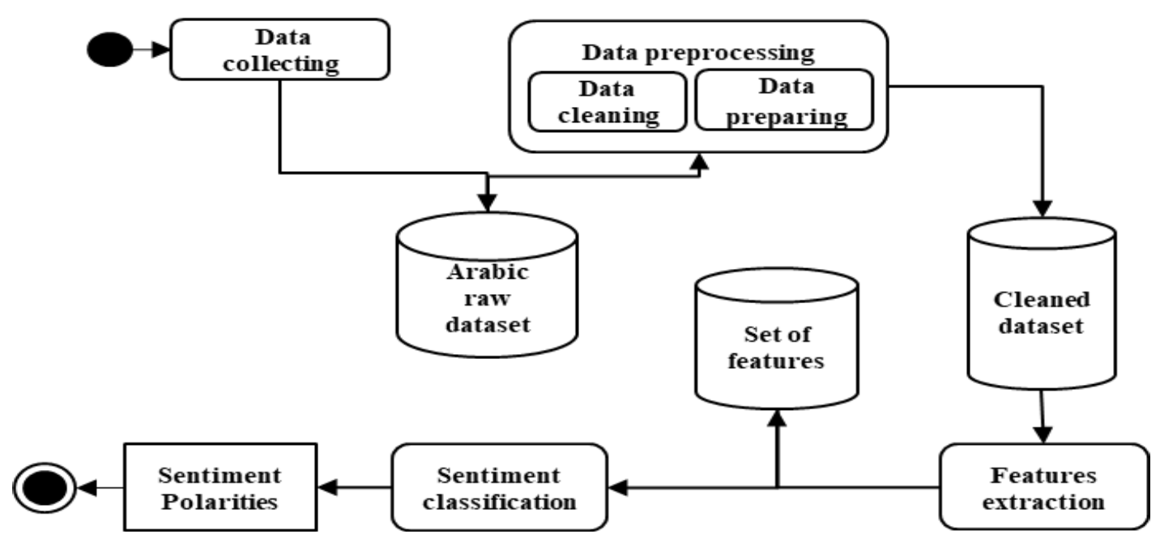
Proposed System Architecture
Feature extraction could be done using tf-idf or BOG or Arabert
Sentiment classification could be done using ML model

Slide 16
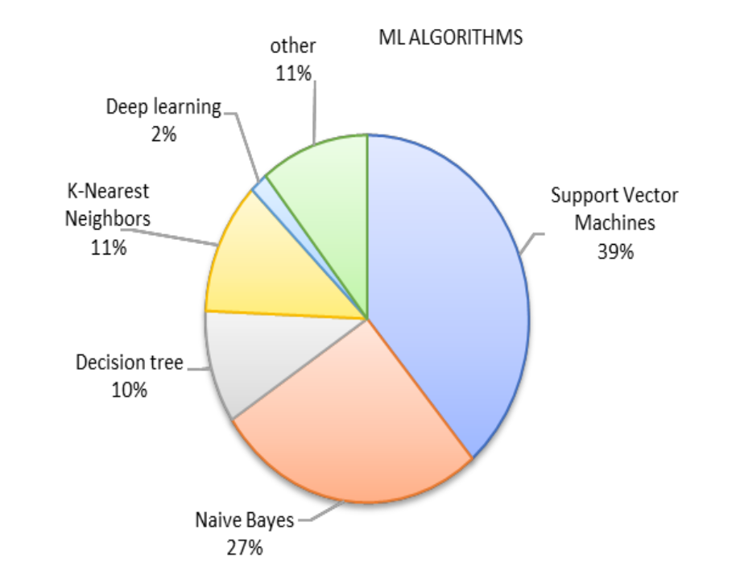
Proposed System Architecture
Sentiment classification could be done using ML model
SVM is the most common ML model for Arabic sentiment analysis

Slide 17
Outline
Introduction
Motivation
Dataset
Data Analysis & Preprocessing
Challenges
Proposed System Architecture
Conclusion

Slide 18
Conclusion
Arabic is a challenging language for sentiment analysis.
Arabic sentiment analysis can help understand customer opinions and feedback

Slide 19
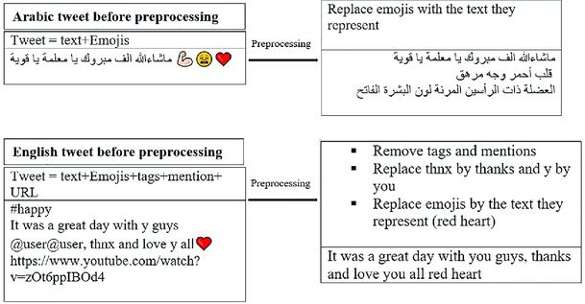
Clean Tweet
Remove mentions
Remove retweets
Remove URL
Remove any non-Arabic character
Remove emojis
Remove Tashkeel and Tatweel

Slide 20
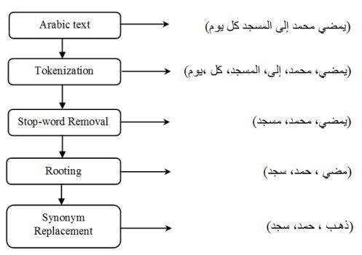
Tokenization & Punctuation Removal
Tokenization is a way of separating a piece of text into smaller units called tokens
Punctuation removal refers to the process of eliminating punctuation marks, such as periods, commas, semicolons, and exclamation marks, from a piece of text.

Slide 21
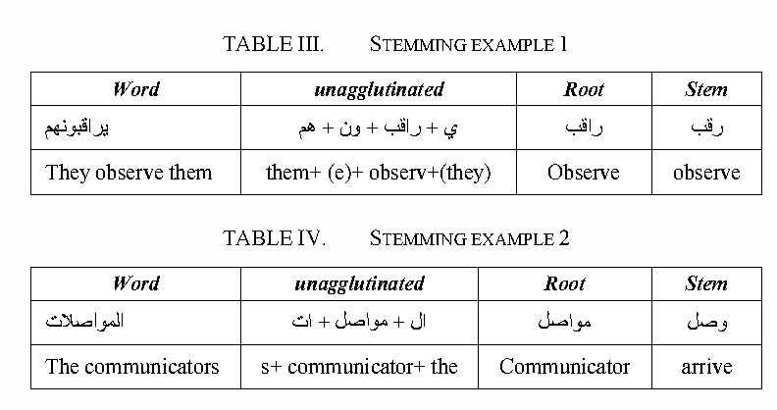
Stop Word Removal & Stemming
Stop words removal is a text preprocessing technique used in natural language processing (NLP) to eliminate commonly occurring words in a language from a piece of text.
Stemming is a technique used to extract the base form of the words by removing affixes from them
https://www.researchgate.net/figure/Preprocessing-examples-for-Arabic-and-English-tweets_fig1_353567030
https://www.researchgate.net/figure/An-example-of-preprocessing-steps-of-an-Arabic-text_fig2_272853366
https://www.semanticscholar.org/paper/Integrating-effective-rules-to-improve-arabic-text-Cherif-Madani/de1900b776827e036baea69769b09668fdf9d166

Slide 22
References
https://www.google.com/url?sa=i&url=https%3A%2F%2Fwww.hindawi.com%2Fjournals%2Ftswj%2F2014%2F631394%2Ffig3%2F&psig=AOvVaw09iToFhJsH4Lwa5iBk7nKY&ust=1683485478905000&source=images&cd=vfe&ved=0CBEQjRxqFwoTCJixl6Su4f4CFQAAAAAdAAAAABAD
https://monkeylearn.com/sentiment-analysis/
https://www.cfilt.iitb.ac.in/resources/surveys/SentimentAnalysis-Vinita.pdf
https://ijci.journals.ekb.eg/article_118803_309a4df86113b74b158b9f7959b59def.pdf
https://ieeexplore.ieee.org/stamp/stamp.jsp?arnumber=8890900
https://www.kaggle.com/datasets/mksaad/arabic-sentiment-twitter-corpus

Slide 23
THANK YOU ☺
ANY QUESTIONS?

Slide 24
Refrences(papers)
https://www.cfilt.iitb.ac.in/resources/surveys/SentimentAnalysis-Vinita.pdf
https://ijci.journals.ekb.eg/article_118803_309a4df86113b74b158b9f7959b59def.pdf
https://ieeexplore.ieee.org/stamp/stamp.jsp?arnumber=8890900

Slide 25
References(dataset)
https://www.kaggle.com/datasets/mksaad/arabic-sentiment-twitter-corpus

