Slide 1

Sentiment Analysis For Arabic Tweets
Team 09
Supervised by : Prof. Mervat Abuelkheir and Eng. Mayar Osama

Slide 2
Outline
Introduction
Dataset
Data Analysis & Preprocessing
System Architecture
Sentiment Analysis
Sarcasm Detection & Sentiment Analysis
Challenges
Conclusion

Slide 3
Outline
Introduction
Dataset
Data Analysis & Preprocessing
System Architecture
Sentiment Analysis
Sarcasm Detection & Sentiment Analysis
Challenges
Conclusion

Slide 4
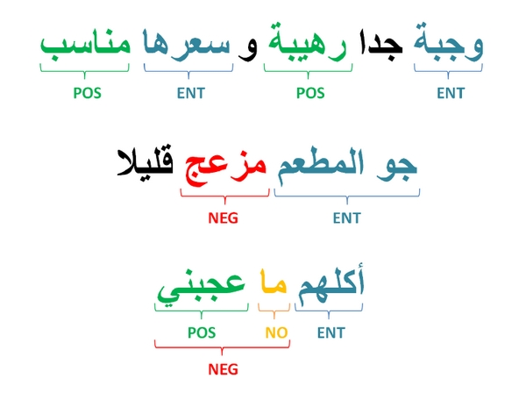
Introduction
Sentiment analysis is the task of automatically identifying the emotional tone or attitude expressed in a piece of text, such as positive or negative.
Twitter data is popular for sentiment analysis.
Arabic is a challenging language for sentiment analysis.
Notes:
Sentiment analysis is the task of automatically identifying the emotional tone or attitude expressed in a piece of text, such as positive, negative, or neutral.
Social media platforms like Twitter have become popular sources of data for sentiment analysis, since they allow people to express their opinions and emotions publicly and in real-time.
Arabic is one of the most widely spoken languages in the world, with over 420 million native speakers. It is also a challenging language for sentiment analysis due to its complex grammar, rich vocabulary, and diverse dialects.

Slide 5
Outline
Introduction
Motivation
Dataset
Data Analysis & Preprocessing
Challenges
Proposed System Architecture
Conclusion

Slide 6
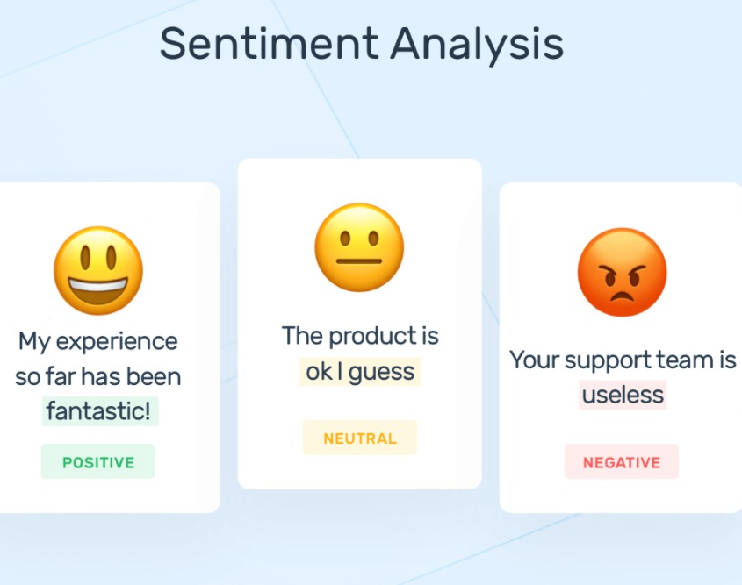
Motivation
Understand customer opinions and feedback
Monitor brand reputation
Improve customer experience

Slide 7
Outline
Introduction
Dataset
Data Analysis & Preprocessing
System Architecture
Sentiment Analysis
Sarcasm Detection & Sentiment Analysis
Challenges
Conclusion

Slide 8
Dataset
This dataset was collected in April 2019
It contains 58K Arabic tweets annotated in positive and negative label
Balanced dataset

Slide 9
Outline
Introduction
Dataset
Data Analysis & Preprocessing
System Architecture
Sentiment Analysis
Sarcasm Detection & Sentiment Analysis
Challenges
Conclusion

Slide 10
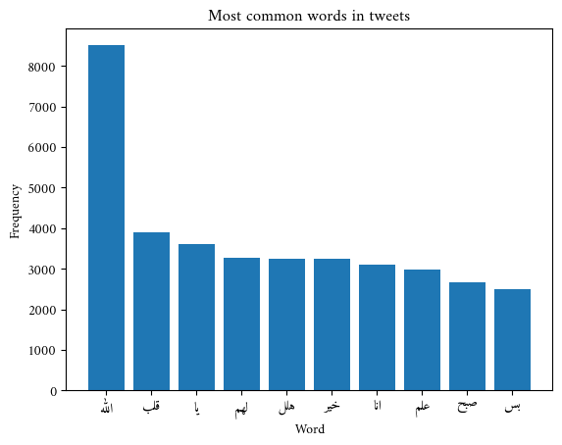
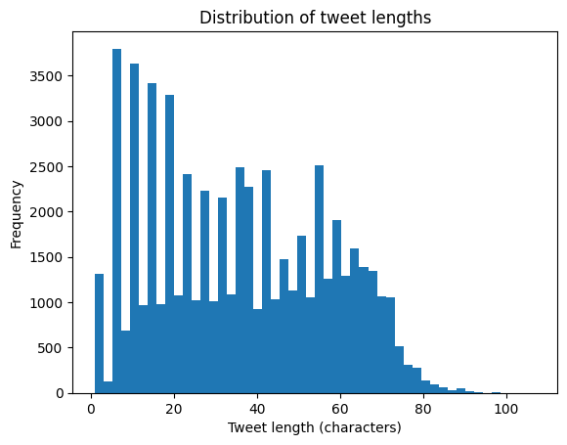
Data Analysis & Preprocessing
Data cleaning reduced dataset size.
"Allah" is the most common word.

Slide 11

Data Analysis & Preprocessing

Slide 12
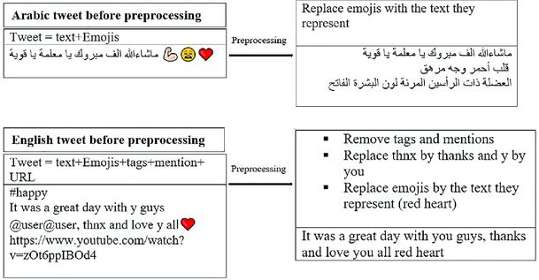
Clean Tweet
Remove mentions
Remove retweets
Remove URL
Remove any non-Arabic character
Remove emojis
Remove Tashkeel and Tatweel

Slide 13
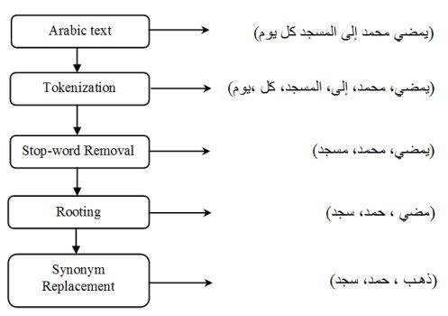
Tokenization & Punctuation Removal
Tokenization is a way of separating a piece of text into smaller units called tokens
Punctuation removal refers to the process of eliminating punctuation marks, such as periods, commas, semicolons, and exclamation marks, from a piece of text.

Slide 14
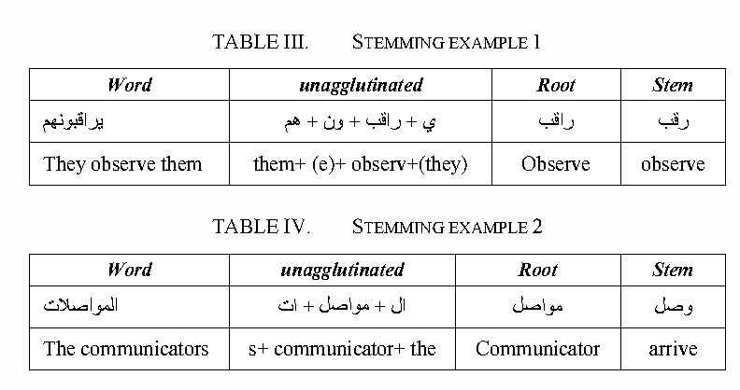
Stop Word Removal & Stemming
Stop words removal is a text preprocessing technique used in natural language processing (NLP) to eliminate commonly occurring words in a language from a piece of text.
Stemming is a technique used to extract the base form of the words by removing affixes from them

Slide 15
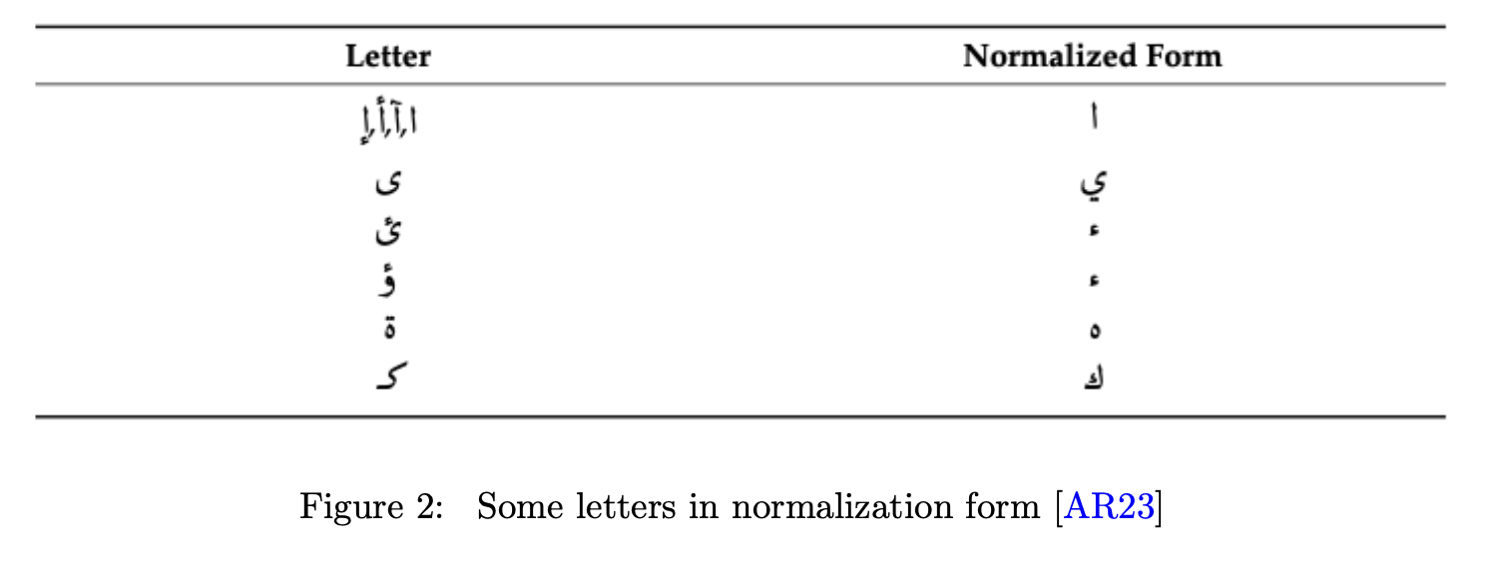
Normalization
Normalization refers to the process of reducing letters to their most basic form
Normalization is essential to simplify the language and make it more manageable for analysis and processing.

Slide 16
Outline
Introduction
Dataset
Data Analysis & Preprocessing
System Architecture
Sentiment Analysis
Sarcasm Detection & Sentiment Analysis
Challenges
Conclusion

Slide 17
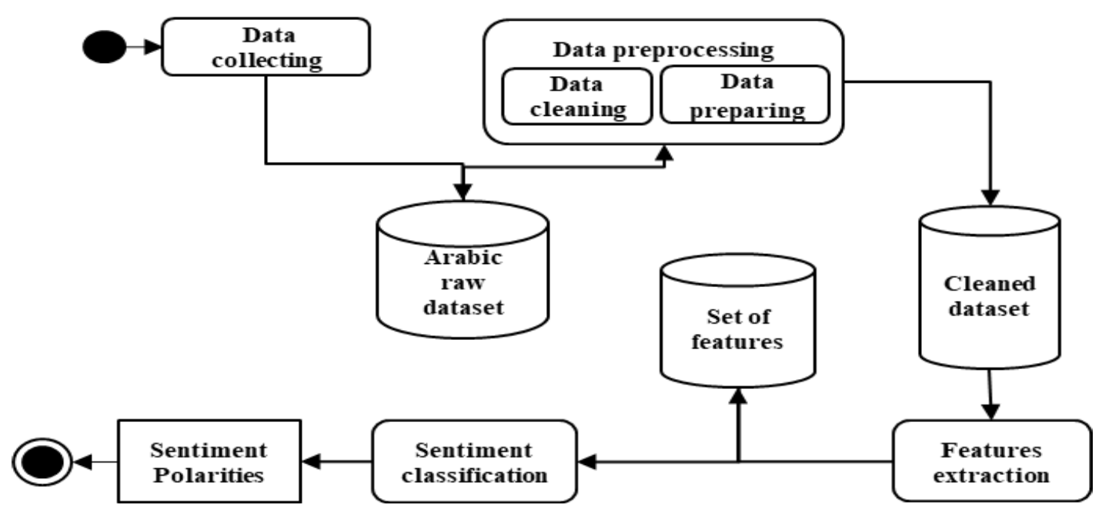
System Architecture
Feature extraction is done using tf-idf
Sentiment classification is done using SVM, Naïve Bayes ,and Decision Tree

Slide 18
Outline
Introduction
Dataset
Data Analysis & Preprocessing
System Architecture
Sentiment Analysis
Sarcasm Detection & Sentiment Analysis
Challenges
Conclusion

Slide 19
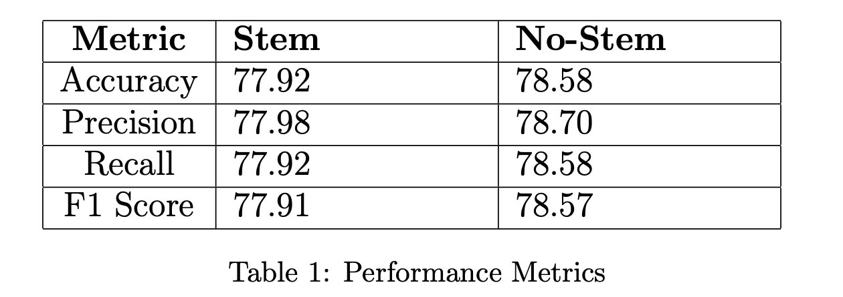
Sentiment Analysis (SVM)
We tested on stemmed and non-stemmed
We used 3 metrics which are F1-score, Recall and precision
Learning rate (c =0.1) and kernel used was linear

Slide 20
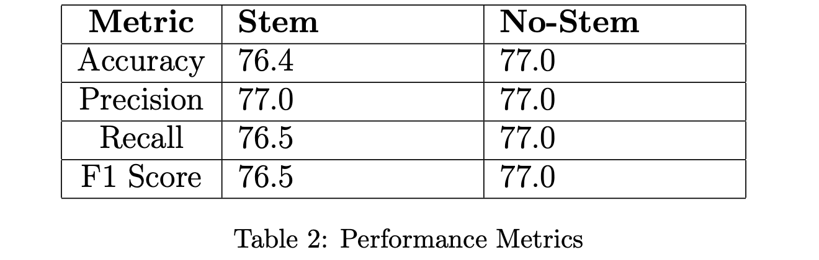
Sentiment Analysis (Naïve Bayes)
We tested on stemmed and non-stemmed
We used 3 metrics which are F1-score, Recall and precision

Slide 21
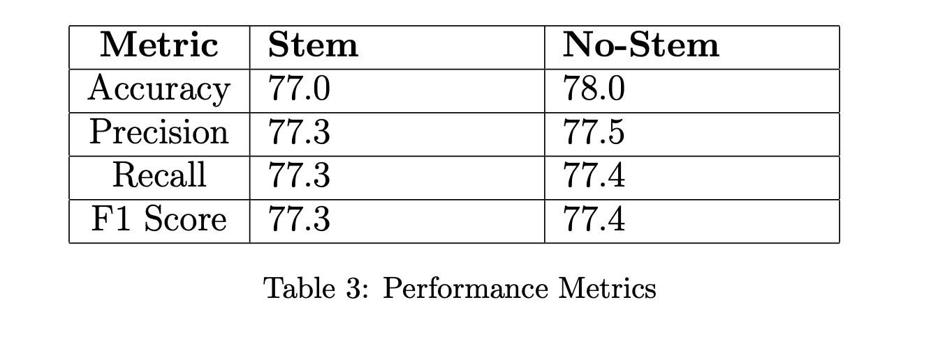
Sentiment Analysis (Decision Tree)
We tested on stemmed and non-stemmed
We used 3 metrics which are F1-score, Recall and precision

Slide 22
Fine Tuning
We performed grid search for fine tuning to obtain the best parameters.
Regarding Decision Trees, parameters were criterion, max depth and mini samples split
Optimal parameters were gini for the criterion, max depth None and 5 for mini samples split.
Regarding Naïve Bayes, we defined a set of alphas(learning rate) in our gird search, so we can obtain the optimal one using grid search. The optimal one was 0.1.

Slide 23
Outline
Introduction
Dataset
Data Analysis & Preprocessing
System Architecture
Sentiment Analysis
Sarcasm Detection & Sentiment Analysis
Challenges
Conclusion

Slide 24
Sarcasm Detection & Sentiment Analysis (Dataset)
ArSarcasm is a new Arabic sarcasm detection dataset.
The dataset contains 10,547 tweets, 1,682 (16 percent) of which are sarcastic.

Slide 25
Sarcasm Detection & Sentiment Analysis (Feature Extraction)
For the feature extraction process, we utilized a combined model incorporating both tf-idf and word embedding techniques
Our combined model leveraged the strengths of both methods to effectively represent the content of Arabic tweets

Slide 26
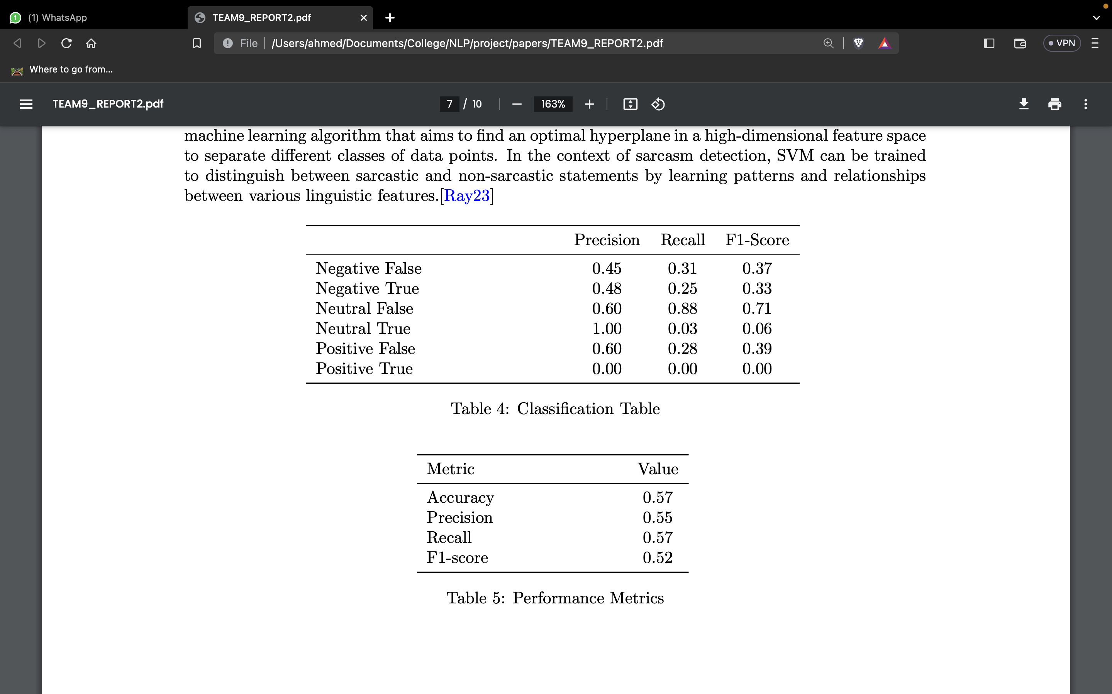
Sarcasm Detection & Sentiment Analysis (SVM)
We tested on stemmed and non-stemmed
We used 3 metrics which are F1-score, Recall and precision
Learning rate (c =0.1) and kernel used was linear

Slide 27
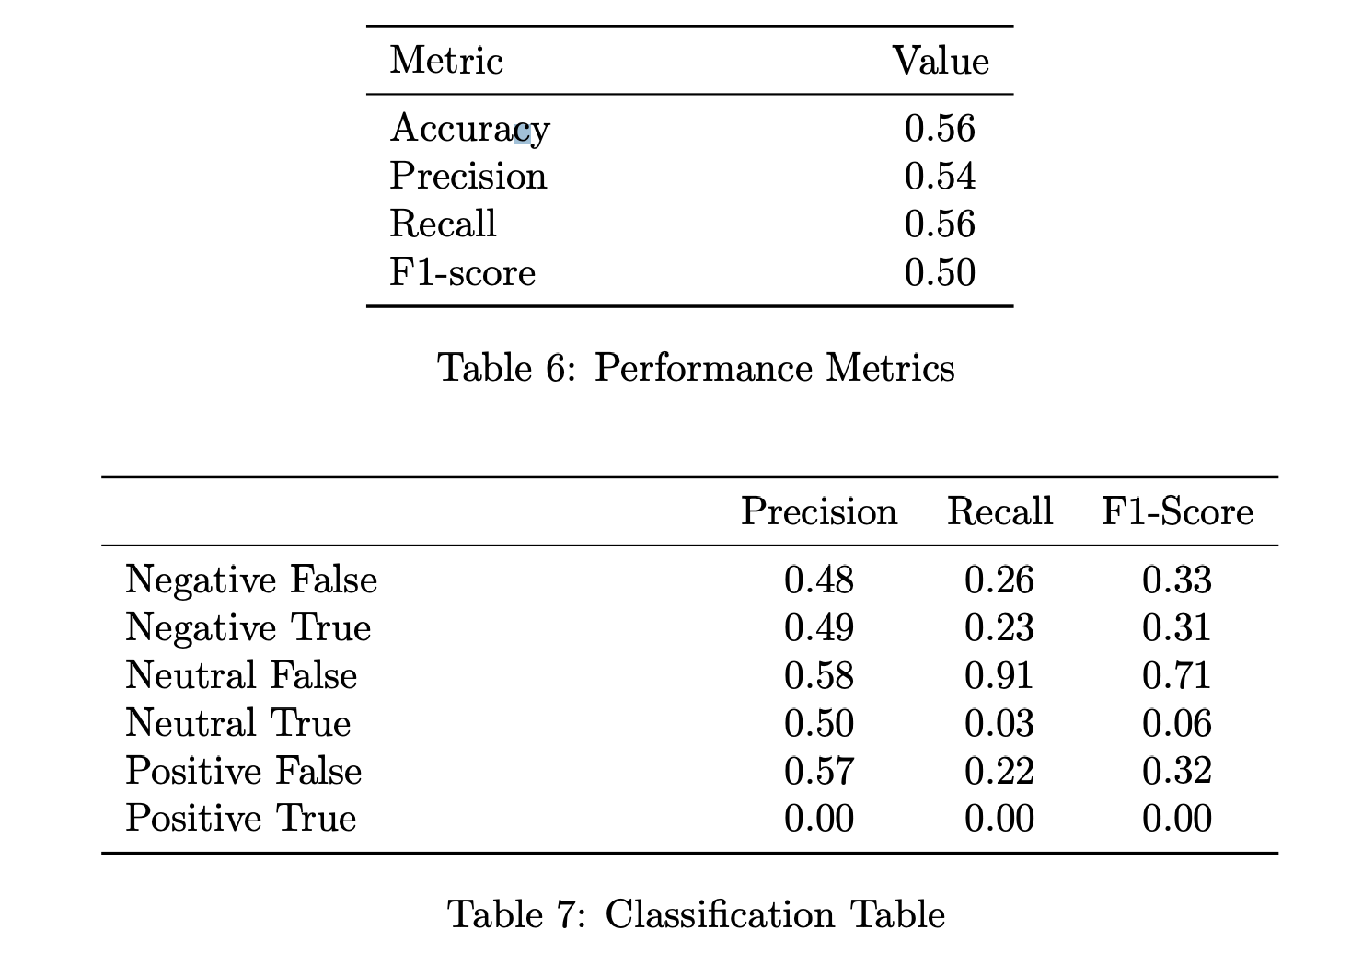
Sarcasm Detection & Sentiment Analysis (Naïve Bayes)
We tested on stemmed and non-stemmed
We used 3 metrics which are F1-score, Recall and precision

Slide 28
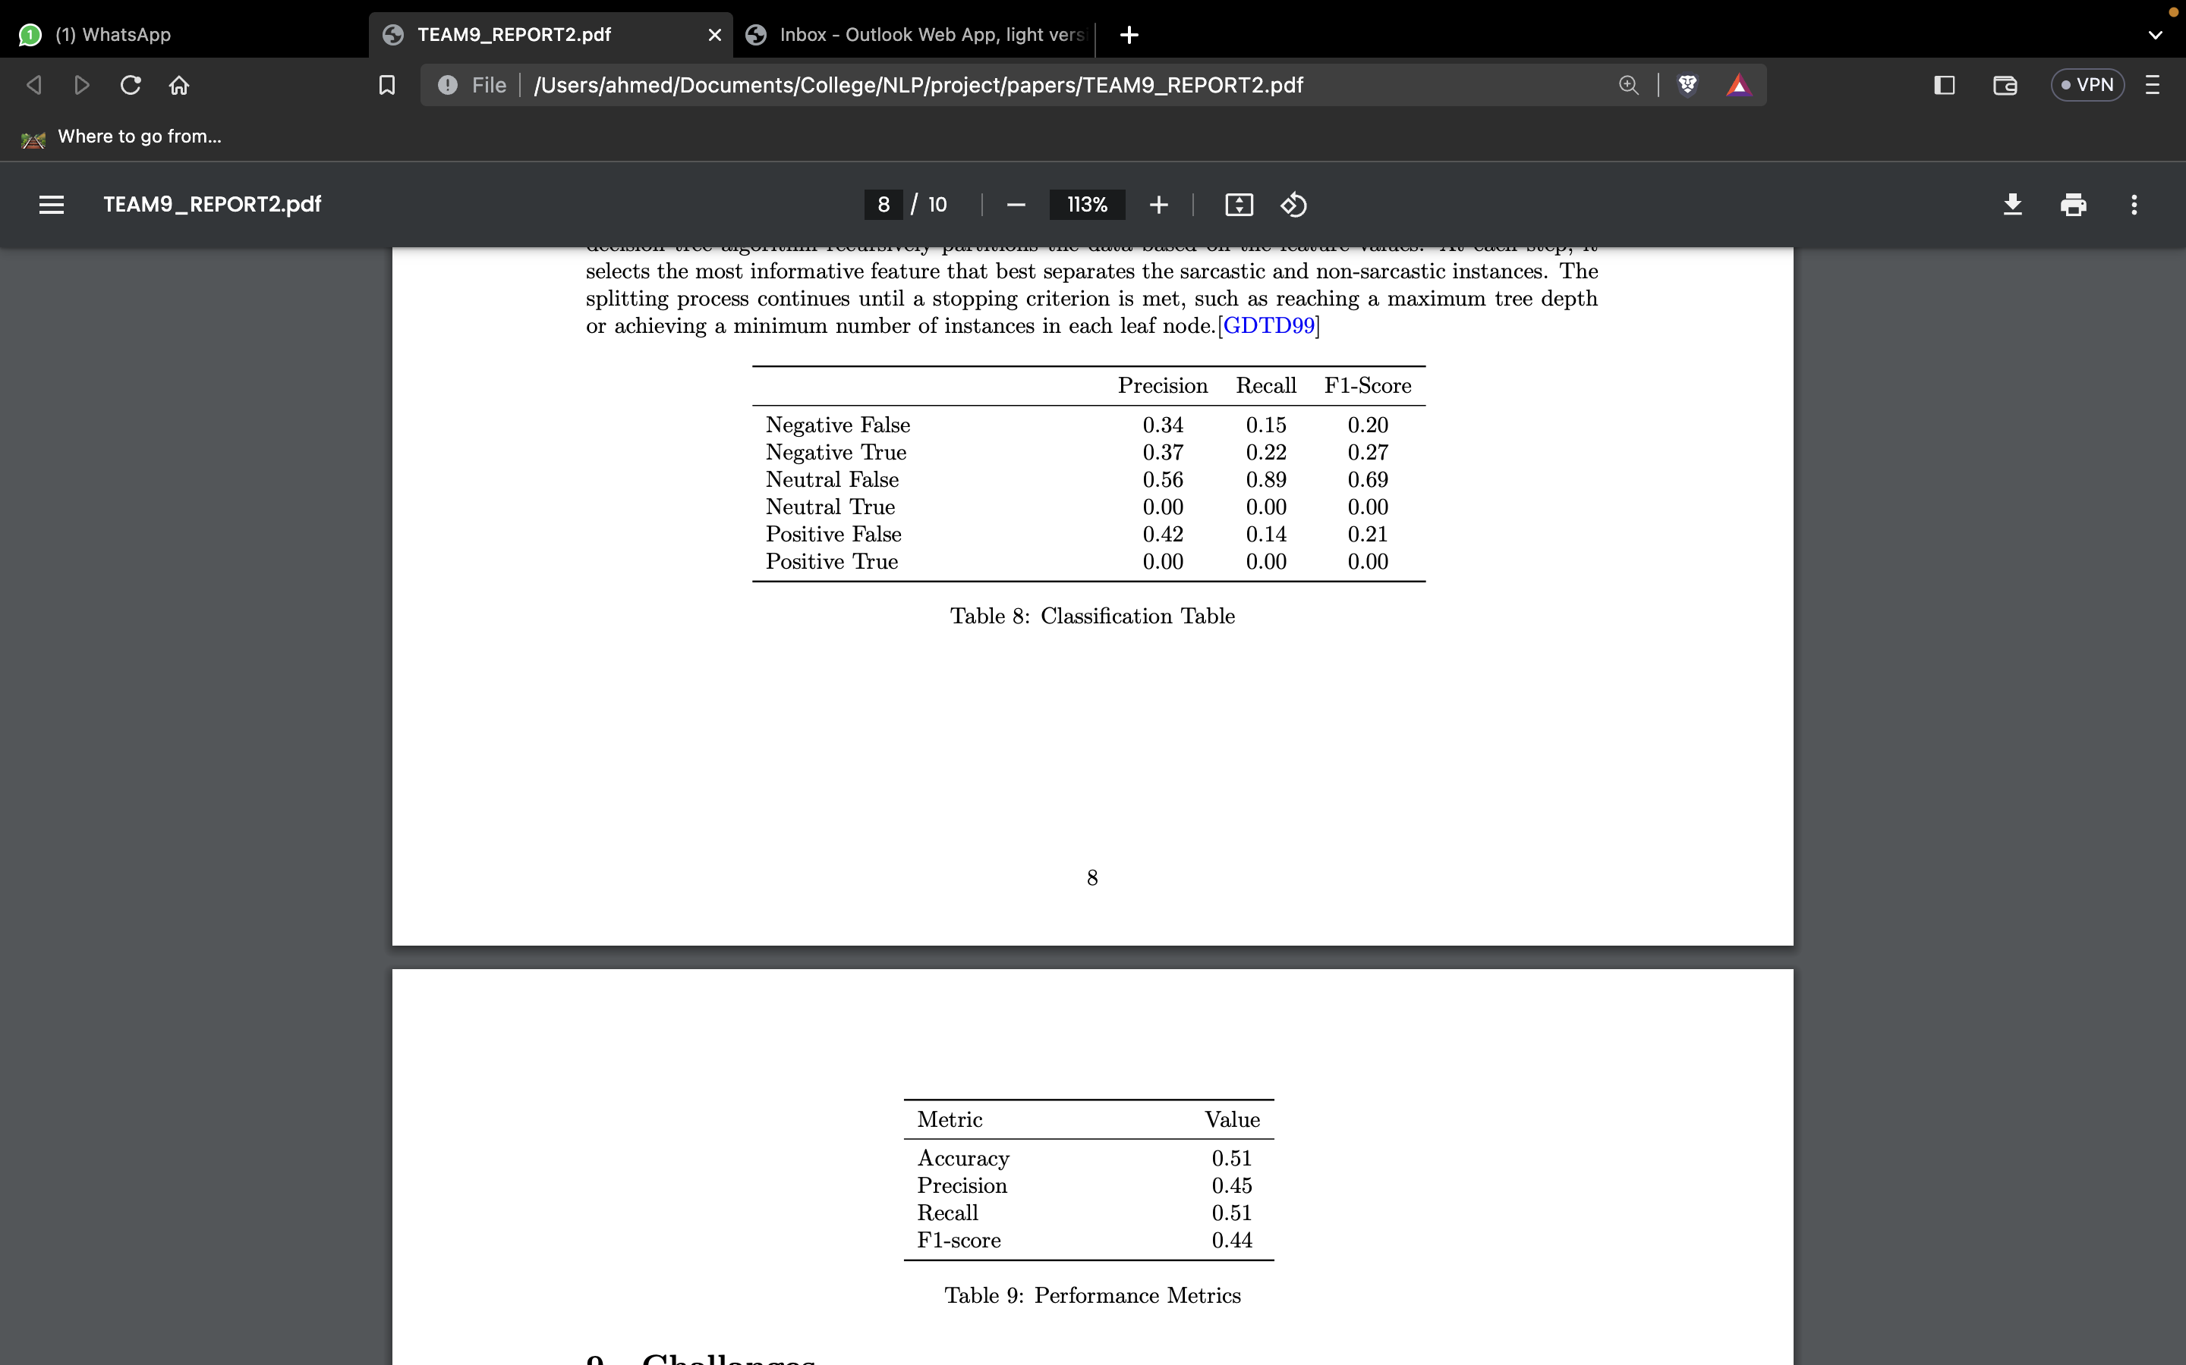
Sentiment Analysis & Sentiment Analysis (Decision Tree)
We tested on stemmed and non-stemmed
We used 3 metrics which are F1-score, Recall and precision

Slide 29
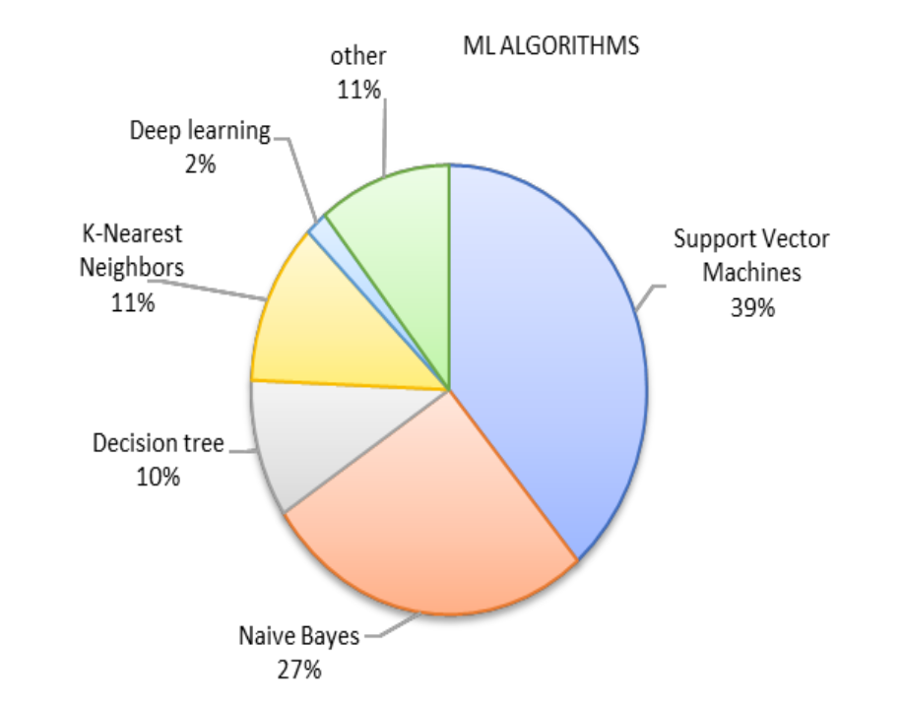
Proposed System Architecture
Sentiment classification could be done using ML model
SVM is the most common ML model for Arabic sentiment analysis

Slide 30
Outline
Introduction
Dataset
Data Analysis & Preprocessing
System Architecture
Sentiment Analysis
Sarcasm Detection & Sentiment Analysis
Challenges
Conclusion

Slide 31
Challenges
Time-consuming fine-tuning of the SVM model
Limited availability of sarcasm detection dataset
Impact of Arabic dialects on the model

Slide 32
Outline
Introduction
Motivation
Dataset
Data Analysis & Preprocessing
System Architecture
Sentiment Analysis
Sarcasm Detection & Sentiment Analysis
Challenges
Conclusion

Slide 33
Conclusion
Arabic sentiment analysis and sarcasm detection present distinct challenges that need to be addressed to achieve accurate results
Results shows that SVM was the best model regarding sentiment analysis and sarcasm detection.
Non stemming produced better results.

Slide 34
References
https://www.google.com/url?sa=i&url=https%3A%2F%2Fwww.hindawi.com%2Fjournals%2Ftswj%2F2014%2F631394%2Ffig3%2F&psig=AOvVaw09iToFhJsH4Lwa5iBk7nKY&ust=1683485478905000&source=images&cd=vfe&ved=0CBEQjRxqFwoTCJixl6Su4f4CFQAAAAAdAAAAABAD
https://monkeylearn.com/sentiment-analysis/
https://www.cfilt.iitb.ac.in/resources/surveys/SentimentAnalysis-Vinita.pdf
https://ijci.journals.ekb.eg/article_118803_309a4df86113b74b158b9f7959b59def.pdf
https://ieeexplore.ieee.org/stamp/stamp.jsp?arnumber=8890900
https://www.kaggle.com/datasets/mksaad/arabic-sentiment-twitter-corpus
https://www.researchgate.net/figure/Preprocessing-examples-for-Arabic-and-English-tweets_fig1_353567030
https://www.researchgate.net/figure/An-example-of-preprocessing-steps-of-an-Arabic-text_fig2_272853366
https://www.semanticscholar.org/paper/Integrating-effective-rules-to-improve-arabic-text-Cherif-Madani/de1900b776827e036baea69769b09668fdf9d166

Slide 35
THANK YOU ☺
ANY QUESTIONS?

Slide 36
Refrences(papers)
https://www.cfilt.iitb.ac.in/resources/surveys/SentimentAnalysis-Vinita.pdf
https://ijci.journals.ekb.eg/article_118803_309a4df86113b74b158b9f7959b59def.pdf
https://ieeexplore.ieee.org/stamp/stamp.jsp?arnumber=8890900

Slide 37
References(dataset)
https://www.kaggle.com/datasets/mksaad/arabic-sentiment-twitter-corpus

