Slide 1

Intellitest:
Using AI Models and Testing

Slide 2

Introduction :
Intellitest is an intelligent VS Code extension designed to help students and junior developers apply software testing in real projects.
It analyzes code, suggests what to test, generates test cases and automated tests, and explains failures in a simple way, bridging the gap between testing theory and practical implementation.

Slide 3

Problem Statement:
Students and junior testers face several key challenges:
They don’t know what to test in real projects.
They cannot convert theory into real test cases
They are confused about which testing strategy to use
Writing automated tests requires technical knowledge they don’t have yet
Test failures are hard to understand

Slide 4
Proposed Solution (IntelliTest)
Intellitest is a smart assistant inside VS Code that helps users learn and apply testing at the same time.
Instead of asking the user to figure everything alone, the system:
✔ Analyzes the project code automatically
✔ Understands the application type (web, API, backend, etc.)
✔ Suggests what should be tested
✔ Generates real test cases
✔ Creates automated test scripts
✔ Explains test failures in simple language

Slide 5
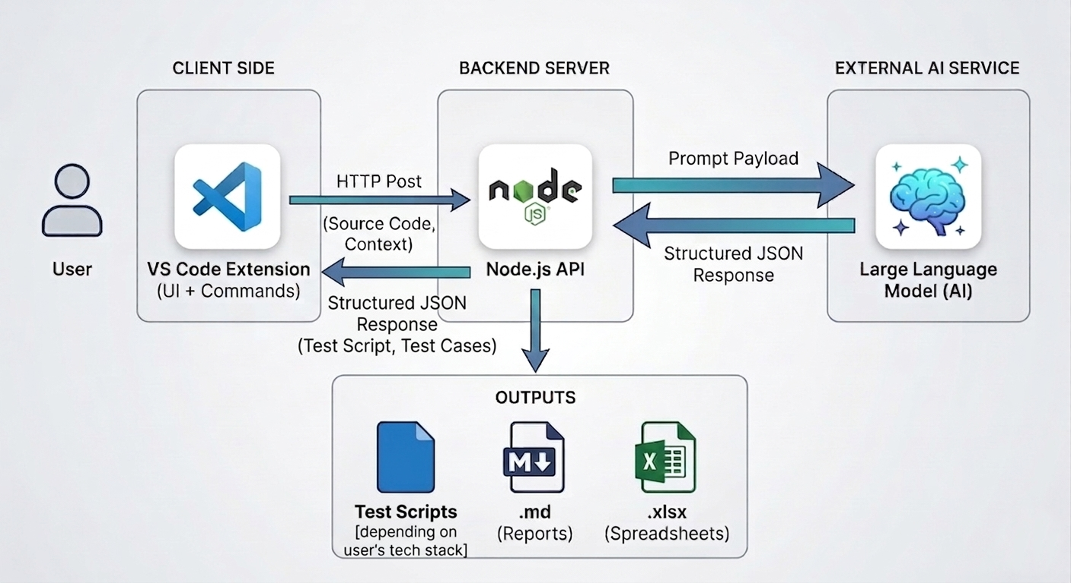
High Level Architecture

Slide 6
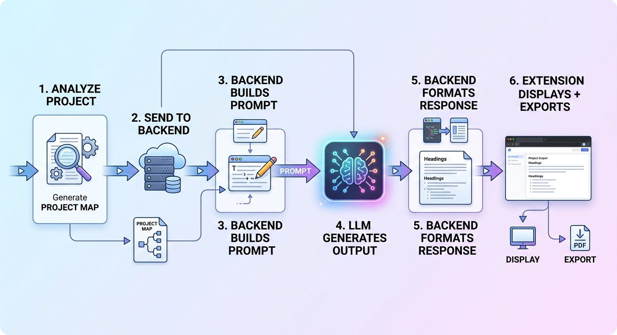
System Flow

Slide 7
Current Progress
VS Code extension (commands + UI)
Project Analyzer (Project Map generation)
Backend API (Node.js)
Integration with Groq LLM
Test case generation (JSON → UI)
Excel export functionality

Slide 8
Practical Presentation

Slide 9
Project Map JSON example
{
"type": "e-commerce / online store (web)",
"language": "javascript",
"framework": "Node.js",
"modules": [
"middleware",
"models",
"package-lock.json",
"package.json",
"public",
"routes",
"server.js",
"views"
],
"routes": [
"routes\\BrandsRoutes.js",
"routes\\CollectionsRoutes.js",
"routes\\ProductsRoutes.js",
"routes\\UsersRoutes.js",
"routes\\api.js"
],
"prompt": "test the cart"
}

Slide 10
Full Prompt sent to the model
You are a senior QA engineer. Project context (structured):
- type: e-commerce / online store (web)
- language: javascript
- framework: Node.js
- modules: ["middleware","models","package-lock.json","package.json","public","routes","server.js","views"]
- routes: ["routes\\BrandsRoutes.js","routes\\CollectionsRoutes.js","routes\\ProductsRoutes.js","routes\\UsersRoutes.js","routes\\api.js"]
Tester request (highest priority — honor explicit scope limits; otherwise broaden sensibly):
test the cart
Task: Propose manual test cases that cover critical user flows and edge cases for this system.
Rules:
- Output ONLY valid JSON (no markdown, no commentary).
- Return a JSON array of objects. Each object MUST have: "id" (e.g. TC-001), "name", "steps" (array of strings), "expected" (string).
- Also include "priority" for each: one of "critical", "high", "medium", "low" (critical = main revenue/auth/safety flows).
- Include "tags": array of short labels drawn from modules/routes/context (e.g. "auth", "cart", "checkout").
- Order the array so critical items appear first.
Example shape (structure only):
[{"id":"TC-001","name":"...","steps":["..."],"expected":"...","priority":"critical","tags":["auth"]}]

Slide 11
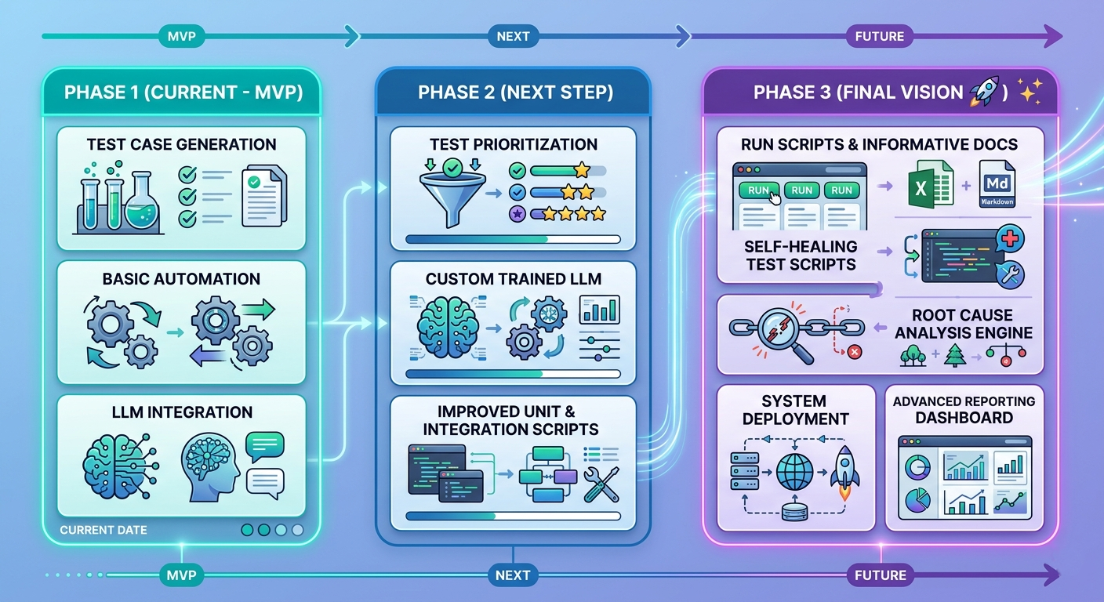
Roadmap

Slide 12
Thank You
Questions?

