Slide 1

Netflix Stocks
Visualizing data using Python
By Ahmed Alhomeidy

Slide 2
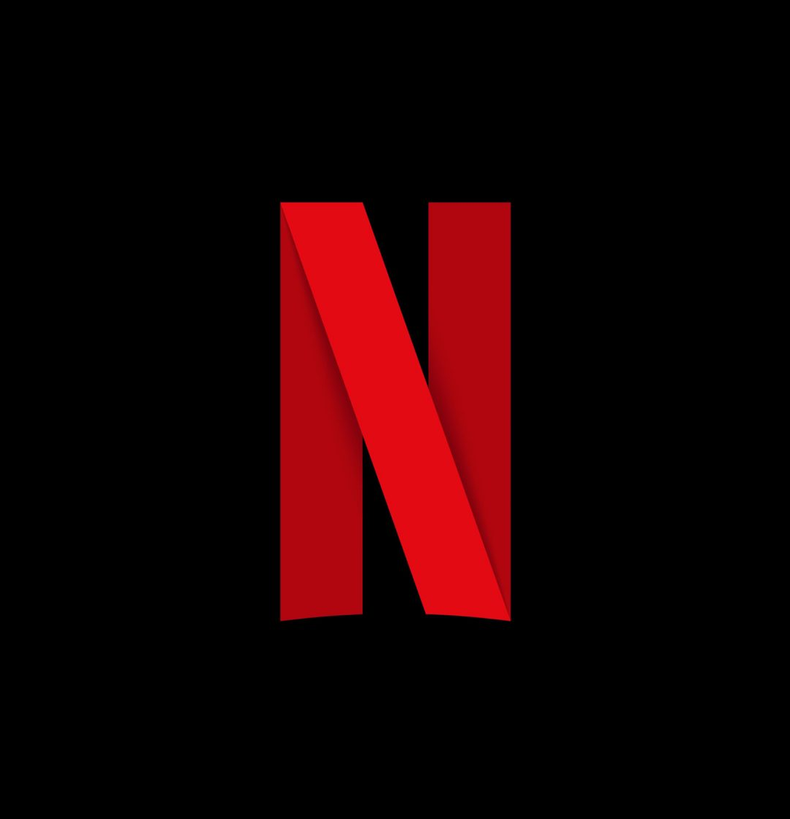

This Photo by Unknown Author is licensed under CC BY-ND

Slide 3

Table of Contents
Distribution of 2017 Netflix Stock Prices by Quarter
First impressions after observing the data and price fall ranges
Highest and Lowest prices
Earnings per Share in Cents
Actual vs Estimate
Revenue vs Earnings
Does Revenue and Earnings follow a trend?
what percentage of the revenue constitutes earnings
Netflix vs Dow Jones
How did Netflix perform relative to Dow Jones industrial average in 2017?
Which was more volatile?

Slide 4
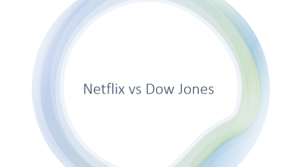
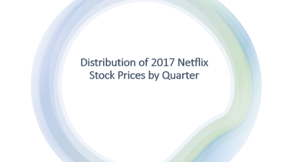
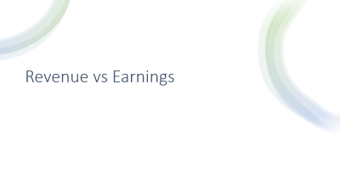
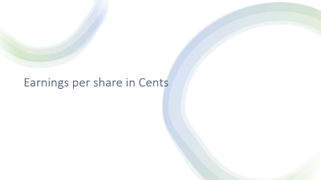

Slide 5
Distribution of 2017 Netflix Stock Prices by Quarter

Slide 6
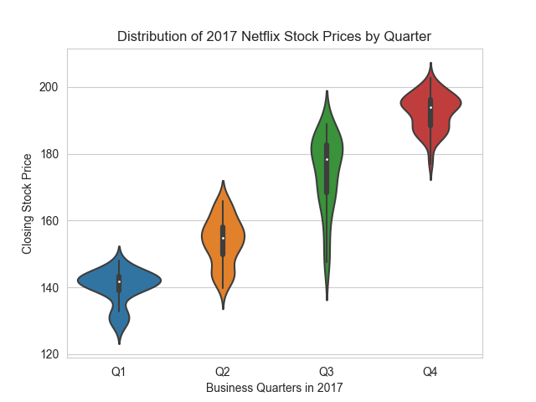
1/ Violin graphs are immensely helpful in knowing the different distributions of data, in this case the different distributions for each quarter.
2/ Most prices fell in the 20 dollars range, except for Q3 the range was 60 dollars.
3/ The lowest price recorded was 120 in Q1, and the highest price recorded was 200 in Q4.

Slide 7
Earnings per share in Cents

Slide 8
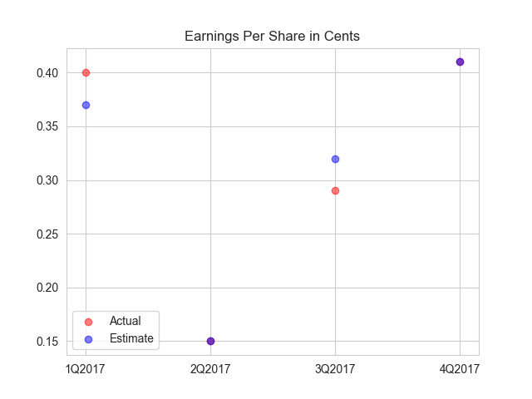
The Graph shows the difference between the Estimated earnings and Actual earnings per share.
Estimated earnings are represented with the Blue dots.
And the Actual Earnings are represented by the Red dots
The purple dots in the graph above indicate that the estimated earnings per share and actual earnings per share are equal or very close.

Slide 9
Revenue vs Earnings

Slide 10
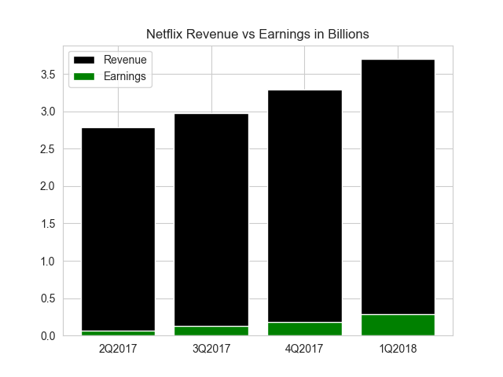
Revenue does follow a trend, its increasing for each quarter.
Earnings do follow a trend similar to revenue, earnings are increasing for each quarter.
The percentage of revenue that constitute earnings is between 3 to 5 %.

Slide 11
Netflix vs Dow Jones

Slide 12
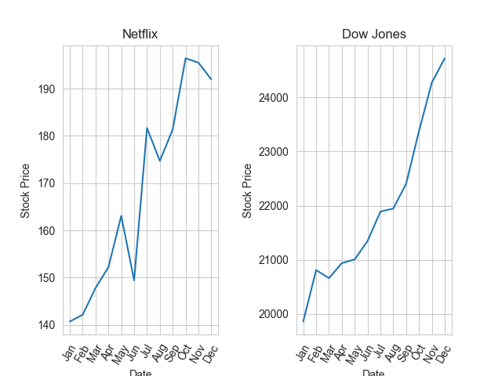

Slide 13
The graph demonstrates a comparison between Netflix and Dow Jones in terms of their Stock price in 2017.
Stock price followed an ascending trend for both Netflix and Dow Jones, Netflix had a 35.7% increase in their stock price and Dow Jones had a 24% increase.
In terms of volatility Netflix was more Volatile this could be a result of many factors like: Controversial Shows that could spark a big public reaction
Fluctuation in the number and quality of new shows on the platform
The availability of other streaming services that offer a better value for money services
finally, it could be due to some Controversial Business decisions .

