Slide 1
“Real Estate Sales 2001-2022 GL”
“state of Connecticut”

Slide 2
Project content
Data collection
Read & understanding data
Eda
Pre-processing

Slide 3
Data collection
https://catalog.data.gov/dataset/real-estate-sales-2001-2018

Slide 4
Read & understanding data
Serial-Number: A unique identifier assigned to each property record.
List-Year: The year the property was listed or
recorded for sale or assessment.
Date-Recorded: The date when the property sale or transaction
was officially recorded.
Town: The town or city where the property is located.
Address: The street address of the property.

Slide 5
Assessed-Value: The value assigned to the property for tax or assessment purposes.
Sale-Amount: The actual sale price of the property.
Sales-Ratio: The ratio of the assessed value to the sale price,
often used to evaluate the accuracy of property assessments.
Property-Type: The general category of the property (e.g., Residential, Commercial).
Residential-Type: A more specific classification of the property if
it falls under the residential category (e.g., Single Family, Condo, Two Family).

Slide 6
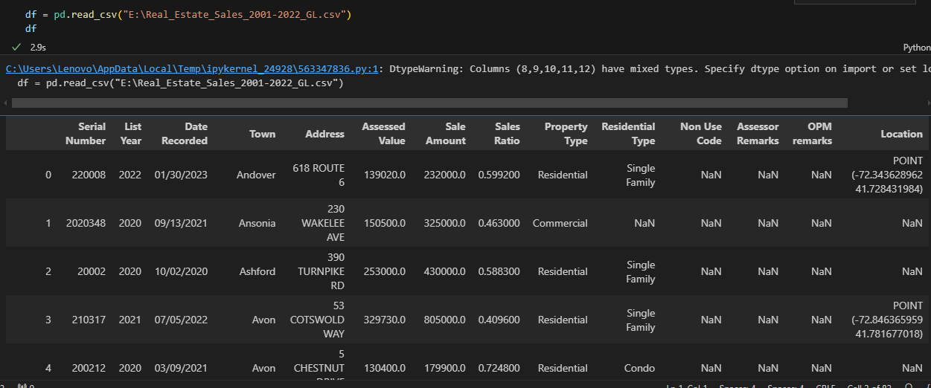
Read csv

Slide 7
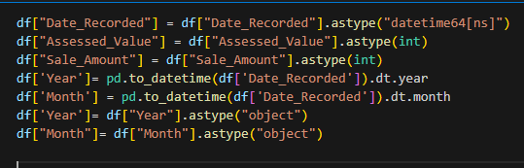
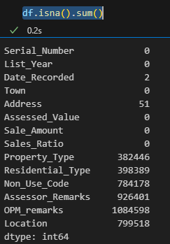
Extract feature

Slide 8
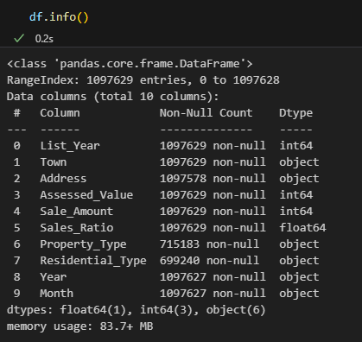
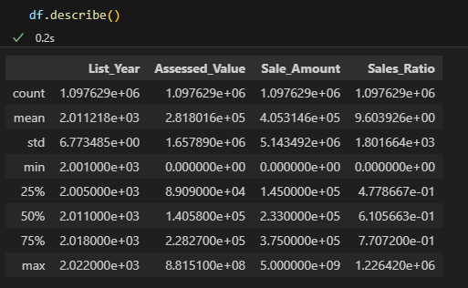
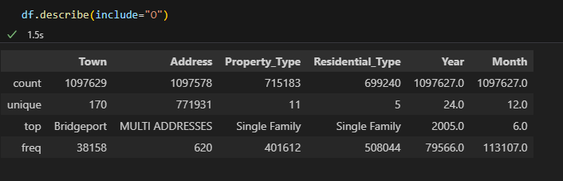
Decribe numerical columns
Decribe categorical columns

Slide 9

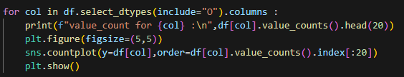
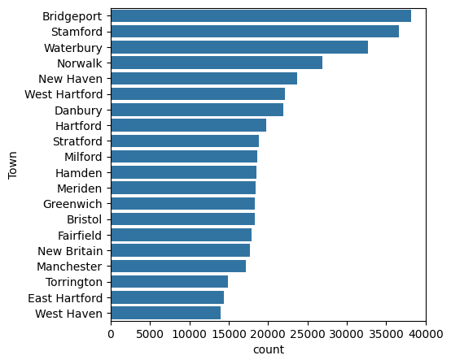
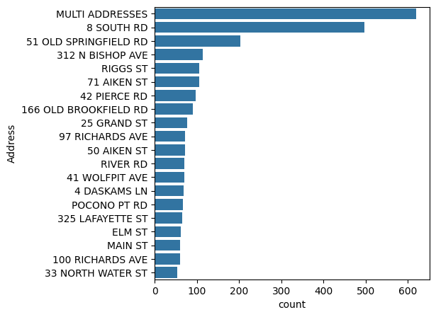
EDA
Uni-variate Analysis

Slide 10
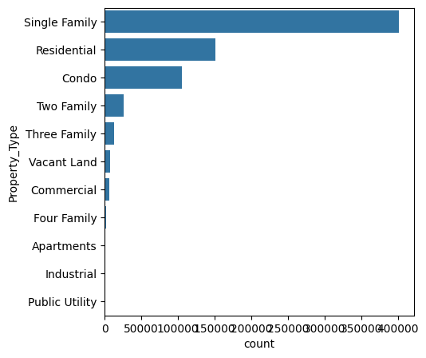
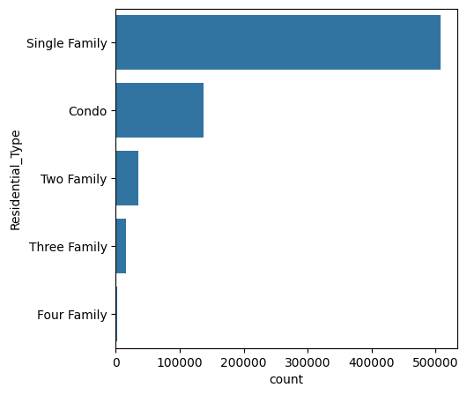

Slide 11
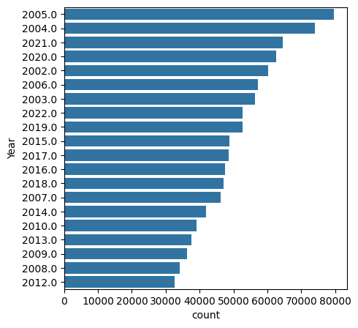
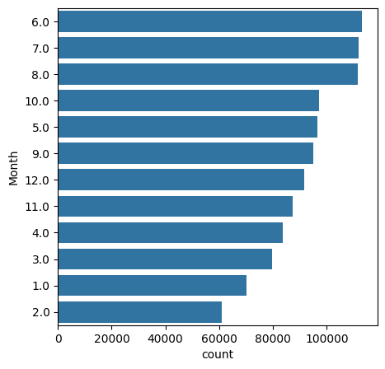

Slide 12
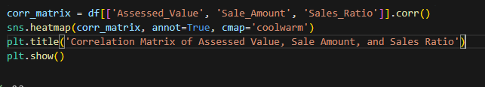
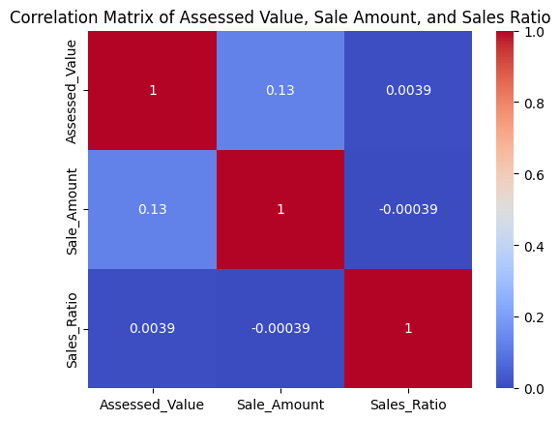

Slide 13
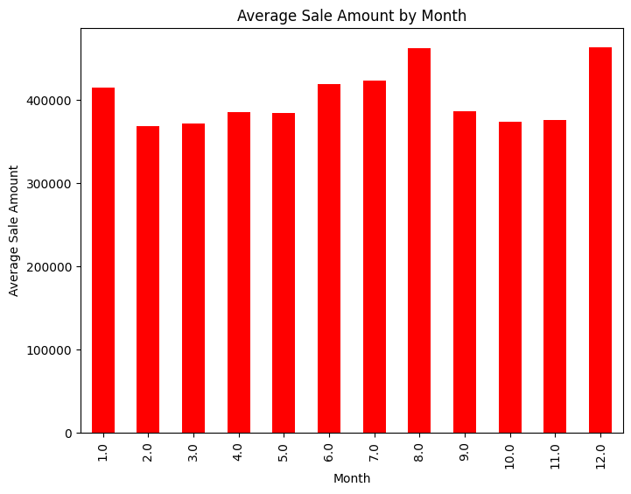
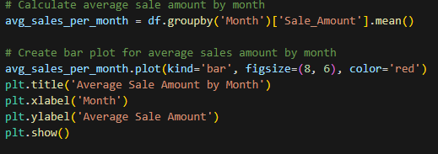
1. Which months have the highest average sales amount?

Slide 14
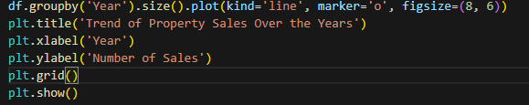
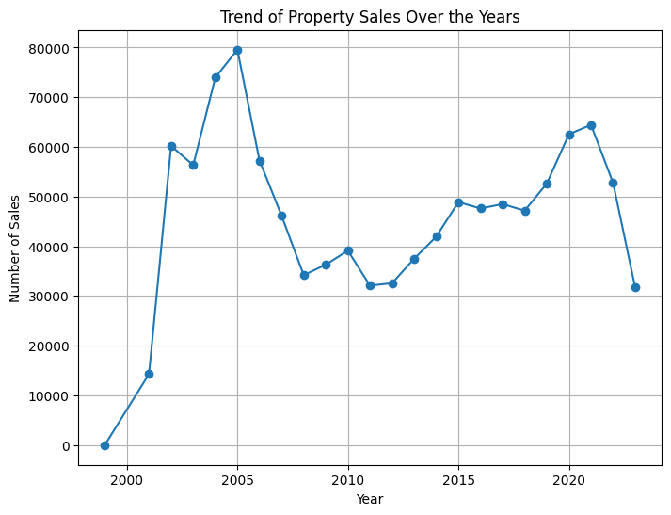
.2How many sales each year?

Slide 15
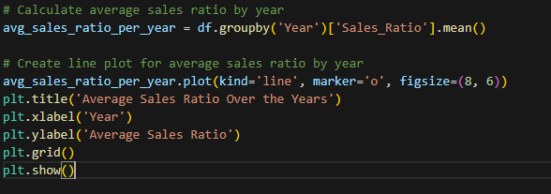
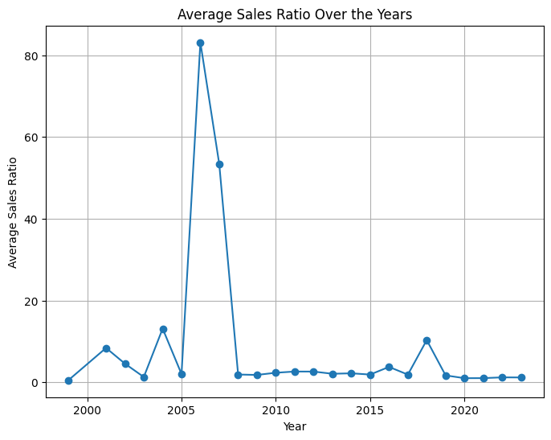
.3How does the average sales ratio change over the years?

Slide 16

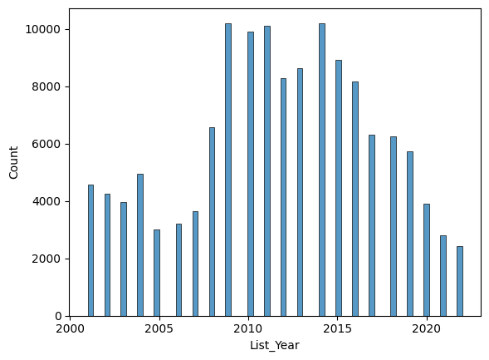
.4the best year was Sales-Ratio > 1 ?

Slide 17
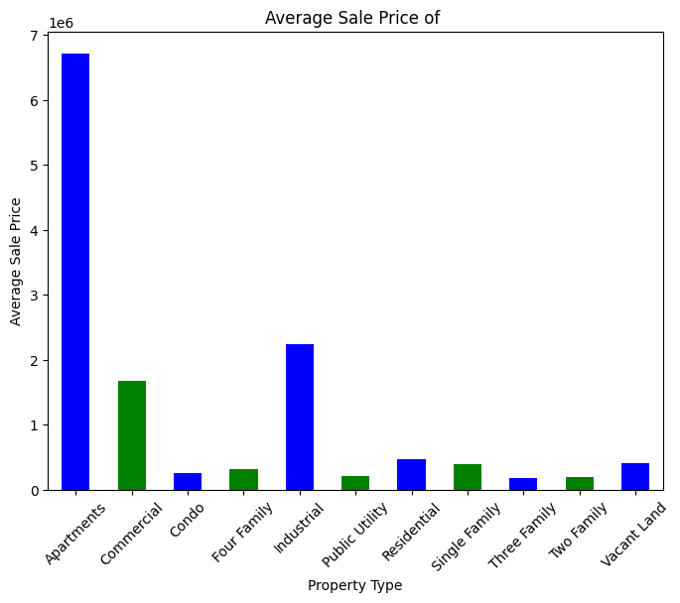
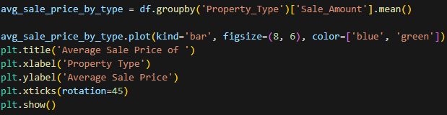
5.What is the average sale price of Property-Type ?

Slide 18
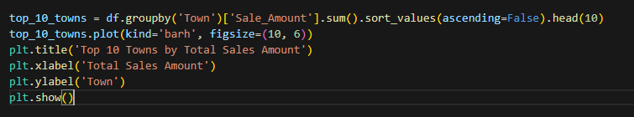
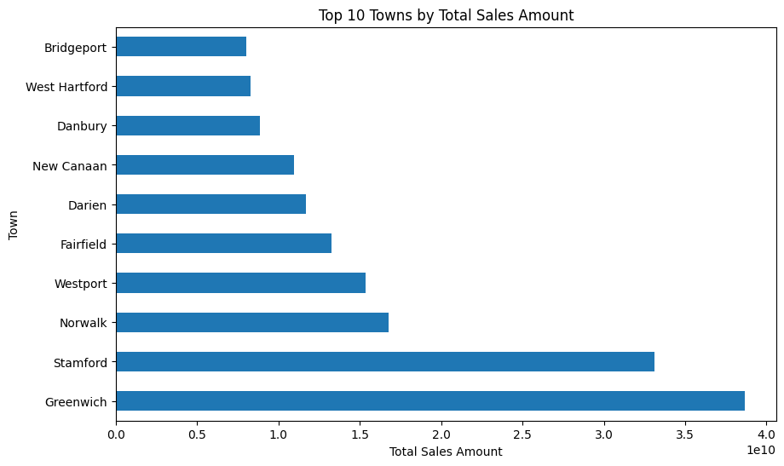
5.What are the top 10 towns by total sales amount?

Slide 19
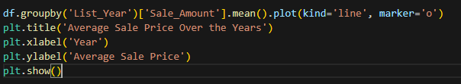
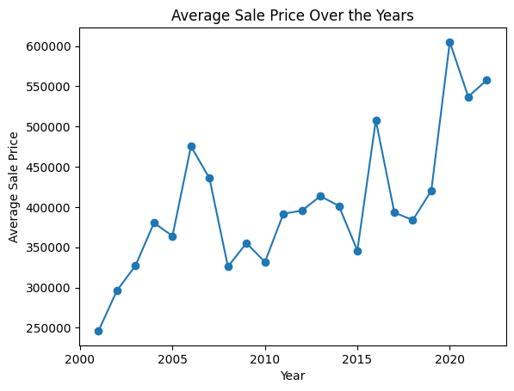
7.What is the trend of the average sale price over the years?

Slide 20
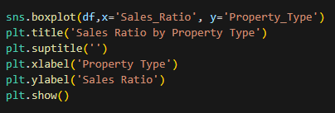
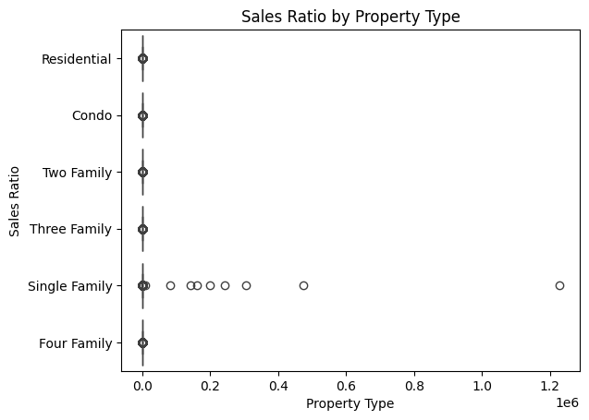
8. How does sales ratio vary for different property types?

Slide 21
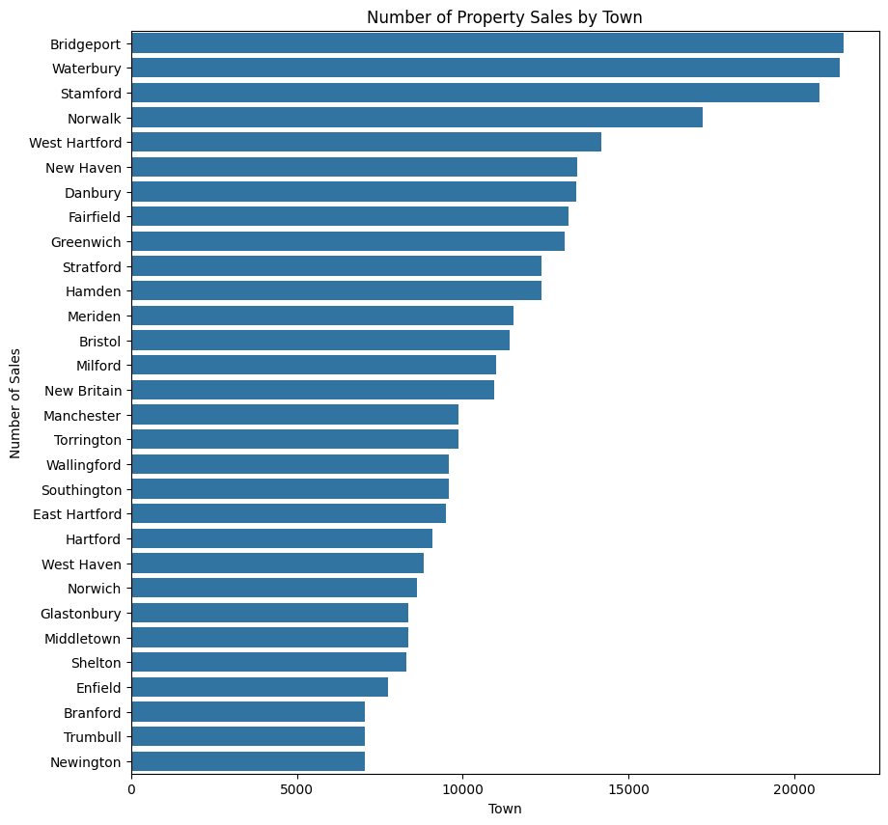

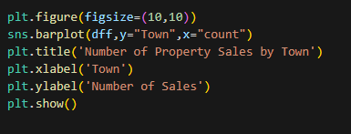
9. Which top 30 towns have the most property sales?

Slide 22
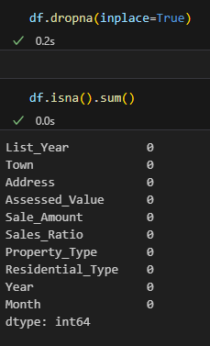
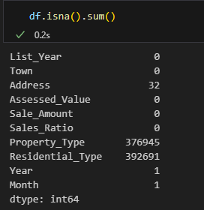
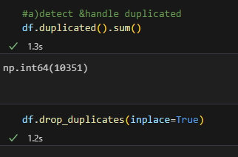
Pre-processing
Detect & handle Nan
Detect & handle duplicates

Slide 23

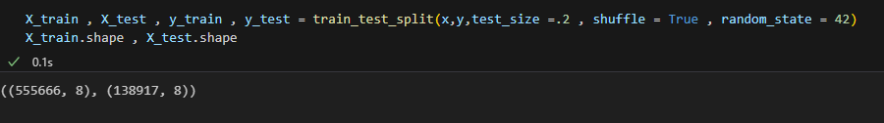
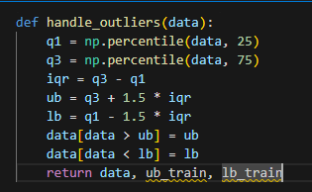
Train-test split
Handle outliers

Slide 24


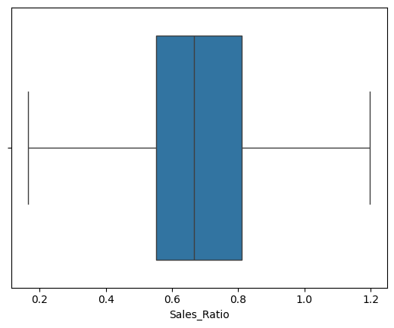
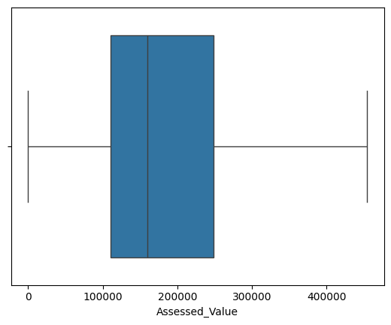





Slide 25
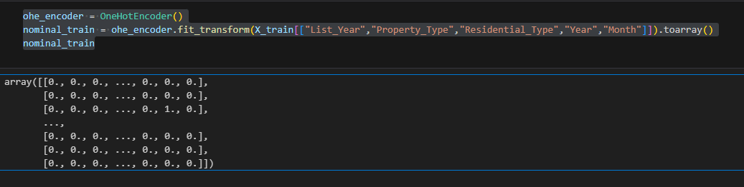
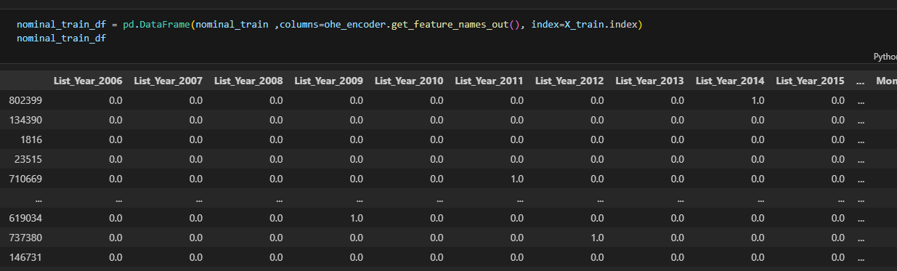
encoding

Slide 26
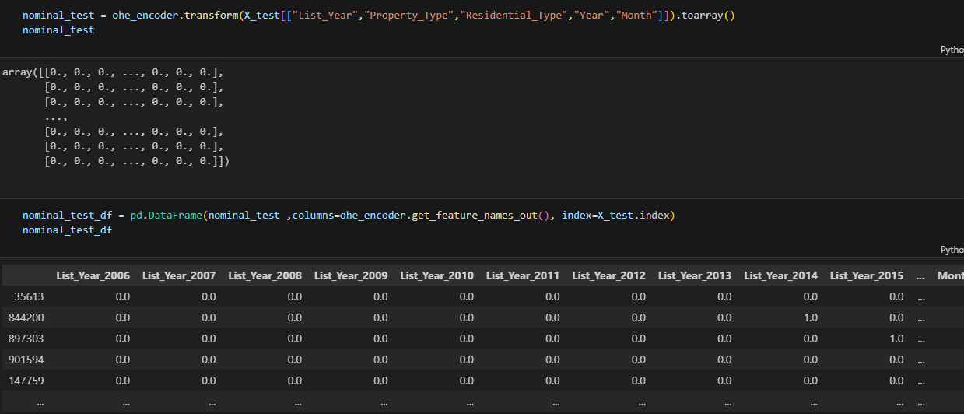

Slide 27
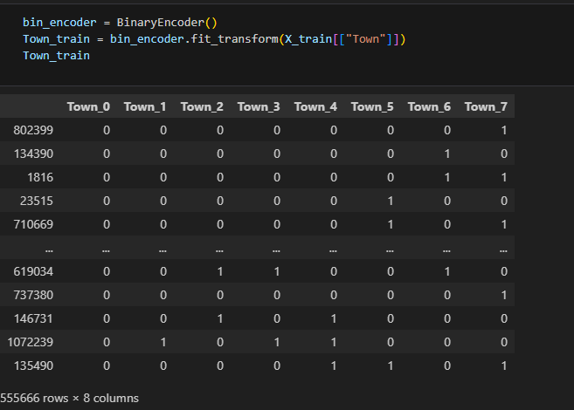
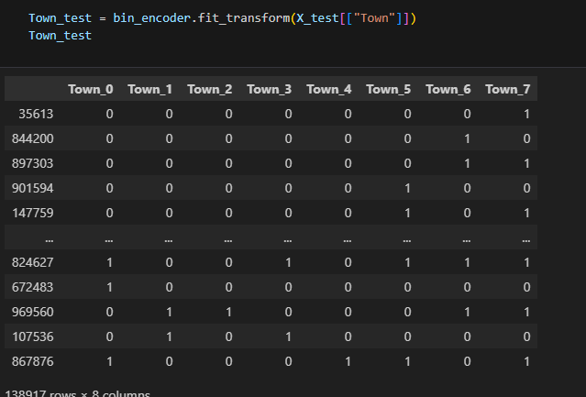

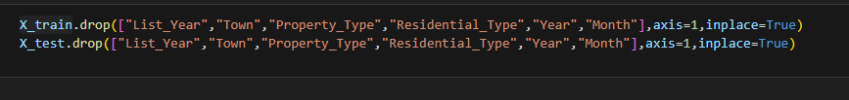

Slide 28
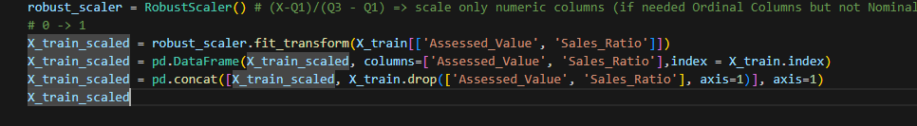
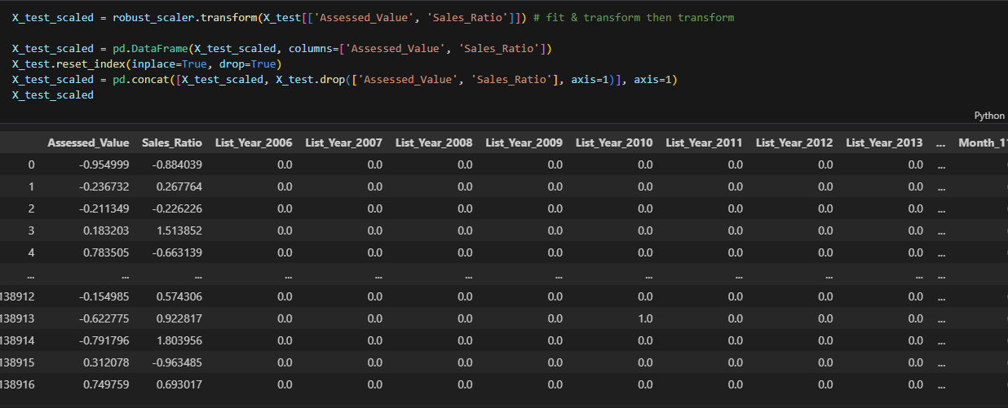
scaling

