Slide 1
Project
Autonomous Car

Slide 2
Students Name
Ahmed helal Ahelal869@gmail.com
Kholood Khaled Kholoodkhaled637@gmail.com
Mohamed Asaad Mohamed.asaad2@msa.edu.eg
Zeyad Bassem zeyad.bassem@msa.edu.eg

Slide 3
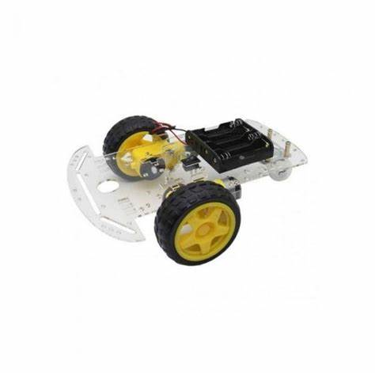
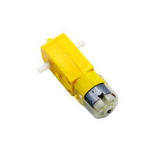
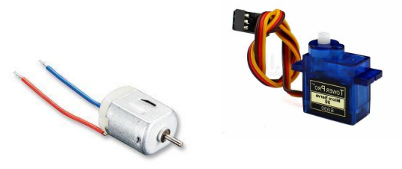
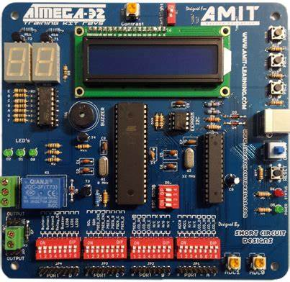
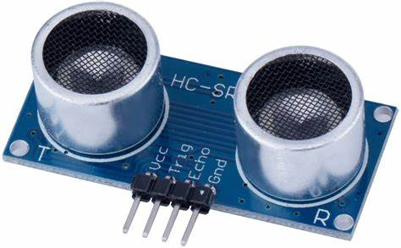
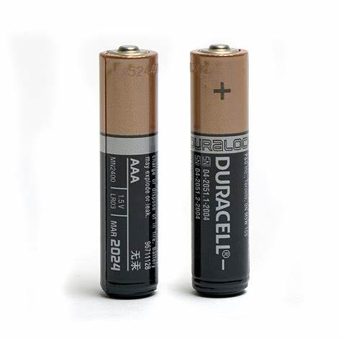
Project components
Dc motor
Servo motor
Wheel chassis
AVR
Ultra Sonic
Batteries

Slide 4
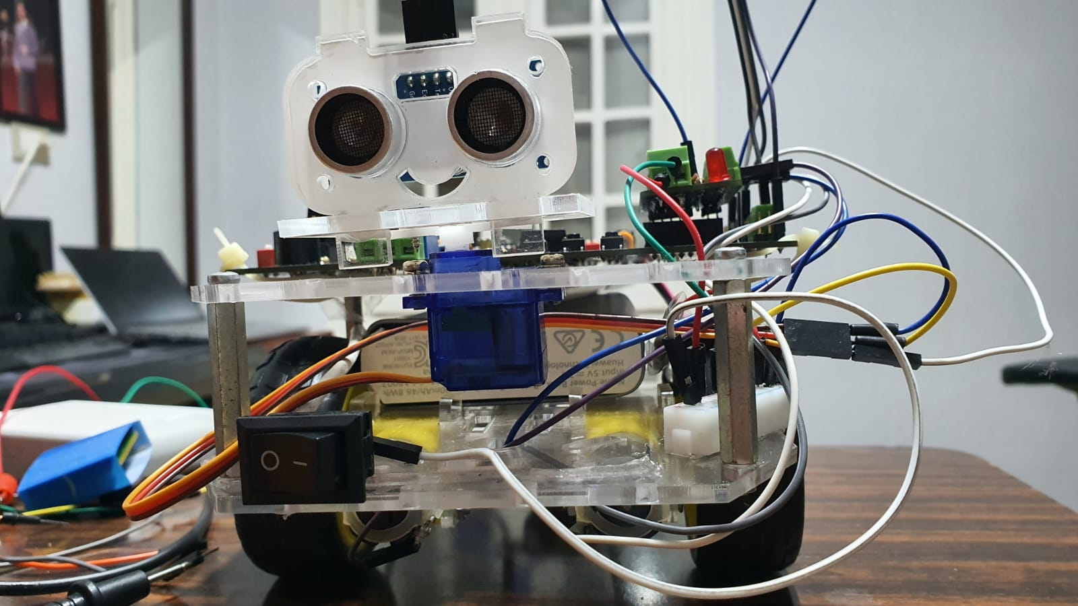
Project
Autonomous Vehicle.

Slide 5
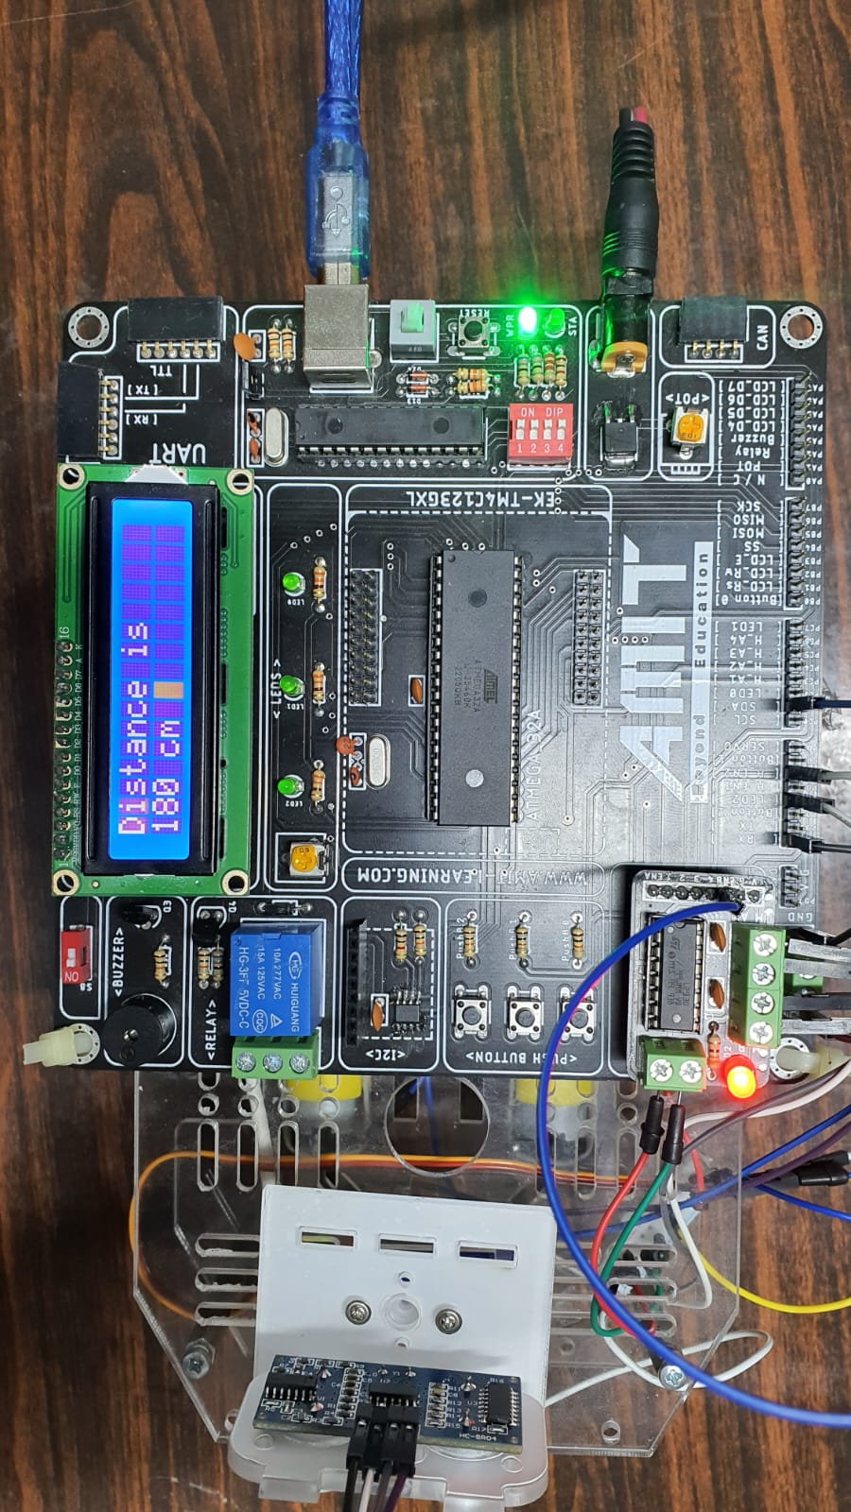


Slide 6
How Does Vicky work?
It measures the forward distance.
When the distance is ideal the car moves forward.
The minimum distance from the wall is reached the vehicle stops.
The car will now search for a better destination.
Looks right first then measures the distance if it is ideal the right motor is braked to pivot around and the left motor is on so the car turns right.
If the right is not ideal it looks to the left and if it is ideal the left motor brakes to pivot on and the right motor is on so the car turns left.
If both direction are blocked the car reverses and rechecks the directions.

Slide 7
start
yes
Dist>30cm
forward
No
stop
Look right
yes
Turn right
Dist >15
No
Look left
yes
No
Turn Left
Dist>15cm
Reverse

Slide 8
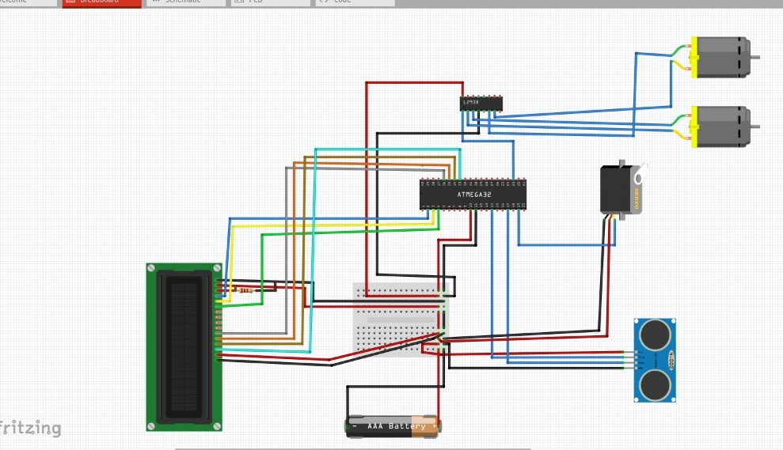




Project circuits
I want you to have a great and successful year!
You may visit with me about questions or concerns any time we are not in the middle of direct instruction, or I am not helping other students.
You may email me if necessary, and I will respond when I am able.
I am available for extra help before or after school. When possible, please let me know in advance so I can plan accordingly.

Slide 9
GitHub link
https://github.com/Ahmedselim8/Autonomous-Car
01

Slide 10
Thank you

