Slide 1

Network Security Fundamentals & FortiGate Integration
Understanding Cybersecurity Threats & Mitigation Strategies
Presented by: group 1

Slide 2
Name : Ahmed Mohamed Sobhy Khalifa
Id Student : 21055586
-------------------------------
Name : Ziad waled Ibrahim Hassan
Id Student : 21077415
------------------------------
Name : Nada Ehab Ghorab
Id Student : 3116104706
------------------------------
Name : Mazen Amr Mohamed Hassan
Id Student : 21060209
-----------------------------
Name : Abdelrahman Ebrahem Osman
Id Student : 3101117779
-----------------------------
Name : Menna Mohamed Sayed Eldash
Id Student : 21071072

Slide 3
Introduction to Network Security
• Definition of Network Security
• Importance in modern IT environments
• Key components: Firewalls, IDS/IPS, VPNs, Endpoint Security

Slide 4
Common Cybersecurity Threats
• Malware (Viruses, Trojans, Ransomware, Worms)
• Phishing & Social Engineering
• DoS & DDoS Attacks
• MITM Attacks
• Insider Threats

Slide 5
Network Attacks & Their Impact
• Packet Sniffing & Eavesdropping
• SQL Injection & XSS
• Zero-Day Exploits
• Advanced Persistent Threats (APT)
• Consequences: Data breaches, financial loss, reputational damage

Slide 6

Mitigation Strategies
• Strong Authentication & Access Control
• Network Segmentation & Least Privilege
• Regular Security Updates
• Encryption & Secure Communication
• Security Awareness Programs

Slide 7
Introduction to FortiGate
• Overview of FortiGate as NGFW
• Key features: Firewall, VPN, IPS, Antivirus, Web Filtering, Application Control
• Role in Secure Network Architecture

Slide 8
FortiGate Deployment & Integration
• Deployment Modes: Transparent Mode, NAT/Route Mode
• Integration with security solutions
• Policies & Rule Configuration
• VPN Configuration for Secure Access

Slide 9
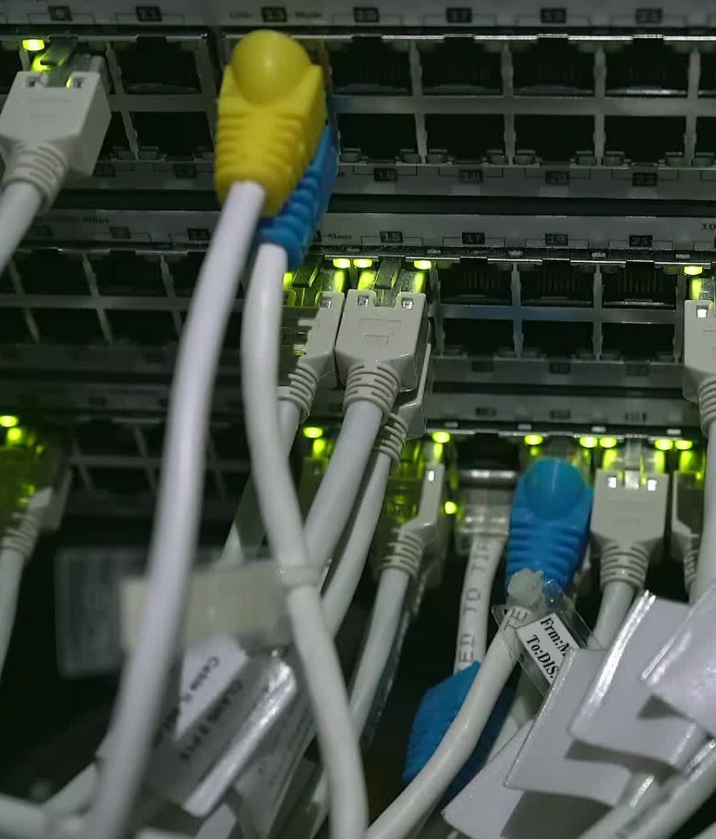
FortiGate Security Features in Action
• Intrusion Prevention System (IPS)
• Web & Email Filtering
• Threat Intelligence & Sandboxing
• Traffic Monitoring & Logging

Slide 10

Best Practices for FortiGate Security
• Regular Firmware Updates
• Multi-Factor Authentication (MFA)
• Logging & Monitoring with FortiAnalyzer
• Role-Based Access Control (RBAC) & Least Privilege

Slide 11
Case Study & Real-World Application
• Example of a Cyber Attack & FortiGate Prevention
• Lessons Learned & Key Takeaways

Slide 12
Q&A
Open for Questions & Discussion

