Slide 1

CAMPUS ONLINE HELP DESK
A Project Work Submitted in Fulfillment of the requirements for the ACCP course third semester ASP.NET Core MVC
In
Software Engineering
By
Ahmer Ali (ID 1339395)
Muhammad Muslim (ID 1334422)
Muhammad Ahad (1340771)
Samuel (1335826)
Tania Dcruz (1335826)
Under the Supervision of Sir Jawed Awan Iqbal Sahb.

Slide 2
Acknowledgement
It gives us great pleasure to find an opportunity to express our deep and sincere gratitude to our project guide Sir. Jawed Iqbal sahib. We do very respectfully recollect his constant encouragement, kind attention and keen interest throughout the course of our work. We are highly indebted to him for the way he modeled and structured our work with his valuable tips and suggestions that he accorded to us in every respect of our work.
We are extremely grateful to the Department of Computer Science & Engineering. We humbly extend our sense of gratitude to other faculty members, and Administration of this Institute for providing us their valuable help and time with a congenital working environment.
Last but not the least: we would like to convey our heartiest thanks to all our classmates who time to time have helped us with their valuable suggestions during our project work.
Ahmer Ali
Muhammad Muslim
Muhammad Ahad
Samuel
Tania Dcruz

Slide 3
Index
Abstract
Introduction
  Purpose
  Scope
  Overview
  Aim & Objectives
Functional Requirements
  Admin
  End-User
  Faculty head
Environmental Characteristics
  Hardware
  Software
Output
Conclusion
References

Slide 4
Abstract:
The project titled "Online help desk" (OHD) is using MS SQL Server, C# with onion Architecture.
This project is aimed at developing an Online Help Desk for the facilities in the campus. This is an Internet based application that can be accessed throughout the campus. This system can be used to automate the workflow of service requests for the various facilities in the campus. This is one integrated system that covers different kinds of facilities like class-rooms, Labs, Hostels, Mess, Computer Center faculty club etc. Registered users (Students, Faculty-head, and Admin) will be able to log in a request for service for any of the supported facilities. These requests will be sent to the concerned people, who are also valid users of the system, to get them resolved. There are attractive features like online notice board, chat box, query resolution etc.
Ther are registered people in the system (students, faculty and admin). Some of them are responsible for maintaining the facilities (like, admin is responsible for keeping the records of all the queries and send it to particular faculty head, the students can make queries to any department faculty head, faculty-head, faculty head will responsible for answering all the queries sent by students or admin etc.

Slide 5
Introduction
Help Desk systems are mainly used in colleges with big number of students. Manual method of checking students information will no longer be there again because it will be done by the computer with the help of the computerized Campus Online Help Desk. Because of the easy to use rature of the Campus Online Help Desk, any organization can easily buy it to make use of them.
The goal of this document is to give a description of the development of practical online helpdesk for facilities in the campus.
Purpose:
The purpose of this document is to give a detailed description of the requirements for the "Online Help Desk". It will illustrate the purpose and describe the software requirement of Development of practical online help desk.
b) Scope:
It deals with the development of Campus Online Help Desk to help in the checking of customers information.
c) Overview:
This is an Intrnal based application that can be accessed throughout the campus.
This system can be used to automate the workflow of service requests for the various facilities in the campus.
This is one integrated system that covers different kinds of facilities like class-rooms, labs, computer center, hostels faculty club etc.
Registered users (Admin, Students and Faculty-heads) will be able to log in a request for service for any of the supported facilities.

Slide 6
Aims and Objectives
The aims and objectives of the project are listed below:
To develop software called Campus Online Help Desk that will replace the manual method.
To develop, promote, and provide adequate and efficiently Campus Online help Desk.
To maintain an efficient system of collection, sorting and delivery of users information.
To eliminate the error involved with the marual method of checking users information.
To save the time wasted with manual method of checking users information.
Architectural Strategies:
The following tools have been used to develop the system:
MS SQL: is the database where all information/data related to requests records and logs are stored.
C#: is programming language used to develop the system to enable it to be web-based application. C# is considered the link used to connect users to databases through a user-friendly interface. Additionally SQL server application was used as a local server to host C# file to generate them.
Server: is the place that hosts all project code.

Slide 7
Functional Requirements
Administrator:
Login to the first page.
Create new faculty account.
View all student details.
View all faculty details.
Check request sent by the user.
Forward request to the faculty as per requirement.
View all queries.
View new queries.
Reply/delete queries.
Add new notice for students.
Add new notice for faculty.
Logout.

Slide 8
Students
Students:
Register Him/Her.
Login to the first page.
Change the password after login into the system.
Edit user details.
Create queries in the system.
View the status of the query.
View the list of queries created by him/her over the past.
Edit and delete query created by him/her.
Live chat with the faculty.
Logout

Slide 9
Facility-heads
Facility-Heads:
Login to the first page.
Change the password after login into the page..
Edit details of his/her profile..
View all queries.
View new queries..
See the queries created by the users and assigned by the Admin.
Work on the queries assigned to them.
Reply/delete the query..
View replied queries..
Add new notice for students.
View all notice..
Logout.

Slide 10
Environmental Characteristics
Hardware:
ProBook 6460b Laptop with 128G SSD hard-disk and 4GB RAM.
Network infrastructure (wired and wireless).
Windows personal Laptop.
The environment that will host the Local host MS SQL Server.
Software:
Windows 10Pro N version 22H2
System Type 64 bit operating system, x64-based processor.
MS-SQL Server
Visual Studio 2022 version 7.O
Network software and protocols in order for systems to communicate: HTTP, HTTPS.

Slide 11
Data Flow Diagram
Online Help Desk System
Faculty-Head
Student
DFD Level 0
Admin

Slide 12
Database Structure
Data Table Properties:
The System database is normalized and designed with the needed table that store the needed information inside columns. Also the need for developing the system capabilities and functionalities has been taken in to account.
Database table created with the following structure:
1. Each table column is assigned with suitable data type.
2. Each table column is assigned with suitable data auto increment primary Key.
3. For each table a foreign key is assigned when necessary plus its constraint type on.
Delete and on Update
4. For each table an index and its type is assigned when necessary.
5. For each column a default value is set when necessary.

Slide 13
SYSTEM DATABASE MAIN TABLES
All Query Table:
# | Name | Type | Collation | Null | Default
1
2
3
4
5
6

Slide 14
FACULTY INFO TABLE:
# | Name | Type | Collation | Null | Defa
1
2
3
4
5

Slide 15
STUDENT INFO TABLE:
# | Name | Type | Collation | Null | Defa
1
2
3
4
5

Slide 16
DEPARTMENT TABLE:
# | Name | Type | Collation | Null | Defa
1
2
3
4
5

Slide 17
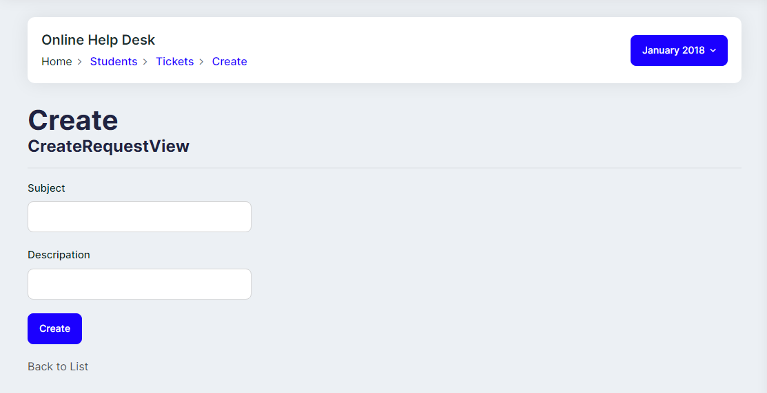
Create User Request Page

Slide 18
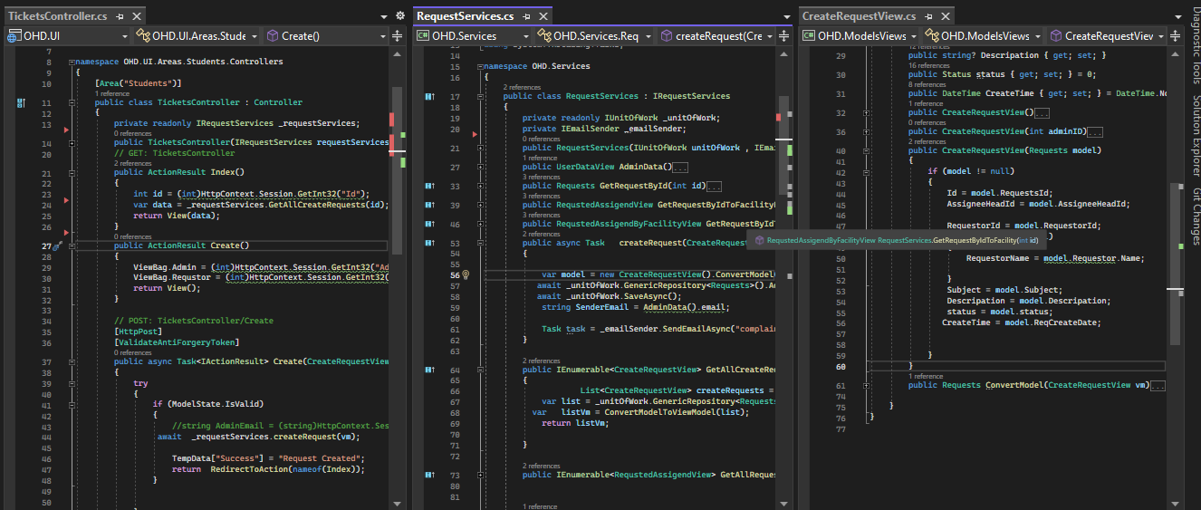
Create User Request Code

Slide 19
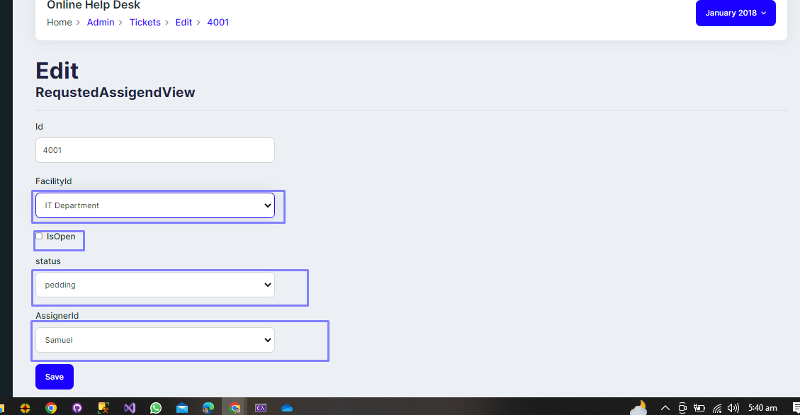
Admin assign the request to the assigner

Slide 20
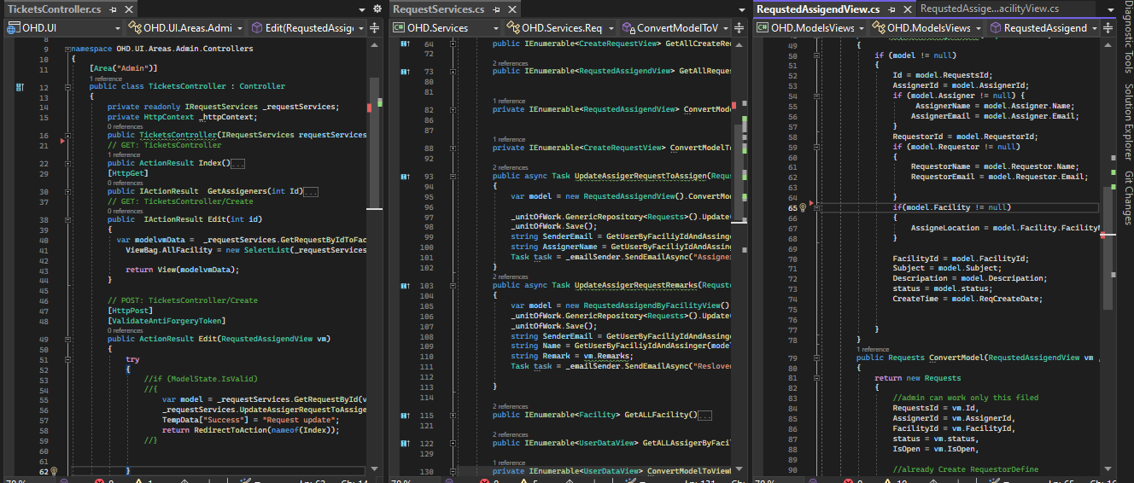
Admin Assign the Request to the Assigner Code

Slide 21
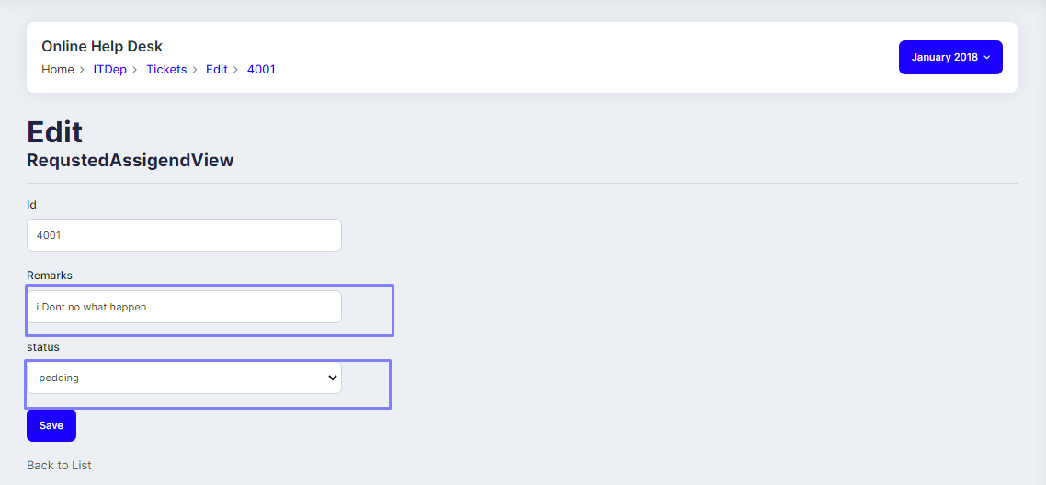
Assigner Remarks pages after done job

Slide 22
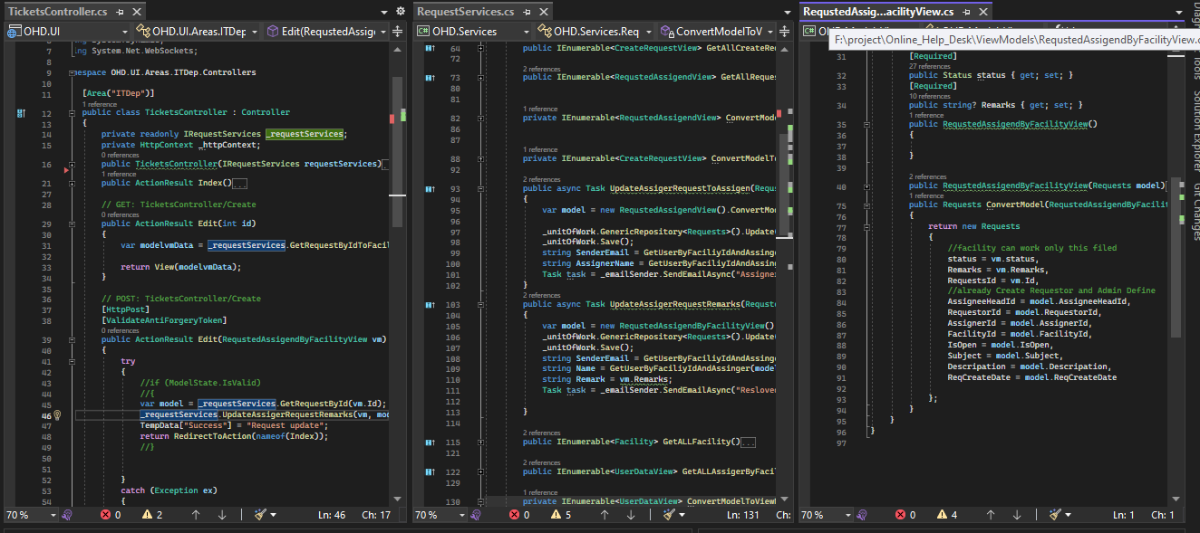
Assigners given Remarks after done job page Controller and Service and ViewModel code

Slide 23
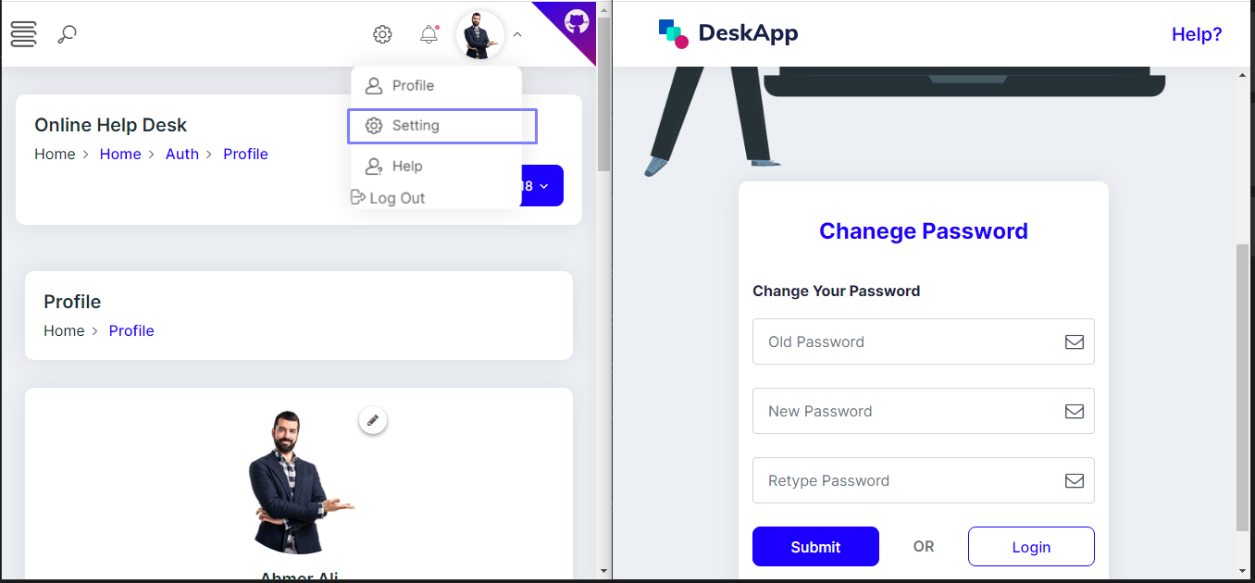
Change password page

Slide 24
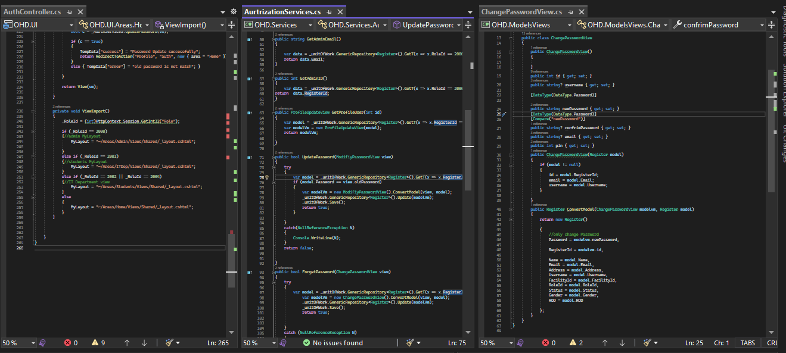
Change password page Controller and Service and ViewModel code

Slide 25
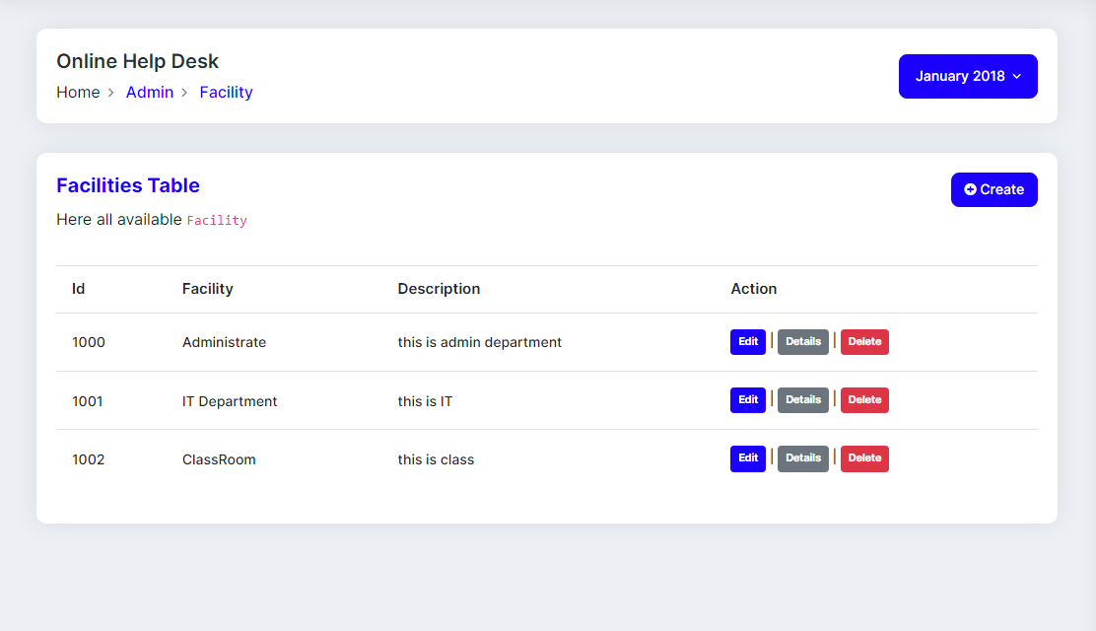
All Facility pages

Slide 26
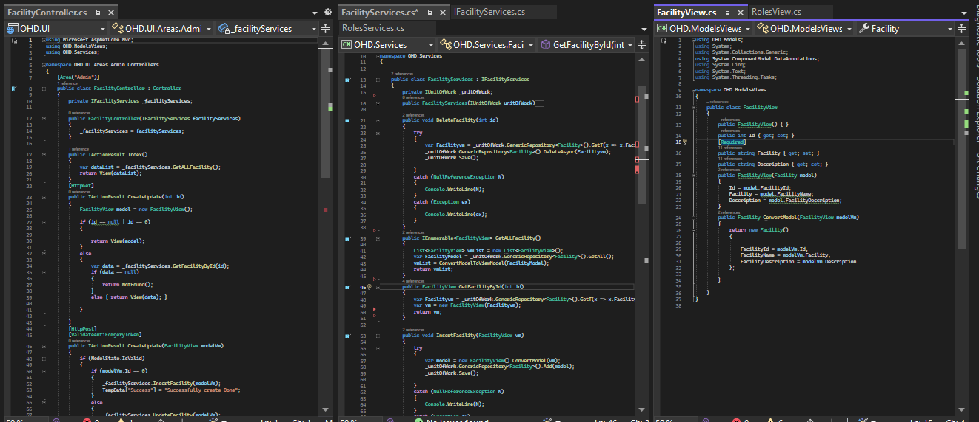
Facility page Controller, Service and ViewModel code

Slide 27
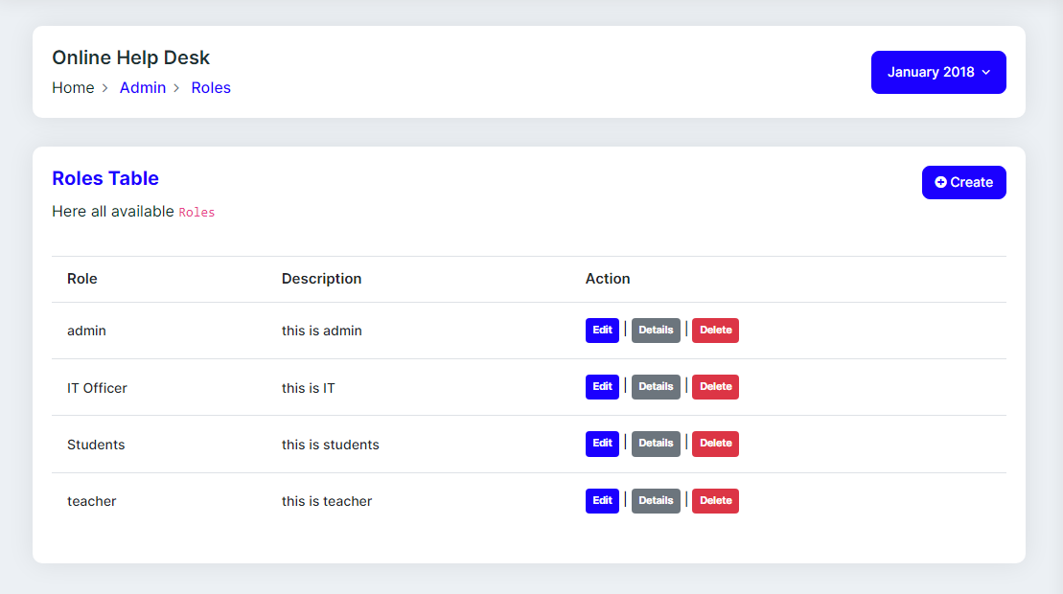
Role Page

Slide 28
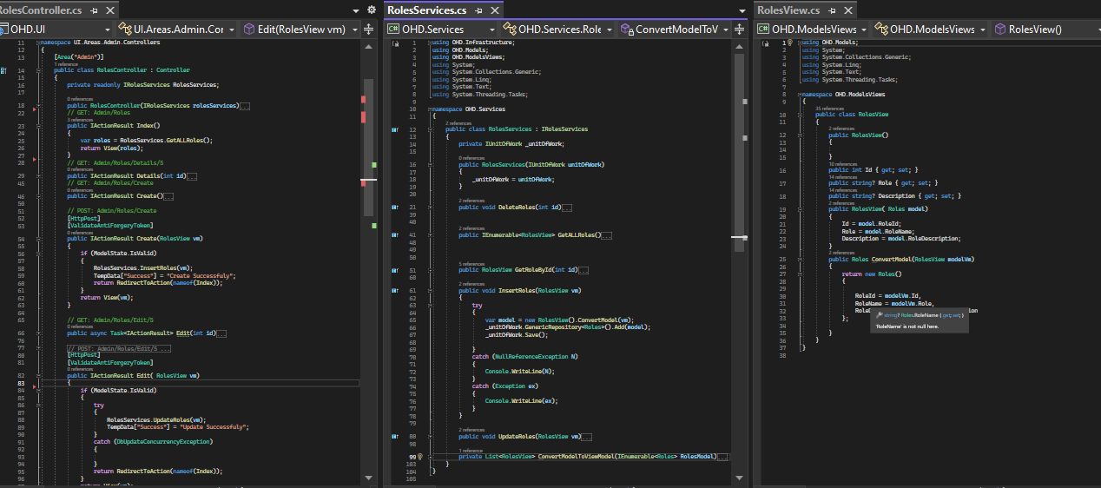
Roles page Controller and Service and ViewModel code

Slide 29
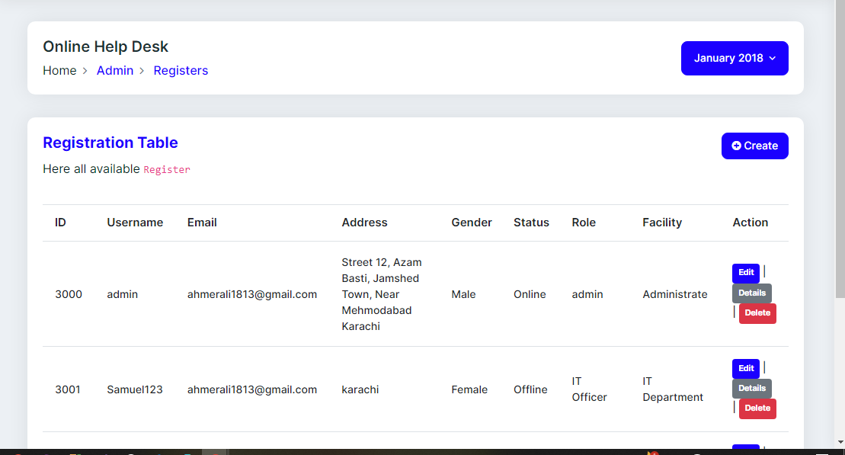
Register page

Slide 30
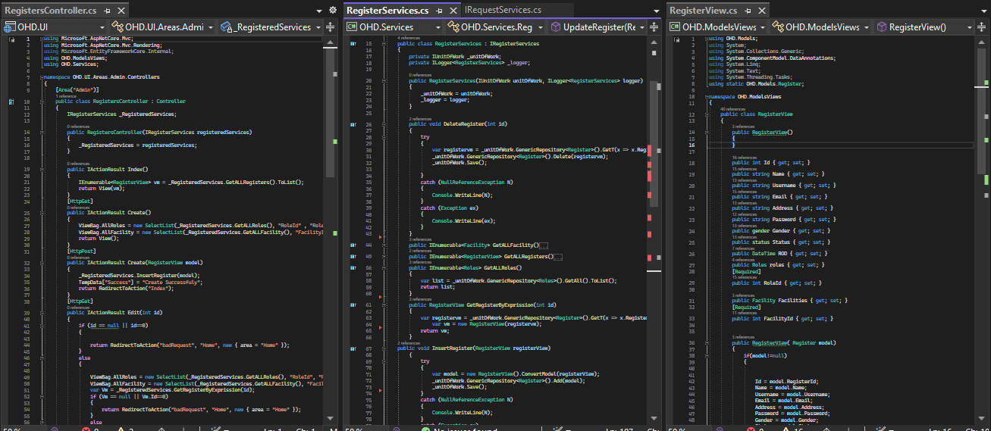
Register page Controller and Service and ViewModel code

Slide 31
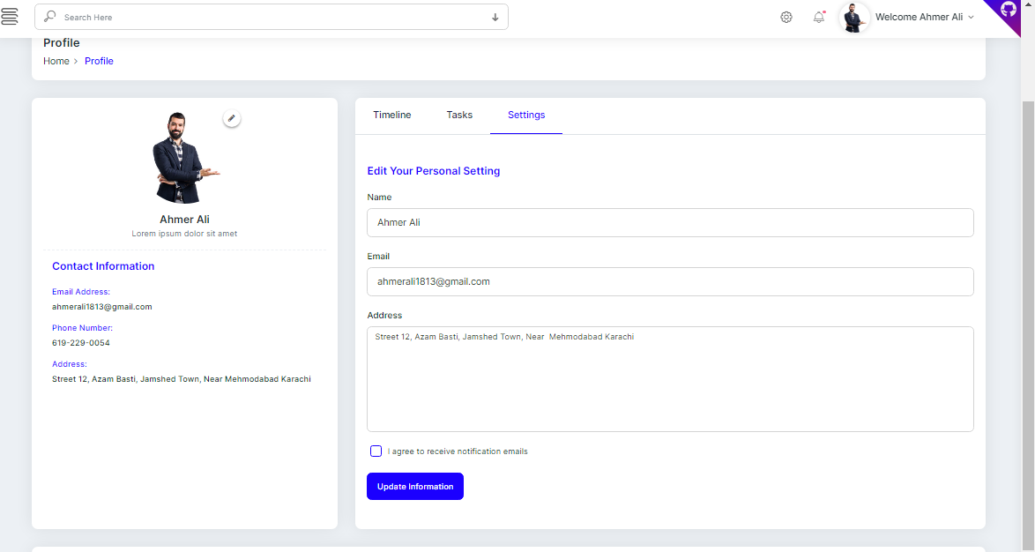
Profile Page View

Slide 32
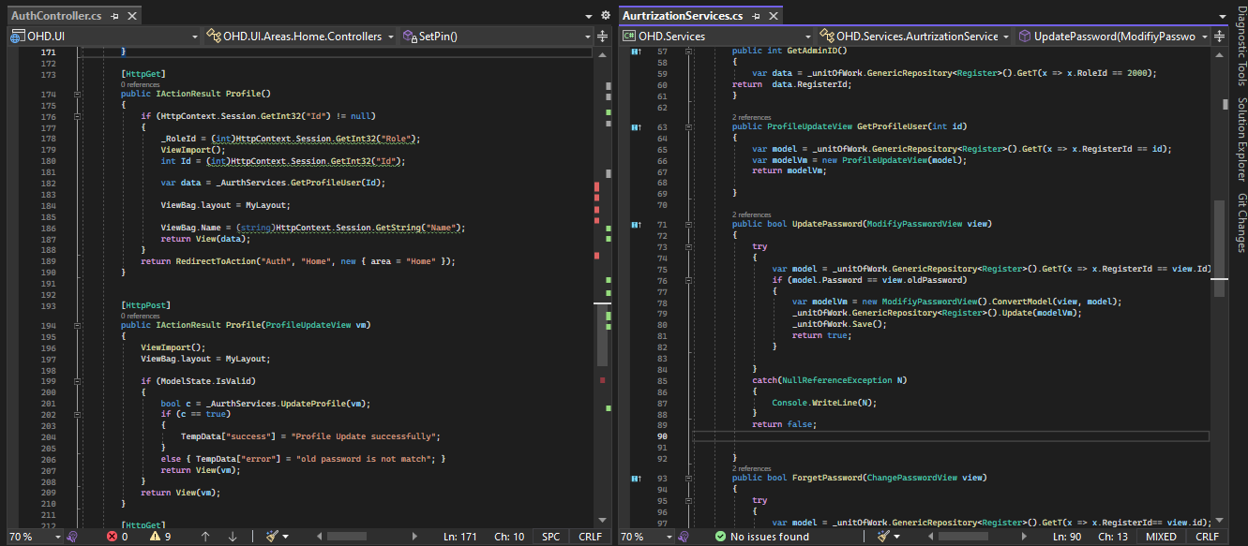
Profile page view controller , services

Slide 33
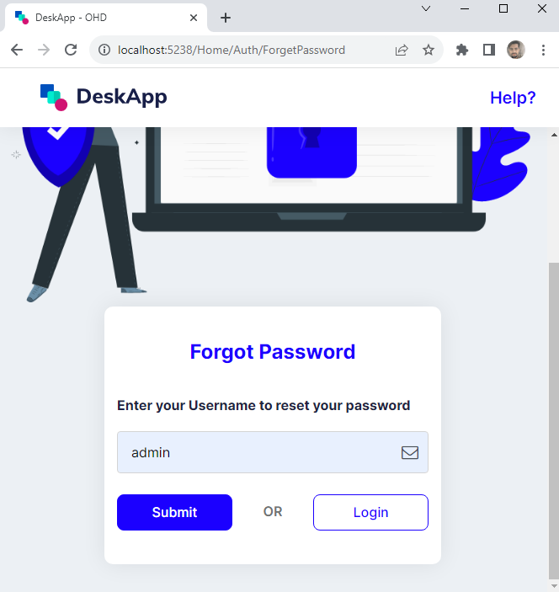
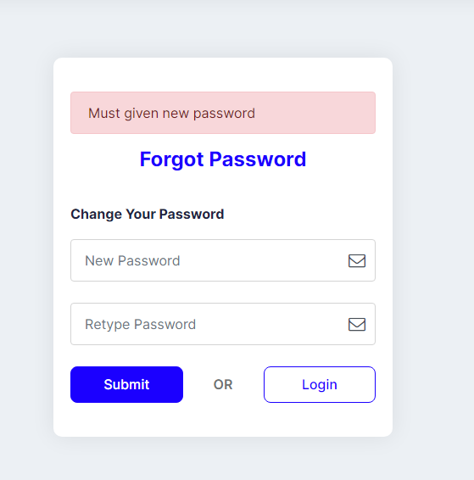
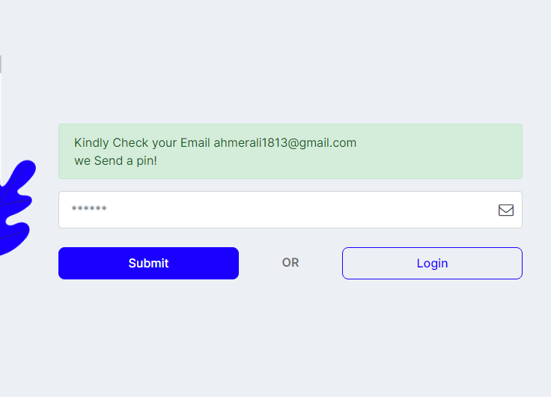
Forget password Pages

Slide 34
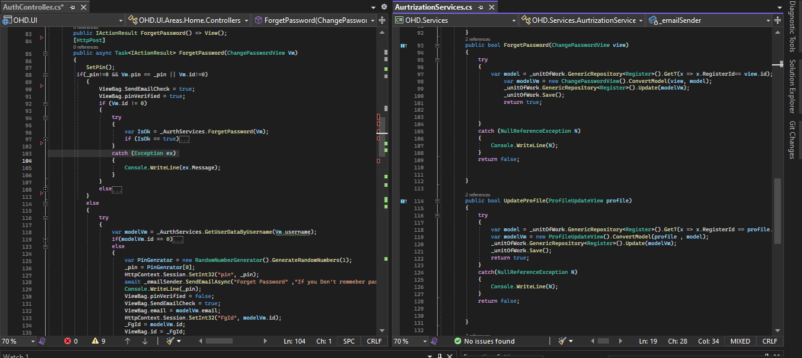
Forget Password Auth Controller and Services

Slide 35
CONCLUSION
The Online Help Desk Project is the small step to reduce the communication distance between the staff and the students.
As the growing use of computers and other electronic devices would mean the growing demand on rapid and quick technical support, this Help Desk Support System is carefully designed to fit with the rapid technical support. It not only helps reducing the time of recording and tracking inquires and problems traditionally, but also improves quality and accuracy of data produced by the system which can lead to more facilitation of decision making process in time.
OHD is designed to accommodate future upgrading and development without the need for building a new system to fit with the growing needs and demands of the system. Having this system hosted online means the ability of both technicians and administrator to track and respond to demands of students at any time beyond the boundaries and walls of college which add one more advantage to replacing the paper-based style.

Slide 36
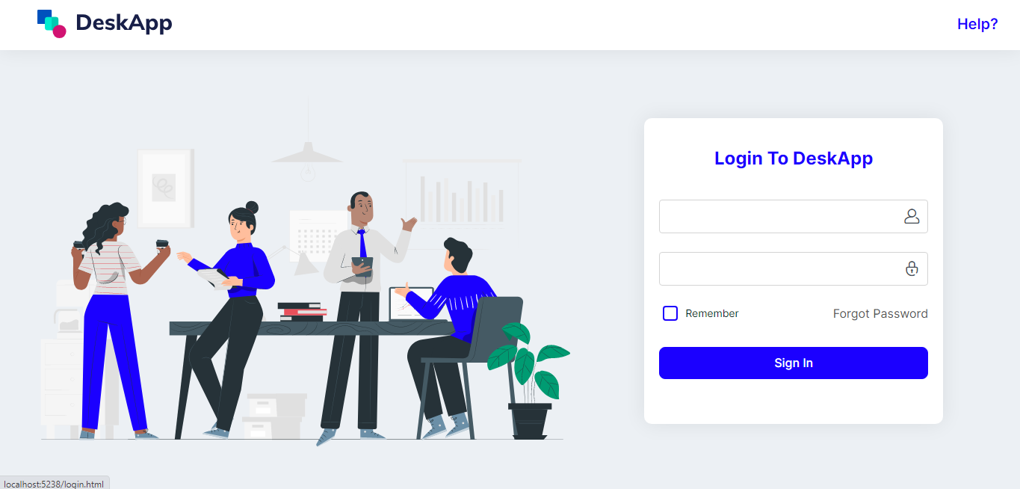
Login page

Slide 37
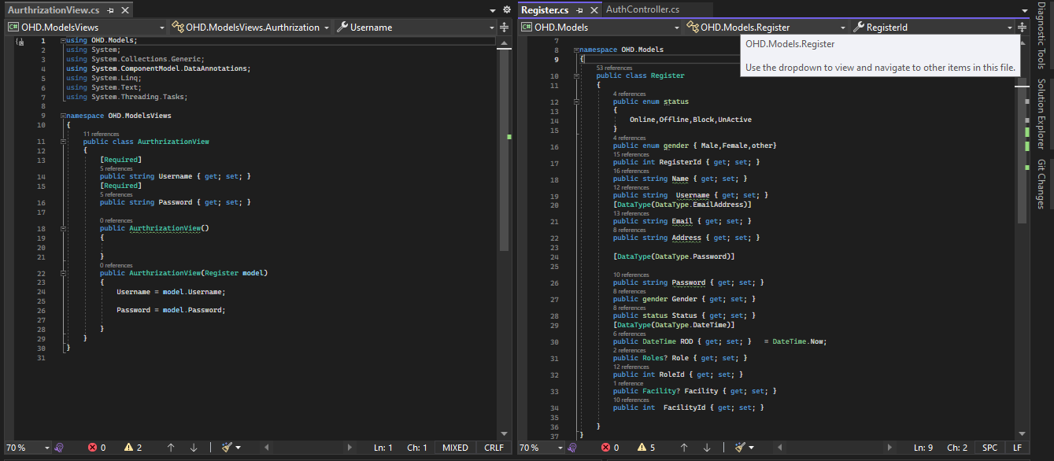
Login Auth ViewModel And Registers Models

