Slide 1

Topic: Client-server and peer-to-peer networks

Slide 2
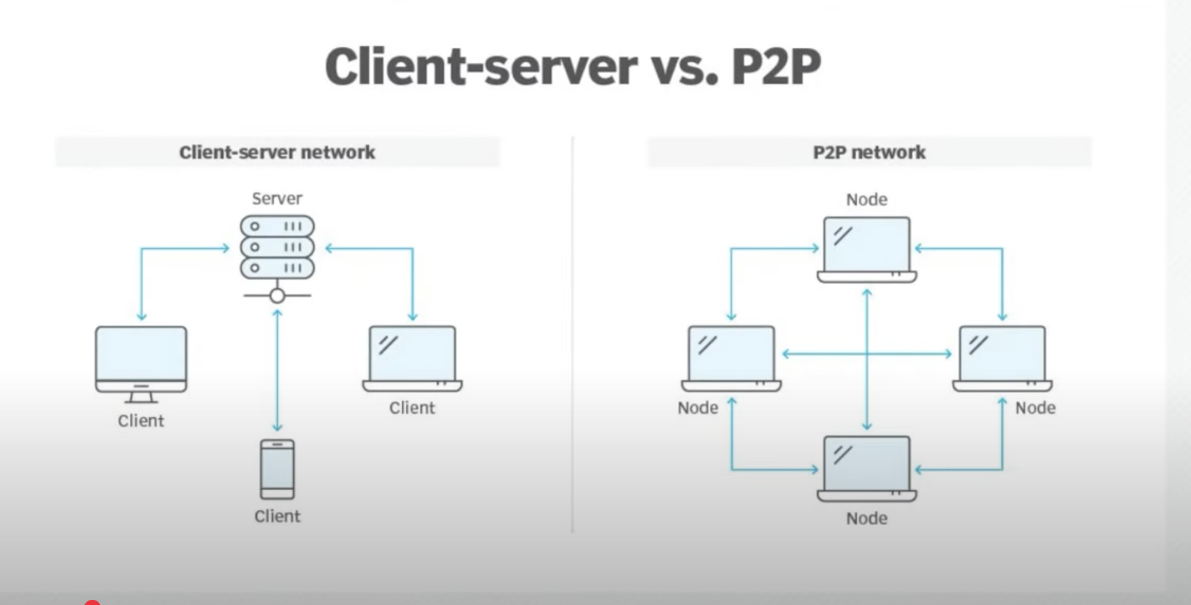
How do computers talk to each other?
Topic: Client-server and peer-to-peer networks
Let’s find out in 5 minutes!

Slide 3
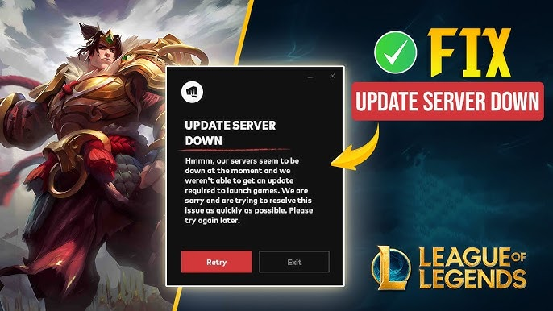
How do computers talk to each other?
Ever had this happen?
You can’t log in at school.
AirDrop works, but WiFi doesn’t.
Why is that?

Slide 4
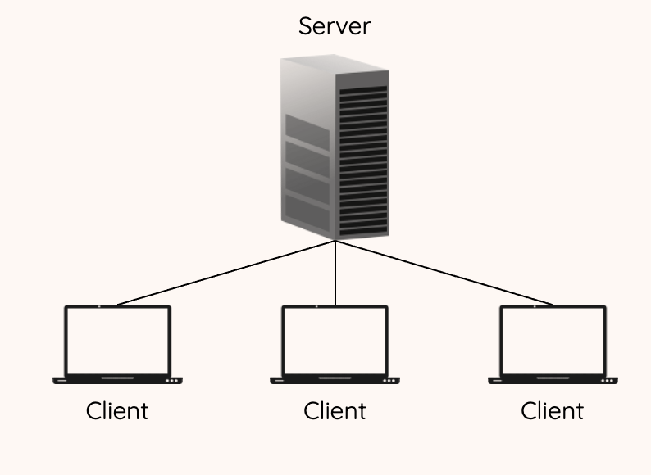
How do computers talk to each other?
Client-Server: School Login
One big computer (server) in charge.
You ask, it gives access.
Secure, but if it fails—no one gets in!

Slide 5
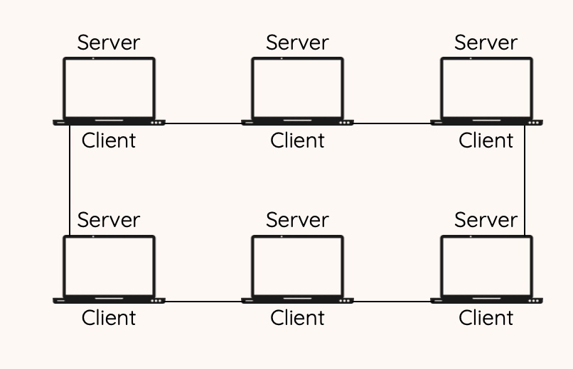
How do computers talk to each other?
Peer-to-Peer: Like AirDrop
No boss—everyone’s equal.
Share files directly.
Fast, but less secure.

Slide 6
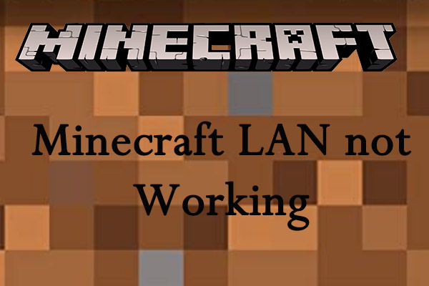
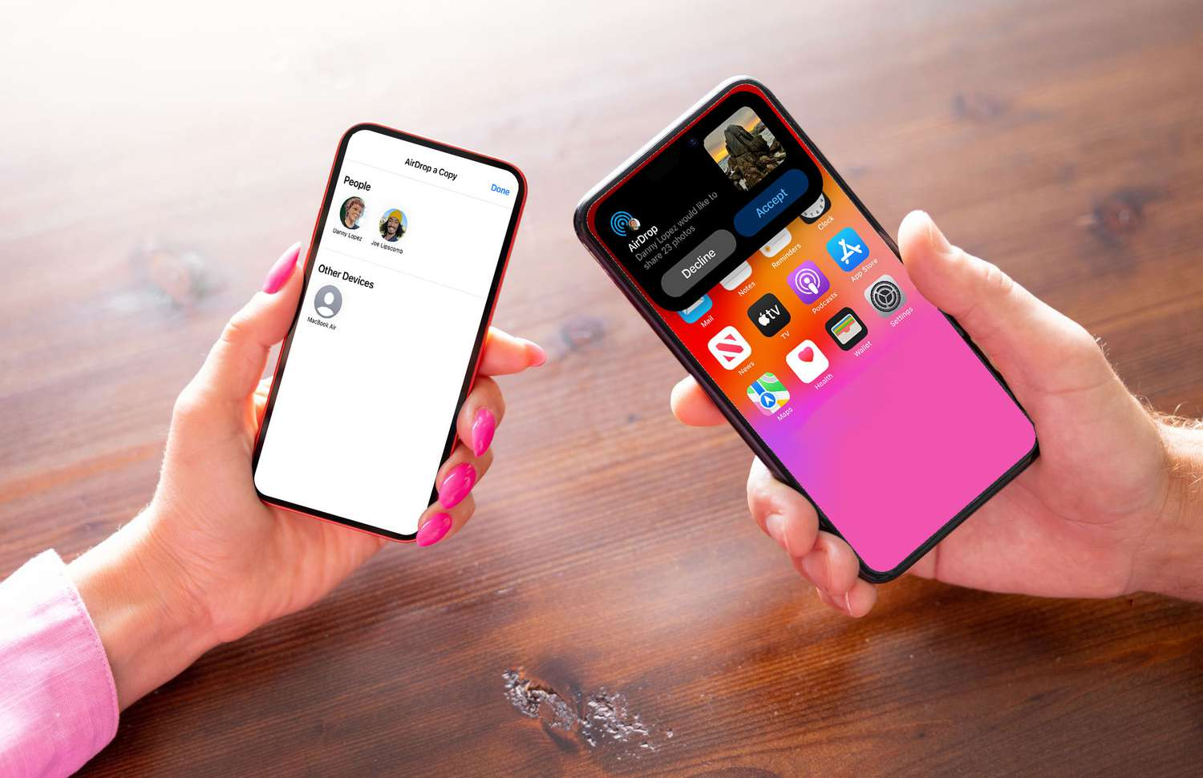
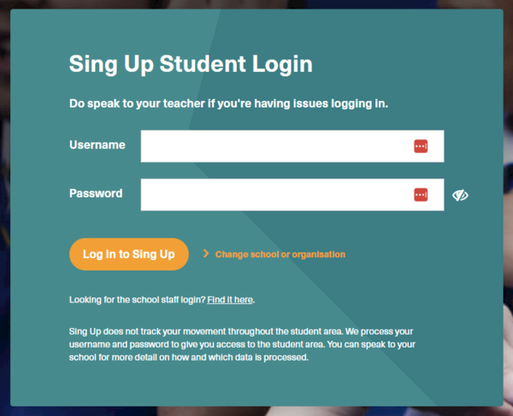
How do computers talk to each other?
Which is which?
1. School login?
2. AirDrop?
3. Minecraft LAN?
Hold up 1 or 2 fingers!

Slide 7
How do computers talk to each other?
Similarities and Differences
Client-Server Model
Advantages: Centralized control, scalability, reliability
Disadvantages: Single point of failure, higher cost, infrastructure needs
Real-world examples: Google Drive, Spotify, Microsoft Teams
Peer-to-Peer (P2P) Model
Advantages: No central server, cost-effective, natural scaling
Disadvantages: Less secure, harder to manage, performance issues at scale
Real-world examples: BitTorrent, AirDrop, LAN gaming

Slide 8

How do computers talk to each other?
Why care?
Pick the right network for the job.
Stay safe online.
You’re the next IT expert!

Slide 9
Big picture
Consider this:
If you save your work on a laptop, then want to work on it at school – how do you get to the file?
Should you save all of your work in one central location, or save your work on the device where you are working on it?

Slide 10
Learning objectives
Understand what is meant by a client-server network
Understand what is meant by a peer-to-peer network
Understand similarities and differences between these models

Slide 11
Engagement activity
In a restaurant, what is the role of the server?
What is the role of the customer/client?
How would a restaurant be different if everyone could fulfil every role – including the customers?

Slide 12
Keywords
Client
Server
Peer

Slide 13
Activity 1
How would you define the following words?
Client
  A device capable of obtaining information from a server
Server
  A computer which manages access to a centralised resource
Peer
  Someone / something of the same status or ability

Slide 14
Activity 1
How would you define the following words?
Client
  A device capable of obtaining information from a server.
Server
  A computer which manages access to a centralised resource.
Peer
  Someone/something of the same status or ability.

Slide 15
Network models
There are two ways of setting up a network to share data and services:
  1. Client-server
  2. Peer-to-peer

Slide 16
Client-server
Client-server
  The network relies on a central server.
  All clients (devices) request services from the server (e.g. print services/file services).
  Additional hardware would be needed e.g. high end powerful servers.

Slide 17
Peer-to-peer
Peer-to-peer
  All computers have equal status.
  Each device can act as a client and a server.
  All devices can request and provide network services.
  No additional hardware/software needed to set up this type of network.

Slide 18
Activity 2
Describe which model you think your school uses.
Identify which devices are clients, servers or peers depending on your answer.
Why do you think the school has chosen this model?

Slide 19
Comparison – File management
All files can be stored centrally on a client-server network:
  workers can access files from any computer
  all computers can update central databases.
On peer-to –peer network all files are stored on their own computers:
  users have to log-in to the same computer every time.

Slide 20
Comparison – Backups
Backups are easily managed on a client-server as these can be done centrally from the File Server:
  all data is backed up in one go
  individual computers do not need to be backed up.
With peer-to-peer all computers are responsible for backing up their own files.

Slide 21
Comparison – Security
Centralised security on client-server – antivirus and firewall can be installed and configured from a central location.
Peer-to-peer – individual security may need to be installed on individual machines.

Slide 22
Comparison – Traffic
Peer-to-peer is appropriate for a small number of computers and a low traffic environment.
Client-server is useful for if there are lots of computers and it will be a high traffic environment.

Slide 23
Activity 3
Complete the worksheet by ticking the correct box(es) to show whether the statements apply to a client-server, a peer-to-peer or to both networks.

Slide 24
Plenary
Write three things you have learnt from today’s lesson and one you don’t understand on a sticky note and post it on the board as you leave the class.
Add your name if you want specific help with a task.

Slide 25
Next lesson
In this lesson, you…
Identified the role of a computer in a client–server network
Described the role of a computer in a peer-to-peer network
Compared the advantages and disadvantages of each model
Next lesson, you will…
Explain different network topologies
Illustrate how data travels through each topology
Evaluate which topology might suit different scenarios best

