Slide 1
New Deep RL Approach: QR-DQN
Group 11:
Ahmet Salman, 21901004
Mustafa Hakan Kara, 21703317
Ahmet Cemal Alicioglu, 21801700
Alp Uneri, 21802481
Beril Canbulan, 21602648

Slide 2
Overview
Motivation
What is The Problem
Significance of The Problem
Previous Methods
Background
Evaluations
Discussion
Summary
Q&A

Slide 3
Motivation
What is The Problem
Classical DQN tries to find the average cumulative reward of each action in a particular state
Threshold for more risk-averse (or risk-taking) decisions.
Averaging of rewards → Unideal/Unstable behavior [1].
If not expected rewards, what could be used?

Slide 4
Motivation
Significance of The Problem
More robust approach to deep RL, particularly in the domain of the Pacman game.
Better performance
Learning the probability distributions rather than value averages.
Result?
More effective agents in terms of rational decision-making.

Slide 5
Motivation
Previous Methods
Q-Learning:
Eventually Converges, but takes too much time + instability problem due to function approximations.
TD (Temporal Difference):
Faster than Q-Learning by using Dynamic Programming, problem of instability still exists.
C51 (First Distributional RL)
Very theoretical (uses KL-Divergence)

Slide 6
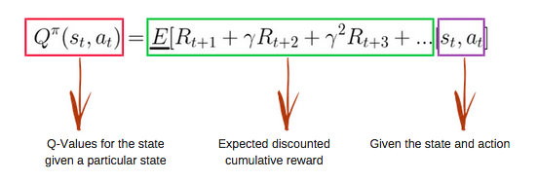
Background
Q-Learning:
[2]

Slide 7

Background
C51:
[2]

Slide 8
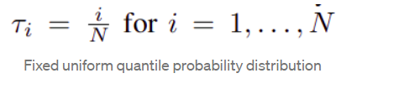
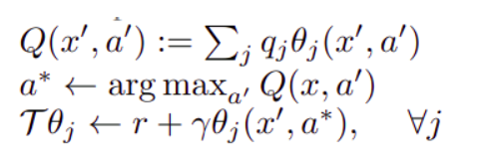

Background
QR-DQN:
[3]

Slide 9
Evaluations
Domain: Pacman Game
Goal: Solve instability problem and promise better performance
Approach: Pacman was trained on 3 maps of varying difficulties. The score of the agent, was used as performance metrics

Slide 10
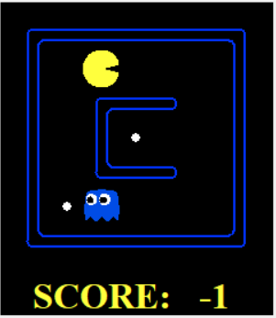
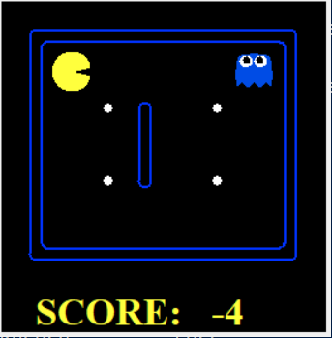
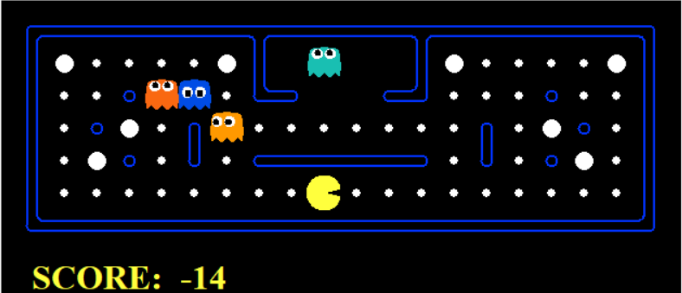
Evaluations
Results Continued
smallGrid Map
mediumGrid Map
powerClassic Map

Slide 11
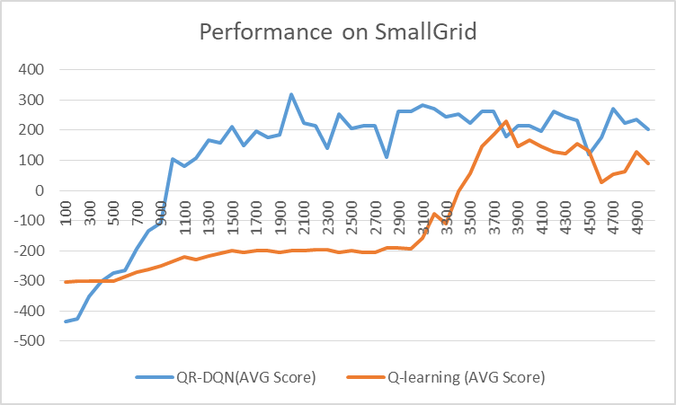
Evaluations
Results Continued (SmallGrid Map)

Slide 12
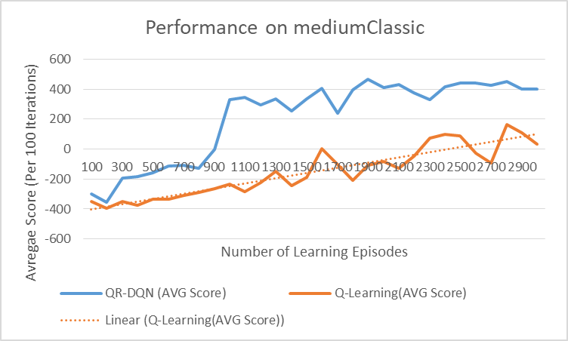
Evaluations
Results Continued (MediumClassic Map)

Slide 13
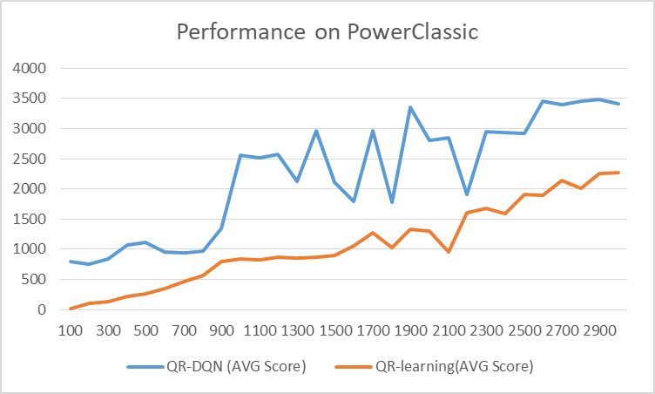
Evaluations
Results Continued (PowerClassic Map)

Slide 14
Discussion
Performance:
Given the same amount of iterations, QR-DQN performs better.
Moreover, an iteration of QR-DQN learns much faster than Q-learning (orders of magnitude faster)
Instability:
QR-DQN has been proven not to cause any problems [4]
Generalizability:
Could be generalized to fields/domains other than games (e.g. a dialog system [5])

Slide 15
Summary
Distributional RL: Averages over probability distributions rather than values
C51: uses Wasserstein metric as loss function, but is not practical because stochastic gradient is not applicable
QR-DQN: uses Quantile Regression as a loss function
Performance: QR-DQN trains faster than Q-learning and results in better performance while solving the instability problem.

Slide 16
References
[1] Bellemare, M. G., Dabney, W., & Munos, R. (2017, July). A distributional perspective on reinforcement learning. In International Conference on Machine Learning (pp. 449-458). PMLR.
[2] https://doi.org/10.48550/arXiv.1707.06887
[3] https://medium.com/analytics-vidhya/distributional-reinforcement-learning-part-1-c51-and-qr-dqn-a04c96a258dc
[4] Tsitsiklis, J. N., and Van Roy, B. 1997. An Analysis of Temporal-Difference Learning with Function Approximation. IEEE Transactions on Automatic Control 42(5):674– 690.
[5] C. Sankar and S. Ravi, “Deep reinforcement learning for modeling chit-chat dialog with discrete attributes,” Proceedings of the 20th Annual SIGdial Meeting on Discourse and Dialogue, 2019.

