Slide 1
Rotation Task
Ahmet Alp

Slide 2
Rotation Task - Usage
Run on Node.js
  http://localhost:3000/ for rotate function in server(Node.js) side
    Image rotation time written in Node.js console with console.log()
  http://localhost:3000/local for rotate function in client(html) side
    Image rotation time written in browser console with console.log()
Run configuration
  npm run dev
  For unit testing: npm run test

Slide 3
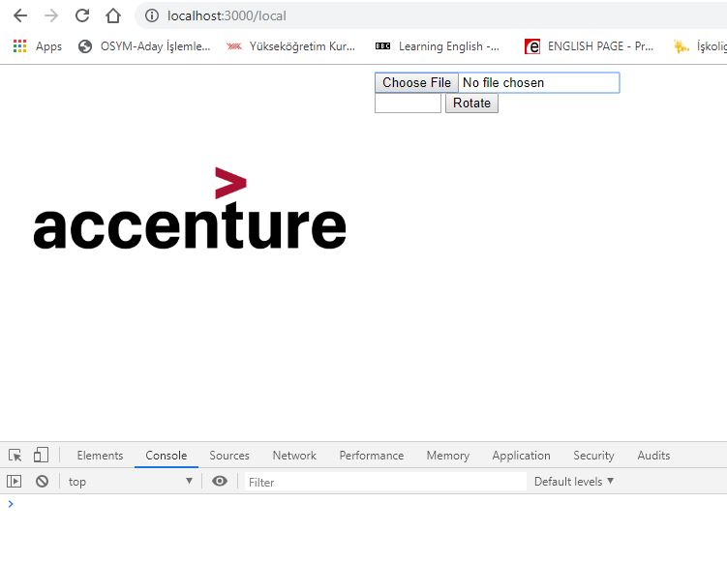
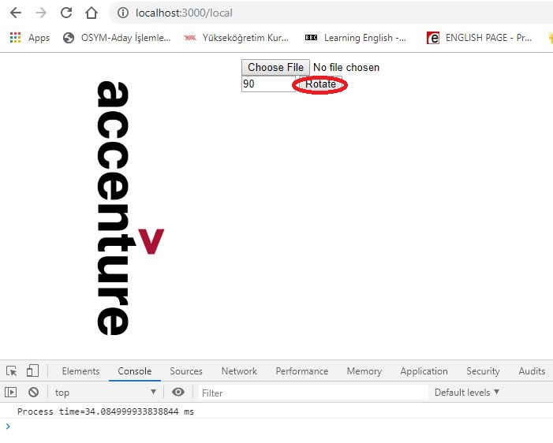
Rotation Task - Usage
Before
After

Slide 4
Rotation Task - Approach
Load image on File Upload
  Create context from file and draw
  Save uploaded ImageData in global variable
  Pre calculate maxWidth and maxHight
    45 degree gives maxWitdh and maxHight
Rotate Image
  Get angle from inbox
  Call rotate(image: ImageData, angle: double) function

Slide 5
Rotation Task - Algorithm
Calculate the Size of a Rotated Image
  For 180 and 360 degrees, size is same
  For 90 and 270 degrees, width and height are reversed
  For acute angles
    new-width=w x cosΘ + h x sinΘ
    new-height=w x sinΘ + h x cosΘ
  For obtuse angles
    new-width=h x cosΘ + w x sinΘ
    new-height=h x sinΘ + w x cosΘ

Slide 6
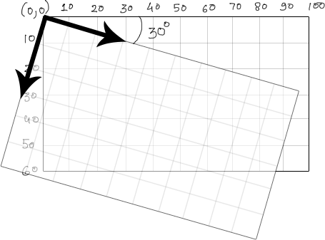
Rotation Task - Algorithm
Calculate the Size of a Rotated Image
For acute angle
w`=w x cosΘ + h x sinΘ
h`=w x sinΘ + h x cosΘ
h`
h
For obtuse angle
h`=w x cosΘ + h x sinΘ
w`=w x sinΘ + h x cosΘ
w
30°
w`

Slide 7
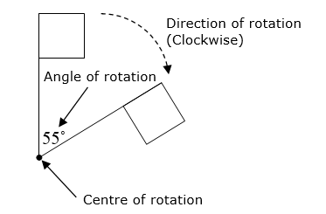
Rotation Task - Algorithm
Rotation Point Calculation
p`.x = xx * cos(Θ) - yy * sin(Θ) + ncx
p`.y = xx * sin(Θ) + yy * cos(Θ) + ncy
p
Θ
p`
ncx
ncy

Slide 8
Rotation Task - Algorithm
Rotation Point Calculation
  For each point
    xx = difference between point.x and center point.x
    yy = difference between point.y and center point.y
    ncx = rotated image center point.x
    ncy = rotated image center point.x
    New point.x = xx * Math.cos(Θ) - yy * Math.sin(Θ) + ncx
    New point.y = xx * Math.sin(Θ) + yy * Math.cos(Θ) + ncy
    Copy new point to new array

Slide 9
Rotation Task – Unit Test
Test.js
Mocha and jsdom are used
Run with
  $npm run test
  > nodejs@1.0.0 test c:\nodejs
  > mocha
  Rotation Task Test
  √ should return width=10 height=5
  √ should return in 1 s (83ms)
  √ should return in 1s(local)
  3 passing (97ms)

Slide 10
Rotation Task – Statistics
On PC
  Intel i5 4210
  8 GB
  Windows 10 64 bit
  Chrome browser
324 Kb image
  1045 x 640 pixel
  300 DPI
  Process time average = 55 ms

Slide 11
Rotate Task - References
Rotation Border Size Calculation
  https://iiif.io/api/annex/notes/rotation/
Rotation Point Calculation
  https://medium.com/possible-cee/geometry-done-right-with-js-16706b33e88

Slide 12
Thank you

