Slide 1
PIZZA ORDERING PROJECT
Made by:
Ahmet arda öz
Melisa karadağ

Slide 2
ABSTRACT
In the pizza ordering system, the customers choose their own pizza menu. If The Customers would not choose from already existing menu, they can either create their own menus as an option. If they choose to create their own menu, they are going to be able to choose ingredients, sauce, extra food and drinks separately.

Slide 3
INGREDIENTS,EXTRAS,SAUCES,DRINKS
We have different options .Customers can choose their ingredient,sauces,drinks and extras(french fries ,chicken nuggets etc.).

Slide 4
Campaign Code
There will be some codes to sale up the menus bill price

Slide 5
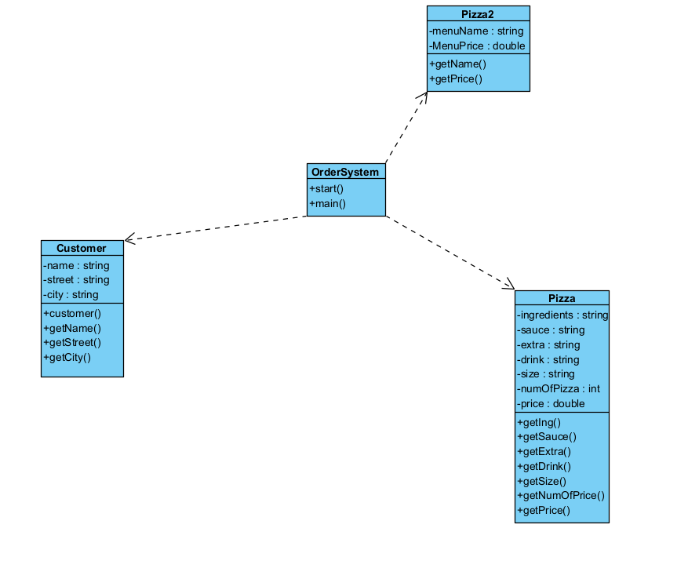
UML DRAFT(WORK IN PROGRESS)

