Slide 1
MCH4202 Autonomus Robotics Project 1
Group 1
Ahmet Burak Akyüz 1904193
Ali Göktaş 1904089
Ata Berk Kaya 1903042
Yarkın Seymen 1903007

Slide 2
Assignment of Responsibilities
Ali Göktaş -> Constructing the MATLAB code from derived kinematic equations.
Ahmet Burak Akyüz -> Derivation of the kinematic equations & Optimization of algorithms.
Ata Berk Kaya -> Helping the MATLAB code construction & Finding supplementary material for the project.
Yarkın Seymen -> Software/Simulation testing & Troubleshooting

Slide 3
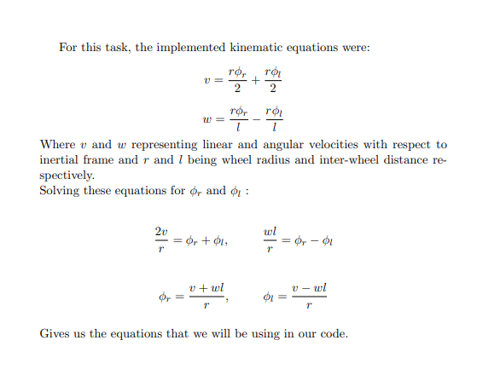
Kinematic Equations

Slide 4
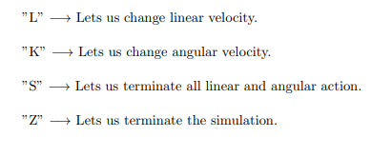
Keybindings

Slide 5

The End Thank you for listening

