Slide 1
Effects of Environmental and Behavioral Factors on Human Health
BBM469 Data Intensive Applications Laboratory
Data Science Capstone Project
Ahmet Deniz GÜNER
Oktay UĞURLU

Slide 2
CONTENTS
Problem
-Definition
Data Understanding
- Data Definitions
Data Preparation
-Process
-Our Solutions
Modelling
-Correlations
-Final Version Of Dataset
- Why not Air Pollution
-Clustering
-Regression
Evaluation
References

Slide 3
Problem

Slide 4
PROBLEM
DEFINITION
Recently, as we observe with COVID-19, lack of investments about the significant field causes great problems. Of course, a virus is not a predictable factor however, at least some provisions must be made before turning predictable diseases into an enormous problem. Naturally, these should depend on some external and behavioral factors to be predictable. Thus, health investments can be extended to predict forward looking by observing external factors and people's behaviors. At the same, social education can be improved and social opportunities can be extended in favor of analyzing these relations.

Slide 5
PROBLEM
Our Solution and Project Definition
The project aims to create a model by analyzing the distribution of people's behaviors and external factors and the effects of them on the most common chronic diseases in the cities of the United States. This model purposes to classify the regions by their health situations and predict the percentage of diseases occurring.

Slide 6
Data Understanding

Slide 7
Data Understanding
DATA DEFINITIONS
We used the datasets we provided from CDC (Centers for Disease Control and Prevention) for this research. This datasets is based on research from over 500 cities in America. Datasets include the ratio of some diseases and behavioral factors of people to the population of the city.

Slide 8
Data Understanding
Which datas include in our resarch?
-Rates of binge drinking. -Rates of sleep less than 7 hour in one day. -Rates of occuring mental ilnessess more than 14 day. -Rates of occuring cancer (skin cancer is excluded) -Rates of cholesterol patients. -Rates of occuring hearth disease. -Rates of obesity. -Rates of occuring diabete disease. -Rates of lack of exercise. -Rates of regularly visiting the hospital for check-up. -Rates of no have health insurance. -Rates of kidney disease

Slide 9
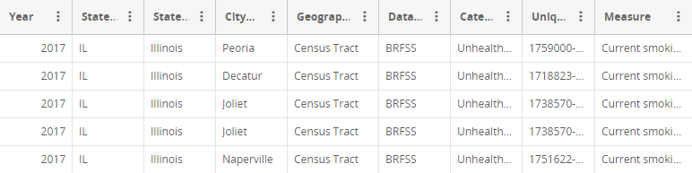
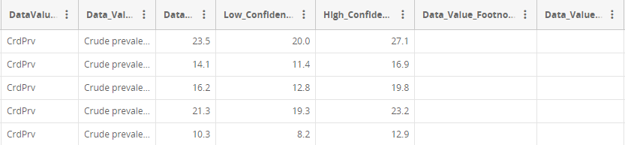
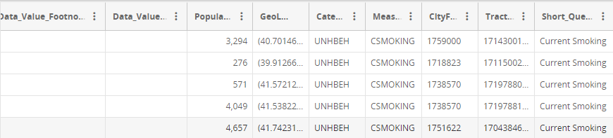
Data Understanding
Sample Dataset:

Slide 10
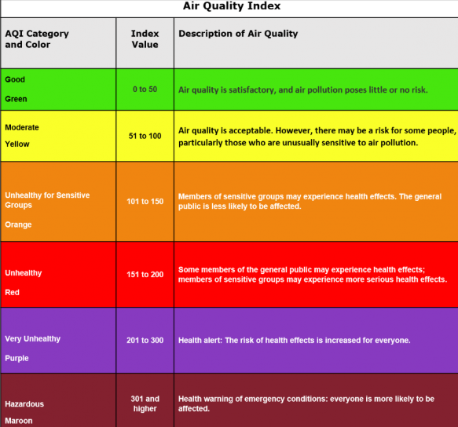
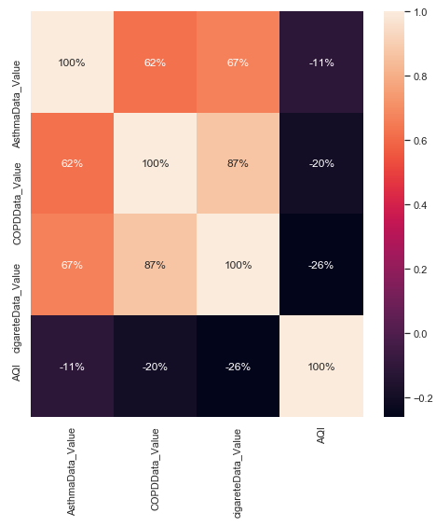
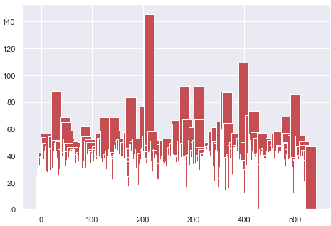
Data Understanding
Why Not Air Pollution Effects?
We compare air pollution data and respiratory disease by using heatmap but we can't find the correlation which we expected. After, we decide on the reason for this. In above table shows the air quality scale according to AQIs (Air quality Index) and below box-plot shows the rates of the 2017 year AQI values for every 532 cities of the US. When we observe these 2 plot and table, almost all cities have good air quality values expect just 2 of them. Thus, we can't use AQI values as a factor of occurring respiratory disease in the cities of the US.

Slide 11
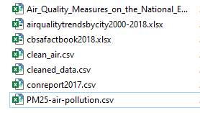
Data Understanding
Why Not Air Pollution Effects?
We tried different datasets to make sure we didn't stick to a single dataset.
We use U.S EPA's daily air pollution measuring data which indicates 272 cities of the US. All datasets belong to the 2017 year.
We could not spread our research around the world because there were insufficient data on the number of patients, although there were data sets related to air pollution.

Slide 12
Data Preparation

Slide 13
Data Preparation
Process:
After adding the dataset we dropped the empty columns.
After that, we also dropped the rows with nA value and without data value type "Crude-prevalence".,
We had to convert the data in the population column to numerical data because it had a comma in it.
We converted the datasets into formats with averages of 500 cities because the data was scattered across the cities.
After sorting all the datasets in the same way, we combined the datasets.
We use min-max scaling for clustering.

Slide 14
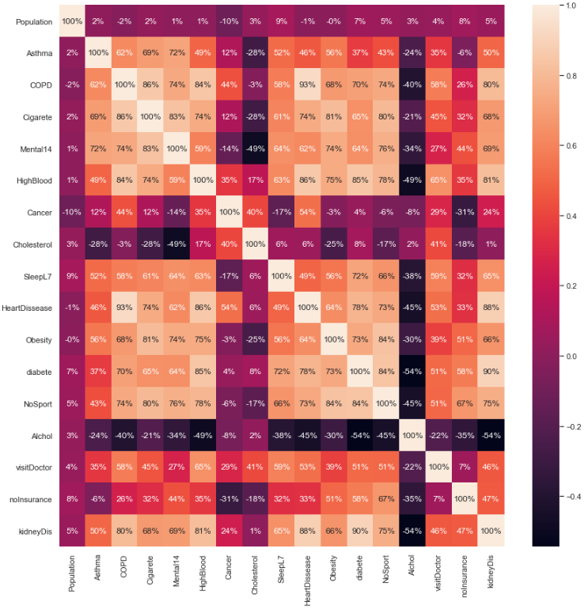
Data Preparation
Correlations:
After monitoring the correlations of the fields, we decide drop some features which have less correlation ratio with diseases than the others. Thus, fields about no health insurance, visiting doctor, population, cholesterol disease and cancer are dropped from dataframe.

Slide 15
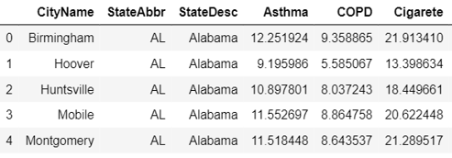
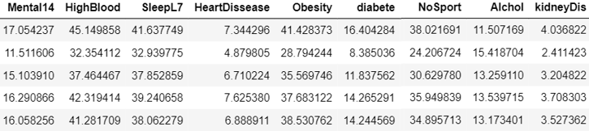
Data Preparation
Final version of the dataset after dropping and combining operations:

Slide 16
Modeling

Slide 17
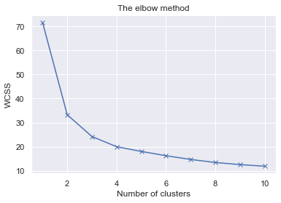
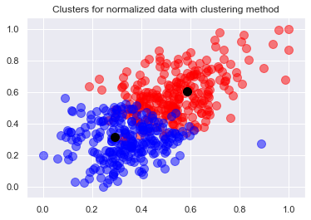
Modeling
Clustering Model
We use K-means algorithm to classify the dataset.
According to elbow method, number of clusters are
selected as two different cluster.
This means that, peoples are grouped as healthy
and unhealthy.

Slide 18
Model
Regression Model
We try to predict ratio of occurring 4 different disease which are COPD, heart disease, diabetes and kidney disease.
We evaluate 4 different regression algorithm to choose. These are SVR, Gradient Boosting Regression, Ridge and Linear Regression.
Mean-squared error and R^2-score are used to evaluation
For COPD, Linear Regression, which has 80% accuracy and -0.75 R^2-score, is used.
For heart disease, Linear Regression, which has 82% accuracy and -0.41 R^2-score, is used.
For diabetes, Gradient Regression, which has %83 accuracy and -1,99 R^2-score, is used.
For kidney disease, SVR Regression, which has %87 accuracy and -0,039 R^2-score, is used.

Slide 19
Evaluation

Slide 20
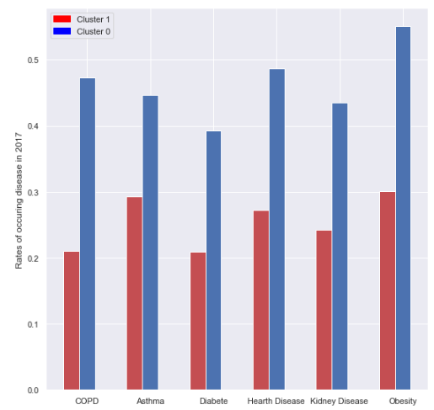
Evaluation
Clustering Model
The model classified the rates of
behaviors as healthy and unhealthy
as we can see means of COPD,
asthma, diabet, hearth disease,
kidney disease and obesity
rates for two different clusters.

Slide 21
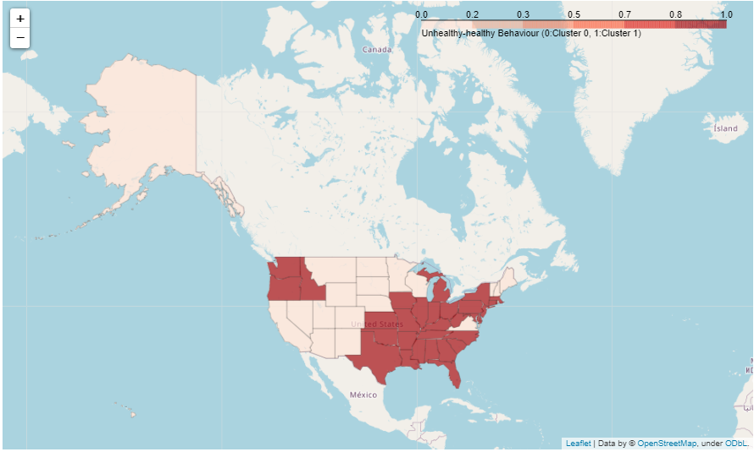
Evaluation
We can observe the distribution
of the clusters on each state
on US map. According to clusters,
west region is more healthy
than east region of US.

Slide 22
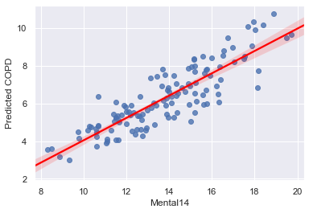
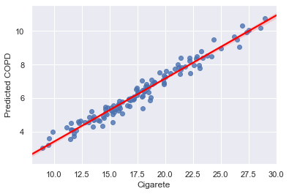
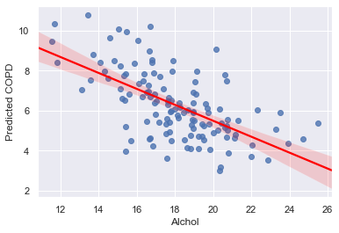
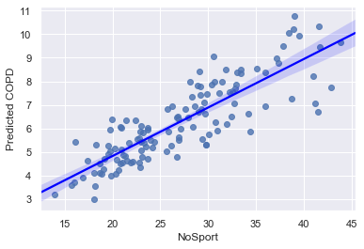
Evaluation
As we can see from the model, COPD disease
has a strong connection with the usage of alcohol
and cigarette, having mental illnesses, and lack of exercise.
When we look at the regression plot, we can see that COPD
disease is more dependent on smoking cigarettes than other factors.

Slide 23
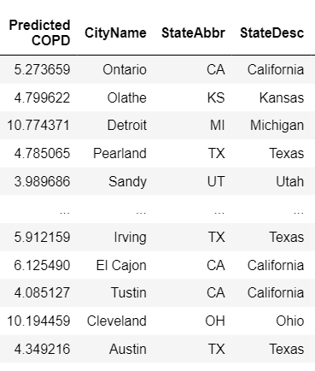

Evaluation
When look at prediction and actual values for some cities, we can see that our model predicts the ratios almost close to real ones such as Ontario’s COPD ratio is actually 4.8% and its predicted is equal 5.2%.

Slide 24
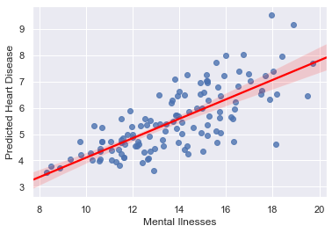
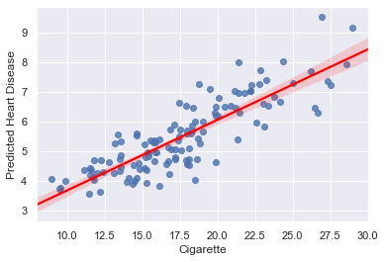
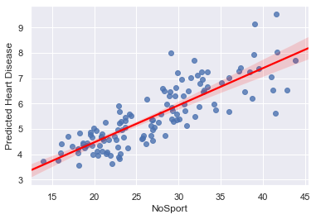
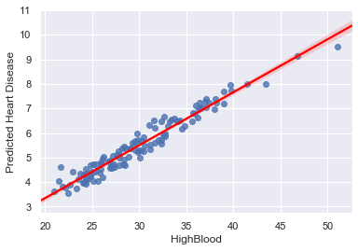
Evaluation
We can observe same things for hearth disease
by looking its regression plot
High blood pressure is more dominant as a predictor.

Slide 25
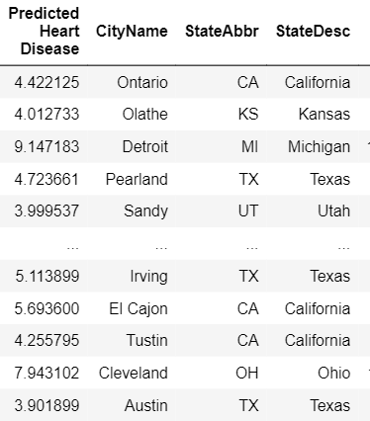
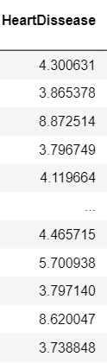
Evaluation
Predicted ratio and real ones for
heart disease

Slide 26
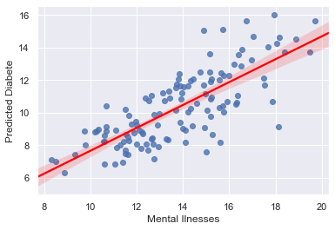
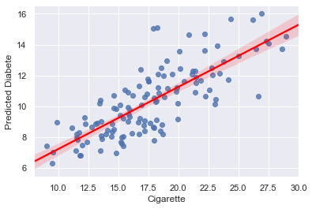
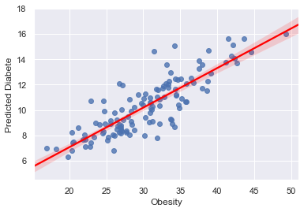
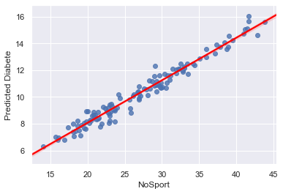
Evaluation
Diabetes disease is mostly dependent
lack of exercise than other factors.

Slide 27
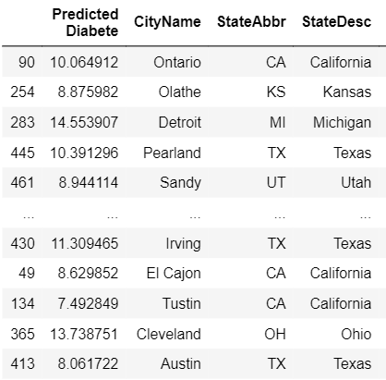
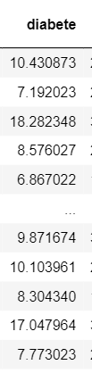
Evaluation
Predicted ratio and real ones for
diabetes

Slide 28
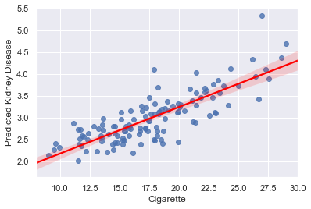
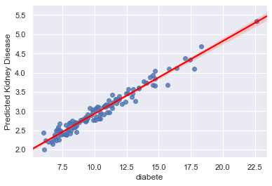
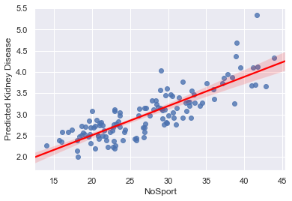
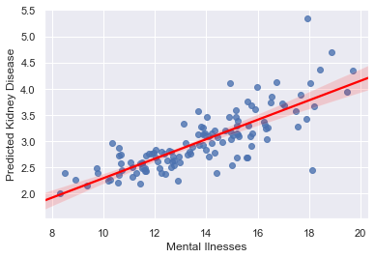
Evaluation
Kidney disease is mostly dependent
on occurring diabetes disease
than other factors.

Slide 29
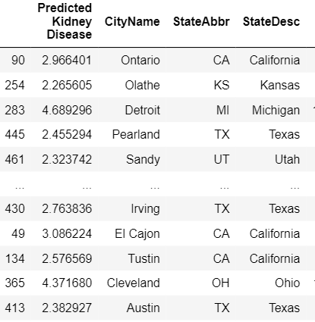

Evaluation
Predicted ratio and
real ones for kidney disease

Slide 30
References
A folium library to indicate clusters on the US map:
https://github.com/python-visualization/folium/
Disease and behavior datasets for 500 cities of US:
https://chronicdata.cdc.gov/browse?q=500&sortBy=relevance
Air pollution dataset of the US:
https://aqs.epa.gov/aqsweb/airdata/download_files.html

