Slide 1
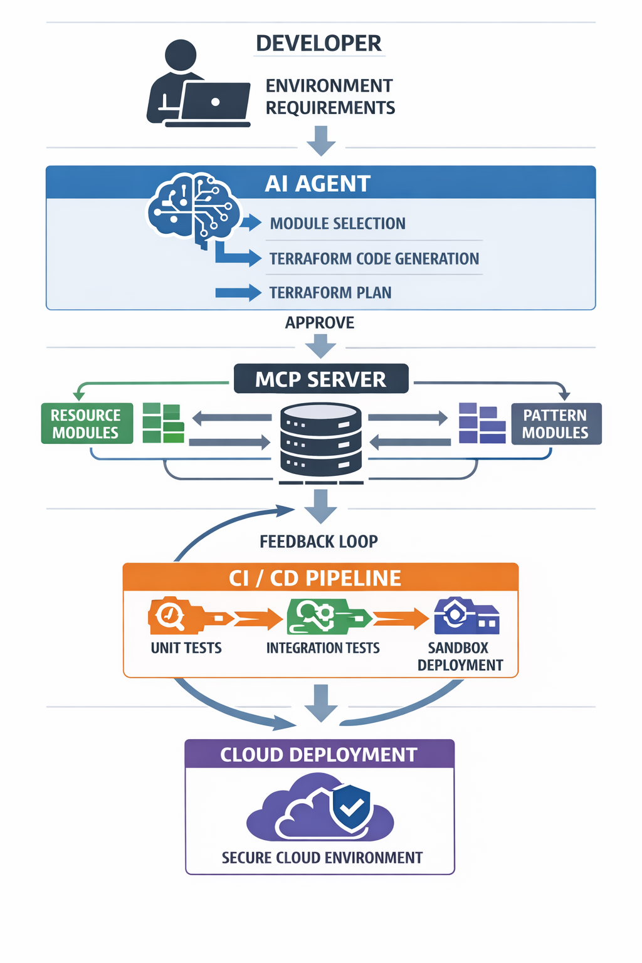
AI-Augmented Well-Architected Modules: Architecture & Workflow

Slide 2
AI-Augmented Well-Architected Modules (WAM)
Accelerates deployments, standardizes infrastructure, integrates AI with MCP server.

Slide 3

Challenges in LZaaS Deployments
Manual coding slows deployments, inconsistent modules, technical debt, missed best practices.

Slide 4
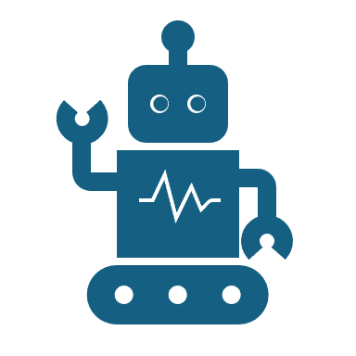
AI-Augmented WAM Workflow
AI accesses modules, generates Terraform code, validates, developer approves.

Slide 5
Developer & AI Collaboration
Dev specifies environment, AI plans and previews, CI/CD tests.

Slide 6
Key Benefits
Faster deployments, reduced debt, upskilled teams, safe automation.

