Slide 1

Search Node Ahmet Emin SAĞLIK

Slide 2
WHY I WORK ON THIS PROJECT?
My Goal is to create a faster sorting and searching algorithm than the fastest one.
No problem if it failes. It is a dream.

Slide 3
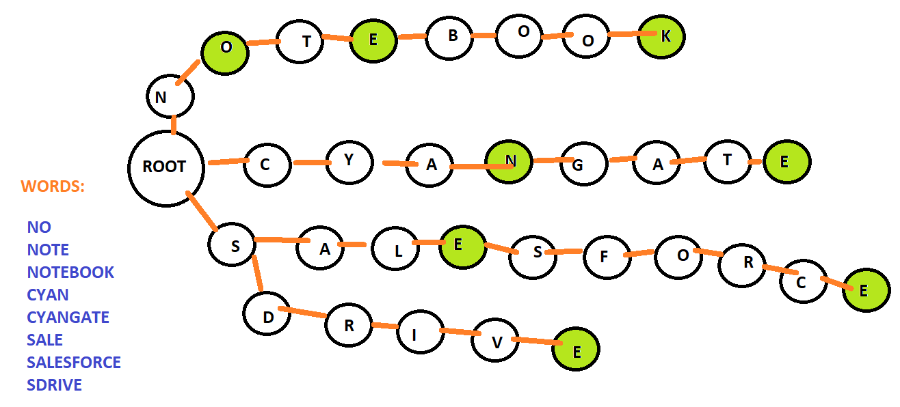

Slide 4
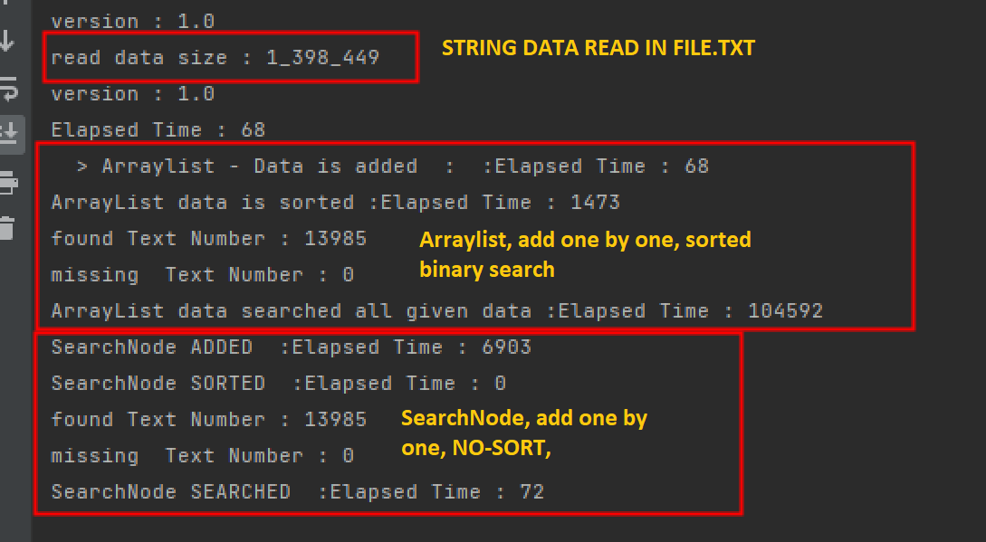

Slide 5


(Search algorithm)/ (Binary Search)
= Search fast algorithm time ratio
72 /104 592(long diff) => 1 452.
The ratio is changeable according to string text and it’s length
Use more memory. Not for this but before in my studies, The ram is used about %50 is in SearchNode. So SearchNode algorithm uses more Ram than ArrayList does.

