Slide 1
CENG 707
Data Structures and Algorithms
Introduction & C++
Assoc. Prof. Yusuf Sahillioğlu
Department of Computer Engineering
Middle East Technical University

Slide 2
CENG 213
Instructor: Yusuf Sahillioğlu
Office: B107
Email: ys@ceng.metu.edu.tr
Lecture Hours:
Tue
Web Page: http://user.ceng.metu.edu.tr/~ys/ceng707-dsa/
Follow odtuclass as well.
Playlist: https://www.youtube.com/playlist?list=PLamOUbhy_opKnRsYsOPvkw3lBEiaL0VjY

Slide 3
Course Description
Course Objectives: To introduce abstract concepts for data organization and manipulation, to show how these concepts are useful in problem solving.
Text Book and References
Mark Allen Weiss, Data Structures and Algorithm Analysis in C++ (3rd ed.), Addison Wesley, 2006 (Current Textbook).
M. T. Goodrich, R. Tamassia and D. Mount, Data Structures and Algorithms in C++, John Wiley & Sons, 2004 Mark Allen Weiss, Data Structures and Problem Solving Using C++, 2nd ed., Addison Wesley 2000
Sartaj Sahni, Data Structures, Algorithms, and Applications in C++, McGraw Hill, 1998.
H.M. Deitel, P.J. Deitel, How To Program C++ and Java by Prentice-Hall, 2001.
The C++ Tutorial: http://www.learncpp.com/

Slide 4
Grading
Midterm: 30%
Final Exam: 35%
Programming Assignments: 30% (2 x 15%)
Participation in Class: 5%
All assignments are to be your own work. No group projects or assignments are allowed.
Exams are closed-book.

Slide 5
Course Outline
Overview of object-oriented programming with C++ [chapter 1]
Algorithm analysis [chapter 2]
Sorting [chapter 7]
Lists, stacks, queues [chapter 3]
Trees [chapter 4]
Priority queues [chapter 6]
Hashing [chapter 5]
Graphs [chapter 9]

Slide 6
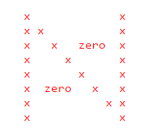
Motivational Example # 1
All these structures are there to efficiently store and process data
Even a simple data structure you already know may be very useful if used in the right context
Store nxn entries of an N-matrix in an array
  Huge profit considering n=1 million, usual case
  Column 1, column n, diagonal (remaining)
  Size of the compact array A?

Slide 7
Motivational Example # 1
All these structures are there to efficiently store and process data
Even a simple data structure you already know may be very useful if used in the right context
Store nxn entries of an N-matrix in an array
  Huge profit considering n=1 million, usual case
  Column 1, column n, diagonal (remaining)
  3n-2
  Implement set(i,j,v) to update A[] accordingly

Slide 8
Motivational Example # 1
All these structures are there to efficiently store and process data
Even a simple data structure you already know may be very useful if used in the right context
Store nxn entries of an N-matrix in an array
  Huge profit considering n=1 million, usual case
  Column 1, column n, diagonal (remaining)
  3n-2
  if (j==1) A[i] = v;
  else if (j==n) A[n+i] = v;
  else if (i==j) A[2n+i-1] = v;

Slide 9
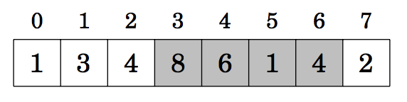
Motivational Example # 2
All these structures are there to efficiently store and process data
We did 2D array → 1D array.
Now do 1D array → auxiliary 1D array.
Problem: find the sum of a subarray quickly:
sum_{q}(3, 6) = 19

Slide 10
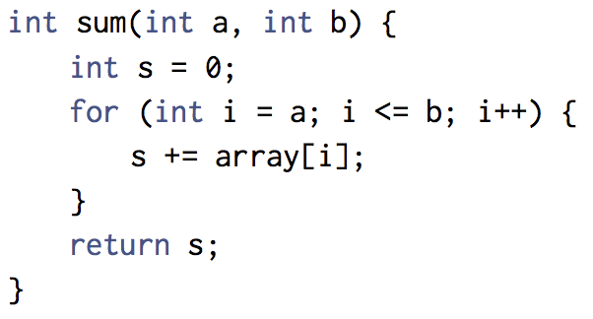
Motivational Example # 2
All these structures are there to efficiently store and process data
We did 2D array → 1D array.
Now do 1D array → auxiliary 1D array.
Problem: find the sum of a subarray quickly:
sum_{q}(3, 6) = 19
Slower way ➔

Slide 11
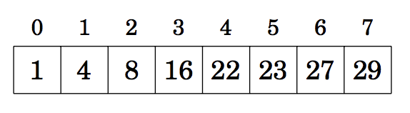
Motivational Example # 2
All these structures are there to efficiently store and process data
We did 2D array → 1D array.
Now do 1D array → auxiliary 1D array.
Problem: find the sum of a subarray quickly:
sum_{q}(3, 6) = 19
Auxiliary Prefix Sum Array:
Cooler/faster way ➔

Slide 12
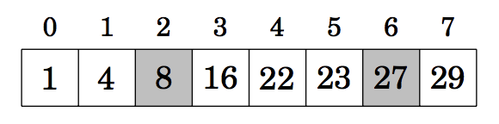
Motivational Example # 2
All these structures are there to efficiently store and process data
We did 2D array → 1D array.
Now do 1D array → auxiliary 1D array.
Problem: find the sum of a subarray quickly:
sum_{q}(3, 6) = 19
Auxiliary Prefix Sum Array:
Cooler/faster way ➔
sum_{q}(0,6) - sum_{q}(0,2) = 27 – 8.

Slide 13
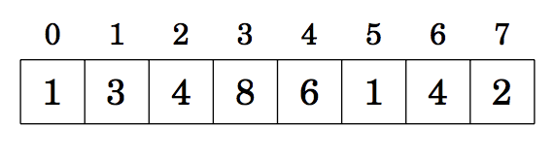
Motivational Example # 2
All these structures are there to efficiently store and process data
We did 2D array → 1D array.
Now do 1D array → auxiliary 1D array.
Problem: find the sum of a subarray quickly.
How to compute Prefix Sum Array P?
Array:
P:

Slide 14
Motivational Example # 2
All these structures are there to efficiently store and process data
We did 2D array → 1D array.
Now do 1D array → auxiliary 1D array.
Problem: find the sum of a subarray quickly.
How to compute Prefix Sum Array P?
  Dead simple application of dynamic programming:
    P[0]=A[0]; for(i=1 to n-1) P[i]=P[i-1]+A[i];

Slide 15
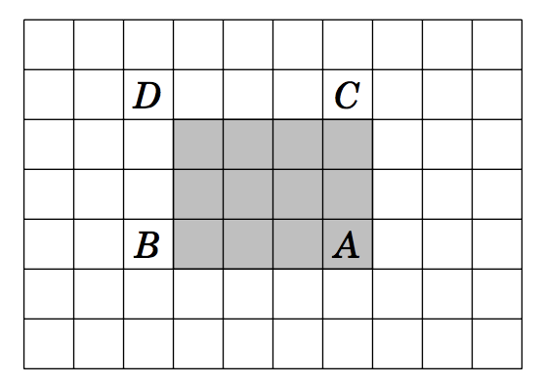
Motivational Example # 2
All these structures are there to efficiently store and process data
We did 2D array → 1D array.
Now do 2D array → auxiliary 1D array.

Slide 16
Motivational Example # 2
All these structures are there to efficiently store and process data
We did 2D array → 1D array.
Now do 2D array → auxiliary 1D array.
Sum of gray subarray: S(A) - S(B) - S(C) + S(D) where S(X) is the sum of values in a rectangular subarray from the upperleft corner to the position of X.

Slide 17
Programming in C++
C++
  Improves on many of C's features
  Has object-oriented capabilities
    Increases software quality and reusability
  – Developed by Bjarne Stroustrup at Bell Labs
    Called "C with classes"
    C++ (increment operator) - enhanced version of C
  Superset of C
    Can use a C++ compiler to compile C programs
    Gradually evolve the C programs to C++

Slide 18
Object Oriented Programming
The emphasis is on creating a set of tools which can be used cleanly, with a minimum knowledge about implementation in the user’s driver files. The following concepts are relevant to accomplishing clean interface:
1. Data Abstraction
  Providing only essential information to the outside world and hiding their background details, i.e., to represent the needed information in program without presenting the details
    TV: you can turn on and off, change the channel, adjust the volume, BUT you do not know its internal details, that is, you do not know how it receives signals over the air or through a cable, how it translates them, and finally displays them on the screen.
    sort: you can sort an array with this C++ call, BUT you do not know the algorithm.
  In C++, we use classes to define our own abstract data types (ADT).

Slide 19
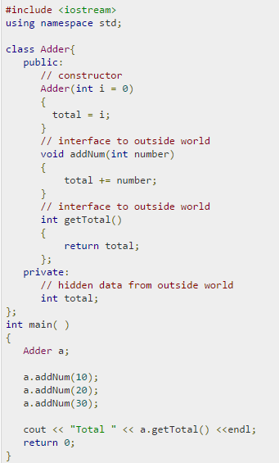
Object Oriented Programming
1. Data Abstraction
  Example:
The public members addNum and getTotal are the interfaces to the outside world and a user needs to know them to use the class. The private member total is something that the user doesn't need to know about, but is needed for the class to operate properly.

Slide 20
Object Oriented Programming
2. Information hiding
  Example:
Restrict access to data so that it can be manipulated only in authorized ways. Separate class declarations from implementation (e.g. public, private in C++).

Slide 21
Object Oriented Programming
3. Encapsulation
  bundling of data with the methods (or other functions) operating on that data (implementation of the methods).

Slide 22
C++ Techniques
Relevant techniques include:
C++ classes, with private and public members
Function and operator name overloading to give "natural" function calls
Templates to allow the same code to be used on a variety of different data types
A clean built-in I/O interface, which itself involves overloading the input and output operators
Learning these techniques is much of what C++ is all about.

Slide 23
A Basic C++ Program
#include <iostream> //input/output
#include <math.h> //usual C lib header file for math
using namespace std;
int main()
{
float x;
cout << "Enter a real number: " << endl;
cin >> x; //scanf("%f", &x); in C
cout << "The square root of " << x << " is: "
<< sqrt(x) << endl; //see comments part
}
Notes:
How do the operators << and >> work?
Each one is a binary operator.
The left-hand operand is the class that handles the relevant stream. The right hand operand is some variable or constant (including string literals). The insertion operator takes a variable or constant value and inserts it into the output stream. The extraction operator (>>) extracts a value from the input stream and initializes a variable with it.
Concatenation
Notice several output operators in one expression. This is made possible because the insertion operator also returns a value. Here is how the output line is actually executed: ( ( ( ( cout << "The square root of " ) << x ) << " is: " ) << sqrt(x) ) << endl; Thus, the innermost expression cout << "The square root of " is executed, inserting the string into the output stream. Then the expression itself evaluates as cout since that is the value returned by <<. The next nested expression now has the form cout << x which is then executed in turn. This chain continues. The final expression is cout << endl which is the last one executed. The same principle would allow an expression like cin >> x >> y Parse this out in the same way! Each of these operators has left-to-right associativity.
Operator overloading
Each expression has the form A << B or A >> B but the types of A B can vary. So in fact, we need a set of overloaded extraction or insertion operators -- one operator for each possible set of operands. In the Complex class of the previous lecture notes, we did our own overloading of these operators so that we could use a clean I/O interface for a user-defined data type.
endl
This is actually a stream manipulator. It inserts a newline character into the stream so the output jumps down a line. But it also has another effect that is often invisible: it flushes the output stream buffer. This action is relevant since Unix systems often wait till the buffer is full before printing output. endl forces the output even though the buffer may not be full. This can be useful when running things under the debugger.

Slide 24
A Basic C++ Program
cout << "Enter a real number: " << endl;
Here, you don't need to understand how cout displays the text on the user's
screen. You need to only know the public interface and the underlying
implementation of cout is free to change. //Data Abstraction
In C++, all I/O is done by classes. A class is set up to handle input and output
streams. Output to the screen is handled by the stream with standard name
cout. This is a variable of class ostream. Similarly for cin.

Slide 25
A Basic C++ Program
// second C++ program
#include <iostream>
using namespace std;
int main(){
int a=23;
int b=34;
cout << "Enter two integers:" << endl;
cin >> a >> b;
cout << endl;
cout << “a + b =“ << a+b << endl;
return 0;
}

Slide 26
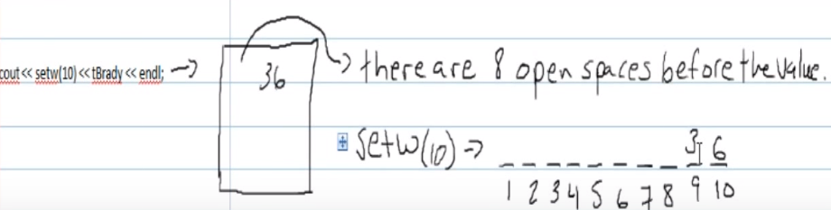
A Basic C++ Program
// third C++ program
#include <iostream>
#include <iomanip>
using namespace std;
int main(){
double a=15.2;
double b=34.3434343;
cout << fixed << showpoint;
cout << setprecision(2); //2 digits after the dot
cout << setw(6) << a << endl;
cout << setw(7) << b << endl;
return 0;
}

Slide 27
A Basic C++ Program
// third C++ program
#include <iostream>
#include <iomanip>
using namespace std;
int main(){
double a=15.2;
double b=34.3434343;
cout << fixed << showpoint;
cout << setprecision(2); //2 digits after the dot
cout << setw(6) << a << endl; //15.20
cout << setw(7) << b << endl; //34.34
return 0;
}

Slide 28
Classes and Objects
Class: a type definition that includes both
  data properties, and
  operations permitted on that data
Object: a variable that
  is declared to be of some Class
  therefore includes both data and operations for that class
Appropriate usage:
  “A variable is an instance of a type.”
  “An object is an instance of a class.”

Slide 29
Basic Class Syntax
A class in C++ consists of its members.
  A member can be either data or functions.
The functions are called member functions (or methods)
Each instance of a class is an object.
  Each object contains the data components specified in class.
  Methods/functions are used to act on an object.

Slide 30
Class syntax - Example
// A class for simulating an integer memory cell
class IntCell
{
public:
IntCell( )
{ storedValue = 0; }
IntCell(int initialValue )
{ storedValue = initialValue;}
int read( )
{ return storedValue; }
void write( int x )
{ storedValue = x;}
private:
int storedValue;
};
constructors

Slide 31
Class Members
Public member is visible to all routines and may be accessed by any method in any class.
Private member is not visible to non-class routines and may be accessed only by methods in its class.
Typically,
  Data members are declared private
  Methods are made public
Restricting access is known as information hiding.

Slide 32
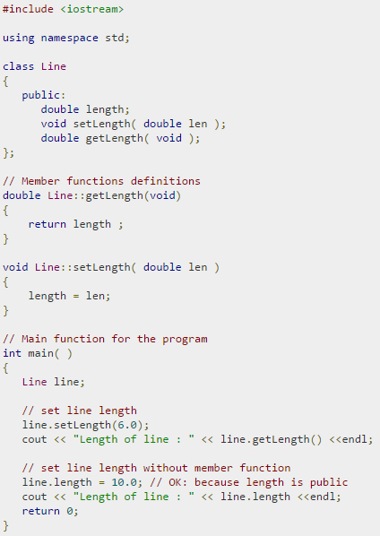
Class Members

Slide 33
Constructors
A constructor is a method that executes when an object of a class is declared and sets the initial state of the new object.
A constructor
  has the same name with the class,
  no return type
  has zero or more parameters (the constructor without an argument is the default constructor)
There may be more than one constructor defined for a class.
If no constructor is explicitly defined, one that initializes the data members using language defaults is automatically generated.

Slide 34
Extra Constructor Syntax
// A class for simulating an integer memory cell
class IntCell
{
public:
IntCell( int initialValue = 0 )
: storedValue( initialValue) { }
int read( ) const
{ return storedValue; }
void write( int x )
{ storedValue = x; }
private:
int storedValue;
};
Single constructor (instead of two)

Slide 35
Object Declaration
In C++, an object is declared just like a primitive type.
#include <iostream>
using namespace std;
#include "IntCell.h"
int main()
{
//correct declarations
IntCell m1;
IntCell m2 ( 12 );
IntCell *m3;
// incorrect declaration
Intcell m4(); // this is a function declaration,
// not an object

Slide 36
Object use in driver program
// program continues
m1.write(44);
m2.write(m2.read() +1);
cout << m1.read() << " " << m2.read() << endl;
m3 = new IntCell;
cout << "m3 = " << m3->read() << endl;
return 0;
}

Slide 37
Example: Class Time
class Time {
public:
Time( int = 0, int = 0, int = 0 ); //default
//constructor
void setTime( int, int, int ); //set hr, min,sec
void printMilitary(); // print am/pm format
void printStandard(); // print standard format
private:
int hour;
int minute;
int second;
};

Slide 38
Declaring Time Objects
// Note that implementation of class Time not given
// here.
int main()‏{
Time t1, // all arguments defaulted
t2(2), // min. and sec. defaulted
t3(21, 34), // second defaulted
t4(12, 25, 42); // all values specified
. . .
}

Slide 39
Class Interface and Implementation
In C++, separating the class interface from its implementation is common.
  The interface remains the same for a long time.
  The implementations can be modified independently.
  The writers of other classes and modules have to know the interfaces of classes only.
The interface lists the class and its members (data and function prototypes) and describes what can be done to an object.
The implementation is the C++ code for the member functions.

Slide 40
Separation of Interface and Implementation
It is a good programming practice for large-scale projects to put the interface and implementation of classes in different files.
    For small amount of coding it may not matter.
Header File: contains the interface of a class. Usually ends with .h (an include file)
Source-code file: contains the implementation of a class. Usually ends with .cpp (.cc or .C)
    .cpp file includes the .h file with the preprocessor command #include.
        Example: #include ”myclass.h”

Slide 41
Separation of Interface and Implementation
A big complicated project will have files that contain other files.
  There is a danger that an include file (.h file) might be read more than once during the compilation process.
    It should be read only once to let the compiler learn the definition of the classes.
To prevent a .h file to be read multiple times, we use preprocessor commands #ifndef and #define in the following way.

Slide 42
Class Interface
#ifndef _IntCell_H_
#define _IntCell_H_
class IntCell
{
public:
IntCell( int initialValue = 0 );
int read( ) const;
void write( int x );
private:
int storedValue;
};
#endif
IntCell class Interface in the file IntCell.h

Slide 43
Class Implementation
#include <iostream>
#include “IntCell.h”
using std::cout;
//Construct the IntCell with initialValue
IntCell::IntCell( int initialValue)
: storedValue( initialValue) {}
//Return the stored value.
int IntCell::read( ) const
{
return storedValue;
}
//Store x.
void IntCell::write( int x )
{
storedValue = x;
}
Scope operator:
ClassName :: member
IntCell class implementation in file IntCell.cpp

Slide 44
A driver program
#include <iostream>
#include “IntCell.h”
using std::cout;
using std::endl;
int main()
{
IntCell m; // or IntCell m(0);
m.write (5);
cout << “Cell content : “ << m.read() << endl;
return 0;
}
A program that uses IntCell in file TestIntCell.cpp

Slide 45
Destructors
Member function of class
Performs termination housekeeping before the system reclaims the object’s memory
Complement of the constructor
Name is tilde (~) followed by the class name
E.g. ~IntCell( );
~ Time( );
Receives no parameters, returns no value
One destructor per class

Slide 46
Destructors
A destructor is a special member function of a class that is executed whenever an object of it's class goes out of scope or whenever the delete expression is applied to a pointer to the object of that class.

Slide 47
Destructor Example
class IntCell{
public:
IntCell(int initialValue=0)‏
{ storedValue = new int (initialValue);}
~IntCell()‏
{ delete storedValue; }
int read( ) const
{ return *storedValue; }
void write( int x ) { *storedValue = x; }
private:
int *storedValue;
}

Slide 48
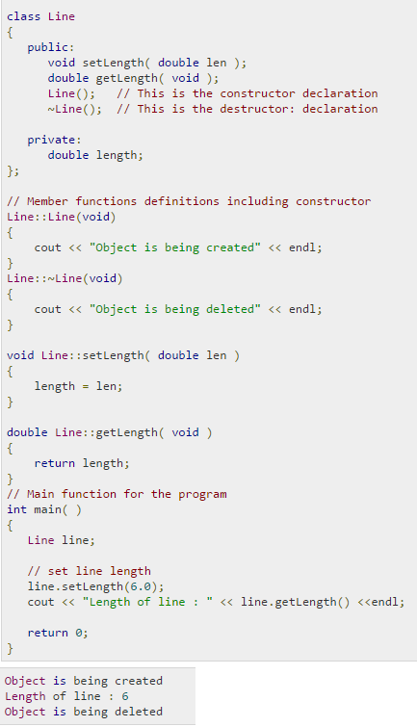
Destructor Example

Slide 49
When are Constructors and Destructors Called
Global scope objects
    Constructors called before any other function (including main)
    Destructors called when main terminates (or exit function called)
Automatic local objects
    Constructors called when objects defined
    Destructors called when objects leave scope (when the block in which they are defined is exited)
static local objects
    Constructors called when execution reaches the point where the objects are defined
    Destructors called when main terminates or the exit function is called

Slide 50
Accessor and Modifier Functions
A method that examines but does not change the state of its object is an accessor.
  Accessor function headings end with the word const
A member function that changes the state of an object is a mutator.

Slide 51
Another Example: Complex Class
#ifndef _Complex_H
#define _Complex_H
using namespace std;
class Complex
{
float re, im; // by default private
public:
Complex(float x = 0, float y = 0)
: re(x), im(y) { }
Complex operator*(Complex rhs) const;
float modulus() const;
void print() const;
};
#endif
Complex class Interface in the file Complex.h

Slide 52
Implementation of Complex Class
#include <iostream>
#include <cmath>
#include "Complex.h"
Complex Complex::operator*(Complex rhs) const
{
Complex prod;
prod.re = (re*rhs.re - im*rhs.im);
prod.im = (re*rhs.im + im*rhs.re);
return prod;
}
float Complex::modulus() const
{
return sqrt(re*re + im*im);
}
void Complex::print() const
{
std::cout << "(" << re <<"," << im << ")" << std::endl;
}
Complex class implementation in file Complex.cpp

Slide 53
Using the class in a Driver File
#include <iostream>
#include "Complex.h"
int main()
{
Complex c1, c2(1), c3(1,2);
float x;
// overloaded * operator!!
c1 = c2 * c3 * c2;
// mistake! The compiler will stop here, since the
// re and im parts are private.
x = sqrt(c1.re*c1.re + c1.im*c1.im);
// OK. Now we use an authorized public function
x = c1.modulus();
c1.print();
return 0;
}
A program that uses Complex in file TestComplex.cpp

Slide 54
Function Overloading
Function overloading:
  Functions with same name and different parameters
  Overloaded functions performs similar tasks
    Function to square ints and function to square floats
    int square( int x) {return x * x;}
    float square(float x) { return x * x; }
  Program chooses function by signature
    Signature determined by function name and parameter types
    Type safe linkage - ensures proper overloaded function called

Slide 55
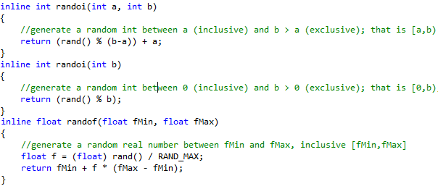
Function Overloading
Function overloading:
  Functions with same name and different parameters
  Overloaded functions performs similar tasks
  Program chooses function by signature
    Signature determined by function name and parameter types

Slide 56
// Using overloaded functions
#include <iostream>
using std::cout;
using std::endl;
int square( int x ) { return x * x; }
double square( double y ) { return y * y; }
int main()
{
cout << "The square of integer 7 is " << square( 7 )
<< "\nThe square of double 7.5 is " << square( 7.5 )
<< endl;
return 0;
}

Slide 57
Overloaded Operators
An operator with more than one meaning is said to be overloaded.
2 + 3 3.1 + 3.2 ➔ + is an overloaded operator
To enable a particular operator to operate correctly on instances of a class, we may define a new meaning for the operator.
➔ we may overload it
Ex: operator* from Complex and Vector classes

Slide 58
Operator Overloading
Format
  – Write function definition as normal
  – Function name is keyword operator followed by the symbol for the operator being overloaded.
  – operator+ would be used to overload the addition operator (+)
No new operators can be created
  – Use only existing operators
Built-in types
  – You cannot change how two integers are added

Slide 59
Overloaded Operators -- Example
What if we want to multiply a complex number with a scalar? Define another function with the same name but different parameters.
class Complex
{
...
Complex operator*(Complex rhs) const;
Complex operator*(float k) const;
...
};

Slide 60
Implementation of Complex Class
Complex Complex::operator*(Complex rhs) const
{
Complex prod;
prod.re = (re*rhs.re - im*rhs.im);
prod.im = (re*rhs.im + im*rhs.re);
return prod;
}
Complex Complex::operator*(float k) const
{
Complex prod;
prod.re = re * k;
prod.im = im * k;
return prod;
}
Complex class implementation in file Complex.cpp

Slide 61
Using the class in a Driver File
#include <iostream>
#include "Complex.h"
int main()
{
Complex c1, c2(1), c3(1,2);
c1 = c2 * c3 * c2;
c1.print();
c1 = c1 * 5; // translated to c1.operator*(5)
c1.print();
// How about this?
c1 = 5 * c1;
return 0;
}
A program that uses Complex in file TestComplex.cpp

Slide 62
Using the class in a Driver File
#include <iostream>
#include "Complex.h"
int main()
{
Complex c1, c2(1), c3(1,2);
c1 = c2 * c3 * c2;
c1.print();
c1 = c1 * 5; // translated to c1.operator*(5)
c1.print();
// How about this?
c1 = 5 * c1; // CANNOT translate to 5.operator*(c1)
return 0;
}
A program that uses Complex in file TestComplex.cpp

Slide 63
Putting the Scalar to the Left
To support multiplying with a scalar on the left, we must define a new function that is outside the class scope.
Complex operator*(float k, Complex c)
{
Complex prod;
prod.re = k * re; // Compile Error: cannot access re
prod.im = k * im; // Compile Error: cannot access im
return prod;
}
Note that this function has access errors: an outside function cannot access the private members of a class! We can solve this in two ways.

Slide 64
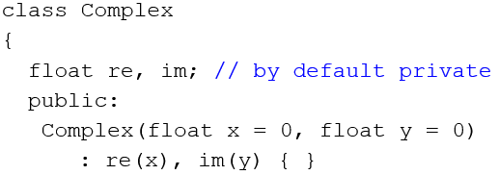
Solution 1: Setter/Getter Functions
Recall the old class:
class Complex
{
...
public:
// add the following functions to the class
void setReal(float x) { re = x; }
void setImag(float x) { im = x; }
float getReal() const { return re; }
float getImag() const { return im; }
...
};

Slide 65
Solution 1: Setter/Getter Functions
Complex operator*(float k, Complex c)
{
Complex prod;
prod.setReal(k * c.getReal());
prod.setImag(k * c.getImag());
return prod;
}

Slide 66
Solution 2: Friend Functions
Declare the outside function as the friend of this class. It can then access the private members of the class.
class Complex
{
...
friend Complex operator*(float k, Complex rhs);
...
};

Slide 67
Solution 2: Friend Functions
Complex operator*(float k, Complex c)
{
Complex prod;
prod.re = k * re; // Now it is ok
prod.im = k * im; // Now it is ok
return prod;
}
Note that the “friend” keyword is not used here. It is only used inside the class (see the previous slide).

Slide 68
Friend Classes
A class may declare another class as a friend as well. In that case all member functions of the “befriended” class can access the private members of its friend class
class A
{
...
};
class B
{
...
friend A;
};
“A” can access private members of “B” (but not vice versa!!!)

Slide 69


Slide 70
Exercise 1
What is the output from the following loops?
a)
  for ( int i=0; i < 5 ; i++) {
  cout << i;
  }
  cout<<endl;
b)
for ( int i = 0; i < 10 ; i += 2) {
cout << i << endl ;
}

Slide 71
Exercise 2
What is the output?
int i = 24 ;
while ( i > 0) {
cout << i << endl ;
i /= 2 ;
}

Slide 72
Pointers
Pointer fun video: https://youtu.be/i49_SNt4yfk
Normal variables contain a specific value (direct reference)
int count = 7;
Pointer variables contain memory addresses as their values
int * countPtr;
countPtr = & count;
count
7
countPtr
count
7

Slide 73
Pointer Variable Declarations and Initialization
A pointer declaration takes the following form:
type *identifier;
e.g.
int *myPtr;
  Declares a pointer to an int (pointer of type int *)
We can declare pointers to any data type.
e.g. float *fptr; char *cptr;
We usually initialize pointers to nullptr
    nullptr – points to nothing
e.g.
myPtr = nullptr;

Slide 74
Pointer Operators
& (address operator) - Returns the address of operand
    int y = 5;
    int *yPtr;
    yPtr = &y; // yPtr gets address of y
  yPtr “points to” y
y
yptr
y
yPtr
5
500000
600000
600000
5
Address of y is value of yptr

Slide 75
Pointer Operators
* (indirection/dereferencing operator)
  Returns an alias of what its operand points to
  *yptr returns y (because yptr points to y)
  * can be used for assignment
      *yptr = 7; // changes y to 7
* and & are inverses
  They cancel each other out

Slide 76
int rate;
int *p_rate;
rate = 500;
p_rate = &rate;
1000
1004
1008
1012
Memory
1008
500
p_rate
rate
/* Print the values */
cout <<"rate = "<< rate << endl; /* direct access */
cout <<"rate = "<< *p_rate << endl; /* indirect access */

Slide 77
Exercise 3
int a, b, *p;
a = b = 7;
p = &a;
// 1st print statement
cout << "*p = " << *p << endl;
*p = 3;
// 2nd print statement
cout << "a = " << a << endl;
p = &b;
*p = 2 * *p - a;
// 3rd print statement
cout << "b = " << b << endl;

Slide 78
Passing parameters to functions by value
void SetToZero (int var)
{
var = 0;
}
You would make the following call:
SetToZero(x);
This function has no effect whatever to change the value of x.
This is referred to as call-by-value.

Slide 79
Passing parameters by reference
void SetToZero (int *ip)
{
*ip = 0;
}
You would make the following call:
SetToZero(&x);
This is referred to as call-by-reference.

Slide 80
/* Swapping arguments (incorrect version) */
#include <iostream>
void swap (int p, int q)
{
int tmp;
tmp = p;
p = q;
q = tmp;
}
int main (void)
{
int a = 3;
int b = 7;
cout << a << b << endl;
swap(a,b);
cout << a << b << endl;
return 0;
}

Slide 81
/* Swapping arguments (correct version) */
#include <iostream>
void swap (int *p, int *q)
{
int tmp;
tmp = *p;
*p = *q;
*q = tmp;
}
int main (void)
{
int a = 3;
int b = 7;
cout << a << b << endl;
swap(&a, &b);
cout << a << b << endl;
return 0;
}
p
q
a
b
3
7

Slide 82
References
References are a type of C++ variable that act as an alias to another variable.
A reference variable acts just like the original variable it is referencing.
References are declared by using an ampersand (&) between the reference type and the variable name.

Slide 83
Example
int n = 5, m = 6;
int &rn = n;
n = 6;
rn = 7,
cout << n << rn << m << endl;
rn = m ;
cout << n << rn << m << endl;
You cannot declare a reference without giving a value.

Slide 84
/* Swapping arguments - with reference variables*/
#include <iostream>
void swap (int &p, int &q)
{
int tmp;
tmp = p;
p = q;
q = tmp;
}
int main (void)
{
int a = 3;
int b = 7;
cout << a << b << endl;
swap(a, b);
cout << a << b << endl;
return 0;
}
p
q
a
b
3
7

Slide 85
Exercise 4
What is the output?
void fun1(int *a, int b){
b = b - 1;
*a = *a + b;
cout << *a << " " << b << endl;
}
int main(){
int a=3, b=3;
fun1(&a,b);
cout << a << " " << b << endl;
}

Slide 86
Exercise 5
What is the output?
void fun2(int &a, int b){
a = a * 2;
b = a + b;
cout << a << “ “ << b << endl;
}
int main(){
int x=3, y=5;
fun2(x,y);
cout << x << “ “ << y << endl;
}

Slide 87
Classes and Objects
Class: a type definition that includes both
  data properties, and
  operations permitted on that data
Object: a variable that
  is declared to be of some Class
  therefore includes both data and operations for that data
Appropriate usage:
  “A variable is an instance of a type.”
  “An object is an instance of a class.”

Slide 88
Basic Class Syntax
A class in C++ consists of its members.
  A member can be either data or functions.
The functions are called member functions (or methods)
Each instance of a class is an object.
  Each object contains the data components specified in class.
  Methods are used to act on an object.

Slide 89
Class syntax - Example
// A class for simulating an integer memory cell
class IntCell
{
public:
IntCell( )
{ storedValue = 0; }
IntCell(int initialValue )
{ storedValue = initialValue;}
int read( )
{ return storedValue; }
void write( int x )
{ storedValue = x;}
private:
int storedValue;
};
constructors

Slide 90
Object declaration and use
In C++, an object is declared just like a primitive type.
#include <iostream>
using namespace std;
#include "IntCell.h"
int main()
{
//correct declarations
IntCell m1;
IntCell m2 (8);
IntCell *m3;

Slide 91
Object use in driver program
// program continues
m1.write(44);
m2.write(m2.read() +1);
cout << m1.read() << " " << m2.read() << endl;
m3 = new IntCell;
cout << "m3 = " << m3->read() << endl;
return 0;
}

Slide 92
Dynamic Memory Allocation
new and delete
  – new - automatically creates object of proper size, calls constructor, returns pointer of the correct type
  – delete - destroys object and frees space
  You can use them in a similar way to malloc and free in C.
Syntax:
  – TypeName *typeNamePtr;
  – typeNamePtr = new TypeName;
    – new creates TypeName object, returns pointer (which typeNamePtr is set equal to)
  – delete typeNamePtr;
    – Calls destructor for TypeName object and frees memory

Slide 93
Examples
// declare a ptr to user-defined data type
IntCell *ptr1;
int *ptr2;
// dynamically allocate space for an IntCell;
// initialize values; return pointer and assign
// to ptr1
ptr1 = new IntCell(5);
// similar for int:
ptr2 = new int(2);
// free up the memory that ptr1 points to
delete ptr1;

Slide 94
// dynamically allocate array of 23
// IntCell slots
// each will be initialized to 0
ptr1 = new IntCell[23];
// similar for int
ptr2 = new int[12];
// free up the dynamically allocated array
delete [] ptr1;

Slide 95
References
References are a type of C++ variable that act as an alias to another variable.
A reference variable acts just like the original variable it is referencing.
References are declared by using an ampersand (&) between the reference type and the variable name.

Slide 96
Example
int n = 5, m = 6;
int &rn = n;
n = 6;
rn = 7,
cout << n << rn << m << endl; //776
rn = m ;
cout << n << rn << m << endl; //666
You cannot declare a reference without giving a value.
Makes n equal to m (doesn't make rn refer to m)

Slide 97
const Reference
A const reference will not let you change the value it references:
Example:
  int n = 5;
  const int & rn = n;
  rn = 6; // error!!
const reference is like a const pointer to a const object.

Slide 98
References vs Pointers
Everything that is accomplished by references can be accomplished by pointers but the syntax of references is simpler:
Example
  int n= 5;
  int &rn = n;
  int *const p = &n;
  *p = 6;
  rn = 6;
  Pointer fun video: https://youtu.be/i49_SNt4yfk
Same effect

Slide 99
Pointers and const
There are two different ways that pointers and const can be intermixed:
  Constant pointer
  Pointer to a constant variable

Slide 100
Constant Pointer
A const pointer must be initialized to a value upon declaration, and its value can not be changed.
However, because the value being pointed to is still non-const, it is possible to change the value being pointed to via dereferencing the pointer:
  int *const p = &i;
  *p = 6; // it is O.K.
  p = &j; // NOT O.K.

Slide 101
Pointer to a const variable
It is also possible to declare a pointer to a constant variable by using the const before the data type:
  int i;
  const int * p = &i;
  *p = 6; // it is NOT O.K., because i is
  //treated as constant when accessed by p.
However, it can be changed independently:
  i = 6; // It is O.K.
It is also possible to declare a const pointer to a constant value:
  const int n = 5;
  const int * const p = &n;

Slide 102
Parameter Passing
In C, all parameters are passed by value (call by value). But C++ offers three options:
Call by value
  Copy of data passed to function
  Changes to copy do not change original
Call by reference
  Uses &
  Avoids a copy and allows changes to the original
Call by constant reference
  Uses const&
  Avoids a copy and guarantees that actual parameter will not be changed

Slide 103
Example
#include <iostream>
using std::cout;
using std::endl;
int squareByValue( int ); // pass by value
void squareByReference( int & ); // pass by reference
int squareByConstReference ( const int & ); // const ref.
int main()
{ int x = 2, z = 4, r1, r2;
r1 = squareByValue(x);
squareByReference( z );
r2 = squareByConstReference(x);
cout << "x = " << x << " z = “ << z << endl;
cout << “r1 = " << r1 << " r2 = " << r2 << endl;
return 0;
}

Slide 104
Example (cont.)
int squareByValue( int a )
{
return a *= a; // caller's argument not modified
}
void squareByReference( int &cRef )
{
cRef *= cRef; // caller's argument modified
}
int squareByConstReference (const int& a )
{
// a *= a; not allowed (compiler error)
return a * a;
}

Slide 105
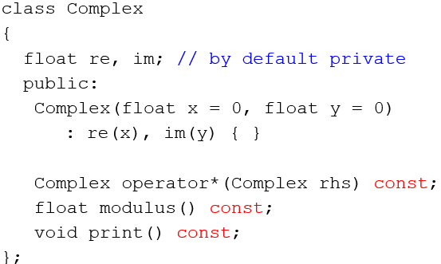
Improving the Complex Class
#ifndef _Complex_H
#define _Complex_H
using namespace std;
class Complex
{
float re, im; // by default private
public:
Complex(float x = 0, float y = 0)
: re(x), im(y) { }
Complex operator*(const Complex& rhs) const;
float modulus() const;
void print() const;
};
#endif
Old class:
Complex class Interface in the file Complex.h

Slide 106
Improving the Complex Class
#include <iostream>
#include <cmath>
#include "Complex.h"
Complex Complex::operator*(const Complex& rhs) const
{
Complex prod;
prod.re = (re*rhs.re - im*rhs.im);
prod.im = (re*rhs.im + im*rhs.re);
return prod;
}
float Complex::modulus() const
{
return sqrt(re*re + im*im);
}
void Complex::print() const
{
std::cout << "(" << re <<"," << im << ")" << std::endl;
}
Complex class implementation in file Complex.cpp

Slide 107
The uses of keyword const
We may encounter const in the following cases:
  Const reference parameter:
  Const member function:
  Const object/variable:
  In this case it means the object cannot be modified.
Complex operator*(const Complex& rhs) const;
In this case it means the parameter cannot be modified.
Complex operator*(const Complex& rhs) const;
In this case it means the function cannot modify class members.
const Complex c1(3, 4);

Slide 108
Memory Management
In C++ we use new and delete instead of malloc and free used in C
  – new - automatically creates object of proper size, calls constructor, returns pointer of the correct type
  – delete - destroys object (calls the destructor) and frees space
Example:
int* pi = new int(6);
Complex *pc = new Complex(3, 5);
delete pi;
delete pc;

Slide 109
// Allocate an array of complex objects (calls the default constructor for each object).
Complex *ptr1 = new Complex [10];
for (int i = 0; i < 10; ++i)
  ptr[i]->print();
delete[] ptr1; // note the delete[] syntax
// similar for int
int* ptr2 = new int[12];
// free up the dynamically allocated array
delete [] ptr2; //use [] iff [] is used in allocation

Slide 110
Default Arguments Revisited
In C++ functions can have default arguments
This is specified in the function declaration (not the definition):
int foo(int x = 1, int y = 2, int z = 3);
foo(); // all parameters use the default value
foo(5); // y and z use the default value
foo(5,8); // z uses the default value
foo(5,8,9); // default values are not used

Slide 111
Default Arguments Revisited
Note that it is impossible to suppy a user-defined value for z without also supplying a value for x and y. That is the following does not work:
For this reason the default parameters must be the rightmost ones:
foo(,,9); // compile error
int foo(int x = 1, int y = 2, int z); // WRONG
int foo(int z, int x = 1, int y = 2); // CORRECT

Slide 112
Function Overloading Revisited
Functions with the same name and different parameters
Overloaded functions should perform similar tasks (otherwise it would be confusing):
Function to square ints and function to square floats
    int square( int x) {return x * x;}
    float square(float x) { return x * x;}
Compiler chooses based on the actual parameter types:
square(4); // calls the integer version
square(4.0f); // calls the float version

Slide 113
Function Overloading Revisited
Functions that only differ by return type cannot be overloaded:
int square(int x);
float square(int x); // Compile error

Slide 114
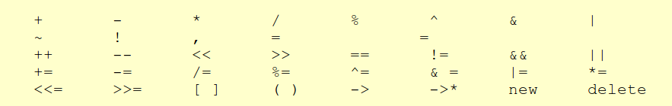
Operator Overloading Revisited
Remember that we overloaded the * operator for the Complex class.
Operator overloading allows us to use existing operators for user-defined classes.
The following operators can be overloaded:
Note that the precedence, associativity, and arity of the operators cannot be changed!

Slide 115
Copy Constructor
The copy constructor for a class is responsible for creating copies of objects of that class type whenever one is needed. This includes:
  when the user explicitly requests a copy of an object,
  when an object is passed to function by value, or
  when a function returns an object by value.

Slide 116
Example
//The following is a copy constructor
//for Complex class. Since it is same
//as the compiler’s default copy
//constructor for this class, it is
//actually redundant.
Complex::Complex(const Complex & C )
{
re = C.re;
im = C.im;
}

Slide 117
Example
class MyString
{
public:
MyString(const char* s = ””);
MyString(const MyString& s);
...
private:
int length;
char* str;
};

Slide 118
Example (cont.)
MyString::MyString(const MyString& s)
{
length = s.length;
str = new char[length + 1];
strcpy(str, s.str);
}

Slide 119
Calling the copy constructor
Examples:
MyObject a; // default constructor call
MyObject b(a); // copy constructor call
MyObject bb = a; // identical to bb(a) : copy
//constructor call
MyObject c; // default constructor call
c = a; // assignment operator call

Slide 120
Assignment by Default:
Memberwise Copy
Assignment operator (=)
  – Sets variables equal, i.e., x = y;
  – Can be used to assign an object to another object of the same type
  – Memberwise copy — member by member copy
myObject1 = myObject2;
  This is shallow copy.

Slide 121
this Pointer
Each class object has a pointer which automatically points to itself. The pointer is identified by the keyword this.
Another way to think of this is that each member function (but not friends) has an implicit first parameter; that parameter is this, the pointer to the object calling that function.

Slide 122
Example: overloading operator=
// defining an overloaded assignment operator
Complex & Complex :: operator=(const Complex & rhs )
{
// don't assign to yourself!
if ( this != &rhs ) // note the "address of" rhs
// why?
{
this -> Re = rhs.Re; // correct but
//redundant: means Re = rhs.Re
this -> Imag = rhs.Imag;
}
return *this; // return the calling class object
// enables cascading
}

Slide 123
Example
MyString& MyString::operator=(const MyString& rhs)
{
if (this != &rhs) {
delete[] this->str; // donate back useless memory
this->length = rhs.length;
// allocate new memory
this->str = new char[this->length + 1];
strcpy(this->str, rhs.str); // copy characters
}
return *this; // return self-reference
}

Slide 124
Copy constructor and assignment operator
Note that the copy constructor is called when a new object is being created
The assignment operator is called when an existing object is assigned to a new object
class MyObject {
public:
MyObject(); // Default constructor
MyObject(const MyObject &a); // Copy constructor
MyObject& operator=(const MyObject& a) // Assignment op.
};
MyObject a; // constructor called
MyObject b = a; // copy constructor called
b = a; // assignment operator called

Slide 125
Destructor
For classes with pointers we also need to define a destructor to avoid memory leaks
class MyString {
public:
MyString(const char* s = ””);
MyString(const MyString& s);
~MyString(); // destructor
MyString& operator=(const MyString& s);
...
private:
int length;
char* str;
};

Slide 126
Destructor
For classes with pointers we also need to define a destructor to avoid memory leaks
MyString::~MyString()
{
  delete[] str;
}

Slide 127
Rule of Three
Whenever you need to define a copy constructor, assignment operator, or the destructor, you must define all three of them
This is known as the rule of three
In general, for every class that contains pointer members you must define all three functions

Slide 128
static Class Members
Shared by all objects of a class
  Normally, each object gets its own copy of each variable
Efficient when a single copy of data is enough
  Only the static variable has to be updated
May seem like global variables, but have class scope
  Only accessible to objects of same class
Exist even if no instances (objects) of the class exist
Can be variables or functions
    public, private, or protected

Slide 129
Example
In the interface file:
private:
static int count;
...
public:
static int getCount();
...

Slide 130
Implementation File
int Complex::count = 0;
int Complex::getCount()
{
return count;
}
Complex::Complex()
{
Re = 0;
Imag = 0;
count ++;
}

Slide 131
Driver Program
cout << Complex :: getCount() << endl;
Complex c1;
cout << c1.getCount();

Slide 132
Templates
The template allows us to write routines that work for arbitrary types without having to know what these types will be.
Two types:
  Function templates
  Class templates

Slide 133
Function Templates
A function template is not an actual function; instead it is a design (or pattern) for a function.
The compiler creates the actual function based on the actual types used in the program.
// swap function template.
template < class T>
void swap( T &lhs, T &rhs )
{
T tmp = lhs;
lhs = rhs;
rhs = tmp;
}
The swap function template

Slide 134
Using a template
Instantiation of a template with a particular type, logically creates a new function.
Only one instantiation is created for each parameter-type combination.
int main()
{ int x = 5, y = 7;
double a = 2, b = 4;
swap(x,y); //instanties an int version of swap
swap(x,y); //uses the same instantiation
swap(a,b); //instantiates a double version of swap
cout << x << “ “ << y << endl;
cout << a << “ “ << b << endl;
// swap(x, b); // Illegal: no match
return 0;
}

Slide 135
Class templates
Class templates are used to define generic classes:
  e.g. it may be possible to use a class that defines several operations on a collection of integers to manipulate a collection of real numbers.
template <class T>
class TemplateTest
{
// this class can use T as a generic type
public:
void f(T a);
T g();
...
private:
T x, y, z;
...
};

Slide 136
Implementation
Each member function must be declared as a template.
All member functions must be implemented in the header file (so that the compiler can find their definition and replace “T” with the actual parameter type)
// Typical member implementation.
template <class T>
void TemplateTest<T>::f(T a)
{
// Member body
}

Slide 137
Object declarations using template classes
Form:
class-name <type> an-object;
Interpretation:
  Type may be any defined data type. Class-name is the name of a template class. The object
  an-object is created when the arguments specified between < > replace their corresponding parameters in the template class.

Slide 138
Example
// Memory cell interface (MemoryCell.h)
template <class T>
class MemoryCell
{
public:
MemoryCell(const T& initVal = T());
const T& read( ) const;
void write(const T& x);
private:
T storedValue;
};

Slide 139
Class template implementation
// Implementation of class members
template <class T>
MemoryCell<T>::MemoryCell(const T& initVal) : storedValue(initVal){ }
template <class T>
const T& MemoryCell<T>::read() const
{
return storedValue;
}
template <class T>
void MemoryCell<T>::write(const T& x)
{
storedValue = x;
}

Slide 140
A simple test routine
int main()
{
MemoryCell<int> m; // instantiate int version
MemoryCell<float> f; // instantiate float ver.
MemoryCell<int> m2; // use the previously created class
m.write(5);
m2.write(6);
f.write(3.5);
cout << “Cell content: ” << m.read() << endl;
cout << “Cell content: ” << m2.read() << endl;
cout << “Cell content: ” << f.read() << endl;
return 0;
}

Slide 141
Friend functions - revisited
A friend function of a class is a nonmember function of the class, but has access to all members of the class.
Reserved word friend appears only in the function prototype(not in definition of the friend function)

Slide 142
Example 1: Complex Class
#include <iostream>
#ifndef _Complex_H
#define _Complex_H
using namespace std;
class Complex
{ private: // default
float Re, Imag;
public:
Complex( float x = 0, float y = 0 )
{ Re = x; Imag = y;}
~Complex() { }
float modulus();
void print() const;
friend void dummy(Complex One); //only main’s dummy has //access
};
#endif
Complex class Interface in the file Complex.h

Slide 143
Example: Friend functions of a Class (cont’d)
void dummy(Complex One)‏{
One.Re = 3;
One.Imag = 5;
cout << One.Re << One.Imag << endl;
}
...
int main()‏{
Complex MyComplexNo(1,1);
dummy(MyComplexNo);
return 0;
}

Slide 144
Example 2: Complex Class
#include <iostream>
#ifndef _Complex_H
#define _Complex_H
using namespace std;
class Complex
{ private:
float Re, Imag;
public:
Complex( float x = 0, float y = 0 )
{ Re = x; Imag = y;}
~Complex() { }
Complex operator* ( Complex & rhs ) const;
float getReal() const;
float getImag() const;
float modulus() const;
friend ostream & operator<< (ostream &os, Complex & rhs);
};
#endif
Complex class Interface in the file Complex.h

Slide 145
Using the class in a Driver File
#include <iostream>
#include "Complex.h"
using namespace std;
int main()
{
Complex c1, c2(1), c3(1,2);
float x;
c1 = c2 * c3 * c2;
x = c1.modulus();
cout << c1 << " " << c2 << endl;
return 0;
}
A program that uses Complex in file TestComplex.cpp

Slide 146
Implementation of Complex Class
// File complex.cpp
#include <iostream>
#include “Complex.h"
Complex Complex:: operator*( Complex & rhs )
{
Complex prod; //some place to store the results...
prod.Re = (Re*rhs.Re - Imag*rhs.Imag);
prod.Imag = (Imag*rhs.Re + Re*rhs.Imag);
return prod;
}
float Complex:: modulus() const
{ // this is not the real def of complex modulus
return Re / Imag;
}
ostream & operator<< (ostream & out, Complex & rhs)
{ out << "(" << rhs.Re <<"," << rhs.Imag << ")";
return out; // allow for concat of << operators
}
float Complex::getReal() const { return Re; }
float Complex::getImag() const { return Imag; }
Complex class implementation in file Complex.cpp

Slide 147
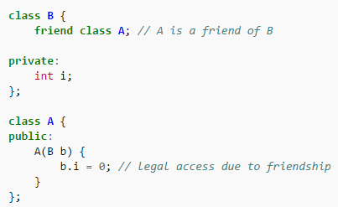
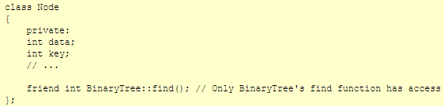
Recap of friend-ship

Slide 148
C++ Error Handling
In C, errors are reported by returning error codes from functions:
int read(const char* filename, char data[])
{
FILE* fp = fopen(filename, “r”);
if (fp == NULL)
return -1; // indicate error
// read file contents into data
...
}

Slide 149
C++ Error Handling
In C++, we have a more advanced mechanism called exceptions
It uses three keywords: throw, catch, try
The function that encounters an error throws an exception:
int read(const char* filename, char data[])
{
FILE* fp = fopen(filename, “r”);
if (fp == NULL)
throw “file open error”; // indicate error
// read file contents into data
...
}

Slide 150
C++ Error Handling
This exception must be caught, otherwise the program will abnormally terminate:
int main()
{
char data[128];
try {
read(“test.txt”, data);
... // some other code
}
catch(const char* error) {
// if read throws an exception,
// program will continue executing from here
cout << “Error message:” << error << endl;
}
}

Slide 151
C++ Error Handling
Note that we throw an object or a variable, and we catch an object or a variable. These types should match for the exception to be caught
In the previous example we threw a const char* and caught a const char*, so it was correct

Slide 152
Another Example
We can also throw an object of a user defined class:
class FileReadError
{
};
int read(const char* filename, char data[])
{
FILE* fp = fopen(filename, “r”);
if (fp == NULL)
throw FileReadError(); // indicate error
// read file contents into data
...
}

Slide 153
C++ Error Handling
Then we must update the catch code as well:
int main()
{
char data[128];
try {
read(“test.txt”, data);
}
catch(FileReadError error) {
// if read throws an exception,
// we will come here
}
}

Slide 154
C++ Error Handling
There are many details of exception handling
In this class, you should only know that the destructors of the local objects will be called when an exception is thrown:
class A {
public:
~A() { cout << “destructor called” << endl; }
};
int read(const char* filename, char data[]) {
A a;
FILE* fp = fopen(filename, “r”);
if (fp == NULL)
throw “file open error”; // a's destructor will be called
}

Slide 155
Example of a try-catch Statement
try
{
// Statements that process personnel data and may throw
// exceptions of type int, string, and SalaryError
}
catch ( int )
{
// Statements to handle an int exception
}
catch ( string s )
{
cout << s << endl; // Prints "Invalid customer age"
// More statements to handle an age error
}
catch ( SalaryError )
{
// Statements to handle a salary error
}

Slide 156
Standard Template Library
I/O Facilities: iostream
Garbage-collected String class
Containers
  vector, list, queue, stack, map, set
Numerical
  complex
General algorithms
  search, sort

Slide 157
Using the vector
  Vector: Dynamically growing, shrinking array of elements
To use it include library header file:
  #include <vector>
Vectors are declared as
  vector<int> a(4); //a vector called a,
  //containing four integers
  vector<int> b(4, 3); //a vector of four
  // elements, each initialized to 3.
  vector<int> c; // 0 int objects
The elements of an integer vector behave just like ordinary integer variables
a[2] = 45;

Slide 158
Manipulating vectors
The size() member function returns the number of elements in the vector.
  a.size() returns a value of 4.
The = operator can be used to assign one vector to another.
e.g. v1 = v2, so long as they are vectors of the same type.
The push_back() member function allows you to add elements to the end of a vector.

Slide 159
push_back() and pop_back()
vector<int> v;
v.push_back(3);
v.push_back(2);
// v[0] is 3, v[1] is 2, v.size() is 2
v.pop_back();
int t = v[v.size()-1]; //t=3
v.pop_back();

