Slide 1
Reinforcement Learning Term Project Phase 2
Ahmet YÜKSEL
Spring 2024

Slide 2
Outline
Phase I Review
Environment Definition Process
Benchmark of Algorithms
Limitations
Future Works

Slide 3
Phase I | Problem Definition
In this term project, reinforcement learning algorithms will be implemented to develop a dynamic pricing system for e-commerce products for a company which wants to maximise its long-term revenue. The price of a product can be affected by market conditions, competitors' price of the product, cost of the product, and regulations.

Slide 4
Phase I | Problem Definition | Why to use Reinforcement Learning(RL)
Sequential Decision-Making: Pricing under volatile economies requires updating price of product in repeated manner. focuses on learning an optimal strategy through sequential decision-making.
Dealing with Uncertainty: RL is well-suited for environments with uncertainty and incomplete information, which is a common scenario in dynamic pricing. Market conditions, consumer behavior can be highly unpredictable. RL algorithms can learn and adapt to these changing conditions in real-time.
Automation and Adaptivity: RL can automate the decision-making process for pricing, continuously learning and adapting without human intervention. This is particularly beneficial in dynamic environments where conditions change rapidly, and manual adjustment is impractical.
Exploration vs. Exploitation: RL naturally balances exploration (trying new pricing strategies to gather more information) with exploitation (using strategies known to perform well).

Slide 5
Phase I | Problem Definition | In Terms of RL
Environment: The marketplace in which the product is sold.
State Space: Demand level of the product, it can be discretized for simplicity (ex: Low, Medium, High)
Action: Incerasing, decreasing or not changing price of the product
Reward: Revenue = Price x demand
Objective: Maximise long-term profits

Slide 6
Phase I | Papers Planning to Read
Dynamic Online Pricing with Incomplete Information Using Multiarmed Bandit Experiments, 2019, by Misra ,et al
Online pricing of demand response based on long short-term memory and reinforcement learning, 2020, by Kong, et al
Dynamic pricing under competition using reinforcement learning, 2021, by Kastius et al
Enhancing Sparse Data Performance in E-commerce Dynamic Pricing with Reinforcement Learning and Pre-Trained Learning, 2023, by Yuchen Liu, et al
Convex Combination Based Reinforcement Learning Algorithm for Dynamic Pricing Demand Response, 2023, by Ma Haining et al
Multi-agent Deep Reinforcement Learning for Dynamic Pricing by Fast-charging Electric Vehicle Hubs in competition,2024, by Paudel et al

Slide 7
Adapted Gym Environment for Pricing
Demand_{t} of Product in Market
Market Demand Generator Class
State_{t}
Agent
Class
Pricing Environment
Class
Lower &
Upper
Bound
Reward_{t}
Product Information
Class
Action_{t}

Slide 8
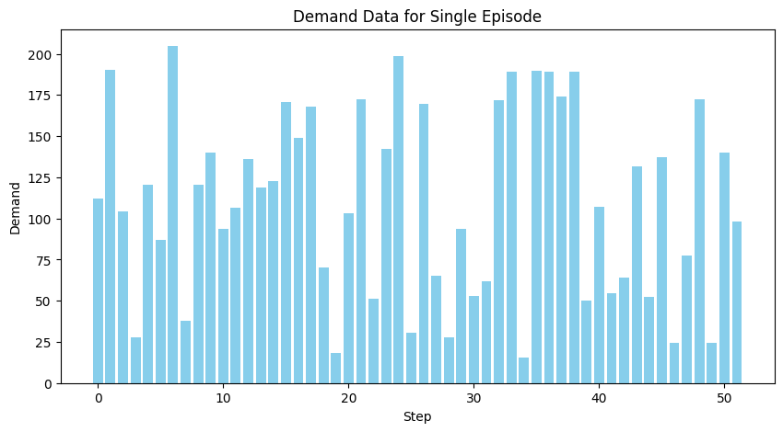
Market Demand Generator Class
Parameters:
# Steps : 52 weeks
Lower Bound : 10
Upper Bound: 200
Seasonality True

Slide 9
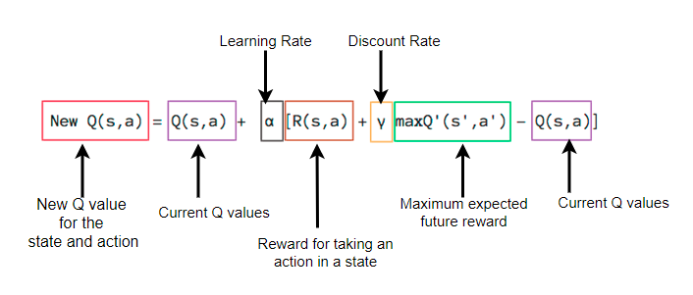
Pricing Agents | Q-Learning
State Space : Classificaiton of Captured Demand -> {Very Low, Low, Medium, High, Very High}
Action Space : New Price Offers -> {Big Sales, Regular Sale, Do Nothing, Slightly Increase, Increase}
Reward : Total Revenue = Captured Demand * Current Price
Q Table: An estimate of the total reward an agent can expect to receive for each state and action pairs (zero initialization)
Learning Process:

Slide 10
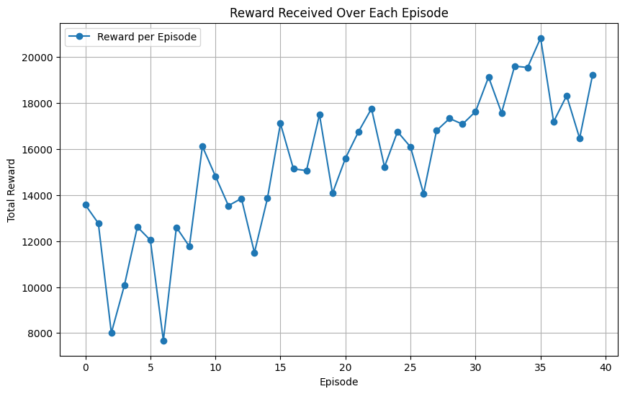
Pricing Agents | Q-Learning
Parameters:
# of States : 5
# of Actions : 5
# Of Episodes : 40
Max # of Steps : 5 * 52 Weeks
Learning Rate : 0.1
Discount Rate : 0.95
Exploration Rate : 1
Exploration Decay : 0.99
Min Exploration Rate : 0.01

Slide 11
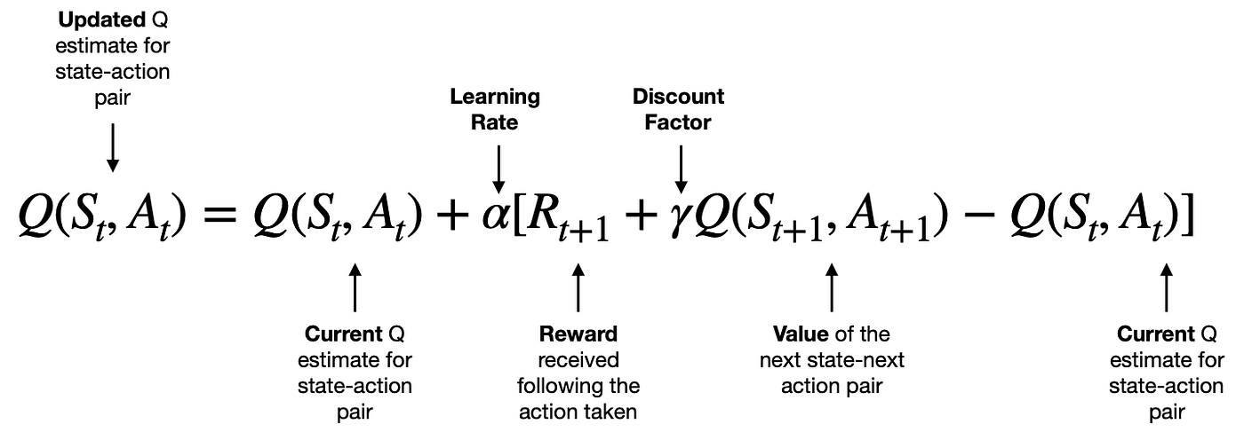
Pricing Agents | SARSA
State Space : Classificaiton of Captured Demand -> {Very Low, Low, Medium, High, Very High}
Action Space : New Price Offers -> {Big Sales, Regular Sale, Do Nothing, Slightly Increase, Increase}
Reward : Total Revenue = Captured Demand * Current Price
Q Table: An estimate of the total reward an agent can expect to receive for each state and action pairs (zero initialization)
Learning Process:

Slide 12
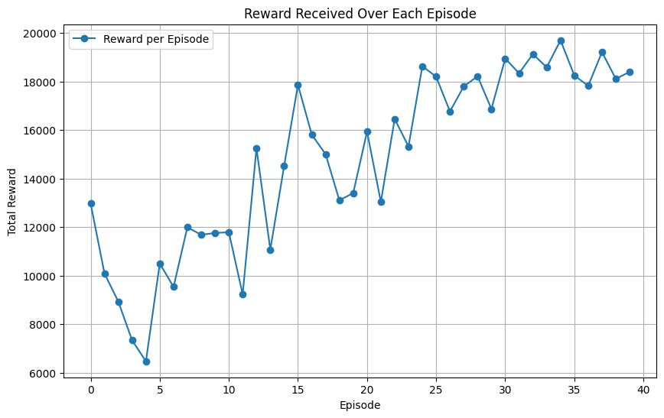
Pricing Agents | SARSA
Parameters:
# of States : 5
# of Actions : 5
# Of Episodes : 40
Max # of Steps : 5 * 52 Weeks
Learning Rate : 0.1
Discount Rate : 0.95
Exploration Rate : 1
Exploration Decay : 0.99
Min Exploration Rate : 0.01

Slide 13
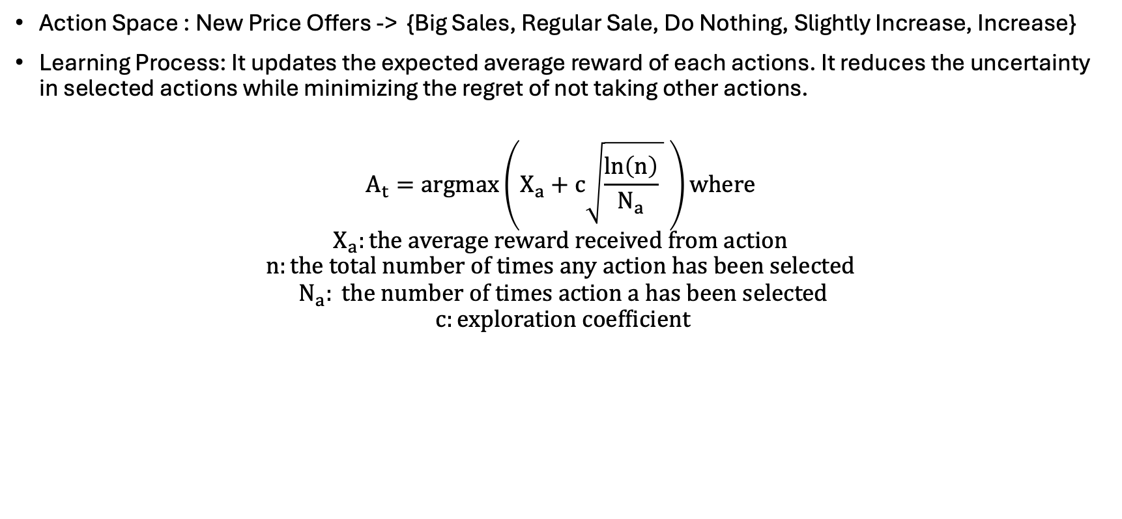
Pricing Agents | Upper Confidence Bound (UCB)
Action Space : New Price Offers -> {Big Sales, Regular Sale, Do Nothing, Slightly Increase, Increase}
Learning Process: It updates the expected average reward of each actions. It reduces the uncertainty in selected actions while minimizing the regret of not taking other actions.
$$A_{t}=argmax\left(X_{a}+c\sqrt{\frac{\ln\left(n\right)}{N_{a}} } \right)where$$
$$X_{a}:the average reward received from action$$
$$n:the total number of times any action has been selected$$
$$N_{a}: the number of times action a has been selected$$
$$c:exploration coefficient$$

Slide 14
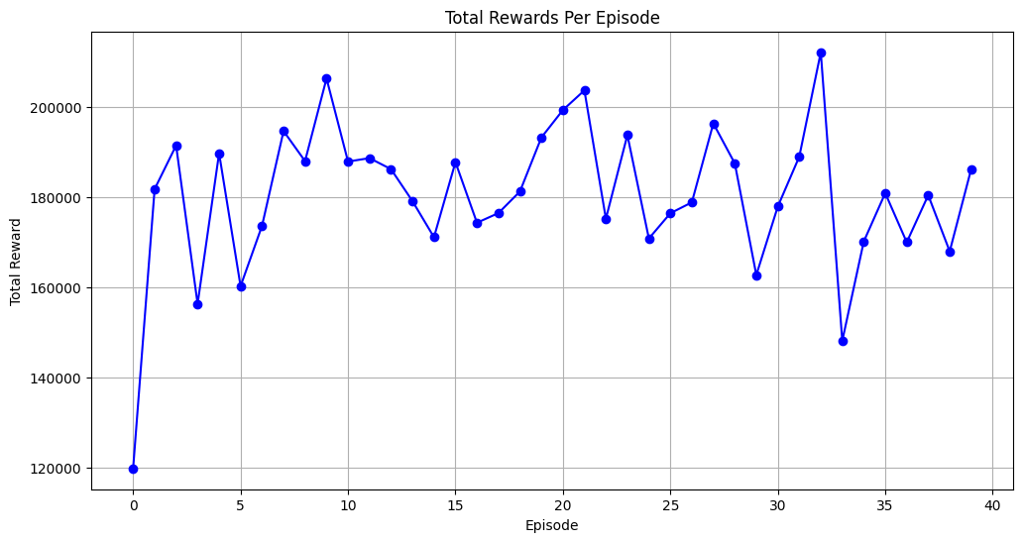
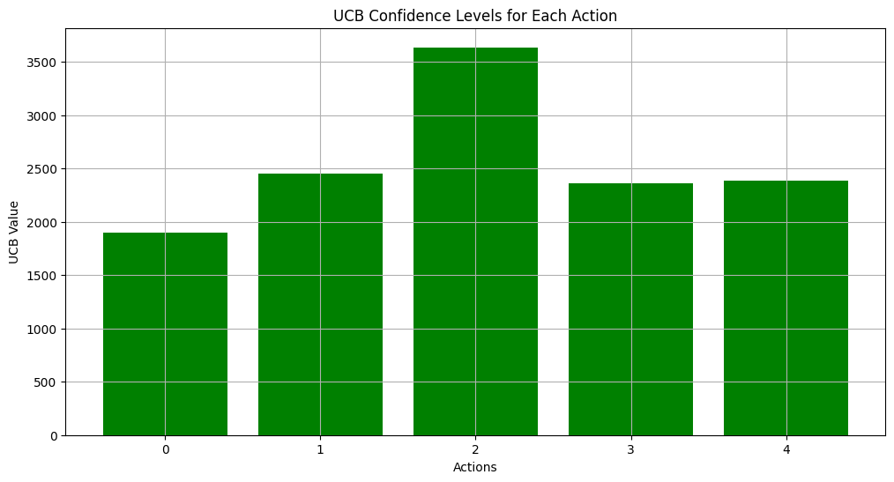
Pricing Agents | Upper Confidence Bound
Parameters:
# of Actions : 5
Exploration coefficient : 2

Slide 15
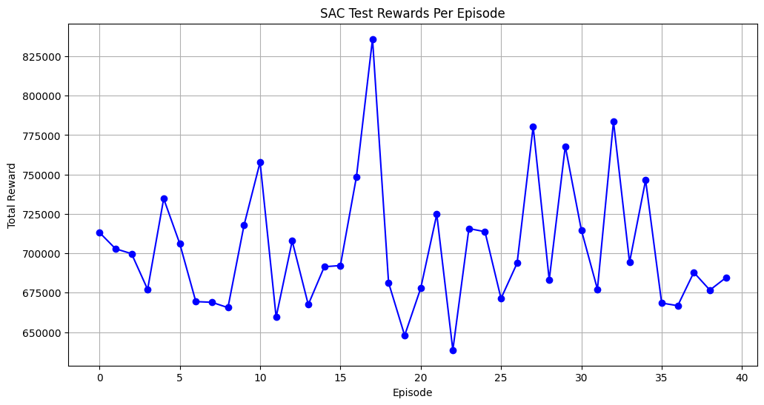
Pricing Agents | Soft Actor Critic
Learning Process: Uses stochastic policy gradients with entropy regularization to encourage exploration, while dual critics provide a stable and less biased estimate of future rewards.
The actor not only aims to maximize the expected reward but also to increase the entropy of the action distribution, which encourages exploration.
Uses two critics to mitigate positive bias in the policy improvement step seen in traditional actor-critic methods by taking the minimum Q-value predicted by the two critics.
Employs a soft update mechanism for the critics, gradually updating target values to stabilize training.
To Be Improved

Slide 16
Comparison Between Algorithms
Algorithms | Exploration Strategy | Update Rule | Bias-Variance Trade-Off | Computation Complexity
Q-Learning | e-Greedy | Max future reward | Potentially high bias | Moderate
SARSA | e-Greedy | Next action | Lower variance | Moderate
UCB | Confidence Int | Greedy with confidence | Low variance | Lower
Soft-Actor Critic | Entropy max | Stochastic with entropy | Balanced | High

Slide 17
Comparison Between Algorithms
Q-Learning: The trend shows a general increase in total rewards per episode, which indicates learning and improvement over time. However, there are noticeable dips, suggesting episodes where exploration or stochasticity led to lower rewards.
SARSA: The results are similar to Q-Learning. But shows less volatility through end of episodes. The reward trend is increasing but with some volatility, possibly due to the trade-off between exploring and exploiting.
UCB: The graph for the Upper Confidence Bound algorithm shows considerable variability in rewards from episode to episode, indicating an ongoing exploration and exploitation process without a clear sign of convergence within the given episodes.

Slide 18
Limitations
Contionous Large Set of Action Spaces (From Phase 1)
Price and demand levels are continous variables and fundamental RL algorithms use discrete set of actions
Difficulty of Encoding Discrete State Spaces
In fluctuating market demand environment decision of boundaries for state space is hard and requires to be updated regularly.
Non-stationary environment (From Phase 1)
The underlying distribution of states and the reactions to actions can change over time. For example, fx ratio and so customer preferences can evolve, making the learned policy outdated.
Training Neural Nets without Dedicated Machines
Soft Actor Critic model requires longer training time

Slide 19
Future Works & Completion
Creating the RL environment
Applying several RL algorithms:
Q-Learning,
SARSA,
Upper Confidence Bound and
Soft Actor Critic
Applying Thompson sampling algorithm
Improving Soft-Actor Critic algorithm
Improving state space (including market conditions) and action space (implementation of continuous action space) definitions
Reducing learning time by applying transfer learning

Slide 20
Appendix
https://github.com/AhmetY21/MMI_706_Reinforcement_Learning_Term_Project

Slide 21
Thank You For Your Attention

