Slide 1
ONLINE MULTI-AGENT POLICY IMPROVEMENT FOR PATH PLANNING PROBLEMS IN ROBOTICS
Ahmet yıldız
514231055

Slide 2
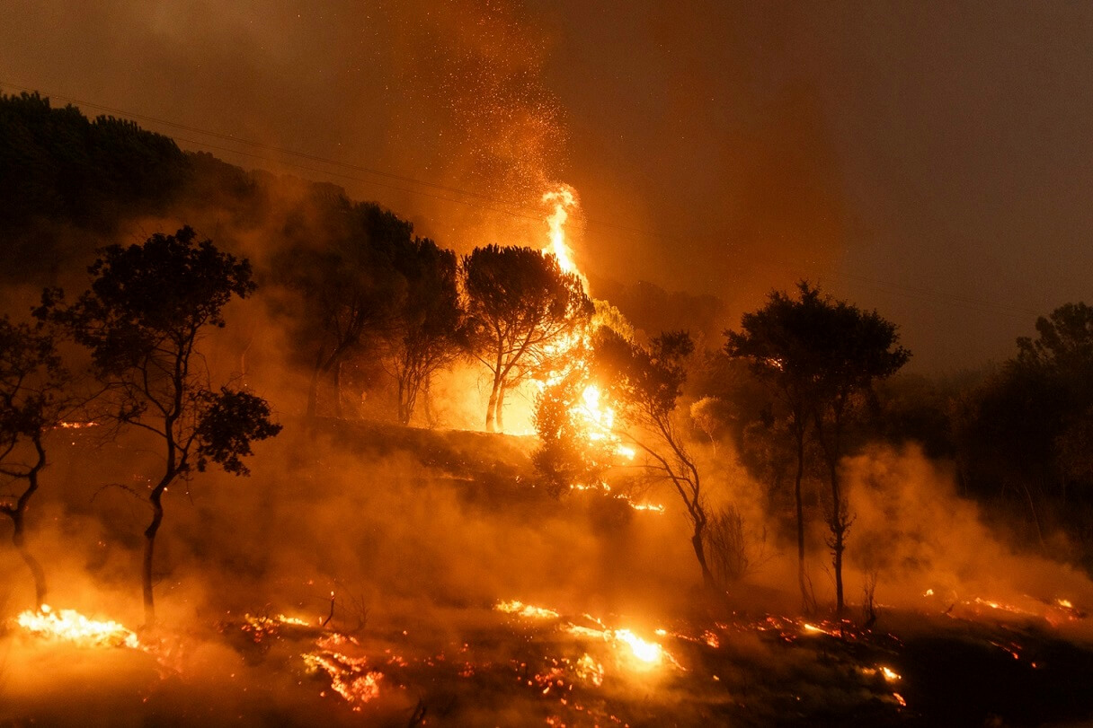
Introduction
Problem Definition:
We are experiencing major problems in combating forest fires. Forest areas at risk of fire need to be constantly monitored, especially during certain seasons. Monitoring via satellites may not be enough. If there are drones constantly monitoring the area, we will have the chance for rapid detection and intervention.

Slide 3
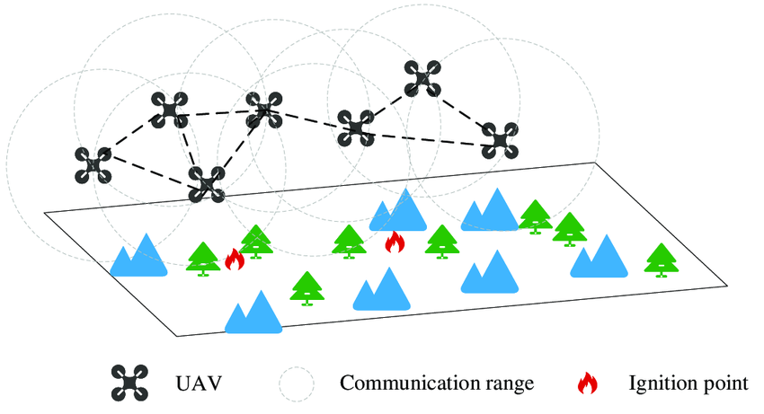
Introduction
Aim of Project:
  Developing fire detection and response strategies using multiple drone systems in a Python-based simulation environment
  Testing how multi-drone systems can contribute to solving the forest fire problem
  Activating communication between drones and ensuring they respond quickly together

Slide 4
Multi Drone Systems
Properties of Drones and Simulation Environment:
Drones can communicate with each other
They have limited battery and fire extinguisher
They need to return to base if it is low on battery or fire extinguishers they carry run out
Simulation environment is a 10x10 discrete World
Drones move in eight directions, one grid at one time step
Drones can sense fire in 2 grid space radius area
Simulation environment has been built in Python
Fire can be spread, and fire will extinguish at a point after a while
There are randomly placed 4 drones and 5 hotspots at the initial

Slide 5
MLAT-R Algorithm
Multi Level Action Tree Rollout (MLAT-R) Algorithm:
This algorithm chooses the best action for each drone based on their action tree
Action tree demonstrates the sequences of actions from an inital state for each agent
Agent decides its path in this tree based on either a cost function or a set of conditions

Slide 6
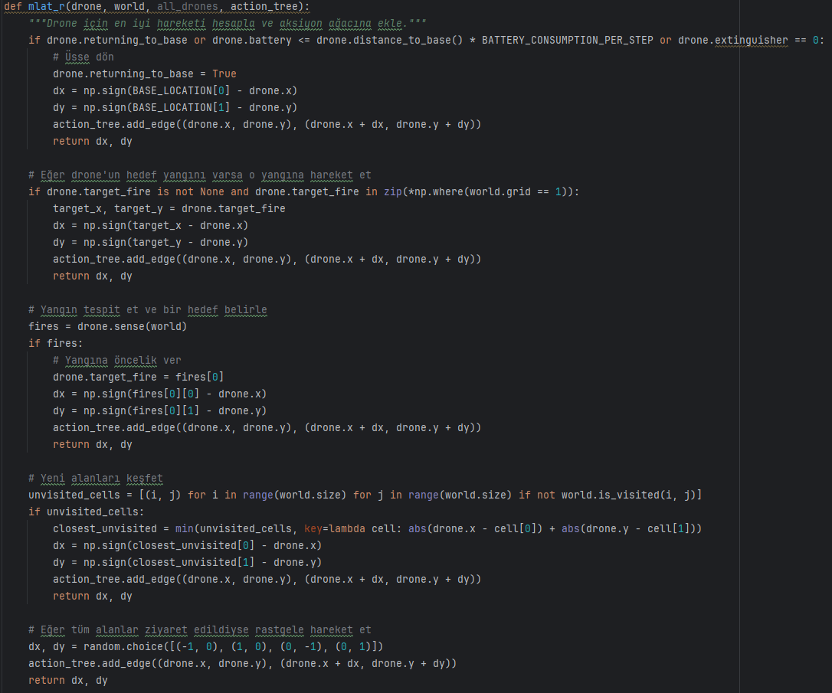
MLAT-R Algorithm
There are 5 possible way to choose next action:
Returning to base
Move to fire location if detected by swarm
Sense the environment (passive action) and move to fire location
Explore the unvisited areas
Choose a random action if environment is completely explored

Slide 7
Study Process and Challenges
Challenges:
Implementing the simulation on the ROS platform is very costly in terms of time
Being a beginner at Ubuntu and ROS
Applying MLAT-R in a desired manner
Establishing a simulation environment for multi drone systems
Solutions:
Being able to use and debug various functions together in harmony in Python
Basic visualization tools like matplotlib
Python is adequate to simulate this level of project

Slide 8
Results
Sim ID | Simulation Termination Time Step | Extinguished Cells | Burnt Cells | Success Rate
1 | 8 | 9 | 0 | 100%
2 | 14 | 22 | 6 | 78.5%
3 | 38 | 45 | 12 | 78.9%
4 | 6 | 12 | 0 | 100%
5 | 13 | 14 | 2 | 87.5%
6 | 6 | 14 | 0 | 100%
7 | 12 | 12 | 1 | 92.3%
8 | 19 | 23 | 11 | 67.6%
9 | 11 | 13 | 1 | 92.8%
10 | 14 | 25 | 0 | 100%

Slide 9
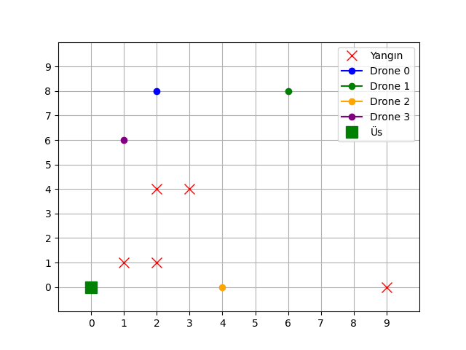
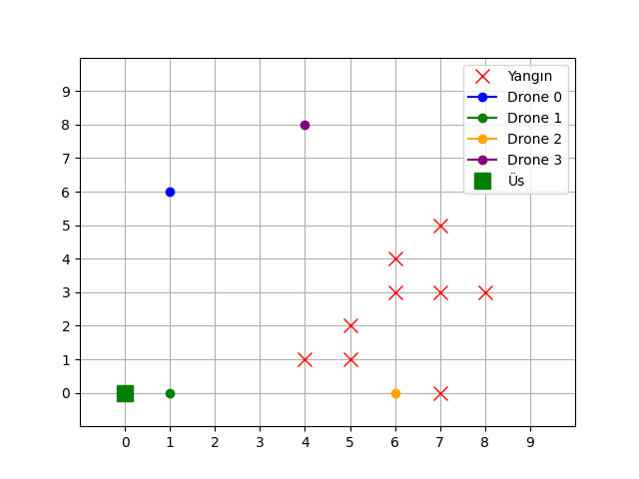
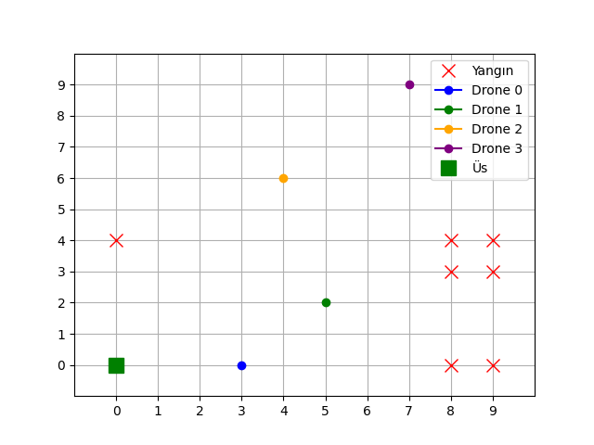
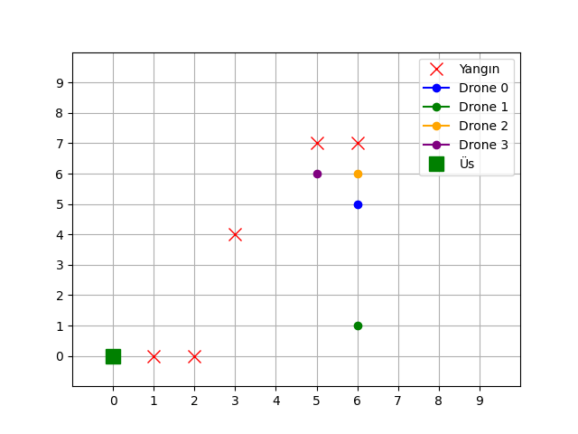
Results

Slide 10
Future Work
Applying the project in a high quality 3D simulation environment
Adding the real dynamics and kinematics of robots and sensors
Experimenting in real-World
Exploring or creating benchmarks to evaluate the algorithm properly
Assigning the input variables of the algorithm based on a realistic data

Slide 11

THANKS FOR LISTENING

