Slide 1

HOMEWISE
Smart Home System mobile app for Predictive Maintenance

Slide 2
Abstract
The aim of this project is to develop a mobile application that collects data from sensors in home appliances and transfers this data to users. Thus, users will be able to monitor and detect potential problems in their smart home devices through the mobile application. The name of the application is “HomeWise”.

Slide 3
Planning and Requirements
Scope:
-laundry machine
-dishwasher
-fridge
-climate
-Robot Vacuum Cleaners

Slide 4
Planning and Requirements
Functional requirement:
-Microcontrollers in the device analyze error codes
-Sensors automatically calculate the maintenance period
-The data from the sensors is transferred to the cloud via Wi-Fi
Non-functional requirements:
-The system must work stably in any environment.
-Data must be well secured.
-Easy to develop.

Slide 5
desIgn
System Layers:
Smart home device layer: collects and analyzes data from devices and identifies error codes.
Cloud-based server layer: stores, analyzes and processes the transmitted data and forwards it to the mobile app.
Mobile Application layer: is the mobile application user interface, providing the user with information about fault information, error codes, device history, performance status and maintenance schedule.

Slide 6
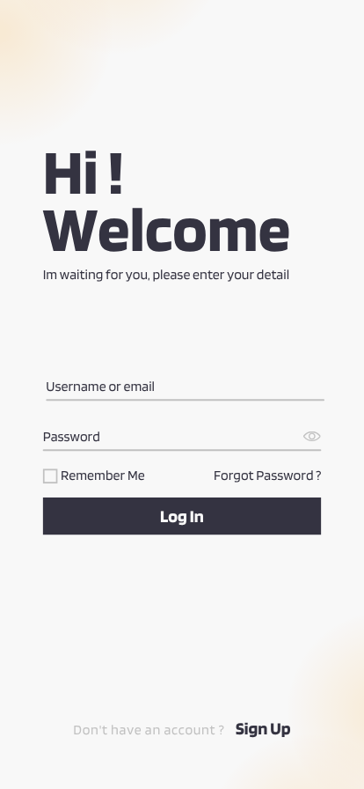
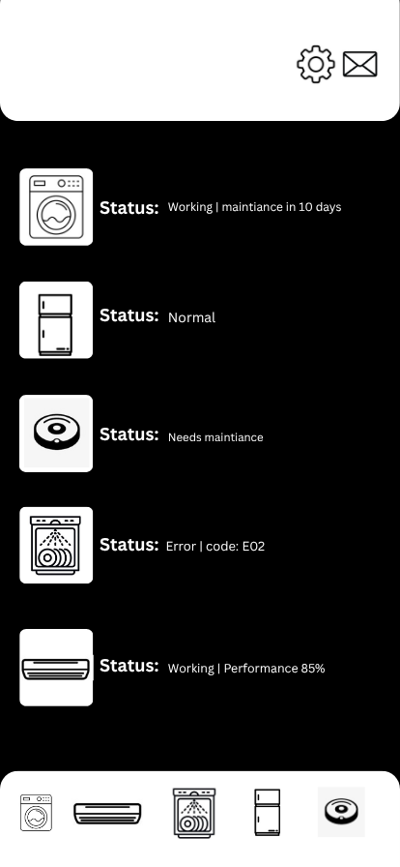
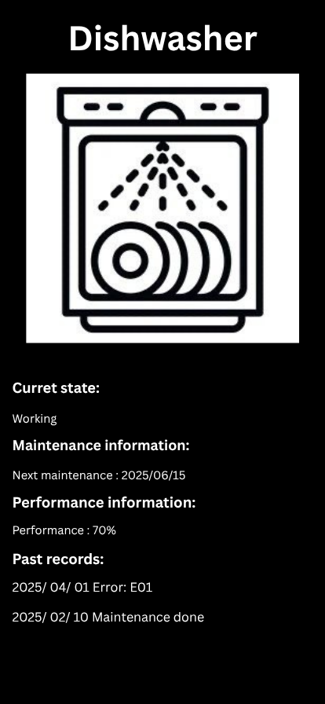
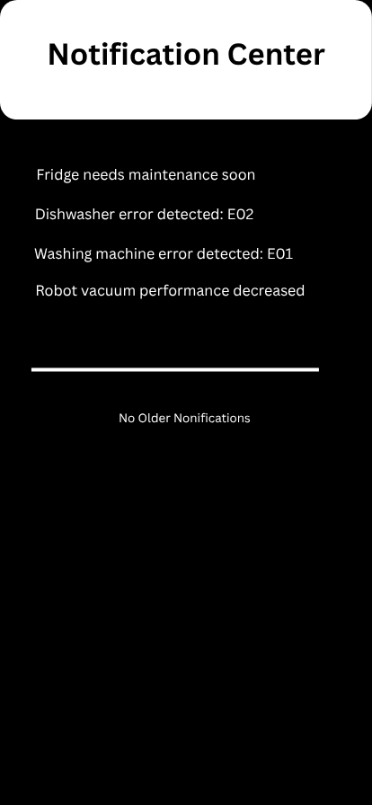
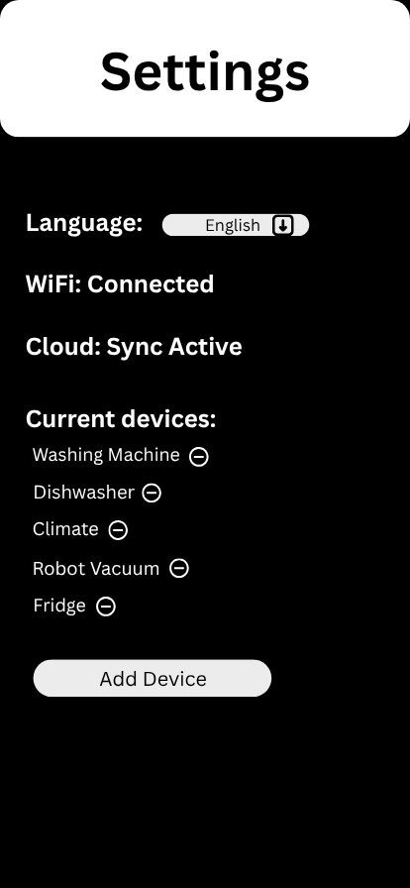
UI DESIGNS

Slide 7
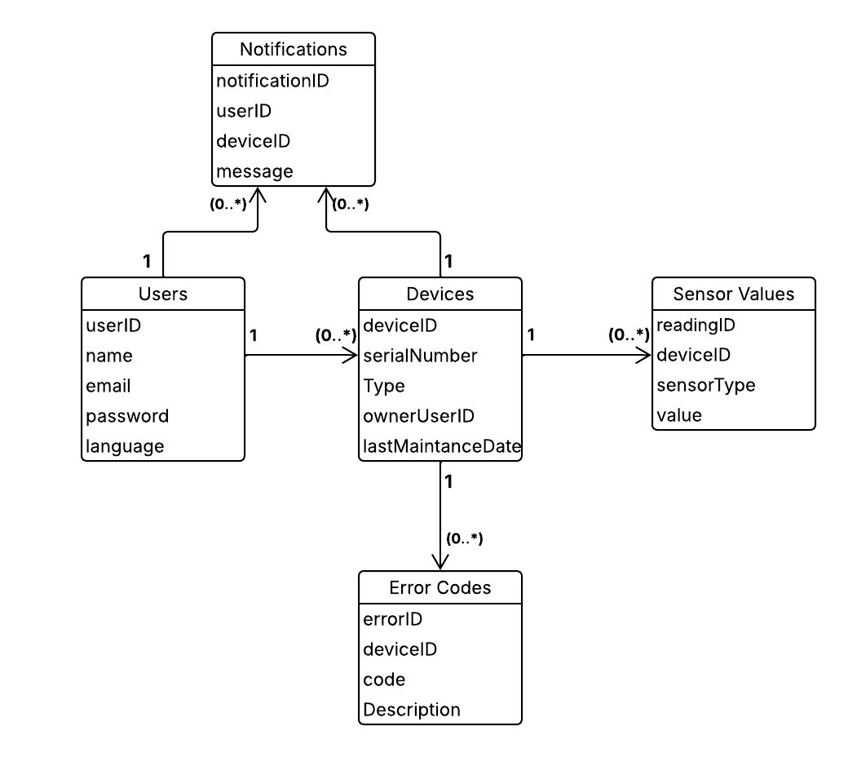
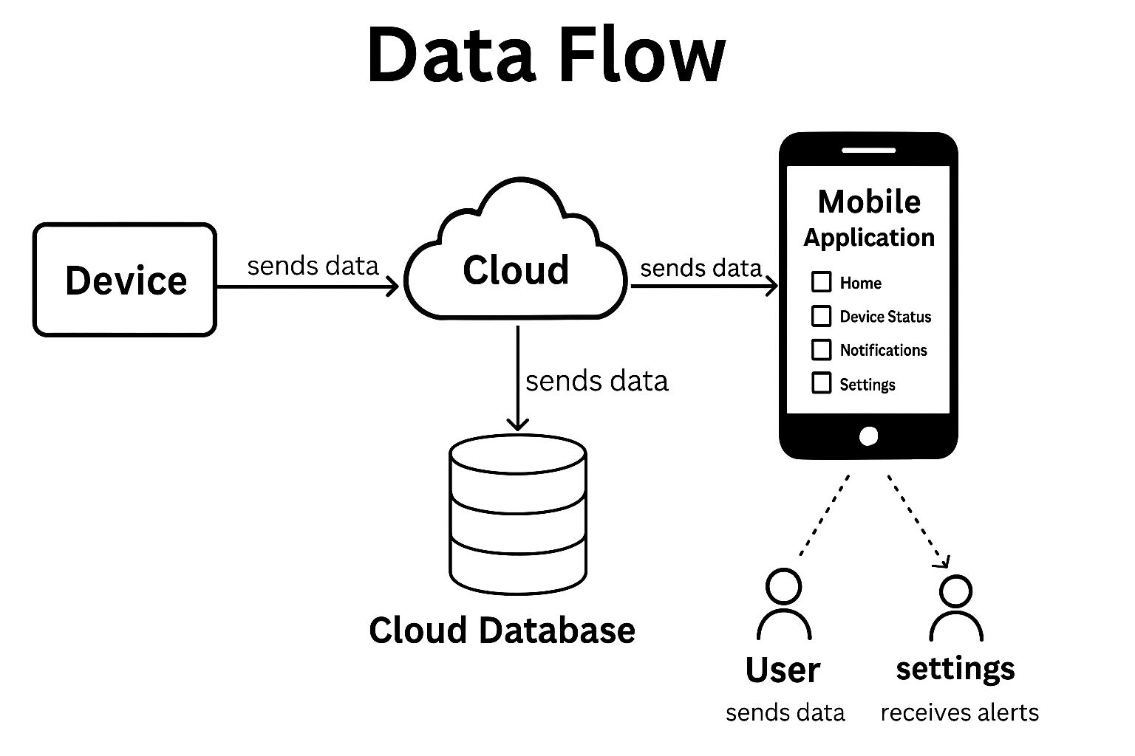
Desıgn
DIAGRAMS:
DATABASE DIAGRAM
DATAFLOW DIAGRAM

Slide 8
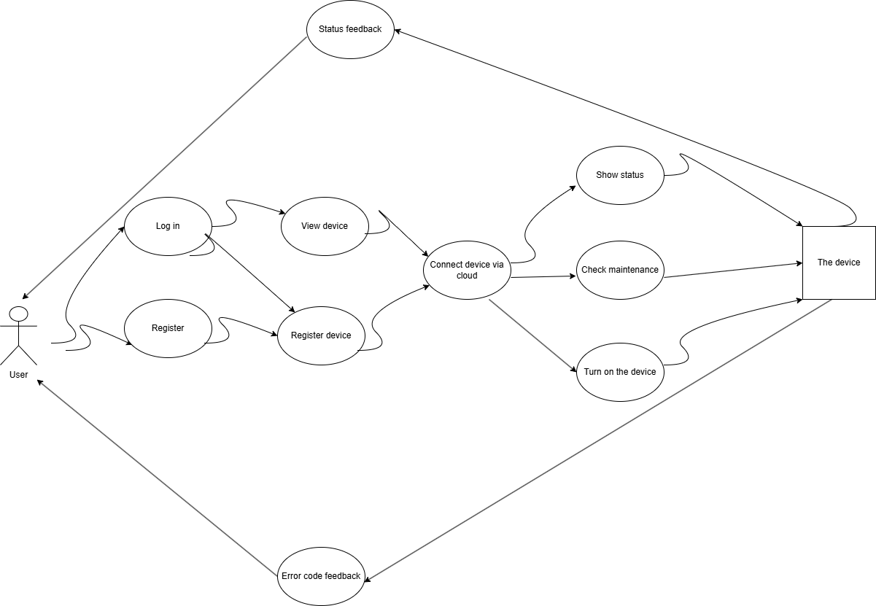
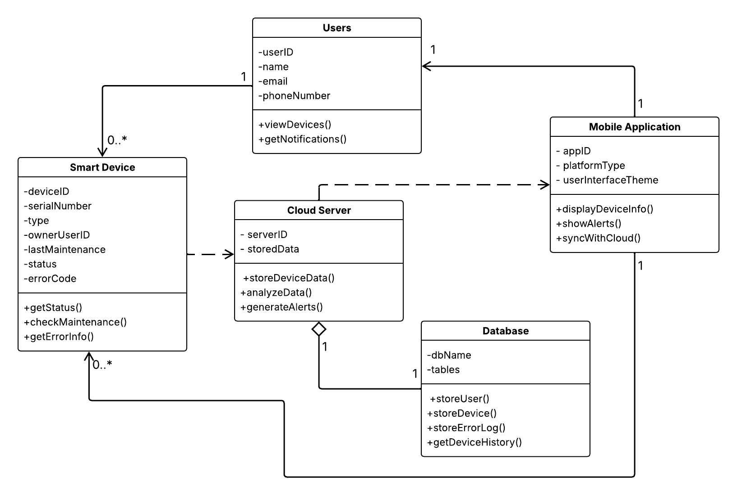
dESIGN
UML CLASS DIAGRAM
USE CASE DIAGRAM

Slide 9
dESIGN
System Dependency:
-Hardware Compatibility
-Network Connections
-Cloud Servers
-Mobile Application

Slide 10
Methodology
Tools and Technologies Used:
Programming Language : Python
Database : Firebase cloud-based data storage and real-time data synchronization
IDE: Thonny IDE is preferred because its interface is simple and understandable.

Slide 11
mETHODOLOGY
agile methodology was considered for the project developed, the project was divided into sprints and a dynamic mindset was adopted for each sprint, and it was prepared with team awareness by distributing different tasks to different people.

Slide 12
Methodology
Some alghorithms examples:
-Getting the error code
-Sending the error code to user
-Check the maintenance
-Showing device status
-Water heater control
Getting the error code
algorithm does error checking the moment the application is opened
Checks if any device has received an error
Send to the database if any error is found
If no errors are found, terminate the process

Slide 13
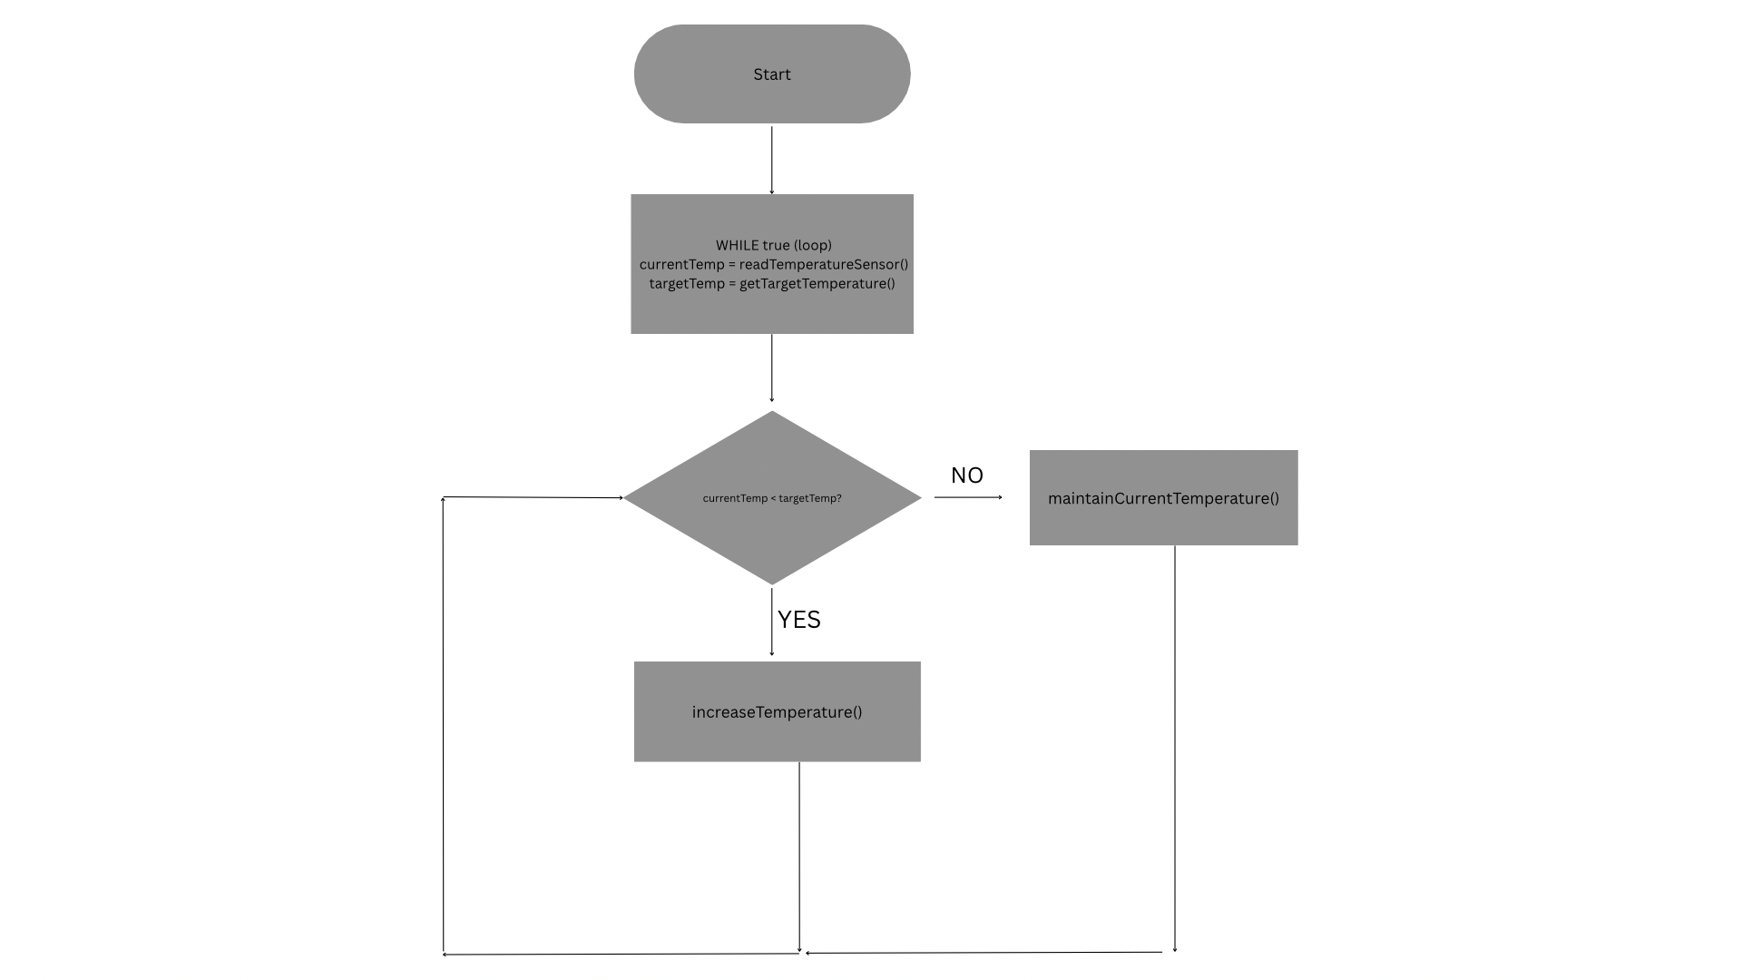
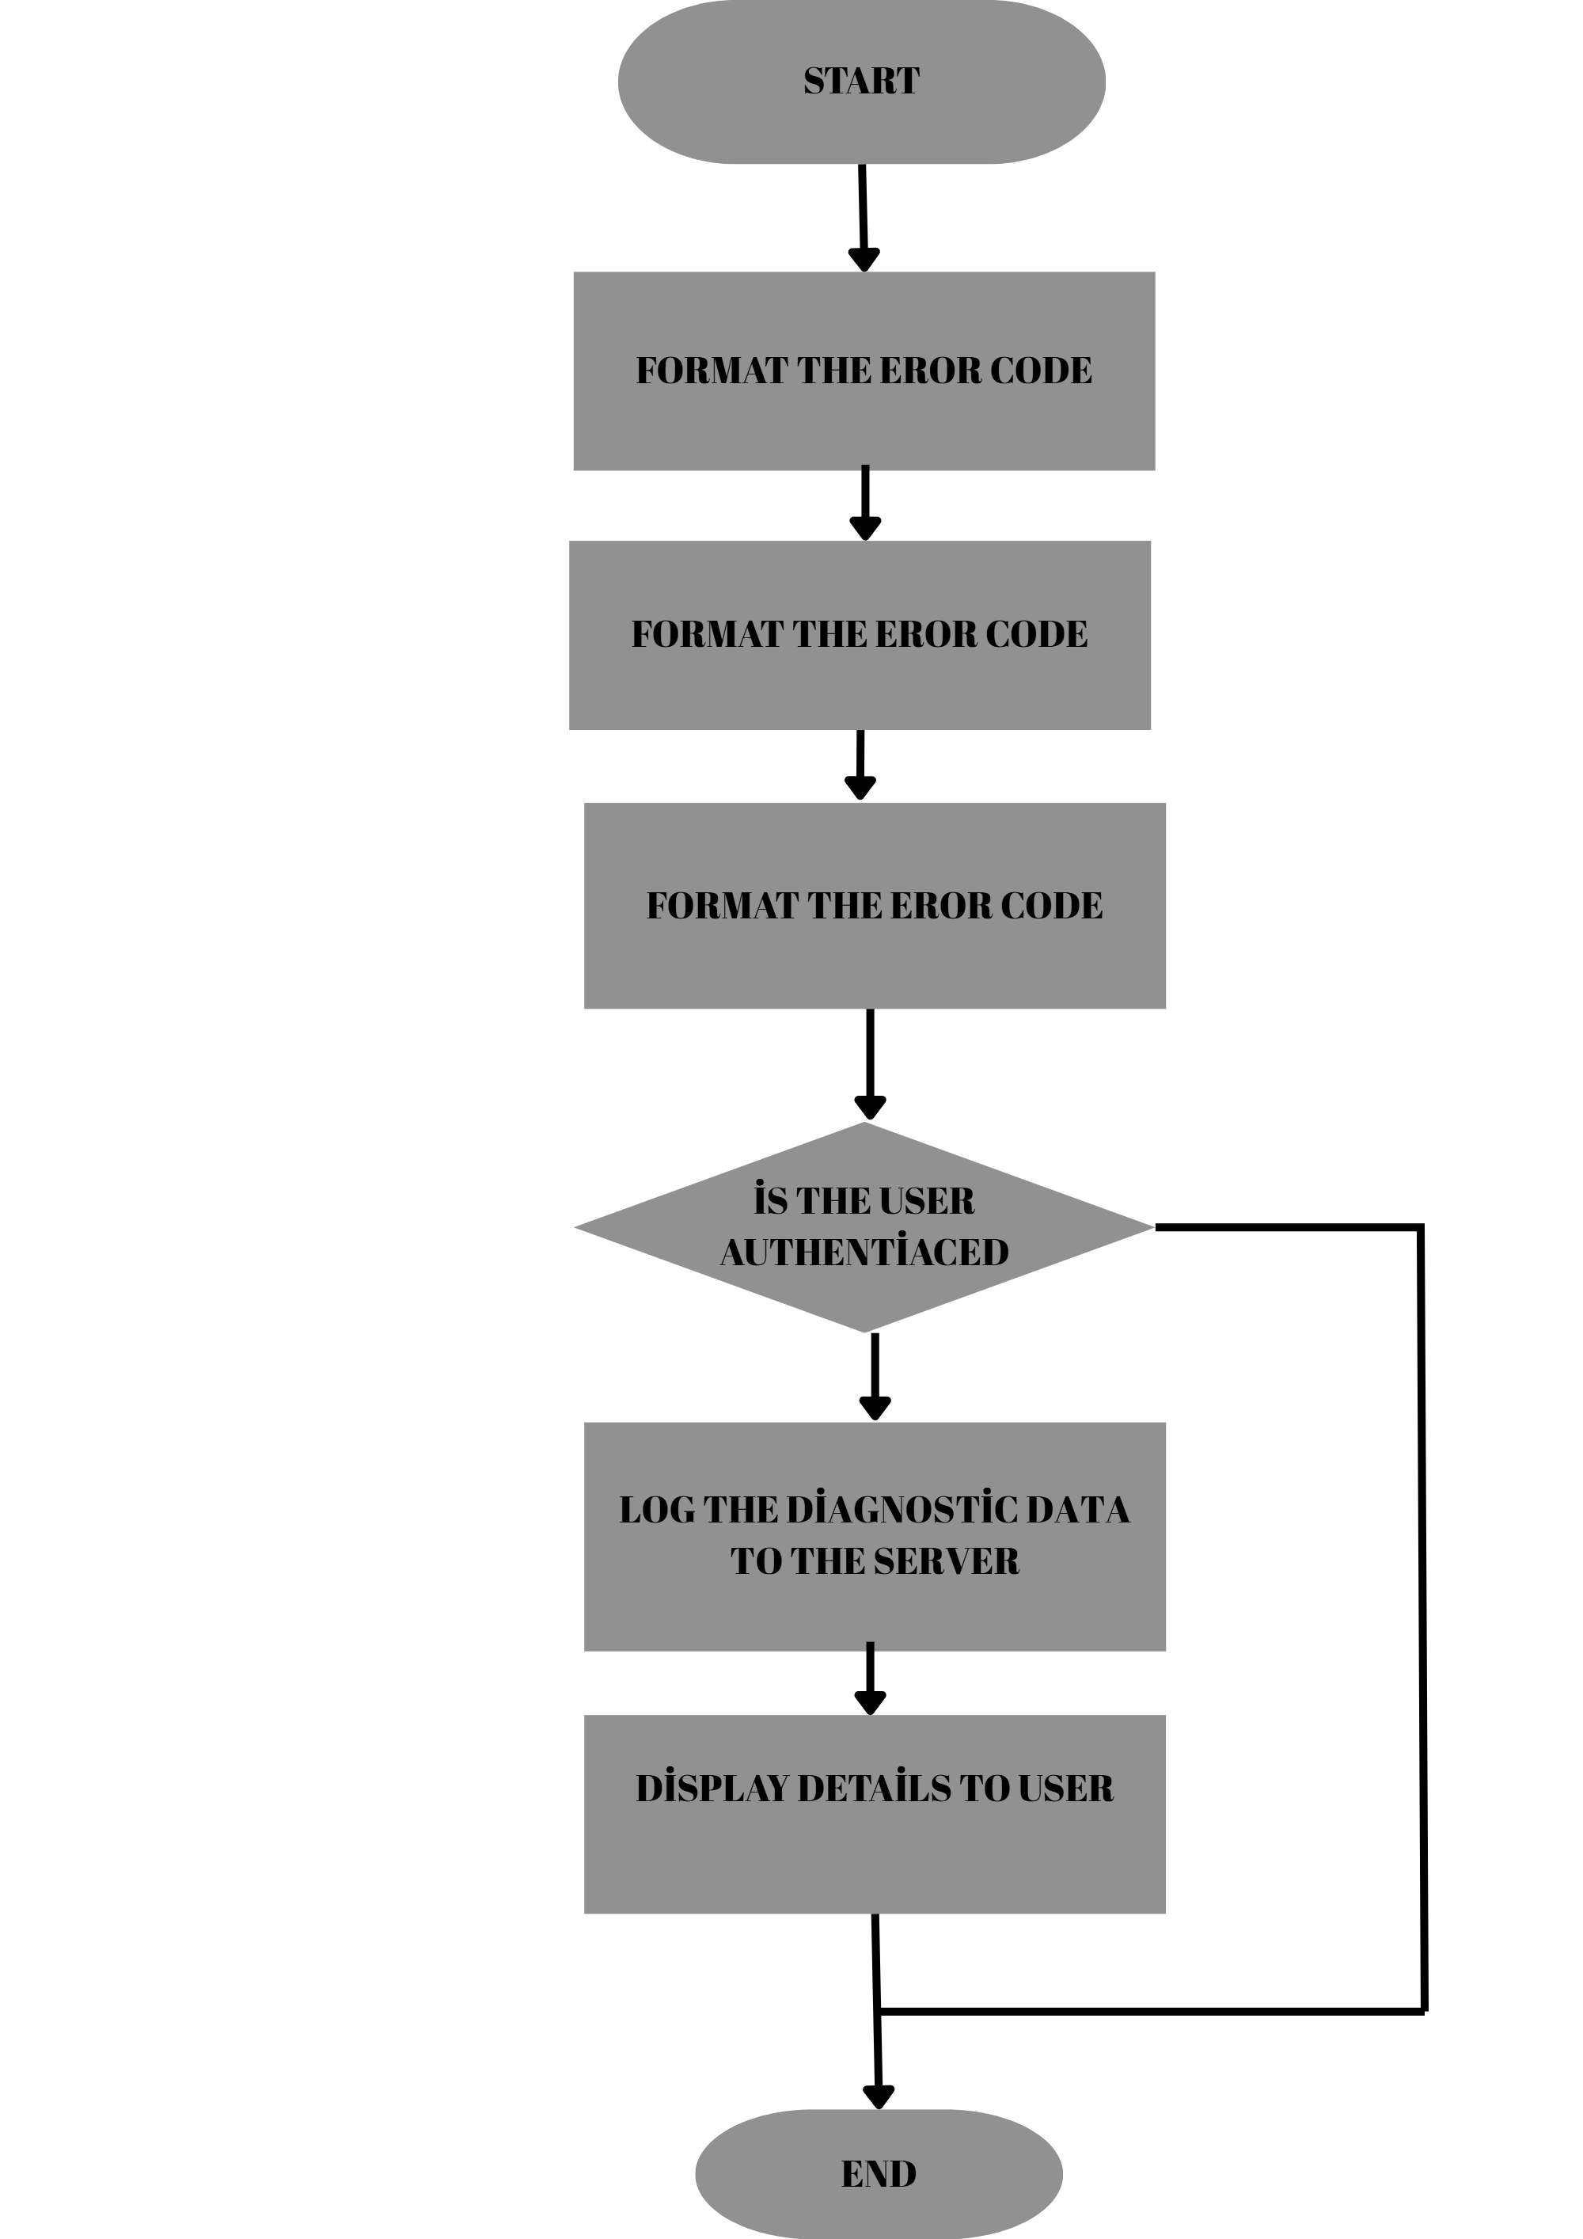
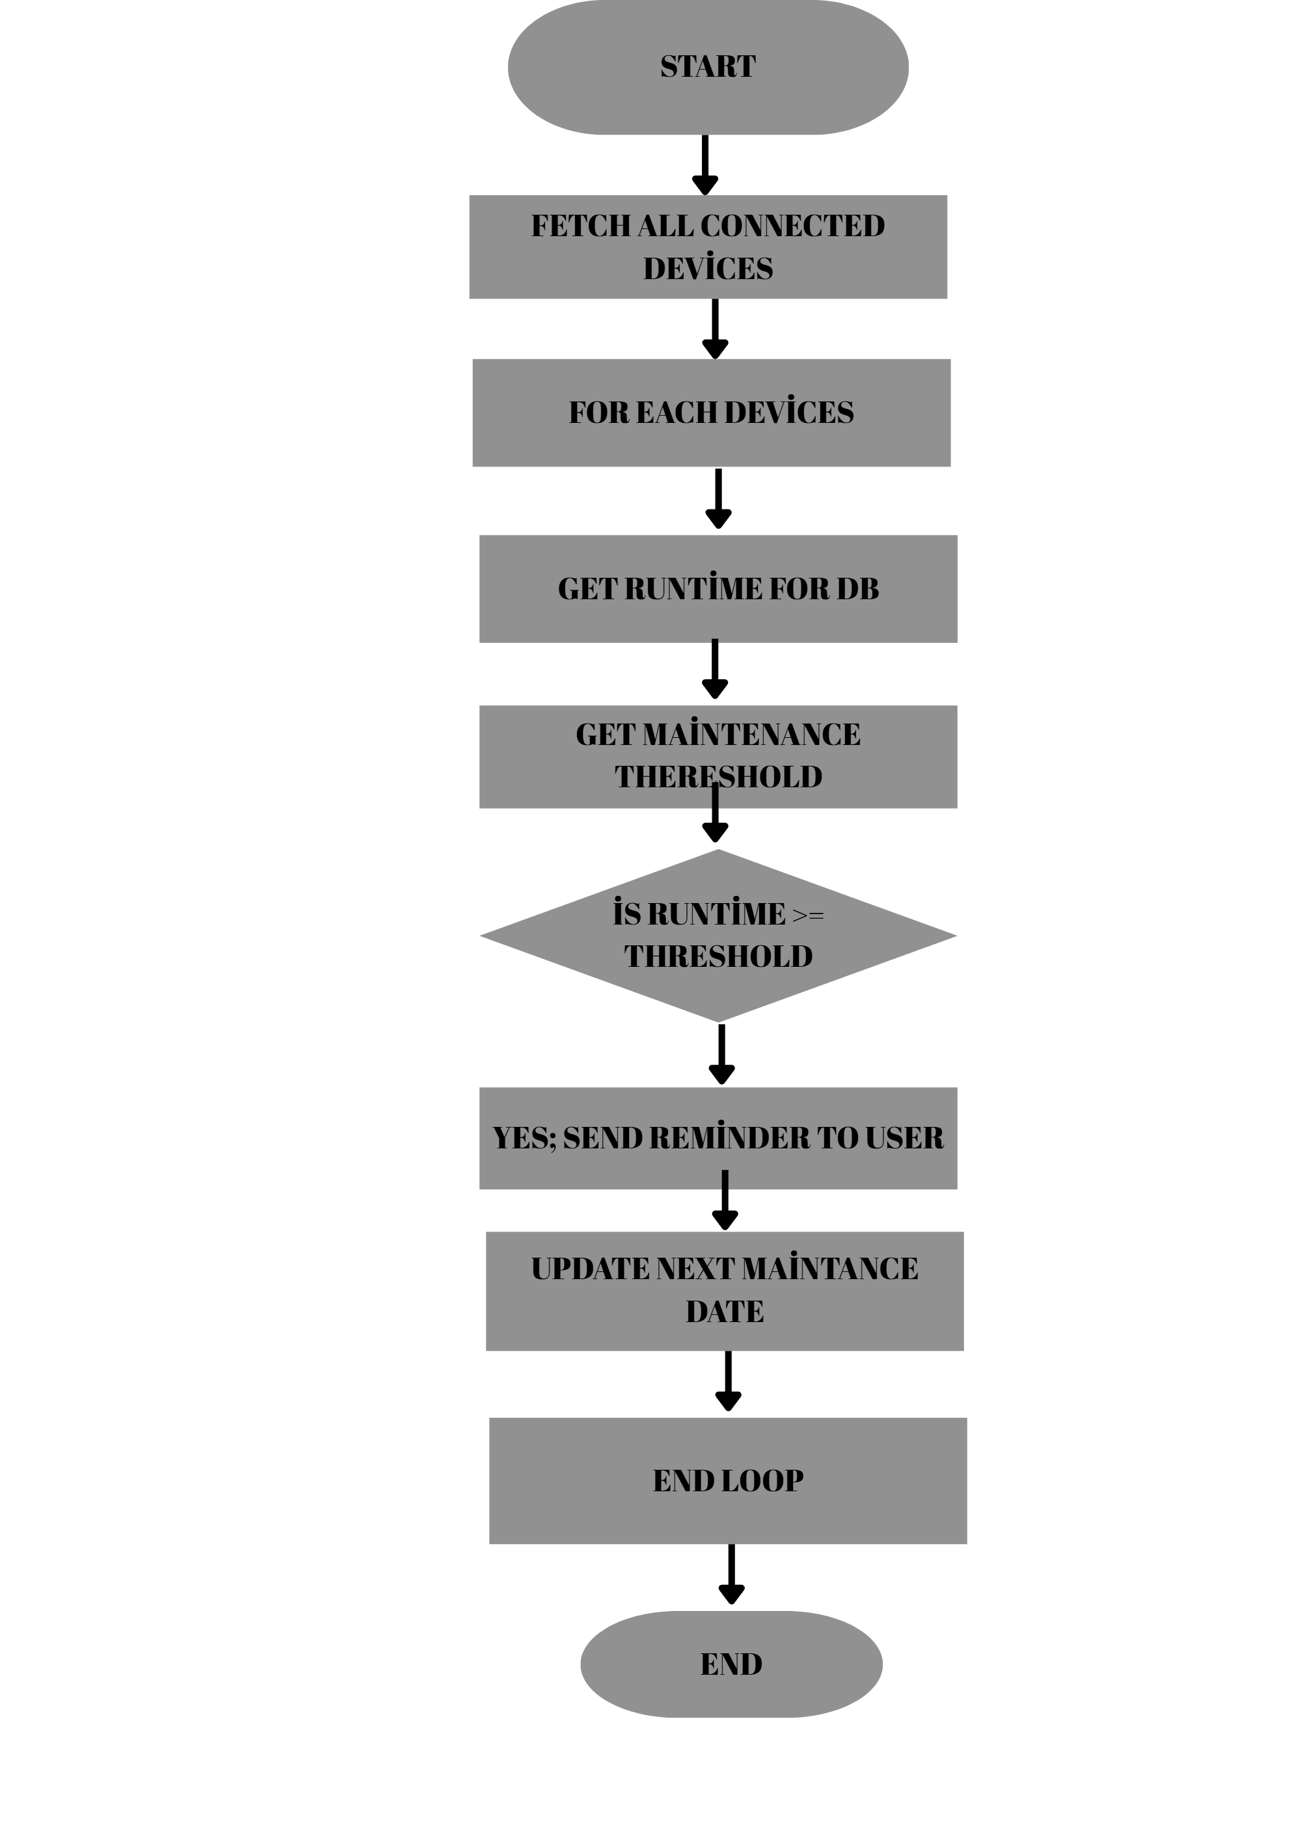
Methodology
Flowcharts:

Slide 14
Implementation
First, a data processing module was developed to detect the fault codes of the devices, then a fault code matching algorithm was created to make sense of this data.
Another important part of the application was the calculation of maintenance times. An algorithm was developed that dynamically estimates the maintenance time for each device based on its usage time, fault history and model. Thanks to this algorithm, the maintenance time of the device could be notified to the user via the mobile application.
The python codes of the algorithms are given in a simplified form.
NOTE: These codes are draft and do not reflect the actual implementation

Slide 15
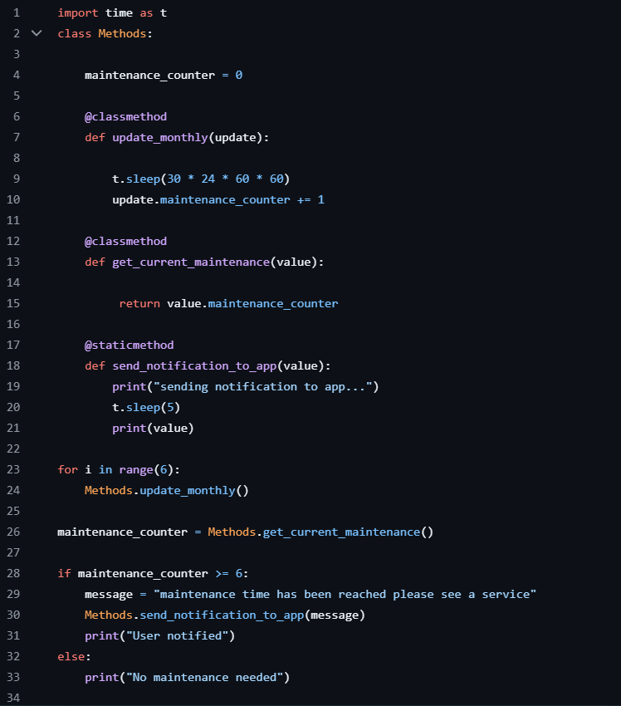
Implementation
This script allows to check the maintenance date monthly

Slide 16
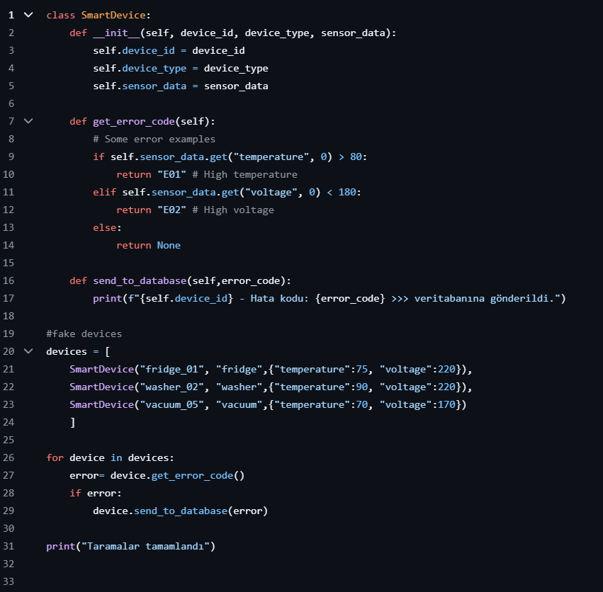
This script allows to getting error codes

Slide 17
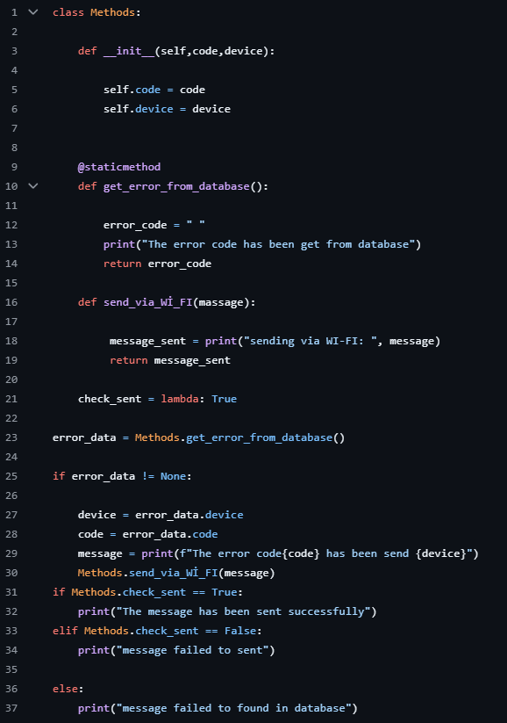
This script allows to sending error codes to user

Slide 18
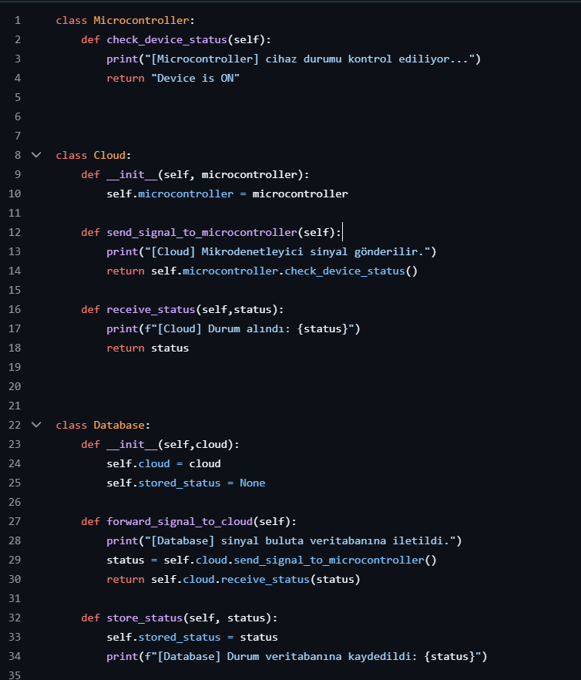
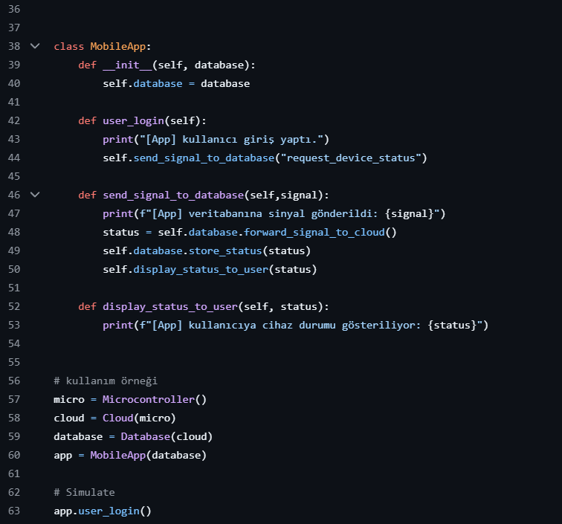
This script allows to show device status

Slide 19
TEST PROCESS
The mobile application developed in the project was tested for basic functions such as real-time data retrieval, error code processing and maintenance time calculation. This testing process was carried out to increase the stability, reliability and user experience of the software and to eliminate potential errors.
-Unit testing:
Unit tests were performed to see if each module worked correctly individually.
-System Testing:
All components of the system were assembled and tested end-to-end.
-Security Testing:
Login, user authentication and database access permissions were checked on Firebase for data security.
-Acceptance Test:
User scenarios were created to test whether the application is functional for the end user.

Slide 20
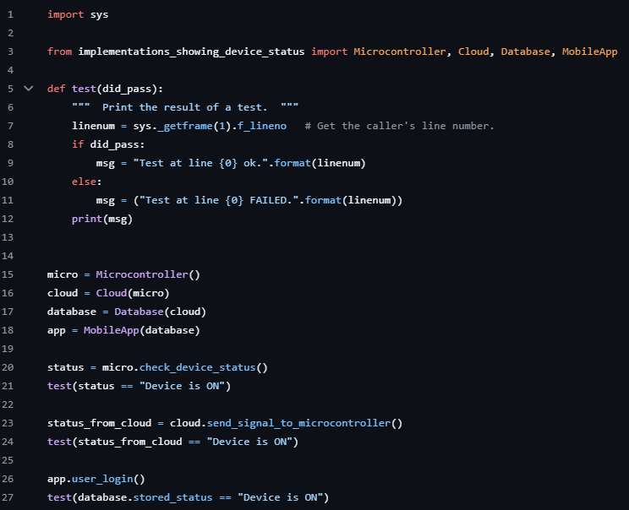
Test process
Example of unittes script
this code does unit testing and checks that the software works correctly.

Slide 21
Deployment and maıntenance
Deployment:
After the completion of this project, the software is not only intended to be published, but also to be easy, efficient and functional for the users. Several steps were taken to achieve this goal:
-User Guides
-Education Support
-On-Site Support
Maintenance:
It is designed to ensure that the system can be easily adapted to new software during the maintenance process without interruption in the long term. Maintenance has several critical points:
-Updates and Bug Fixes
-User Online Support

Slide 22
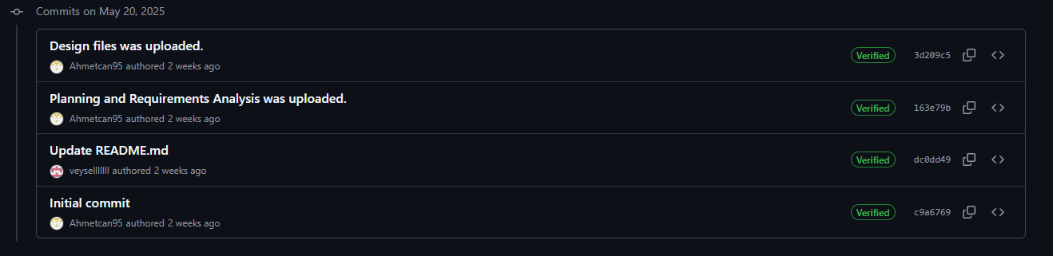
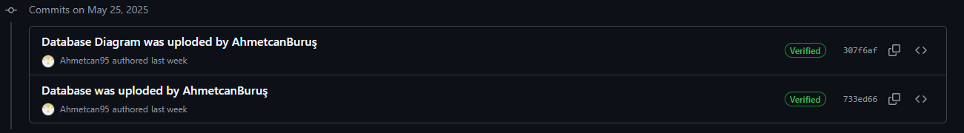
Gıthub logs
May 20, 2025
May 25, 2025

Slide 23
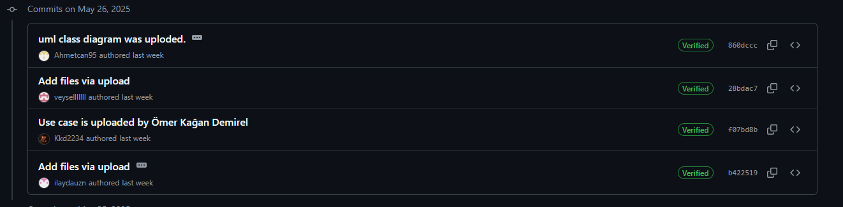
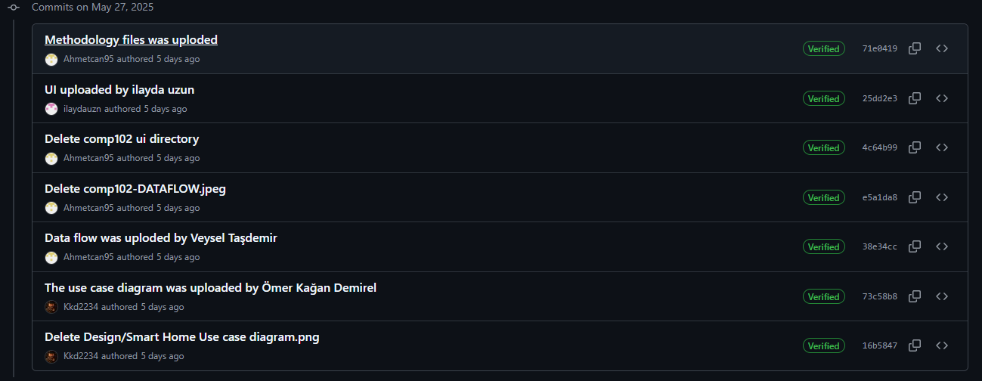
May 26, 2025
May 27, 2025

Slide 24
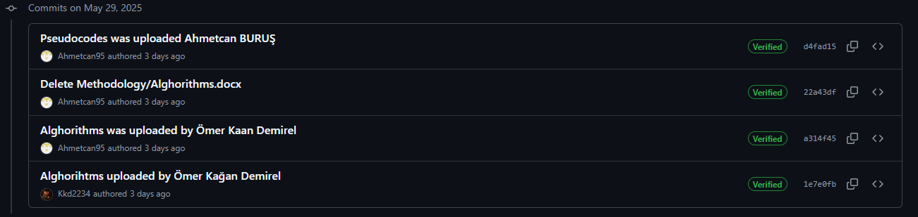
May 28, 2025 May 29, 2025

Slide 25
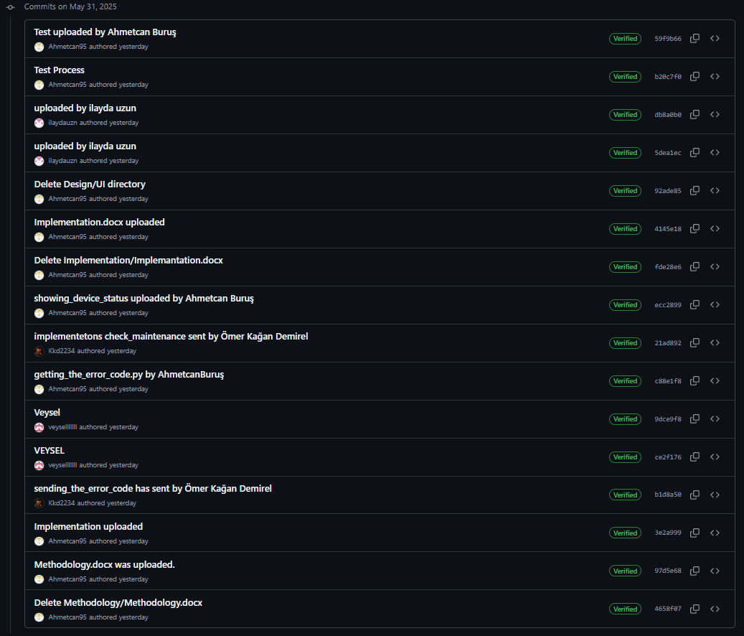
May 31, 2025

Slide 26
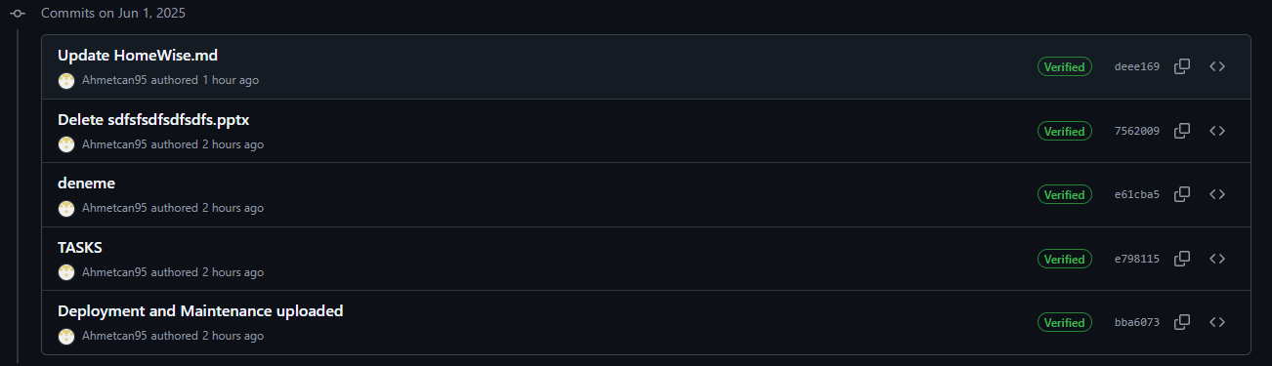
Jun 1, 2025

Slide 27
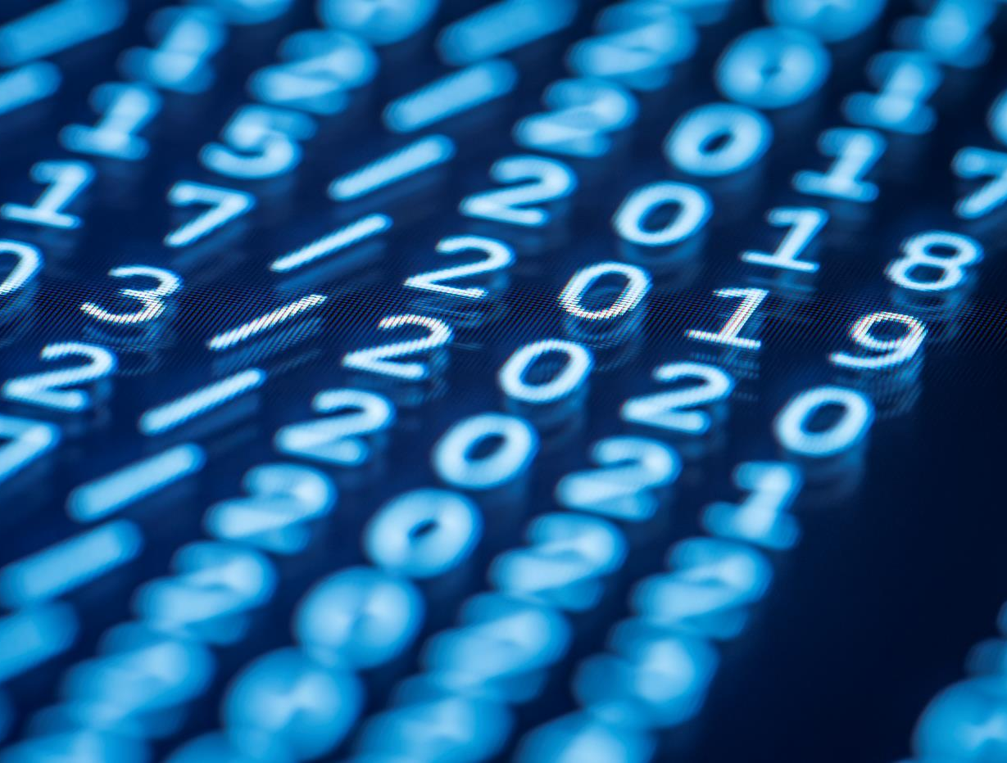
Thank you for listening
Prepared by
-Ahmetcan Buruş
-Ömer Kaan Demirel
-İlayda Uzun
-Veysel Taşdemir

