Slide 1

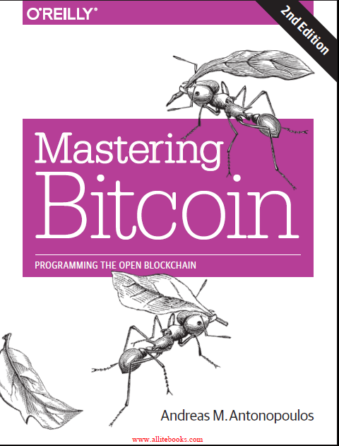
Chapter 2:
How Bitcoin Works
Course Notes
CSE0469 Blockchain: Special Topics in SW Engineering
Yusuf Altunel
Based on Mastering Bitcoin 2e; Andreas M. Antonopoulos; O’Reilly, 2017

Slide 2
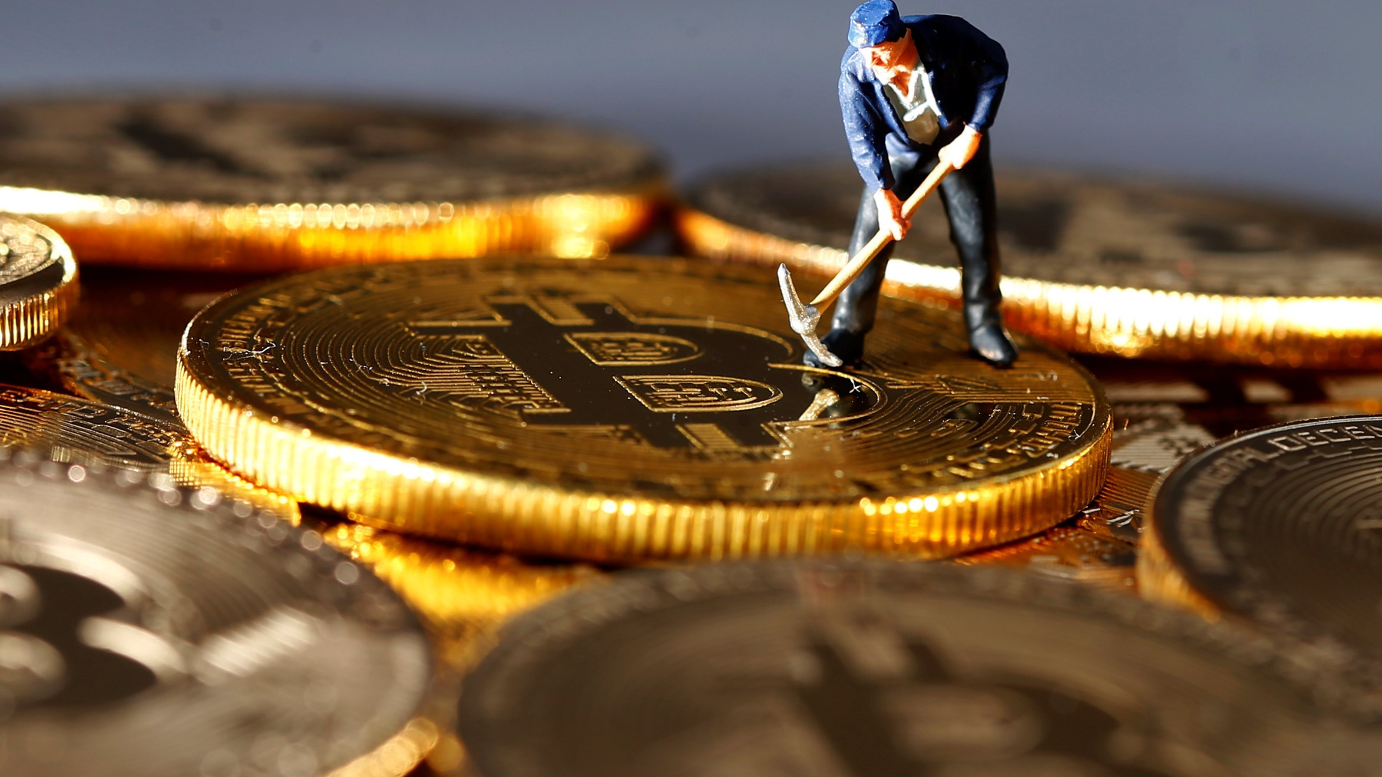
Content
Transactions, Blocks, Mining, & Blockchain
Bitcoin Transactions
Constructing a Transaction
Bitcoin Mining
Mining Transactions in Blocks
Spending the Transaction

Slide 3

Transactions, Blocks, Mining, & Blockchain
Decentralized Trust
No trusting authority
Distributed Consensus
Trust achieved from interactions of different participants
Distributed Ledger
Transactions recorded to distributed ledger

Slide 4
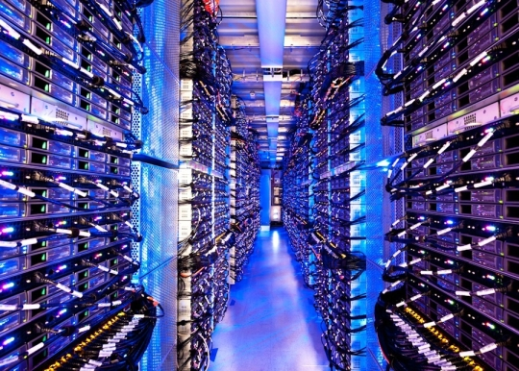

Bitcoin Overview
Users
  Wallets
  Keys
Miners
  Produce consensus
  Competitive computation
Transactions
  Propagated across the network

Slide 5

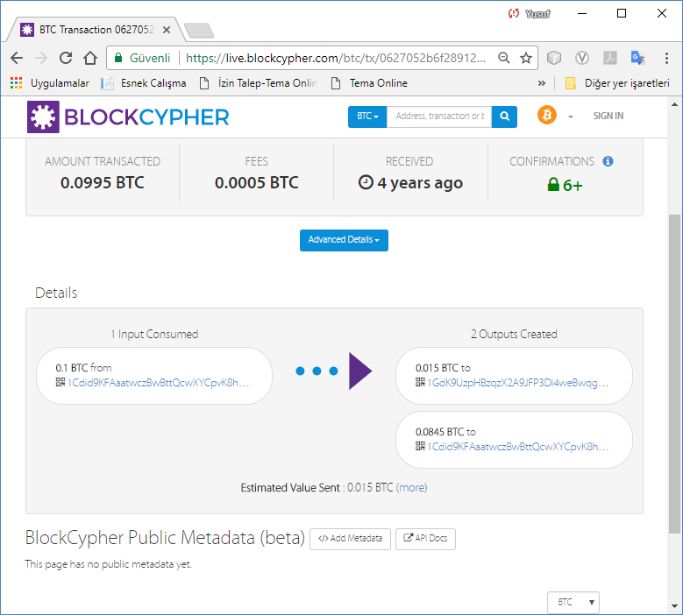
Block Chain Explorers
Search
Bitcoin address
retrieve
Popular blockchain explorers include:
Blockchain.com
BlockCypher Explorer
blockchain.info
BitPay Insight
transaction hash
block number
block hash
corresponding information
from the bitcoin network

Slide 6
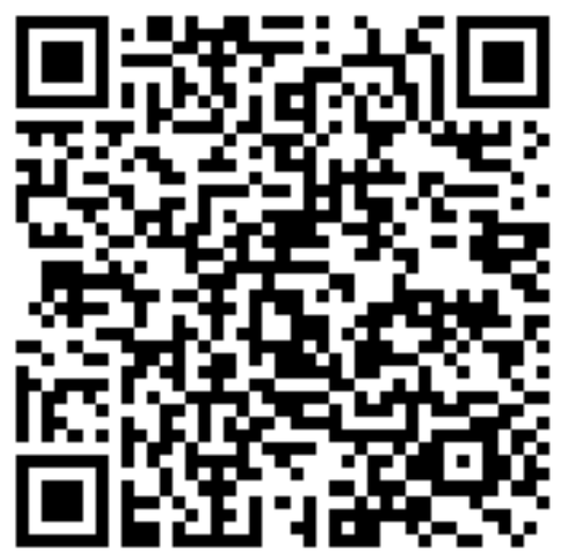
How to Pay with Bitcoin
Payment request
Created automatically
With a special QR code
Includes
a destination bitcoin address
a payment amount
a generic description such as “Bob’s Cafe.”
Payment
Scan QR Code With wallet application
Select Send to authorize the payment
by Point of Sell accepting Bitcoin
bitcoin:1GdK9UzpHBzqzX2A9JFP3Di4weBwqgmoQA?amount=0.015&label=Bob%27s%20Cafe&message=Purchase%20at%20Bob%27s%20Cafe

Slide 7





Some Bitcoin Fractions
Bitcoin
MilliBitcoin (Bitcoin Dollar)
1000 Satoshi
1 000 Bitcoin Dollar
100 000 Bitcoin Cent
100 000 000 Satoshi
Satoshi
1/100,000,000 Bitcoin
1/1000th of a Bitcoin Cent
1/1000th of a Bitcoin
100 000 Satoshi
Bitcoin Cent
100 Bitcoin Cent
1/100 000th Bitcoin
1/100 000th of a Bitcoin Dollar
1/100th of a Bitcoin Dollar

Slide 8
Questions on Transcations
how wallet constructs the transaction?
How is transaction propagated across the network?
How is it verified?
How to use the amount received?

Slide 9
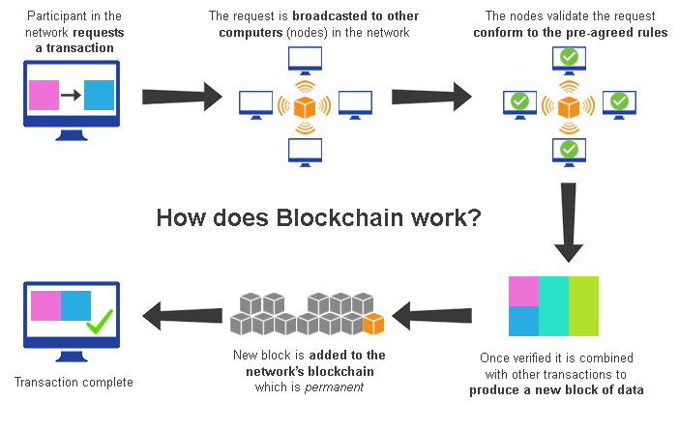
Netsend.com/Introduction to blockchain Technology
Notes:
Image from http://netsend.com/blog/introduction-to-blockchain-technology/attachment/introduction-to-blockchain-technology/

Slide 10
Bitcoin Transactions
Authorization
transaction tells the network:
Spending
The new owner can now spend the bitcoin
by creating another transaction
Chain of Ownership
a chain of ownership is created
Tracebale to the minting block
the transfer of that value to another owner.
the owner of some bitcoin value has authorized
authorizes transfer to another owner
Notes:
27.02.2021

Slide 11

Transaction Inputs and Outputs
Transactions
are like lines
Inputs
Each transaction contains
are like debits against an account
Outputs
are like credits added
there are
in a double-entry
bookkeeping ledger
one or more “inputs”
one or more “outputs
to a bitcoin account
Notes:
Figure from https://medium.com/@micheledaliessi/how-does-the-blockchain-work-98c8cd01d2ae

Slide 12
Transaction Fee
Transaction fee
the difference represents an implied transaction fee
a small payment collected by the miner
Comes from
The inputs and outputs (debits and credits)
do not necessarily add up to the same amount.
Instead, outputs add up to slightly less than inputs

Slide 13
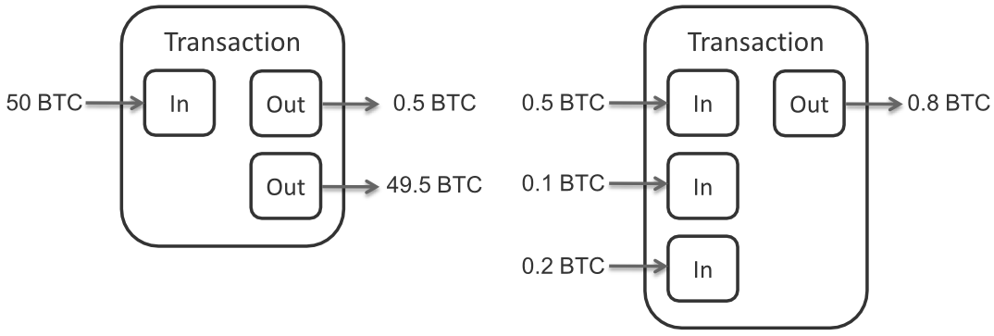
Transaction Input/Output
Notes:
https://commons.wikimedia.org/wiki/File:Bitcoin_Transaction_Inputs_and_Outputs.png

Slide 14
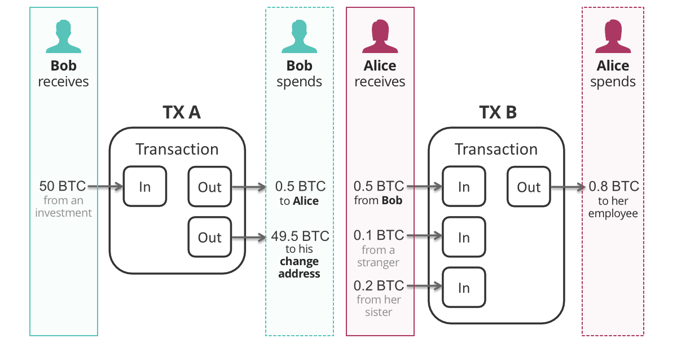
Transaction Inputs and Outputs
Medium.com: How Does the Blockchain Work?
Notes:
Figure from https://medium.com/@micheledaliessi/how-does-the-blockchain-work-98c8cd01d2ae

Slide 15
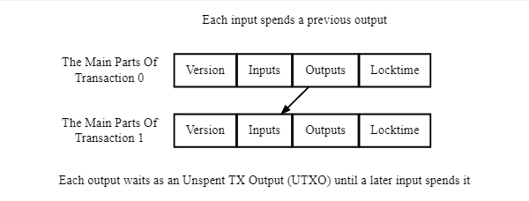
Transaction Input/Output
Notes:
https://developer.bitcoin.org/devguide/transactions.html

Slide 16
Ownership & Spending
Ownership of amount
a digital signature as a proof of ownership from the owner
Spending
from a previous transaction over
to a new owner
in a transaction for each bitcoin
signing a transaction to transfer value
Notes:
Figure is from https://bitcoin.org/en/developer-guide#transactions

Slide 17
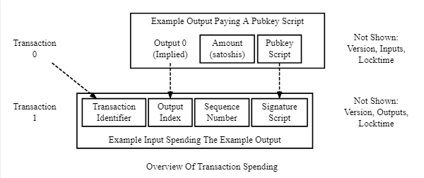
Ownership & Spending
Notes:
https://developer.bitcoin.org/devguide/transactions.html

Slide 18
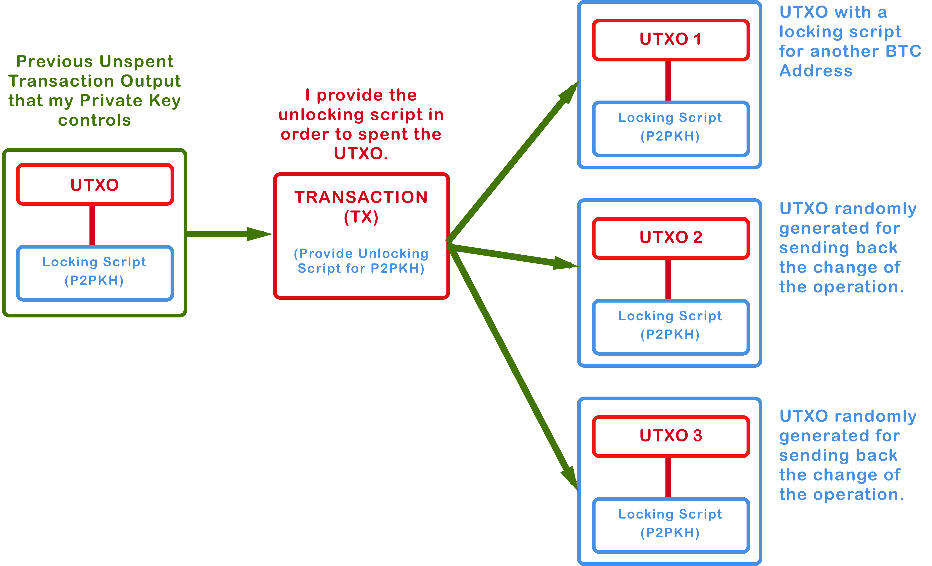
Ownership & Spending
Notes:
https://medium.com/coinmonks/bitcoin-transactions-be401b48afe6

Slide 19
Transaction Chains
Transaction chains
The transactions form a chain
The inputs from the latest transaction correspond
to outputs from previous transactions
Key
The value in wallet is locked by personal Keys
Key provides a signature to unlock previous transaction outputs
Prove the network the fund is owned by the person
Payment
Contains the information of the receiver
Reciever can spend the amount attaching own signature
Notes:
Figure «Creating…» from https://bitcoin.org/en/developer-guide#transactions
Figure «Transaction A…» from https://en.bitcoin.it/wiki/File:Transaction.png

Slide 20
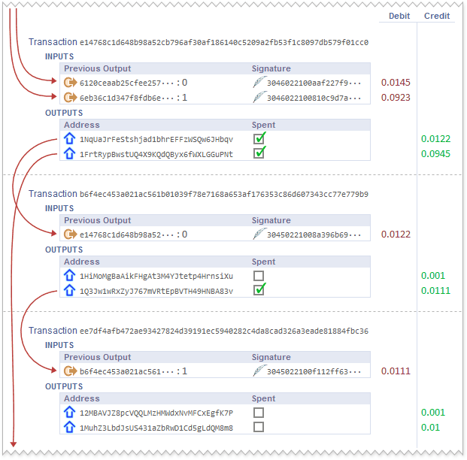
Transaction Sequences
Notes:
https://medium.com/@ryanmyhercrypto/bitcoin-currency-or-store-of-value-wrote-this-awhile-back-figured-i-would-publish-for-fun-lol-b4252c8d5901

Slide 21
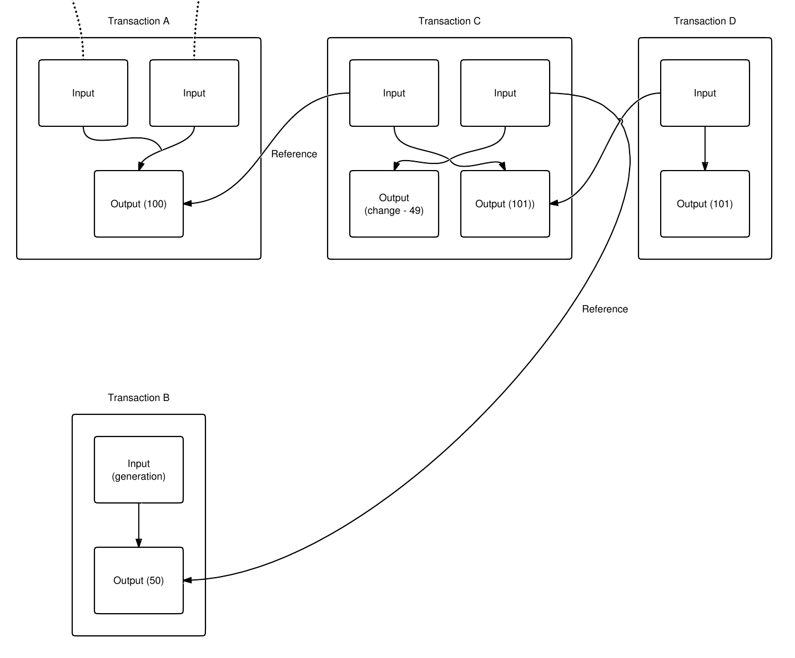
Transaction Chains
bitcoin.wiki
Notes:
Figure «Creating…» from https://bitcoin.org/en/developer-guide#transactions
Figure «Transaction A…» from https://en.bitcoin.it/wiki/File:Transaction.png

Slide 22
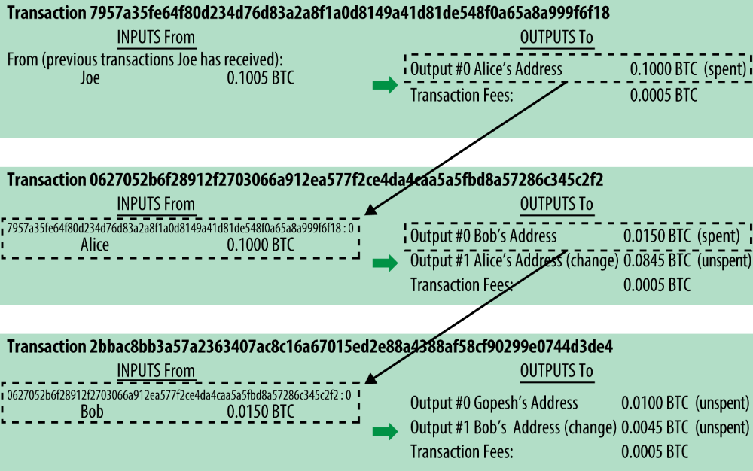
Figure 2-4. A chain of transactions, where the output of one transaction is the input of the next transaction

Slide 23
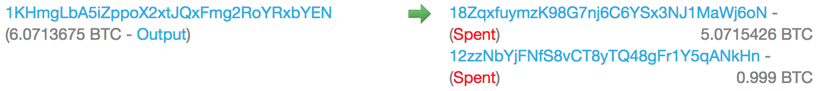
Real World Transactions
Notes:
https://arstechnica.com/tech-policy/2017/12/how-bitcoin-works/

Slide 24
Change
Change Address
bitcoin transactions include outputs
reference both an address of the new owner
and an address of the current owner, called the change address.
No Division of inputs
transaction inputs, like currency notes
cannot be divided.

Slide 25
Receiving the Change
Spending $5 out of $20
but use a $20 US dollar bill to pay for the item,
you expect to receive $15 US dollars in change.
If you purchased an item that costs 5 bitcoin from a 20 bitcoin input
you would send one output of 5 bitcoin to the store owner
and one output of 15 bitcoin back to yourself as change
If you purchase a $5 item in a store
Keep the change

Slide 26
Common Transaction Forms
Simple payment
Aggregating Funds
Distributing Funds

Slide 27
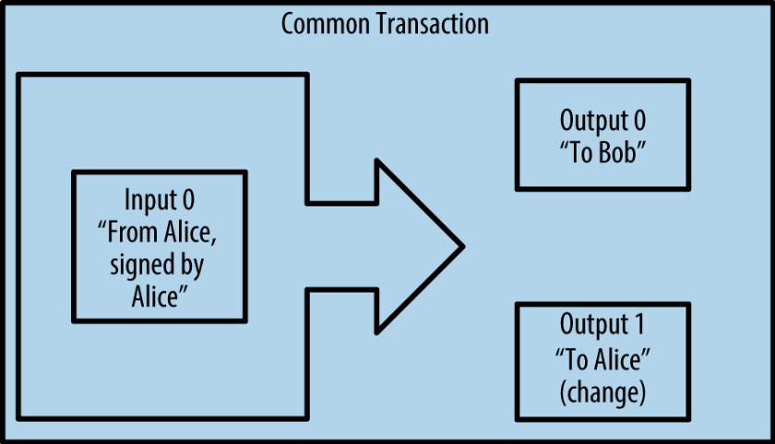
Common Transaction Forms-1
Simple payment
payment from one address
often includes
to another,
some “change”
returned to the original owner.

Slide 28
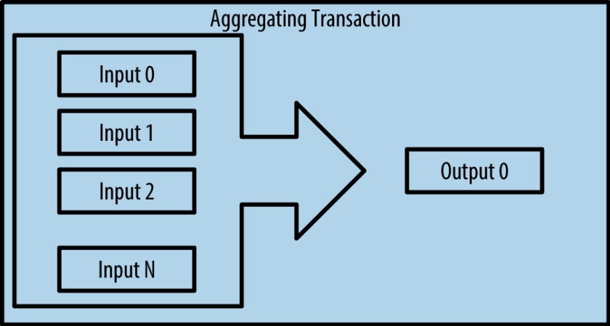
Common Transaction Forms
Aggregating Funds
payment from many addresses into single output.
Usage
Transactions are generated by wallet applications
to clean up lots of smaller amounts that were received as change for payments.

Slide 29
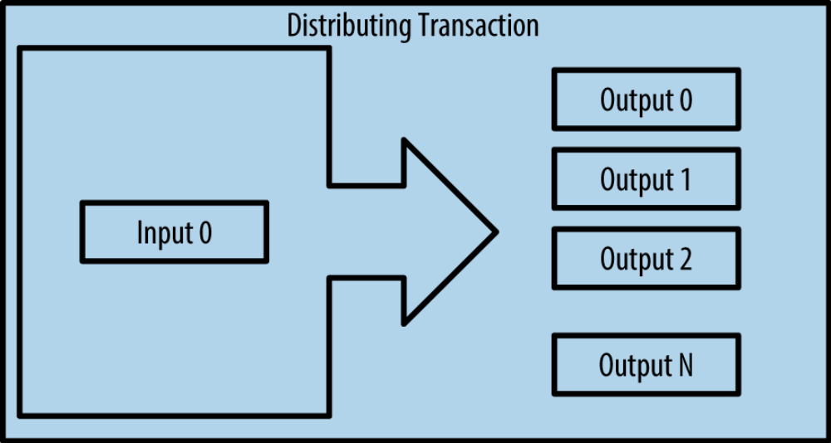
Common Transaction Forms
Distributing Funds
distributes one input to multiple outputs
representing multiple recipients
Usage
used by commercial entities tocdistribute funds,
such as when processing payroll payments to multiple employees

Slide 30
Constructing a Transaction
Transactions are created by Wallet
to build a transaction specified by the owner
Offline/online
Wallets can construct transactions
even if it is completely offline
Selecting appropriate inputs and outputs

Slide 31
Getting the Right Inputs
Finding input
Wallet finds input to pay
Keeping transaction outputs
Most wallets keep track of all the available outputs
belonging to addresses in the wallet
for the amount the owner wants to send

Slide 32
Getting the Right Inputs
Full node client wallet
contains a copy of every unspent output
from every transaction in the blockchain.
Lightweight clients
Track only owner’s unspent outputs
Provider API
Wallet can query using a variety of provider APIs
To retrieve owners unspent outputs

Slide 33
Creating the Outputs
Lock the value
can only be spent by the owner having the signature
Signature
Keys
Receiver’s wallet has the keys to produce such signatures
Owner’s transaction locks the value
Produced using receiver’s public address

Slide 34
Creating the Outputs
Change
Owner’s wallet breaks the fund into two payments:
Receiver for the spent amount
Back to the owner if there is a change
Transaction fee
Implied by the difference between inputs and outputs
Collected by the miners as a fee
Validation by Miner
for validation and recording in blockchain

Slide 35
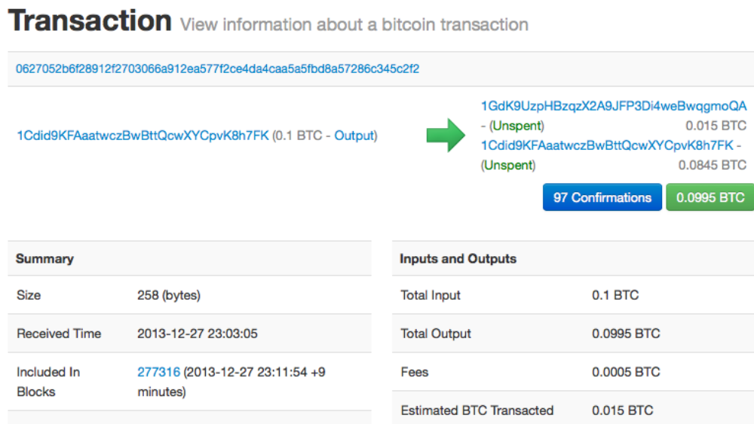

Slide 36
Adding the Transaction to the Ledger
Node
Any system in the bitcoin network
a server
“speaking” the bitcoin protocol
Types
desktop
laptop

Slide 37
Adding the Transaction to the Ledger
it does not matter how or where it is transmitted
The bitcoin network is a peer-to-peer network
each bitcoin client participates
Transmitting the transaction
Peers
Number of connections
connecting to several other bitcoin clients

Slide 38
Adding the Transaction to the Ledger
a propagation technique
From a bitcoin node
Very fast
Flooding
Speed
reaching a large percentage of the nodes within a few seconds
to forward a valid transaction
Direction
to connected other nodes

Slide 39
10 Minutes Misconception
10 Minutes
Reason
Transactions must be “confirmed”
6 Confirmations
up to 60 minutes
Confirmations ensure the transaction
has been accepted by the whole network
by waiting 10 minutes for a new block
for a full six confirmations
Notes:
http://www.ledgerprojects.com/bitcoin-transaction-how-does-it-work/

Slide 40
10 Minutes Misconception
Small value items
A merchant may accept a valid small-value transaction
Risk
10 miutes delay is unnecessary
more risky than a credit card payment made
such as a cup of coffee
for small-value items
Simplify
with no confirmations
without an ID or a signature,
Notes:
http://www.ledgerprojects.com/bitcoin-transaction-how-does-it-work/

Slide 41
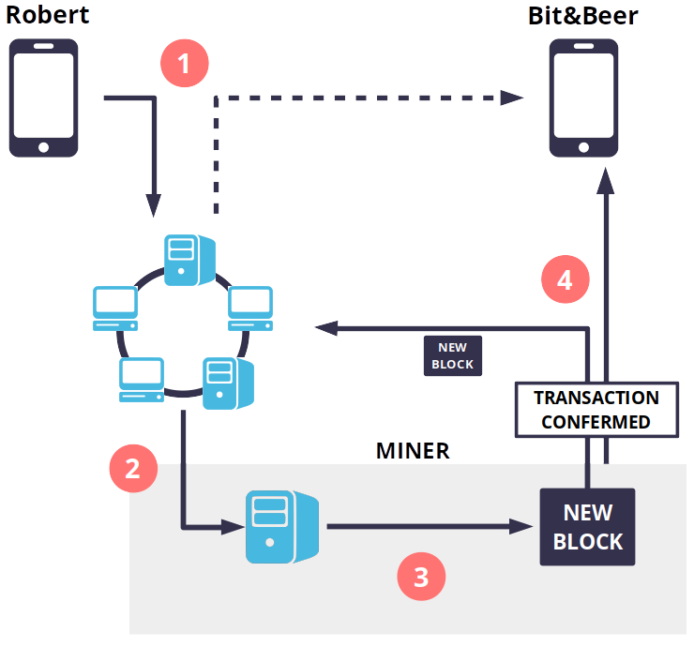
10 Minutes Misconception
Bitcoin transaction: how does it work?
Notes:
http://www.ledgerprojects.com/bitcoin-transaction-how-does-it-work/

Slide 42
Bitcoin Mining
Trust on computation
The bitcoin system of trust is based on computation
Validation
transaction is now propagated on the bitcoin network cannot become part of the blockchain
until it is verified and included in a block by a process called mining
Prove vs verification
Transactions are bundled into blocks,
require an enormous amount of computation to prove,
but only a small amount of computation to verify

Slide 43
Mining: 2 Purposes
Validation
Mining nodes validate all transactions
mining provides security for bitcoin transactions
New Bitcoins
Mining creates new bitcoin in each block,
Security for Transaction
by rejecting invalid or malformed transactions
by reference to bitcoin’s consensus rules.
like a central bank printing new money.

Slide 44
Balance between Cost & Reward
Cost-Reward balance
Mining uses electricity to solve a mathematical problem.
Miner earnings
Conditions be rewarded
Security with no Authority
if the miner has correctly validated all the transactions,
to the satisfaction of the rules of consensus.
reward will only be collected
Mining achieves a fine balance between cost and reward.
A successful miner will collect a reward in the form of
new bitcoin and transaction fees.
This delicate balance provides security for bitcoin
without a central authority.

Slide 45
Mining & Sudoku
good way to describe mining is
resets every time someone finds a solution
difficulty automatically adjusts
Size
several thousand rows and columns in size
If I sow you a completed puzzle
Sudoku Analogy
like a giant competitive game of sudoku
Reset
so it takes approximately 10 minutes to find a solution
you can verify it quite quickly

Slide 46
Mining & Sudoku
Adjust the difficulty
The difficulty of the sudoku can be adjusted
still be verified quite easily
by changing its size
more or fewer rows and columns
Easy to verify
even if it is very large

Slide 47
Mining & Sudoku
Bitcoin puzzle
based on a cryptographic hash
it is asymmetrically hard to solve
exhibits similar characteristics:
Exclusive property
easy to verify,
its difficulty can be adjusted.

Slide 48

How it Works?
Proof-of-Work
Finding such a solution, the so called Proof-of-Work (PoW),
requires quadrillions of hashing operations per second across the entire bitcoin network.
Invloves
repeatedly hashing
the header of the block
a random number with the SHA256 cryptographic algorithm
until a solution matching a predetermined pattern emerges.
Winner
The first miner to find such a solution
wins the round of competition and publishes that block into the blockchain.

Slide 49
How Hard is it?
in 2010
using a very fast desktop computer
to find a suitable Proof-of-Work for new blocks.
More miners come
As more miners started joining the bitcoin network,
the difficulty of the problem increased rapidly.
Later
miners upgraded to more specialized hardware,
such as high-end dedicated graphical processing units (GPUs) cards
such as those used in gaming desktops or consoles.

Slide 50
How Hard is it?
At the time of this writing, the difficulty is so high that
it is profitable only to mine with application specific integrated circuits (ASIC),
essentially hundreds of mining algorithms printed in hardware,
running in parallel on a single silicon chip.
ASIC Miners
thousands of ASIC miners to mine for bitcoin 24 hours a day.
pays its electricity costs by selling the bitcoin
Difficulty
A typical mining company may run a warehouse containing

Slide 51
Mining Transactions in Blocks
user wallets
new transactions
constant flow
Originated
other applications
regularly arrive

Slide 52
Mining Transactions in Blocks
get added new transactions
Network nodes
to a temporary pool of
Temporary pool
contains unverified transactions
maintained by node

Slide 53
Mining Transactions in Blocks
they add unverified transactions
to prove the validity of that new block
Miner
Constructing new block
Using transaction pool
from the pool to the new block
Mining
Execute Proof-of-Work mining algorithm

Slide 54
How to earn bitcoin by mining?
Transactions are added to the new block
prioritized by the highest-fee transactions first
and a few other criteria.

Slide 55
How to earn bitcoin by mining?
Each miner starts the process of mining a new block of transactions
as soon as he receives the previous block from the network,
knowing he has lost that previous round of competition.

Slide 56
How to earn bitcoin by mining?
He immediately creates a new block,
fills it with transactions and the fingerprint of the previous block,
starts calculating the Proof-of-Work for the new block..

Slide 57
How to earn bitcoin by mining?
Each miner includes a special transaction in his block
one that pays his own bitcoin address the block reward
plus the sum of transaction fees
currently 6.25 newly created bitcoin
from all the transactions
included in the block.

Slide 58
How to earn bitcoin by mining?
If he finds a solution
he “wins” this reward
This successful block
the reward transaction
makes that block valid
is added
to the global blockchain
included
becomes spendable.

Slide 59
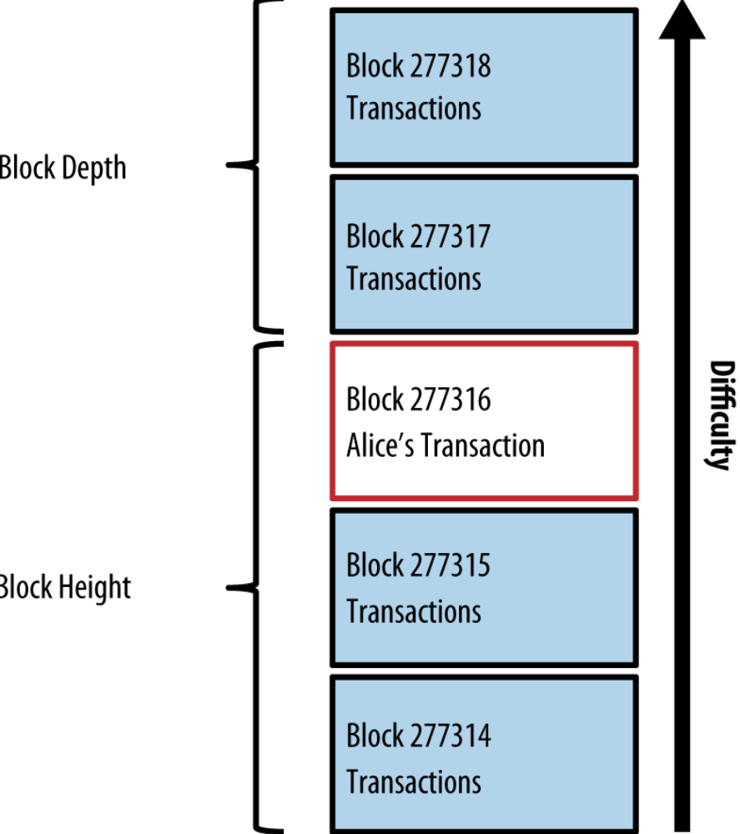
Chain of Blocks

Slide 60
Spending the Transaction
Validation
Each bitcoin client
can independently verify the transaction
as valid and spendable

Slide 61
Spending the Transaction
Full-node clients
can track the source of the funds
incrementally from transaction to transaction
from
the moment the bitcoin
were first generated in a block

Slide 62
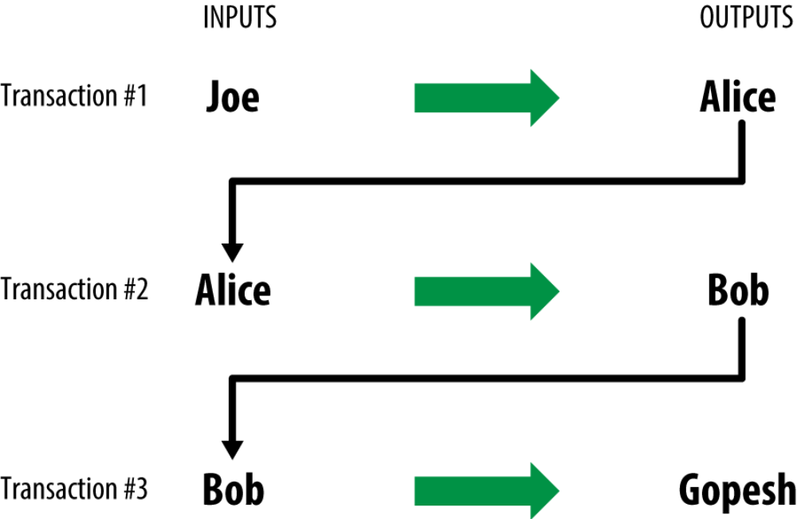
Figure 2-10. Alice’s transaction as part of a transaction chain from Joe to Gopesh

Slide 63
Spending the Transaction
Lightweight clients
can do
providing assurance
confirming that
has several blocks mined after it
the miners accepted it as valid
a simplified payment verification
Verification
the transaction is in the blockchain
Assurance

Slide 64
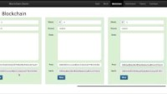
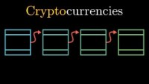
Related Videos
https://www.youtube.com/watch?v=_160oMzblY8&t=7s
https://www.youtube.com/watch?v=bBC-nXj3Ng4&t=531s
The application to experience the video: https://andersbrownworth.com/blockchain/hash

Slide 65



Discussions
Asses what you got so far!
Noticible issues
Interesting Details
Unclarified issues
What do you think on this chapter?
Do you think the bitcoin inspiring?
What is the most interesting point?
Select and explain a critical issu in this chapter
What are the points need further explanations?

Slide 66
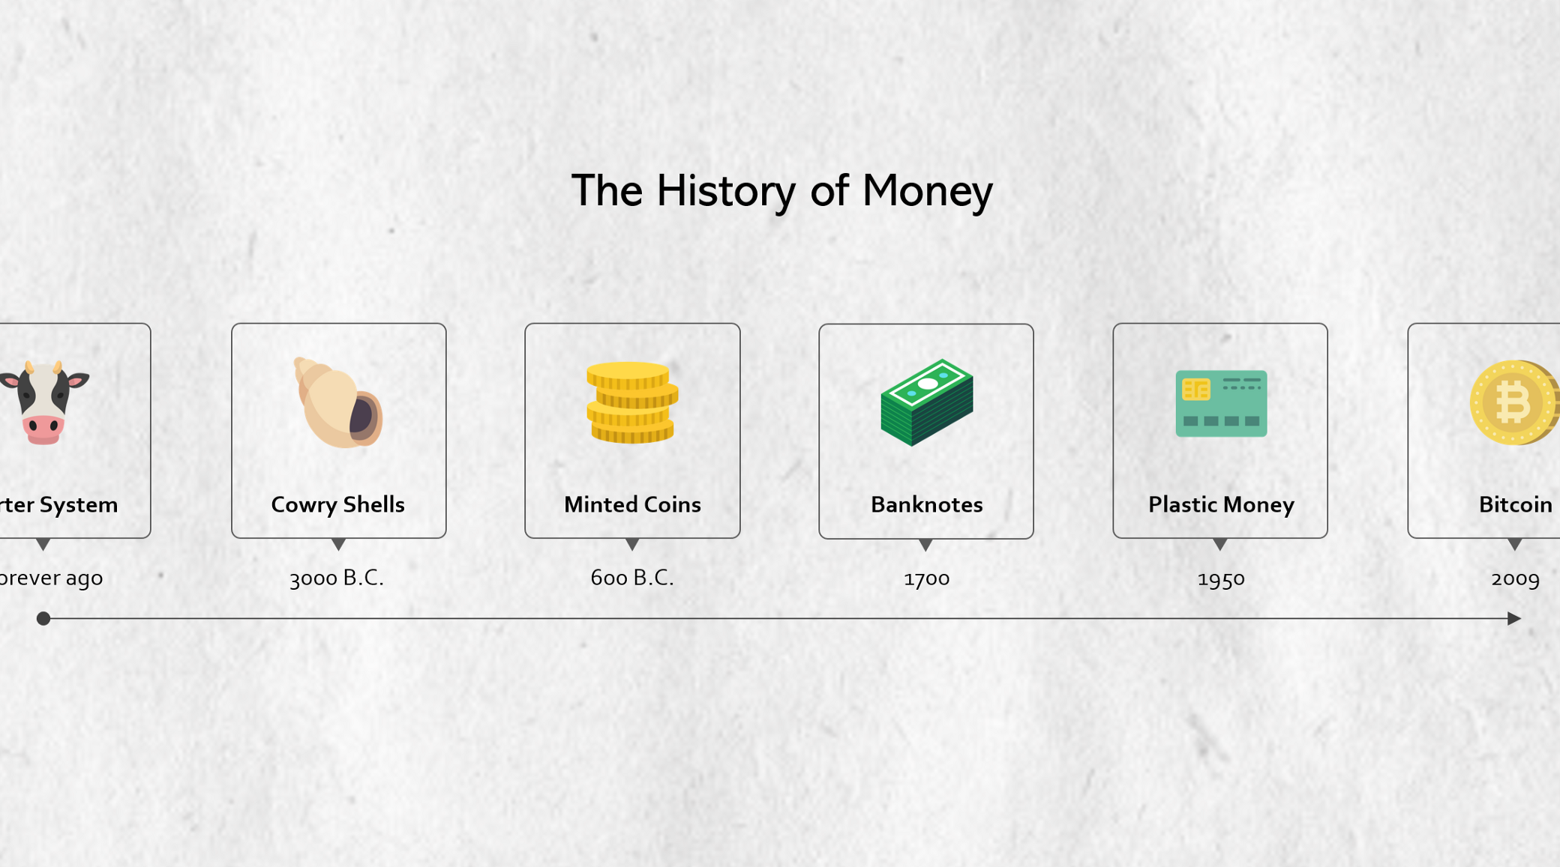





Thank You
y.altunel@iku.edu.tr
Yusuf Altunel, PhD
https://www.linkedin.com/in/yusuf-altunel-2070a31b/
https://cats.iku.edu.tr/portal/site/cd88fc16-3584-46f0-a539-890caf466d53

