Slide 1
Chapter 5
Wallets
Course Notes
CSE0469 Blockchain: Special Topics in SW Engineering
Yusuf Altunel
Based on Mastering Bitcoin 2e; Andreas M. Antonopoulos; O’Reilly, 2017

Slide 2

Content
Wallet Technology Overview
Wallet Technology Details
Nondeterministic (Random) Wallets
Mnemonic Code Words (BIP-39)
Using an Extended Public Key on a Web Store
Creating HD Wallet from the Seed
Deterministic (Seeded) Wallets
HD Wallets (BIP-32/BIP-44)
Seeds and Mnemonic Codes (BIP-39)
Wallet Best Practices
Using a Bitcoin Wallet

Slide 3
Wallets
Semantic
Items Controlled
What is «Wallet» in Block Chain?
What is in control of «Wallet»

Slide 4
Wallets
The word Wallet
is used to describe
a few different things
in bitcoin
At a high level
application
the primary user interface
programmer’s perspective
the data structure
to store and manage a user’s keys

Slide 5
Wallet Usecases
access to a user’s money
managing keys and addresses
tracking the balance
Create and sign transactions

Slide 6
Wallet Technology Overview
Nondeterministic (Random) Wallets
Deterministic (Seeded) Wallets
HD Wallets (BIP-32/BIP-44)
Seeds and Mnemonic Codes (BIP-39)
Wallet Best Practices
Using a Bitcoin Wallet

Slide 7
Wallet Technology Overview
Misconception
«bitcoin wallets
In fact
the wallet
contain bitcoin»
only contains keys

Slide 8
Wallet Technology Overview
Where are «coins»?
on the bitcoin network
Users control the coins
by signing transactions
Wallet = Keychain
bitcoin wallet is a keychain
The “coins” are recorded
in the blockchain
with the keys
in their wallets
Keeps chain of keys

Slide 9
Wallet Technology Overview
Keys not coins
Bitcoin wallets contain keys,
Wallet for User
Each user has a wallet
Wallets are keychains
keeping pairs of
not coins
containing keys
private/public keys

Slide 10
Wallet Technology Overview
Sign with Keys
Users sign transactions
Prove of Ownership
Transaction outputs
The coins are stored on the blockchain
in transaction outputs
often noted as vout
the transaction outputs
TXOUT
or txout
with the keys
can be spent
Transaction Ouptput

Slide 11
Types of Wallet vs Key Relations
2 Wallet Types
There are two primary types of wallets
keys are related to each other
keys are not related to each other
Deterministic
Nondeterministic

Slide 12
Nondeterministic or JBOK wallet
Nondeterministic wallet
each key is independently generated
JBOK wallet
Alias of nondeterministic wallet
Abbreviation
Features
Historically older
from a random number.
Just a Bunch Of Keys

Slide 13
Deterministic Wallet
Seed
master key
Regeneration
All the keys in the wallet
to derive other keys from
are related to each other
keys
can be generated again
from the original seed
Keys are related

Slide 14
Deterministic Wallet
HD Wallet
Hierarchical
The most common
Consistute a tree-like structure
Seed
Deterministic wallets are initialized
Mnemonic
seeds are encoded as words
Deterministic
Tree structure
derivation method
from a seed.
for easier use use

Slide 15
Nondeterministic (Random) Wallets
Historic
Bitcoin Core: the first bitcoin wallet
wallets were collections of
100 Keys
Bitcoin Core client pre-generates
New keys
generated as needed,
using each key only once
100 private keys randomly at the start
Random keys
randomly generated private keys

Slide 16
Nondeterministic (Random) Wallets
Replaced
Random wallets are replaced
Reasons
Hard to manage
with deterministic wallets
back up
import

Slide 17
Nondeterministic (Random) Wallets: Disadvantages
Many keys to backup
keep copies of all keys
backed up wallet frequently
Risk
if wallet becomes inaccessible
the funds are irrevocably lost

Slide 18

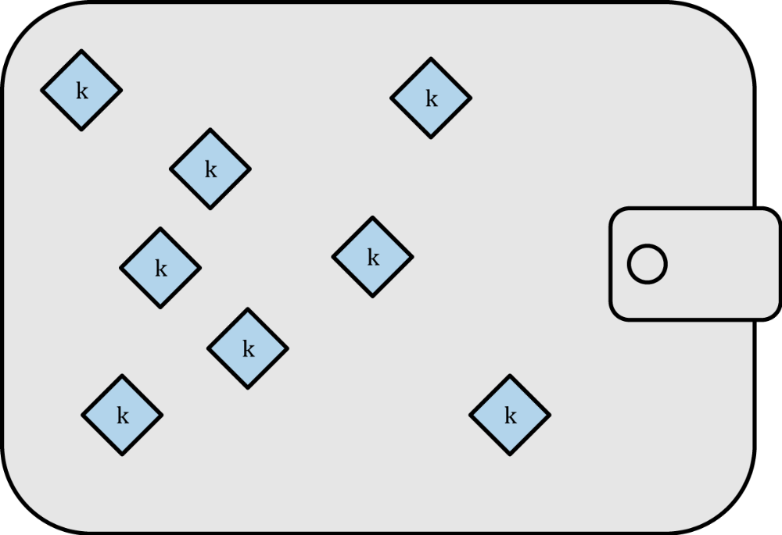
Figure 5-1. Type-0 nondeterministic (random) wallet: a collection of randomly generated keys

Slide 19
Deterministic (Seeded) Wallets
Wallets with Seed
contain private keys
derived from a common seed
one-way hash
Keys are derived through
the use of a one-way hash function.

Slide 20
Deterministic (Seeded) Wallets
Seed
a randomly generated number
“chain code”
Data
index number
combined
with other data

Slide 21
Deterministic (Seeded) Wallets
Recovery
the seed is sufficient
Single backup
a single backup
Seed
between different wallet implementations
to recover all the derived keys
is sufficient
is enough
Easy migration
for a wallet export or import

Slide 22
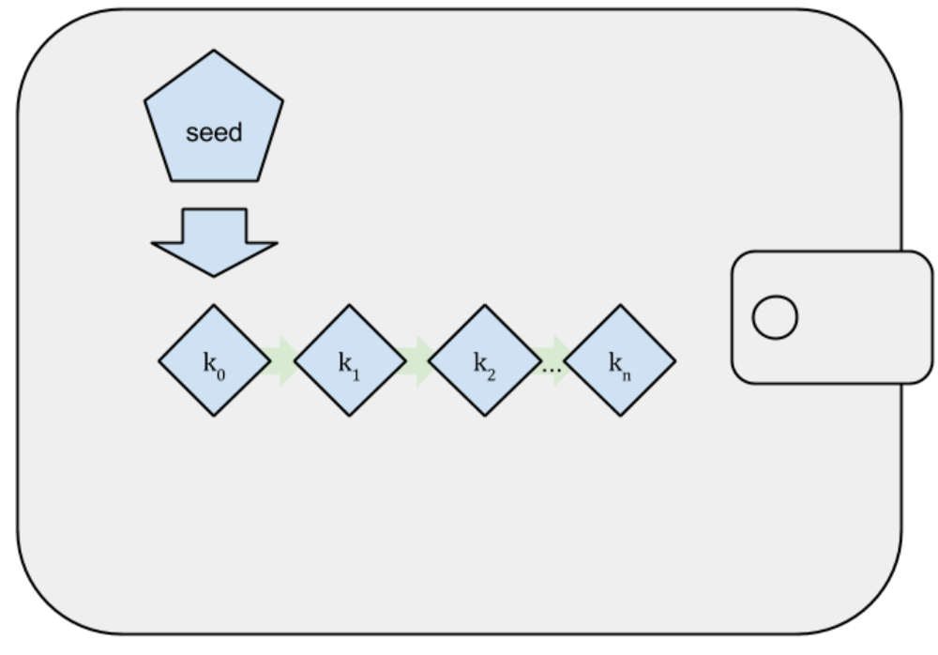
Figure 5-2. Type-1 deterministic (seeded) wallet: a deterministic sequence of keys derived from a seed

Slide 23
HD Wallets (BIP-32/BIP-44)
BIP-32 standard
advanced form of deterministic wallets
Key Hierarchy
HD wallets contain keys
derive a sequence of children keys
Child key
derive a sequence of grandchildren keys successively
to an infinite depth
HD wallet
derived in a tree structure,
Parent key
Infinite depth

Slide 24
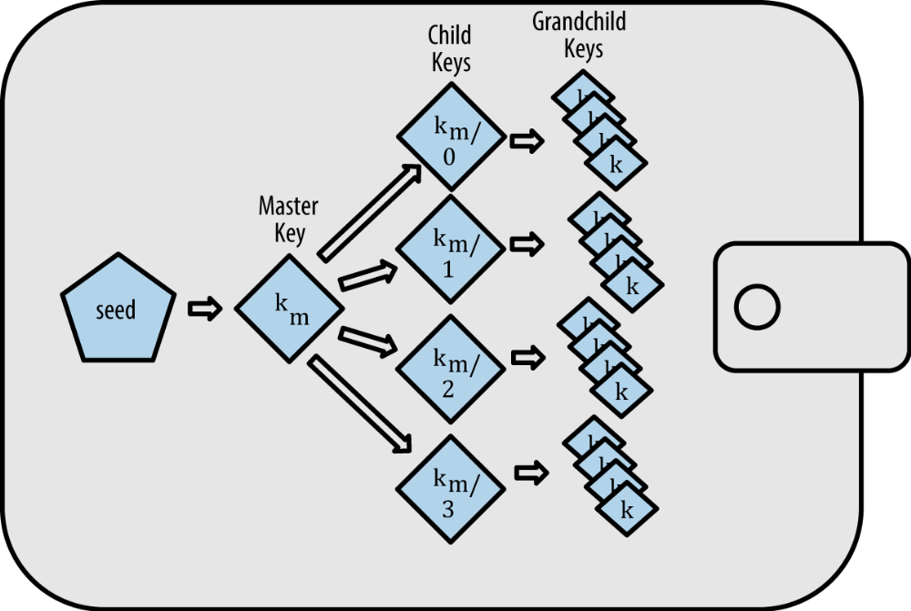
Figure 5-3. Type-2 HD wallet: a tree of keys generated from a single seed

Slide 25
Advantages of HD Wallets
Organizational use
Tree structure
Branches for
Corporate settings
express organizational meaning
departments subsidiaries
incoming/outgoing payments
accounting categories
specific functions
other corporate settings

Slide 26
Advantages of HD Wallets
create sequence of public keys
Secure payment receive
No spending of server
it doesn’t have the private keys
Production public keys
without accessing private keys
A different public key per transaction
on insecure servers
so cannot spend the fund

Slide 27


BIP-39-Seeds and Mnemonic Codes
BIP-39: Mnemonics
interoperable mnemonics
to import and export seeds
using a sequence of English words
Popularity
BIP-39: most common standard for
other cryptocurrencies
bitcoin wallet implementation
for backup and recovery
to create seeds

Slide 28
Seed Mnemonics
Compare
Which of usecases are easier?
to transcribe
record on paper
read without error
export
and import into another wallet
Use cases
Random seed
0C1E24E5917779D297E14D45F14E1A1A
army van defense carry jealous true garbage claim echo media make crunch
Mnemonic

Slide 29
Wallet Best Practices
BIP Standards
BIP-32
wallet interoperability
easy usage
more secure environment
increase the flexibility
Standarts help
BIP-39
BIP-43
BIP-44

Slide 30
Wallet Implementation Standards
BIP-32
Mnemonic code words
BIP-43
Multipurpose
BIP-44
Multicurrency
HD wallets
BIP-39
HD wallet structure
multiaccount wallets
Notes:
These standards may change or
may become obsolete by future developments,
but for now they form a set of interlocking technologies
have become the de facto wallet standard for bitcoin.
The standards have been adopted
by a broad range of software and hardware bitcoin wallets,
making all these wallets interoperable.
A user can
export a mnemonic generated on one of these wallets
and import it in another wallet, recovering all transactions, keys, and addresses.

Slide 31
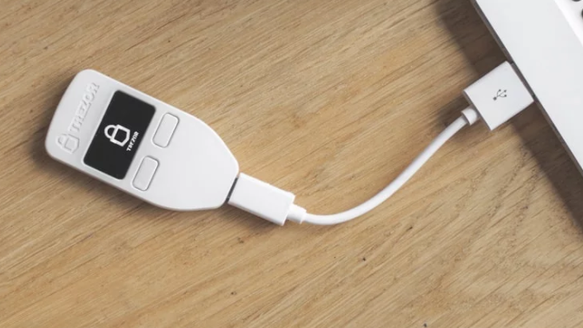
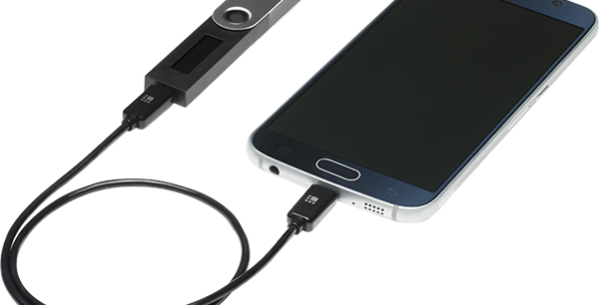
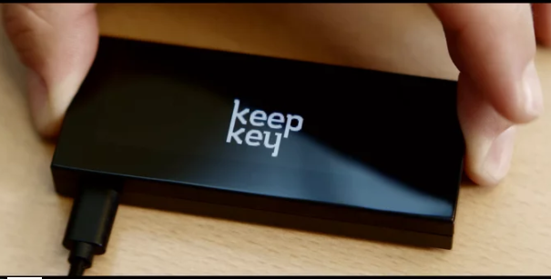
Examples
Software Wallets
supporting the standards
Breadwallert Github
Copay
Mycelium
Hardware Wallets
supporting the standards
Keepkey
Ledger
Trezor
Notes:
Multibit HD: No more supported!

Slide 32
Standards for Implementation
Implementation
bitcoin wallet
seed for backup
should be built as a HD wallet
encoded as mnemonic code
for backup

Slide 33

Hardware Wallet
Trezor
bitcoin hardware wallet
Device
with two buttons
signs transactions
Compliancy
user is not reliant on
to securely bitcoin
stores keys in HD
Usage
any proprietary technology
Trezor is compliant to Standards
Independence
or single vendor solution
simple USB device

Slide 34
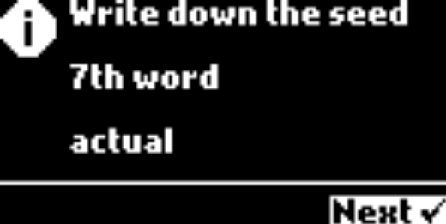
Trezor Usage
Start
for the first time the device
a built-in
Mnemonics
the wallet displays
on the screen
generates a mnemonic and seed
From
hardware random number generator
a numbered sequence of words

Slide 35
Gabriel Case
Create a Backup
writing down the mnemonic
Mnemonic for recovery
for recovery
or in compatible wallets
Sequence is important
each word in the numbered space
in the case of loss or damage
in a new Trezor
Preserve Sequence of words
Recovery

Slide 36
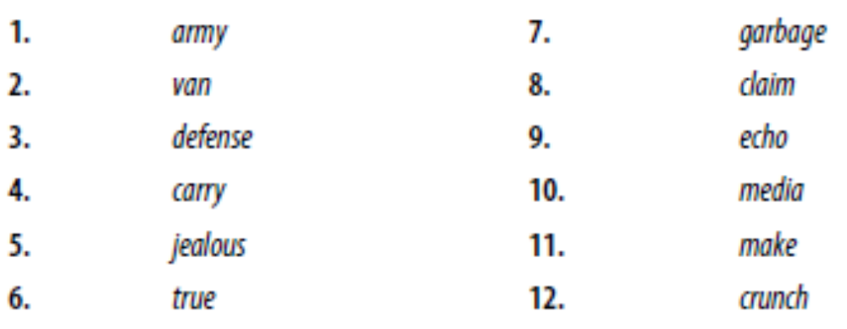
Table 5-1. Example paper backup of the mnemonic
24 Words
Usage
Most hardware wallets generate more secure 24-word mnemonic.
The mnemonic is used in exactly the same way, regardless of length.

Slide 37
Wallet Technology Details
Mnemonic Code Words (BIP-39)
Creating an HD Wallet from the Seed
Using an Extended Public Key on a Web Store

Slide 38
BIP-39: Mnemonic Code Words
Mnemonic code words
Mnemonic code words are word sequences
to represent (encode) a random number
Random seed
used as a seed to derive a deterministic wallet.

Slide 39
BIP-39: Mnemonic Code Words
re-create the keys
and all the derived keys
# of Words to show
at first creation of wallet
from the sequence of words
12 to 24 words

Slide 40
BIP-39: Mnemonic Code Words
Backup
The sequence of words
is the wallet backup
Recovery
sequence of words
all the keys
can be used to recover and re-create
in the same technology
Options
or any compatible wallet

Slide 41
BIP-39: Mnemonic Code Words
Mnemonic words
easier for users
to back up wallets
random seeds vs mnemonic
easy to read
and correctly transcribe

Slide 42
«Brainwallets» vs «Mnemonics»
Brainwallets vs Mnemonic words
often confused with “brainwallets.”
Brainwallet
consists of words chosen by the user
Mnemonic words
are created randomly by the wallet

Slide 43
«Brainwallets» vs «Mnemonics»
Security
mnemonic words
Reason
humans are very poor sources
much more secure
of randomness

Slide 44
BIP-39 vs Electrum Wallet
BIP-39
was proposed by the company
behind the Trezor hardware wallet
BIP-39 vs Electrum
is incompatible with
Electrum
a different standard
De facto standard
BIP-39 is achieved broad industry support
dozens of interoperable implementations
Electrum’s implementation.
with a different set of words

Slide 45
Generating mnemonic words
Automated
Mnemonic words automatically
BIP-39 Compliant
Word generation
Compliant to BIP-39
by the wallet
generated

Slide 46
Steps of mnemonic word generation
start
Add
map
to a word list
from a source of entropy
a checksum
the entropy

Slide 47
Generating mnemonic words
Random sequence
Checksum
Add to the end of the sequence
11 bits sections
Map each 11-bit value
2¹¹
Create a random sequence
from 128 to 256 bits
Take its first 32 bits
SHA256 hash of sequence
Divide the sequence
into sections of 11 bits.
2048 words
to a word
from a predefined 2048 words.
=2048

Slide 48
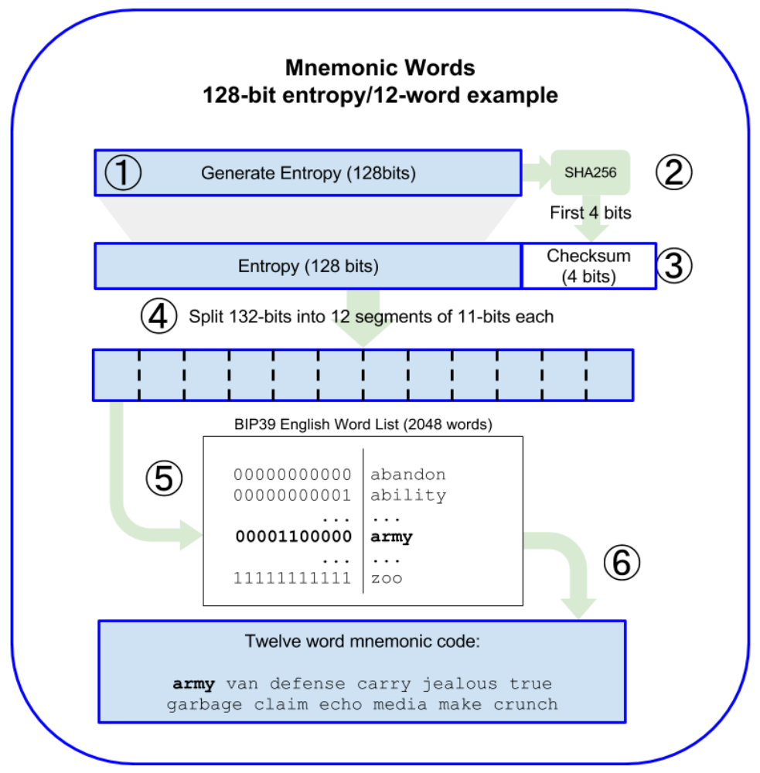
Figure 5-6. Generating entropy and encoding as mnemonic words

Slide 49
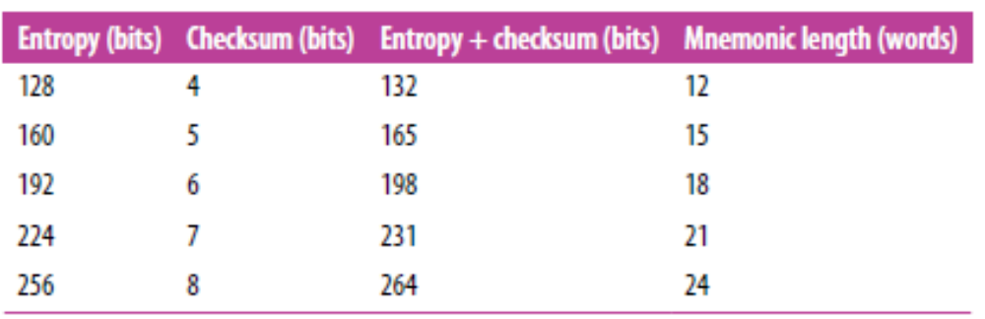
Table 5-2. Mnemonic codes: entropy and word length

Slide 50
From mnemonic to seed
Mnemonic words
words represent entropy
with a length of 128 to 256 bits.
Seed
The entropy is used
to derive a 512-bit seed
Keys from Seed
derive HD wallet keys
from the seed
Key stretching
PBKDF2: Password-Based Key Derivation Function
key-stretching function

Slide 51
From mnemonic to seed
key-stretching function
takes two parameters:
the mnemonic and a salt
Salt
make it difficult
Passphares
additional security factor
to build a lookup table
protecting the seed

Slide 52
Next Steps in “Generating mnemonic words”
PBKDF2
2048 rounds of hashing
Produces
The Seed
stretches the mnemonic
HMAC-SHA512
a 512-bit value
That 512-bit value
is the seed.
and salt parameters
as its final output

Slide 53
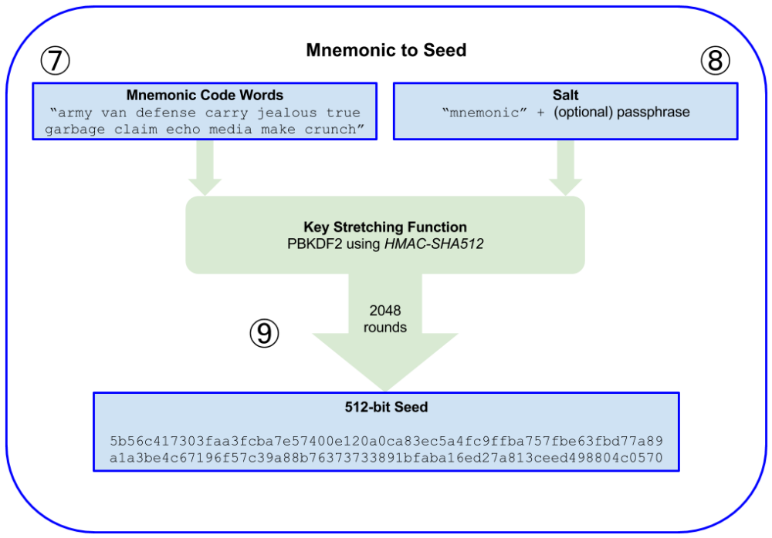
Figure 5-7 shows how a mnemonic is used to generate a seed.

Slide 54
Protection
key-stretching function
Against breach
the mnemonic
makes it computationally costly
# of Possible Seeds
Cost of Attack
or the passphrase
is 2⁵¹²
to protect against brute-force attacks
2048 rounds of hashing

Slide 55
Optional passphrase in BIP-39
The BIP-39
Standard allows use of
If no phrase
the mnemonic is stretched
Product
producing a specific 512-bit seed
from any given mnemonic
optional passphrase
with a salt "mnemonic"

Slide 56
Optional passphrase in BIP-39
Passphrase affect
a passphrase leads to
Seed entropy
every possible passphrase
a different seed
leads to a different seed

Slide 57
Passphares
passphrase
Protect backup
protect mnemonic backups
Distract attacker
two important features
creates
from compromise by a thief
from the “real” wallet
containing the majority of funds
“duress wallet”
wallet with small amount of funds

Slide 58
Risks of Passphrase
Risks
use of passphrase
introduces risks of loss
Owner’s safety
wallet owner is incapacitated
or dead
Impact of loss
the seed is useless
funds in the wallet are lost forever

Slide 59
Risks about Passphrase
Backup together
No gain
it defeats the purpose of
in the same place as the seed
the passphrase might be backed up
a second factor protection

Slide 60
Backup & Recovery
Survival
to recover the
cryptocurrency estate
inheritors
family
other parties

Slide 61
Working with mnemonic codes
Libraries
BIP-39 is implemented as a library
python-mnemonic
bitcoinjs/bip39
JavaScript BIP-39 implementation
as part of the bitcoinJS framework
libbitcoin/mnemonic
BIP-39 implementation in C++
in many different programming languages:
reference implementation SatoshiLabs team
of the BIP-39 standard
as part of Libbitcoin framework

Slide 62
Working with mnemonic codes
BIP-39 generator
testing
Web page
Access
https://iancoleman.io/bip39/
experimentation
implemented
in a standalone web page
Notes:
11.04.2020

Slide 63
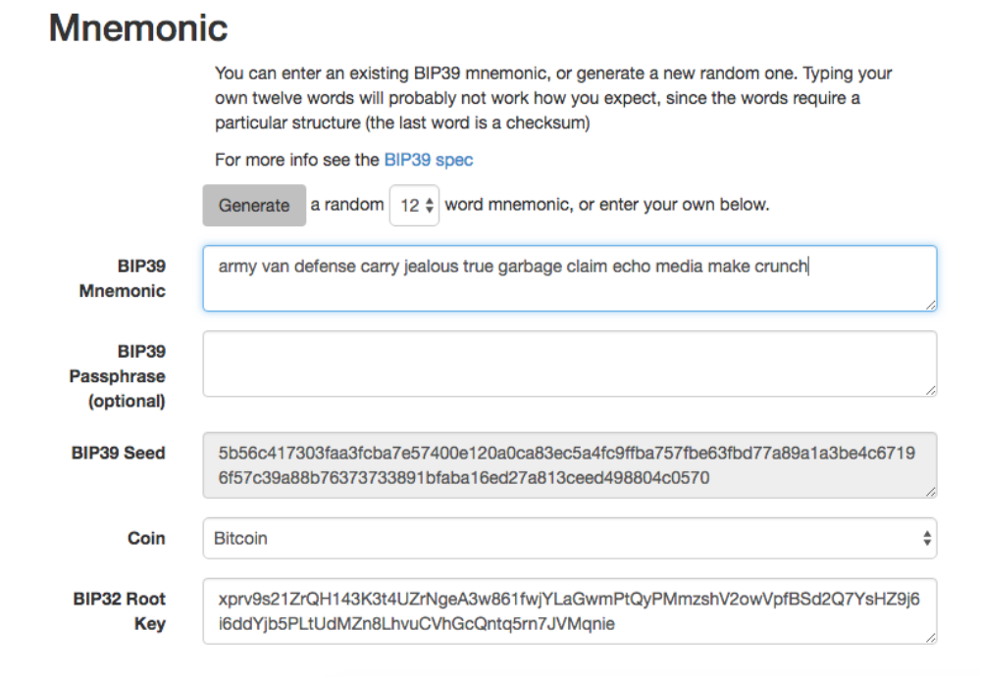
Figure 5-8. A BIP-39 generator as a standalone web page

Slide 64
Creating an HD Wallet from the Seed
HD wallets
random number
Root seed size
created from
Root seed
a single root seed
generated from a mnemonic
128
256
512-bit

Slide 65
Creating an HD Wallet from the Seed
Mnemonic to Root seed
derived from the root seed
Recreation
any compatible HD wallet
can recreate the entire wallet
Every key in the HD wallet is
Root Seed to Keys
the root seed
is derived from mnemonic
Mnemonic
Root Seed
Keys

Slide 66
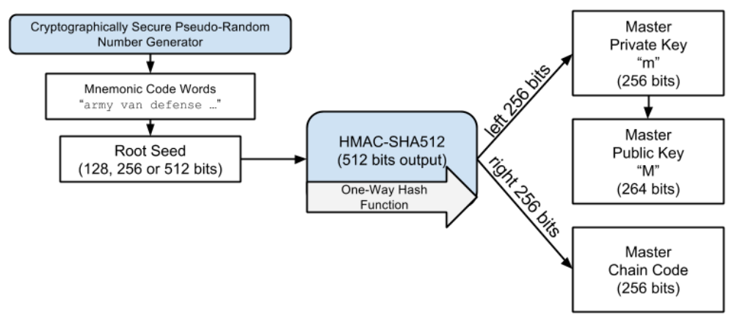
Figure 5-9. Creating master keys and chain code from a root seed
Random Number
Root Seed
SHA 512
Mnemonic
Master Chain Code: Right 256 Bits
Master Private Key: Left 256 Bits

Slide 67
Root Seed, Master Key, Chain Code
The root seed
input into the HMAC-SHA512 algorithm
Result
a master chain code.
master private key
to generate master public key
elliptic curve multiplication process
to introduce entropy in the function
a master private key
m
The chain code
master public key
c
M = m * G
to create child keys from parent keys
Master Private Key
Master Public Key
Random Number
Mnemonic
Root Seed
Master Chain Code

Slide 68
Private child key derivation
Child keys
derived from parent
Child Key Derivation function
CKD Combines
private key
Seed
a chain code
Index
index number
A Parent
Parent
Seed
Index
using a child key derivation function
or public key
256 bits
32 bits
based on one-way hash function

Slide 69
Chain Code
chain code
the index and child key is not sufficient
Secure the siblings
to introduce
deterministic random data
Secure the children
to find child’s sibling keys
to derive other child keys
using the child key
chain code prevents

Slide 70
Chain Code
is generated from the seed
Subsequent Chain Codes
derived from
at the root of the tree
The initial chain code
parent chain codes

Slide 71
Children Key Production
Children keys
combine
hash
512-bit hash
combine
hash with the HMAC-SHA512 algorithm
parent key
chain code
index
to generate
parent public key
chain code
index number
children keys
to produce a 512-bit hash

Slide 72
Children Key Production
Split 512-bit hash
into two 256-bit halves
The right-half
become the chain code
The left-half
production steps
to the parent private key
for the child: 256 bits
used in prodcution of
child private key
add 256 bits of the hash

Slide 73
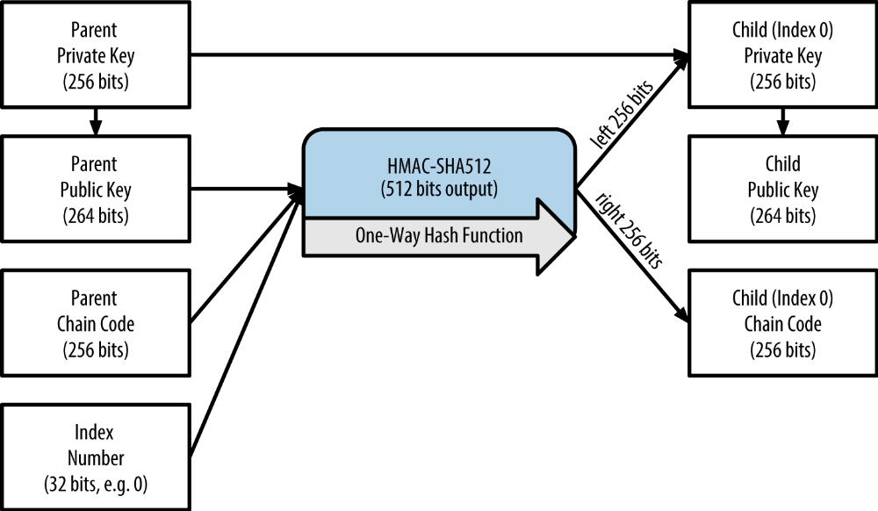
Figure 5-10. Extending a parent private key to create a child private key

Slide 74
Indexes
Other Children
Child 0
create the other children
in the sequence
Such as
the index is changed
to extend the parent
Steps
Child 1
Child 2
…

Slide 75
Indexes
2³¹ children
Parent capacity
2,147,483,647
around 2 Billions
Leveling
Repeating the process
one level down the tree
Intermediate Node
each child can become a parent
to create its own children
# of generations
in an infinite number of generations.

Slide 76
Usage of derived child keys
Child private keys are random
the derivation function is
the child key cannot be used
siblings cannot be found
Randomness
One way function
Inaccessible Siblings
as if a random key
a one-way function
Unreachable Parent
to find the parent key
from the child keys

Slide 77
Using derived child keys
Children are protected
parent key and chain code
can derive all the children
are needed
can be started with
and the child chain code
New branch
Grandchild derivation
the child
the child private key
child chain code

Slide 78

Usage of Child Private Key
to generate
to sign transactions
to spend anything
child private key
Signature
a public key
a bitcoin address
paid to that address
Signing
Elliptic Curve Multiplication
ripemd160
Private Key
Public Key
Bitcoin Adress

Slide 79
Derived Keys
bitcoin address
Randomness
all are indistinguishable
from random keys and addresses
public key
Visibility
nobody can see them
outside of the HD wallet
child private key
Keys
Once created
Can be used as normal keys
Provide a Sequence

Slide 80
Derived Keys: Extended keys
at any level of tree
a key
Extensible keys
Inputs
index of the desired child
Extended Key
Combination of
Key and Child code
Can be used
to derive new children keys
a chain code

Slide 81
Chain Code
Index Value
CKD
(HMAC-SHA512)
Private Key
CKD
(HMAC-SHA512)
Private Key
CKD
(HMAC-SHA512)
Parent
Child
Ecliptic Curve Multiplication
Ecliptic Curve Multiplication
Chain Code
Index Value
CKD
(HMAC-SHA512)
Public Key
CKD
(HMAC-SHA512)
CKD
(HMAC-SHA512)
Public Key
Parent
Child

Slide 82
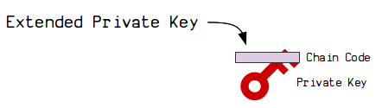
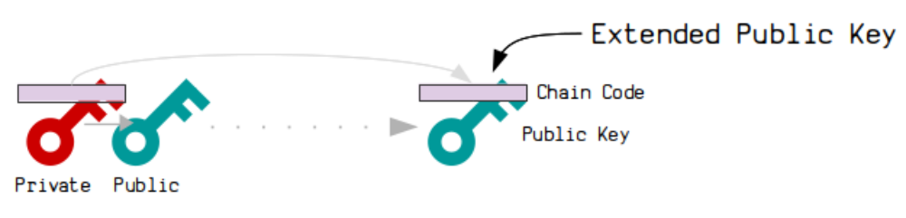
Key Extending
Extended keys
extended private key
extended public key
concatenation
Key Types
Key: 256-bit
Chain Code: 256-bit
512 Bits
https://learnmeabitcoin.com/technical/extended-keys

Slide 83
Extended Keys
combination of
used to
is a public key
Extended Private Key
Extended Public Key
used to
a private key
chain code
derive child private keys
and chain code
create child public keys

Slide 84
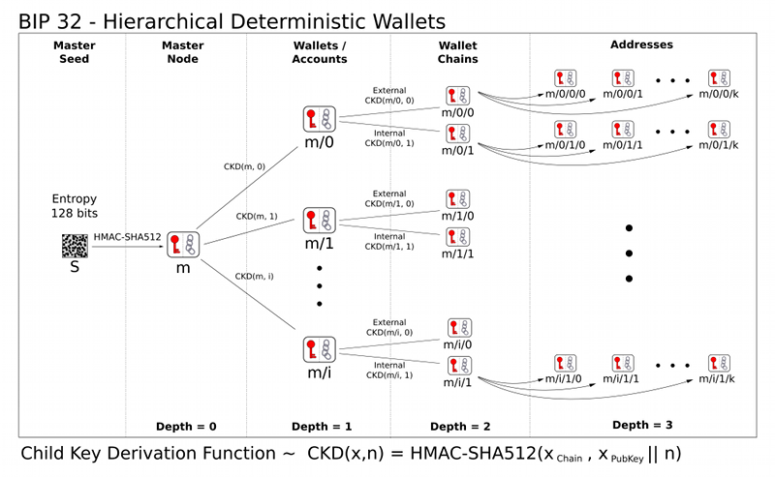
Extended Key: Root of Branch
Root of Branch
Access or derive
in the HD wallet tree structure
Access to Rest
the rest of the branch

Slide 85
Extended Key Sharing
Extended key
To share
give access to the branch
share extended key
Generation
Key + Chain Code
Extended key is enough
to derive the rest

Slide 86
Encoding Extended Keys
Extended keys
are encoded
Between Wallets
Base58Check
Simplify transfer
different
Simplification of
BIP-32–compatible wallets
export and import

Slide 87
Encoding Extended Keys: Version Number
Version Number
Uses Special Version Number
For Extended Key
prefix “xprv”
Encoded public key
“xpub”
Extended private key
Base58Check coding

Slide 88
Example: Extended Private Key
starts with xprv
xprv9tyUQV64JT5qs3RSTJkXCWKMyUgoQp7F3hA1xzG6ZGu6u6Q9VMNjGr67Lctvy5P8oyaYAL9CAWrUE9i6GoNMKUga5biW6Hx4tws2six3b9c
Base58Check
Example
extended private key

Slide 89
Example Extended Public Key
extended public key
xpub67xpozcx8pe95XVuZLHXZeG6XWXHpGq6Qv5cmNfi7cS5mtjJ2tgypeQbBs2UAR6KECeeMVKZBPLrtJunSDMstweyLXhRgPxdp14sk9tJPW9
Base58Check
Example
starts with xpub

Slide 90
Public child key derivation: Alternatives
Child Public Key
Child public key
from the
1.From child Private Key
1.
2.
parent public key
from the child private key
2. From parent Public Key
Child Private Key
Child Public Key
Parent Public Key

Slide 91
Chain Code
Index Value
CKD
(HMAC-SHA512)
Private Key
Elliptic Curve Multp.
Child
Public Key
Private Key
Parent
Child
Public Key
Chain Code
Index Value
Elliptic Curve Multp.
CKD
(HMAC-SHA512)
Parent

Slide 92
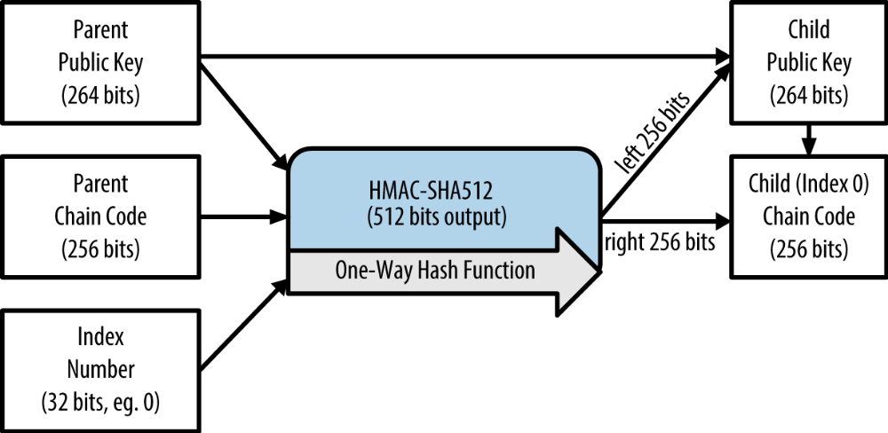
1.From Parent Public Key: Method
Figure 5-11. Extending a parent public key to create a child public key

Slide 93
1. From Parent Public Key: Protection
Secure deployment
creates very secure
No private keys
a server or application
no private keys
public key–only deployments
Only public keys
extended public key available
on server or application

Slide 94
1. From Parent Public Key: E-Commerce
E-Commerce Solution
install an extended public key
Key Reproduction
create new bitcoin address
Protection
no private keys on servers
on a web server
Job
for every transaction of shopping cart
use the public key derivation function
can derive infinite number of public keys
vulnerable to theft.

Slide 95
1.From Parent Public Key: Cold Storage
Cold-storage
physical storage like paper wallet
extended private key
can be kept online
Physical storage
Online
hardware wallets like Trezor
can be physically stored
Extended Public key

Slide 96
1.From Parent Public Key: Receving Funds
Fund Receiving
“receive” addresses at will
while the private keys are safely stored offline.
Fund Spending
the user can use the extended private key
on an offline signing bitcoin client
or sign transactions on the hardware wallet device
To spend the funds
The user can create

Slide 97
1.From Parent Public Key: Gabriel’s Case
Let’s see how HD wallets are used
by continuing our story with Gabriel’s web store.
Gabriel first set up his web store as a hobby,
based on a simple hosted Wordpress page.
His store was quite basic
with only a few pages and
an order form with a single bitcoin address.
HD Wallet on Web Store
Simple Word Press Page
Basic Store

Slide 98
Gabriel’s Case
Gabriel used the first bitcoin address generated by his Trezor device
as the main bitcoin address for his store.
This way, all incoming payments would be paid
Customers would submit an order using the form
triggering an email with the order details
this system worked well enough
Address from Trezor
Wallet controlled by Trezor
Well for Few Orders
Order Form
to an address controlled by his Trezor hardware wallet.
and send payment to Gabriel’s published bitcoin address
Trigger Email
for Gabriel to process.
just a few orders each week

Slide 99
Gabriel’s Case
However, the little web store became quite successful
and attracted many orders from the local community.
Soon, Gabriel was overwhelmed.
With all the orders paying the same address
it became difficult to correctly match orders and transactions
especially when multiple orders
for the same amount came in close together.
New Orders
Too Processes
Match Orders
The same Amount

Slide 100
Gabriel’s Case
Better solution
offers a much better solution
Child public key
without knowing the private keys.
xpub
to derive a unique address for every customer order.
Spend from Trezor
but the xpub loaded on the website
can only generate addresses and receive funds.
Security
Gabriel’s website does not contain any private keys
and therefore does not need high levels of security.
Gabriel’s HD wallet
through the ability to derive public child keys
Gabriel can load an extended public key (xpub) on his website
Gabriel can spend the funds from his Trezor,
This feature of HD wallets is a great security feature.

Slide 101
Gabriel’s Case
Export
To export the xpub Gabriel uses the web-based software
in conjunction with the Trezor hardware wallet.
Plug in
The Trezor device must be plugged in
for the public keys to be exported.
Note
hardware wallets will never export private keys
those always remain on the device

Slide 102
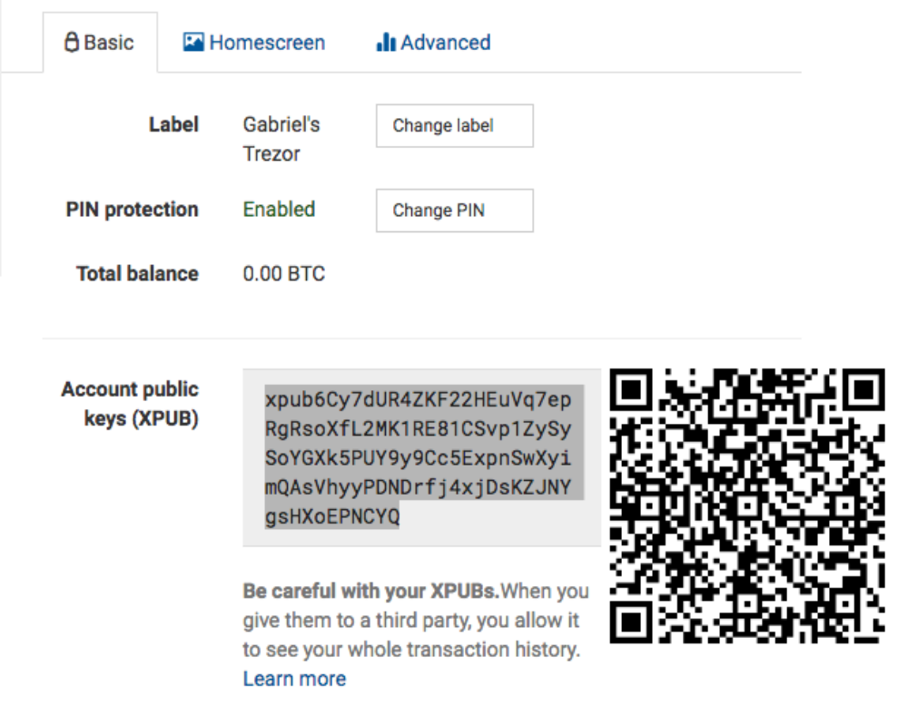
Figure 5-12. Exporting an xpub from a Trezor hardware wallet

Slide 103
Gabriel’s Case
Gabriel copies the xpub
to his web store’s bitcoin shop software.
He uses Mycelium Gear
which is an open source web-store plugin
for a variety of web hosting and con tent platforms.
Mycelium Gear uses the xpub
to generate a unique address for every purchase.
Copy xpub
Web-Store Plugin
Unique Addresses for Purchases

Slide 104
Hardened child key derivation
to derive a branch of public keys
from an xpub
Leakage of private child key
the chain code
to derive all the other child private keys
Useful feature
Potantial harm
Potential risk
xpub contains the chain code
xPRV

Slide 105
Hardened child key derivation
Parent private key
Accident
Risk-2
All child private keys
Leakage of child private key
Risk-1
with parent chain code
can be deduced
can be deduced

Slide 106
Hardened child key derivation
HD wallets use
between
and child chain code
Hardened Derivation
Counter risk
an alternative derivation function
Break Relationship
parent public key
Parent-Child Chain

Slide 107
Hardened child key derivation
to derive the child chain code
in the parent/child sequence
using the chain code
use the parent private key
Creates a Firewall
not the parent public key
No Key Compromisation
a parent or sibling private key
cannot be compromised

Slide 108
Hardened child key derivation
The hardened derivation function
looks almost identical
the parent private key
is used as input to the hash function
not the parent public key
Identical function
Difference
to the
normal child private key derivation

Slide 109
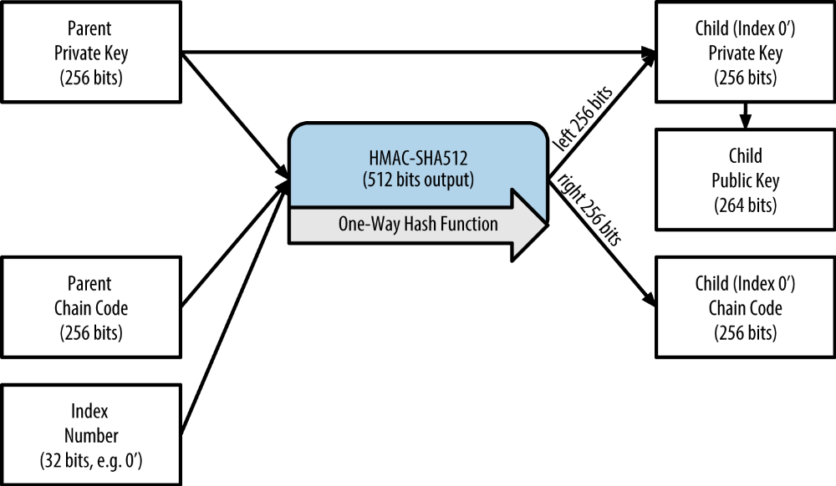
Hardened child key derivation
Figure 5-13. Hardened derivation of a child key; omits the parent public key

Slide 110
Hardening Derivation
from normal derivation function.
can be used to produce
The resulting “branch” of keys
derivation is different
extended public keys
Derivation
and chain code
child private key

Slide 111
Hardening Derivation
create a “gap” in the tree
Protection
the chain code
to reveal any private keys
Reason
cannot be exploited
Hardened derivation

Slide 112
Best Practice
rather than a normal parent
are always derived
to prevent compromise
Derive from Hardened Parent
master keys level-1 children
through the hardened derivation
Reason
of the master keys

Slide 113
Index numbers for normal and hardened derivation
index numbers
the normal derivation
indexes: 32-Bit Integer
Distinguish
hardened derivation
two range indexes
normal derivation
hardened derivation
Split
is a 32-bit integer
in the derivation function

Slide 114
Index numbers for normal and hardened derivation
Index numbers
Index numbers
Normal Derivation
Hardened Derivation
Index <2³¹
between
between
0: 0x0
2³¹–1: 0x7FFFFFFF
Index >=2³¹
2^{31:} 0x80000000 and
2³²–1: 0xFFFFFFFF

Slide 115
Index numbers for normal and hardened derivation
displayed as 0
When you see an HD wallet index i
First Normal Child
HD wallet index i
displayed as 0’
First Hardened Child
Second hardened key
be displayed as 1’
that means 2³¹+i.
and so on
2’
3’
…
index 0x80000000
would have index 0x80000001

Slide 116
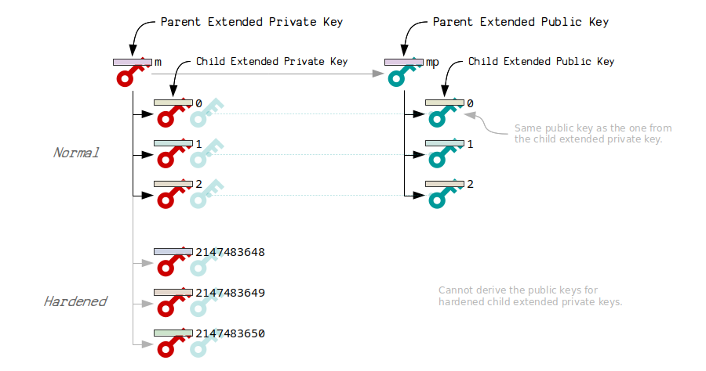
https://learnmeabitcoin.com/technical/extended-keys

Slide 117
HD Wallet Key Identifier (Path)
Keys in an HD wallet are identified using a “path” naming convention
Private keys derived from the master private key
Path Convention
Master Private Key
with each level of the tree separated by a slash (/) character.
start with “m.”

Slide 118
HD Wallet Key Identifier (Path)
Public keys derived from the master public key start with “M.”
Public Keys Derived from «m»
First Child
The second grandchild
Second Grandchild
m/0/1, and so on.
private key is m/0
Public Key is M/0.
of the first child is

Slide 119
HD Wallet Key Identifier (Path)
Finding Master Key
The “ancestry” of a key is read from right to left
until you reach the master key from which it was derived.
Identifier m/x/y/z
the z^{th} child of key m/x/y
which is the y^{th} child of key m/x
which is the x^{th} child of m

Slide 120
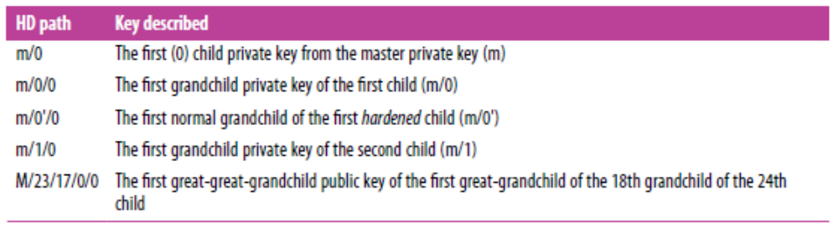
HD Wallet Key Identifier (Path)
Table 5-6. HD wallet path examples

Slide 121
Navigating The HD Wallet Tree Structure
The HD wallet tree structure offers tremendous flexibility.
Each parent extended key can have 4 billion children:
Each of those children can have another 4 billion children, and so on.
Flexibility of HD Structure
4 Billion Children
2 billion normal children and 2 billion hardened children.
Next Level

Slide 122
Navigating The HD Wallet Tree Structure
The tree can be as deep as you want, with an infinite number of generations.
With all that flexibility, however, it becomes quite difficult to navigate this infinite tree.
It is especially difficult to transfer HD wallets between implementations,
because the possibilities for internal organization into branches and subbranches are endless.
Tree Height
Navigation
Transfer of Wallets

Slide 123
Navigating The HD Wallet Tree Structure
Two BIPs offer a solution to this complexity
BIP-43
Based on BIP-43, an HD wallet should use only one level-1 branch of the tree,
For example, an HD wallet using only branch m/i/
Solutions
by creating some proposed standards for the structure of HD wallet trees.
proposes the use of the first hardened child index
as a special identifier
that signifies the “purpose” of the tree structure.
1 Level Per Branch
with the index number identifying the structure and namespace of the rest of the tree by defining its purpose.
m/i/
is intended to signify a specific purpose
and that purpose is identified by index number “i”

Slide 124
Navigating The HD Wallet Tree Structure
Extending that specification,
All HD wallets following the BIP-44 structure are
Multiaccount Structure
BIP-44 structure
BIP-44 proposes a multiaccount structure
as “purpose” number 44 under BIP-43.
identified by the fact that
they only used one branch of the tree: m/44/.

Slide 125
Navigating The HD Wallet Tree Structure
BIP-44 specifies the structure
m / purpose
5 Predefined Tree Levels
1
/ account
/ coin_type
/ change
/ address_index
as consisting of five predefined tree levels
Levels
2

Slide 126
Navigating The HD Wallet Tree Structure
Bitcoin is m/44'/0',
The third level
two bitcoin “accounts”
The first-level
The second-level
“purpose” is always set to 44’.
“coin_type” specifies the type of cryptocurrency coin,
allowing for multicurrency HD wallets
where each currency has its own subtree under the second level.
3 Currencies
Bitcoin Testnet is m/44'/1',
Litecoin is m/44'/2'.
is “account,”
which allows users to subdivide their wallets into separate logical subaccounts,
for accounting or organizational purposes.
For example, an HD wallet might contain two bitcoin “accounts”:
m/44'/0'/0'
and m/44'/0'/1'.
Each account is the root of its own subtree.

Slide 127
Navigating The HD Wallet Tree Structure
The fourth level
Normal derivation
This is to allow this level of the tree
Usable addresses are derived by the HD wallet
For example,
“change,” an HD wallet has two subtrees,
one for creating receiving addresses
and one for creating change addresses.
Note that whereas the previous levels used hardened derivation,
this level uses normal derivation.
Usage
to export extended public keys
for use in a non-secured environment.
Fifth level
as children of the fourth level,
making the fifth level of the tree the “address_index.”
the third receiving address for bitcoin payments
in the primary account would be M/44'/0'/0'/0/2.

Slide 128
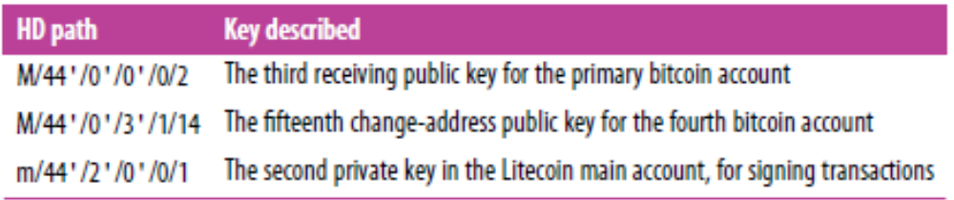
Table 5-7. BIP-44 HD wallet structure examples

Slide 129

Discussions
Your opinion
Challenging
Clarification
Critical issue
What do you think on this chapter?
What is the most interesting point?
What are the unclarified points?
Select and explain a critical issu in this chapter

Slide 130
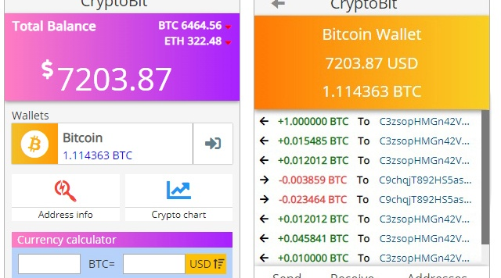





Thank You
y.altunel@iku.edu.tr
Yusuf Altunel, PhD
https://www.linkedin.com/in/yusuf-altunel-2070a31b/
https://cats.iku.edu.tr/portal/site/cd88fc16-3584-46f0-a539-890caf466d53

