Slide 1
Chapter 6
Transactions
Course Notes
CSE0469 Blockchain: Special Topics in SW Engineering
Yusuf Altunel
Based on Mastering Bitcoin 2e; Andreas M. Antonopoulos; O’Reilly, 2017

Slide 2
Content
Introduction
Transactions in Detail
Transaction Outputs & Inputs
Transaction Script & Script Language
Digital Signatures
Bitcoin Addresses, Balances, & Other Abstractions

Slide 3
Bitcoin is Designed for Transactions
Transactions
the most important part
Most critical part
Everything else in bitcoin
Life of Transaction
created
propagated on the network
validated
added to the global ledger
of the bitcoin system.
is designed for transactions

Slide 4
Transactions are Data Structures
data structures
encode the transfer of value
Public Entries
Each transaction is
Bitcoin Blockchain
the global double-entry
between bitcoin participants
a public entry in blockchain
bookkeeping ledger

Slide 5
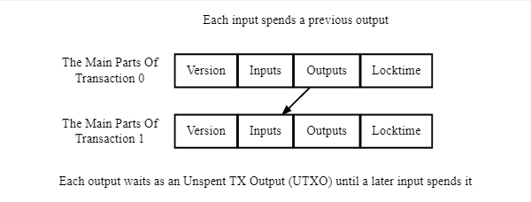
Spending Concept of Blockchain
UTXO
Unspent Transaction Output
TXO
Transaction Output
Spending
TXO is unspent
Until appears in Input of a Transaction

Slide 6
Chapter 6
Examine
various forms of transactions
Containment
what they contain
how to create them
how they are verified
how they become permanent records
Creation
Verification
Stone

Slide 7
Transactions in Detail
Transactions: Behind the Scenes

Slide 8
Example Alice’s Case
to Bob’s “address.”
a simplified view
what is contained
much of the information shown
Artificial contstruction
is constructed by the block explorer
The block explorer
shows a transaction
from Alice’s “address”
Adresses
in a transaction

Slide 9

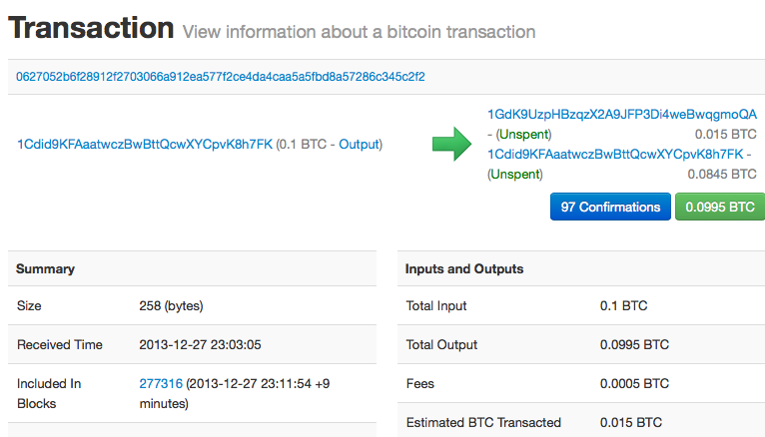
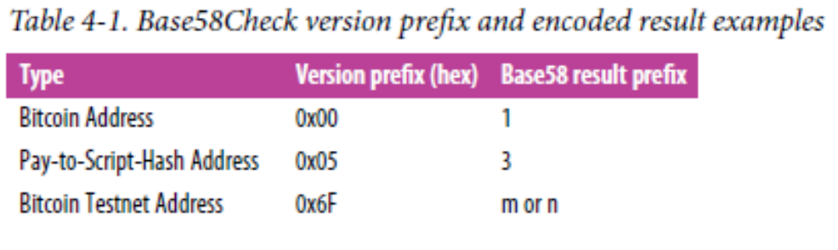
Table 4-1 first appeared on Chapter 4: Keys & Addresses as slide 71
Notes:
Table 4-1 first appeared on Chapter 4: Keys & Addresses as slide 71

Slide 10
Transactions—Behind the Scenes
Artificial constructs
represented information
not in the bitcoin system
Bitcoin command line
getrawtransaction
Alice’s “raw” transaction
retrieve
see what it contains
Bitcoin Core’s command-line interface
decoderrawtransaction
Commands
decode

Slide 11
{
"version": 1,
"locktime": 0,
"vin": [
{
"txid":
"7957a35fe64f80d234d76d83a2a8f1a0d8149a41d81de548f0a65a8a999f6f18",
"vout": 0,
"scriptSig" :
"3045022100884d142d86652a3f47ba4746ec719bbfbd040a570b1deccbb6498c75c4ae24cb02204
b9f039ff08df09cbe9f6addac960298cad530a863ea8f53982c09db8f6e3813[ALL]
0484ecc0d46f1918b30928fa0e4ed99f16a0fb4fde0735e7ade8416ab9fe423cc5412336376789d1
72787ec3457eee41c04f4938de5cc17b4a10fa336a8d752adf",
"sequence": 4294967295
}
],
"vout": [
{
"value": 0.01500000,
"scriptPubKey": "OP_DUP OP_HASH160
ab68025513c3dbd2f7b92a94e0581f5d50f654e7 OP_EQUALVERIFY OP_CHECKSIG"
},
{
"value": 0.08450000,
"scriptPubKey": "OP_DUP OP_HASH160
7f9b1a7fb68d60c536c2fd8aeaa53a8f3cc025a8 OP_EQUALVERIFY OP_CHECKSIG",
}
]
}

Slide 12
Transaction Content
Where is
Bob’s address?
the 0.1 input “sent” by Alice?
Not part of bitcoin
coins
senders
recipients
balances
accounts
addresses
Alice’s address?

Slide 13
Transaction Content
Constructed
to make things easier
Real transactions
hexadecimal strings
to understand
made up of actual data
strange & indecipherable fields
Seems to contain
different from what users see

Slide 14
Transaction Outputs & Inputs
TXO &TXI
Transaction Inputs
Transaction Fees
Adding Fees to Transactions
Transaction Outputs

Slide 15
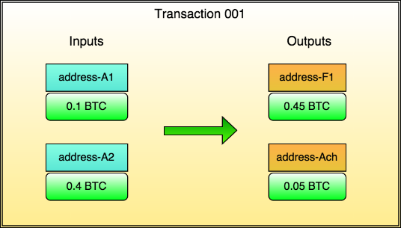
Transaction Outputs & Inputs
transaction output
The fundamental building block
Indivisible Chunks
Transaction outputs
recorded on the blockchain
are indivisible chunks of bitcoin currency
Resides on
of a bitcoin transaction

Slide 16
Transaction Outputs & Inputs
recognized as valid
UTXO
Validity
by the entire network
all available
and spendable outputs
known as
unspent transaction outputs
Spendable

Slide 17
UTXO Set
UTXO set
The collection of all UTXO
Grows
when new UTXO
when UTXO is consumed
Transactions
and its state
Shrinks
millions of UTXO’s
means spent
changes the UTXO set
grows & shrinks
at any time
is created

Slide 18

Wallet Balance
Receiving Bitcoin
Wallet’s key
Transaction output
Balance
Wallet detects UTXO
is the sum of all UTXO
Generated from public key
Can be spent with a key
user’s wallet can spend
contains a bitcoin address
Bitcoin Address
Elliptic Curve Multiplication
ripemd160
Private Key
Public Key
Bitcoin Adress

Slide 19

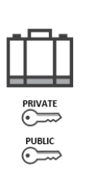
Wallet Balance
UTXO Scattered
hundreds of blocks
calculation
scanning the blockchain
aggregating the value of UTXO
among hundreds of transactions
…

Slide 20
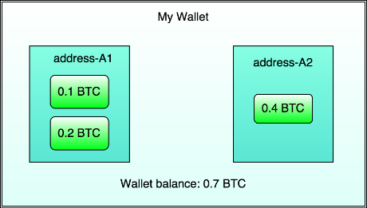
Wallet Balance
balance is a concept
created by
the wallet can spend UTXO
the wallet application
Condition To Spend
with the keys it controls

Slide 21
Wallet Database
wallets
maintain a database
Reference
store a quick reference set
to the UTXO
or use a database service
of all the UTXO
Quick access
with the keys they control.
they can spend
…

Slide 22
Transaction Value Bitcoin vs Satoshi
A transaction output
is denominated
as a multiple of Satoshies
Division of Bitcoin
to Satoshies
bitcoin can be divided down
1BTC = 100 000 000 Satoshies
an arbitrary integer value
Value
can have
Bitcoin vs Satoshi

Slide 23
Indivisible Units of Value
Output
once created
Discrete
outputs are
discrete units of values
consumption
consumed in its entirety
can have any arbitrary value
Indivisible
value is indivisible
An unspent output can

Slide 24
Change
UTXO larger?
it must still be consumed
If an UTXO is larger
Indivisible nature
As a result of
than the desired value
Entirety consumed
in its entirety
the indivisible nature

Slide 25
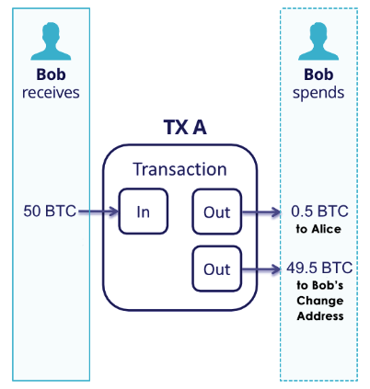
Change
Example
First UTXO
paying 49.5 bitcoin
back to own wallet
UTXO worth 50 bitcoin
to pay only 0.5 bitcoin
paying 0,5 bitcoin
to recipient
Second UTXO

Slide 26
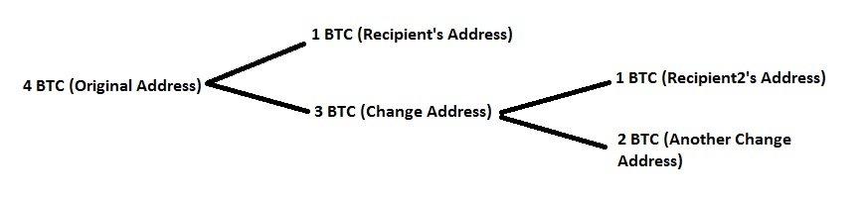
Move of Value
transaction creates
new UTXO can be consumed
value move forward
from owner to owner
in a chain of transactions
consuming UTXO
new transaction outputs
spend in future
by a future transaction
transaction is a node
and creating new UTXO

Slide 27
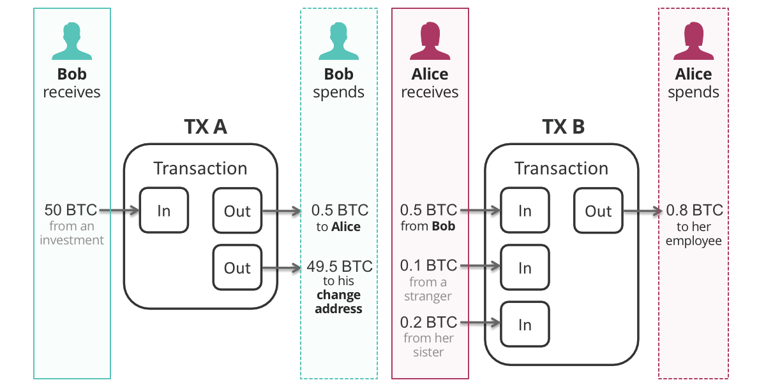

Slide 28
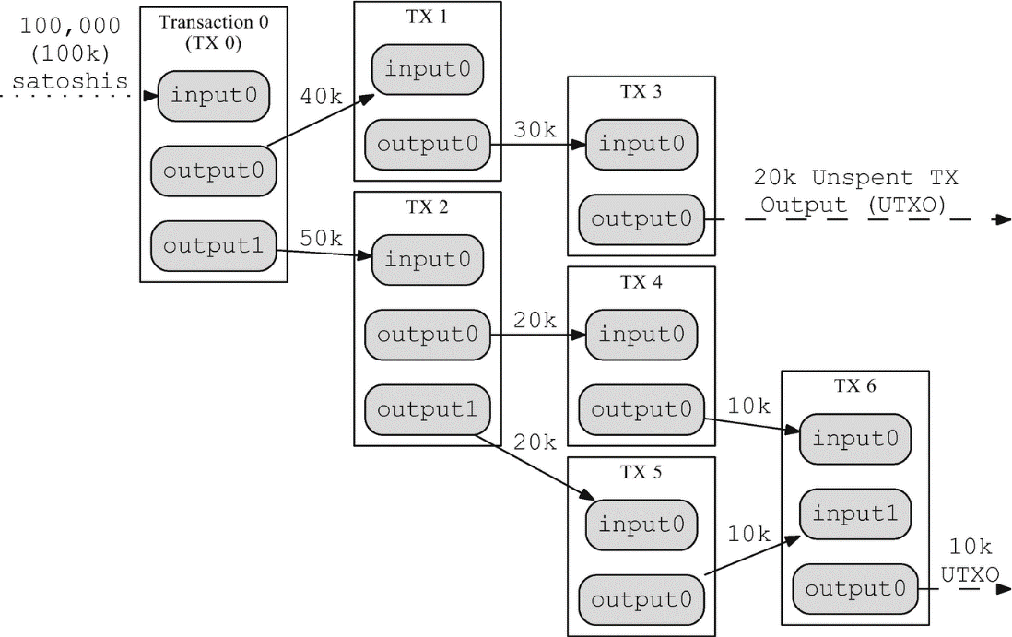

Slide 29
Coinbase Transaction
Coinbase transaction
in each block
Minting
creates brand-new
for successful mining
No UTXO consumption
Coinbase transaction
First transaction
bitcoin payable
Miner’s Reward
being the first among competitors
does not consume UTXO

Slide 30
Transaction Outputs
Every bitcoin transaction
are recorded
Create UTXO
create spendable chunks of bitcoin
available for the owner
UTXO are tracked
by all full-node bitcoin clients
creates outputs
Valid transactions
recognized by the whole network
Can be spent
to spend in a future transactions
on the bitcoin ledger

Slide 31
Transaction Output
Two parts
Transaction outputs
Amount
denominated in Satoshies
consist of two parts
An amount of bitcoin
Locking script
conditions to be able
to spend the amount

Slide 32
Transaction Output
cryptographic puzzle
determines the conditions
Other names
a locking script
a witness script
or a scriptPubKey
required to spend the output

Slide 33
Transaction
JSON encoding, the outputs are in an array (list) named vout
Value
Cryptograhic puzzle
"vout": [
{
"value": 0.01500000,
"scriptPubKey": "OP_DUP OP_HASH160 ab68025513c3dbd2f7b92a94e0581f5d50f654e7 OP_EQUALVERIFY OP_CHECKSIG"
},
{
"value": 0.08450000,
"scriptPubKey": "OP_DUP OP_HASH160 7f9b1a7fb68d60c536c2fd8aeaa53a8f3cc025a8 OP_EQUALVERIFY OP_CHECKSIG",
}
]
Output-1
Satoshis Not Bitcoins in Real
Output-2
transaction contains two outputs
a value
the value
the cryptographic puzzle
scriptPubKey
a cryptographic puzzle.
is shown in bitcoin
recorded as an integer denominated in satoshis.
sets the conditions for spending
human-readable representation of the script

Slide 34
Transaction serialization—outputs
Transaction Serialization
Usage
Serialization
also known as a byte stream
to transmit over the network
exchange between applications
storage in a file
converting the data structure
to transmit one byte at a time

Slide 35
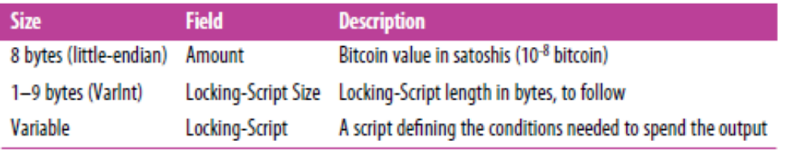
Table 6-1. Transaction output serialization

Slide 36
Transaction Storage
Not preferred
require complex parsing
to access a single field
internally as bytestreams
Reason
Storing transactions

Slide 37
Transaction Storage
Preferred storage
store transactions internally
in data structures
usually object-oriented structures
Reason
For convenience
and readability
Data structures

Slide 38
Deserialization
Deserialization
Parsing from
to internal data structure
Serialization
for
bitcoin libraries
for serialization and deserialization.
the byte-stream representation
Converting data structure
to Byte-stream
transmission over the network
have built-in functions

Slide 39
Example 6-1. Alice’s transaction, serialized and presented in hexadecimal notation
0100000001186f9f998a5aa6f048e51dd8419a14d8a0f1a8a2836dd73
4d2804fe65fa35779000000008b483045022100884d142d86652a3f47
ba4746ec719bbfbd040a570b1deccbb6498c75c4ae24cb02204b9f039
ff08df09cbe9f6addac960298cad530a863ea8f53982c09db8f6e3813
01410484ecc0d46f1918b30928fa0e4ed99f16a0fb4fde0735e7ade84
16ab9fe423cc5412336376789d172787ec3457eee41c04f4938de5cc1
7b4a10fa336a8d752adfffffffff0260e31600000000001976a914ab6
8025513c3dbd2f7b92a94e0581f5d50f654e788acd0ef800000000000
1976a9147f9b1a7fb68d60c536c2fd8aeaa53a8f3cc025a888ac 00000000
There are two outputs in the highlighted section, each serialized
The value of 0.015 bitcoin is 1,500,000 satoshis.
That’s 16 e3 60 in hexadecimal.
In the serialized transaction, the value 16 e3 60 is encoded in little-endian
least-significant-byte-first byte order
so it looks like 60 e3 16
The scriptPubKey length is 25 bytes, which is 19 in hexadecimal.

Slide 40
Transaction Inputs
Transaction inputs
Identify UTXO
provide proof of ownership
through an unlocking script
Proof of Ownership
to be consumed
Notes:
02.12.2022

Slide 41
Building a Transaction
To build a transaction,
a wallet selects from the UTXO it controls
UTXO must be with enough value
Wallet creates
an unlocking script
to make the requested payment.
Enough Value
UTXO that will be consumed
One input for each spending
Content

Slide 42
Components of an Input
Input content
and sequence number
Unlocking script
constructed byt the wallet
satisfy the spending conditions
The 1st part
a pointer to an UTXO in Blockchain transction
set in the UTXO
To
2nd part
UTXO reference

Slide 43
Components of an Input
unlocking script
and public key.
Exceptions
Usually is a digital signature
not all unlocking scripts
contain signatures
proving ownership of the bitcoin
Content

Slide 44
"vin": [
{
"txid": "7957a35fe64f80d234d76d83a2a8f1a0d8149a41d81de548f0a65a8a999f6f18",
"vout": 0,
"scriptSig" :
"3045022100884d142d86652a3f47ba4746ec719bbfbd040a570b1deccbb6498c75c4ae24cb02204
b9f039ff08df09cbe9f6addac960298cad530a863ea8f53982c09db8f6e3813[ALL]
0484ecc0d46f1918b30928fa0e4ed99f16a0fb4fde0735e7ade8416ab9fe423cc5412336376789d1
72787ec3457eee41c04f4938de5cc17b4a10fa336a8d752adf",
"sequence": 4294967295
There is only one input in the list
  because one UTXO contained sufficient value to make this payment.
The input contains four elements:
A transaction ID, referencing the transaction that contains the UTXO being spent
An output index (vout), identifying which UTXO from that transaction is referenced (first one is zero)
A scriptSig, which satisfies the conditions placed on the UTXO, unlocking it for spending
A sequence number (to be discussed later)
In Alice’s transaction, the input points to the transaction ID:
7957a35fe64f80d234d76d83a2a8f1a0d8149a41d81de548f0a65a8a999f6f18
and output index 0 (i.e., the first UTXO created by that transaction).

Slide 45
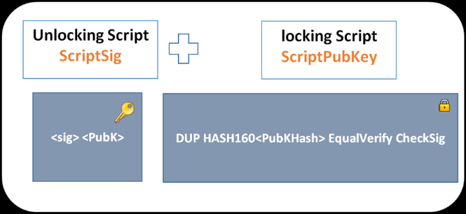
Unlocking Script
The unlocking script
is constructed
by sender’s wallet

Slide 46
Unlocking Script
The unlocking script
retrieve the referenced UTXO
examine its locking script
build the unlocking script
1
to satisfy it
Construction steps
2
3

Slide 47
What is Known about UTXO?
Transaction input
is just a reference to the transaction
Details
the amount in Satoshies
the locking script
Retrieve
Transaction of UTXO
containing UTXO

Slide 48
Retrieving UTXO
Finding the fee
the value of the input
every validating node
to validate the transaction
is not explicitly stated
use the referenced UTXO
to calculate the fees
to be paid in the transaction
Reason
Validation process
will also to retrieve the UTXO

Slide 49
Incompleteness of Transactions
Transactions on their own seem incomplete
because they lack context.
They reference UTXO in their inputs
but without retrieving that UTXO
we cannot know the value of the inputs
or their locking conditions.

Slide 50
Simple Operations to Multiple Steps
For example,
to calculate the amount paid in fees,
you must know the sum of the values of inputs and outputs.
But without retrieving the UTXO referenced in the inputs,
you do not know their value.
So a seemingly simple operation
like counting fees in a single transaction
in fact involves multiple steps
and data from multiple transactions.

Slide 51
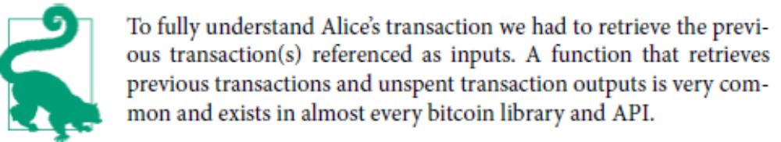
Retrieve referenced UTXO
use the same sequence of commands with Bitcoin Core
to get the UTXO referenced
in the preceding input
"vout": [
{
"value": 0.10000000,
"scriptPubKey": "OP_DUP OP_HASH160
7f9b1a7fb68d60c536c2fd8aeaa53a8f3cc025a8 OP_EQUALVERIFY OP_CHECKSIG"
}
]
This UTXO
has a value of 0.1 BTC
has a locking script
script PubKey
contains “OP_DUP OP_HASH160 7f9b1a7fb68d60c536c2fd8aeaa53a8f3cc025a8 OP_EQUALVERIFY OP_CHECKSIG”.

Slide 52
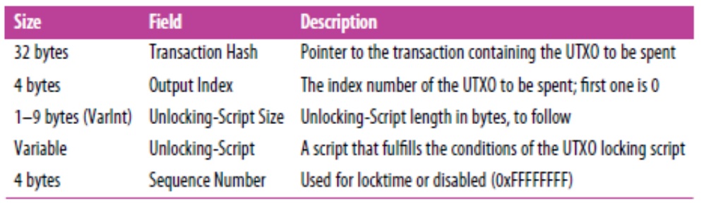
Transaction serialization—inputs
When transactions are serialized for transmission on the network,
their inputs are encoded
into a byte stream
Table 6-2. Transaction input serialization

Slide 53
Transaction Fees
transaction fees
Optional
for securing the network
Additional security
to flood the network with transactions
Fee inclusion
and include transaction fees automatically.
Programmatic & Command line
must manually be accounted for
compensate the bitcoin miners
Rationale
Most wallets calculate
and include transactions
makes it economically infeasible for attackers

Slide 54
Transaction Fees
Prevents abuse
by imposing a small cost on every transaction
Miner collects
Fees on Kilobytes
Fees are based on the size of the transaction in kilobytes
not the value of the transaction in bitcoin.
Market influenced
based on market forces within the bitcoin network.
serve as an incentive
fees are collected by the miner
Overall, transaction fees

Slide 55
Transaction Fees
Miners prioritize transactions
based on many different criteria
including fees,
and might even process transactions for free
under certain circumstances.
Priority of Transaction
Fees affect the processing priority
Fast process
is likely to be included in the next block mined,
Delayed process
might be delayed
or not processed at all
a transaction with sufficient fees
a transaction with insufficient or no fees

Slide 56
Evolution of Fee Policy
First approach: Fixed fees
Gradually relaxed
Radical change from 2016
capacity limits created competition between transactions
resulting in higher fees
making free transactions a thing of the past
Not minded transactions
rarely get mined
even be propagated across the network.
network capacity
, transaction fees were fixed
influenced by market forces
constant across the network.
transaction volume
Zero fee or very low fee transactions

Slide 57
Bitcoin Core Fee Relay Policies
minrelaytxfee
are set by the minrelaytxfee option.
current default
0.00001 bitcoin/KB
a hundredth of a millibitcoin per kilobyte.
Free
are treated as free
are only relayed if there is space in the mempool
otherwise, they are dropped.
Override default
by adjusting the value of minrelaytxfee
In Bitcoin Core, fee relay policies
minrelaytxfee is
transactions with a fee less than 0.0001 bitcoin
Bitcoin nodes can override the default fee relay policy

Slide 58
Dynamic Fees
Any bitcoin service that creates transactions,
including wallets, exchanges, retail applications, etc.,
must implement dynamic fees
Dynamic fees can be implemented
through a third-party fee estimation service
or with a built-in fee estimation algorithm.
If you’re unsure
begin with a third-party service
as you gain experience
design and implement your own algorithm
to remove the third-party dependency.

Slide 59
Fee Estimation Algorithms
calculate the appropriate fee
based on capacity and the fees
offered by “competing” transactions
These algorithms range
from simplistic
to sophisticated
They estimate
the necessary fee (in satoshis per byte)
that will give a transaction a high probability of being selected
and included within a certain number of blocks.
average
median fee in the last block
statistical analysis)

Slide 60
Fee Estimation Algorithms
Most services offer users
the option of choosing
high, medium, or low priority fees.
High priority means
users pay higher fees but the transaction is likely
to be included in the next block.
Medium and low priority means
users pay lower transaction fees
but the transactions may take much longer to confirm.
https://bitcoinfees.earn.com/

Slide 61
Adding Fees to Transactions
The data structure of transactions
does not have a field for fees.
fees are implied
as the difference between the sum of inputs
and the sum of outputs.
Any excess amount
that remains after all outputs
have been deducted
from all inputs is the fee
that is collected by the miners:
Fees = Sum(Inputs) – Sum(Outputs)

Slide 62
Adding Fees to Transactions
if you consume a 20-bitcoin UTXO
to make a 1-bitcoin payment,
You must include a 19-bitcoin change output
back to your wallet.
Otherwise, the 19-bitcoin “leftover”
will be counted as a transaction fee
and will be collected by the miner

Slide 63
Transaction Script & Script Language
Turing Incompleteness
Stateless Verification
Script Construction
Pay-to-Public-Key-Hash

Slide 64
Transaction Scripts and Script Language
Script
The bitcoin transaction script language,
a Forth-like reverse-polish notation stack-based execution language.
very simple language
designed to be limited in scope
Wide range of Hardware
executable on a range of hardware,
perhaps as simple as an embedded device.
requires minimal processing
security feature
cannot do many of the fancy things
modern programming languages can do.

Slide 65
Script Types
Today, most transactions on Bitcoin
have the form “Payment to Bob’s bitcoin address”
are based on a script called a Pay-to-Public-Key-Hash script.
However, bitcoin transactions
are not limited to the “Payment to Bob’s bitcoin address” script.
locking scripts can be written
to express a vast variety of complex conditions.

Slide 66
Programmable Money
Bitcoin transaction validation
is not based on a static pattern,
achieved through
the execution of a scripting language.
This language allows
for a nearly infinite variety of conditions
to be expressed.
This is how bitcoin gets
the power of “programmable money.”

Slide 67
Turing Incompleteness
The bitcoin transaction script language
contains many operators,
limited in one important way
there are no loops
or complex flow control capabilities
other than conditional flow control.
This ensures that
the language is not Turing Complete
meaning that
scripts have limited complexity
and predictable execution times.

Slide 68
Turing Incompleteness
Limitation
Script cannot be used
to create an infinite loop
or other form of “logic bomb”
This is a limited language
To prevent vulnerability
against
the transaction validation mechanism

Slide 69
Turing Incompleteness
DAD Risk
infinite loop
every transaction is validated
by every full node
Impact on Network
on the bitcoin network
could be embedded in a transaction
DAD denial-of-service attack
against the bitcoin network
Method

Slide 70
Stateless Verification
Script is stateless
there is no state prior to execution of the script
or state saved after execution of the script.
all the information needed to execute a script
is contained within the script
A script will predictably execute
the same way on any system.

Slide 71
Stateless Verification
If your system verifies a script,
you can be sure that every other system in the bitcoin network
will also verify the script
a valid transaction
is valid for everyone
Predictability is essential
an essential benefit of the bitcoin system.
and everyone knows this

Slide 72
Script Construction (Lock + Unlock)
Validation
two types of scripts
locking script
spending conditions
unlocking script
allows the output to be spent
Bitcoin’s transaction validation engine
to validate transactions
placed on an output
locking script
unlocking script

Slide 73
Script Construction (Lock + Unlock)
locking script
specifies the conditions
unlocking script
to spend the output in the future
“solves”: satisfies the conditions
placed on an output

Slide 74
Locking Script: scriptPubKey
Historical name
witness script
cryptographic puzzle
contains
bitcoin address
hash of a public key
Other names
scriptPubKey
public key
or bitcoin address
Notes:
25.04.2020

Slide 75
Unlocking Script: scriptSig
Unlocking script
Digital Signature
exists in every transaction input
contain a digital signature
Historical name: scriptSig
Can also be referred to
as a witness
scriptSig = Witness
produced from the private key

Slide 76
Execution on Bitcoin Nodes
Every Bitcoin node
will validate
executing the locking
UTXO
Validation
and unlocking scripts together
transactions
unlocking script
refers to a previously existing UTXO

Slide 77
Validation
unlocking script
retrieve the UTXO
copy the locking script
Execute
in sequence
The input is valid
if the unlocking script
from that UTXO
unlocking and locking script
satisfies the locking script conditions

Slide 78
Verification
Locking script (Prevİous UTXO-Alice)
DUP HASH160 <PubKHash> EQUALVERIFY CHCKSIG
Unlocking script (INP-Bob)
<sig> <pubK>
Verification script
Unlocking script Locking Script
<sig> <pubK> DUP HASH160 <PubKHash> EQUALVERIFY CHCKSIG

Slide 79
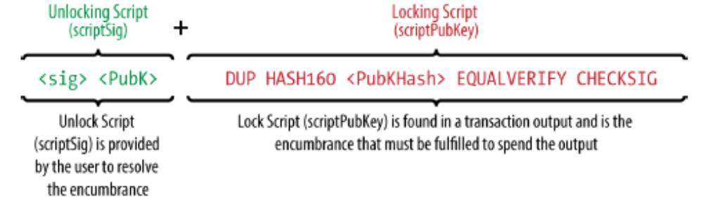
payment to a public key hash example
combined script
unlocking script
locking script
prior to script validation
resulting from the concatenation of
The unlocking and locking scripts
Figure 6-3. Combining scriptSig and scriptPubKey to evaluate a transaction script

Slide 80
Protection of UTXO
Protected
Valid transaction
correctly satisfies output conditions
Permenant
permanently recorded
in the blockchain
only valid transaction can spend
unaffected by failed attempts
removes from UTXO SET

Slide 81
The Script Execution Stack
Stack-based
is a stack-based language
Processing
by processing each item
executes the script
from left to right.
Bitcoin’s scripting language
Stack-based
Script is processed
using a stack

Slide 82
The Script Execution Stack
Push Numbers
are pushed onto the stack.
Pop for Operators
act on them
push a result
data constants
pop numbers from the stack
Push the results
onto the stack

Slide 83
The Script Operator OP_ADD
OP_ADD
add them
push the resulting sum
will pop two items
from the stack
Pop two items
Add
Push the reuls
onto the stack

Slide 84
Conditional Operators
Conditional operators
evaluate a condition
Boolean Results
TRUE
FALSE
produces a Boolean result
TRUE
represented by
represented by
FALSE
the number 1
the number zero

Slide 85
Conditional Operator: OP_EQUAL
pops
Push
FALSE: they are not equal
Remaining Stack
any other result
if the result is TRUE
signifies a valid transaction
two items
from the stack
Valid
TRUE: they are equal
TRUE or

Slide 86
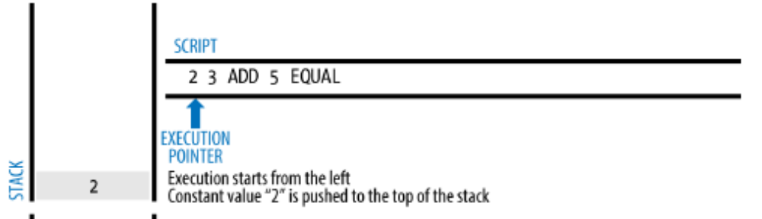
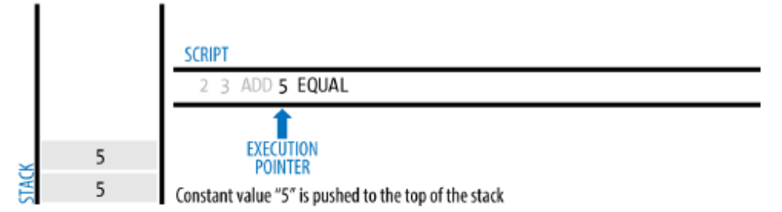
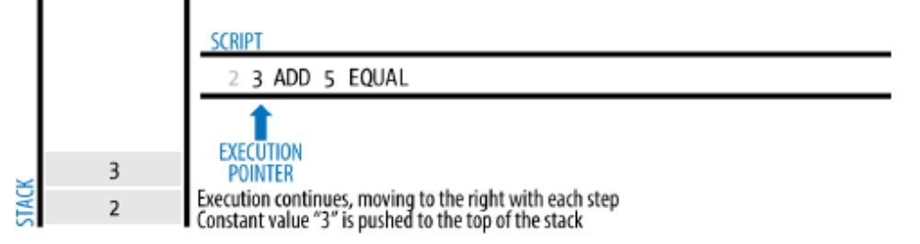
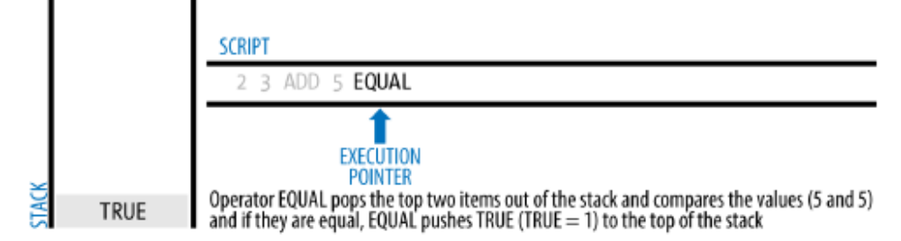
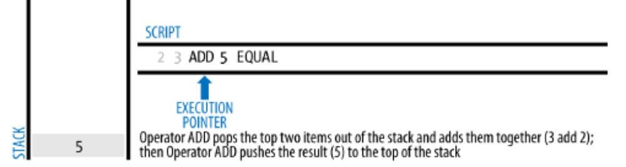
A Simple Script
1
4
2
5
3

Slide 87
Original Execution of Scripts
scripts are concatenated
and executed in sequence
Original approach
Execution
for execution
unlocking and locking scripts

Slide 88
2010 Separation of Execution
Security
to push data onto the stack
and corrupt the locking script
Execution separated
In 2010 the scripts are
For security reasons
due to a vulnerability
malformed unlocking script
executed separately

Slide 89
Separate Execution of Scripts
Start with unlocking script
If no error encountered
the unlocking script
is executed first
no “dangling” operators
left over
the main stack is copied
No error means
the locking script is executed

Slide 90
Separate Execution of Scripts
Success of unlocking script
Outcome
the input is a valid authorization
result is “TRUE”
the unlocking script has succeeded
locking script conditions
TRUE means
to spend the UTXO
are resolved
a valid spend

Slide 91
Separate Execution of Scripts
invalid
May remain
the combined script
other than “TRUE”
If any result
after execution of

Slide 92
Pay-to-Public-Key-Hash (P2PKH)
processed on the bitcoin network
Contains
a locking script
locks the output
Common in Bitcoin
spend outputs locked
to a public key hash
Pay-to-Public-Key-Hash
with a public key
majority of transactions

Slide 93
Pay-to-Public-Key-Hash (P2PKH)
Public key hash
digital signature
Spending
known as a bitcoin address
generated by hashing public key
unlocking P2PKH script output
by presenting a public key
and a digital signature
produced from the private key
of the public key

Slide 94
Alice’s Payment: Locking Script
Alice made a payment of 0.015 bitcoin
to the cafe’s bitcoin address.
That transaction output
would have a locking script
OP_DUP OP_HASH160 <Cafe Public Key Hash> OP_EQUALVERIFY OP_CHECKSIG
Locking script

Slide 95
Alice’s Payment: Locking Script
The Cafe Public Key Hash
is bitcoin address of the cafe
without the Base58Check encoding.
hexadecimal encoding
not Base58Check format that begins with a “1.”
Locking script
OP_DUP OP_HASH160 <Cafe Public Key Hash> OP_EQUALVERIFY OP_CHECKSIG
Most applications show the public key hash
in hexadecimal encoding

Slide 96
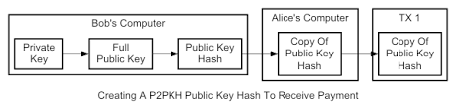
Alice’s Payment: Locking Script

Slide 97
Bob’s Spending: Unlocking Script
Locking script
To be specified
<Cafe Signature> <Cafe Public Key>
OP_DUP OP_HASH160 <Cafe Public Key Hash> OP_EQUALVERIFY OP_CHECKSIG
need an unlocking script of the form

Slide 98
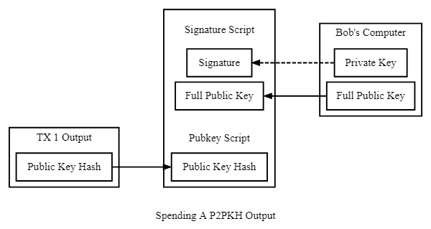
Alice’s Payment, Bob’s Spending

Slide 99
Bob’s Spending: Validation
Combination
validation script
<Cafe Public Key Hash> OP_EQUALVERIFY OP_CHECKSIG
The two scripts together
would form the combined validation script
<Cafe Signature> <Cafe Public Key> OP_DUP OP_HASH160

Slide 100
Bob’s Spending: Validation
Evaluate to TRUE
if, and only if
the conditions set by the locking script. I
When executed combined script
will evaluate to TRUE
Condition
the unlocking script matches

Slide 101
Alice’s Payment, Bob’s Spending

Slide 102
Steps of Validation
Execution of Locking & Unlocking Scripts

Slide 103
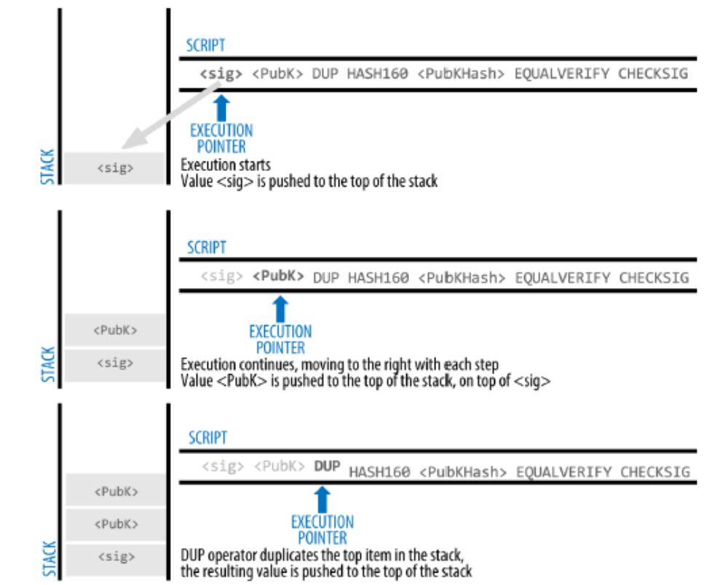

Slide 104
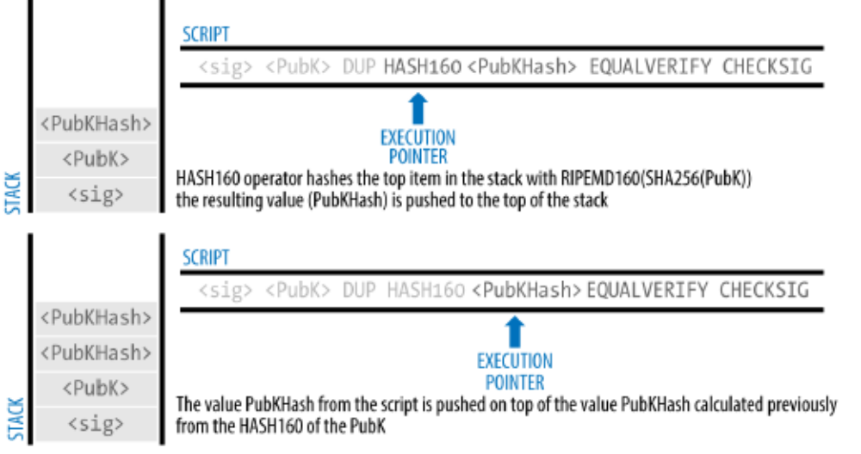
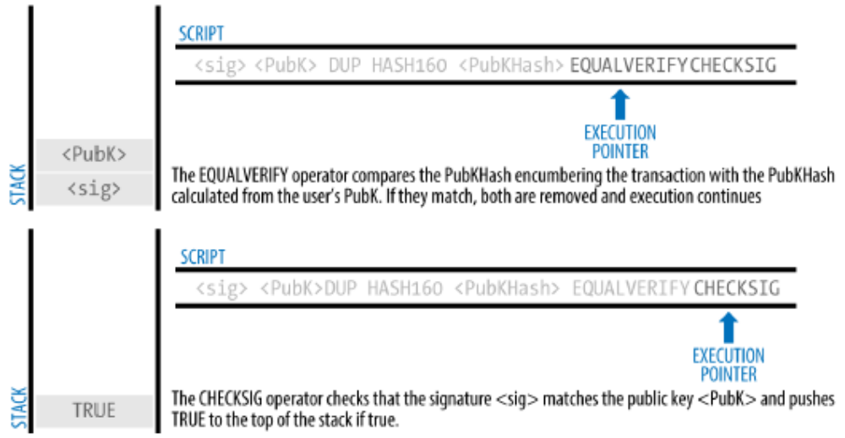

Slide 105
Digital Signatures
How Digital Signatures Work
Verifying the Signature
Signature Hash Types
ECDSA Math
The Importance of Randomness

Slide 106
Digital Signatures (ECDSA)
ECDSA
Elliptic Curve Digital Signature Algorithm
The digital signature algorithm
Bitcoin’s Algorithm
used in bitcoin
based on elliptic curve private/public key pairs
script functions
OP_CHECKSIG
OP_CHECKSIGVERIFY
OP_CHECKMULTISIG
OP_CHECKMULTISIGVERIFY

Slide 107
Digital Signature Usage
Owner
proves the ownership
Digital signature
the digital signature
implies the ownership
has authorization
in spending of funds
Proof of Ownership
to the private key

Slide 108
Digital Signature Usage
Transaction Unmodifiability
have not and cannot be modified
Validation
or its specific parts
transaction fully
the signature proves
Once signed by anyone
after it has been signed
Full or Partial

Slide 109
How Digital Signatures Work
A digital signature is
consists of two algorithms
Mathematical scheme
signature generation
a mathematical scheme
signature verification

Slide 110
How Digital Signatures Work
Signature generation
signature is generated
using a signing key
the signing key
the transaction
the private key
message
and a message

Slide 111
How Digital Signatures Work
Signature verification
an algorithm
given
allows anyone
to verify the signature
the message
and a public key

Slide 112
Creating a Digital Signature
Formula
Sig = F_{sig} (F_{hash} (m) , dA)
Sig
dA
m
F_{hash}
F_{sig}
the signature
Sig = (R, S)
the signing private key
the transaction
or parts of it
the hashing function
the signing algorithm

Slide 113
Serialization of Signatures (DER)
Sig = (R, S)
two values R and S
R & S are
DER
international standard encoding scheme
have been calculated
Serialization
Distinguished Encoding Rules
serialized into a bytestream

Slide 114
Alice’s case
transaction input
Signature having R & S
9f039ff08df09cbe9f6addac960298cad530a863ea8f53982c09db8f6e381301
unlocking script contains
DER-encoded signature
Generated from Alice’s wallet
Wallet generation
R
3045022100884d142d86652a3f47ba4746ec719bbfbd040a570b1deccbb6498c75c4ae24cb02204b
S

Slide 115
Serialization of Signatures (DER)
That serialized signature
Signature proves
9 Elements
The serialization format
consists of nine elements
produced by Alice’s wallet
Alice owns the private key
authorized to spend that output.

Slide 116
The Serialization Format
3045022100884d142d86652a3f47ba4746ec719bbfbd040a570b1deccbb6498c75c4ae24cb02204b9f039ff08df09cbe9f6addac960298cad530a863ea8f53982c09db8f6e381301
0x30—indicating the start of a DER sequence
0x45—the length of the sequence (69 bytes)
0x02—an integer value follows
0x21—the length of the integer (33 bytes)
R—00884d142d86652a3f47ba4746ec719bbfbd040a570b1deccbb6498c75c4ae24cb
0x02—another integer follows
0x20—the length of the integer (32 bytes)
S—4b9f039ff08df09cbe9f6addac960298cad530a863ea8f53982c09db8f6e3813
A suffix (0x01) indicating the type of hash used (SIGHASH_ALL)

Slide 117
Verifying the Signature
Verification
Certain conditions must hold
on this transaction.
Meaning of verification
“Only the owner
generated this public key
could have produced
of the private key that
this signature

Slide 118
Verifying the Signature
the serialized transaction
the public key
Verification Fields
The signature: R & S
Public key is generated
Public & Private keys
by the owner of private key
Private Key & Signature
the owner of the private key
can generate the digital signature
Transaction
The owner of private key
Can generate
The signature usint the transaction

Slide 119
Verifying the Signature
The signature verification algorithm
the signer’s public key
returns TRUE
for this message and public key.
takes the message
Hash
a hash of the transaction
or parts of it
Public key
R and S values
Signature
if the signature is valid

Slide 120
Bitcoin Addresses, Balances, & Other Abstractions
Bitcoin Addresses
Balances
Other Abstractions

Slide 121
Constructing the “Final Balance”
The blockchain explorer
keeps a separate database
UTXO set
Monitoring
add newly created UTXO
remove spent UTXO
Real time processing
monitor the bitcoin network
Continues operation
unconfirmed transactions
as they appear in
the blockchain explorer
for arrival of new transactions

Slide 122
Constructing the “Final Balance”
Final balance
depends on
maintaining consensus
a complicated process
keeping track of
transactions as they propagate
plus
with the bitcoin network

Slide 123
Constructing the “Final Balance”
Going out of sync
its perspective of the UTXO set
goes out of sync
is incomplete
or incorrect.
Sometimes the blockchain explorer
Causes

Slide 124
Constructing the “Final Balance”
Final balance
the number
produced by
the blockchain explorer
shown to the user
Operation
Sum up the value of
all unspent outputs

Slide 125
Constructing the “Final Balance”
Bitcoin address
requires to search
# of transactions
dozens
hundreds of thousands
indexes and transactions
hundreds
Finding the balance
referencing public key hash
in UTXO set

Slide 126
Receiver
Retrieved from previous UTXO
Bob’s Bitcoin Address
Alice’s Bitcoin Address
Paid
Alice’s Bitcoin Address
Change
Sender
Fee

Slide 127
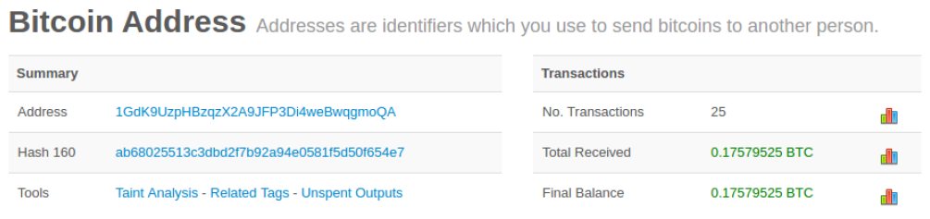
Bob’s Balance

Slide 128

Discussions
Your opinion
Challenging
Clarification
Critical issue
What do you think on this chapter?
What is the most interesting point?
What are the unclarified points?
Select and explain a critical issu in this chapter

