Slide 1
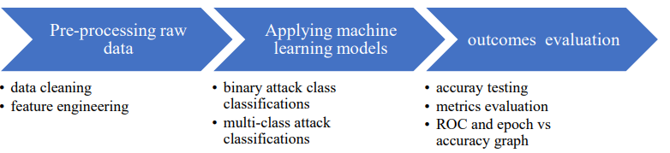
Overview
1- data pre-processing (to be used later in the machine learning models)
2- applying supervised machine learning models

Slide 2
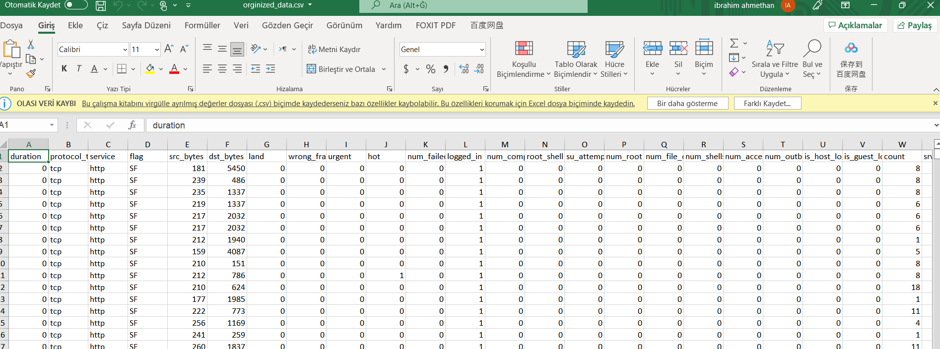



Slide 3
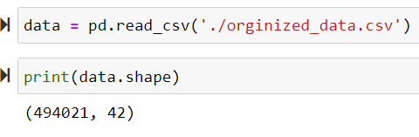
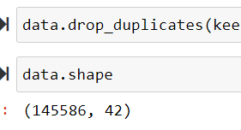
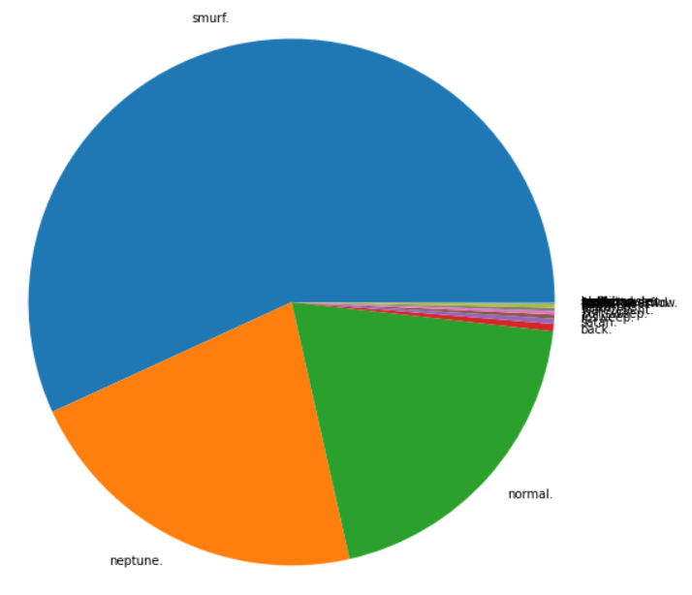
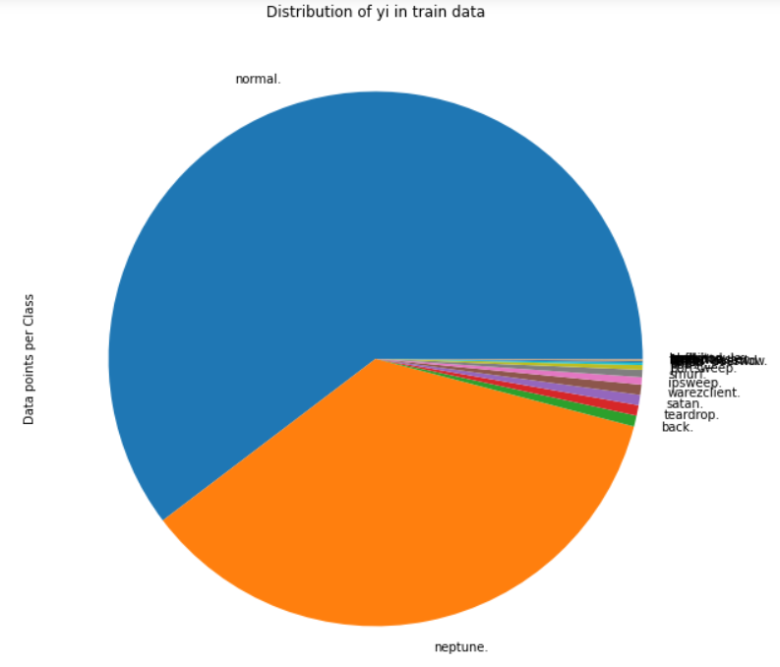
Pre-processing (duplicates)

Slide 4
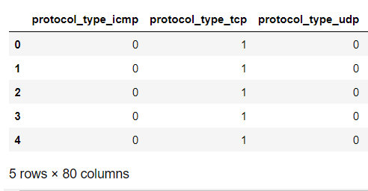
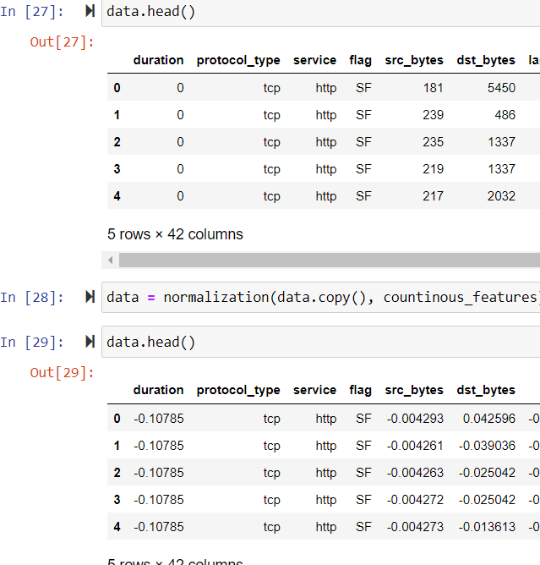
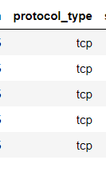
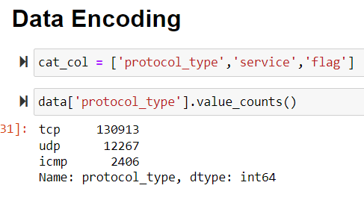
Pre-processing (Encoding & Normalization)

Slide 5
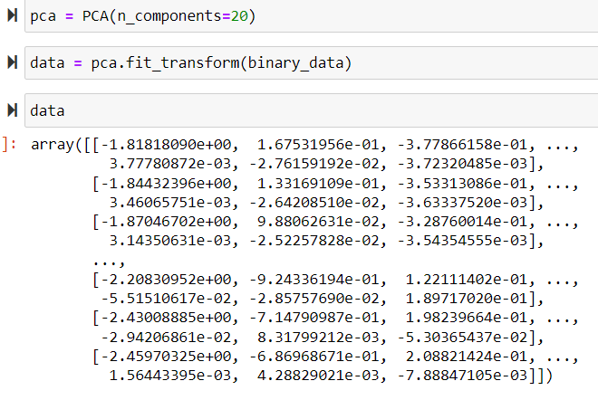
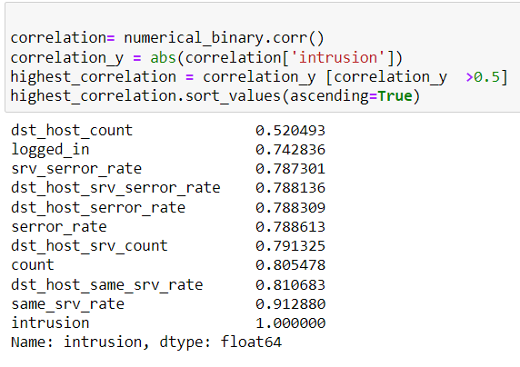
Pre-processing PCA & Correlation

Slide 6
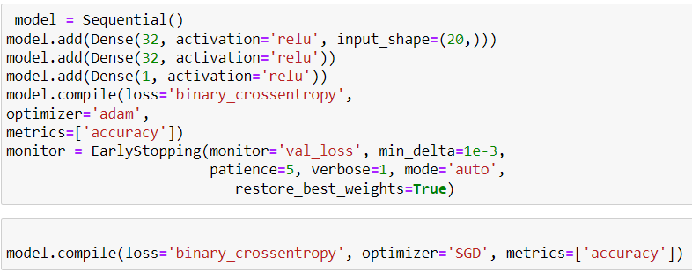
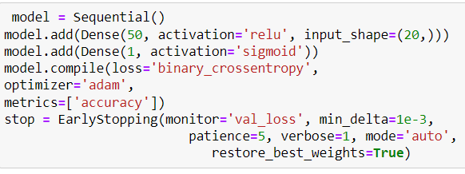
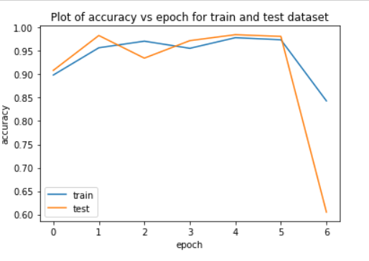
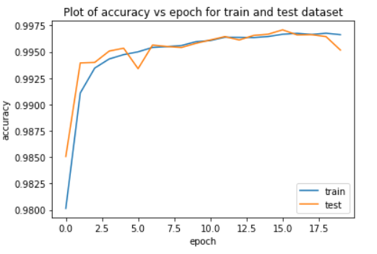
Applying machine learning models MLP

Slide 7
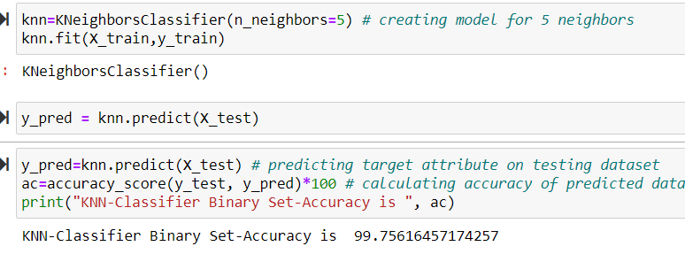
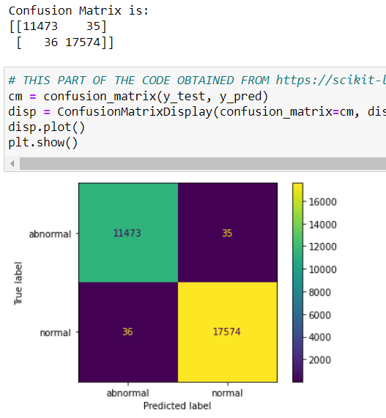
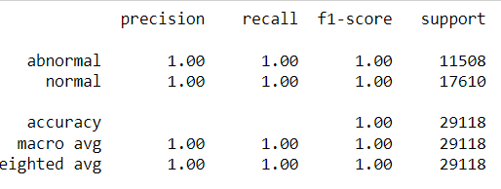
Applying machine learning models KNN

Slide 8
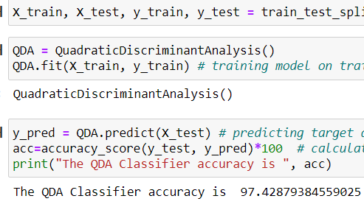
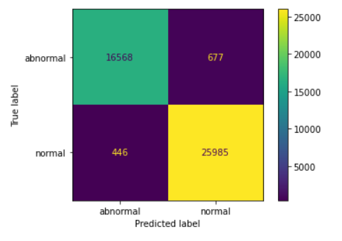
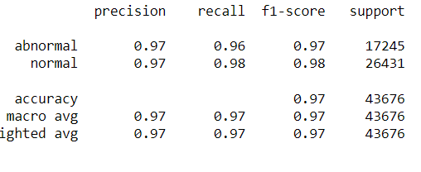
Applying machine learning models QDA

Slide 9

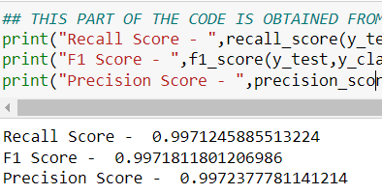

Applying machine learning models comparison
MLP
KNN
V.S
QDA

Slide 10
Conclusion & summary
As a result of well organized and pre-processed dataset, carefully designed topologies of ML used and variety of evaluation techniques applied, the system succeeded to show high performance in both binary and multiclass classification task.
Data pre-processing included
Dataset Exploration and Visualization
Data Cleaning (Duplicates and outliers)
Feature Encoding (OneHotEncoding)
Feature Scaling (Standardization)
Feature Selection (PCA & Correlation)
Applied ML Models
Feed Forward Neural Network - Multilayer Perceptron (MLP)
Machine Learning Algorithm - k-nearest neighbors (K-NN)
Generative Model - Quadratic Discriminant Analysis Classifier (QDA)

Slide 11


