Slide 1

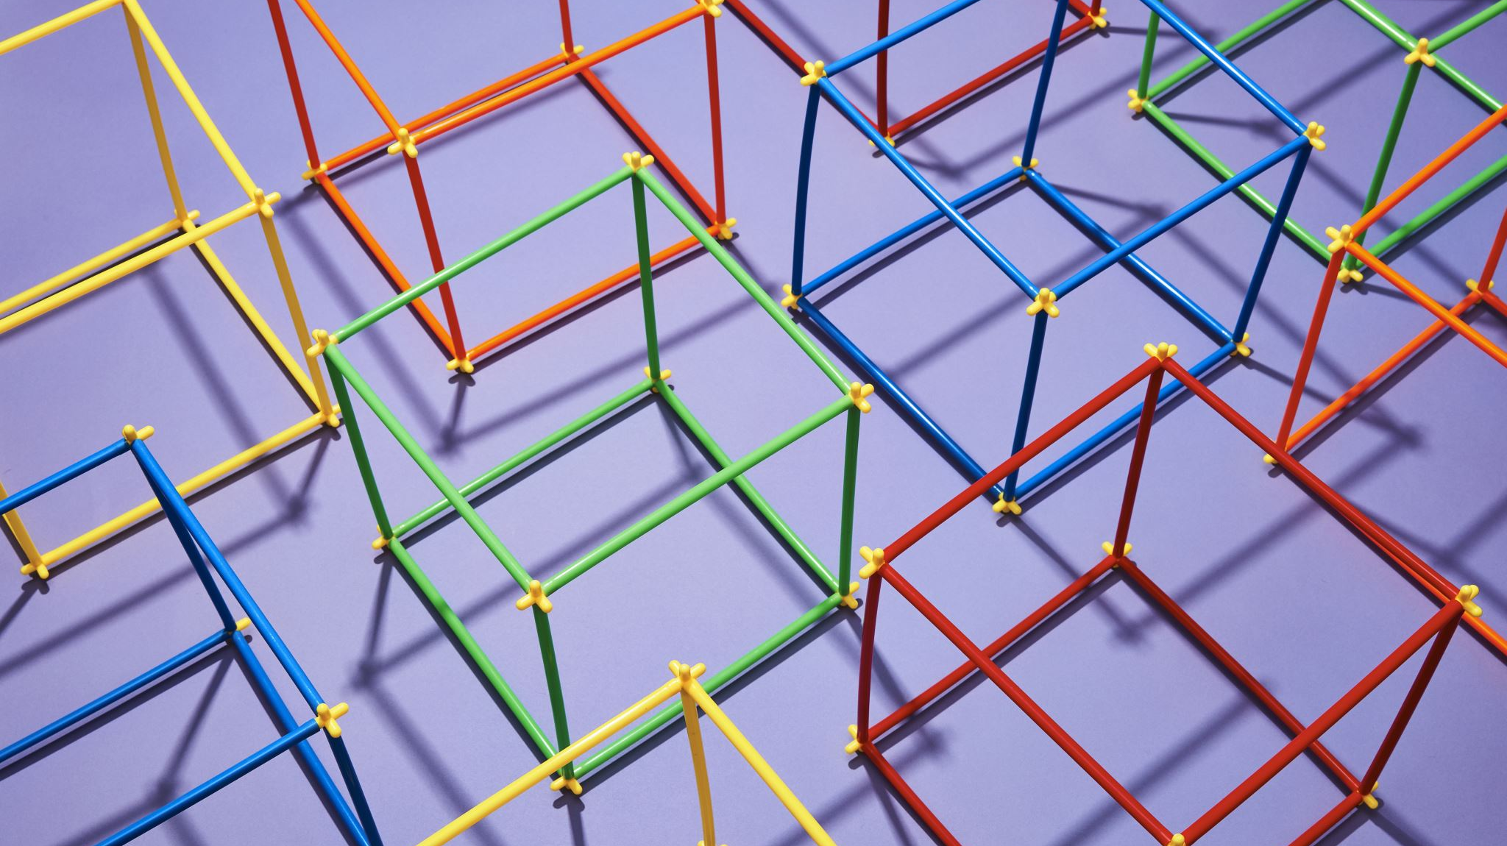
Overview of deep learning models used in llm
Ibrahim Ahmethan
NOVAH AI
October 3, 2023

Slide 2
Contents
Recurrent Neural Networks RNNs
Long Short Memory Term LSTM
Attentional Mechanism
Transformers
Novah AI LLM

Slide 3
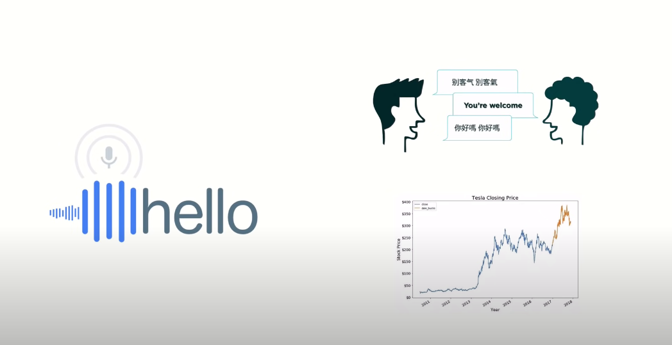
What is the common point?

Slide 4
Recurrent Neural Networks RNN
Recurrent Neural Network(RNN) is a type of Neural Network where the output from the previous step is fed as input to the current step. In traditional neural networks, all the inputs and outputs are independent of each other
RNNs are distinguished by their “memory” as they take information from prior inputs to influence the current input and output.
RNN is required to predict the next word of a sentence, the previous words are required and hence there is a need to remember the previous words. Thus RNN came into existence,

Slide 5
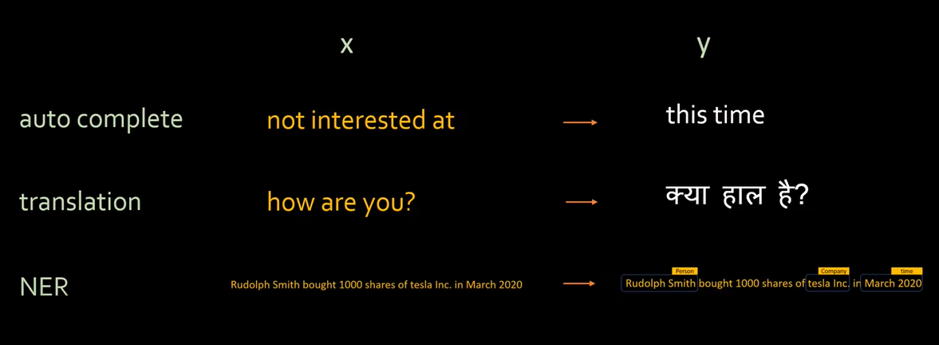
sequence modeling problem

Slide 6
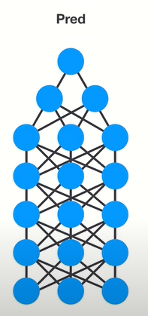
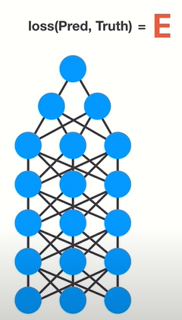
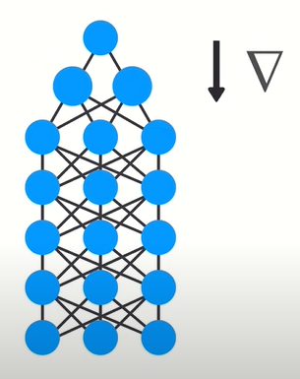
Neural Networks working principles
Back Propagation
Gradient Calculation
Feed Forward
Loss Function Calculation

Slide 7
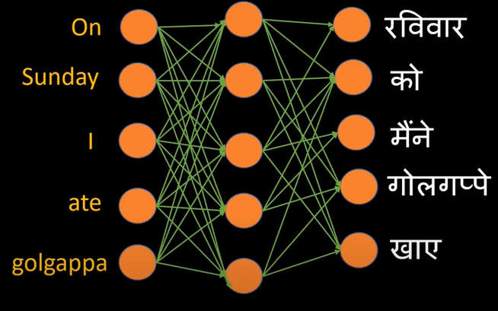
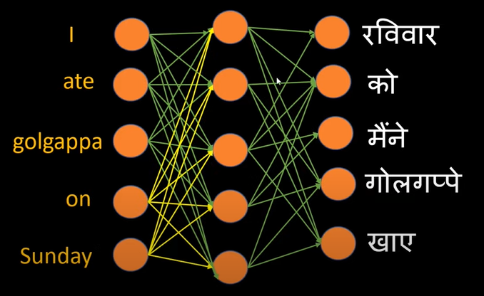
sequence modeling problem

Slide 8
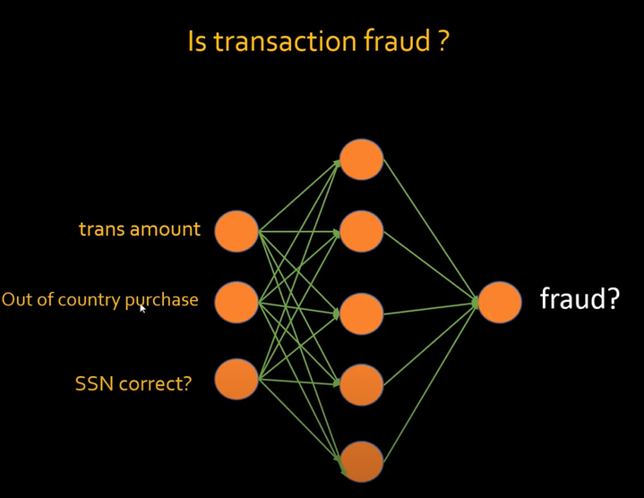
sequence modeling problem

Slide 9
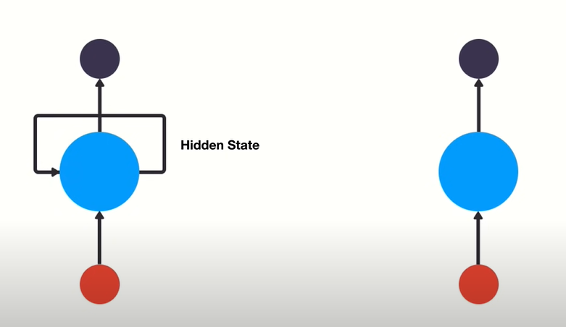
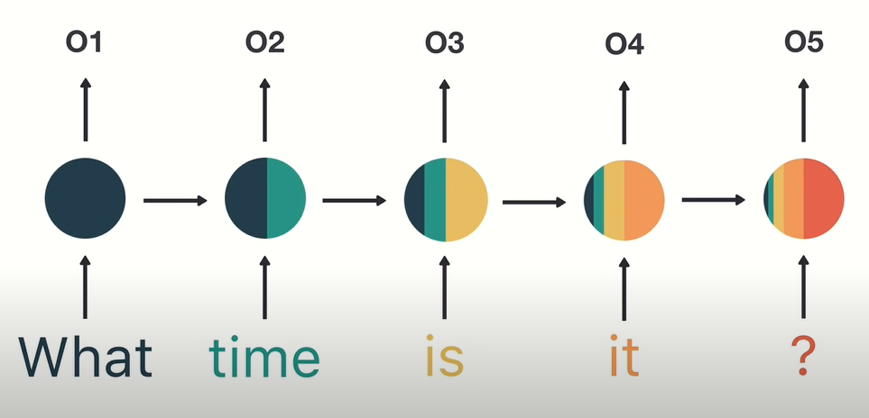
RNN’s are good at processing sequence data for predictions

Slide 10
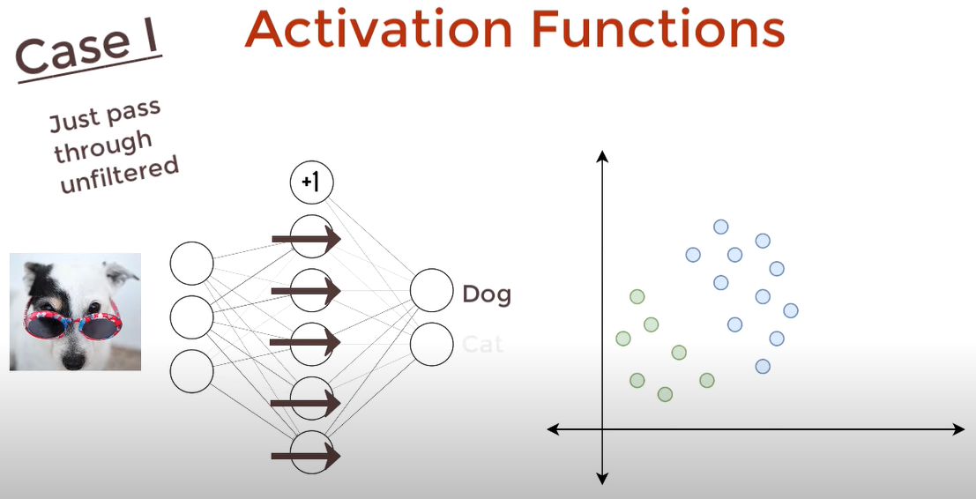
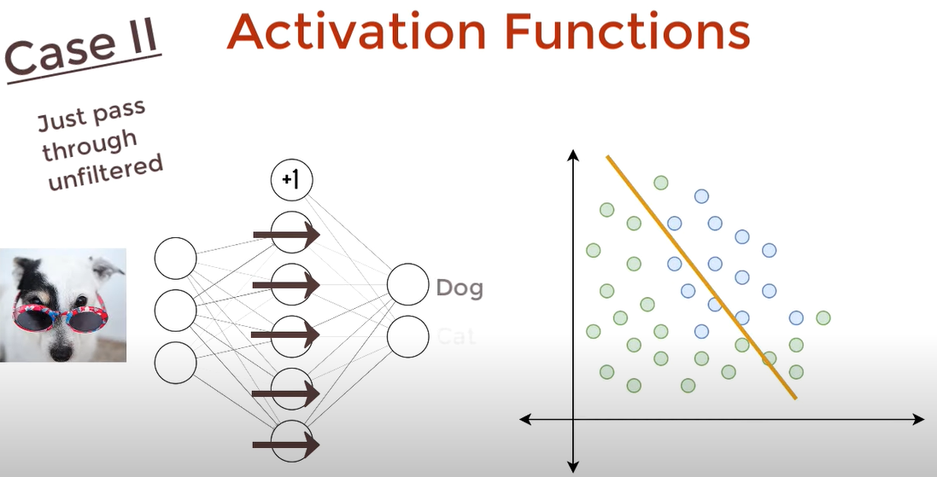
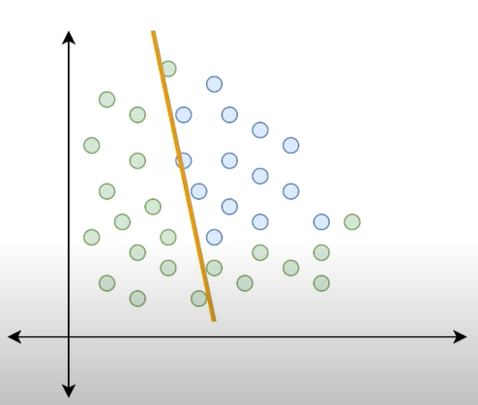
Activation function

Slide 11
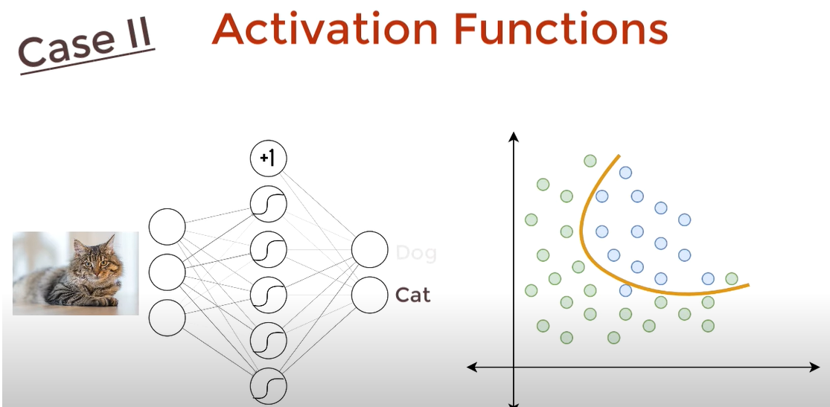
Activation function

Slide 12
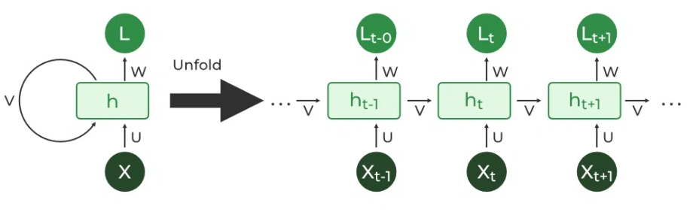
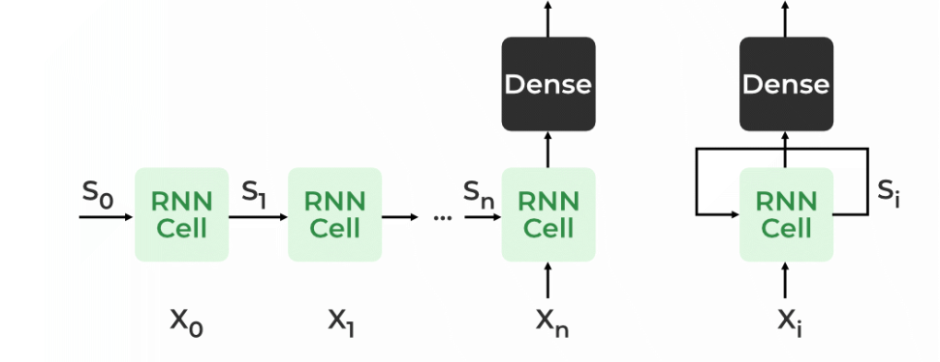
Rnn architecture

Slide 13
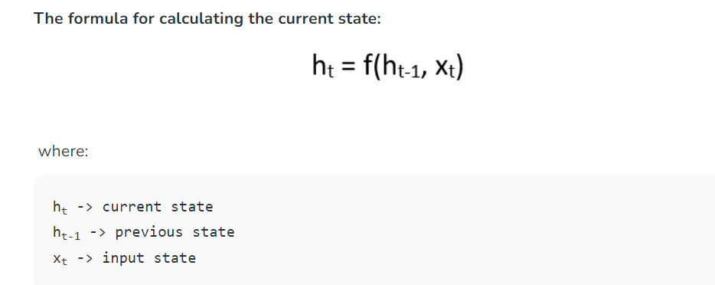
Basic formula of rnn

