Slide 1

The Impact of Weather and School Terms on Istanbul's Maritime Transport: A Case Study of Beşiktaş Pier Passenger Numbers
Ahmet Çavuşoğlu – 32394

Slide 2

MY DATASET
Date
Station name
Daily passenger count
Humidity
Temperature (min and max)
Wind speed
School vs Holiday Period

Slide 3
MY HYPOTHESES
Null Hypothesis(H0): Weather variables have no significant effect on passenger numbers.
Alternative Hypothesis(H1): At least one weather variable has a significant effect on passenger numbers.
-------------------------------------------------------------------------------------------
Null Hypothesis(H0): The average number of daily ferry passengers during holidays is less than or equal to that during school terms.
Alternative Hypothesis(H1): The average number of daily ferry passengers during holidays is greater than that during school terms.

Slide 4
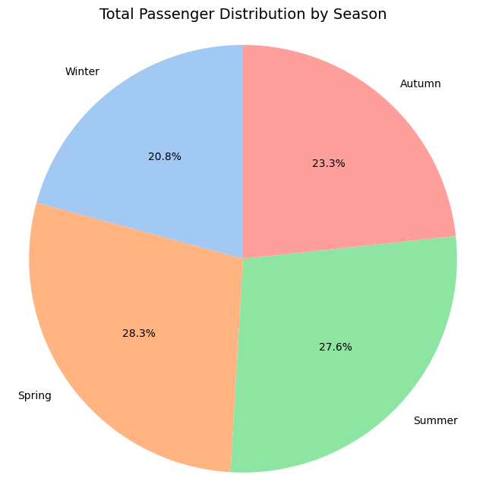
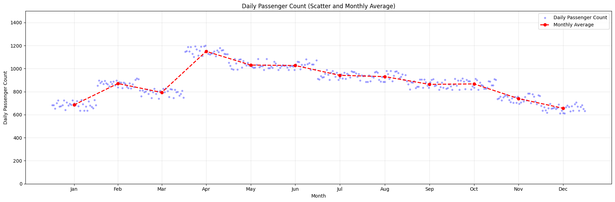
UNIVARIATE ANALYSIS
The scatter plot shows the number of passengers using the Beşiktaş pier on a daily basis throughout the year.
Passenger Statistics:
Mean (Average): 989
Median: 1020
Mode: 1040
This pie chart displays the overall distribution of ferry passengers at the Beşiktaş pier across the four seasons:

Slide 5
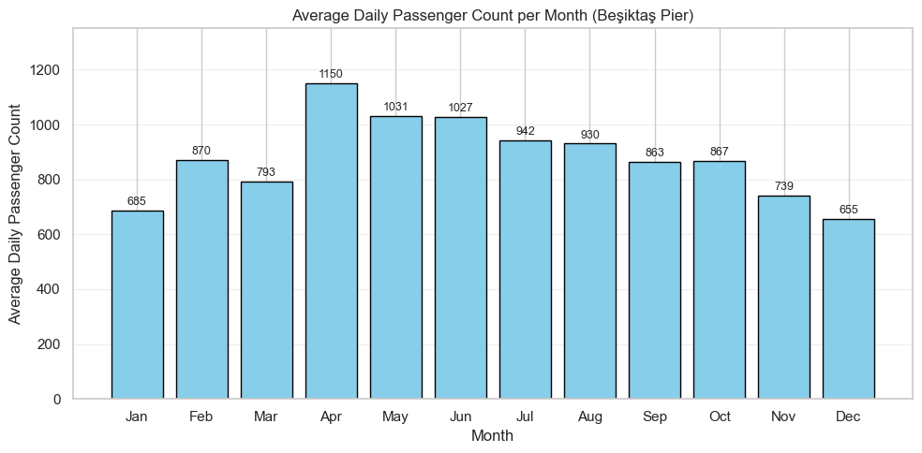
UNIVARIATE ANALYSIS
This bar chart shows the number of passengers using the Beşiktaş pier on a daily basis throughout the year.

Slide 6
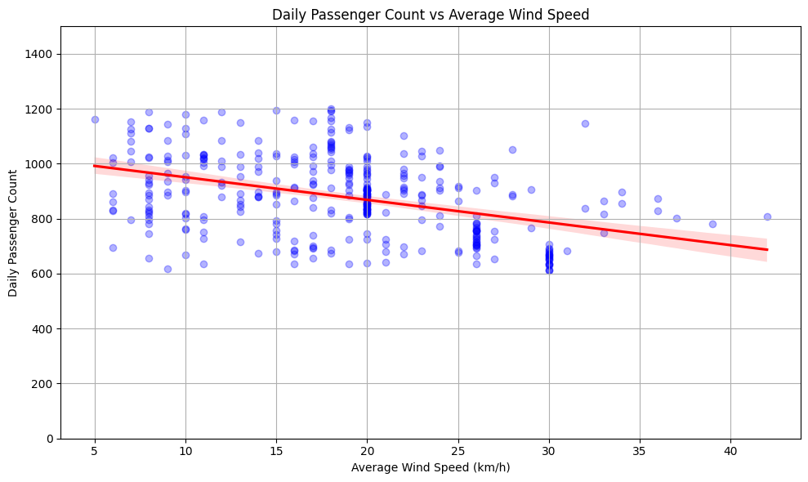
BIVARIATE ANALYSIS
This scatterplot with a trendline shows a slight negative correlation between wind speed and passenger numbers. As wind speed increases, the daily passenger count tends to decrease slightly.
Correlation coefficient (r): -0.405 → Weak negative correlation
P-value: 6.273449728041423e-16 → Statistically significant

Slide 7
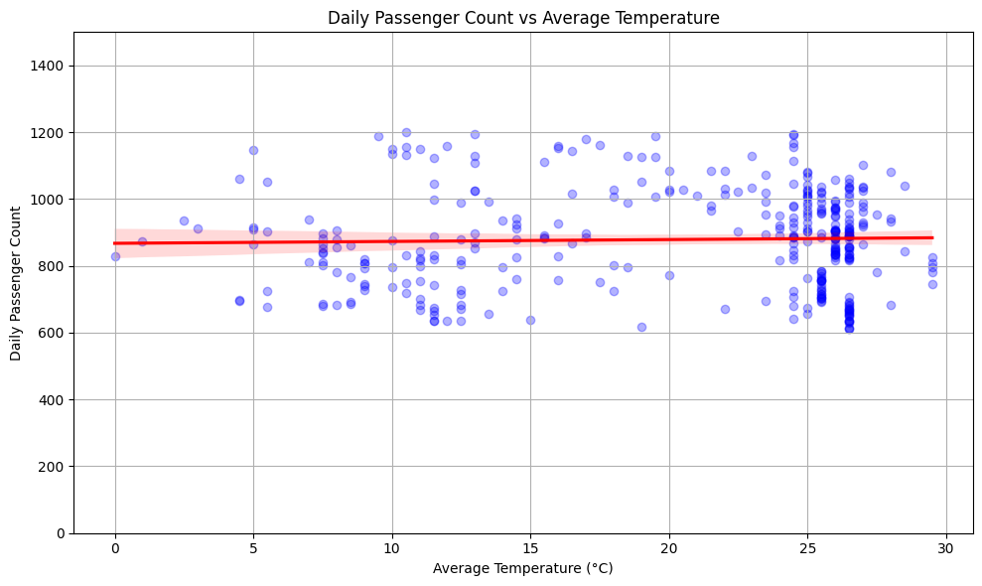
BIVARIATE ANALYSIS
The chart illustrates that temperature has little to no visible effect on passenger numbers. The trendline is almost flat, indicating a weak correlation.
Correlation coefficient (r): -0.057 P-value: 0.275

Slide 8
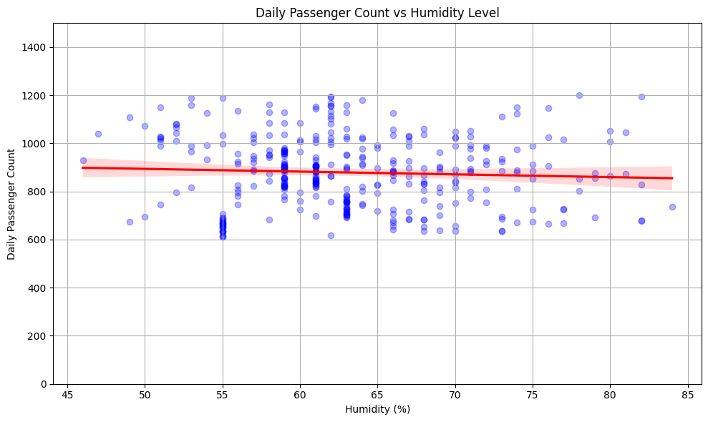
BIVARIATE ANALYSIS
The plot reveals a mild negative relationship between humidity and daily passenger count. Higher humidity days tend to see slightly fewer passengers.
Correlation coefficient (r): 0.028 P-value: 0.584

Slide 9
In summary
📊 ANOVA Test Result:
Variable | F-value | p-value
Wind Speed | 70.65 | 6.27e-16 ✅
Humidity | 0.50 | 0.275 ❌
Avg Temperature | 0.0039 | 0.584 ❌
H₀ is rejected. p-value (Wind Speed) = 6.27e-16
At least one weather variable—wind speed—has a statistically significant effect on daily passenger numbers at Beşiktaş Pier. Humidity and temperature, on the other hand, do not show significant individual effects.

Slide 10
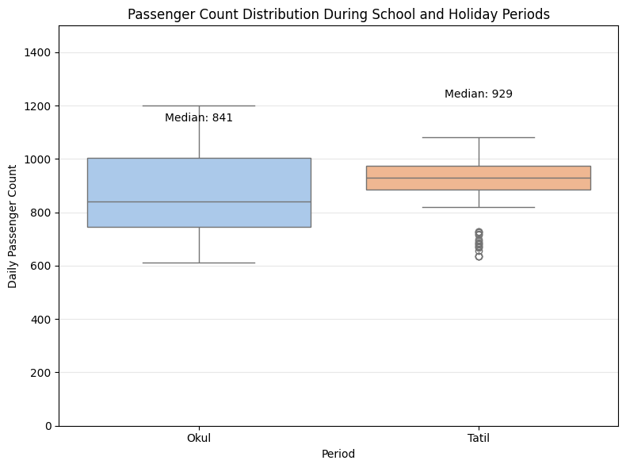
BIVARIATE ANALYSIS
The boxplot compares daily passenger counts during school and holiday periods. The median is higher during holidays compared to school periods, suggesting increased travel activity during breaks.
H0 is rejected.
p-value = 0.0021
Conclusion: The average number of daily passengers is significantly higher during holidays.

Slide 11
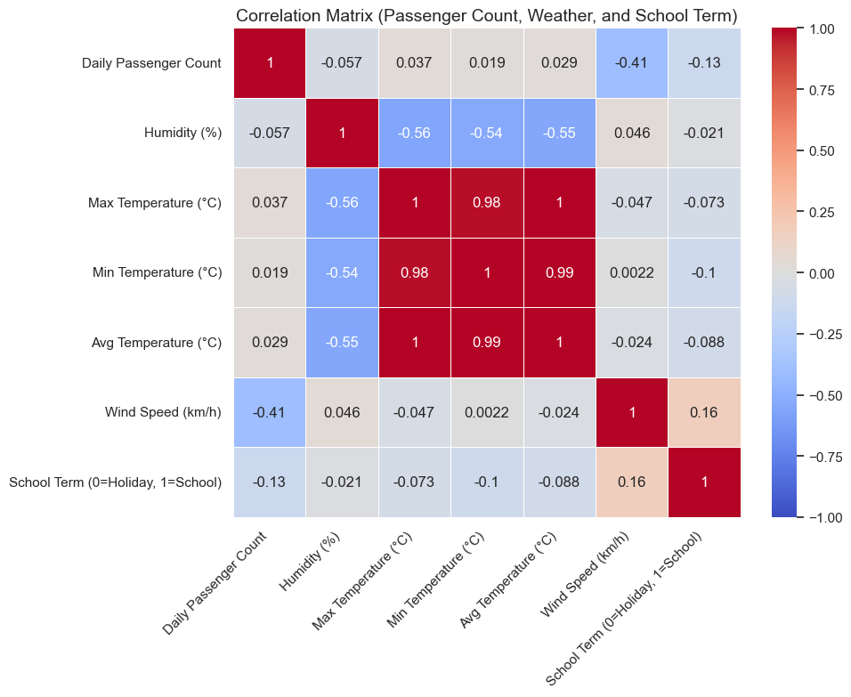
MULTIVARIATE ANALYSIS
Correlation Heatmap:
Notable Correlations with Daily Passenger Count:
🌀 Wind Speed: -0.41 (Higher wind → fewer passengers)
🌡️ Max Temperature: +0.04 (Negligible positive correlation)
🌡️ Avg Temperature: +0.03 (Negligible positive correlation)
💧 Humidity: -0.06 (Very weak negative correlation)
🏫 School Term (0=Holiday, 1=School: -0.13 (Slight decrease during school periods)

Slide 12
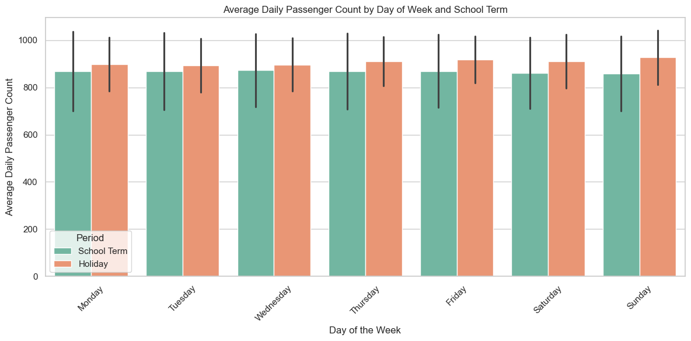
MULTIVARIATE ANALYSIS
This multivariate bar chart shows the average daily number of passengers at Beşiktaş Pier, broken down by day of the week and whether it was during a school term or holiday. Across all days, passenger numbers are consistently higher during holidays compared to school periods. The difference is especially noticeable on Fridays and weekends, suggesting increased leisure travel.
Categorical (X): Day of the Week
Hue (Group): School Term (Holiday vs. School)
Numerical (Y): Daily Passenger Count

Slide 13
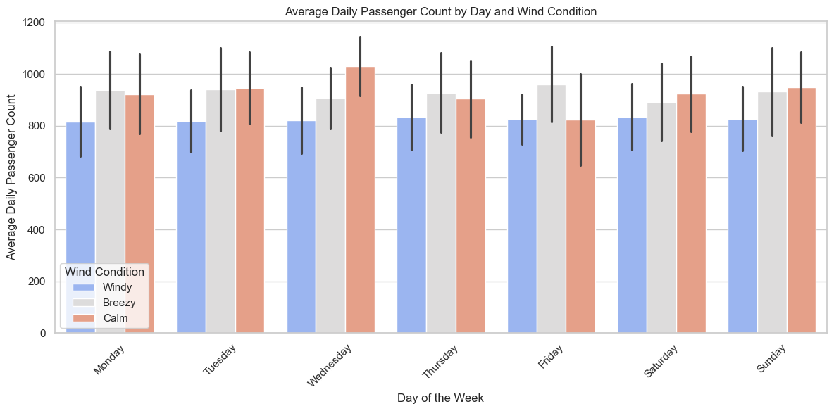
MULTIVARIATE ANALYSIS
This multivariate bar chart visualizes how daily passenger counts at Beşiktaş Pier vary depending on both the day of the week and wind conditions. Across all weekdays, passenger numbers tend to be lower on windy days, especially on weekdays like Wednesday and Friday. The difference suggests that sea travel demand is sensitive to wind strength, particularly during peak travel days.

Slide 14
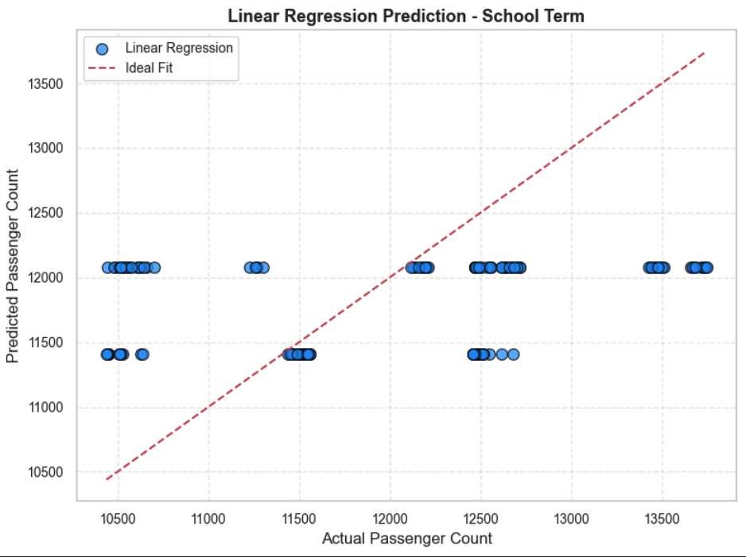
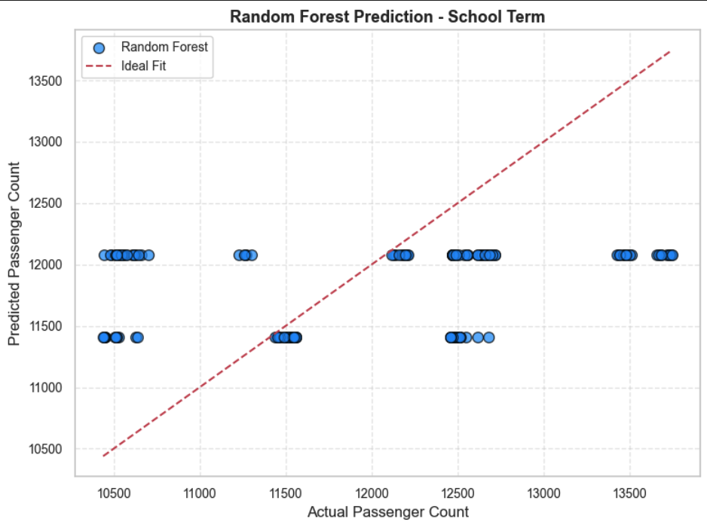
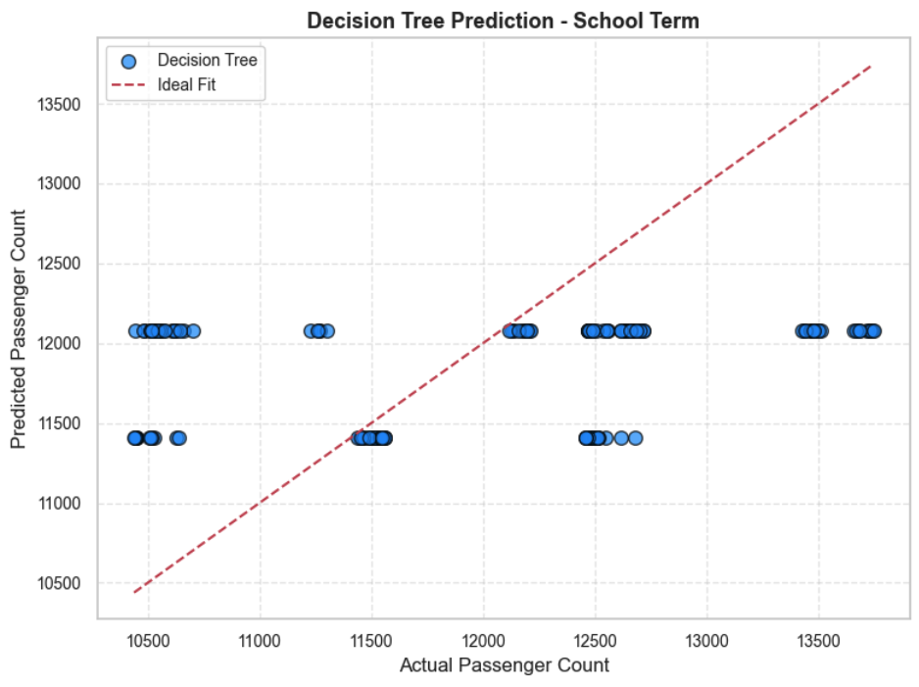
REGRESSION ANALYSIS
Mean Squared Error: 289,92
R² Score: 0.41
Linear Regression
Mean Squared Error: 312,45
R² Score: 0.44
Mean Squared Error: 265,88
R² Score: 0.48

Slide 15
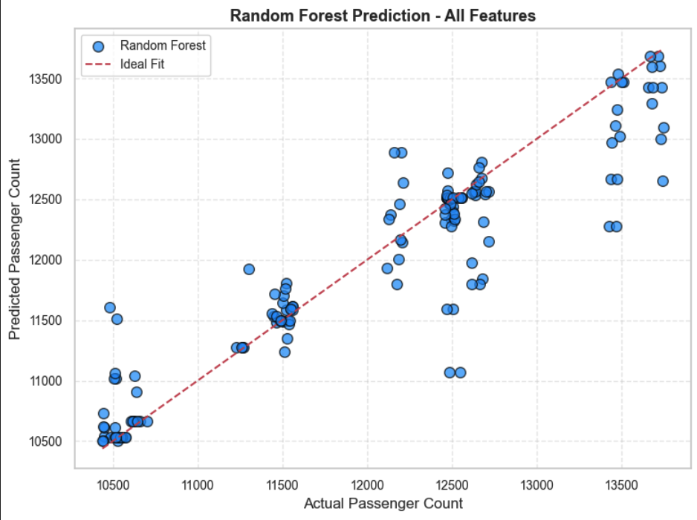
MACHINE LEARNING INFERENCE
Best performing model for Beşiktaş is Random Forest, achieving the lowest MSE and the highest R² (0.48). It successfully captures the relationship between ferry passenger counts and features such as weather and school term status.

Slide 16
CONCLUSION
Pearson Correlation Coefficient (Wind Speed vs Passenger Count): -0.4056
p-value: < 0.001
The null hypothesis is rejected.
There is a statistically significant negative correlation between wind speed and daily ferry passenger numbers.
As wind speed increases, the number of ferry passengers tends to decrease, indicating that weather conditions play a role in sea transportation behavior.
School Term Analysis:
Average daily passengers are higher during holiday periods compared to school terms.
(p-value = 0.0021)

