Slide 1

MediGuide AI
Intelligent Symptom Assessment & Patient Guidance Assistant
Built with LangChain, OpenAI, and Streamlit

Slide 2



Safety First: Educational Use Only
Educational Prototype Only
This is an educational AI prototype — not a medical device or diagnostic tool.
Not a Medical Replacement
NOT a replacement for licensed medical professionals. All outputs are preliminary guidance only.
Always Consult a Doctor
Every medical decision must involve a qualified physician. Emergency symptoms require immediate professional care.
Emergency symptoms require immediate professional care — always call emergency services when in doubt.

Slide 3

Bridging Health and AI
PROJECT VISION
Demonstrating Safe LLM Integration
Vision: Demonstrate how LLMs safely gather health information and provide structured preliminary guidance.
Educational Goal: Show best practices for integrating AI into healthcare workflows — responsibly and transparently.
Key Principle: Keep human doctors in the loop — AI augments, never replaces.
Use Case: Initial symptom assessment and patient education before professional consultation.

Slide 4
Seamless Patient Experience
Patient Data Collection
🟢 LOW
🟡 MEDIUM
Age, gender, symptoms, severity, medical history, and current conditions — all gathered through an intuitive interface with multi-language support: English, Urdu, Arabic, Spanish, and more.
Monitor at home, routine care
Schedule appointment soon
Urgency Level Indicators
🔴 HIGH
⚫ EMERGENCY
Color-coded assessments guide patients to the right level of care:
Seek care within hours
Call emergency services immediately

Slide 5

Under the Hood: Technical Architecture
Build Prompt
Select Cache
Form Input
Validate
LLMChain
The full pipeline — from patient form submission to live dashboard rendering — is powered by Python, Streamlit, LangChain, and OpenAI GPT-4o-mini, ensuring data integrity, cost efficiency, and a responsive user experience at every step.

Slide 6
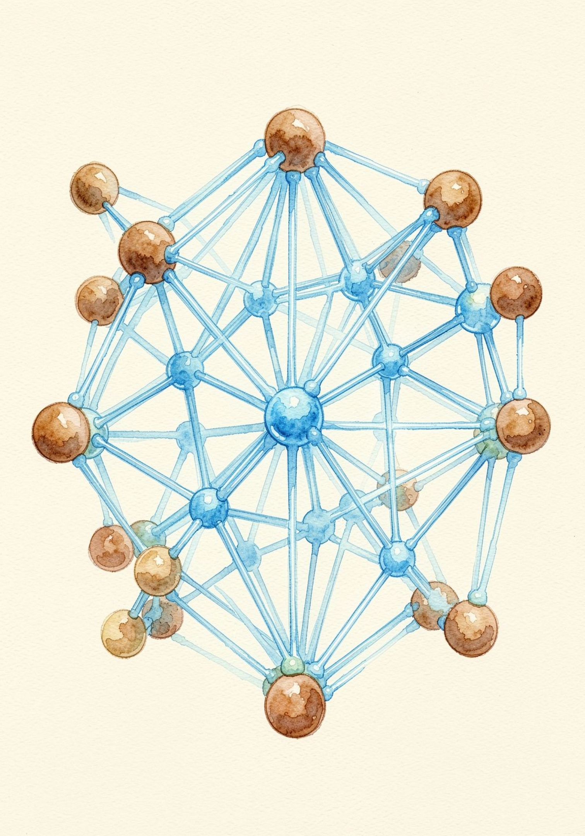





Powering the AI Logic: LangChain Concepts (Part 1)
ChatOpenAI
Prompt Templates
Integrates GPT-4o-mini for reliable, fast natural language processing and medical reasoning.
Reusable structures with distinct roles: System Message (AI behavior & safety), Human Message (patient input), and AI Message (structured response).
LLMChain
Reusable pipeline combining prompt templates with the language model for consistent, reliable outputs every time.

Slide 7
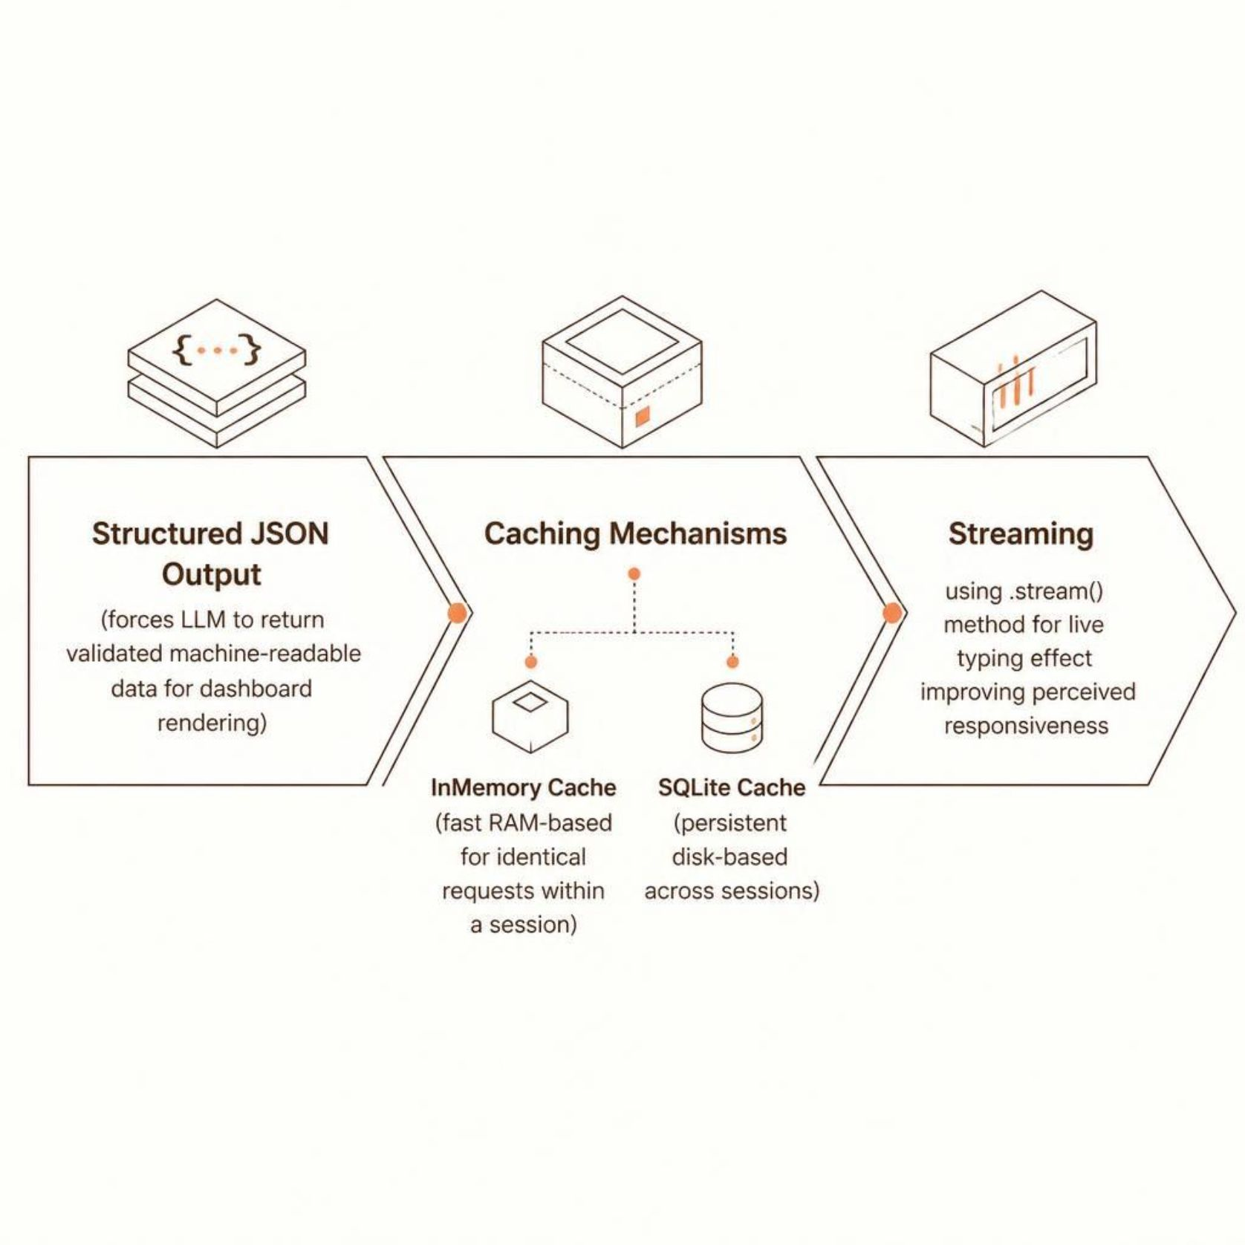
Ensuring Performance & Reliability: LangChain Concepts (Part 2)
Structured JSON Output
Forces the LLM to return safe, validated, machine-readable data for accurate dashboard rendering — no ambiguous free-text responses.
Caching Mechanisms
InMemory Cache — Fast RAM-based caching for identical requests within a session.
SQLite Cache — Persistent disk-based caching across sessions, reducing API costs and latency.
Streaming
Uses the .stream() method for a live typing effect, improving perceived responsiveness and user engagement.

Slide 8
Designing for Medical Safety
System Prompt Guardrails
Emergency Protocols
Explicitly instructs the AI to never diagnose — only assess and guide. Safety constraints are baked into every prompt.
Detects severe symptoms (chest pain, difficulty breathing) and immediately escalates to EMERGENCY urgency with "Call 911" messaging.
Per-Condition Disclaimers
Input & Output Filtering
Frames all outputs as possibilities and educational information — never as medical facts or diagnoses.
Input Validation rejects incomplete or suspicious data. Output Filtering removes any language that could be misinterpreted as medical advice.

Slide 9


Proving the Concept: Testing & Validation
🟢 Mild Cold Scenario
⚫ Severe Chest Pain Scenario
🟡 Chronic Condition Scenario
Cough, sore throat, low fever → LOW urgency, home care, monitor for 7 days
Acute chest pain, shortness of breath → EMERGENCY urgency, immediate "Call 911"
Diabetes + elevated blood sugar → MEDIUM urgency, schedule appointment, medication review
Edge Cases & Results
Empty symptom handling validated
Multi-language accuracy confirmed
Cache performance benchmarked
All tests pass with safe, appropriate guidance and proper escalation across every scenario.

Slide 10





The Future of AI in Healthcare
Success Demonstrated
MediGuide AI proves that LLMs can safely integrate into healthcare workflows with proper guardrails in place.
Key Takeaway
AI excels at gathering information and providing preliminary guidance — but human doctors remain essential for diagnosis and treatment.
Next Steps
EHR system integration, real-time specialist routing, and multi-modal symptom analysis (voice, images).
Our Commitment
Always keep human expertise at the center of healthcare AI — technology serves people, not the other way around.
Thank you. Questions?

