Slide 1

Admission Process - Analysis, Hypothesis Test and Bayes’ Theorem

Slide 2
This dataset is created for prediction of Graduate Admissions from an Indian perspective.
The dataset contains several parameters which are considered important during the application for Masters Programs. The parameters included are :
GRE Scores ( out of 340 )
TOEFL Scores ( out of 120 )
University Rating ( out of 5 )
Statement of Purpose and Letter of Recommendation Strength ( out of 5 )
Undergraduate GPA ( out of 10 )
Research Experience ( either 0 or 1 )
Chance of Admit ( ranging from 0 to 1 )
This dataset was built with the purpose of helping students in shortlisting universities with their profiles. The predicted output gives them a fair idea about their chances for a particular university.

Slide 3
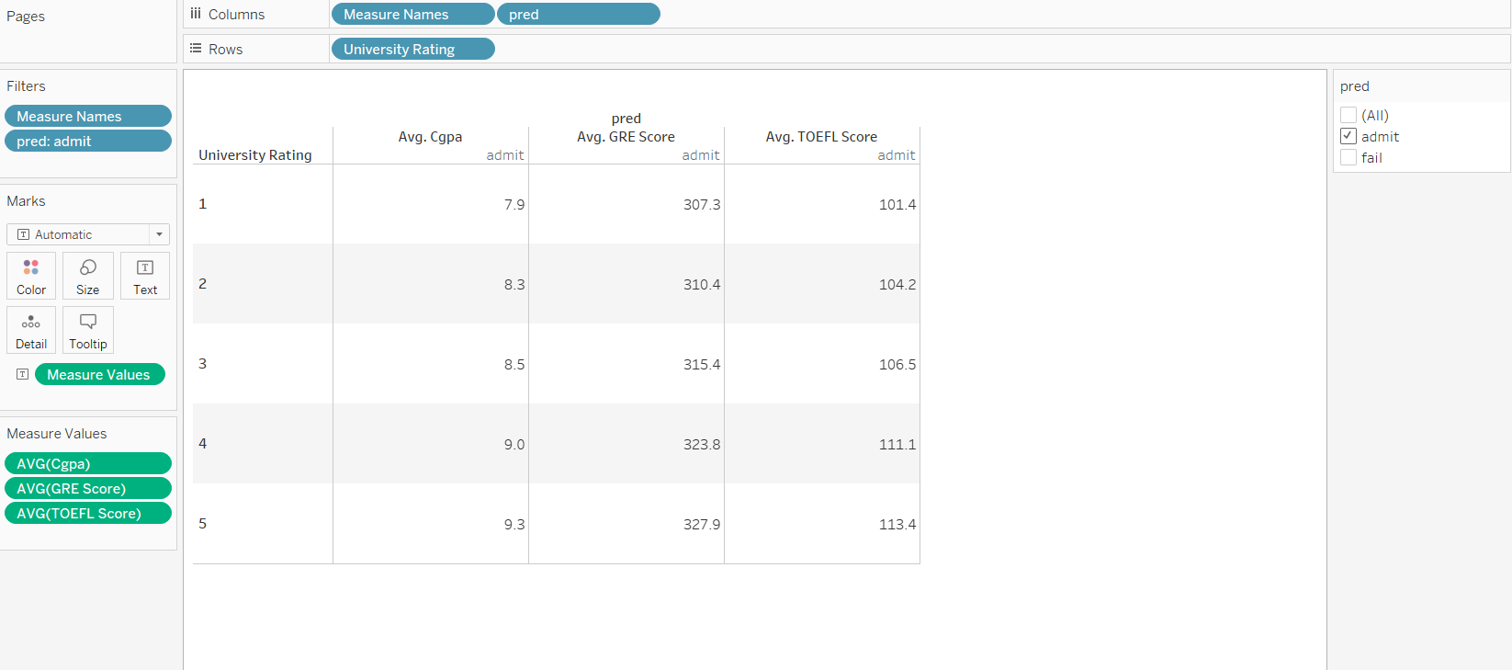
Graphical Analysis Using Tableau
This table shows us that the higher the CGPA, GRE Score and TOEFL Score, the chances of getting a university with higher rating increases.

Slide 4

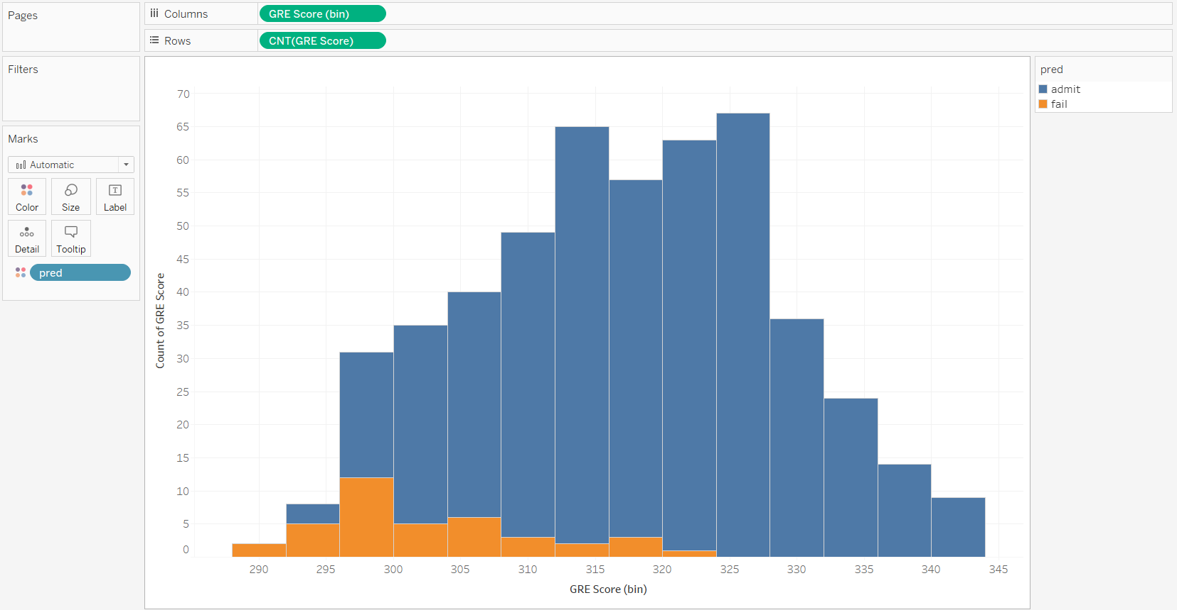
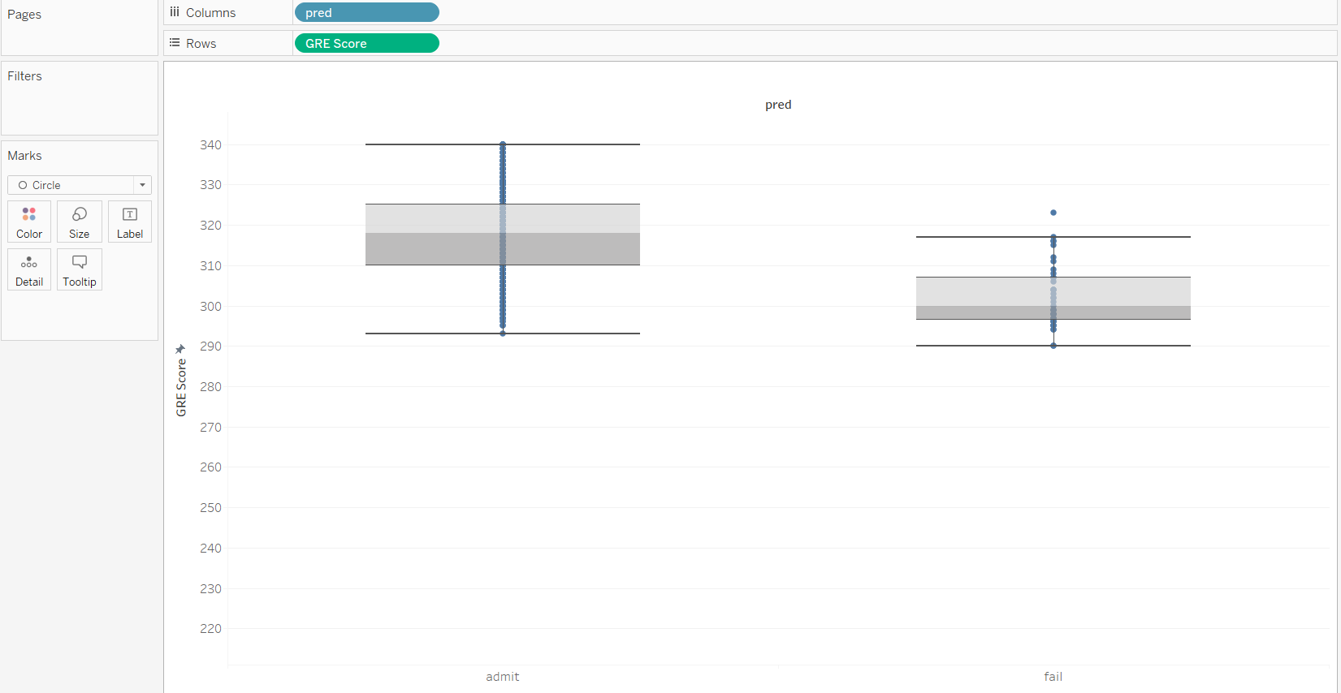
This boxplot shows us the quartile range which depends on the GRE score.
This Histogram shows us that having a minimum GRE score of 300 increases the chance of admission significantly.

Slide 5
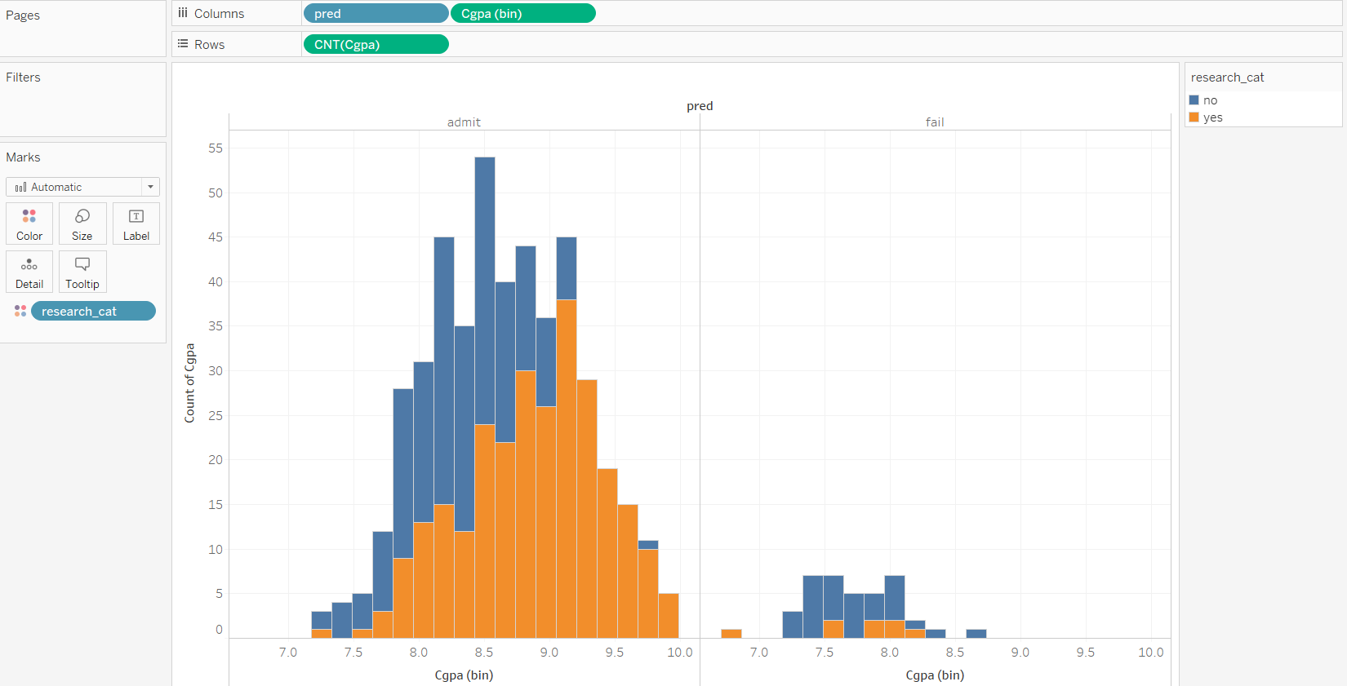
As you can see here that students with CGPA higher than 7.5 will have higher chances of getting admitted but other factors like research experience will also play an important role.

Slide 6
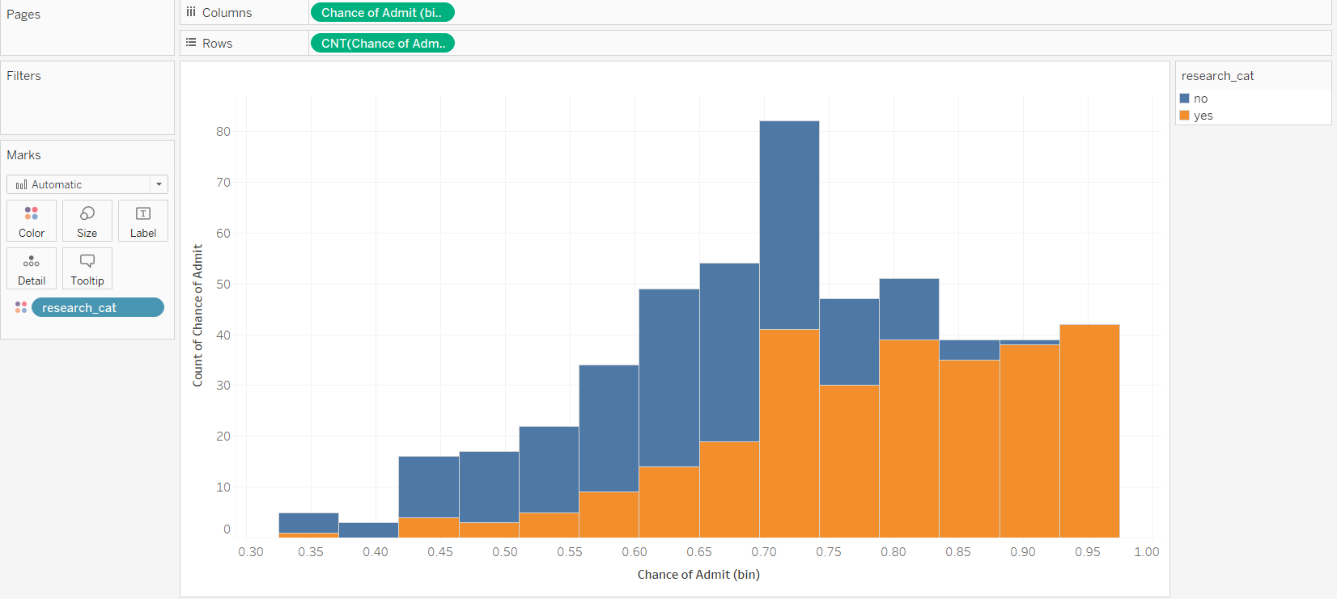
This Histogram depicts that having research experience increases the chances of admission by 70%

Slide 7
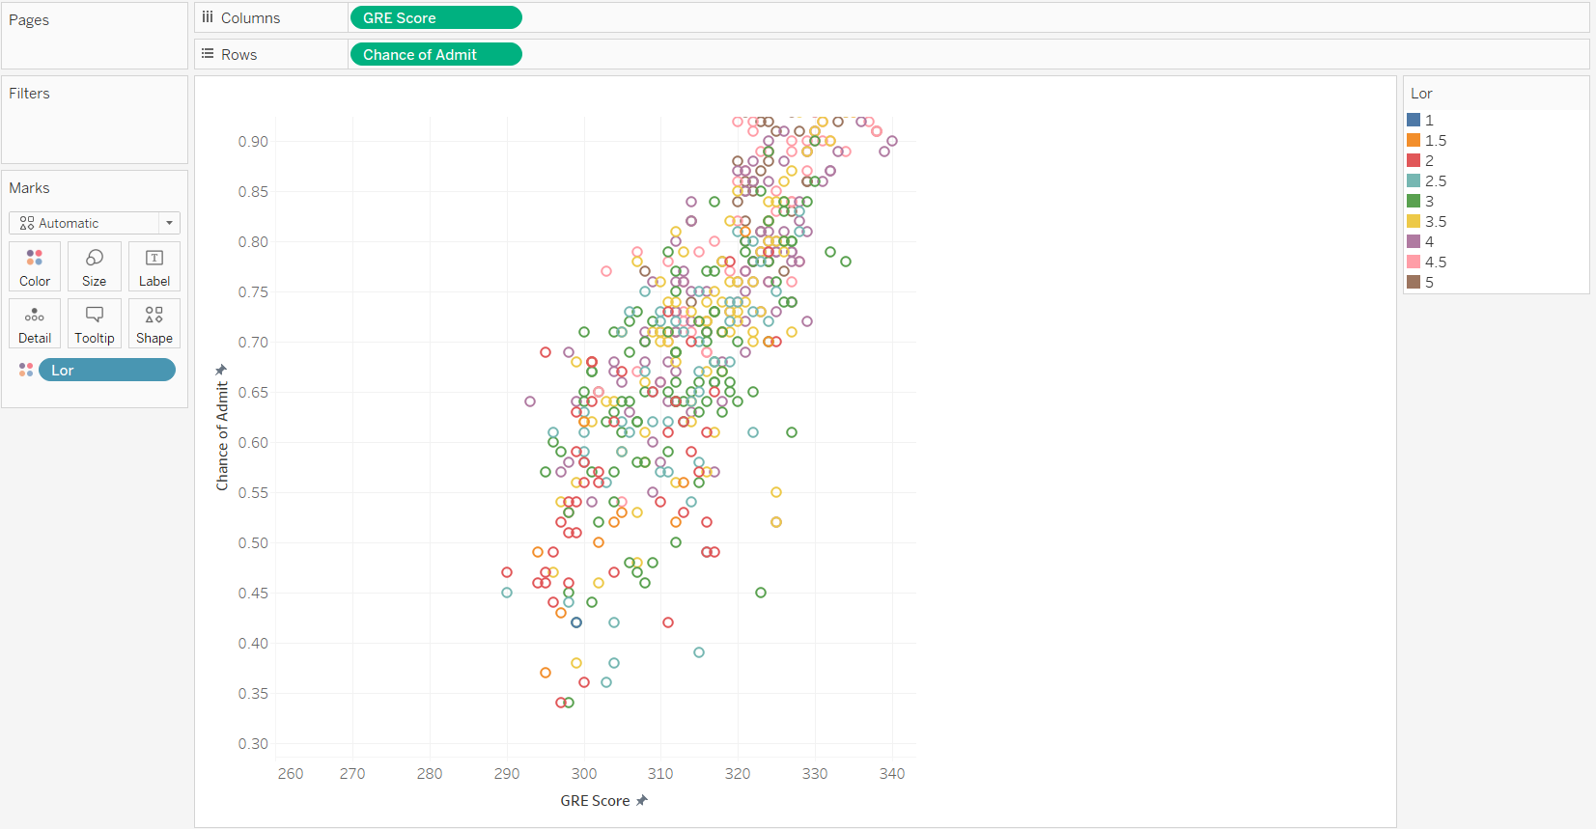
GRE score is linearly proportional to the chance of admission but Letter of Recommendation strength plays an important role as we can see in the given scatterplot.

Slide 8
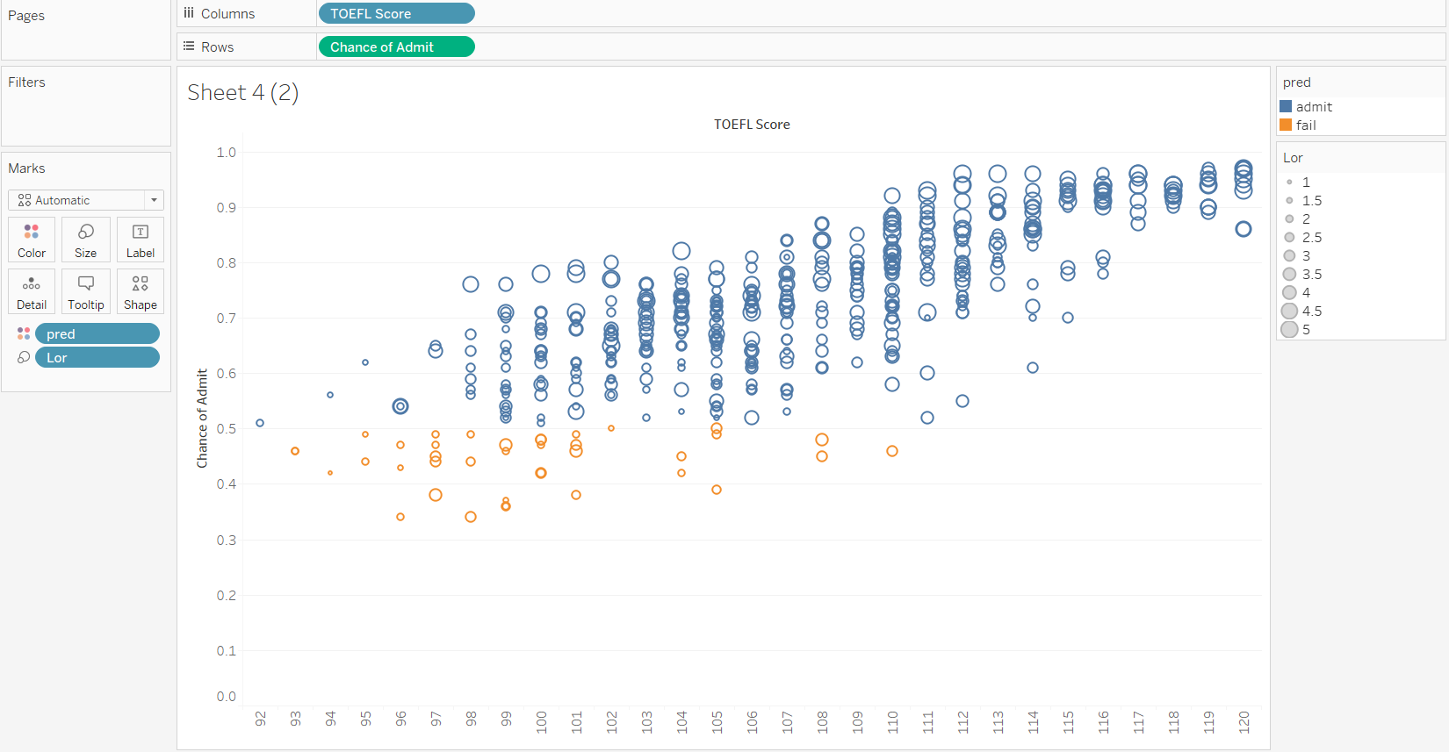
Again we see that TOEFL score is linearly proportional to chances of admission, but having a better letter of recommendation strength makes an impact on your profile.

Slide 9
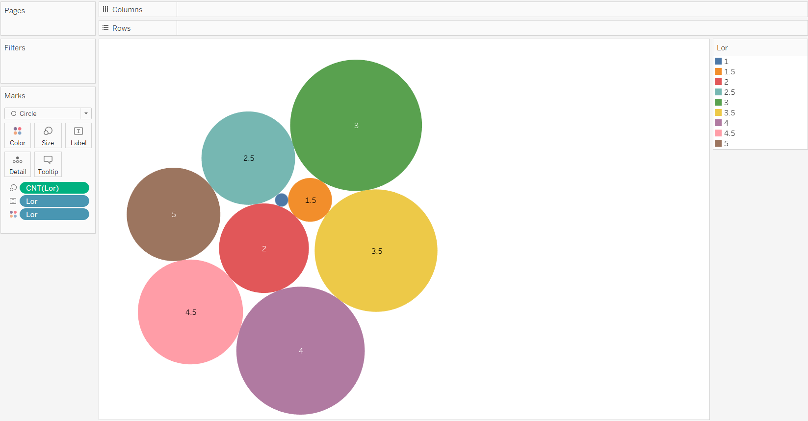
This tree map shows us that more than 60% of the students prefer having a good letter of recommendation strength which is more than 3.

Slide 10
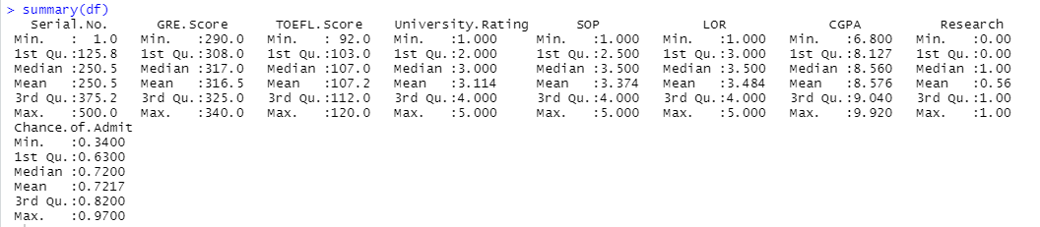
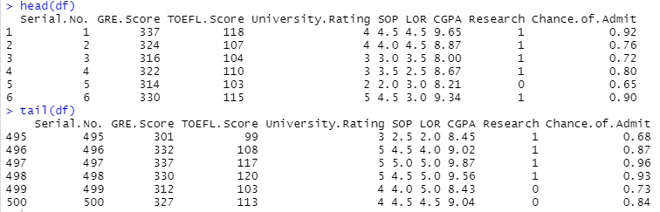
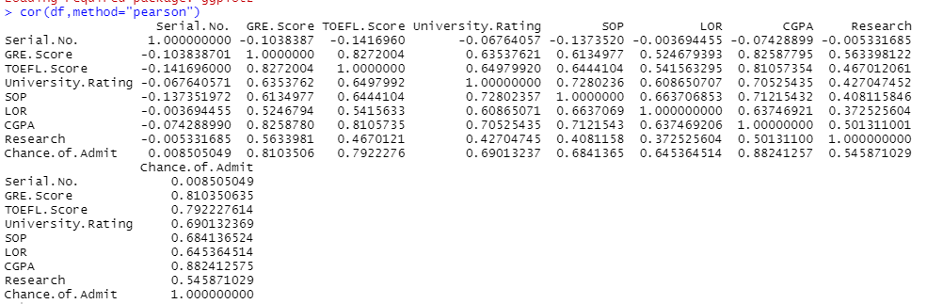
Empirical Analysis

Slide 11
Hypothesis Test
We assume that LOR (Letter of Recommendation) and SOP (Statement of Purpose) strength has equal significance and impact on the chances of admission

Slide 12
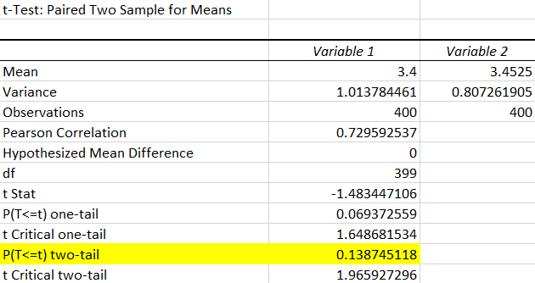

Slide 13
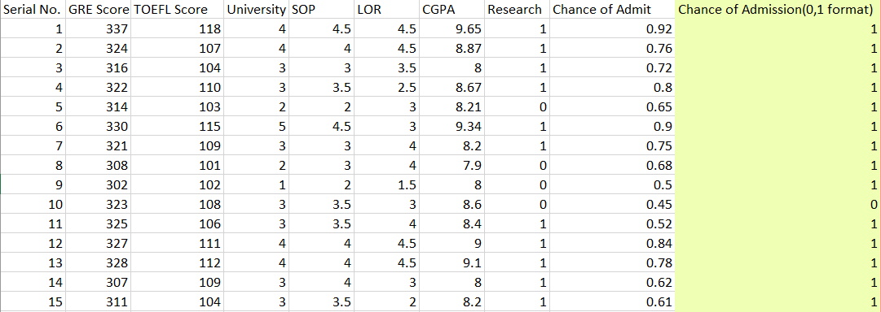
Bayes’ Theorem

Slide 14
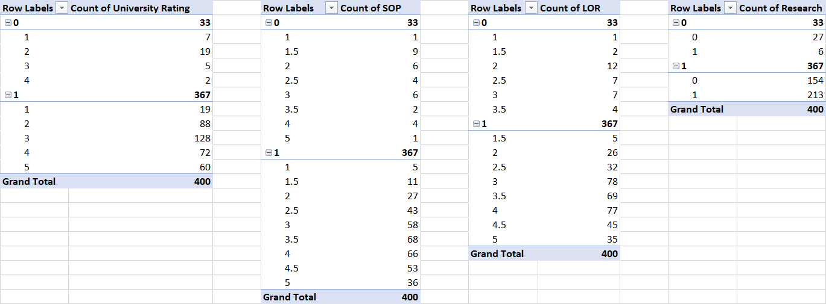
Determining the categorical data

Slide 15
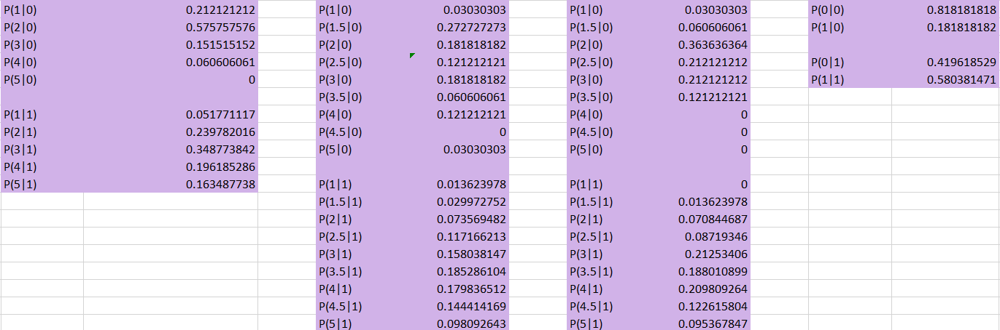

Working on the probabilities with respect to the chances of admission

Slide 16
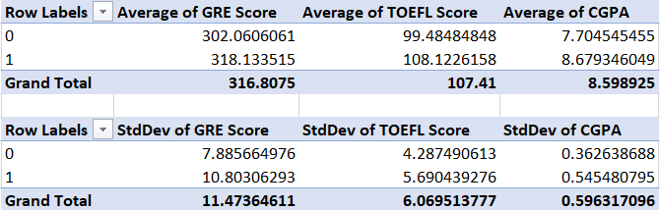
Determining the continuous data and calculating their mean and standard deviation with respect to the chances of admission

Slide 17
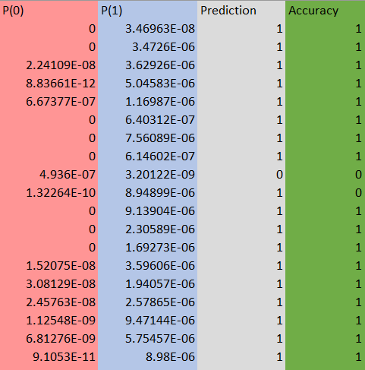
Calculating P(0) and P(1) Columns, predicting the chances of admission and calculating the accuracy

Slide 18

Final Accuracy

Slide 19


