Slide 1

CIVIL PLAN
Using AUTOCAD

Slide 2

Introduction
American International University-Bangladesh
Course : Computer Aided Designing and Drafting
Lecturer : Rethwan Faiz
Group of 3:
Ahnaf Faiaz [20-42213-1]
Muhaiminul Ashrafee [20-42217-1]
Asif Hossain Neloy [20-42996-1]

Slide 3
BNBC Code
What is BNBC
History
Why to use BNBC

Slide 4

Floor plan & Dimensions

Slide 5
Room Sizes
(for B unit only)(in sqft)
room 1 (10'*12') = 120
room 2 (9'2"*12') = 108
dining (12'*15') = 180
bathroom (6'*8'6") = 50'*2 = 100
living (14'*11'8") = 168
varanda 1 (5'*12') = 60
varanda 2 (12'*5'2") = 60
kitchen (6'*11'8") = 72
_____________________________________
Total = 868 sqft
wall = 140 sqft
Total with wall = 1008 sqft

Slide 6
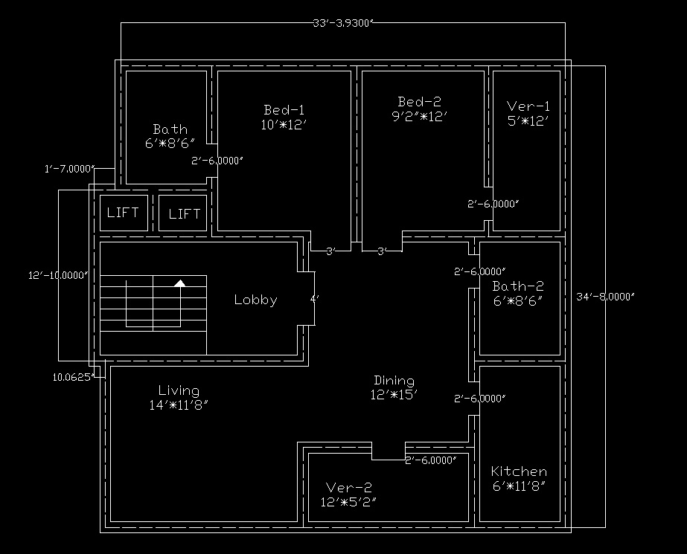
Designing Civil
floor plan

Slide 7
Electric Fittings

Slide 8
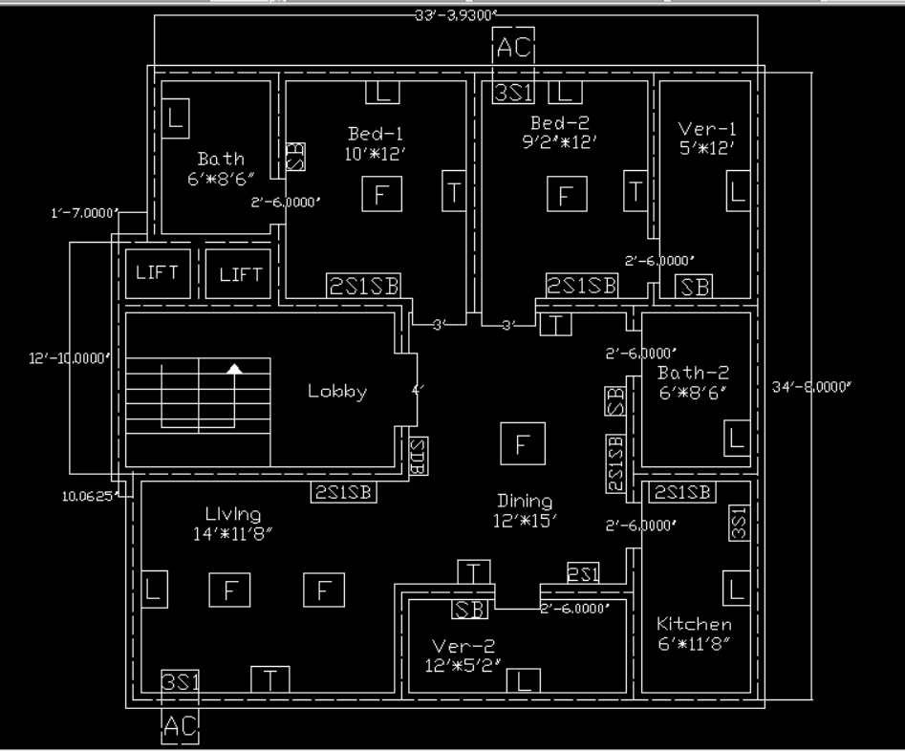
Electric Fittings
(for B unit only)
Bedroom*2 : 1 Lights, 1 tubelights, 1 celling fans,
1 2s1 & 1 3s1(bed-2).
Living room*1 : 1 light, 1 tubelight, 1 fan, 2 2s1 & 1 3s1.
Dining*1 : 1 light, 1 tubelight, 1 fan & 1 2s1.
Kitchen*1 : 1 light, 1 2s1 & 1 3s1.
Bathroom*2 : 1 lights.
Varanda*2 : 1 lights.

Slide 9
Electric Conduit Layout

Slide 10
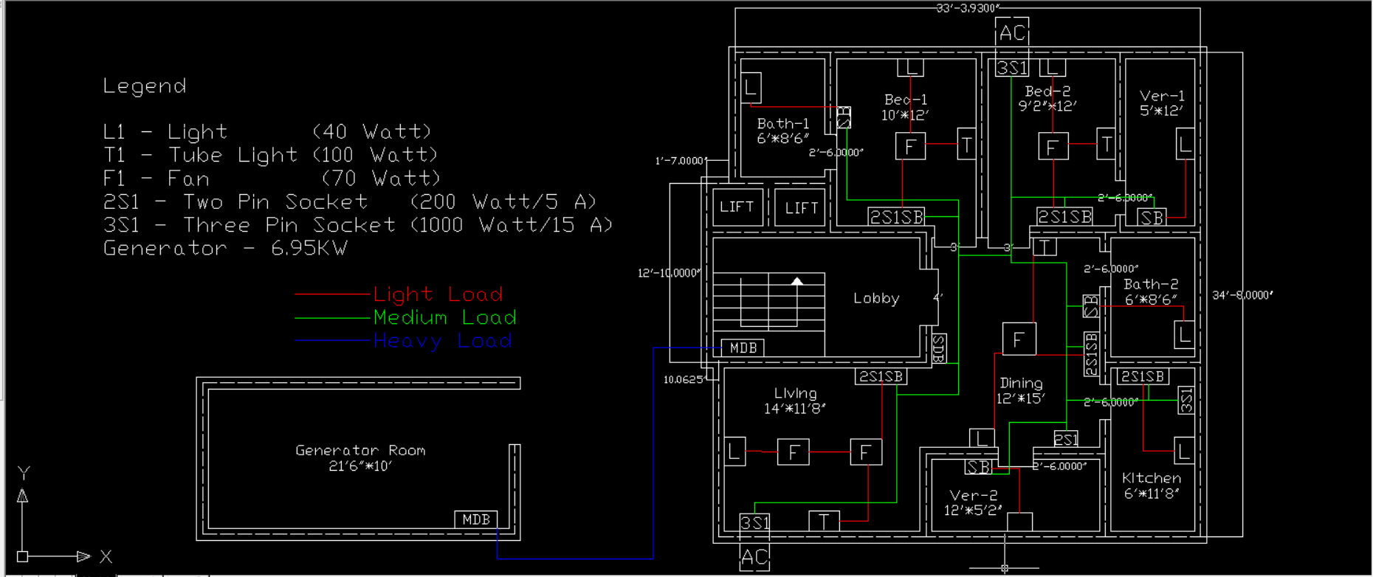

Slide 11
Load Analysis

Slide 12
Load Analysis
Total Load of the unit: 5.81 kW
Total Load of the floor is: 17.43 kW
Total Load of the Building is: 69.72 kW
Required generator room = 215' sqft
Generator Load = 6.95 kW

Slide 13

Thank You

