Slide 1
Enhancing Model Robustness and Fairness with Causality:
A Regularization Approach
CSE431 - Natural Language Processing

Slide 2
Presented by: Group 25
18101291 - Jannatun Nahar
17201134 - Ahnaf Rahman Khan
18101074 - MD Ashikur Rahman
17101221 - Ahanaf Asir
16201085 - Abida Sultana

Slide 3
Abstract
Unintended biases
Causal knowledge integration
Separate penalization
New and improved robust models

Slide 4
Introduction
False correlations
Causal reasoning
Weight redistribution
More accurate and better performance

Slide 5
Related Work
3 types of ML fairness
3 categories of related research
General regularization
Less human annotation

Slide 6
Problem Definition:
Train a model so that it performs well on test set and data from different distributions
3.1 Robustness to Counterfactuals
Model should focus on causal correlations
Spurious correlation can suffer from robustness on counterfactual data
3.2 Fairness to Sensitive Attributes
Group fairness with respect to sensitive attributes
Train a model that ensures members receive fair outcomes

Slide 7
METHOD

Slide 8
OBJECTIVE:
To build a model that is robust to counterfactuals and fair to sensitive attributes.
propose a regularization approach to build a loss function that adds small penalties for causal features and large penalties for spurious features.

Slide 9
ANNOTATION OF THE FEATURES:
CASUAL -
A causal feature is a feature that causes the sample to receive the label in a specific dataset.
SPURIOUS -
a spurious feature is a feature that correlates with the target class in a specific dataset, but replacing it with another feature would be unlikely to change the instance label.

Slide 10
REGULARIZATION WITH FEATURES:
Design a loss function that adds different penalties for different types of features.
pay more attention to small penalty and less attention to large penalty.
train a model that performs well on testing data as well as maintains robustness to counterfactuals and fairness to sensitive attributes.

Slide 11
Experiments
Evaluate the effectiveness of the proposed method from two aspects
Robustness to counterfactuals
Fairness to sensitive attributes
Data
Review class distributions from dataset
5.2 Causal and Spurious Features
Manually label causal and spurious features from each dataset
Train an initial classifier and extract top coefficient features
Identified two sets of causal and spurious features

Slide 12
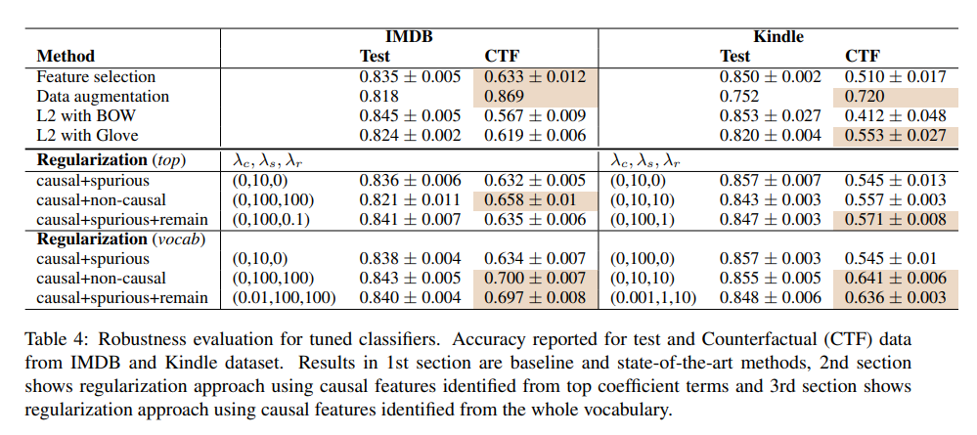
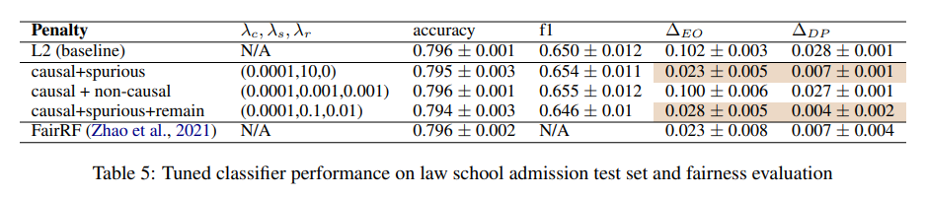
5.3 Experimental Settings
Feature Selection
Data Augmentation
L2 Regularization approach
BOW
Number of casual and spurious feature
BinaryCrossEntropy
Adam optimizer
Early stopping criteria
5.4 Robustness Evaluation
5.5 Fairness Evaluation
Law School Admission dataset
LSAT and GPA

Slide 13
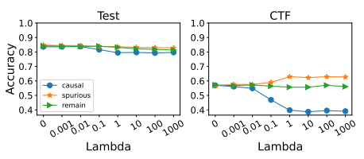
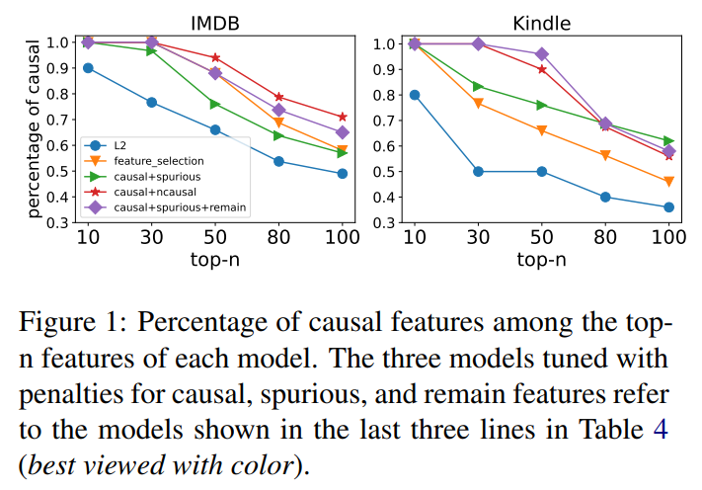

Slide 14
Discussion
Effect of Hyperparameter,𝝺.
Two observation-
Different 𝝺 parameters give more stability.
𝝺_c affects model performance on counterfactual set .

Slide 15
Extension in Deep Learning Framework
Use of logistic regression.
Use of different approaches.

Slide 16
Conclusion
Initiating the idea of integrating causal knowledge through regularization approach.
Identification of causal, spurious features.
Assigning different penalties.
Easy to implement.

