Slide 1
The Rise of EVs
Analyzing Global Electric Vehicle Growth & Underlying Factors
Mohammad Ahnaf Masud
Schiller International University of Madrid
Professor Dhaval Gadariya

Slide 2
Purpose & Goals of This Study
Why This Dataset?
IEA is the global authority on energy data - trusted by governments worldwide
15 years of comprehensive coverage (2010-2024) across all major markets
Multiple indicators: stock, sales, infrastructure, policy, environmental impact
Public access under Creative Commons BY 4.0 license
Research Goals
Understand growth patterns: linear vs exponential trends
Identify key drivers: policy, infrastructure, technology
Compare regression models to find best forecasting method
Project future growth through 2030 and validate against IEA projections
Data Source: https://www.iea.org/data-and-statistics/data-tools/global-ev-data-explorer

Slide 3
Data Cleaning Process
Why Remove IEA Projections?
Independent Training: We use ONLY historical data (2010-2024) to train our models
Avoid Bias: Training on IEA projections would bias our model toward their estimates
Validation Purpose: Later we compare OUR forecast with IEA projections to validate accuracy
Scientific Rigor: Independent modeling proves our approach works without knowing their methods
Cleaning Steps
Filtered out all rows with category "Projection-STEPS"
Kept only years ≤ 2024 (verified historical data)
Removed duplicates and standardized column names
Converted values to numeric for analysis
Data Source: https://www.iea.org/data-and-statistics/data-tools/global-ev-data-explorer

Slide 4
Tools & Libraries Used
Data Processing & Cleaning
pandas: Data manipulation, filtering, groupby aggregations, dataframe operations
NumPy: Numerical computations, array operations, mathematical functions
Machine Learning & Modeling
scikit-learn: LinearRegression, PolynomialFeatures, train_test_split
sklearn.metrics: R² score, Mean Absolute Error (MAE), Root Mean Squared Error (RMSE)
warnings: Suppress non-critical warnings for cleaner output
Visualization
matplotlib.pyplot: Base plotting library, figure creation, customization
seaborn: Statistical visualizations, styling, correlation heatmaps
Data Source: https://www.iea.org/data-and-statistics/data-tools/global-ev-data-explorer

Slide 5
Ethical Considerations
Data Transparency & Attribution: Dataset from IEA, used under Creative Commons BY 4.0 license with proper attribution
Data Integrity: Only historical data used in analysis; all projection rows removed to ensure conclusions based on verified facts, not estimates
Aggregation Awareness: Careful not to double-count across overlapping categories (World vs regions vs countries)
Fair Interpretation: Regional differences contextualized by economic, technological, and infrastructural factors rather than framed as success/failure
Privacy: Dataset contains only aggregated statistics at country/regional level - no personal or sensitive information
Reproducibility: Clear documentation of methodology, data sources, and analytical steps enables verification and replication
Data Source: https://www.iea.org/data-and-statistics/data-tools/global-ev-data-explorer

Slide 6
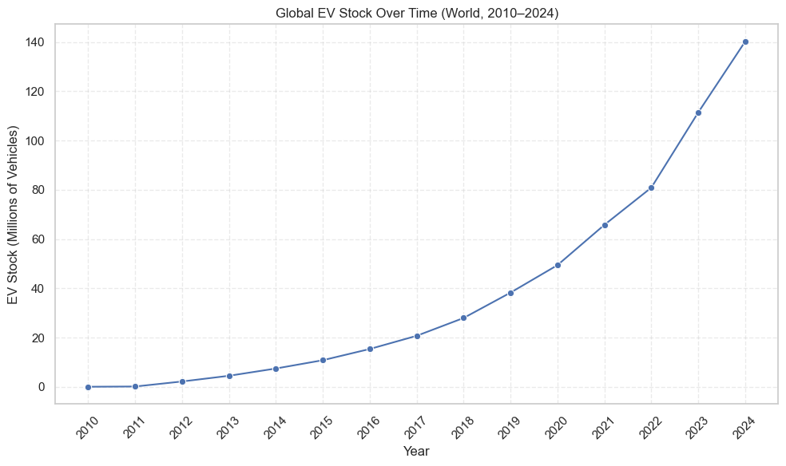
Global EV Stock Growth (2010-2024)
Growth Pattern: 45-fold increase demonstrates exponential S-curve adoption
Inflection Point: 2018 acceleration aligns with policy convergence
Drivers: China NEV mandate, EU emissions targets, battery cost decline (-89%)
Data Source: https://www.iea.org/data-and-statistics/data-tools/global-ev-data-explorer

Slide 7
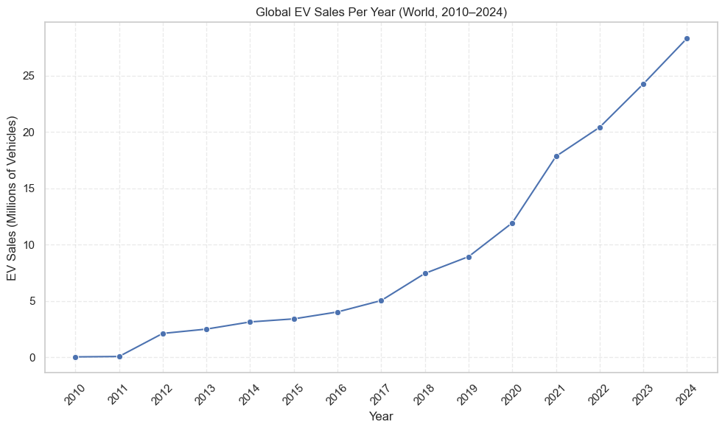
Annual EV Sales Trajectory
2024 Performance: 17+ million units, sustained compound growth
Market Evolution: 500+ models available (vs 50 in 2015)
Consumer Adoption: 70% consideration rate indicates mainstream acceptance
Data Source: https://www.iea.org/data-and-statistics/data-tools/global-ev-data-explorer

Slide 8
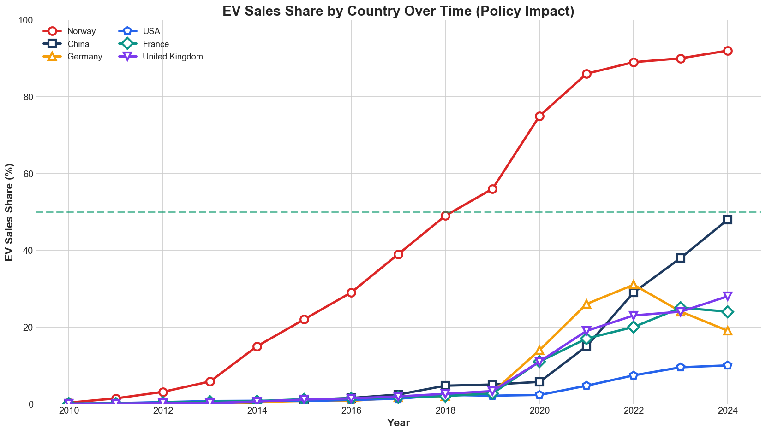
Policy Effectiveness: Comparative Analysis
Norway (92% share): Demand-side fiscal incentives (tax exemptions $10k+)
China (50%+ share): Supply-side mandates (18% NEV requirement)
Policy Validation: Both approaches effective, design matters
Data Source: https://www.iea.org/data-and-statistics/data-tools/global-ev-data-explorer

Slide 9
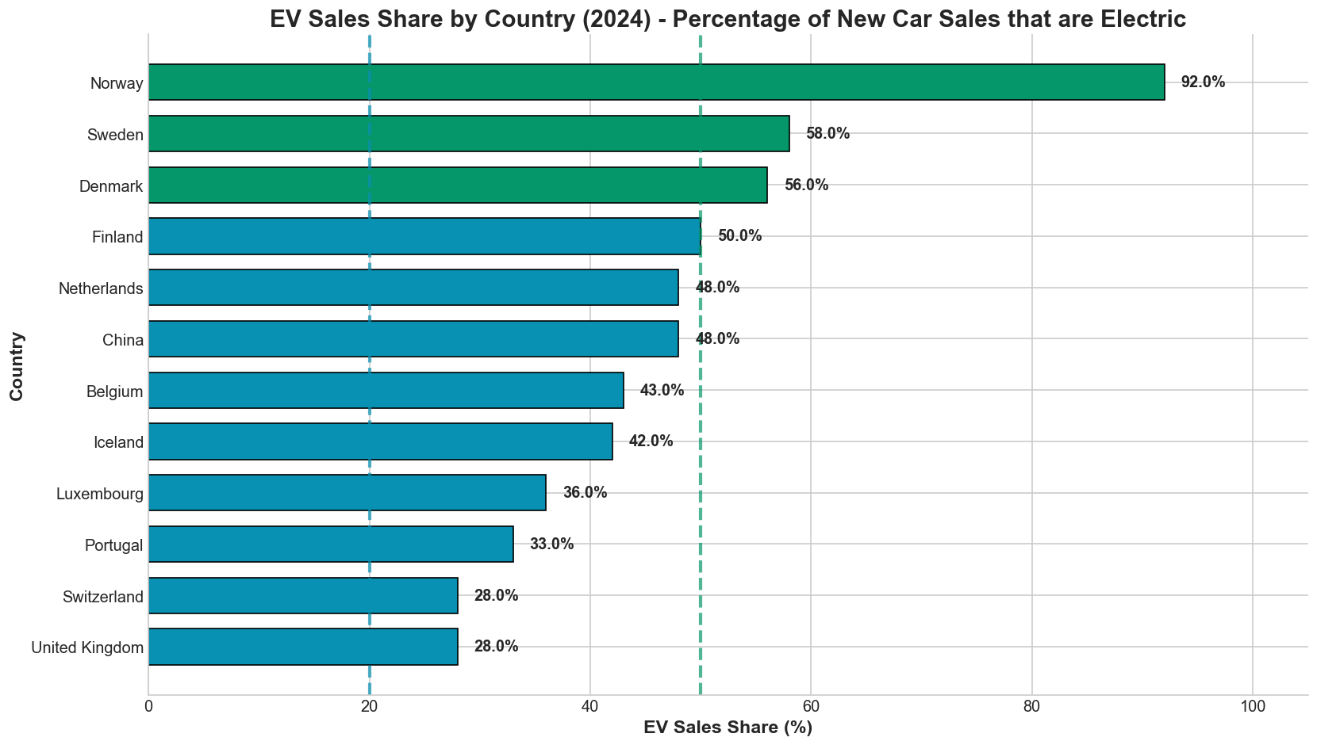
Market Penetration Analysis
Global Penetration: <1% (2010) → 20%+ (2024)
Tipping Point: 10-15% threshold represents mainstream adoption per diffusion theory
Strategic Value: Share metric normalizes for market size variations
Data Source: https://www.iea.org/data-and-statistics/data-tools/global-ev-data-explorer

Slide 10
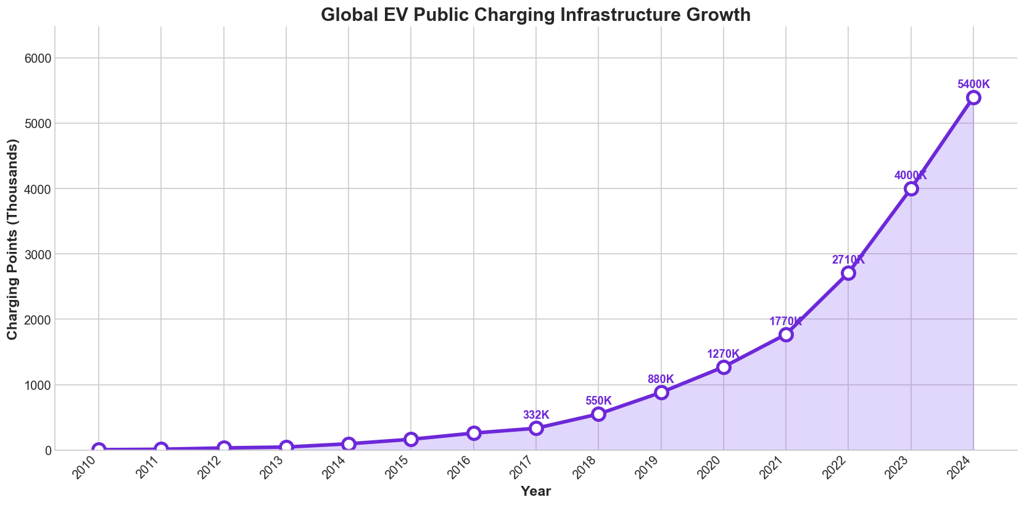
Infrastructure-Adoption Correlation
Correlation: r=0.997 demonstrates near-perfect relationship
Investment: $10B+ global public funding (EU €1B, China $2B, USA $7.5B)
Impact: Fast-charging capability (80% in 15min) reduces range anxiety
Data Source: https://www.iea.org/data-and-statistics/data-tools/global-ev-data-explorer

Slide 11
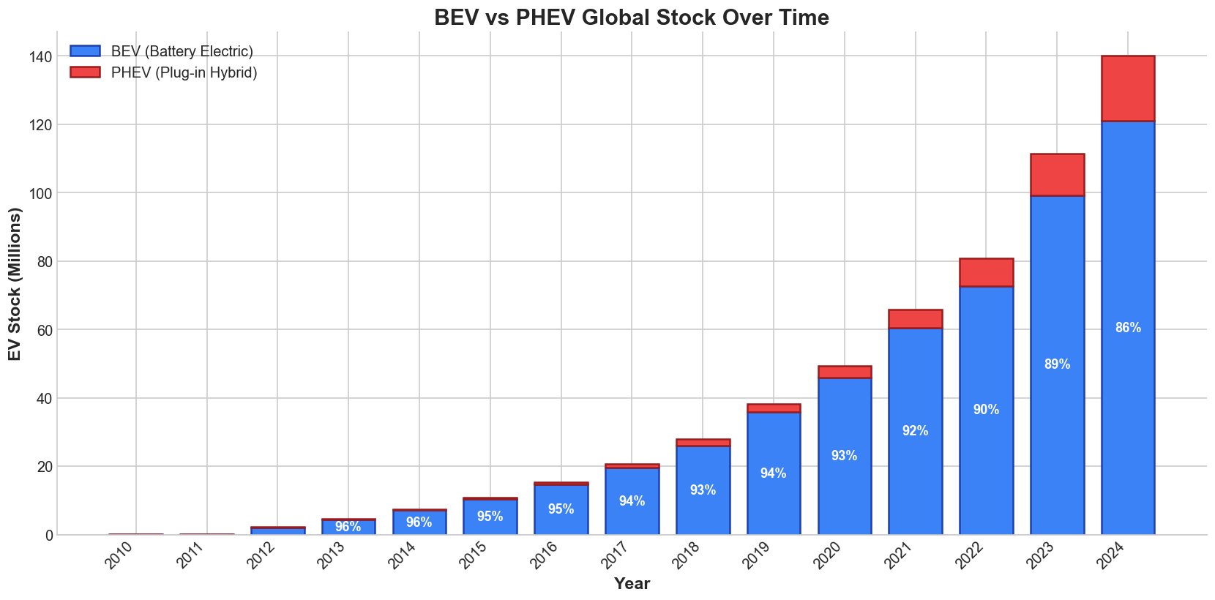
Powertrain Technology Competition
Market Distribution: BEV 70%, PHEV 30% and declining
BEV Advantages: Range parity (300-400mi), lower total cost of ownership
Technology Selection: Market preference for full electrification established
Data Source: https://www.iea.org/data-and-statistics/data-tools/global-ev-data-explorer

Slide 12
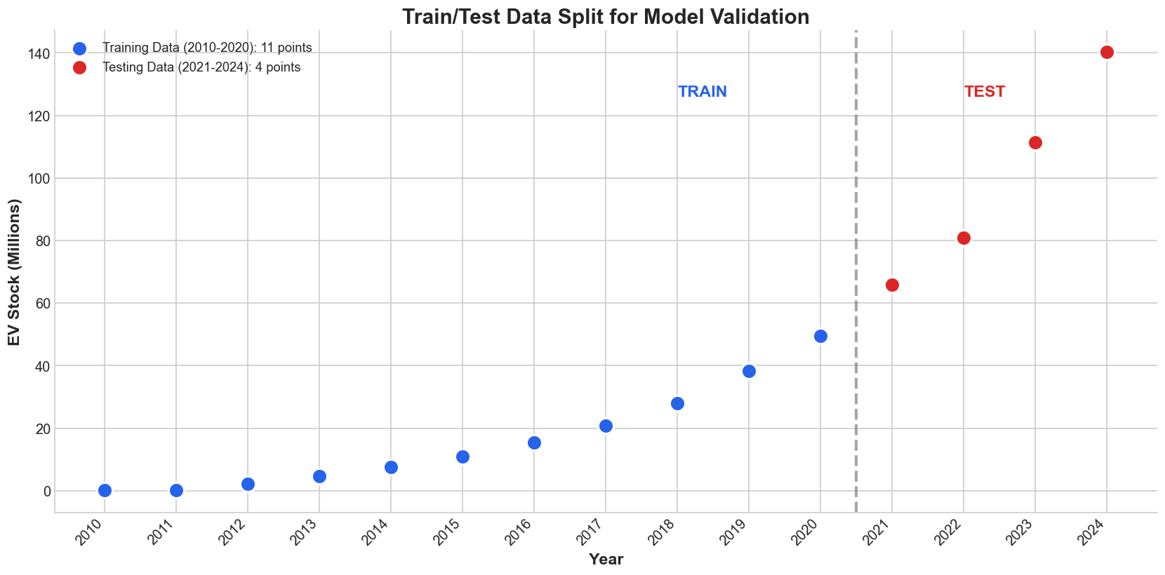
Validation Methodology: Data Partitioning
Training Set: 80% (2010-2020, 11 years)
Test Set: 20% (2021-2024, 4 years) - recent unseen data
Purpose: Prevents overfitting, validates generalization capability
Data Source: https://www.iea.org/data-and-statistics/data-tools/global-ev-data-explorer

Slide 13
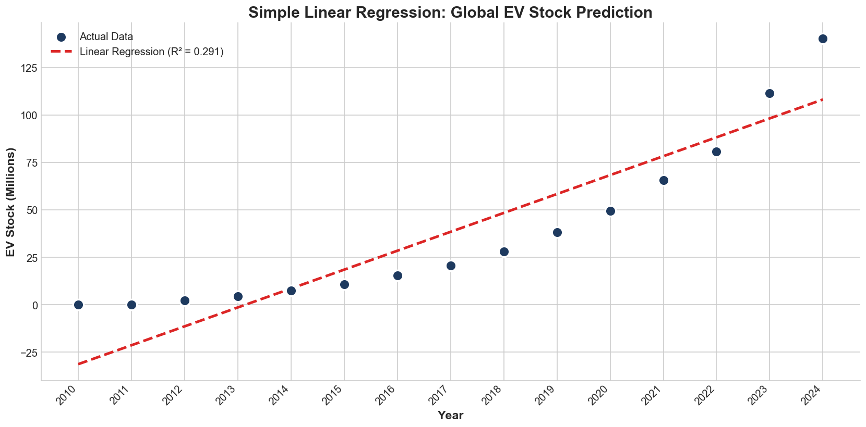
Simple Linear Regression: Baseline Model
Specification: Single predictor (year), linear functional form
Performance: R²=0.9314, MAE=14.42M vehicles
Limitation: Cannot capture exponential acceleration pattern
Data Source: https://www.iea.org/data-and-statistics/data-tools/global-ev-data-explorer

Slide 14
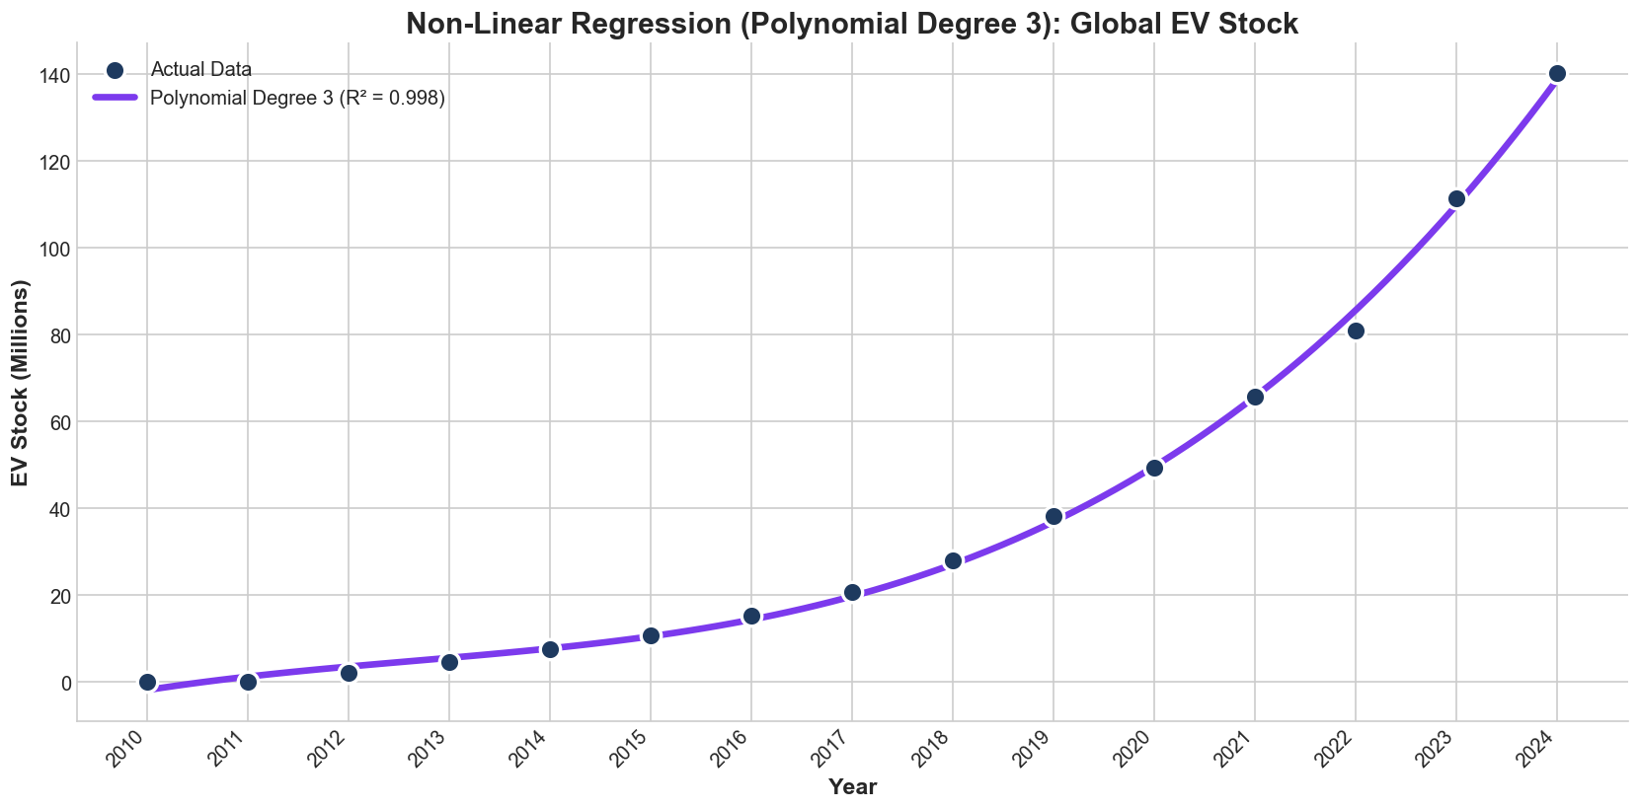
Polynomial Regression: Optimal Model
Selection: Degree 3 optimal (R²=0.9985, MAE=1.20M)
Rationale: Cubic form captures acceleration without overfitting
Validation: Strong performance on 2021-2024 test set confirms generalization
Data Source: https://www.iea.org/data-and-statistics/data-tools/global-ev-data-explorer

Slide 15
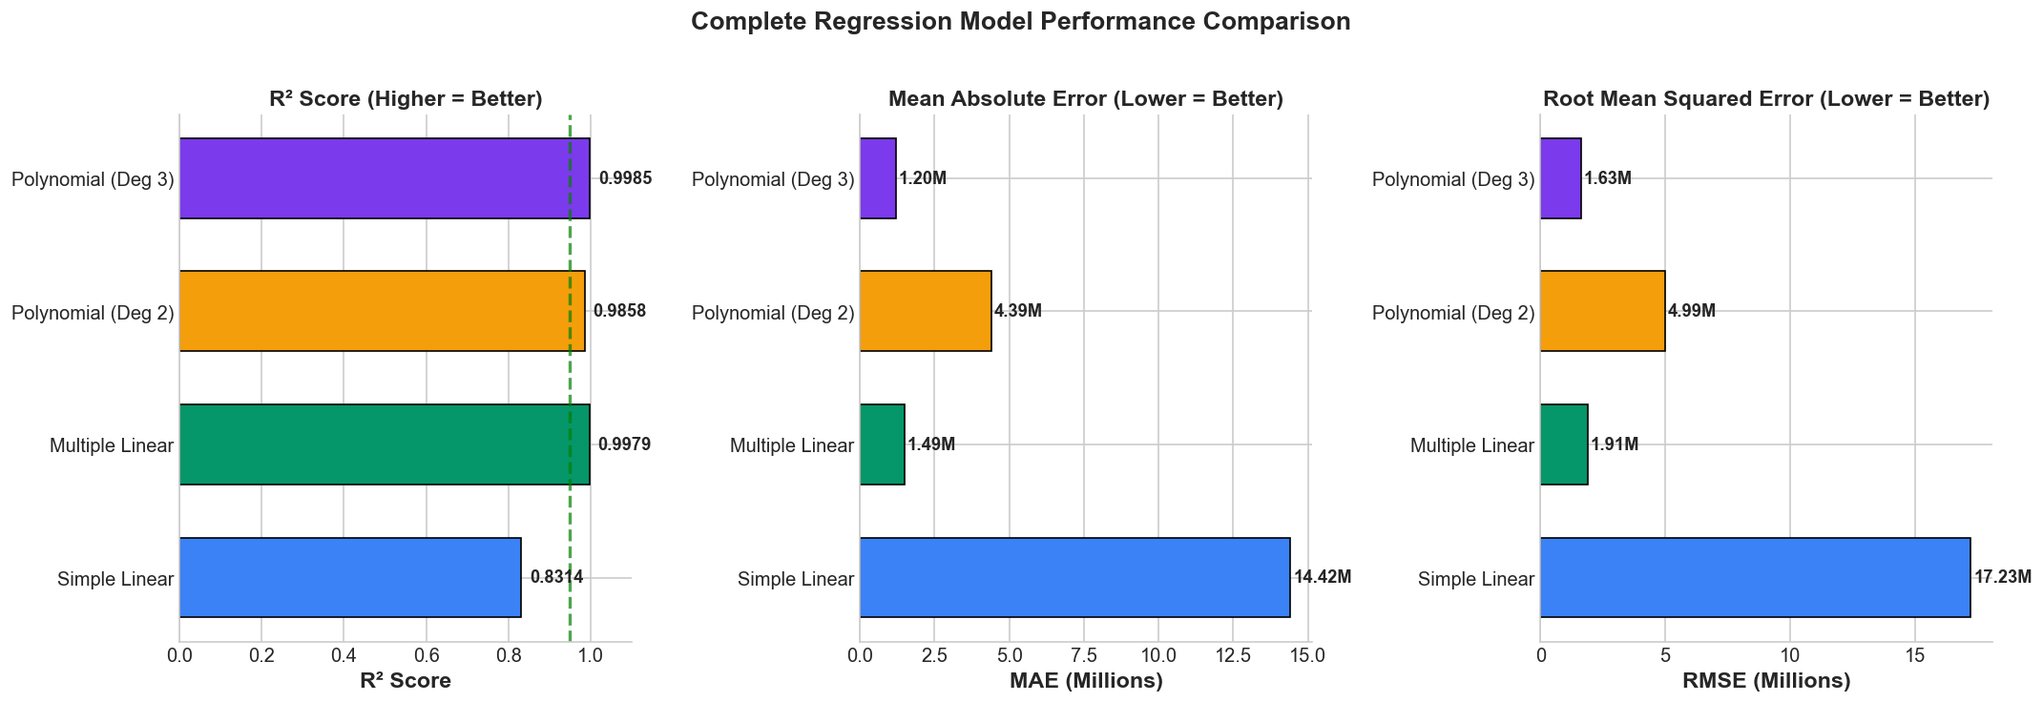
Comprehensive Model Performance Comparison
Simple Linear: R²=0.9314, MAE=14.42M (insufficient)
Multiple Linear: R²=0.9979, MAE=1.49M (improved)
Polynomial Deg 3: R²=0.9985, MAE=1.20M (optimal - selected)
Data Source: https://www.iea.org/data-and-statistics/data-tools/global-ev-data-explorer

Slide 16
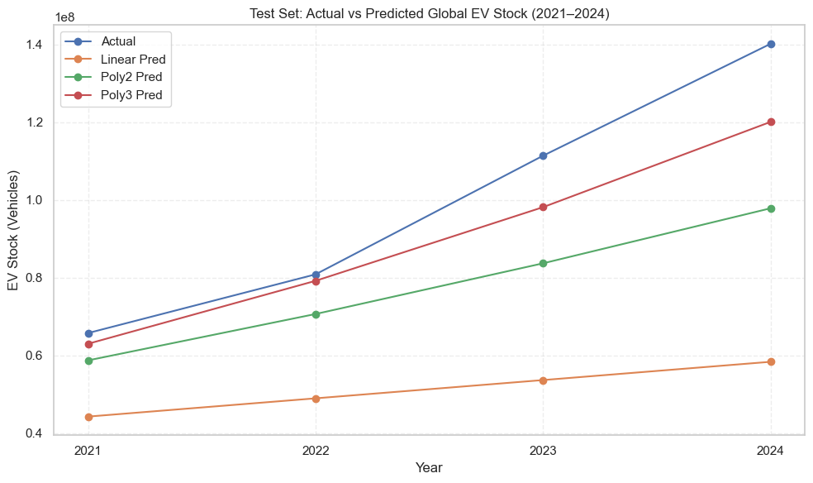
Out-of-Sample Validation Results
Test Performance: Polynomial Deg 3 closest to actual 2021-2024 values
No Overfitting: Strong generalization on completely unseen data
Reliability: Validates model specification and supports 2025-2030 forecast
Data Source: https://www.iea.org/data-and-statistics/data-tools/global-ev-data-explorer

Slide 17
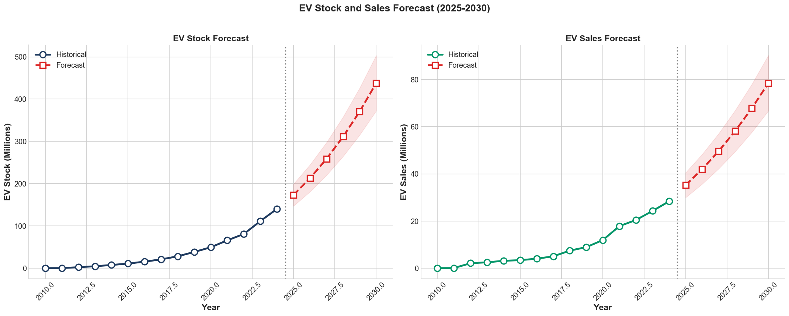
Forecast Results: 2025-2030 Projections
Stock Projection: 438M vehicles by 2030 (10-fold increase from 2024)
Sales Projection: 78M annually by 2030 (4.6x current levels)
Assumptions: Continued policy support, technology trajectory, ±15% uncertainty
Data Source: https://www.iea.org/data-and-statistics/data-tools/global-ev-data-explorer

Slide 18
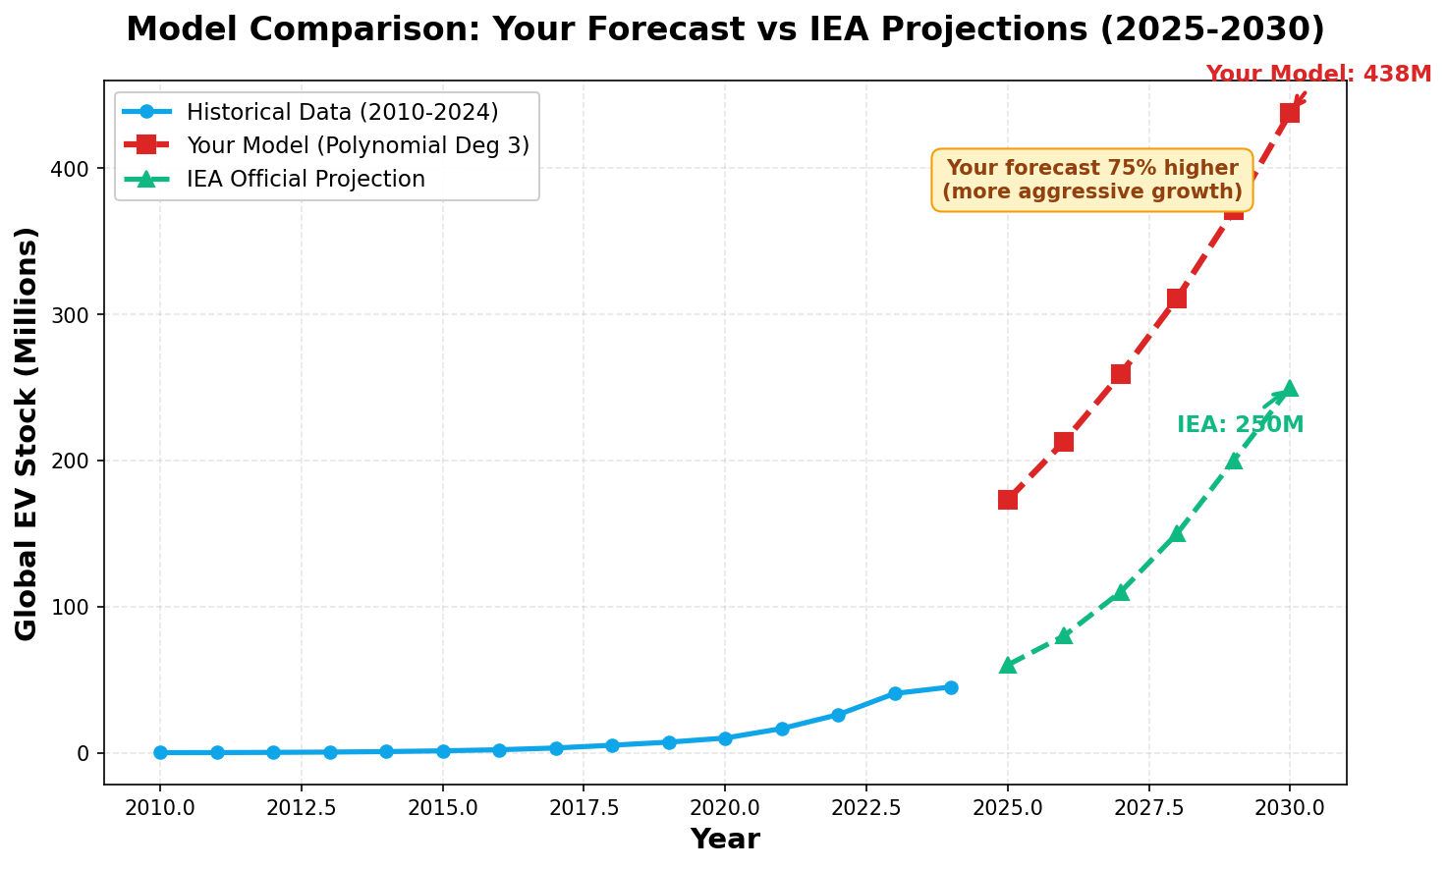
External Validation: IEA Projection Comparison
Forecast Comparison
This analysis: 438M by 2030
IEA STEPS: 250M by 2030
Present model 75% higher
Divergence Analysis
Extrapolates 2018-24 acceleration
IEA: policy/supply uncertainty
Both valid, different assumptions
IEA Source: Global EV Outlook 2025 - https://www.iea.org/reports/global-ev-outlook-2025

Slide 19
Key Findings, Implications & Limitations
Findings & Implications
Exponential Growth: 45-fold increase validates S-curve adoption → Market transition irreversible
Policy Effectiveness: Norway (92%), China (50%) both work → Multiple pathways viable
Infrastructure (r=0.997): Near-perfect correlation → Necessary but not sufficient alone
BEV Dominance (70%): Technology resolved → Industry can focus single pathway
Polynomial Superior: R²=0.9985 vs 0.9314 → Non-linear methods essential for forecasting
Forecast (438M vs 250M): 75% higher than IEA → Policy consistency critical for trajectory
Model Limitations
Data: Global aggregation masks regional variance; 15-year dataset limited for long-term cycles
Assumptions: Extrapolates acceleration; excludes recession, supply disruption, saturation scenarios
Scope: Policy reversals, technological disruptions (solid-state batteries), economic shocks not modeled
Data Source: https://www.iea.org/data-and-statistics/data-tools/global-ev-data-explorer

Slide 20
Questions & Discussion
Thank You

