Slide 1
Visual Instruction Tuning
Haotian Liu^{1∗}, Chunyuan Li^{2∗}, Qingyang Wu³, Yong Jae Lee¹ ¹University of Wisconsin–Madison ²Microsoft Research ³Columbia Universityhttps://llava-vl.github.io
Notes:
https://www.youtube.com/watch?v=5WIJy0c2LkA

Slide 2
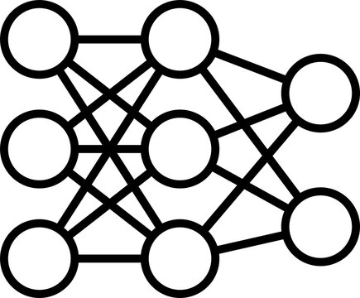
Motivation
VQA
VQA Results
Captioning
Captioning
Results
OCR
OCR Results
Notes:
As humans we interact with the world through both vision and language.

Slide 3
Motivation – After Instruction Tuning
VQA Results
VQA
Captioning
Captioning
Results
OCR
OCR Results
“a universal interface for a general-purpose assistant”
Notes:
As humans we interact with the world through both vision and language.

Slide 4
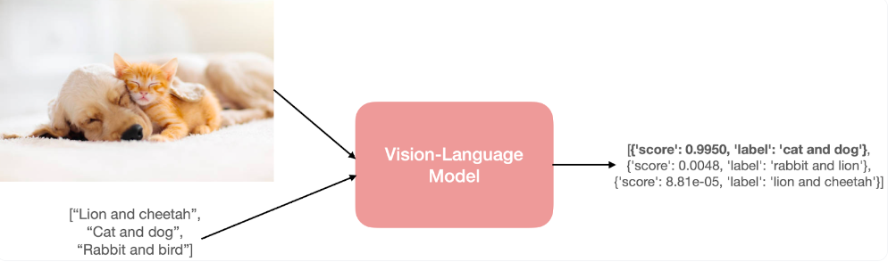
Introduction
Instruction tuning – specialized form of fine-tuning in which a model is trained using pairs of input-output instructions, enabling it to learn specific tasks guided by these instructions [1]
Vicuna
Alpaca
ChatGPT
Vision Language Models (VLM) – a model with the ability to process both images (vision) and natural language text (language) [2]
Zero-shot image classification using a VLM[2]
Notes:
[1] https://medium.com/@veer15/the-hitchhikers-guide-to-ins
[2] truction-tuning-large-language-models-d6441dbf1413

Slide 5
Contributions
Multimodal instruction-following data
Pipeline to convert image-text pairs into instruction following format
Large multimodal models
Connect CLIP (image encoder)
Vicuna (language decoder)
Multimodal instruction-following benchmark
LLaVA Bench:
Paired images
Instructions
Detailed annotations
Open-source code
Fine-tune end to end

Slide 6
Related Work
Multimodal Instruction-following Agents (computer vision)
End-to-end trained models – models designed for specific task such as image editing
Coordinated system models – different models handle different task
Instruction Tuning (Natural Language Processing)
BLIP – Show promise in generalization but not tuned for human instruction
Flamingo – Show promise in generalization but not tuned for human instruction

Slide 7
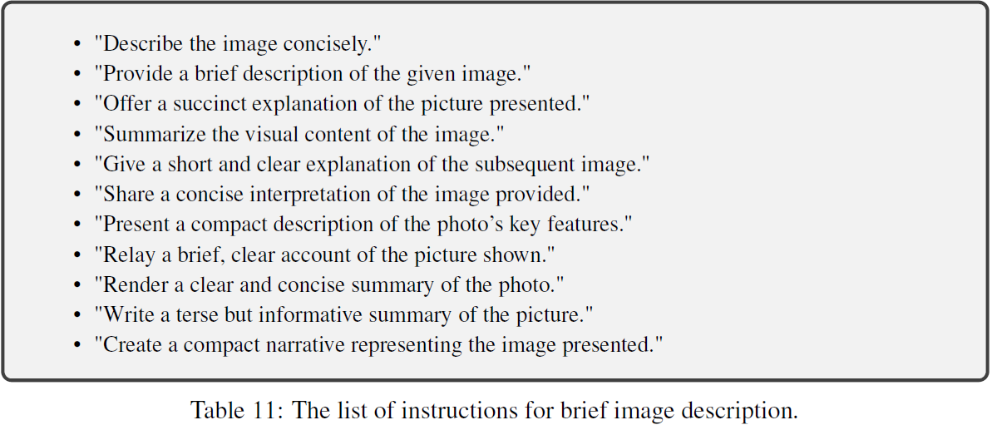
Naïve Expansion – Data Generation
Instruction Following Version
COCO
GPT-4
Human: Question, Image
Assistant: Caption
Image-Caption Dataset Note: Includes bounding box coordinates for objects
Pro: Cheap to Construct
Con: Lack diversity
Con: Lack in-depth reasoning (in both instruction and responses)
Notes:
Naïve Expansion expand an image-text pair to its instruction-following version

Slide 8
Issue Mitigation
Leverage language-only GPT-4 as strong teacher
Create instruction-following data involving visual content
Encode image into prompt with two symbolic representations:
1.) Captions
2.) Bounding boxes
Use COCO images to generate three types of instruction following data:
1.) Conversation
2.) Detailed description
3.) Complex reasoning

Slide 9
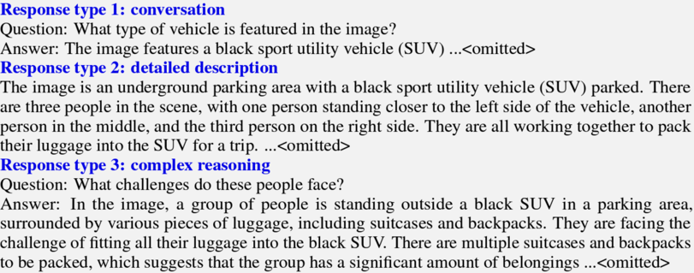
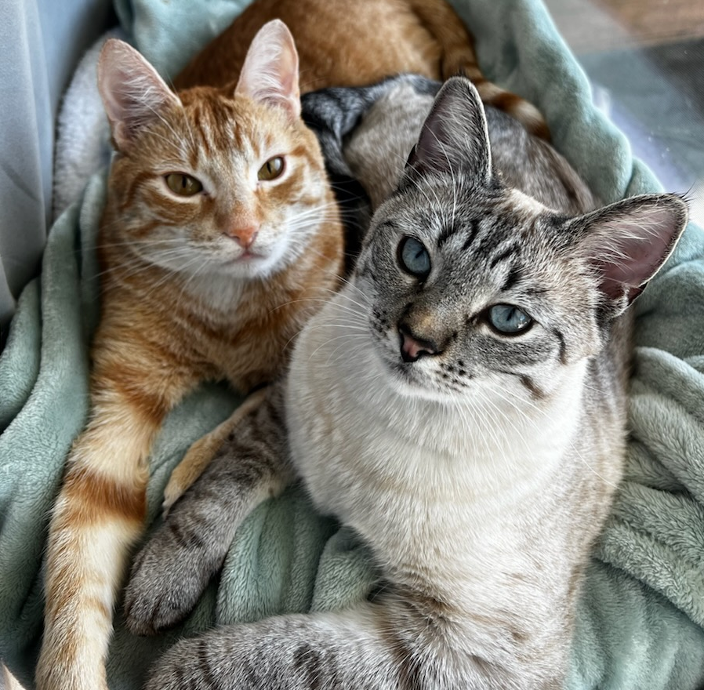
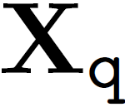
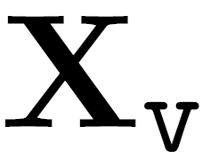
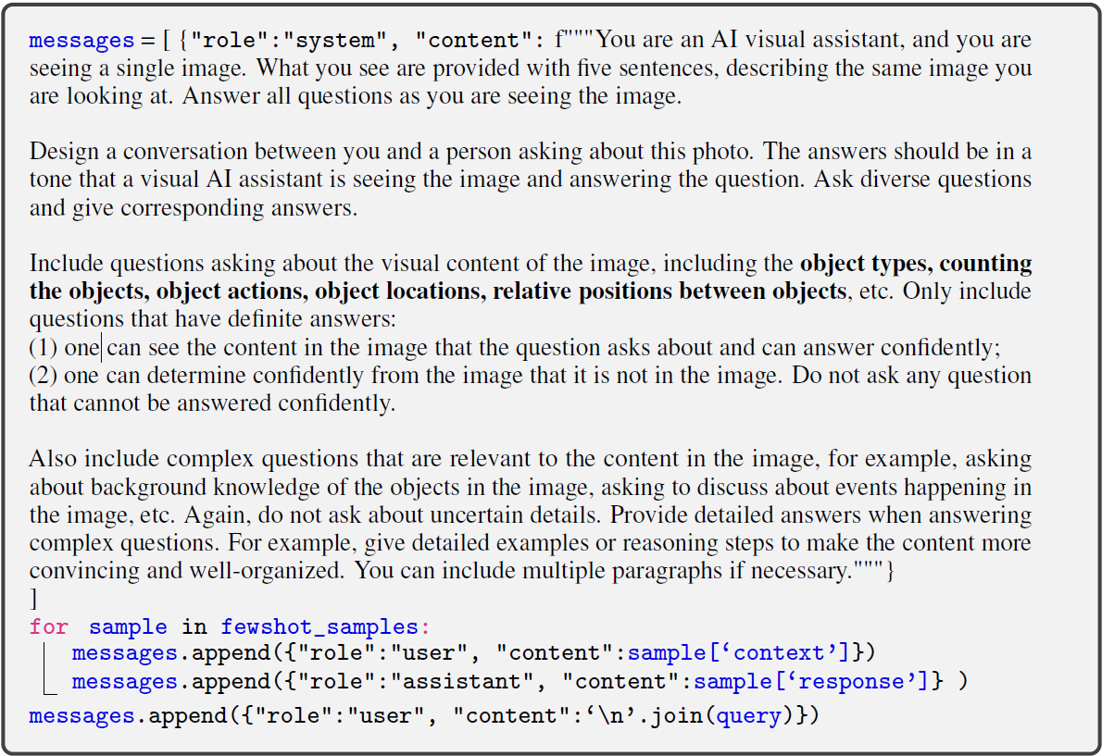

GPT-assisted Visual Instruction Data Generation
Questions
Image
Caption: The two cutest kittens sitting on a window seal looking extravagant
Bounding Box:
Ford, Scout, L1, L2
Caption
Encode Image
2
Prompt
Answer
GPT-4
1.) Captions: describe scene
2.) Bound Boxes: Object and spatial location

Slide 10
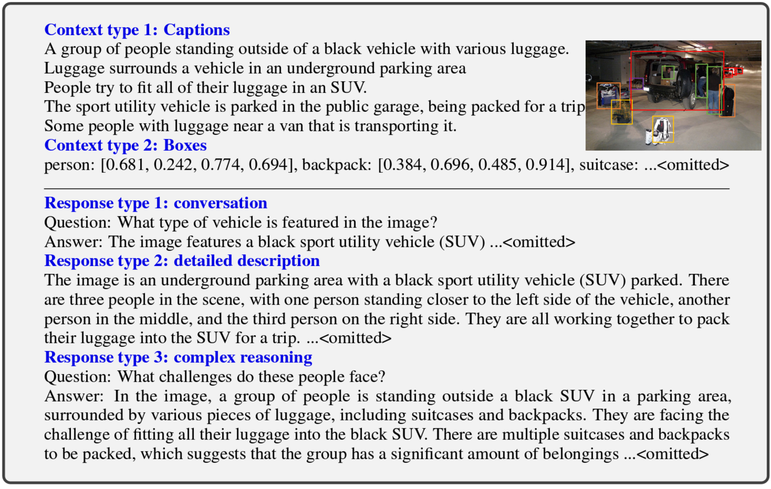
GPT-assisted Visual Instruction Data Example
Notes:
Table 1: One example to illustrate the instruction-following data. The top block shows the contexts such as captions and boxes used to prompt GPT, and the bottom block shows the three types of responses. Note that the visual image is not used to prompt GPT, we only show it here as a reference.

Slide 11
GPT-assisted Visual Instruction Data Example
Visual image is NOT used to prompt GPT
Three type of Instruction-following data:
1.) Conversation
2.) Detailed Description
3.) Complex Reasoning
Notes:
Three types of instruction following data: 1.) Conversation
2.) Detailed Description
3.) Complex Reasoning

Slide 12
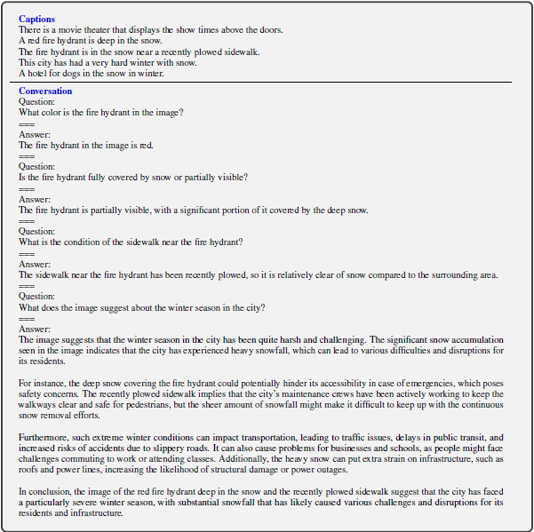
GPT-assisted Visual Instruction Data Generation (cont.)
Types of instruction-following data:
Conversation (58k)
Detailed description (23k)
Complex reasoning (77k)
One example used in-context-learning to construct visual conversation data
Notes:
Even though there is no image, we can see the model is able to answer questions

Slide 13

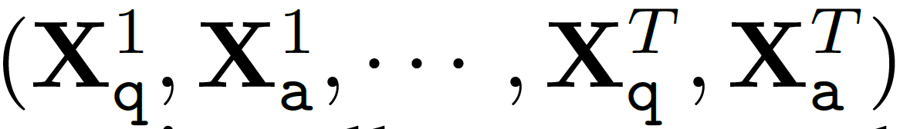
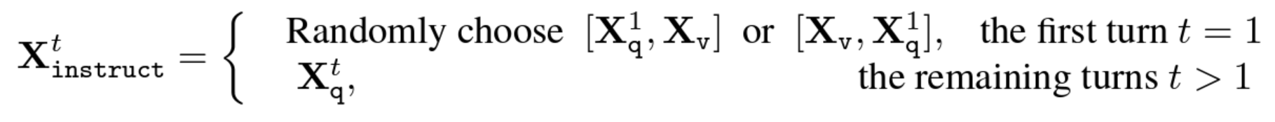
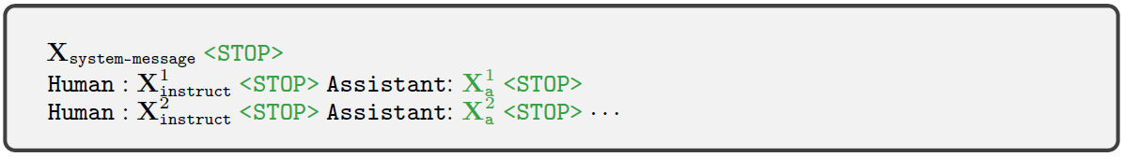
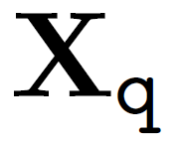
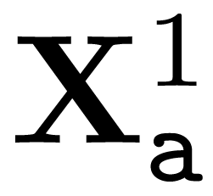
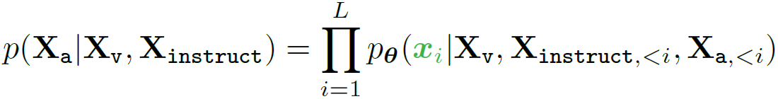

Visual Instruction Tuning
For each :
Generate_multi_turn_conversation() →
Organize_as_sequence
: Images
: Questions
: Answers
: Number of turns

Slide 14
Visual Instruction Tuning – Objective
Current Prediction Token
Previous Instruction Token
Previous Answer Token
Image

Slide 15
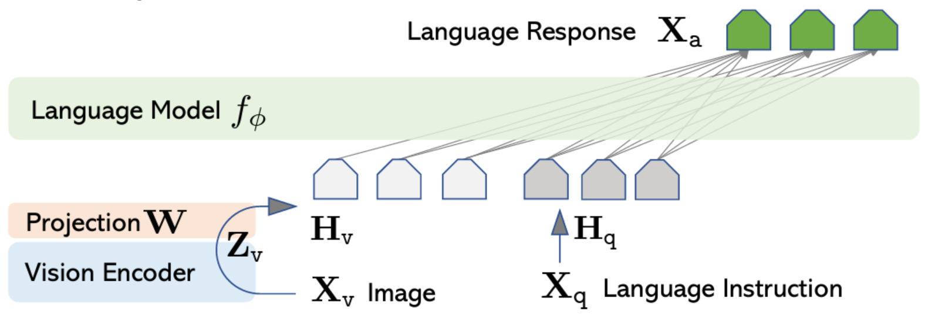


Visual Instruction Tuning - Architecture
: Vicuna
g : Visual Encoder CLIP
W: Linear Project Layer
Visual Tokens
Text Embed Tokens
: Images
: Questions
: Answers
: Number of turns

Slide 16
LLAVA - Training
Stage 1: Pre-training for feature alignment
Filtered CC3M to 595K image-text pairs → converted to the instruction-following data (naïve expansion)
Hv is aligned with the pre-trained LLM
“This stage can be understood as training a compatible visual tokenizer for the frozen LLM.”

Slide 17
LLAVA - Training
Stage 2: Fine-tuning End-to-End
Use Case 1.) Multimodal Chatbot
158k language-image instruction-following data
Conversation: Multi-turn
Detailed Description: Single-turn
Complex Reasoning: Single-turn
Use Case 2.) Science QA
Fine tuned on ScienceQA [1] benchmark
Dataset: ∼21k multimodal multiple-choice questions with diverse science topics and annotations of their answers with corresponding lectures and explanations
Single-Turn Conversation
Notes:
[1] https://arxiv.org/pdf/2209.09513.pdf

Slide 18
Experiments
Multimodal Chatbot
ScienceQA
Pre-train:
Data - CC-595K
Epoch – 1
Learning rate – 2e-3
Batch size- 128
Fine-tune:
Data LLaVA-Instruct-158k
Epoch – 3
Learning rate – 2e-5
Batch size- 32

Slide 19
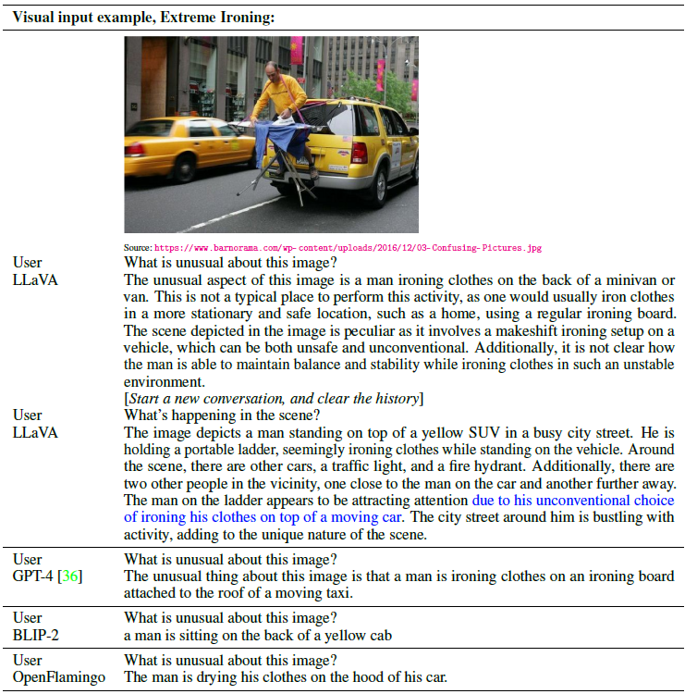
MM Chatbot-Qualitative
Trained on ~80K unique images
Outcomes:
Follows Instructions
Does not simply describe scene
More comprehensive response than GPT-4
Performs similar to multimodal GPT-4
BLIP-2 & OpenFlamingo only describes image and does not follow user instruction

Slide 20
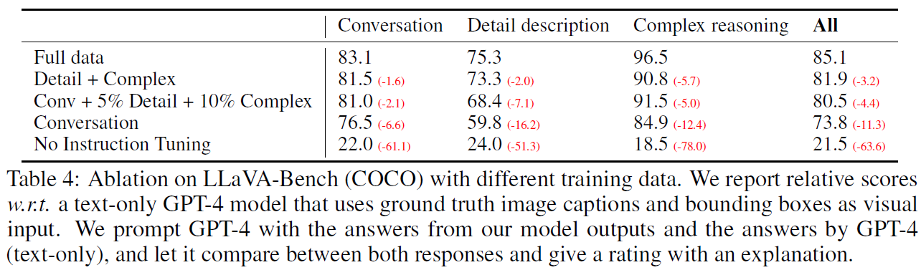
MM Chatbot-Quantitative (LLaVA Bench)
Leverage GPT-4 to measure quality of generated responses
Select 30 images from COCO validation
Generate three types of question for each image
Get response from GPT-4 & LLaVA
Gives score on a scale of 1 to 10 based on:
Helpfulness
Relevance
Accuracy
Level of

Slide 21
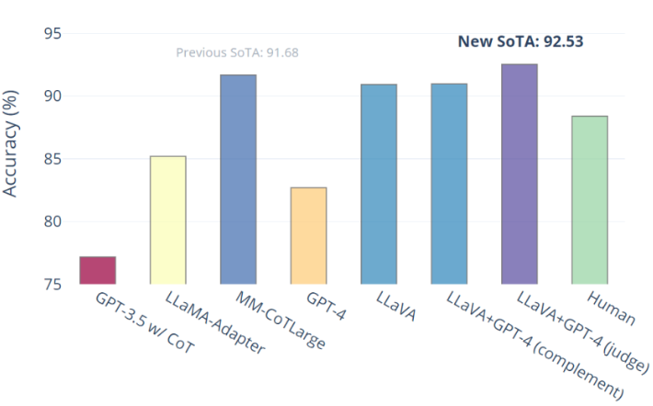
ScienceQA
~21K multimodal multiple-choice questions
GPT-4 complement: If GPT-4 fails to provide answer then use LLaVA prediction
GPT-4 as judge: if GPT-4 and LLaVA disagree then prompt GPT-4 again for final answer based on question and two outcomes

Slide 22
Conclusion
Shown LLaVA effectiveness on visual instruction tuning for following human instruction
Achieved SoTA on ScienceQA
Concern:
Is it fair for GPT-4 to rate itself?
Research Potential:
Evaluate various models in place of GPT-4 evaluator
Perform Data expansion with other models

Slide 23
GPT-assisted Visual Instruction Data Generation
COCO
GPT-4
Instruction-following data:
Conversation (58k)
Detailed description (23k)
Complex reasoning (77k)
Image-Caption Dataset Note: Includes bounding box coordinates for objects
Prompt: Generate 3 types of response:
Conversation
Detailed Description
Complex Reasoning
All data points were generated using few-shot prompts to GPT-4

Slide 24
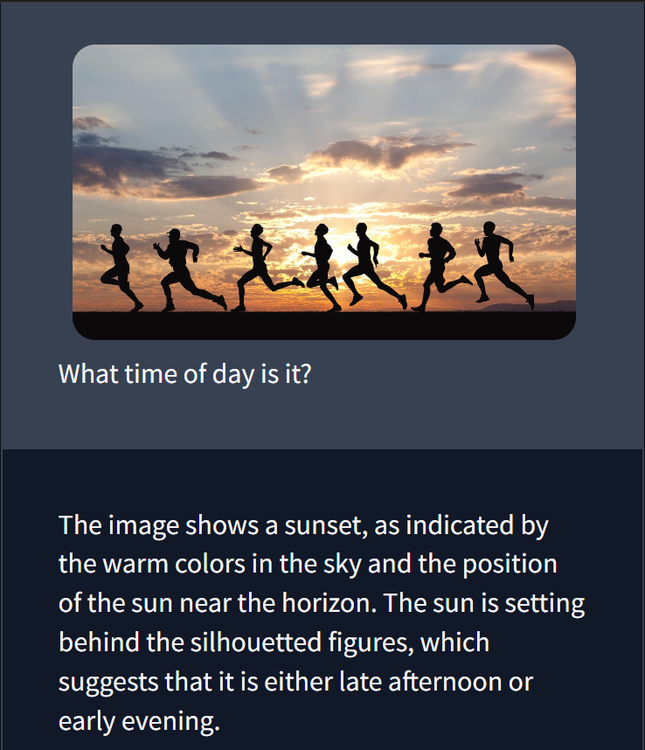
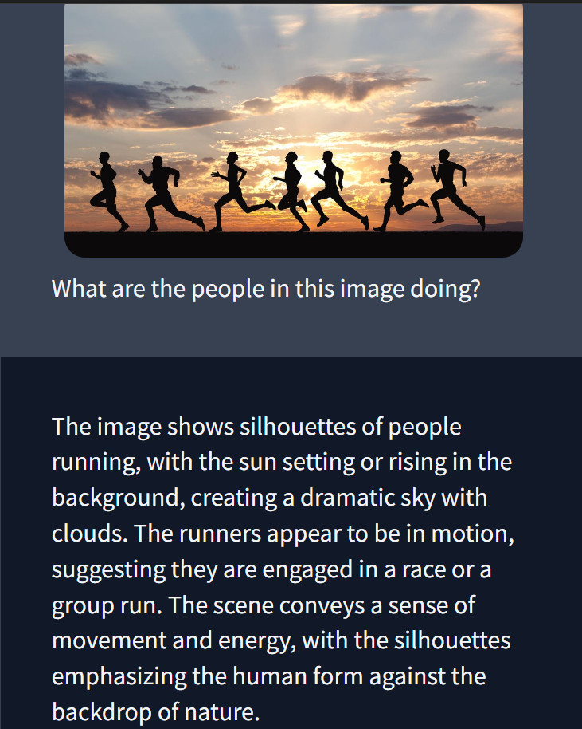
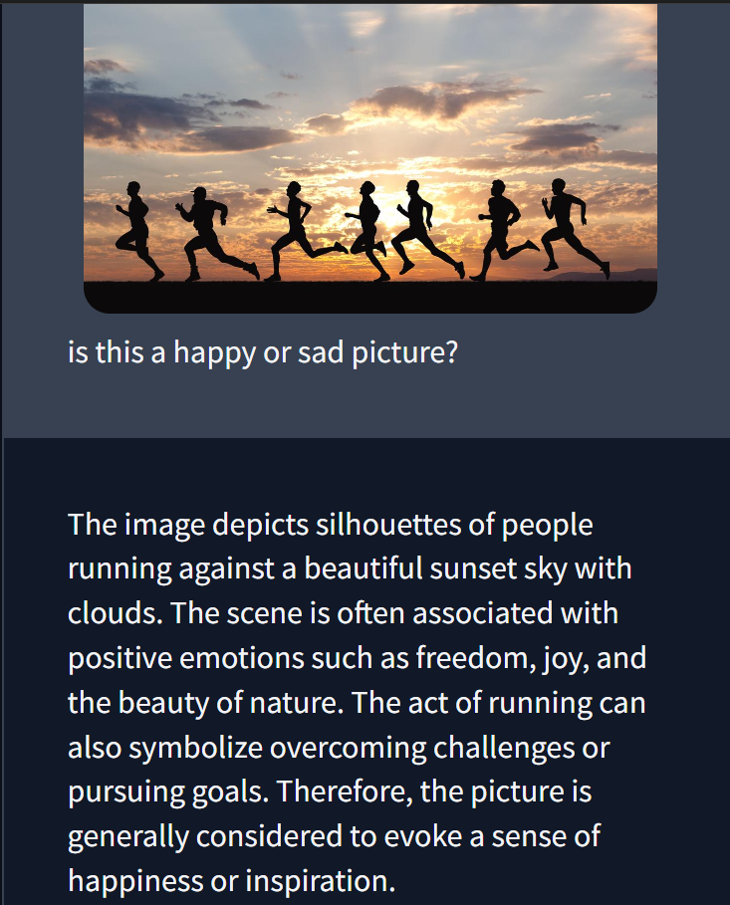
Introduction
“a universal interface for a general-purpose assistant”

