Slide 1

UCL · THE BARTLETT
RESEARCH PLAN · 2026
Comparative Evaluation of Multi-Agent Trajectory Prediction Methods for Autonomous Driving
Using the Waymo Open Motion Dataset
Shadiya Alifu
The Bartlett Centre for Advanced Spatial Analysis
Supervisor meeting · 29 April 2026
Notes:
Today I want to discuss the Waymo Open Sim Agents Challenge. My goal is not to chase a leaderboard ranking, but to use WOSAC as a standardised benchmark for studying simulation, behaviour modelling and multi-agent interaction in autonomous driving, and to find a focused sim-agent design problem worth optimising.

Slide 2

Motivation: building research foundations for autonomous driving
Why I chose this task
Develops core capabilities for autonomous driving: prediction, simulation, multi-agent interaction, behaviour modelling, and planning evaluation.
1
2
3
4
5
Behaviour
modelling
Motion
prediction
Multi-agent
interaction
Planning
evaluation
Safety-critical
simulation
This project treats the challenge as a research platform — not as a competition submission.
What the project will deliver
01
02
03
Reproducible pipeline
Focused sim-agent design
Failure-mode analysis
WOMD scenarios → Waymax → 32-rollout submission. Three baselines scored against the official meta-metric.
One model targeting a single capability — closed-loop stability, interaction realism, map adherence, or multimodal generation.
Evidence of what the design improves, where it still fails, and how it compares with simple baselines.
01
Notes:
I chose this task because it systematically trains the core capabilities of autonomous driving — prediction, simulation, multi-agent interaction, behaviour modelling, planning evaluation. The aim is not a high leaderboard rank, but to identify a clear modelling problem in this benchmark and improve it in a focused way.
Reproducible pipeline: 可复现的流程

Slide 3
Background: why realistic simulation matters
Real-world testing alone is not enough
Simulation provides a scalable alternative
expensive to scale
rare or risky scenarios appear infrequently
evaluation feedback is slow and noisy
hard to attribute failures to specific behaviours
test rare or risky scenarios at scale
evaluate planning and behaviour models
study multi-agent interactions in closed loop
reduce real-world testing cost
Simulation is useful only if the surrounding agents behave realistically.
The key problem is not replaying logs, but generating realistic interactive traffic behaviour.
02
Notes:
Autonomous-driving systems are hard to evaluate by real-world driving alone — the cost is high, the risk is high, and many edge cases rarely appear. Simulation is therefore essential, but only if the surrounding vehicles, pedestrians and cyclists behave realistically. If they do not, the evaluation of planning and behaviour models is unreliable.

Slide 4
Task: simulating the future traffic world
INPUT — PAST 1 SECOND
Vehicle, pedestrian, cyclist states
Autonomous-vehicle (ADV) state
Road map and lane structure
Traffic-light states
Sim-agent model
OUTPUT — 32 ROLLOUTS × 8 S
Joint future for all agents (incl. ADV)
Each agent: x, y, z position + heading
32 stochastic rollouts per scenario
Example rollout — each box is a simulated agent (position + heading) over 8 s.
The model acts as a traffic-world simulator: it generates how the whole scene evolves, not a single trajectory.
03
Notes:
In plain terms, this task is to train a traffic-world simulator. Given roughly 1 second of real-road history — positions, speeds, pedestrians, cyclists, the road map, traffic lights — the model must generate how the next 8 seconds of the entire scene evolve. Crucially, it does not generate a single future, but 32 possible futures, because the real world is not deterministic. The animation on the right is exactly what a rollout looks like: each box is one simulated agent updating its position and heading every step.

Slide 5
Framing: from competition task to sim-agent design problem
I want to use Waymo Open Sim Agents Challenge (WOSAC) as a controlled benchmark, not as a leaderboard target.
COMPETITION OBJECTIVE
MY RESEARCH OBJECTIVE
Submit 32 future rollouts per scenario.
Identify one modelling weakness and turn it into a strong sim-agent design.
fixed format and metric
leaderboard ranking
test-set attempts: 3 per 30 days
diagnose where baselines fail
isolate one capability to optimise
evaluate what the design improves
WOSAC provides the dataset, simulator, metrics and protocol. My contribution is a focused model improvement.
04
Notes:
This is the point I want to align on with you: I am not framing this project as 'compete in a challenge'. It already provides data, simulator, submission format and evaluation. So I want to use it as a research platform: pick one specific weakness — closed-loop stability, interaction realism, map adherence — and design a better sim agent around that single point.

Slide 6
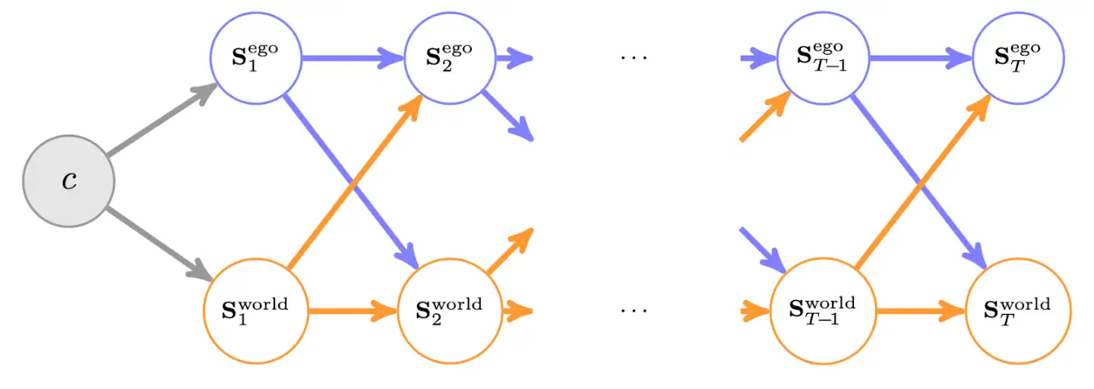
Benchmark platform: data, simulator, submission
Dataset — Waymo Open Motion Dataset
Required factorization
Real-world scenarios: agent trajectories, object types, map features, traffic-light states.
Simulator — Waymax
Scenario loading, multi-agent rollout interface, baseline agents, submission generation.
Rollout format
ADV (blue) and world (orange) states must be conditionally independent given the previous joint state. Object dimensions are fixed from the final history frame.
32 rollouts × 8 s (80 steps @ 10 Hz). Position + heading per agent. 150 serialized protos per submission. 3 test-set attempts per 30 days.
A standardised environment for testing whether a sim-agent design improves realism.
05
Notes:
The benefit of this benchmark is that it is bounded. Data comes from the Waymo Open Motion Dataset; simulation and evaluation can be done in Waymax; the submission is a set of trajectory rollouts, not model code. So it is effectively a standardised experimental environment. The 2025 challenge also requires a specific factorisation: given the previous joint state, the ADV's next state and the world's next state must be conditionally independent — the ego cannot 'peek' at the world's next-step output within the same step. The figure on the right is Waymo's visualisation of that constraint.
ADV（自动驾驶车辆）图就是说自动驾驶车辆和真实世界不断互相影响交互

Slide 7
Evaluation: distribution matching, not trajectory error
WOSAC scores submissions as a distribution-matching problem: the simulated rollout distribution is compared with the real-world distribution.
Motion realism (kinematic)
Interaction realism
Map adherence
linear speed + acceleration
angular speed + acceleration
smoother estimation
collision (capsule shape)
distance to nearest object
time-to-collision (vehicles; new filter)
off-road behaviour
distance to road edges
traffic-light violation
per-feature negative log-likelihood → weighted-mean meta-metric → higher = more realistic
06
Notes:
This is not standard trajectory prediction. The model produces 32 futures, those form a simulated behaviour distribution, and the score asks how well that distribution matches the real-driving distribution. So these metrics also work as diagnostics: they tell me which aspect of the rollout is unrealistic. The 2025 version updated several metrics — capsule-shape collisions, a new traffic-light violation metric, a TTC filter and smoother kinematic estimation — so older bas
eline numbers are not directly comparable.
Motion realism (kinematic) 运动真实性（运动学）
collision (capsule shape) 碰撞情况（使用胶囊体形状）
Map adherence 地图遵循性
per-feature negative log-likelihood → weighted-mean meta-metric → higher = more realistic
每个特征的负对数似然→ 加权平均后的综合指标（meta-metric）→ 分数越高，表示越真实

Slide 8
Candidate optimisation points
Four directions where baseline sim agents typically fail — the project should pick one.
A
Closed-loop stability
B
Interaction realism
PROBLEM
PROBLEM
Small one-step errors accumulate over 80 steps.
Independent prediction causes collisions or unrealistic yielding.
POSSIBLE FOCUS
POSSIBLE FOCUS
Train a model that stays stable during long rollout.
Agent–agent attention or graph-based interaction modelling.
C
Map adherence
D
Multimodal generation
PROBLEM
PROBLEM
Agents drift off-road or violate lane / traffic constraints.
One deterministic future cannot represent real-world uncertainty.
POSSIBLE FOCUS
POSSIBLE FOCUS
Map-conditioned decoding or constraint-aware rollout.
Latent / mixture / token-based sampling for diverse rollouts.
07
Notes:
I do not want to start with one big complex model. The more reasonable path is to run the benchmark, diagnose where baselines fail, then pick the most worthwhile direction — closed-loop stability, interaction realism, map adherence or multimodal generation — so the project's contribution is sharp.
候选优化点
Four directions where baseline sim agents typically fail — the project should pick one.
基线仿真智能体通常会失败的四个方向——项目应该从中选择一个重点突破。
Closed-loop stability
闭环稳定性
Multimodal generation
多模态生成

Slide 9
Proposed initial focus: stable, interaction-aware sim agents
A good sim agent must remain stable and socially plausible across an 80-step closed-loop rollout — not just predict the next position accurately.
1
2
3
4
Adversarial Agents model
Reinforcement Learning
Latent Variable Modeling
Hidden Markov Models
Probabilistic Modelling
Loss terms: collision · off-road · smoothness
First research goal
Design a sim agent that improves closed-loop realism — not just open-loop prediction accuracy.
08
Notes:
I lean towards starting on closed-loop stability and interaction realism, because the essence of a sim agent is not whether the next step is accurate, but whether 80-step rollouts stay stable, plausible, non-colliding, on-road, and socially realistic between agents.
Adversarial Agents
多智能体博弈
Latent Variable Modeling
潜在变量建模
Hidden Markov Models (隐马尔可夫模型)" 和 "Probabilistic Modelling (概率建模)“
Loss terms: collision · off-road · smoothness
损失函数中加入：碰撞 / 离路 / 平滑性
！！！123都是工作实习要求的能力

Slide 10
Proposed roadmap
Diagnosis-driven: understand failures first, then design a focused improvement.
1
2
3
4
5
6
7
Understand data, metrics, rollout format
Reproduce Waymax baseline pipeline
Diagnose baseline failure modes
Select one research focus
Design improved sim-agent model
Compare against simple baselines
Analyse improvements and limitations
PHASE 1
weeks 1–3
PHASE 2
weeks 4–7
PHASE 3
weeks 8–10
Reproduce + diagnose
Focused model design
Evaluate + analyse
Stages 1–3
Stages 4–5
Stages 6–7
Understand data, run Waymax tutorial, score three baselines, characterise failure modes.
Pick one capability, build a sim-agent model around it (encoder, interaction, decoder, losses).
Compare against baselines, analyse where the design improves and where it still fails.
09
Notes:
I do not want to jump straight to a complex model. A safer route is to understand the data and metrics, reproduce the Waymax pipeline, then use simple baselines to expose where the failures are — off-road? collisions? unstable rollouts? Once those are clear, pick one specific direction for the model design.

Slide 11
Phase 1A · Steps 1–2: understand the data, run the official tutorial
1
Understand the data and task format
2
Run the official Waymax tutorial → first valid submission
DATASET — WAYMO OPEN MOTION DATASET v1.2.0
THE TUTORIAL HANDLES
Scenario id and Waymax dataloader
Proto format and binary sharding
SimAgentsChallengeSubmission packaging
9.1 s scenario @ 10 Hz → ~1.1 s history + 8 s future
Future = 80 simulation steps
Up to 128 agents per scenario; 1 is the AV / ADV
Object types: vehicle · pedestrian · cyclist
Per scenario: trajectories, current state, map, traffic lights
OUTPUT PER SCENARIO
32 rollouts × 80 steps × all valid agents
(x, y, z, heading) per (agent, step)
Final artefact: 150 protos · .tar.gz · legal submission
For Phase 1A — a working pipeline that produces a legal submission, not a high score.
10
Notes:
Phase 1A has two steps. Step 1 is to understand the data and the task format. WOMD v1.2.0 scenarios are 9.1 seconds at 10 Hz — about 1.1 s history plus 8 s future, which is 80 simulation steps. Each scenario has up to 128 agents with one ADV. The goal here is not to train, just to read and visualise one scenario. Step 2 is to run the official Waymax tutorial end-to-end with a baseline agent like constant-velocity, and produce a legal SimAgentsChallengeSubmission. Score does not matter yet — pipeline correctness does.

Slide 12
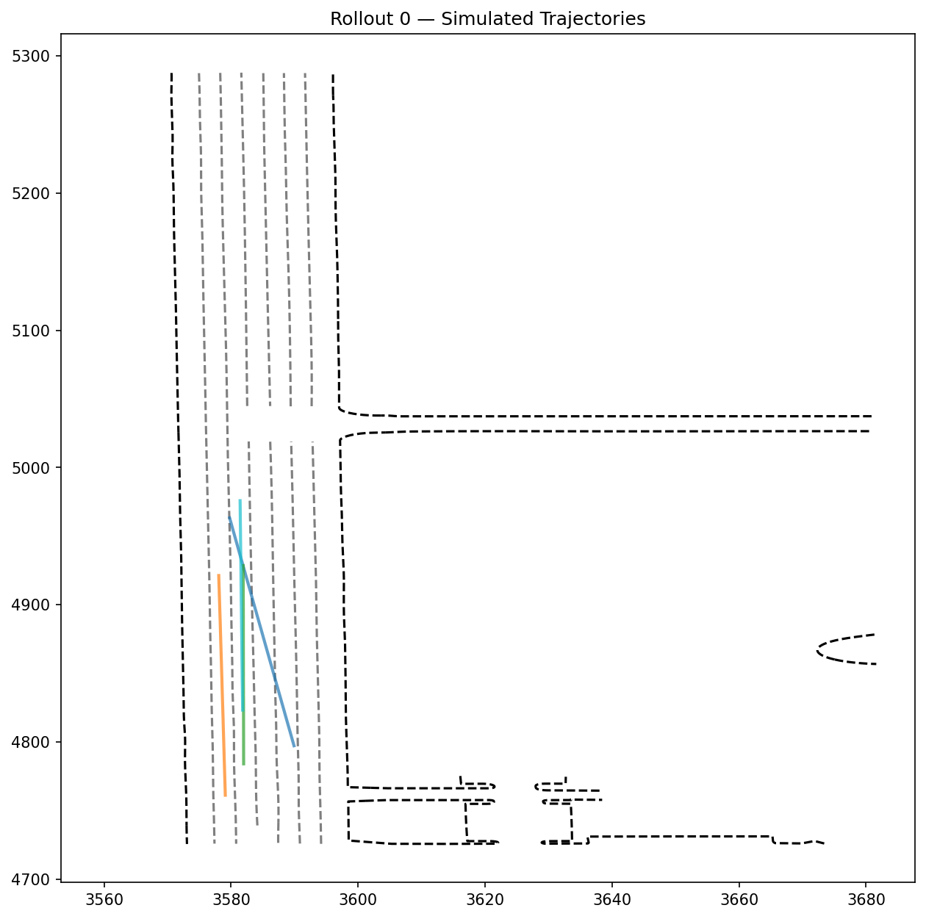
Phase 1A · Step 2 — current status: pipeline running on a validation shard
WHERE I AM RIGHT NOW
Step 1 done · Step 2 running on 1 validation shard
EXAMPLE ROLLOUT — 32 SIMULATED FUTURES
286
32 × 80
scenarios processed (1 of 150 shards)
rollouts × steps per scenario
≈ 0.29
660 KB
metametric (matches WOSAC paper's CV ref of 0.287)
submission .tar.gz — proto-validated for this shard
Constant-velocity rollouts overlaid on the real road network for one scenario.
Pipeline + WOSAC-metric implementation verified — same harness will score the next baselines and the learned model.
11
Notes:
This is where I currently am. Step 1 is done — I can read a Waymo scenario, parse it, and extract the 44-dim feature vector for any agent. Step 2 is running end-to-end on the first validation shard: 286 scenarios, 32 rollouts of 80 steps each, all packaged into a legal submission proto. The constant-velocity baseline scores about 0.29 on the meta-metric, which matches the 0.287 published in the WOSAC paper for the same baseline. So both the simulation pipeline and the metric implementation are verified. The image on the right is one scenario's 32 simulated futures overlaid on the road. Phase 1B (Steps 3 and 4) is the next meeting — that's where I bring in three baselines and the first learned model.

Slide 13
Phase 1B · Steps 3–4: three baselines + first learned model
3
Three simple baselines
4
First learned model
A
Log replay
INPUT
Copy the recorded future. Sanity-checks pipeline; invalid for the test set.
past 1 s agent states
vector map features
agent type + relative positions
traffic-light state
B
Constant velocity
Each agent extrapolates current speed in a straight line.
C
Simple interaction rules
OUTPUT → next-step, Δx, Δy, Δheading
Lane-keep + brake on lead car; basic ped/cyclist motion.
observe simulated scene
predict ADV next state
predict world next state update scene
REPEAT 80 TIMES
Purpose: not to build a model— to read the metric (e.g. const-vel is fine on motion, fails on off-road / red light).
By end of Phase 1: working pipeline · 3 baselines scored · 1 learned model trained · failure modes characterised.
12
Notes:
Phase 1B has two steps. Step 3 is to run three simple baselines: log replay (copies the real future, valid only on training/validation), constant velocity, and a simple interaction rule that keeps lane and brakes on lead vehicles. The point is not to win — it is to read the WOSAC metric: which failure modes does each baseline trigger? Step 4 is the first learned model: take a trajectory-prediction model, give it past 1 s agent states, vector map features, agent type, relative positions and traffic-light state, and predict next-step Δx, Δy, Δheading. Train autoregressively; at rollout time loop 80 steps, predicting ADV and world states separately to honour the WOSAC conditional-independence factorisation.
第一步
先做简单 baseline，不是为了拿高分， 而是为了：
验证流程
读懂指标
分析失败模式
第二步
再训练一个最基础的 learned model， 把闭环 rollout 跑起来。
最终目标
到第一阶段结束时， 你应该已经知道：
pipeline 能跑
baseline 表现如何
learned model 大概是什么水平
主要问题出在哪

Slide 14
Phase 2: from single-agent prediction to joint multi-agent simulation
The hard part is not predicting one car — it is making all agents jointly plausible.
Agent–agent
interaction
Vehicle ↔ pedestrian
yielding
Car following
Lane keeping
Traffic-light
compliance
Multimodal
futures
Vectorized
map encoder
Agent history
encoder
Agent–agent
attention / GNN
Stochastic
decoder
Constraint-aware
post-processing
autoregressive loop · repeat × 80 steps
Independent per-agent prediction often produces collisions — the agent–agent module exists to fix this.
13
Notes:
Phase 2's central insight is that a sim agent is not a one-car predictor — it has to make every agent in the scene jointly plausible. If each agent is decoded independently, two cars will collide, no one will yield, and red lights get ignored. That is why the model recipe puts an agent–agent attention or GNN module between the encoders and the decoder, and why constraint-aware post-processing matters. The WOSAC paper itself states that sim agents must be realistic and interactive — log replay or simple rules are not enough.
从单智能体预测走向联合多智能体仿真
真正困难的地方，不是预测某一辆车，而是让所有智能体在联合演化时都表现得合理可信。

Slide 15
Phase 3: evaluate the design, not only the score
Baselines to compare
Dimensions to analyse
Key research question
Constant-velocity
Simple rule-based
Initial learned baseline
Motion realism
Interaction realism
Map adherence
Closed-loop stability
Diversity across 32 rollouts
Which failure mode does the design reduce most clearly?
Does the gain hold across scenario types?
Where does it still fail?
The final result should explain why the model works, where it improves, and where it still not good.
14
Notes:
Evaluation should not be a single aggregate score. The harder question is: what specifically did this design improve? Fewer collisions? Less off-road? More stable 80-step rollouts? More plausible diversity across the 32 rollouts? That kind of analysis is what makes this a research project rather than a contest.

Slide 16
Discussion questions
Q1
Are there any recommended models for building a foundation in autonomous driving research?
Q2
Is there any GPU server available for training?
Q3
When will the next meeting be?
Q4
Do you have any other suggestions?
Q5
？？？
15
Notes:
前三个问题肯定要问 然后你自己再想想有么有什么问题

Slide 17
References
1
Montali et al. — The Waymo Open Sim Agents Challenge.
2
Gulino et al. — Waymax: An Accelerated, Data-Driven Simulator for Large-Scale Autonomous Driving Research.
3
Waymo Open Dataset 2025 Sim Agents Challenge
4
Waymax WOSAC submission tutorial (official GitHub).
5
Waymo Open Dataset Sim Agents tutorial.
16
Notes:
These are the materials I will read and reproduce. The presentation has folded their content into the earlier slides rather than dedicating a slide per paper.

