Slide 1
CLOUD COMPUTING
Subject Code: 21CSE362T
Video Lecture No.1
UNIT -4
Presented By: Ms. Harshita Sharma
Assistant Professor, AIML

Slide 2
Course Outcomes
Exhibit knowledge on basics of Cloud Computing
Examine the concept of virtualization and capacity planning.

Slide 3
UNIT-4 (Topics To Be Covered)
Virtualization Technologies
Abstraction versus Virtualization
Load Balancing and Virtualization
The Google Cloud
Hypervisors
Virtual Machine Imaging
Porting Applications
Capacity Planning

Slide 4
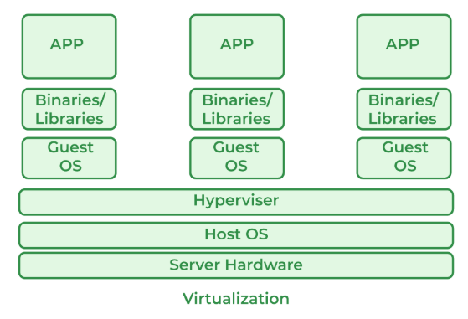
1. Virtualization Technologies
Virtualization technology is a process that creates virtual versions of physical machines, such as servers, storage, and networks. It allows multiple operating systems to run on a single physical computer by using a hypervisor to allocate hardware resources.
Host Machine: The machine on which the virtual machine is going to be built is known as Host Machine.
Guest Machine: The virtual machine is referred to as a Guest Machine.

Slide 5
Benefits of Virtualization
More flexible and efficient allocation of resources.
Enhance development productivity.
It lowers the cost of IT infrastructure.
Remote access and rapid scalability.
High availability and disaster recovery.
Enables running multiple operating systems.

Slide 6
Drawback of Virtualization
High Initial Investment: Clouds have a very high initial investment, but it is also true that it will help in reducing the cost of companies.
Learning New Infrastructure: As the companies shifted from Servers to Cloud, it requires highly skilled staff who have skills to work with the cloud easily, and for this, you have to hire new staff or provide training to current staff.
Risk of Data: Hosting data on third-party resources can lead to putting the data at risk, it has the chance of getting attacked by any hacker or cracker very easily.

Slide 7
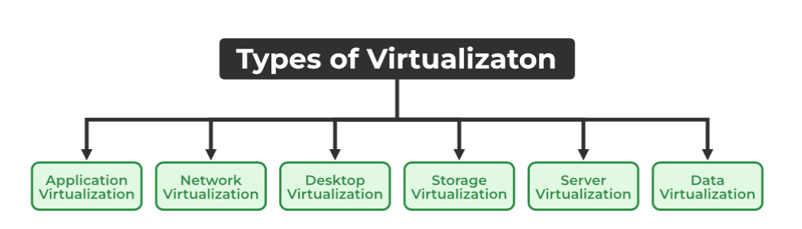
Types of Virtualization
There are the following 6 types of Virtualization
Application Virtualization
Network Virtualization
Desktop Virtualization
Storage Virtualization
Server Virtualization
Data virtualization

Slide 8
1. Application Virtualization: Application virtualization helps a user to have remote access to an application from a server.
2. Network Virtualization: The ability to run multiple virtual networks with each having a separate control and data plan. It co-exists together on top of one physical network.
3. Desktop Virtualization: Desktop virtualization allows the users’ OS to be remotely stored on a server in the data center. It allows the user to access their desktop virtually, from any location by a different machine.
4. Storage Virtualization: Storage virtualization is an array of servers that are managed by a virtual storage system. It makes managing storage from multiple sources be managed and utilized as a single repository.
5. Server Virtualization: This is a kind of virtualization in which the masking of server resources takes place. Here, the central server (physical server) is divided into multiple different virtual servers by changing the identity number, and processors. So, each system can operate its operating systems in an isolated manner. Where each sub-server knows the identity of the central server.
6. Data Virtualization: This is the kind of virtualization in which the data is collected from various sources and managed at a single place without knowing more about the technical information like how data is collected, stored & formatted then arranged that data logically.

Slide 9
2. Abstraction versus Virtualization
Parameters of comparison | Abstraction | Virtualization
Description | It is the act of expressing vital characteristics while obscuring the background information from consumers and developers respectively. | It is a collection of different technologies and ideas that have been brought together with the goal of providing an abstract environment in which program may be executed.
Dependence | The partitioning of interface and implementation is essential to the practice of abstraction. | Software is used to construct a virtual computer system via the process of virtualization, which simulates the capability of hardware.
Types | Data abstraction and process abstraction are the two subcategories that fall under the umbrella term "abstraction." | Types of virtualization include: Storage virtualization, Network virtualization, data virtualization, application virtualization , desktop virtualization and server virtualization.
Importance | It makes it possible for modifications to be made in the backend without having an impact on the functions of the apps that are located in the abstraction layer. | Virtual machines allow for the division or molding of computer resources by concurrently running several environments. These environments are referred to as "virtual machines."

Slide 10
3. Load Balancing and Virtualization
Load balancing is an essential technique used in cloud computing to optimize resource utilization and ensure that no single resource is overburdened with traffic. It is a process of distributing workloads across multiple computing resources, such as servers, virtual machines, or containers, to achieve better performance, availability, and scalability.
In cloud computing, load balancing can be implemented at various levels, including the network layer, application layer, and database layer. The most common load balancing techniques used in cloud computing are:
Network Load Balancing: This technique is used to balance the network traffic across multiple servers or instances. It is implemented at the network layer and ensures that the incoming traffic is distributed evenly across the available servers.

Slide 11
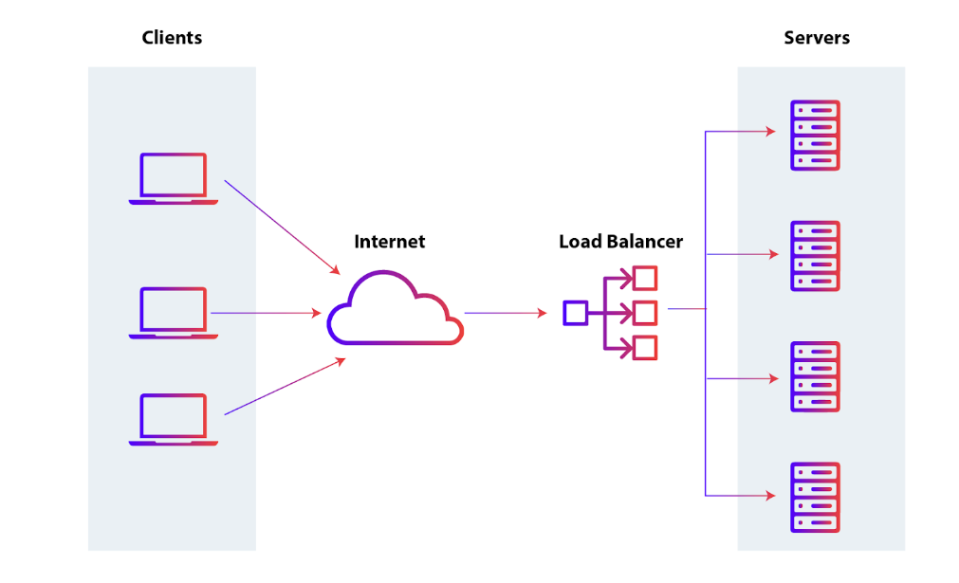
Application Load Balancing: This technique is used to balance the workload across multiple instances of an application. It is implemented at the application layer and ensures that each instance receives an equal share of the incoming requests.
Database Load Balancing: This technique is used to balance the workload across multiple database servers. It is implemented at the database layer and ensures that the incoming queries are distributed evenly across the available database servers.

Slide 12
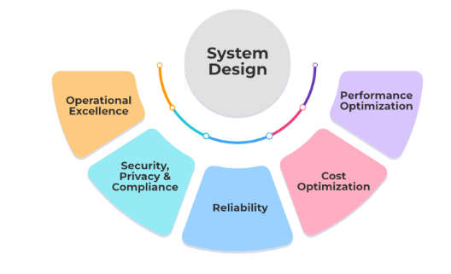
4. The Google Cloud
Google Cloud Platform (GCP) is a suite of cloud computing services provided by Google.
It offers a wide range of services, including computing power, storage, databases, machine learning, networking, and more, all delivered over the internet.
GCP enables businesses to build, deploy, and scale applications and services quickly and efficiently without the need to invest in or manage physical infrastructure.

Slide 13
Security in Google Cloud Platform
Google Cloud Platform offers following security options.
Encryption: Google cloud platform offers security like encryption at rest and in transit for all of your data.
Access control: You can control the access to the individual users like which services they can access and which service they can’t depending on the use cases.
Network Security: You can create the VPC(Virtual Private Network)where you can secure the application by deploying the application in the private network and also you can configure the firewalls and security groups etc.

Slide 14
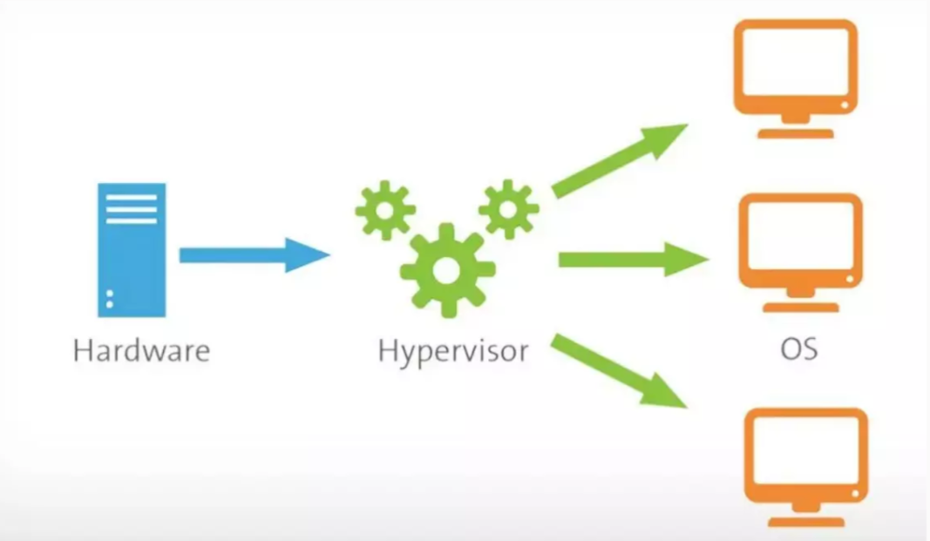
5. Hypervisors
A hypervisor is a software that you can use to run multiple virtual machines on a single physical machine.
Every virtual machine has its own operating system and applications. The hypervisor allocates the underlying physical computing resources such as CPU and memory to individual virtual machines as required.

Slide 15
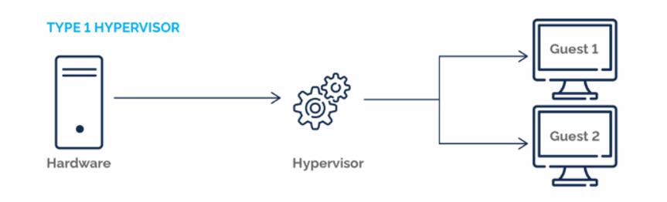
Types of Hypervisors
TYPE-1 Hypervisor: The hypervisor runs directly on the underlying host system. It is also known as a “Native Hypervisor” or “Bare metal hypervisor”. It does not require any base server operating system. It has direct access to hardware resources.

Slide 16
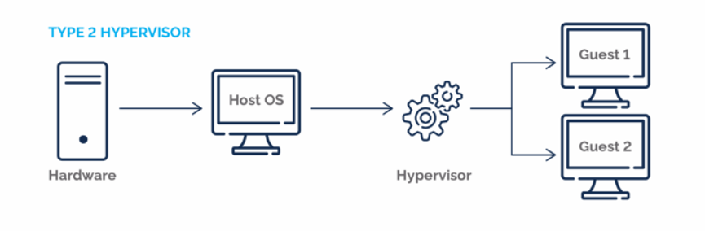
TYPE-2 Hypervisor: A Host operating system runs on the underlying host system. It is also known as ‘Hosted Hypervisor”. Such kind of hypervisors doesn’t run directly over the underlying hardware rather they run as an application in a Host system(physical machine). Basically, the software is installed on an operating system. Hypervisor asks the operating system to make hardware calls.

Slide 17
6. Virtual Machine Imaging
Virtual Machine Imaging refers to the process of creating a standardized, reusable image of a virtual machine (VM) that includes the operating system, applications, configurations, and data.
Key Features of Virtual Machine Imaging
Template Creation: A VM image serves as a blueprint for deploying multiple VMs with the same setup.
Standardization: Ensures uniformity across all virtual machines in terms of operating system, configurations, and installed software.
Rapid Deployment: Images allow for quick provisioning of new VMs, saving time and reducing errors during setup.
Portability: VM images can be transferred and deployed across various cloud platforms or on-premises environments.
Backup and Recovery: Images can be used as backups, enabling restoration of VMs to a specific state.

Slide 18
7. Porting Applications
Application portability in cloud computing provides flexibility to move to different platforms or different cloud service vendors, but technology and provider restrictions persist.
When the term of application portability comes up, the benefits of corporates and cloud computing vendors crashes.
Portable applications are very beneficial in migration of infrastructure, platform, and services from one cloud service provide to any other service providers.
Steps to Port Applications:
Analyze application dependencies.
Optimize for the target environment.
Use tools like Docker for portability.

Slide 19
8. Capacity planning
Capacity planning in cloud computing refers to the process of determining the optimal resource requirements (e.g., compute, storage, network) to ensure that cloud applications and services meet performance demands efficiently, even during peak loads, without over-provisioning.
Key Objectives
Optimize Costs: Prevent over-provisioning of resources (waste) or under-provisioning (performance bottlenecks).
Ensure Scalability: Plan for future growth by predicting resource demands.
Maintain Performance: Avoid degradation in user experience by provisioning adequate resources during peak times.
Support Business Goals: Align cloud infrastructure with the organization’s operational and strategic objectives.

Slide 20
Steps in Capacity Planning
Assess Current Resources:
Evaluate existing cloud infrastructure usage and performance metrics.
Define Resource Requirements:
Set thresholds for acceptable performance under varying loads.
Analyze Workloads:
Categorize workloads based on their criticality and resource consumption patterns.
Forecast Future Demand:
Use predictive analytics to estimate resource requirements based on historical and expected growth.
Implement Auto-Scaling:
Use cloud features like auto-scaling to dynamically adjust resources based on demand.
Continuous Monitoring and Adjustments:
Continuously track resource usage and adjust plans as needed.

Slide 21
Thank You

