Slide 1
5G Network
Yiqiao Jin
Lab 5
TA: Diyu Zhou

Slide 2
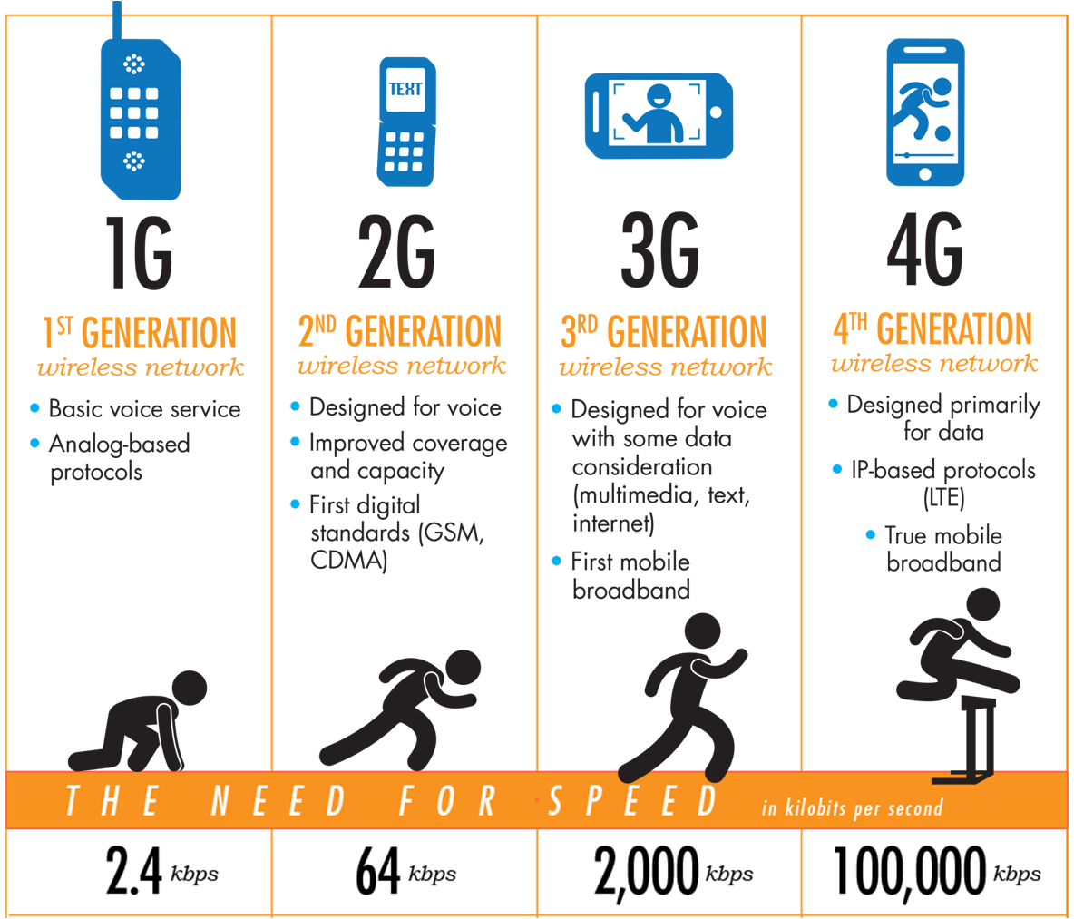
Starting from the 1980s...

Slide 3
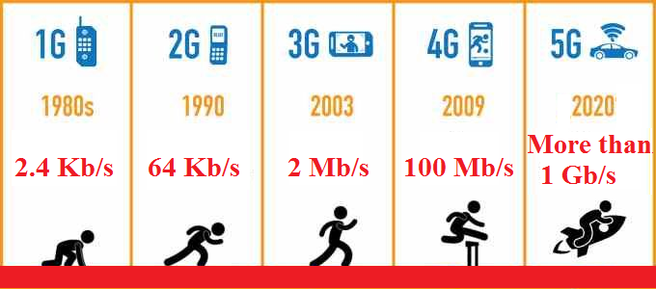

Slide 4
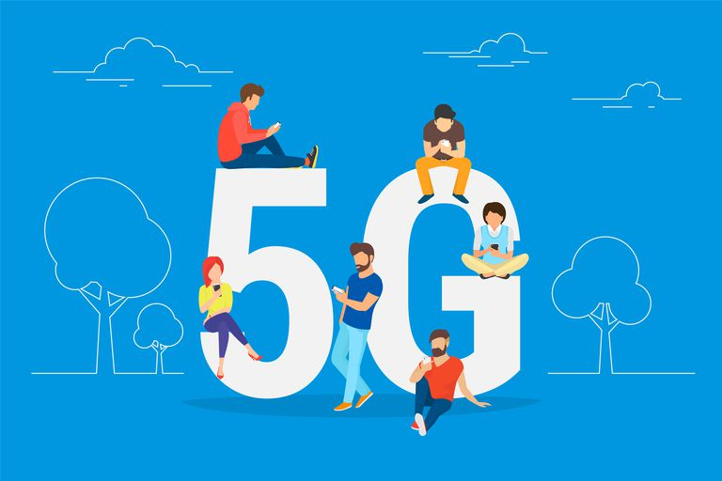
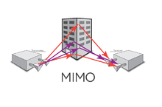
Features
1. high data rate
2. reduced latency
3. massive device connectivity

Slide 5
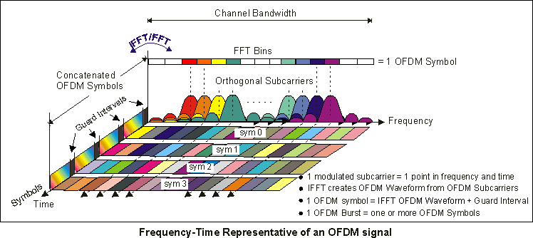
OFDM - orthogonal frequency division multiplexing
Multiple carrier waves are transmitted in the frequency channel
Transfer multiple bits of info simultaneously
more subcarriers per bandwidth

Slide 6
Release 15
The set of standards detailing the use of
the 5G New Radio standard as it applies to networks, software, silicon, handsets and the broader telecom ecosystem
-- 3GPP

Slide 7
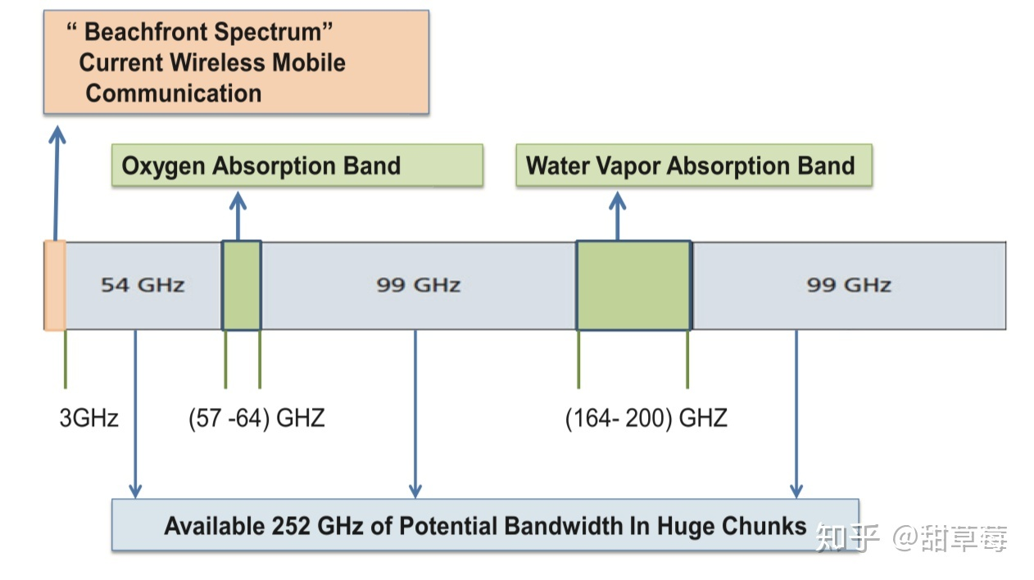
Targeted band
In use - by 1G - 4G
300MHz - 3GHz
Unavailable
57 - 64 GHz
164 - 200 GHz
Available
252GHz of Potential Bandwidth
in huge chunks

Slide 8
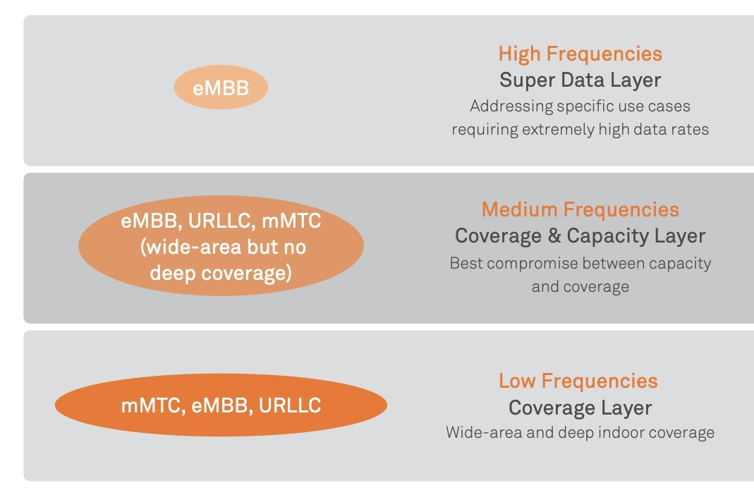
Targeted band
3-6 GHz

Slide 9
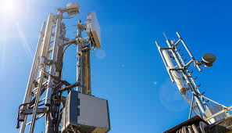

Smaller Coverage
4G as supplement

Slide 10
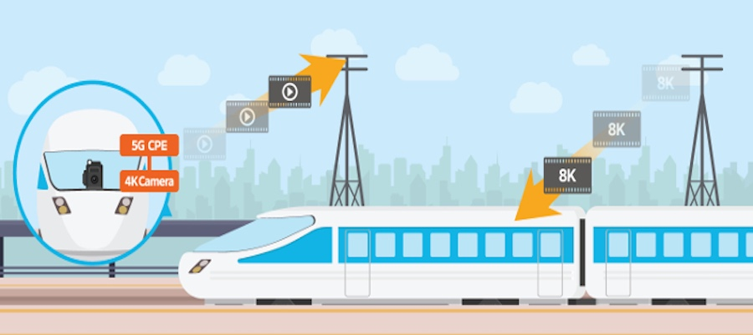
Hand-over of base stations
Supported Max Moving Speed: >500km/h

Slide 11
The Future
New applications
VR & AR (data-heavy)
Machine to Machine interaction in the IoT
e.g. Communication between Self-driving cars

Slide 12
Works Cited
[1] Hoffman, Chris (7 January 2019). "What is 5G, and how fast will it be?". ACM TechNews. 23 January 2019.
[2] "Predicting real-world performance of 5G NR mobile networks and devices". Qualcomm. 07 March 2018.
[3] Nordrum, Amy; Clark, Kristen (27 January 2017). "Everything you need to know about 5G". IEEE Spectrum magazine. Institute of Electrical and Electronic Engineers. 18 January 2019.
[4] Loughran, Jack. "5G: the benefits and difficulties of creating a new wireless standard". Engineering & Technology.

