Slide 1

Active Learning Lecture Slides
For use with Classroom Response Systems
Introductory Statistics:
Exploring the World through Data, 1e
by Gould and Ryan
Chapter 8:
Hypothesis Testing for Population Proportions
© 2013 Pearson Education, Inc.
Slide 8 - <number>

Slide 2
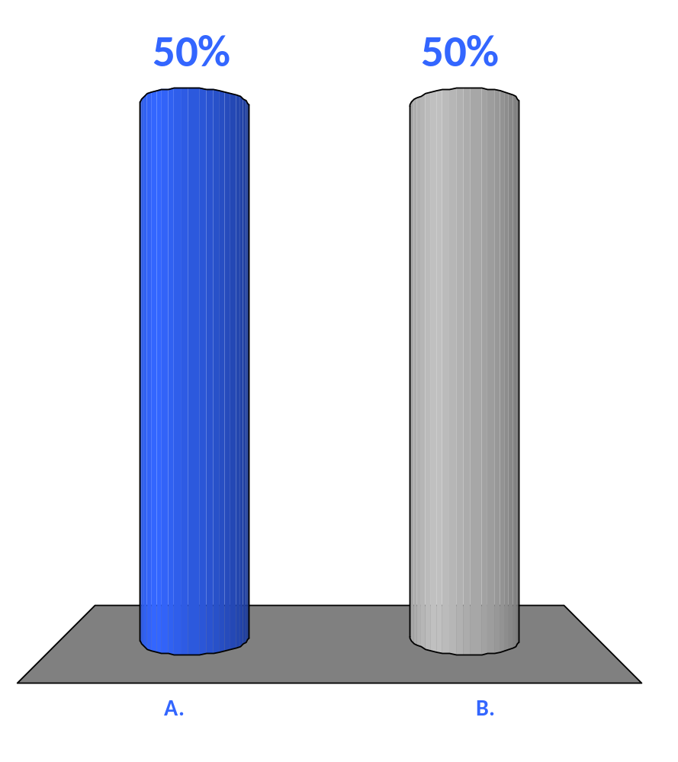
True or False
Hypotheses are always statements about sample statistics.
True
False
© 2013 Pearson Education, Inc.
Slide 8 - <number>

Slide 3

True or False
The null hypothesis, which we write H₀ is the conservative, status-quo, business-as- usual statement about a population parameter.
True
False
© 2013 Pearson Education, Inc.
Slide 8 - <number>

Slide 4

True or False
The alternative hypothesis, H_{a} , is the research hypothesis. It is usually a statement about the value of a parameter that we hope to demonstrate is true.
True
False
© 2013 Pearson Education, Inc.
Slide 8 - <number>

Slide 5

True or False
The null hypothesis always gets the benefit of the doubt and is assumed to be true throughout the hypothesis-testing procedure.
True
False
© 2013 Pearson Education, Inc.
Slide 8 - <number>

Slide 6

True or False
During hypothesis testing, if we decide at the last step that the observed outcome is extremely unusual under this assumption, then and only then do we reject the null hypothesis.
True
False
© 2013 Pearson Education, Inc.
Slide 8 - <number>

Slide 7
True or False
In this book, the null hypothesis always has an equals sign, no matter which alternative hypothesis is used.
True
False
© 2013 Pearson Education, Inc.
Slide 8 - <number>

Slide 8
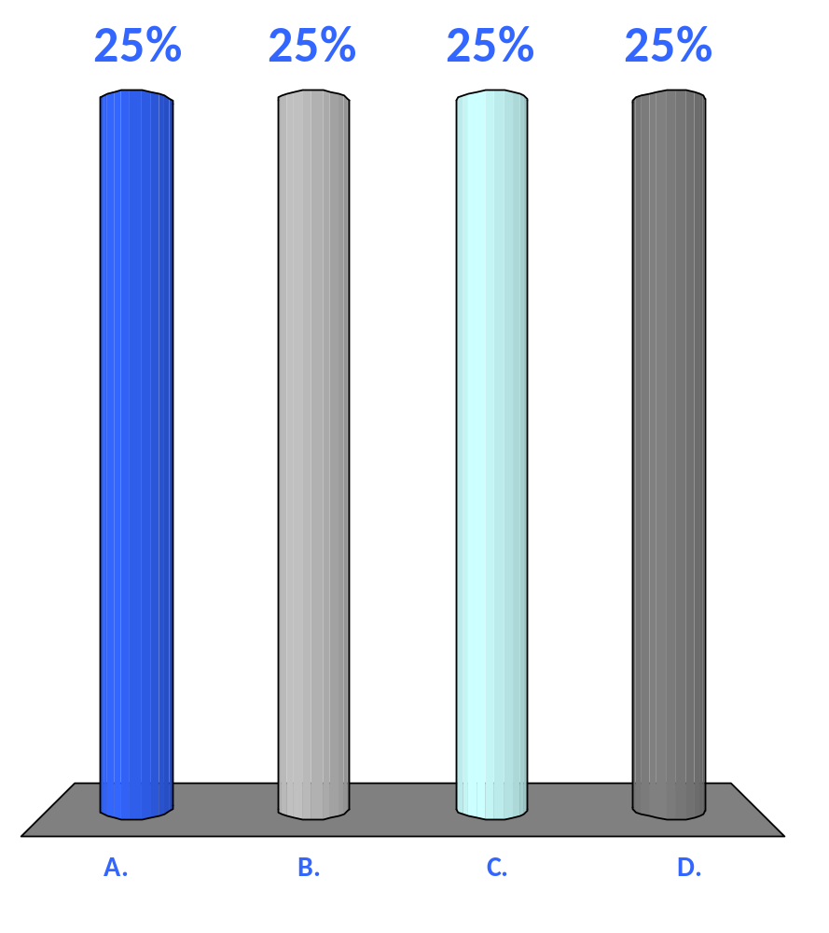
The probability of rejecting the null hypothesis when, in fact, the null hypothesis is true is called the
standard error
p-value
power of the test
significance level
© 2013 Pearson Education, Inc.
Slide 8 - <number>

Slide 9
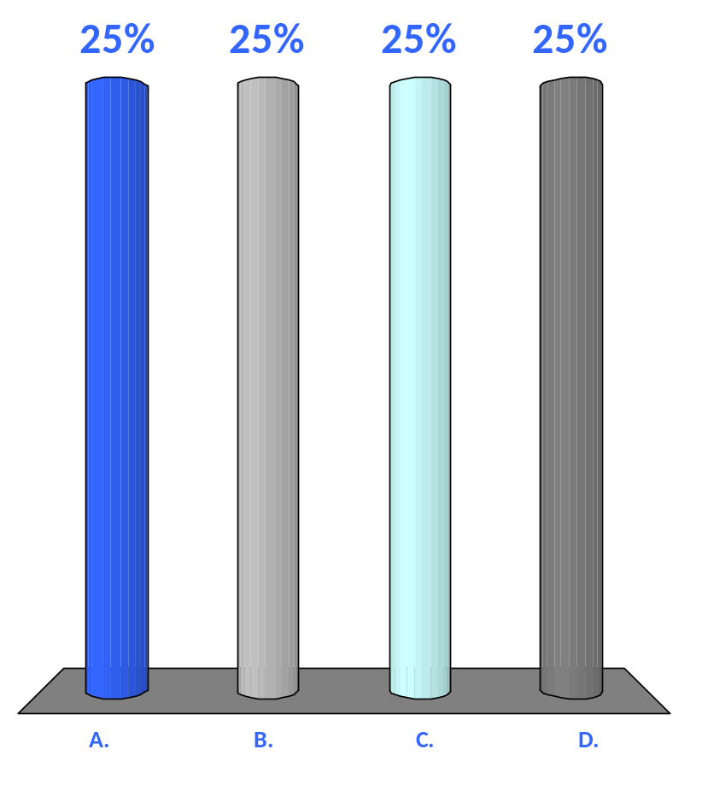
There are three basic pairs of hypotheses. The two-tailed test has the following hypotheses:
H₀: p = p₀ and H_{a}: p < p₀
H₀: p = p₀ and H_{a}: p ≠ p₀
H₀: p = p₀ and H_{a}: p > p₀
H₀: p ≠ p₀ and H_{a}: p = p₀
© 2013 Pearson Education, Inc.
Slide 8 - <number>

Slide 10

There are three basic pairs of hypotheses. The one-tailed (left) test has the following hypotheses:
H₀: p = p₀ and H_{a}: p < p₀
H₀: p = p₀ and H_{a}: p ≠ p₀
H₀: p = p₀ and H_{a}: p > p₀
H₀: p ≠ p₀ and H_{a}: p = p₀
© 2013 Pearson Education, Inc.
Slide 8 - <number>

Slide 11

There are three basic pairs of hypotheses. The one-tailed (right) test has the following hypotheses:
H₀: p = p₀ and H_{a}: p < p₀
H₀: p = p₀ and H_{a}: p ≠ p₀
H₀: p = p₀ and H_{a}: p > p₀
H₀: p ≠ p₀ and H_{a}: p = p₀
© 2013 Pearson Education, Inc.
Slide 8 - <number>

Slide 12

True or False
You should always draw a sketch before you compute the p-value, even if you use technology (as we strongly recommend) to find the probability.
True
False
© 2013 Pearson Education, Inc.
Slide 8 - <number>

Slide 13
Which of the following value(s) for the significance level, α, is/are considered acceptably small?
0.01
0.05
0.10
All of the above
© 2013 Pearson Education, Inc.
Slide 8 - <number>

Slide 14
True or False
A test statistic compares our observed outcome to the alternative hypothesis.
True
False
© 2013 Pearson Education, Inc.
Slide 8 - <number>

Slide 15

True or False
If the null hypothesis is true, then the z-statistic will be close to 0. Therefore, the farther the z-statistic is from 0, the more the null hypothesis is discredited.
True
False
© 2013 Pearson Education, Inc.
Slide 8 - <number>

Slide 16

Assuming the null hypothesis is true, which of the following is the probability that if the experiment were repeated, you would get a test statistic as extreme as or more extreme than the one you actually got?
α-level
z-statistic
p-value
power
© 2013 Pearson Education, Inc.
Slide 8 - <number>

Slide 17
True or False
A small p-value suggests that a surprising outcome has occurred and discredits the null hypothesis.
True
False
© 2013 Pearson Education, Inc.
Slide 8 - <number>

Slide 18

True or False
Under the appropriate conditions, the sampling distribution of the z-statistic is approximately a standard normal distribution, N(0, 1).
True
False
© 2013 Pearson Education, Inc.
Slide 8 - <number>

Slide 19

True or False
Extreme values are rare in a N(0, 1) distribution, so if we see an extreme value, it is evidence that the null hypothesis is true.
True
False
© 2013 Pearson Education, Inc.
Slide 8 - <number>

Slide 20
To achieve a significance level of α, if the p-value is less than (or equal to) α, then
reject the null hypothesis
accept the null hypothesis
do not reject the null hypothesis
accept the alternative hypothesis
© 2013 Pearson Education, Inc.
Slide 8 - <number>

Slide 21
To achieve a significance level of α, if the p-value is greater than α, then
reject the null hypothesis
accept the null hypothesis
do not reject the null hypothesis
accept the alternative hypothesis
© 2013 Pearson Education, Inc.
Slide 8 - <number>

Slide 22
In order to compare proportions from two populations, we write the null hypothesis as
H₀: p₁ = p₂
H₀: p₁ < p₂
H₀: p₁ > p₂
H₀: p₁ ≠ p₂
© 2013 Pearson Education, Inc.
Slide 8 - <number>

Slide 23

True or False
The results of a study are said to have been replicated when researchers using new subjects come to the same conclusion.
True
False
© 2013 Pearson Education, Inc.
Slide 8 - <number>

Slide 24
Which of the following is/are instances for which conditions fail to be met?
the sample size is too small
the samples are not independent
the sample is not randomly selected
All of the above
© 2013 Pearson Education, Inc.
Slide 8 - <number>

Slide 25
The power depends on which of the following factors?
just how wrong the null hypothesis is
the sample size
the significance level
All of the above
© 2013 Pearson Education, Inc.
Slide 8 - <number>

Slide 26
True or False
We cannot make the significance level arbitrarily small because doing so lowers the power—the probability that we will correctly reject the null hypothesis.
True
False
© 2013 Pearson Education, Inc.
Slide 8 - <number>

Slide 27

True or False
The results of a study are said to have been replicated when researchers using new subjects come to the same conclusion.
True
False
© 2013 Pearson Education, Inc.
Slide 8 - <number>

Slide 28
True or False
Statistically significant findings always mean that the results are useful.
True
False
© 2013 Pearson Education, Inc.
Slide 8 - <number>

Slide 29
True or False
Don’t say you “proved” something with statistics.
True
False
© 2013 Pearson Education, Inc.
Slide 8 - <number>

Slide 30
True or False
In hypothesis testing, it is perfectly reasonable to say that you “accept the null hypothesis.”
True
False
© 2013 Pearson Education, Inc.
Slide 8 - <number>

Slide 31
Don’t say you “accept the null hypothesis”; say, rather that you
cannot reject the null hypothesis
failed to reject the null hypothesis
there is insufficient evidence to reject the null hypothesis
All of the above
© 2013 Pearson Education, Inc.
Slide 8 - <number>

