Slide 1
OTUS on CMS Open Data
Joint J/ψ + Z unfolding — status for group meeting
Ziqing Li • Whiteson Group, UC Irvine • September 2026

Slide 2
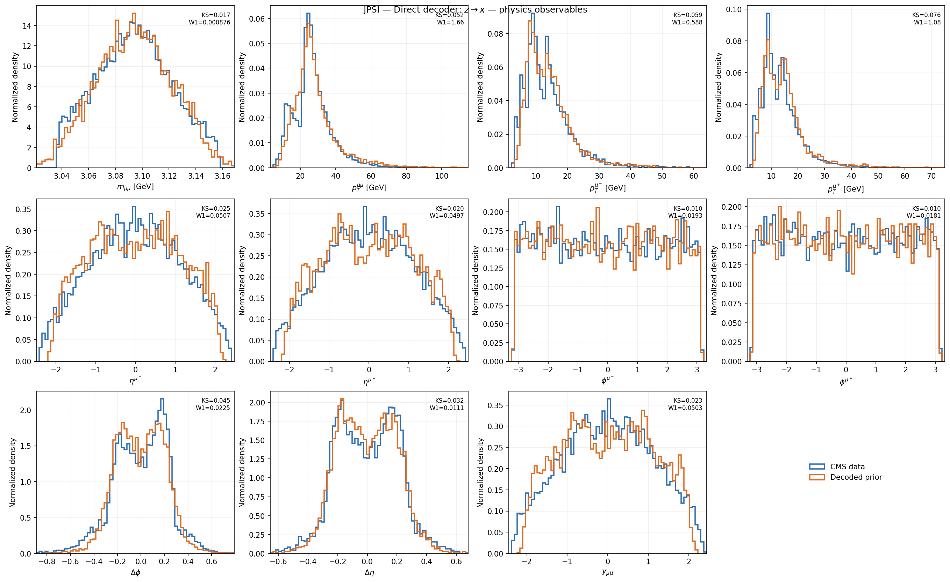
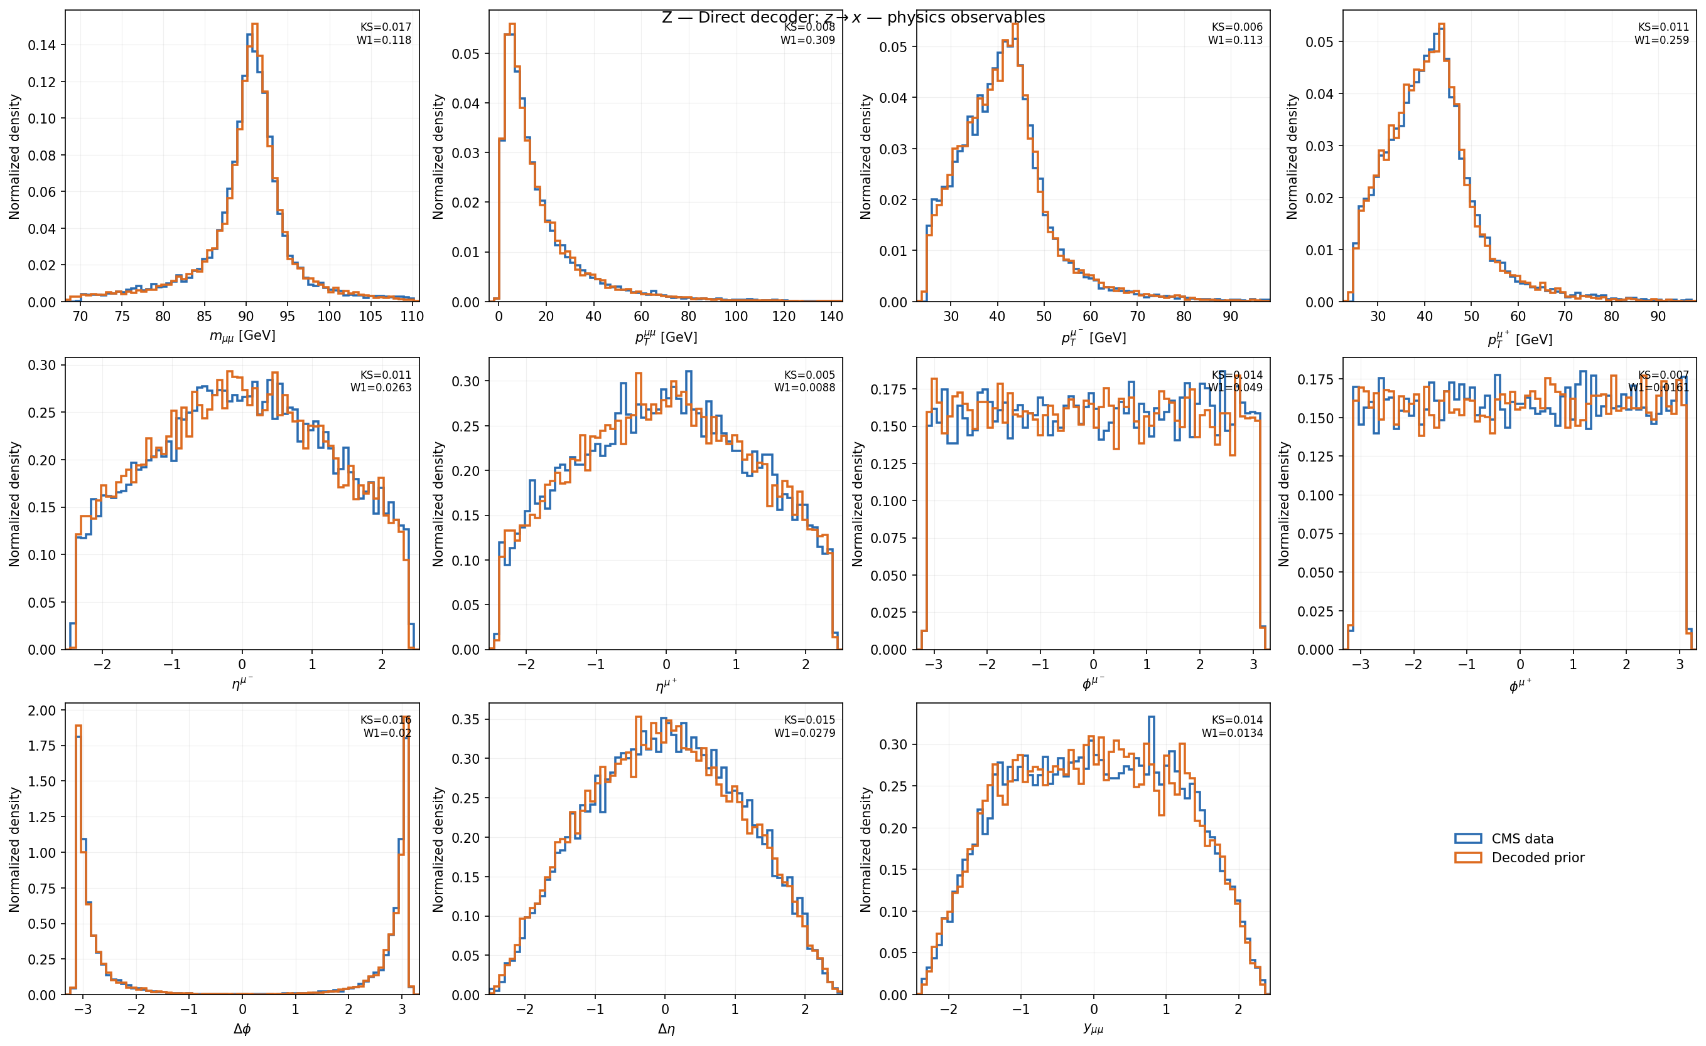
The joint model closes J/ψ and Z together
Run E — one shared, mass-blind response model decoded on both regions (z → x, simulate direction)
J/ψ: mass KS 0.017, W1 0.9 MeV
Z: mass KS 0.013, W1 86 MeV
Two open caveats on this result: the accepted checkpoint is stage-1 deterministic (no demonstrated stochastic detector response), and the J/ψ prior was pre-smeared before training — so genuine resolution removal is still untested. The held-out Upsilon transfer fails outright (mass W1 0.28 GeV, per-state bias –28 to –53 MeV).
!

Slide 3
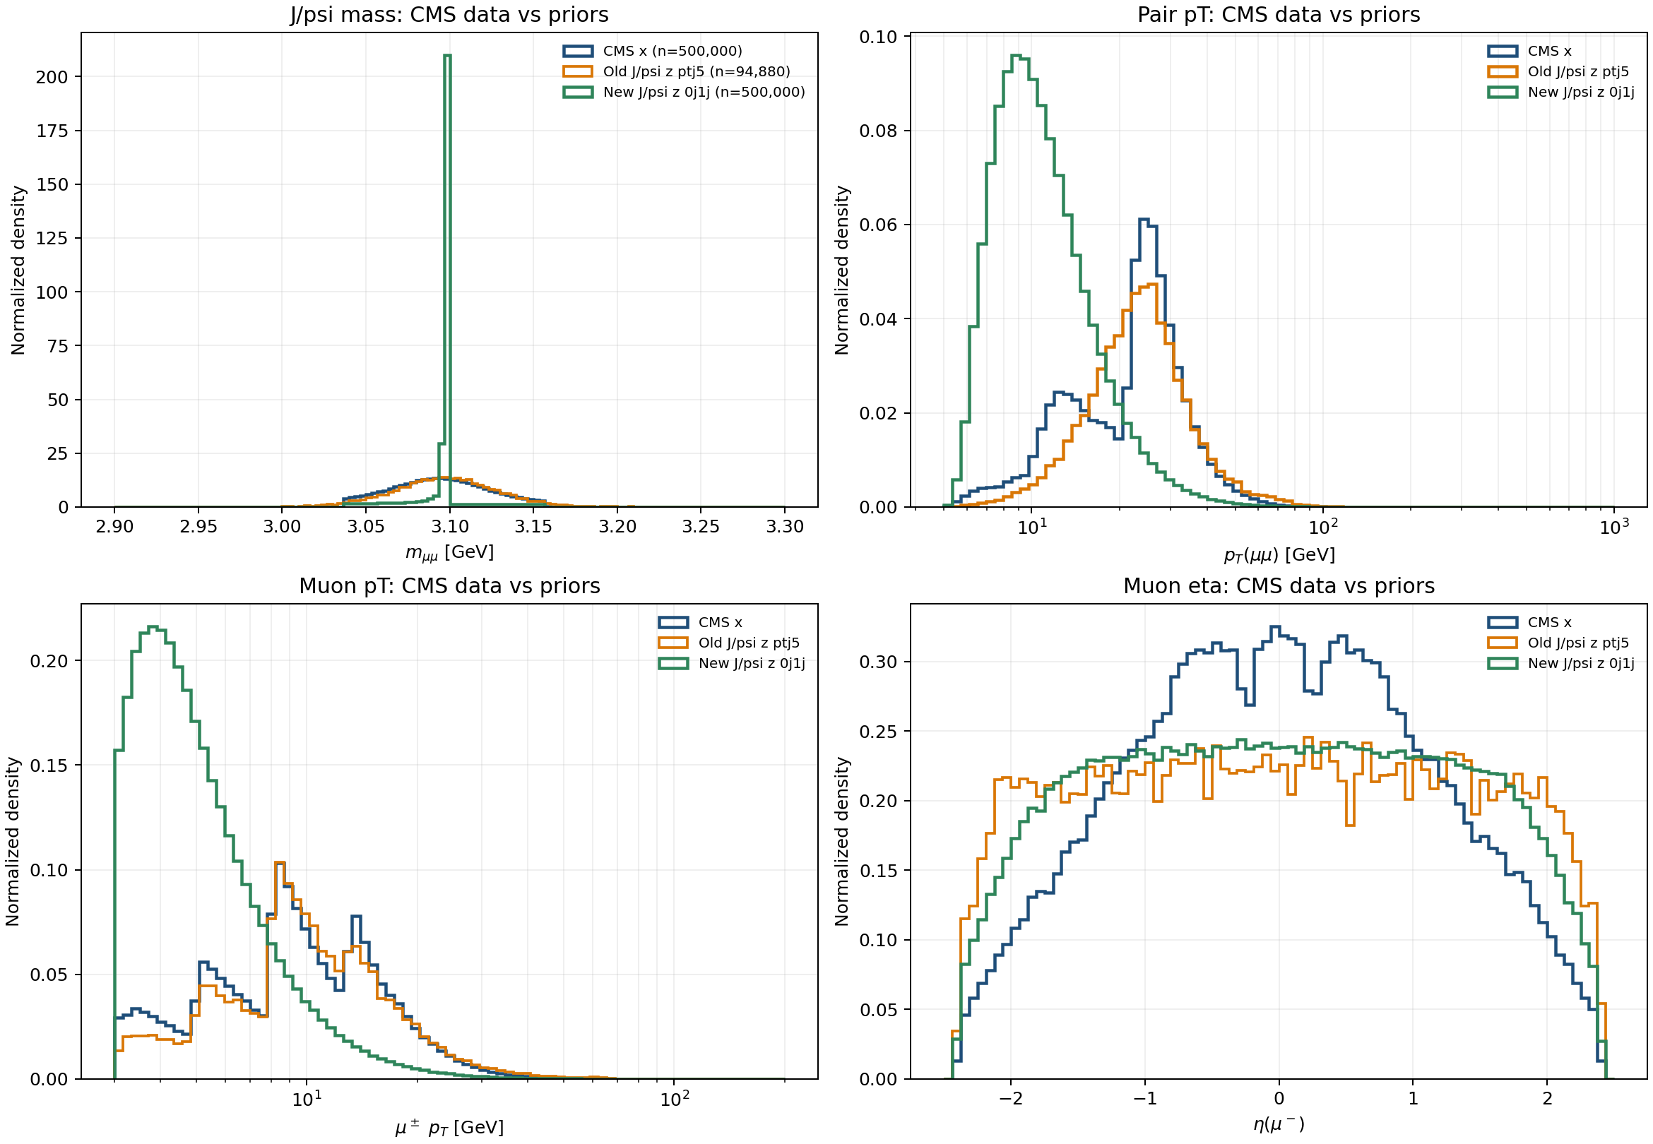
This week: audited how the training priors are built
Session 29 — rebuilt J/ψ, Z and Upsilon priors from first principles; three of the numbers behind Run E turned out to be wrong
1
Statistical power was overstated
The “1M-event” J/ψ prior was reweighted from 500k; 55% of events carry zero weight. Effective sample size is ~63k (12.6%).
2
The Upsilon-transfer explanation was wrong
The Upsilon prior was never actually smeared — the earlier 110–192 MeV figures were std, not width. Its failed transfer is unexplained again.
3
The merging scale (TMS) sets J/ψ kinematics
Pair-pᵀ shifts 93% across TMS 5→20 GeV — not a minor systematic, but the dominant control on the J/ψ spectrum.
Old prior (orange) vs. rebuilt prior (green) vs. CMS data (blue) — pair-pᵀ of the J/ψ

Slide 4
Decisions needed from the group
Four open calls that shape what runs next — looking for guidance this meeting
1
DECISION
2
DECISION
How do we set the J/ψ merging scale?
Prioritize the mixture-fraction loader?
TMS 10–20 GeV would match CMS pair-pᵀ almost exactly — but picking it that way is the same data-derived tuning we removed, just relabeled. Keep the rule-based value and report the mismatch as a systematic instead?
The three rebuilt priors are gate-passing but not trainable yet — the code to read their component labels at load time doesn't exist. Worth building next, ahead of new physics runs?
3
DECISION
4
DECISION
Which branch after M1's null result: M2 or M5?
Do we need a stronger unfolding gate first?
Splitting the encoder/decoder noise schedules didn't beat the identity map in the narrow-prior test. Which alternative should we commit to next?
On the smeared prior, a trivial identity map (no model) passes every current latent-mass gate. Should we hold off trusting new results until a gate exists that a no-op can't pass?

