Slide 1
PROJECT TWATTER
SJSU, CMPE 131 – Fall 2020
Ahror Abdulhamidov

Slide 2
OUTLINE
Goals
Problems
Deliverables
Features
Solution
- Tools and Technology
- Software Design
6. Summary

Slide 3

Problems
Need to spread word to public
Other software lack minimalism
Other software have less freedom of speech

Slide 4

To make a minimalistic Twitter Clone
THE GOAL

Slide 5
Deliverables
Ready for release by 12/01/2020 (done!)
Accessible by any device with modern browser
Minimalistic design
Easy to use
Popularity among people of all ages, races, genders, beliefs, and cultures

Slide 6
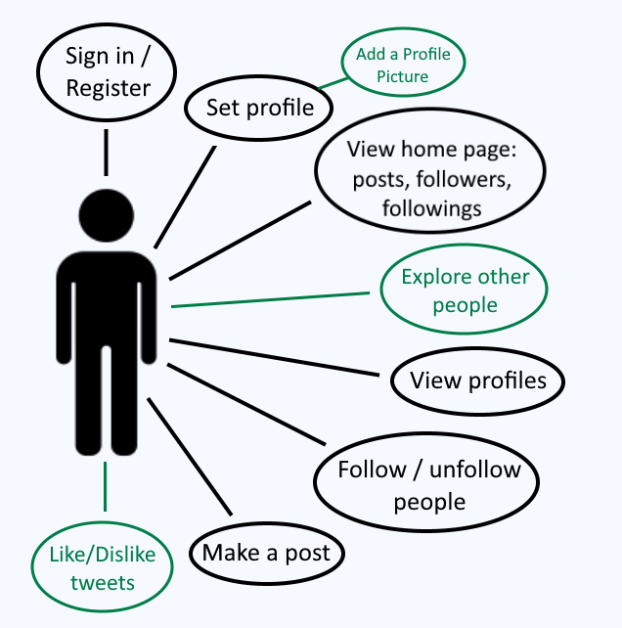
APPLICATION FEATURES
(new features)

Slide 7

SOLUTION (TOOLS AND TECHNOLOGY)
Front-end
Back-end
Html + CSS
Bootstrap + Tailwind
Run on any modern browsers
Fast (Turbo links)
Laravel 7 – PHP framework
MySQL – for database storage and access
Tests done using PHP Artisan Tinker and Laravel Factory API

Slide 8
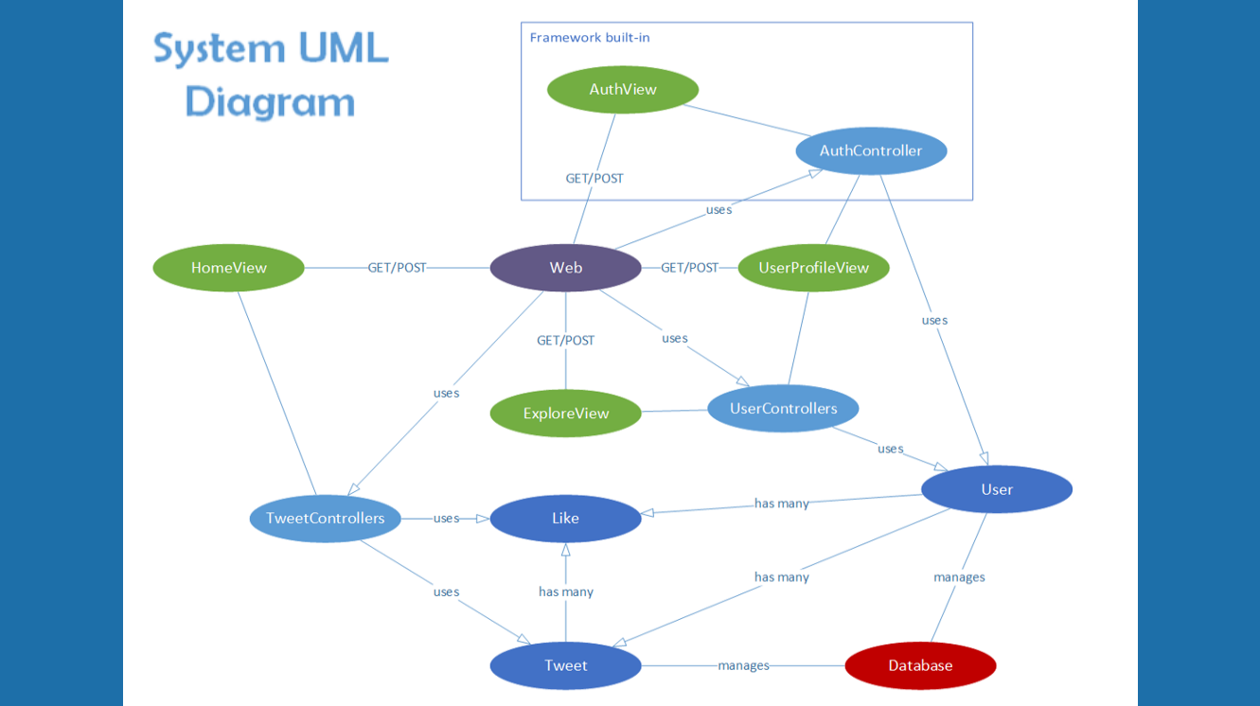

Slide 9
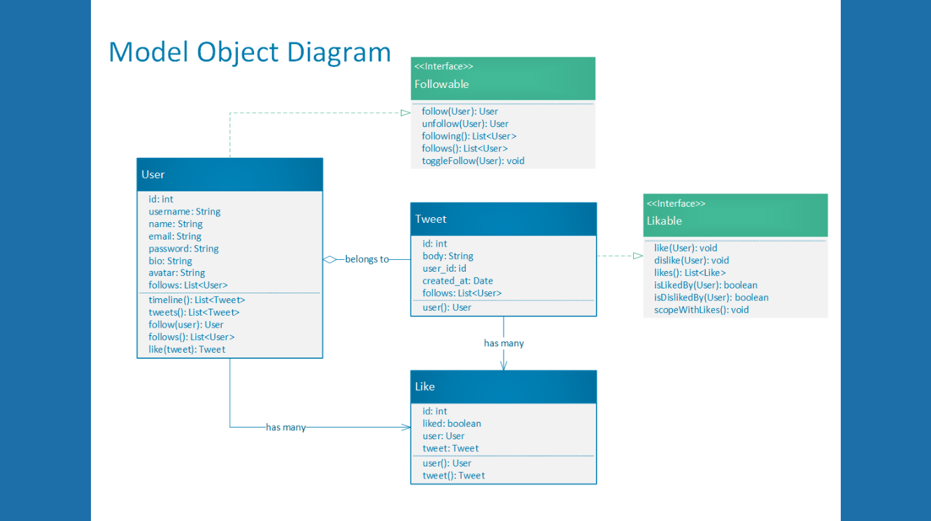

Slide 10
SUMMARY
Perfect Twitter-like minimalistic web application ready for deployment!
(GitHub repository: github.com/Ahrorus/Twatter)

Slide 11
