Slide 1
Candidate Finder
Abdul Arham Aamir FA19-BCS-002
Ahsan Rasheed FA19-BCS-012
Muhammad Awais FA19-BCS-045

Slide 2
Objectives:
To Assist interviewer/HR team in selecting perfect candidate.
To Separately Analyze the Front End & Back-End Positions
Shortlist Best Applicants according to the criteria that we have set.

Slide 3









TOOLS AND TECHNOLOGIES:

Slide 4
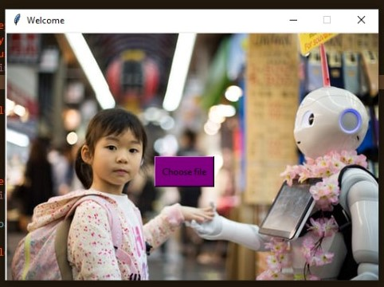
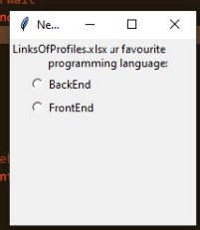

Slide 5
Data Scrapping
Selenium is used for Data Scrapping
HR/Interviewer gives an excel containing Linkedin ID Links of Applicants
Data from each ID will be scrapped and criteria conditions will be applied and then saved in excel

Slide 6
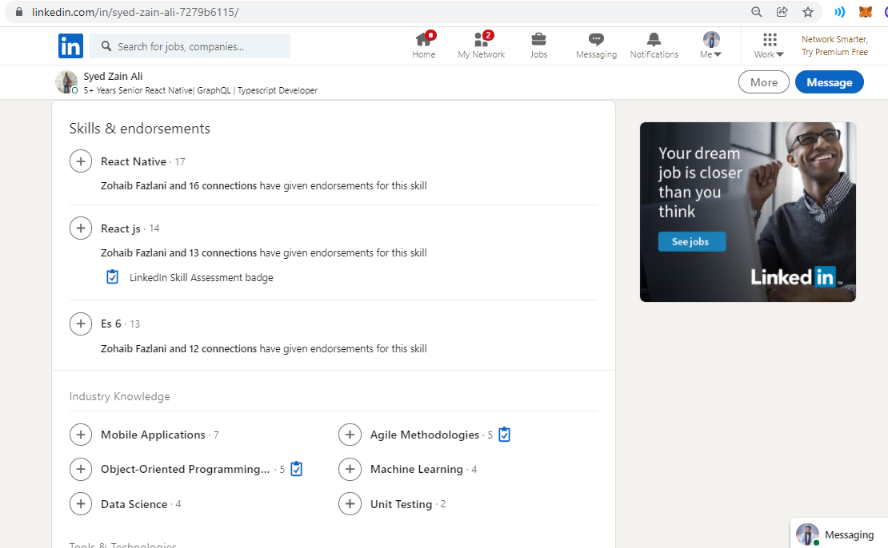
Dataset & Criteria

Slide 7
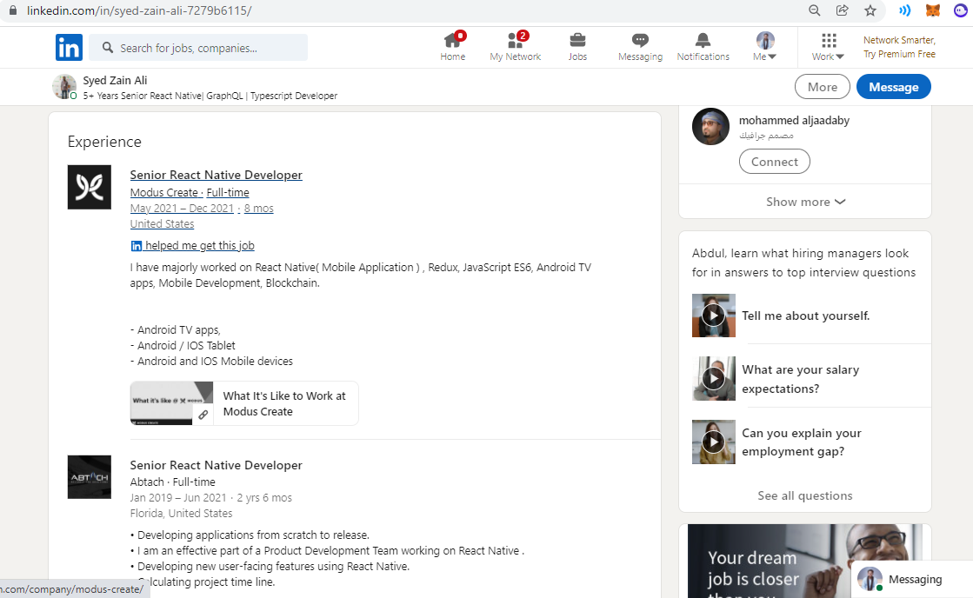
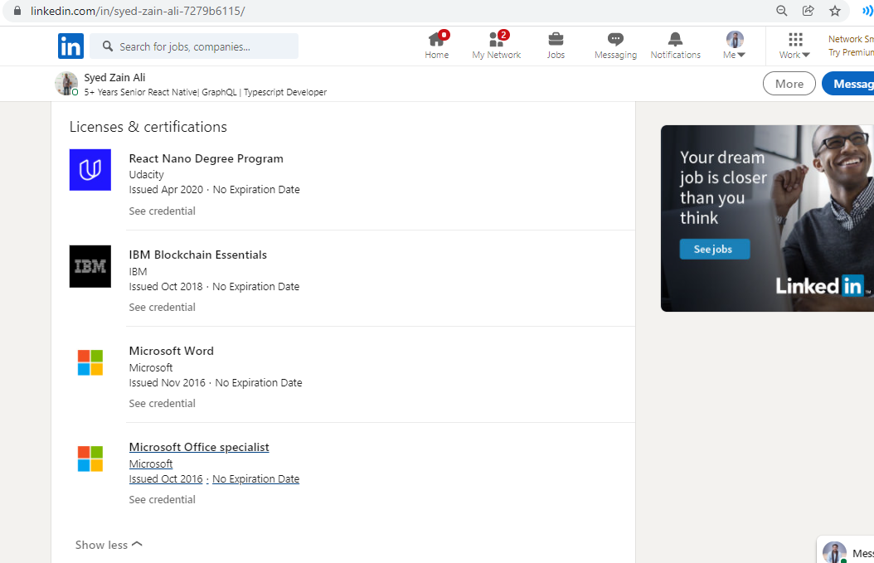

Slide 8
KNN
Classification Algorithm is applied to distinguish between the Frontend & Backend Developers/Candidates
This will help the HR Manager to first distinguish the applicants & then prioritize them.
Feature Scaling is used.

Slide 9
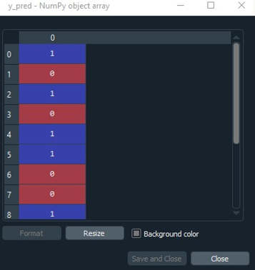
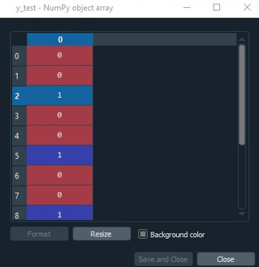

Slide 10
THANKYOU!

