Slide 1
ICT
Student Inventory System
Group Members:
Mohammad Ali, Saddam Hussain, Haris Fida, Ahsan Dar

Slide 2
Tools Used
MS WORD
MS Word fundamentals involve creating, editing, and formatting documents using a user-friendly interface with tabs (Home, Insert, etc.) and a ribbon for tools like bolding, colors, and styles
MS EXCEL
MS Excel Fundamentals involve organising data in a grid of cells (rows and columns) within workbooks for analysis, management, and calculation, using formulas (like =SUM()) and built-in functions (like Average, Max, Min) to automate tasks, and presenting data visually through charts.
HTML and CSS
HTML (Hyper Text Markup Language) is the backbone of web pages, using elements (tags like <p>,<h1> to structure content (text, images, links) for browsers, defining what's a heading, paragraph, or link. Every page starts with <!DOCTYPEhtml> and has a root <html>, a <head> (metadata, title), and a visible <body>

Slide 3
RESEARCH PAPER
MS Word

Slide 4

Clear and Concise Formatting
The research paper is prepared using Microsoft Word, focusing on the proper use of its components.
Text formatting tools (fonts, styles, alignment)
Page layout options (margins, orientation, spacing)
Headers, footers, and page numbering etc.

Slide 5

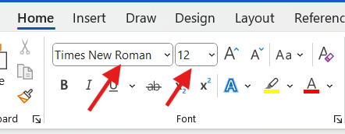
FONT STYLE AND SIZE
Select Home Tab from the Ribbon and choose the font size according to your liking. You can also add some additional features such bold, underline or italic your text.

Slide 6
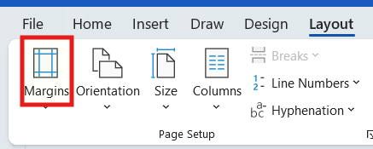
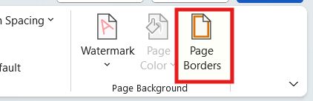
Margins and Border
Select The Layout tab from the ribbon and then click margins to set custom margins.
For setting a Border, Go to the Design tab in the ribbon and choose the Page Borders option.

Slide 7
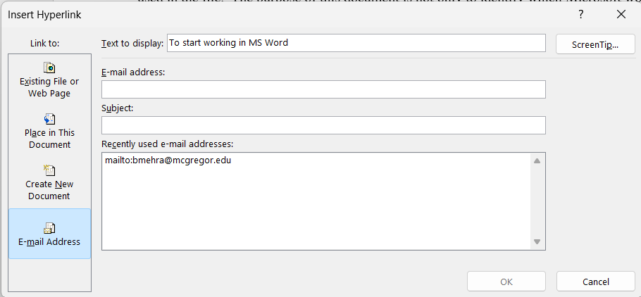
HYperlink
Press Ctrl+K to hyperlink a selected text or right click and then select the Hyperlink option from the menu to hyperlink a text. For removing the link, select the text again, from the menu, click remove link option

Slide 8
Inventory System
MS EXCEL

Slide 9

MS Excel
Inventory System
Microsoft Excel is a spreadsheet application from Microsoft that organizes data into rows and columns, allowing users to input, calculate, and analyze numerical and statistical data using formulas and functions

Slide 10
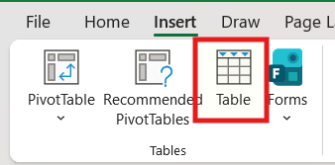
Table
To create a table, go to the insert tab in the ribbon and select the table button
Then you can set number of rows and column you want in the tables.

Slide 11
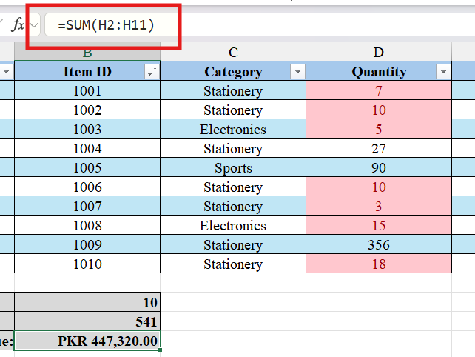
Sum formula

Slide 12
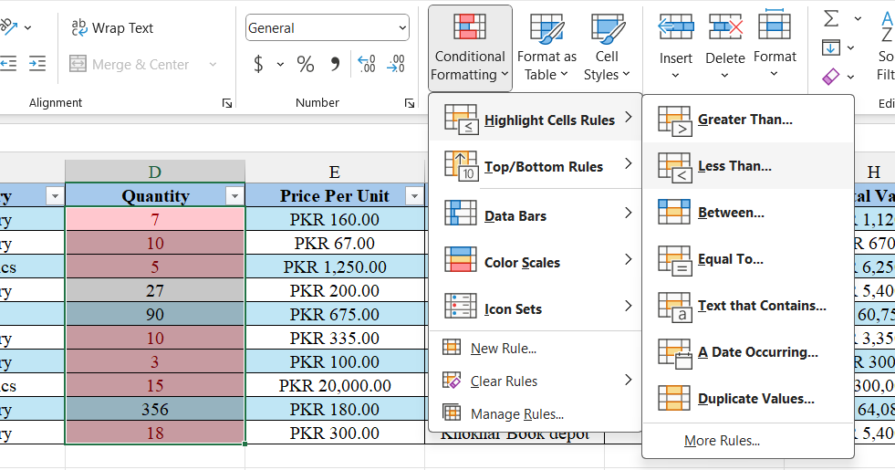
Condition Formatting

Slide 13
Inventory System
HTML and CSS

Slide 14
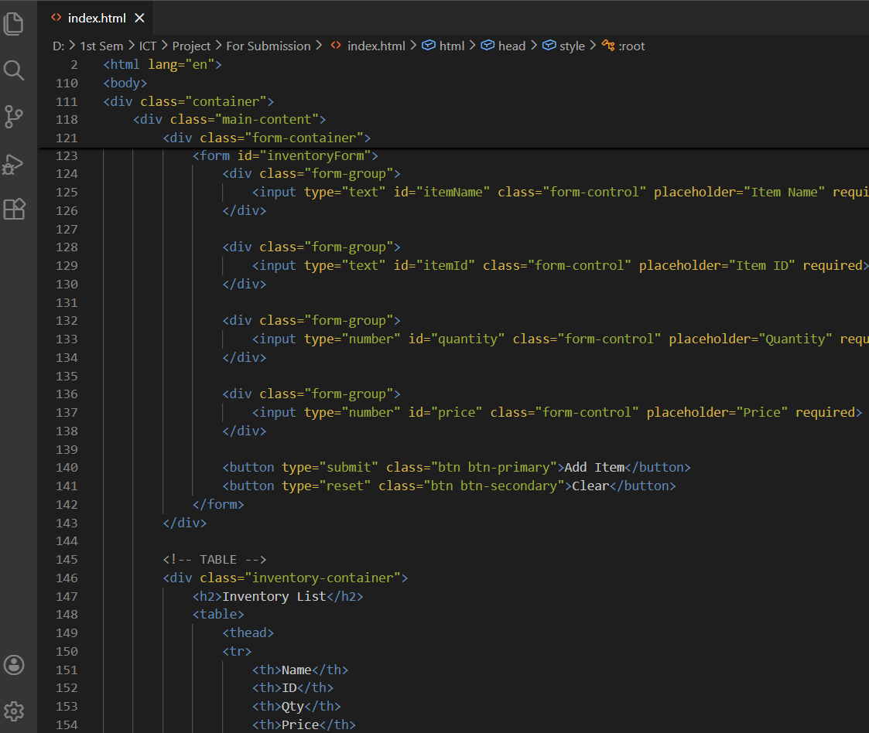
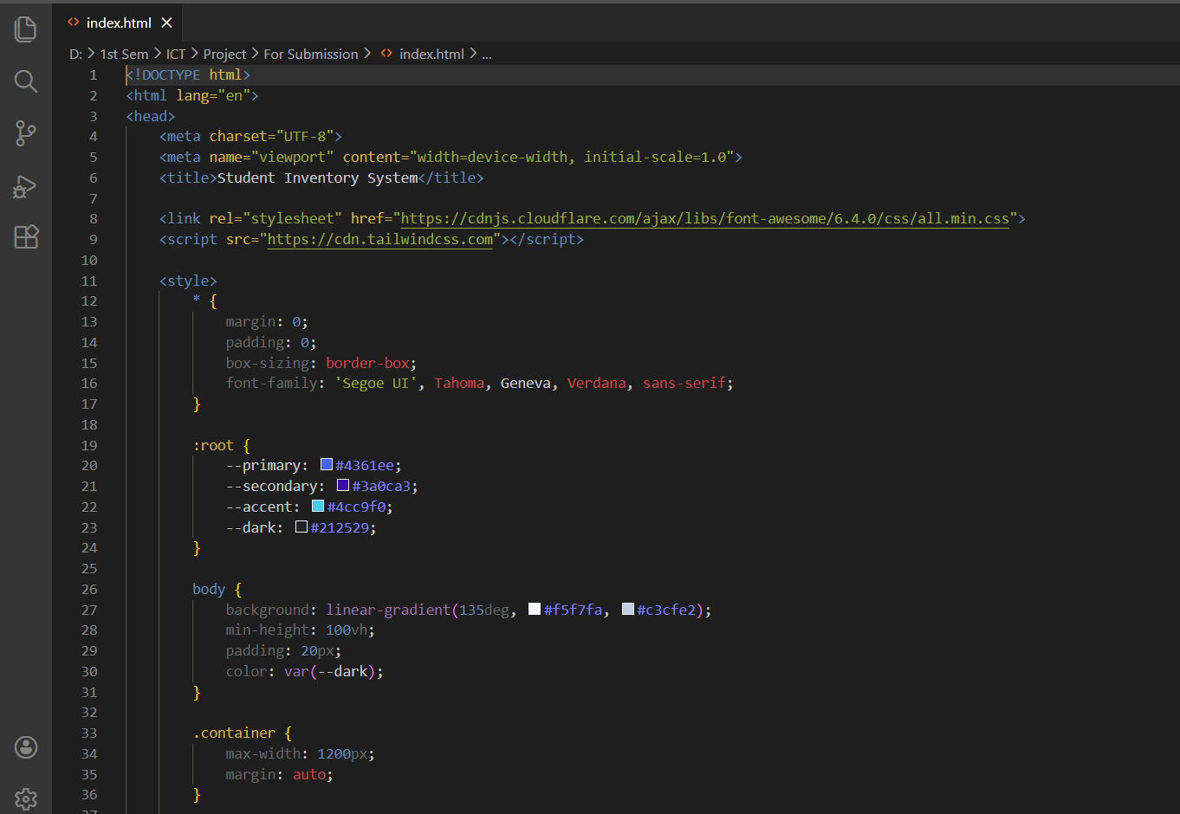
Screenshots

Slide 15
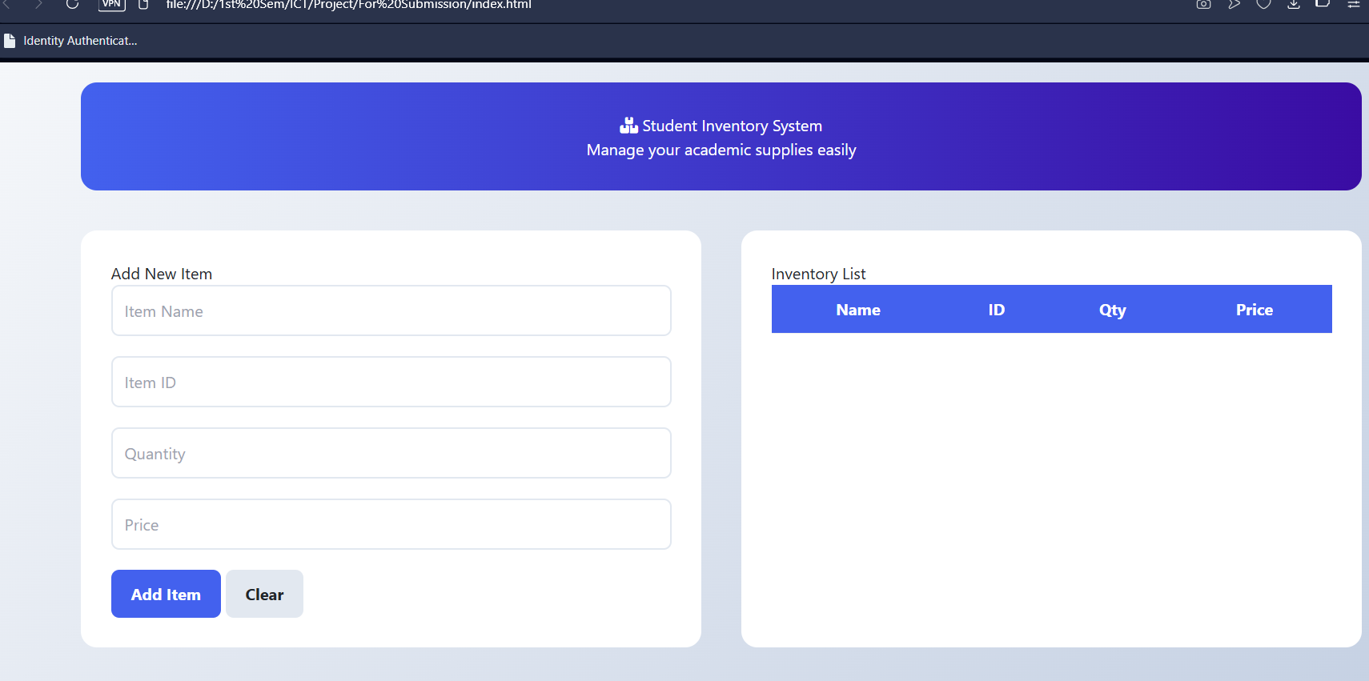
OUTPUT

Slide 16
End of the Presentation
ANY QUESTIONS.

