Slide 1

Telco Customer Churn Analysis: Finding Who Leaves and Why
End-to-end analytics project using Python, PostgreSQL, and Power BI.
Author: Md. Ahsan Ul Hoque Adnan

Slide 2




A telecom company is losing customers every month
Acquiring a new customer costs far more than keeping one.
Measure churn and revenue lost
Find the drivers
Locate high-risk segments
Recommend retention actions

Slide 3
The workflow turns raw customer data into retention actions
IBM Telco dataset (Kaggle) — 7,043 customers, 21 columns.
01
02
03
04
Python cleaning
PostgreSQL analysis
Power BI dashboard
Recommendations
11 blank TotalCharges values (new customers) set to 0. Created ChurnFlag and TenureGroup.

Slide 4
Churn is concentrated, measurable, and expensive
26.5%
$139K
overall churn — 1,869 customers
monthly revenue lost — 30.5% of total
43%
47%
churn on month-to-month contracts vs 3% on two-year
churn in the first 12 months

Slide 5
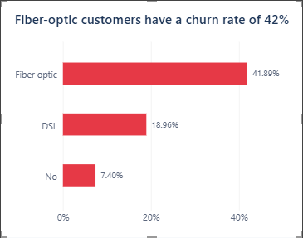
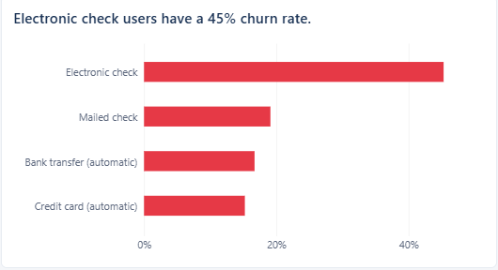
Contract, payment, add-ons, and billing shape churn
Fiber optic: 42% vs DSL: 19%
Electronic check: 45% vs 15–19% for other payment methods
Churn falls as add-ons rise: 54% with none, 7% with all three
Churned customers pay more: $74 vs $61 per month

Slide 6
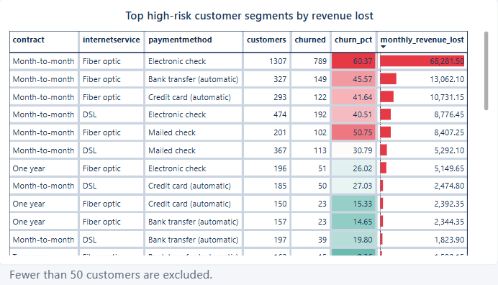
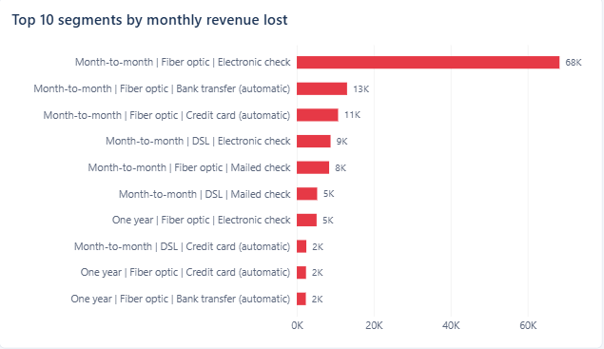
One segment accounts for roughly half of churned revenue
60%
Month-to-month, fiber optic, electronic check customers
1,307 customers
About $68K lost per month
Roughly half of all revenue lost to churn
[DASHBOARD SCREENSHOT PLACEHOLDER — Risk and Action dashboard]
Footnote: segments with fewer than 50 customers excluded.

Slide 7
Retention should start with the highest-risk segment
01
02
03
Move month-to-month customers to longer contracts, starting with the fiber and electronic check segment.
Offer autopay discounts and review fiber pricing and quality.
Give new customers free tech support or online security.

Slide 8
Customers leave early, on flexible contracts, with higher bills and no protection services
Next steps:
Launch the retention offers for the highest-risk segment.
Track churn monthly on the dashboard.
Investigate fiber service quality.
Contact: ehsanhoque29@gmail.com
GitHub: https://github.com/Ahsan-Adnan

