Slide 1
DATACO SUPPLY CHAIN
AND SALES ANALYSIS
Business Analyst portfolio project
Md. Ahsan Ul Hoque
Python · PostgreSQL · Power BI

Slide 2
LATE DELIVERIES AND LOSS-MAKING ORDERS ARE THE CORE BUSINESS RISKS
DELIVERED ITEMS ARRIVED LATE
ORDER ITEMS LOSS-MAKING
57.3%
18.71%
▲ CORE TIME RISK
▲ CORE PROFIT RISK
The analysis starts with two measurable failures.
Management needs a clear view of where time and profit are lost.

Slide 3
ANALYSIS SCOPE
180,519 ORDER ITEMS BECAME A THREE-STEP ANALYSIS WORKFLOW
180,519
order items
01
02
03
About 66K distinct orders, January 2015–January 2018.
Python
PostgreSQL
Power BI
Clean, explore, and engineer analysis fields.
Structure and query sales, delivery, product, and market performance.
Turn findings into interactive dashboards.
Outcome: recommendations focused on delay and loss risk.

Slide 4
CLEANING REMOVED NOISE; EDA RULED OUT SIMPLE EXPLANATIONS
9 columns removed
Missing, empty, private, or unused fields.
NEXT ANALYTICAL LAYER
GO DEEPER
Analysis fields engineered
delay_days · is_late · is_loss · profit_margin
Product, category, market, and shipping mode needed deeper analysis.
Discount rate showed no clear effect on profit
Correlations were weak
Sales–profit 0.13 · discount–profit −0.02 · delay–profit about 0

Slide 5

$36.78M IN SALES PRODUCED A $3.97M PROFIT POOL
SALES
PROFIT
MARGIN
$36.78M
$3.97M
10.78%
Europe + LATAM
About 57% of sales.
Consumer
$19.10M sales and $2.07M profit; largest segment.
Top profit categories
Fishing $756,221 · Cleats $494,637.
Monthly sales were broadly steady before the late-2017 drop.
05

Slide 6

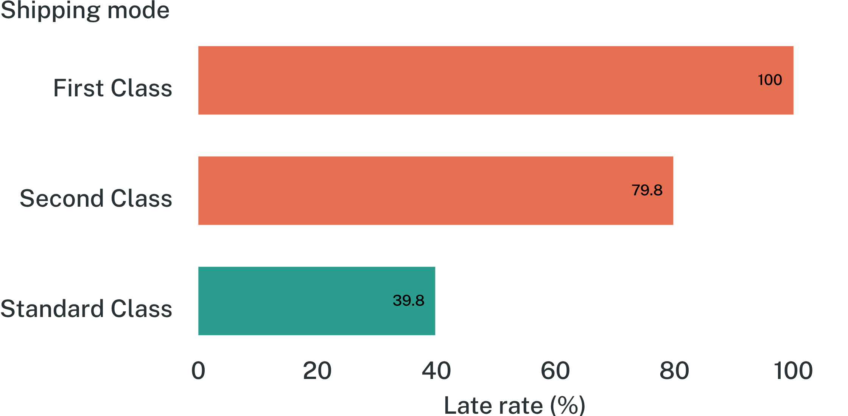
PREMIUM SHIPPING MODES UNDERPERFORM THEIR PROMISE
LATE-DELIVERY RATE BY SHIPPING MODE
DELIVERY PERFORMANCE · 172,765 DELIVERED ITEMS
Overall: 57.3% late across 172,765 delivered items. Standard Class carried about 60% of volume.

Slide 7

LOSS RISK IS BROAD BY RATE, CONCENTRATED BY VALUE
VIEW | LOSS RATE | VALUE SIGNAL
Markets | Near 19% across every market | Broad exposure
Categories | Near 19% across categories | Broad exposure
Top loss categories | — | $1.62M lost
Fishing + Cleats + Camping & Hiking carry the largest value loss. Discount cuts alone are unlikely to solve the problem.
PROFIT AND LOSS RISK · CATEGORY VIEW

Slide 8
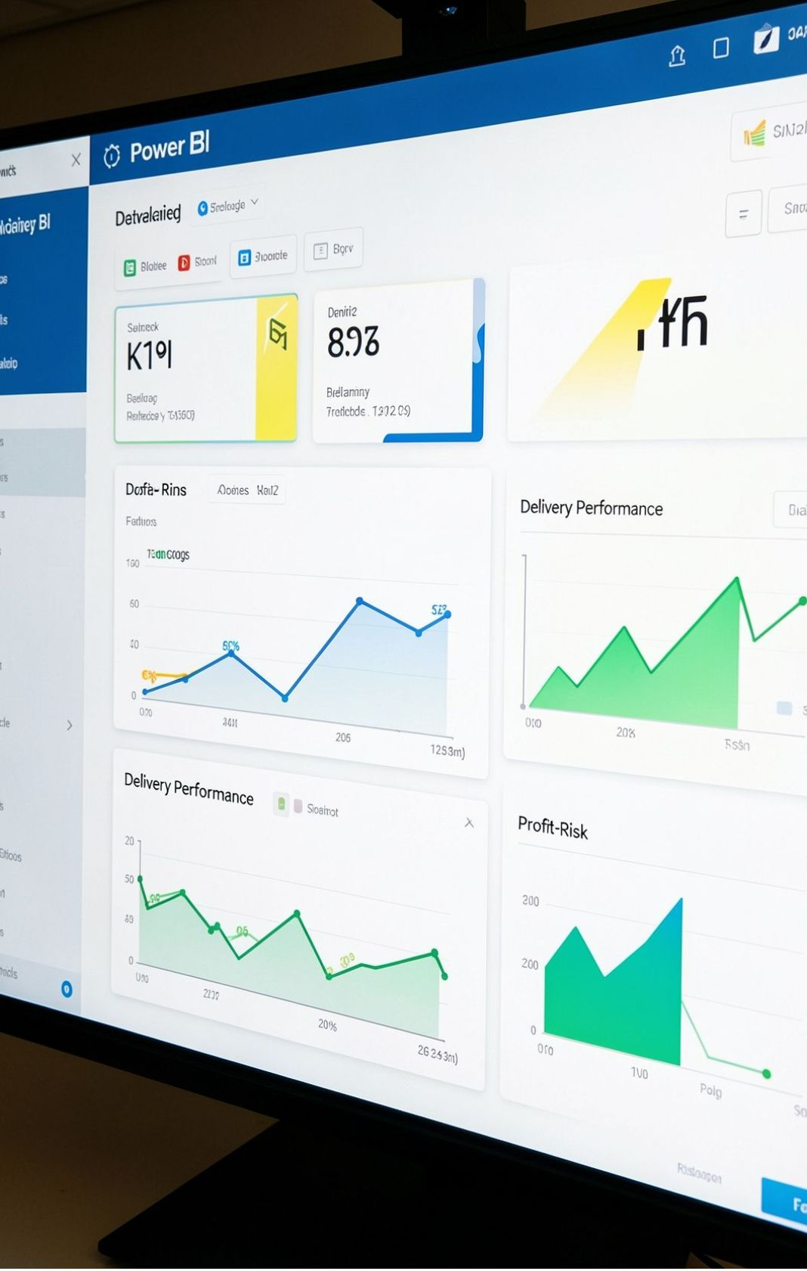




THE DASHBOARD TURNS ANALYSIS INTO A DECISION WORKFLOW
Four pages connect the business question to the next action.
Sales Overview
Delivery Performance
See the commercial baseline.
Find where time is lost.
Profit and Loss Risk
Root Cause Analysis
Locate value at risk.
Move from signal to action.
4 pages: Sales Overview, Delivery Performance, Profit and Loss Risk, Root Cause Analysis
Interactive filters: market, segment, year, category, and shipping mode. Large KPI cards keep the business story visible.
DRILL-THROUGH · TOOLTIPS · FIELD PARAMETER · AI VISUALS

Slide 9
SIX ACTIONS TARGET THE BIGGEST OPERATIONAL AND PROFIT RISKS
DECISION LENS
PROTECT TIME.
PROTECT MARGIN.
Fix First Class and Second Class delivery; validate the First Class data quirk.
1
Treat late delivery as network-wide; start with Europe and LATAM.
2
Review the top loss categories: pricing, product cost, and shipping cost.
3
Do not rely on discount cuts; investigate product cost, pricing, and shipping.
4
Prioritize actions that address both operational and profit risk.
Pilot a February campaign.
5
Verify the sharp sales drop after September 2017.
6

Slide 10
THANK YOU
USE THE FINDINGS WITH TWO IMPORTANT DATA CAVEATS
GITHUB · ADD PORTFOLIO LINK
First Class
100% late may reflect a scheduled-time data quirk.
2018
January is a partial year and should not be compared with full years.
Late 2017
The sharp sales drop may reflect incomplete data.
Next step
Findings are strongest when the data definitions are verified alongside the business signal.
Validate last order dates, order counts, and delivery-time definitions.

