Slide 1
Runge 2nd Order Method
Major: All Engineering Majors
Authors: Autar Kaw, Charlie Barker
http://numericalmethods.eng.usf.edu
Transforming Numerical Methods Education for STEM Undergraduates
http://numericalmethods.eng.usf.edu

Slide 2
Runge-Kutta 2nd Order Method http://numericalmethods.eng.usf.edu

Slide 3
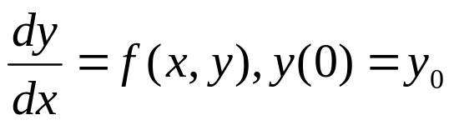



Runge-Kutta 2nd Order Method
For
Runge Kutta 2nd order method is given by
where
http://numericalmethods.eng.usf.edu

Slide 4

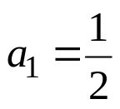



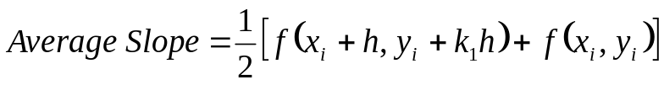
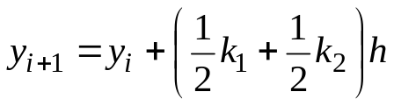


Heun’s Method
Heun’s method
y
Here a₂=1/2 is chosen
y_{i+1,} predicted
resulting in
y_{i}
x_{i}
x_{i+1}
x
where
Figure 1 Runge-Kutta 2nd order method (Heun’s method)
http://numericalmethods.eng.usf.edu

Slide 5


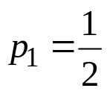
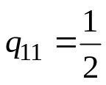


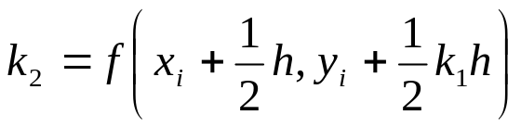
Midpoint Method
Here
is chosen, giving
resulting in
where
http://numericalmethods.eng.usf.edu

Slide 6
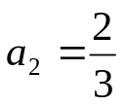
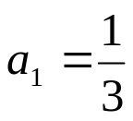
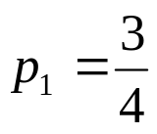
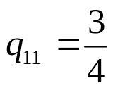
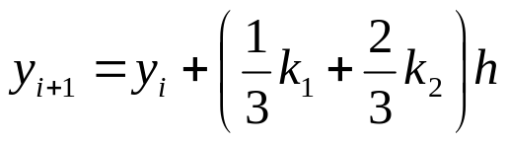
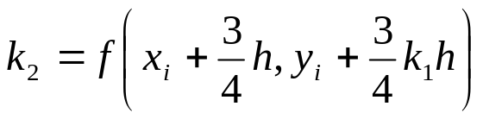
Ralston’s Method
Here
is chosen, giving
resulting in
where
http://numericalmethods.eng.usf.edu

Slide 7
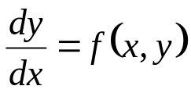
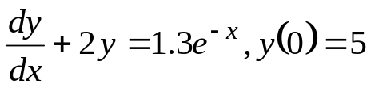
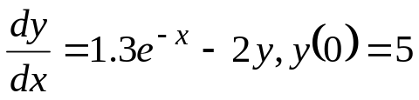

How to write Ordinary Differential Equation
How does one write a first order differential equation in the form of
Example
is rewritten as
In this case
http://numericalmethods.eng.usf.edu

Slide 8
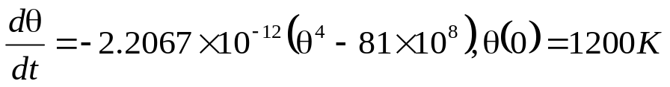


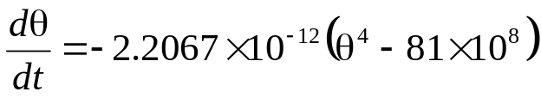
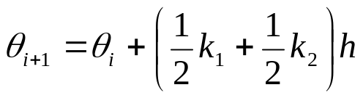
Example
A ball at 1200K is allowed to cool down in air at an ambient temperature of 300K. Assuming heat is lost only due to radiation, the differential equation for the temperature of the ball is given by
Find the temperature at
seconds using Heun’s method. Assume a step size of
seconds.
http://numericalmethods.eng.usf.edu

Slide 9

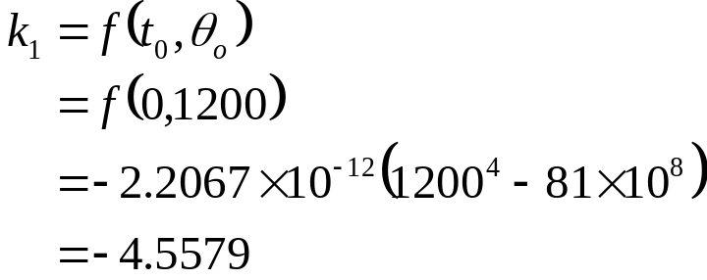
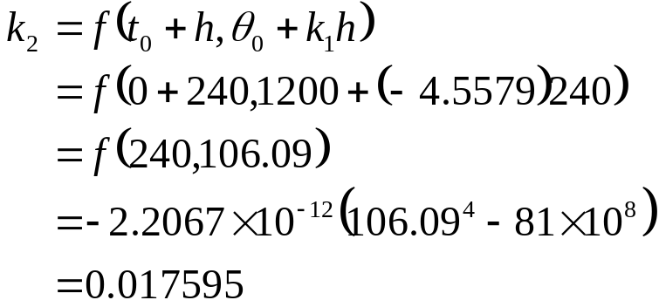
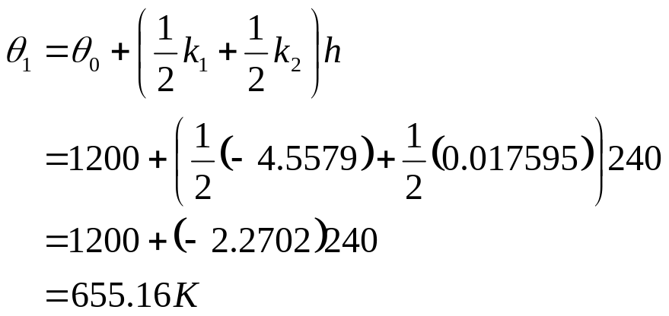
Solution
Step 1:
http://numericalmethods.eng.usf.edu

Slide 10
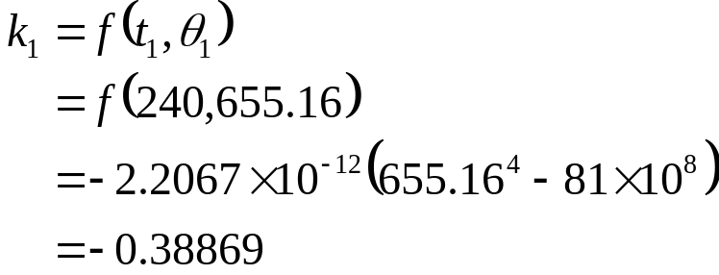
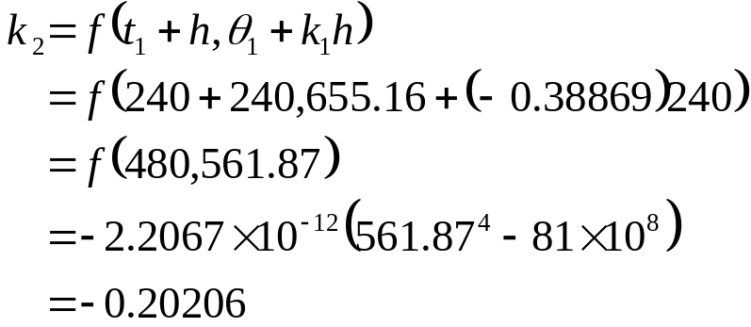
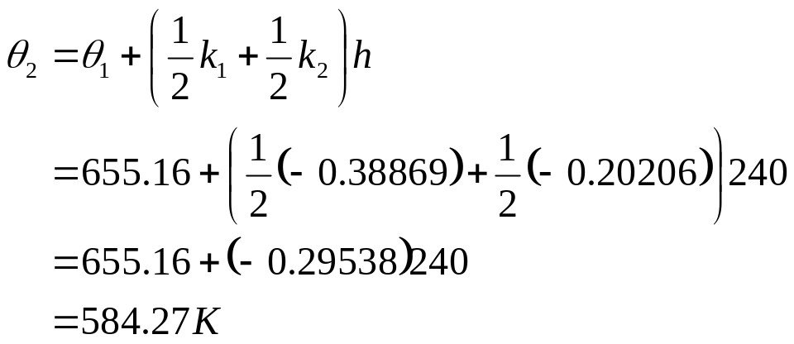
Solution Cont
Step 2:
http://numericalmethods.eng.usf.edu

Slide 11

Solution Cont
The exact solution of the ordinary differential equation is given by the solution of a non-linear equation as
The solution to this nonlinear equation at t=480 seconds is
http://numericalmethods.eng.usf.edu

Slide 12
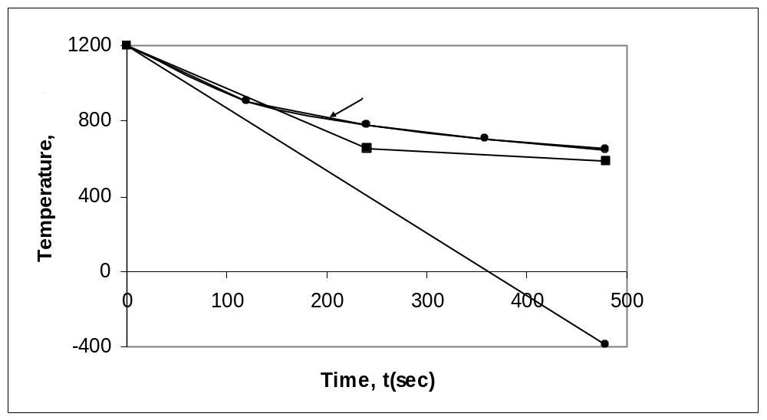
Comparison with exact results
Figure 2. Heun’s method results for different step sizes
http://numericalmethods.eng.usf.edu

Slide 13
Effect of step size
Table 1. Temperature at 480 seconds as a function of step size, h
Step size, h | θ(480) | E_{t} | |є_{t}|%
480 240 120 60 30 | −393.87 584.27 651.35 649.91 648.21 | 1041.4 63.304 −3.7762 −2.3406 −0.63219 | 160.82 9.7756 0.58313 0.36145 0.097625
(exact)
http://numericalmethods.eng.usf.edu

Slide 14
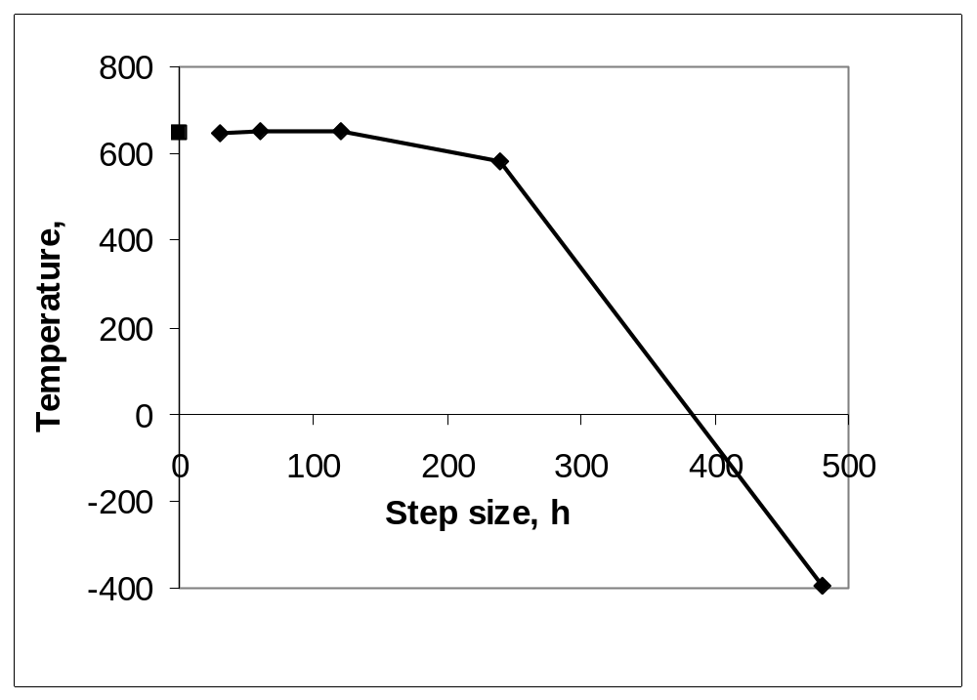
Effects of step size on Heun’s Method
Figure 3. Effect of step size in Heun’s method
http://numericalmethods.eng.usf.edu

Slide 15
Comparison of Euler and Runge-Kutta 2nd Order Methods
Table 2. Comparison of Euler and the Runge-Kutta methods
Step size, h | θ(480)
 | Euler | Heun | Midpoint | Ralston
480 240 120 60 30 | −987.84 110.32 546.77 614.97 632.77 | −393.87 584.27 651.35 649.91 648.21 | 1208.4 976.87 690.20 654.85 649.02 | 449.78 690.01 667.71 652.25 648.61
(exact)
http://numericalmethods.eng.usf.edu

Slide 16

Comparison of Euler and Runge-Kutta 2nd Order Methods
Table 2. Comparison of Euler and the Runge-Kutta methods
Step size, h
 | Euler | Heun | Midpoint | Ralston
480 240 120 60 30 | 252.54 82.964 15.566 5.0352 2.2864 | 160.82 9.7756 0.58313 0.36145 0.097625 | 86.612 50.851 6.5823 1.1239 0.22353 | 30.544 6.5537 3.1092 0.72299 0.15940
(exact)
http://numericalmethods.eng.usf.edu

Slide 17
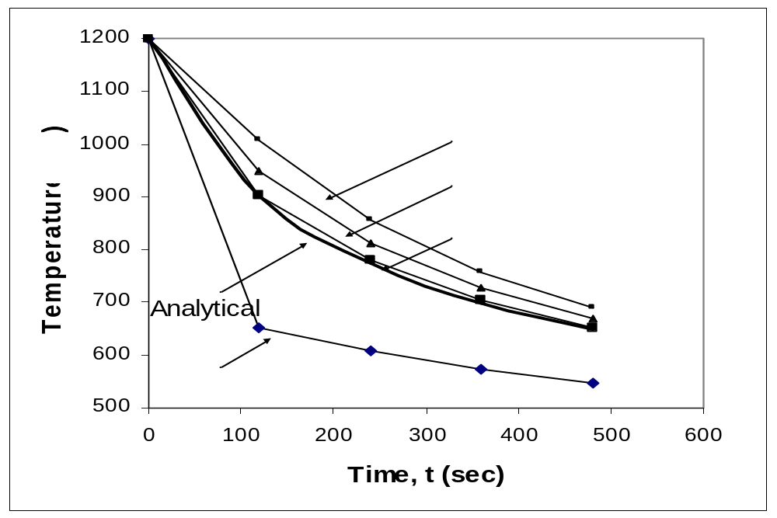
Comparison of Euler and Runge-Kutta 2nd Order Methods
Figure 4. Comparison of Euler and Runge Kutta 2nd order methods with exact results.
http://numericalmethods.eng.usf.edu

Slide 18
Additional Resources
For all resources on this topic such as digital audiovisual lectures, primers, textbook chapters, multiple-choice tests, worksheets in MATLAB, MATHEMATICA, MathCad and MAPLE, blogs, related physical problems, please visit
http://numericalmethods.eng.usf.edu/topics/runge_kutta_2nd_method.html

Slide 19
THE END
http://numericalmethods.eng.usf.edu

